Slide 1

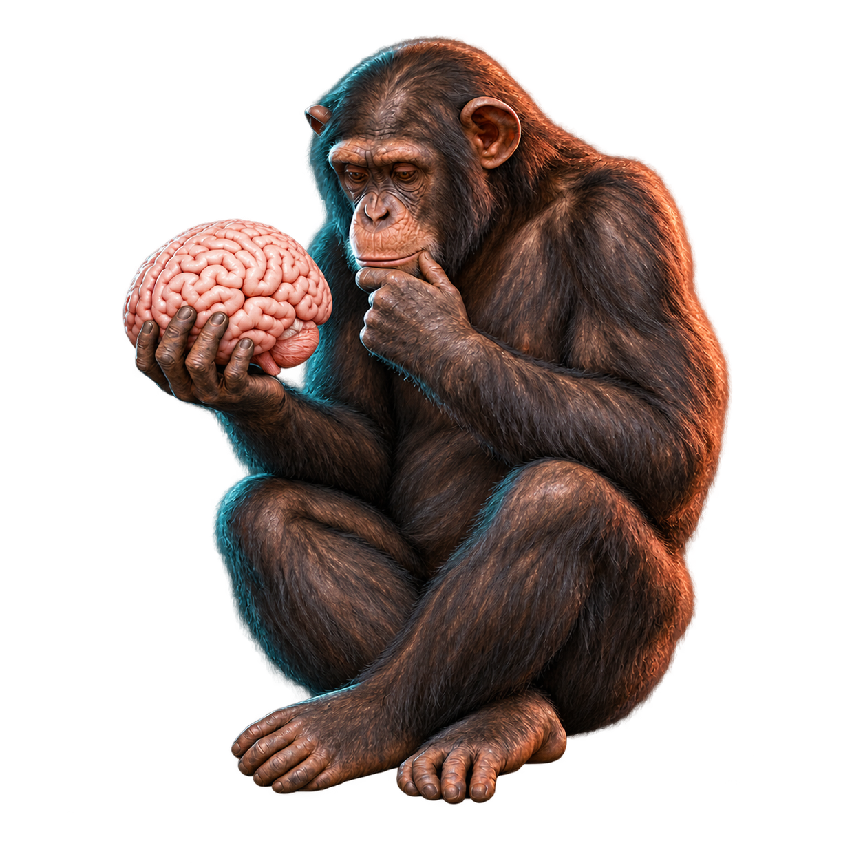
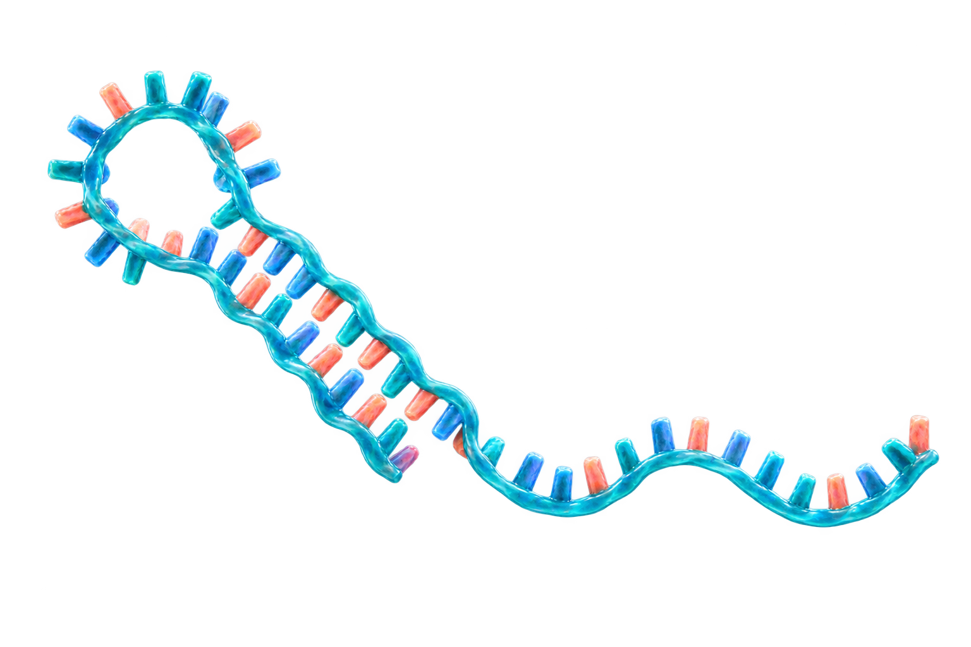
The sound of silencing
Background: microRNA (miRNA) silences gene expression by binding to messenger RNA (mRNA)
Questions: 1.) Do microRNAs regulate genes differently in humans and chimps as the brain develops?
2.) Can that help explain what makes the human brain special?
miRNA–mRNA network
A microRNA molecule
miRNA
target mRNAs
let-7
CDK6
CDKN1A
miR-92
HIPK3
miR-370
NF1
MAP3K8
METHODS
DATA
FIELDS
- Time series analysis of weighted
regulatory networks
- Functional analysis
Publicly available miRNA and mRNA expression data from a study
- Computational neuroscience and
genomics
- General network analysis
Notes:
Sources:
Somel M et al. MicroRNA-driven developmental remodeling in the brain distinguishes humans from other primates. PLoS Biology. 2011;9(12):e1001214. https://doi.org/10.1371/journal.pbio.1001214
NCBI GEO GSE29356: https://www.ncbi.nlm.nih.gov/geo/query/acc.cgi?acc=GSE29356
NCBI GEO GSE22521: https://www.ncbi.nlm.nih.gov/geo/query/acc.cgi?acc=GSE22521
Network sketch: illustrative relationships only; final network edges come from miRDB v6.0, not TargetScan or miRTarBase.
Visual disclosure: chimpanzee illustration generated with OpenAI image generation on 2026-09-25 using the user-provided Ape_with_skull.jpeg as a pose reference only. The pedestal was removed and the skull was replaced with a human brain. The microRNA illustration was generated with OpenAI image generation and is illustrative rather than an atomic-resolution structure.

Slide 2
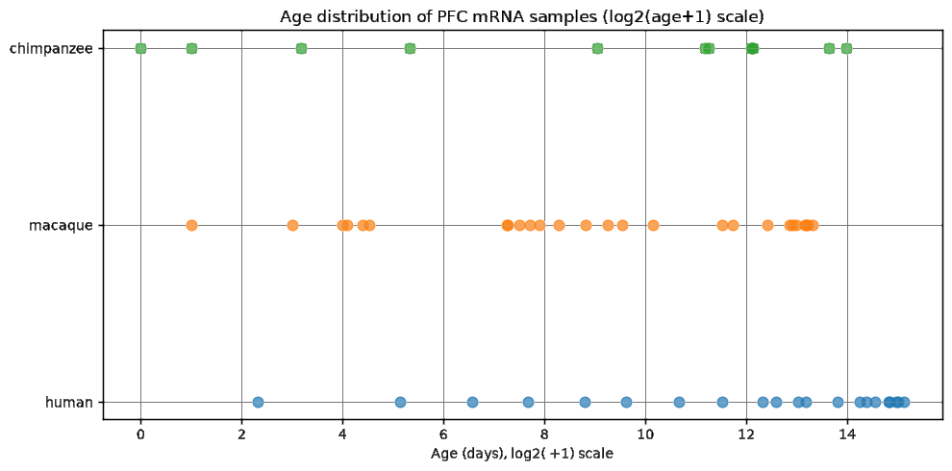
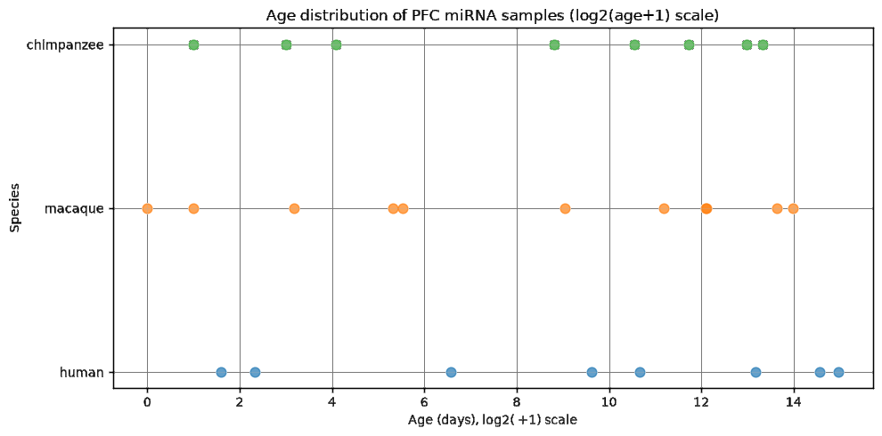
Source data
A) SOURCE DATA AND DATA CLEANING
SOURCE DATA
Prefrontal cortex (PFC) expression data from
Somel et al. MicroRNA-Driven Developmental Remodeling in the Brain Distinguishes Humans from Other Primates. PLOS Biology 9(12) (2011).
DATA FILTERING AND CLEANING
- Removed duplicate measurements,
prenatal individuals and outliers
- Matched probes to genes
Rule: retain 1 probe ↔ 1 gene
mRNA · log₂(age + 1)
RESULT
- mRNA: 58 retained profiles, 11,667 genes
- miRNA: 27 profiles, 198 detected miRNAs
- Human, chimpanzee, rhesus macaque
miRNA · log₂(age + 1)
The sound of silencing
2 / 9
Notes:
Our two public datasets measure prefrontal cortex expression over a large age range in humans, chimpanzees, and macaques. For mRNA we retained 58 profiles and 11,667 genes; for miRNA 27 profiles and 198 miRNAs. The cohorts only partly overlap, motivating careful age adjustment.

Slide 3
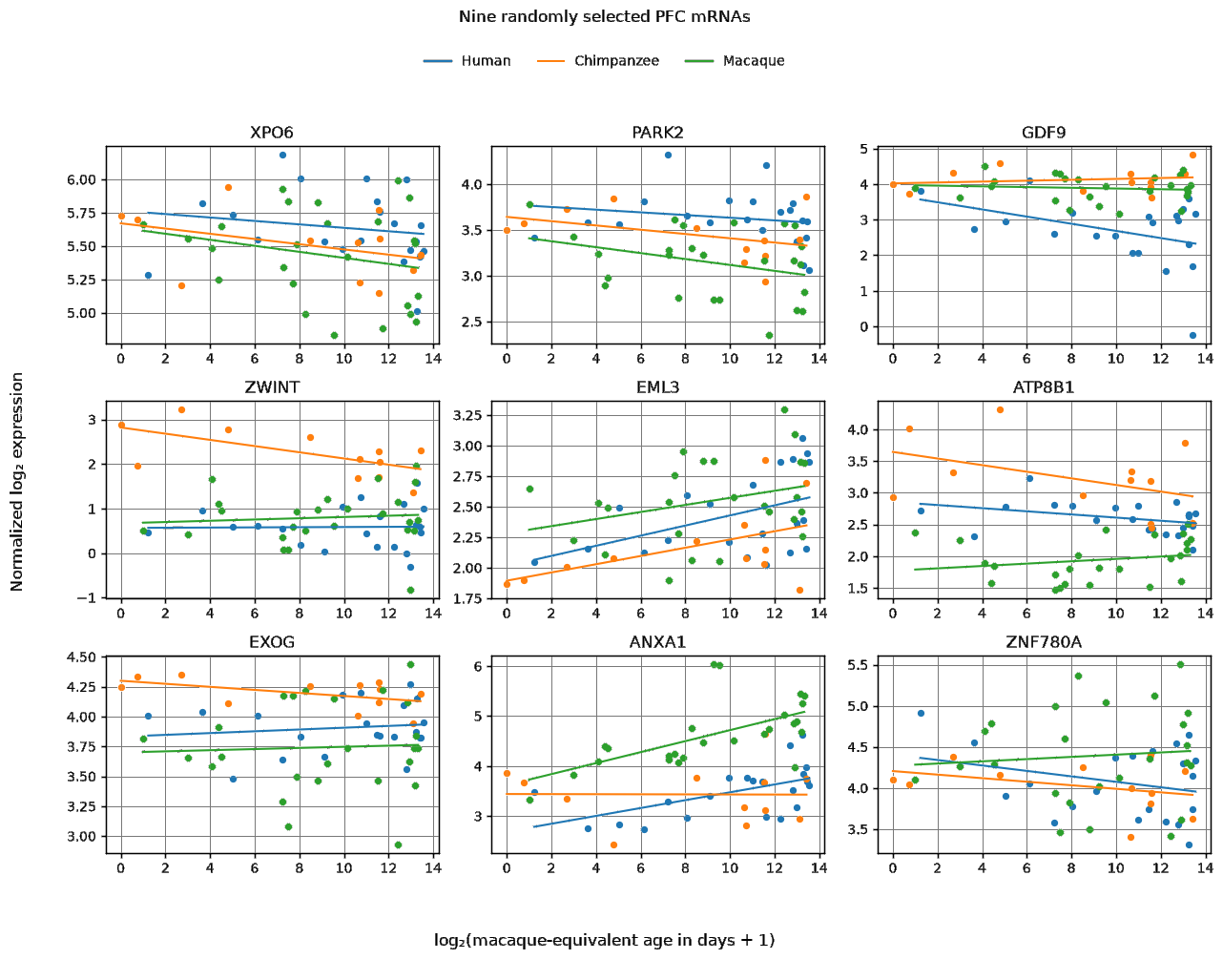
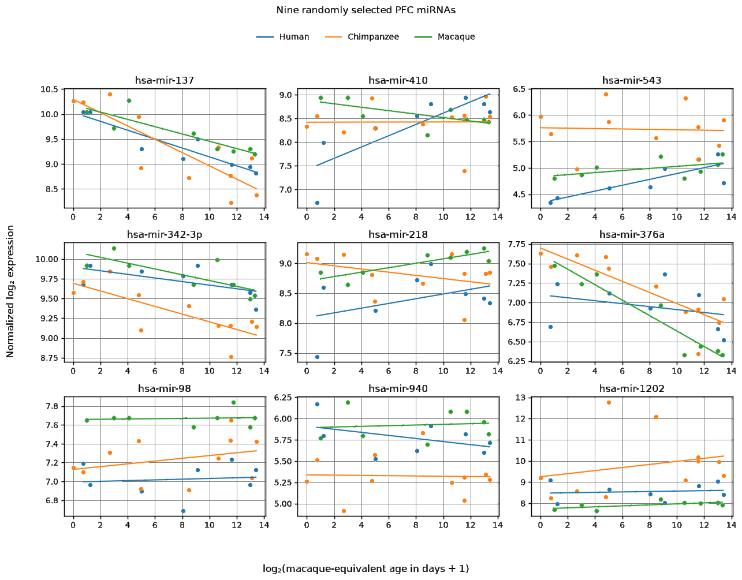
Exploratory data analysis
A) REGRESSION ANALYSIS
MODEL
log₂(expression) ~ species + log₂(age + 1)
mRNA · nine example genes
miRNA · nine example miRNAs
RESULT: MEAN IN-SAMPLE R²
mRNA: species 25.8% | age 13.0% | both 38.2%
miRNA: species 24.8% | age 23.9% | both 49.7%
The sound of silencing
3 / 9
Notes:
Here we regress each gene or miRNA on species and age. The mean in-sample R squared of the combined model is 38 percent for mRNA and 50 percent for miRNA. Age accounts for appreciably more miRNA than mRNA variation. These are descriptive fits, not out-of-sample predictions.
Technical clarification: Expression values are already log2-scale, not log-transformed twice. The mean R-squared table summarizes common-slope models using chronological log2(age+1), whereas the plotted example fits use macaque-equivalent ages.

Slide 4
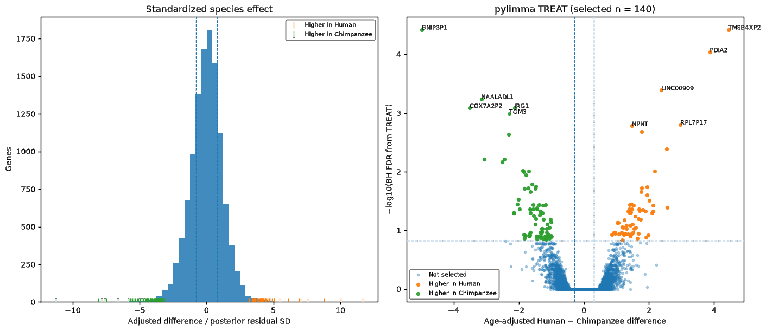
Human–chimpanzee differences in early development
B) DIFFERENTIAL EXPRESSION
EARLY DEVELOPMENT
Nine profiles under 100 days:
5 human and 4 chimpanzee.
TOOL
pylimma: Linear Models for Microarray Data.
RESULT
140 of 11,667 genes selected:
62 higher in humans; 78 in chimps.
SIGNIFICANCE & ROBUSTNESS
Age-adjusted TREAT FDR < 0.15,
|log₂ difference| ≥ 0.30, plus effect-size
and leave-one-out direction checks.
Standardized species effect and TREAT FDR
The sound of silencing
4 / 9
Notes:
We focused on the first hundred days: five humans and four chimpanzees. Across 11,667 genes, 140 passed thresholds for age-adjusted difference, multiple-testing correction at FDR 0.15, effect size, and leave-one-out stability. Sixty-two were higher in humans and seventy-eight in chimpanzees. This is exploratory because the cohort is small.
Implementation uses the Python pylimma package with empirical-Bayes moderation and TREAT, not the R limma package directly.

Slide 5
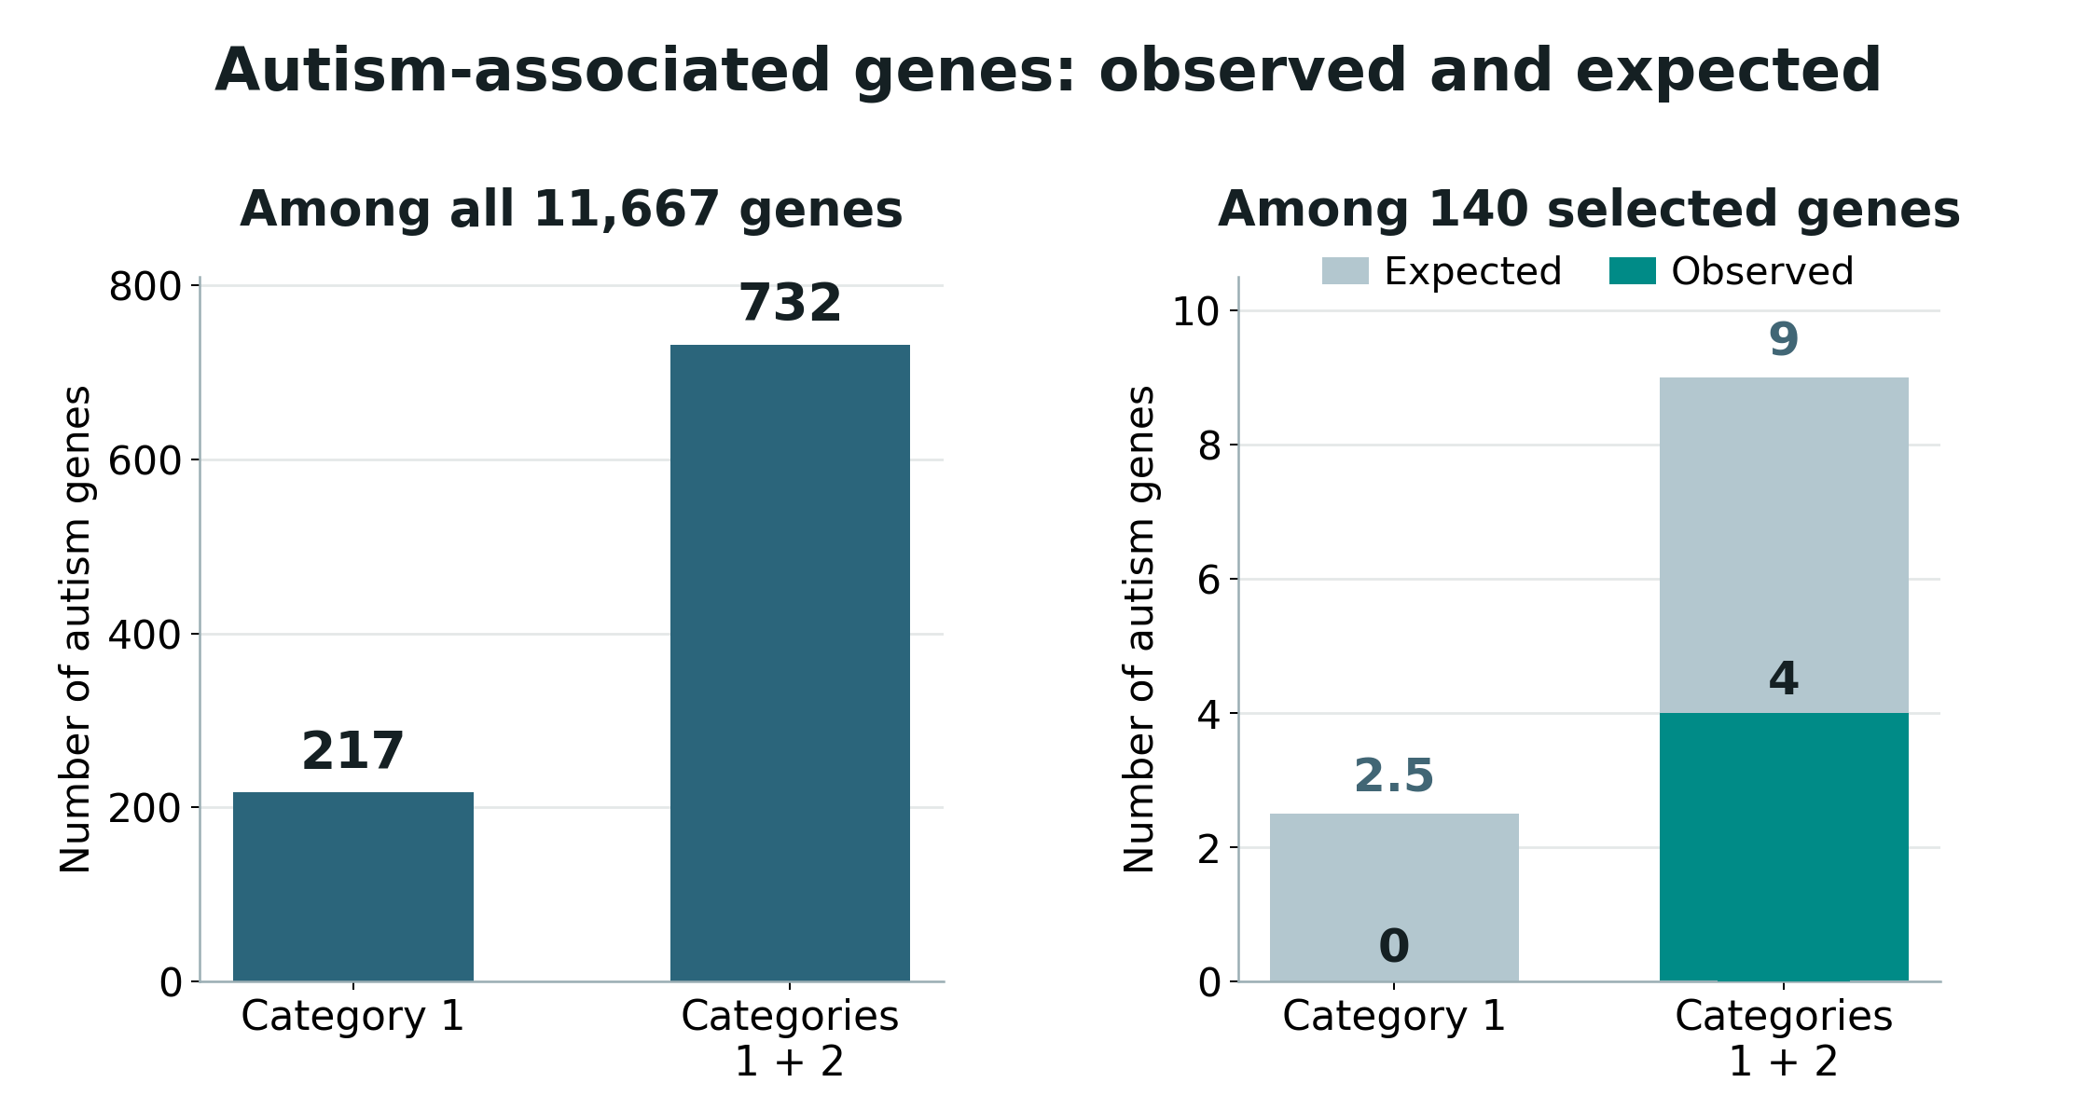
Autism genes in early development
B) SFARI AUTISM-GENE ENRICHMENT
QUESTION
Are autism genes enriched among
the 140 early-expression candidates?
FISHER EXACT TEST (ONE-SIDED)
Category 1: 0 / 140
All tested genes: 217 / 11,667
p = 1.000
Categories 1 + 2: 4 / 140
All tested genes: 732 / 11,667
p = 0.979
CONCLUSION
Neither SFARI set was enriched.
The tests do not prove depletion.
The sound of silencing
5 / 9
Notes:
Fisher exact tests from the Week 4 report: Category 1, selected 0 of 140; all tested 217 of 11667, one-sided enrichment p=1.0000. Categories 1+2, selected 4 of 140; all tested 732 of 11667, p=0.978922. The actual comparison was the 140 selected candidates versus 11,527 non-selected genes; total counts are presented for a visually intuitive column plot. Different scales in panels are deliberate; the Fisher test accounts for the group sizes.

Slide 6
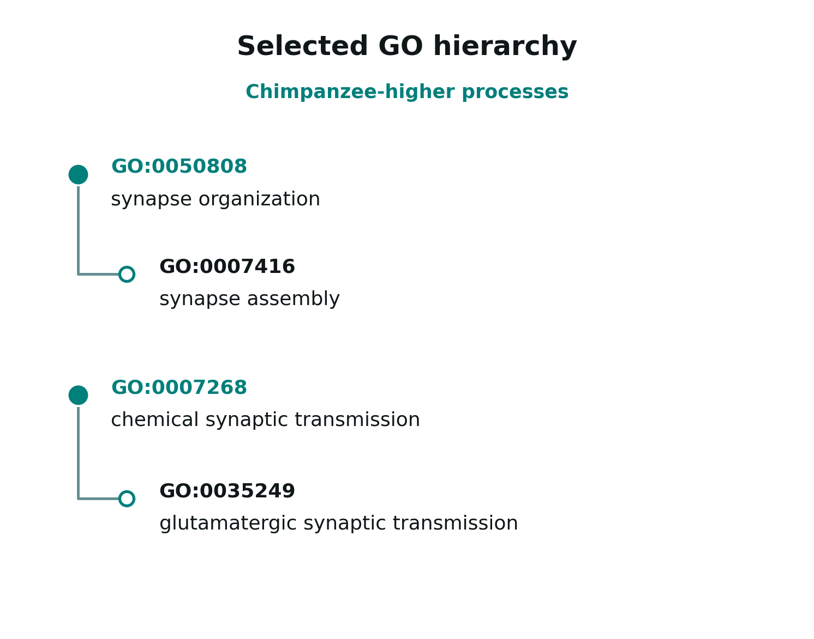
Gene Ontology (GO): functional analysis
C) GO BIOLOGICAL PROCESS ANALYSIS
METHOD
Ranked differential-expression statistics
with GOfuncR;
10,386 annotated genes,
13,796 Biological Process terms tested.
FWER ≤ 0.05 (10,000 random sets).
RESULTS AFTER HIERARCHY REFINEMENT
10 human-higher GO categories:
transcription, RNA splicing, DNA processes.
30 chimp-higher GO categories:
synaptic function, ion transport and
mitochondrial electron transport.
The sound of silencing
6 / 9
Notes:
The GO analysis ranks all genes rather than using only the 140 selected candidates. GOfuncR uses 10,000 random sets to control family-wise error. After removing redundant broader categories, there are 10 human-higher terms, mostly transcriptional and RNA/DNA-related, and 30 chimpanzee-higher terms emphasizing synaptic and ion/mitochondrial processes. The tree is an excerpt of related GO concepts.

Slide 7
Life-history network analysis
D) LIFE-HISTORY NETWORK ANALYSIS
CONSTRUCTION
miRNAs
7-nt seed
Target genes
Measured miRNAs → seven-nucleotide
seed families → miRDB predicted targets
let-7a-5p
HMGA2
NETWORK SIZE
GAGGUAG
24,111 seed–gene edges; 156 seeds
and 7,039 target genes.
let-7b-5p
let-7 family
CDK6
miR-17-5p
CDKN1A
AAAGUGC
AGE-MATCHED PROFILES
miR-20a-5p
miR-17 family
CCND1
24 profiles: 7 human, 10 chimpanzee,
7 macaque. Edge scores combine
standardized seed and target expression.
The sound of silencing
7 / 9
Notes:
The predicted regulatory network uses matched miRNA seed families and target genes. We chose high-confidence miRDB predicted links: 24,111 unique seed to gene edges, 156 seeds and 7,039 genes. Across 24 matched human, chimp and macaque profiles, an edge receives an expression-derived proxy activity score. It is not a direct measurement of repression.

Slide 8
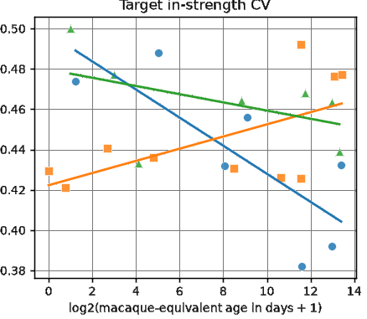
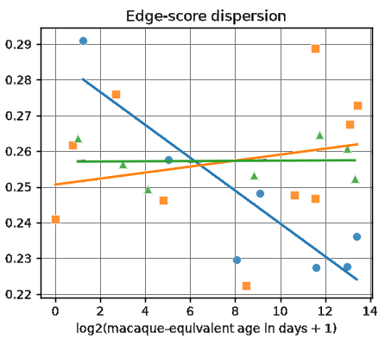
Life-history network results
D) SPECIES × DEVELOPMENTAL AGE
METHOD
17 matched human–chimpanzee profiles; life-history-aligned age; 5,000 permutations and BH-FDR across six features.
TARGET IN-STRENGTH CV
EDGE-SCORE DISPERSION
Δ slope = −0.01003 | FDR = 0.0132
Δ slope = −0.00544 | FDR = 0.0456
MAIN RESULT
Both measures decline more steeply with age in humans than in chimps.
Two of six network features were significant (FDR < 0.05).
The sound of silencing
8 / 9
Notes:
We compared developmental trajectories for 17 paired profiles: seven humans and ten chimpanzees. Two of six network features survive false-discovery correction: target in-strength CV, FDR .0132, and edge-score dispersion, FDR .0456. Both decline more steeply as humans develop compared with chimpanzees. Our findings are exploratory and based on predicted rather than directly observed miRNA regulation.
Current notebook 5: target CV slope difference -0.010028, permutation p=0.002200, BH FDR=0.013197; edge-score dispersion difference -0.005435, p=0.015197, BH FDR=0.045591.

Slide 9
Summary and contribution
E) MAIN FINDINGS AND DISTINCTIVE APPROACH
1.) EARLY HUMAN–CHIMP DIFFERENCES
140 genes (62 human-higher; 78 chimp-higher).
AUTISM-GENES
No enrichment of SFARI Category 1 or 1 + 2 genes
GENE ONTOLOGY
10 human-higher categories:
transcription, RNA splicing, DNA processes.
30 chimp-higher categories:
synaptic function, ion transport and mitochondrial electron transport.
2.) NETWORK LIFE-HISTORY ANALYSIS
With age, regulatory activity became more evenly distributed across
target genes in the human samples.
SCOPE OF NOVELTY
Instead of analyzing network changes, we kept the network fixed and analyzed global network parameters using regression.
The sound of silencing
9 / 9
Notes:
Main results from the executed project notebooks: early differential expression (notebook 6): 140 of 11,667 genes, 62 human-higher and 78 chimp-higher, in 5 human and 4 chimpanzee samples younger than 100 chronological days. SFARI autism enrichment (notebook 7): Category 1 0/140, one-sided Fisher p=1.0; Category 1+2 4/140, p=0.978922. GO (notebook 8): 10 human-higher and 30 chimp-higher refined terms after 10,000 random sets and FWER control. Network (notebooks 4b and 5): miRDB v6.0 score>=80, 156 seeds, 7,039 genes, 24,111 edges; 24 age-matched profiles normalized (7 human,10 chimp,7 macaque); interaction tests n=17. Target in-strength CV BH FDR=0.013197; edge-score dispersion BH FDR=0.045591. The edge weights are proxies, not measured repression. The statistical findings describe different age-associated heterogeneity, not inferred causal regulation. Novelty must be framed narrowly: dynamic miRNA-mRNA methods already exist, including mirDREM (Schulz et al., PNAS 2013, doi:10.1073/pnas.1303236110) and TimiRGeN (Patel et al., Bioinformatics 2021, doi:10.1093/bioinformatics/btab377). Distinctive here is the simple fixed seed-gene graph with standardized expression-contrast edge scores, nested heterogeneity summaries and cross-species life-history interaction tests.
Limitations: exploratory cross-sectional sample, 17 profiles, predicted edges, pooled three-species z-normalization, donor matching not fully verified.

