Slide 1

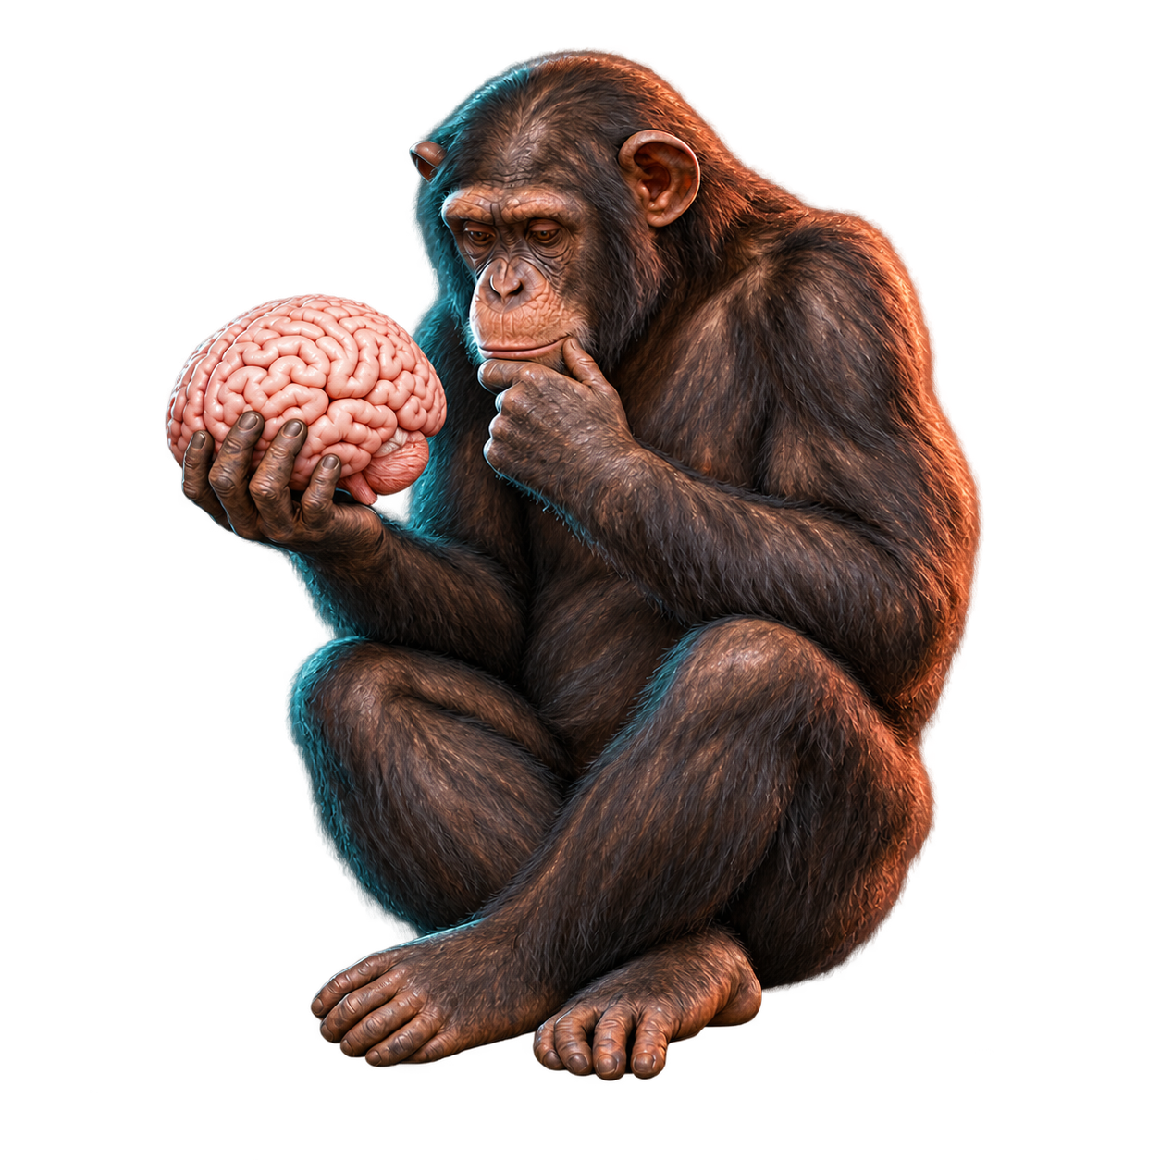
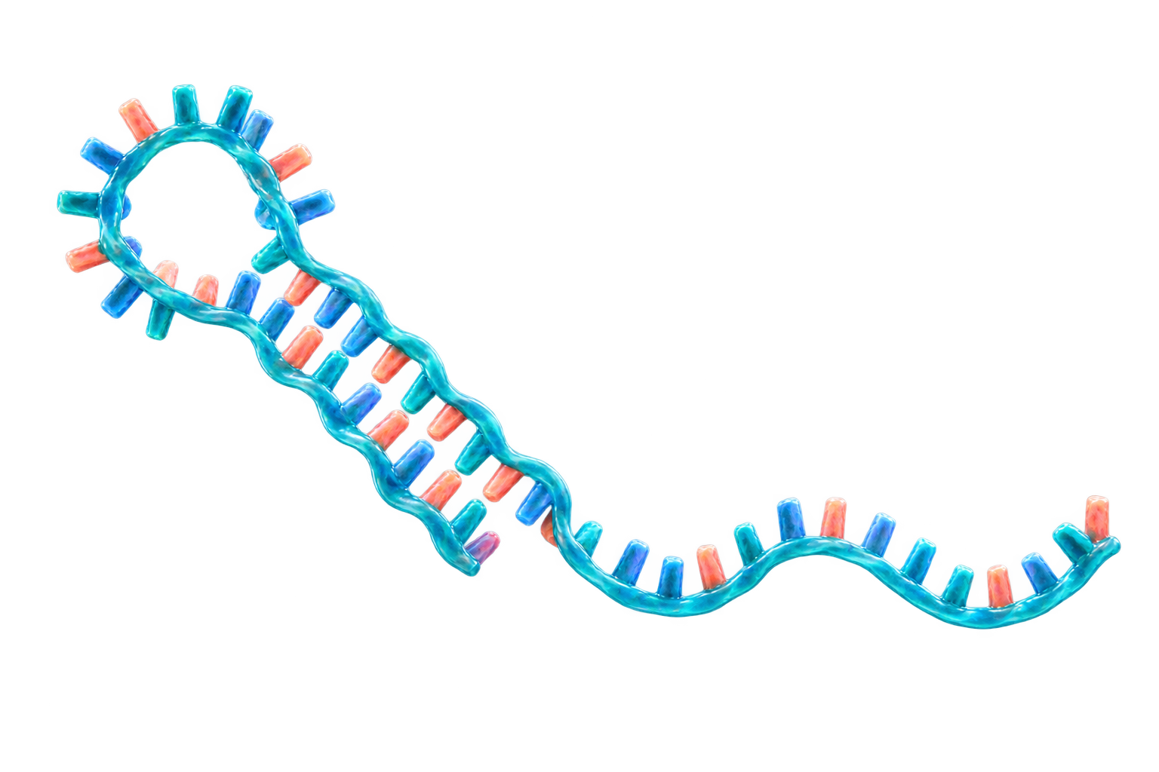
The sound of silencing
Background: microRNA (miRNA) silences gene expression by binding to messenger RNA (mRNA)
Questions: 1.) Do microRNAs regulate genes differently in humans and chimps as the brain develops?
2.) Can that help explain what makes the human brain special?
miRNA–mRNA network
A microRNA molecule
miRNA
target mRNAs
let-7
CDK6
CDKN1A
miR-92
HIPK3
miR-370
NF1
MAP3K8
METHODS
DATA
FIELDS
- Time series analysis of weighted
regulatory networks
- Functional analysis
Publicly available miRNA and mRNA expression data from study
Prefrontal cortex (PFC) expression data from humans, chimpanzees and macaques
- Computational neuroscience and
genomics
- General network analysis
Notes:
Sources:
Somel M et al. MicroRNA-driven developmental remodeling in the brain distinguishes humans from other primates. PLoS Biology. 2011;9(12):e1001214. https://doi.org/10.1371/journal.pbio.1001214
NCBI GEO GSE29356: https://www.ncbi.nlm.nih.gov/geo/query/acc.cgi?acc=GSE29356
NCBI GEO GSE22521: https://www.ncbi.nlm.nih.gov/geo/query/acc.cgi?acc=GSE22521
Network sketch: illustrative relationships only; final network edges come from miRDB v6.0, not TargetScan or miRTarBase.
Visual disclosure: chimpanzee illustration generated with OpenAI image generation on 2026-09-25 using the user-provided Ape_with_skull.jpeg as a pose reference only. The pedestal was removed and the skull was replaced with a human brain. The microRNA illustration was generated with OpenAI image generation and is illustrative rather than an atomic-resolution structure.

Slide 2
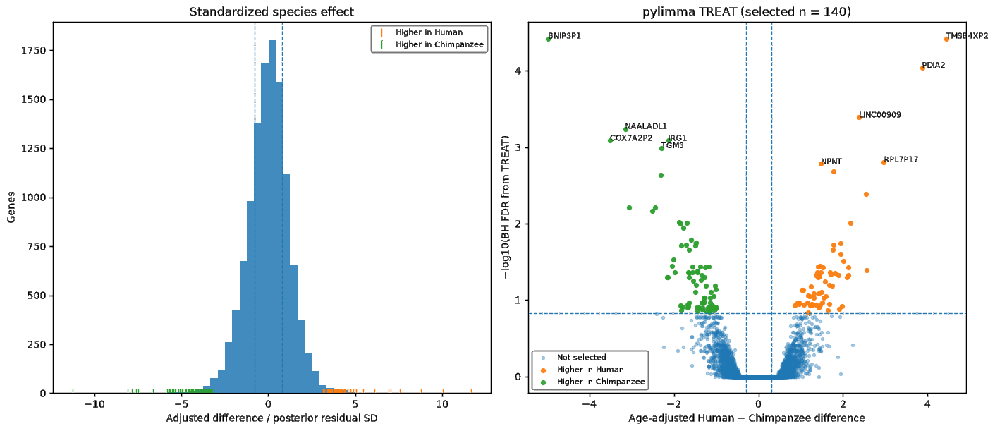
Human–chimpanzee differences in early development
A) DIFFERENTIAL EXPRESSION
EARLY DEVELOPMENT
Nine profiles under 100 days:
5 human and 4 chimpanzee.
TOOL
pylimma: Linear Models for Microarray Data.
RESULT
140 of 11,667 genes significant
62 higher in humans; 78 in chimps.
Standardized species effect and TREAT FDR
The sound of silencing
2 / 5
Notes:
We focused on the first hundred days: five humans and four chimpanzees. Across 11,667 genes, 140 passed thresholds for age-adjusted difference, multiple-testing correction at FDR 0.15, effect size, and leave-one-out stability. Sixty-two were higher in humans and seventy-eight in chimpanzees. This is exploratory because the cohort is small.
Implementation uses the Python pylimma package with empirical-Bayes moderation and TREAT, not the R limma package directly.

Slide 3
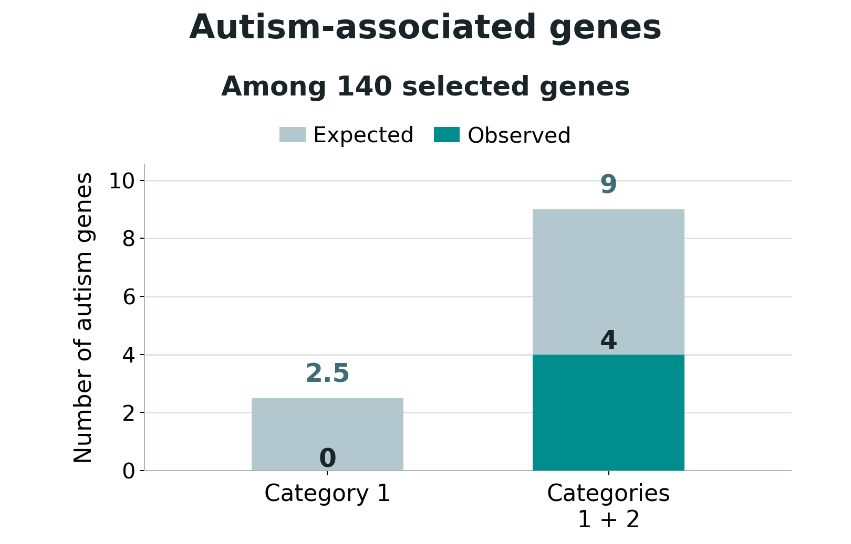
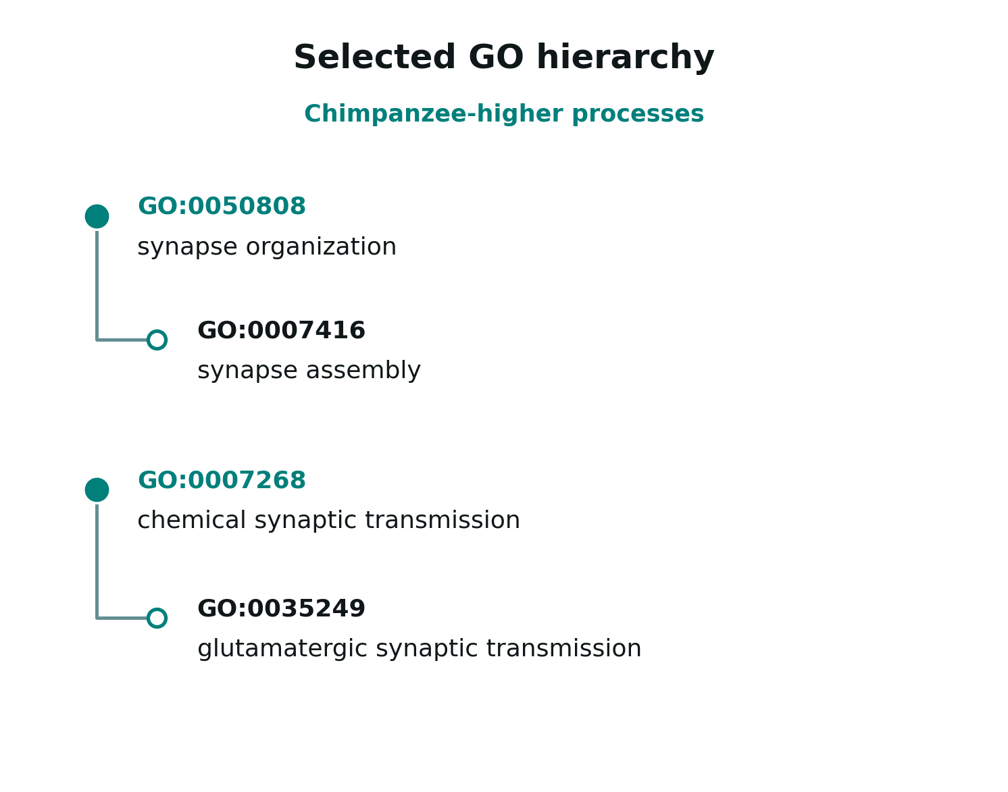
Functional analysis in early development
B) AUTISM-GENE ENRICHMENT
Are autism genes from SFARI database enriched among the 140 early-expression candidates?
FISHER EXACT TEST
No overrepresentation (p = 1.000, one-sided),
or underrepresentation (p > 0.1, two-sided)
C) GO BIOLOGICAL PROCESS ANALYSIS
Ranked differential-expression statistics
with GOfuncR; FWER ≤ 0.05 (10,000 random sets).
RESULTS AFTER HIERARCHY REFINEMENT
10 human-higher GO categories:
transcription, RNA splicing, DNA processes.
30 chimp-higher GO categories:
synaptic function, ion transport and
mitochondrial electron transport.
The sound of silencing
3 / 5
Notes:
The GO analysis ranks all genes rather than using only the 140 selected candidates. GOfuncR uses 10,000 random sets to control family-wise error. After removing redundant broader categories, there are 10 human-higher terms, mostly transcriptional and RNA/DNA-related, and 30 chimpanzee-higher terms emphasizing synaptic and ion/mitochondrial processes. The tree is an excerpt of related GO concepts.

Slide 4
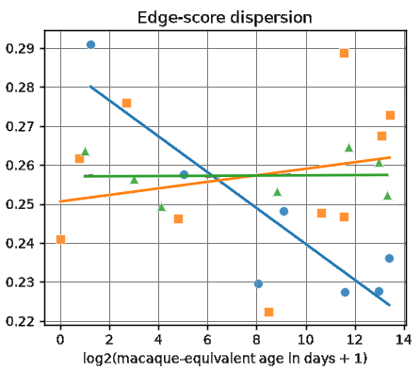
Life-history network analysis
D) LIFE-HISTORY NETWORK ANALYSIS
AGE-MATCHED miRNA-mRNA PROFILES
miRNAs
seeds
Target genes
24 profiles:
7 human, 10 chimpanzee,7 macaque.
let-7a-5p
GAGGUAG
HMGA2
NETWORK SIZE
let-7b-5p
let-7 family
CDK6
About 200 miRNAs resulted in 150 seeds.
About 7,000 genes and 24,000
seed-gene edges.
miR-17-5p
CDKN1A
AAAGUGC
miR-20a-5p
miR-17 family
CCND1
MAIN RESULT
Two of six network features, were significant (FDR < 0.05).
Both decline more steeply with age in humans
than in chimps.
This means, with age, the regulatory activity became more evenly distributed across target genes in humans.
The sound of silencing
4 / 5
Notes:
The predicted regulatory network uses matched miRNA seed families and target genes. We chose high-confidence miRDB predicted links: 24,111 unique seed to gene edges, 156 seeds and 7,039 genes. Across 24 matched human, chimp and macaque profiles, an edge receives an expression-derived proxy activity score. It is not a direct measurement of repression.

Slide 5
Summary and contribution
E) MAIN FINDINGS AND DISTINCTIVE APPROACH
1.) EARLY HUMAN–CHIMP DIFFERENCES
140 genes (62 human-higher; 78 chimp-higher).
AUTISM-GENES
No enrichment of SFARI Category 1 or 1 + 2 genes
GENE ONTOLOGY
10 human-higher categories:
transcription, RNA splicing, DNA processes.
30 chimp-higher categories:
synaptic function, ion transport and mitochondrial electron transport.
2.) NETWORK LIFE-HISTORY ANALYSIS
With age, regulatory activity became more evenly distributed across
target genes in the human samples.
SCOPE OF NOVELTY
Instead of analyzing network changes, we kept the network fixed and analyzed global network parameters using regression.
The sound of silencing
5 / 5
Notes:
Main results from the executed project notebooks: early differential expression (notebook 6): 140 of 11,667 genes, 62 human-higher and 78 chimp-higher, in 5 human and 4 chimpanzee samples younger than 100 chronological days. SFARI autism enrichment (notebook 7): Category 1 0/140, one-sided Fisher p=1.0; Category 1+2 4/140, p=0.978922. GO (notebook 8): 10 human-higher and 30 chimp-higher refined terms after 10,000 random sets and FWER control. Network (notebooks 4b and 5): miRDB v6.0 score>=80, 156 seeds, 7,039 genes, 24,111 edges; 24 age-matched profiles normalized (7 human,10 chimp,7 macaque); interaction tests n=17. Target in-strength CV BH FDR=0.013197; edge-score dispersion BH FDR=0.045591. The edge weights are proxies, not measured repression. The statistical findings describe different age-associated heterogeneity, not inferred causal regulation. Novelty must be framed narrowly: dynamic miRNA-mRNA methods already exist, including mirDREM (Schulz et al., PNAS 2013, doi:10.1073/pnas.1303236110) and TimiRGeN (Patel et al., Bioinformatics 2021, doi:10.1093/bioinformatics/btab377). Distinctive here is the simple fixed seed-gene graph with standardized expression-contrast edge scores, nested heterogeneity summaries and cross-species life-history interaction tests.
Limitations: exploratory cross-sectional sample, 17 profiles, predicted edges, pooled three-species z-normalization, donor matching not fully verified.

