Slide 1

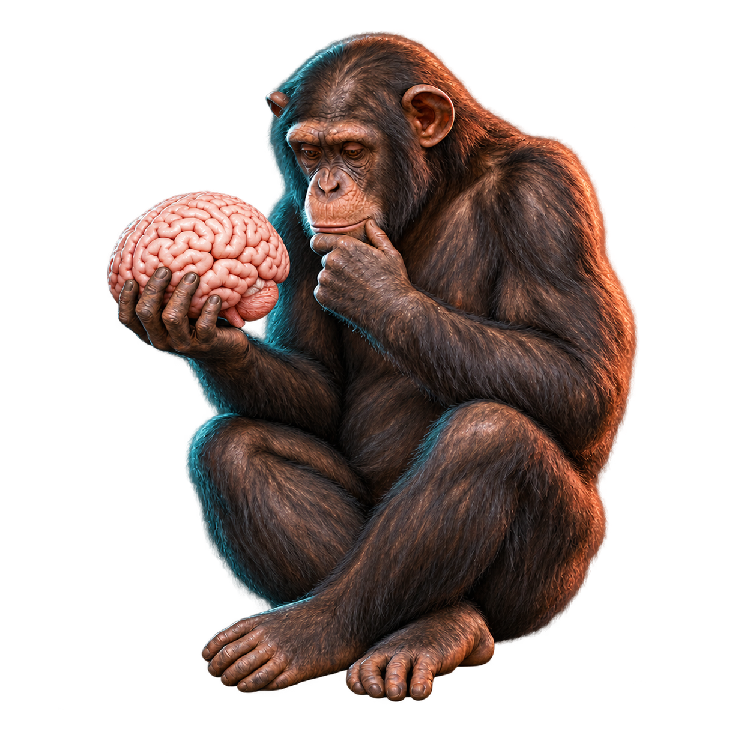
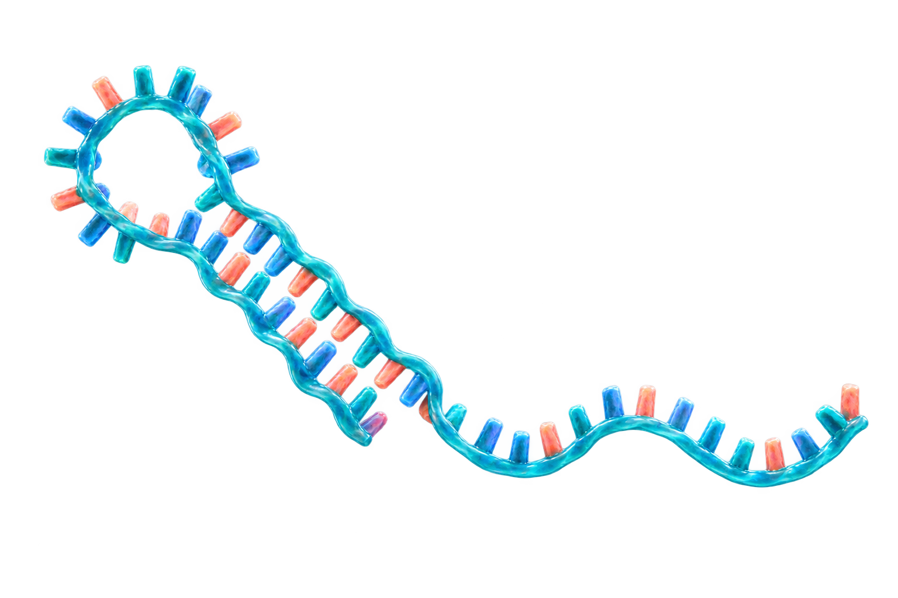
The sound of silencing
Background: microRNA (miRNA) silences gene expression by binding to messenger RNA (mRNA)
Questions: 1.) Do microRNAs regulate genes differently in humans and chimps as the brain develops?
2.) Can that help explain what makes the human brain special?
miRNA–mRNA network
A microRNA molecule
miRNA
target mRNAs
let-7
CDK6
CDKN1A
miR-92
HIPK3
miR-370
NF1
MAP3K8
METHODS
DATA
FIELDS
- Time series analysis of weighted
regulatory networks
- Functional analysis
Publically available miRNA and mRNA expression data from a study
- Computational neuroscience and
genomics
- General network analysis
Notes:
Sources:
Somel M et al. MicroRNA-driven developmental remodeling in the brain distinguishes humans from other primates. PLoS Biology. 2011;9(12):e1001214. https://doi.org/10.1371/journal.pbio.1001214
NCBI GEO GSE29356: https://www.ncbi.nlm.nih.gov/geo/query/acc.cgi?acc=GSE29356
NCBI GEO GSE22521: https://www.ncbi.nlm.nih.gov/geo/query/acc.cgi?acc=GSE22521
Network sketch: illustrative subset of TargetScan/miRTarBase family–gene links used in the project analysis.
Visual disclosure: chimpanzee illustration generated with OpenAI image generation on 2026-09-25 using the user-provided Ape_with_skull.jpeg as a pose reference only. The pedestal was removed and the skull was replaced with a human brain. The microRNA illustration was generated with OpenAI image generation and is illustrative rather than an atomic-resolution structure.

