Slide 1
Models 3–4: Linear Regression and Random Forest — Methods and Performance
Methods
Performance
•
Models: Ordinary least squares (OLS) and tuned Random Forest (RF)
Model / predictors
Test R²
CV R²
Test RMSE
•
Predictor sets: 15 covariates vs. 15 covariates + 12 behaviors
OLS: Covariates
0.068
0.116
8.765
OLS: Covariates + Behaviors
0.085
0.121
8.687
•
Split: 80/20 train/test (2,235 / 559), outcome-stratified
RF: Covariates
0.073
0.116
8.744
•
Preprocessing: Median imputation; OLS predictors standardized
RF: Covariates + Behaviors
0.081
0.122
8.707
•
Validation: Repeated 5-fold CV (25 folds); nested tuning for RF
Added predictive value of behaviors
•
Tuning: 12 RF configurations, RMSE criterion, 3-fold inner CV
•
OLS: Test ΔR² +0.017; 95% CI [−0.003, 0.037]
•
Added value: 2,000 paired test-set bootstrap resamples
•
RF: Test ΔR² +0.008; 95% CI [−0.008, 0.027]
Note. Both CIs include zero; OLS slightly better on test data, with negligible difference.
1

Slide 2
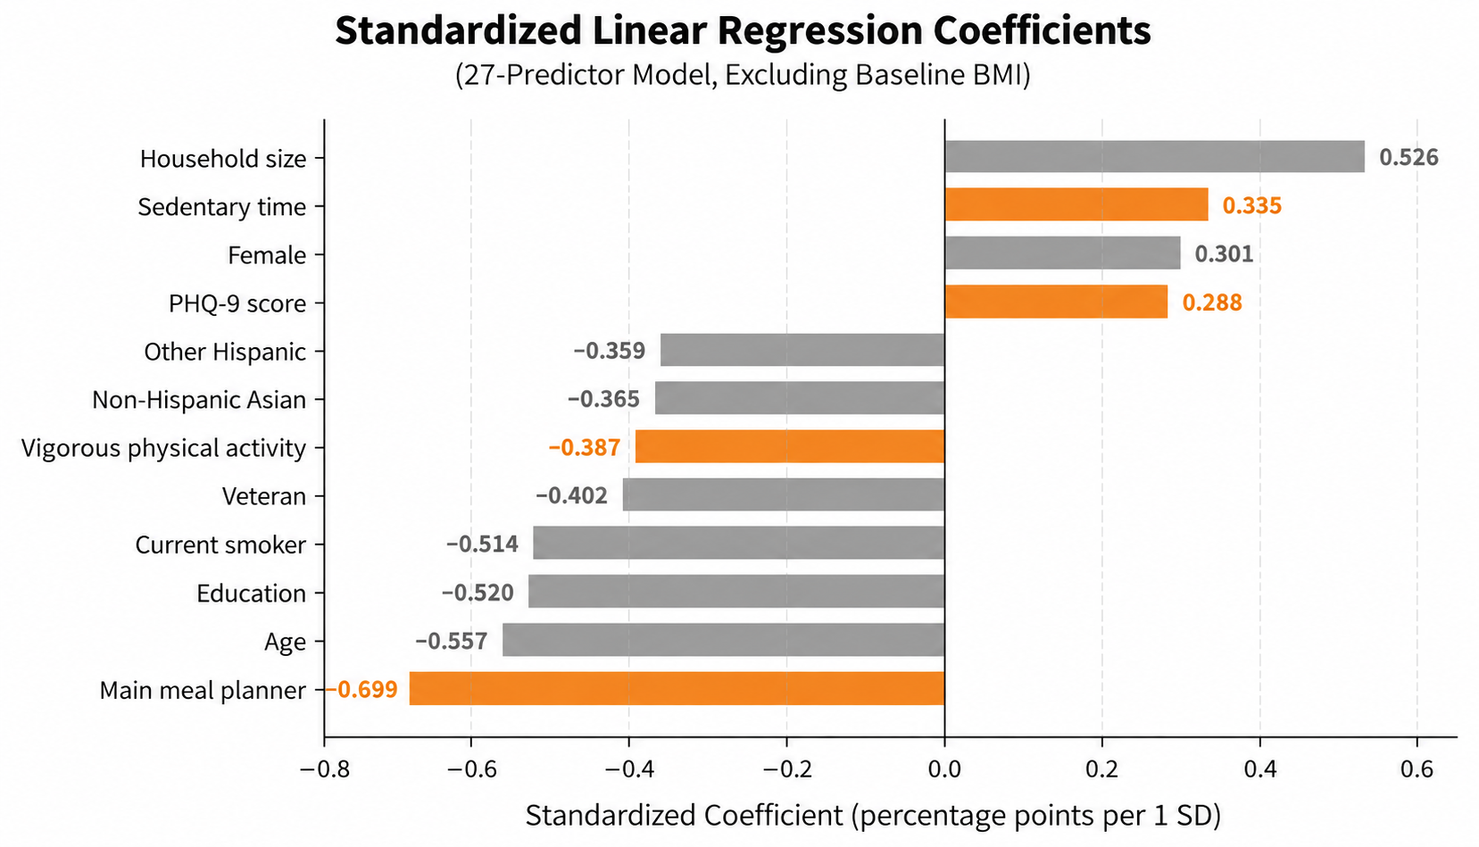
Models 3–4: Which Predictors Matter?
Key Findings
•
Starting BMI dominates: OLS coefficient −3.172; RF importance +1.116 RMSE points.
•
OLS associations: Meal planning and vigorous activity linked to more weight loss; sedentary time and PHQ-9 to less.
•
Binary interpretation: Participants coded as main meal planners had approximately 1.57 percentage points lower predicted weight change than the comparison group, adjusting for the other predictors.
•
RF interpretation: Moderate physical activity ranked third overall and highest among behavioral predictors in permutation importance. However, its contribution to predictive accuracy was small (RMSE increase = 0.037 when shuffled).
← More predicted weight loss Less predicted weight loss →
•
Prediction: Behavioral additions yield modest, uncertain improvement; no clear forest advantage.
Note. BMI excluded for scale: Coefficient = −3.172
2

