Slide 1
Solar Storm Risk Prediction
George H. Seelinger
Erdős Institute
Spring 2026 Data Science Bootcamp

Slide 2
Summary
Sun emits solar wind towards the Earth
Can create geomagnetic storms affecting power grids, satellites, and communication systems.
Useful for operators to receive "early warning" about potential solar storms.
This project: predict solar storms from incoming solar wind data (~45 minute lead time)

Slide 3
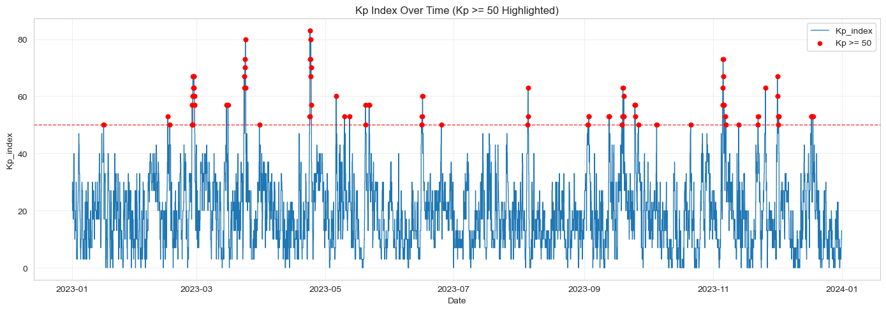
Problem setup
Solar storms do not happen all the time → rare event prediction
Weather is simply not 100% predictable.
False positive (false alarm) is more desirable than false negative → prefer to maximize recall subject to fixed precision.
Weather prediction goals: recall > .60, precision > .30

Slide 4
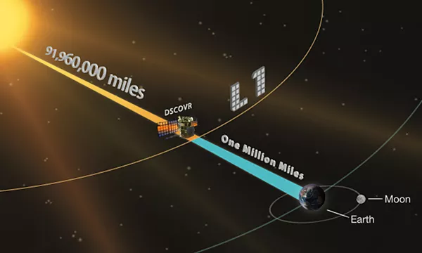
Data sources
NASA and NOAA provide data from satellites situated between the Earth and the Sun.
NASA: historical time-aligned data
NOAA: real time solar wind data
Satellite data can have gaps, so data must be appropriately cleaned
Photo credit: NASA

Slide 5
Feature selection
Physics informed features:
Angle between solar wind and Earth's magnetic field
Energy flux
Rolling averages of measurements
Variation in magnetic orientation of solar wind
"Newell coupling"
Some features were highly correlated, so they were dropped to improve model performance
Many engineered rolling averages were too highly correlated with raw features.
Features encoding solar wind vector had some redundancy and so a few were dropped.

Slide 6
Model Selection
Time series data
Used 20 years of historical data
Cross-validation with 1 year folds
Weather prediction domain
Maximize recall with precision >= .30
Maintain realistic expectations for results
Adjust probability threshold on models
Hyperparameter tuning using Optuna
Baselines
High precision 0 recall: Dummy classifier always says "No Storm"
Other standard models without feature engineering: < 0.3 recall and < 0.6 precision

Slide 7
Results (XGBClassifier)
Overall Precision: 0.3260
Overall Recall : 0.7517

Slide 8
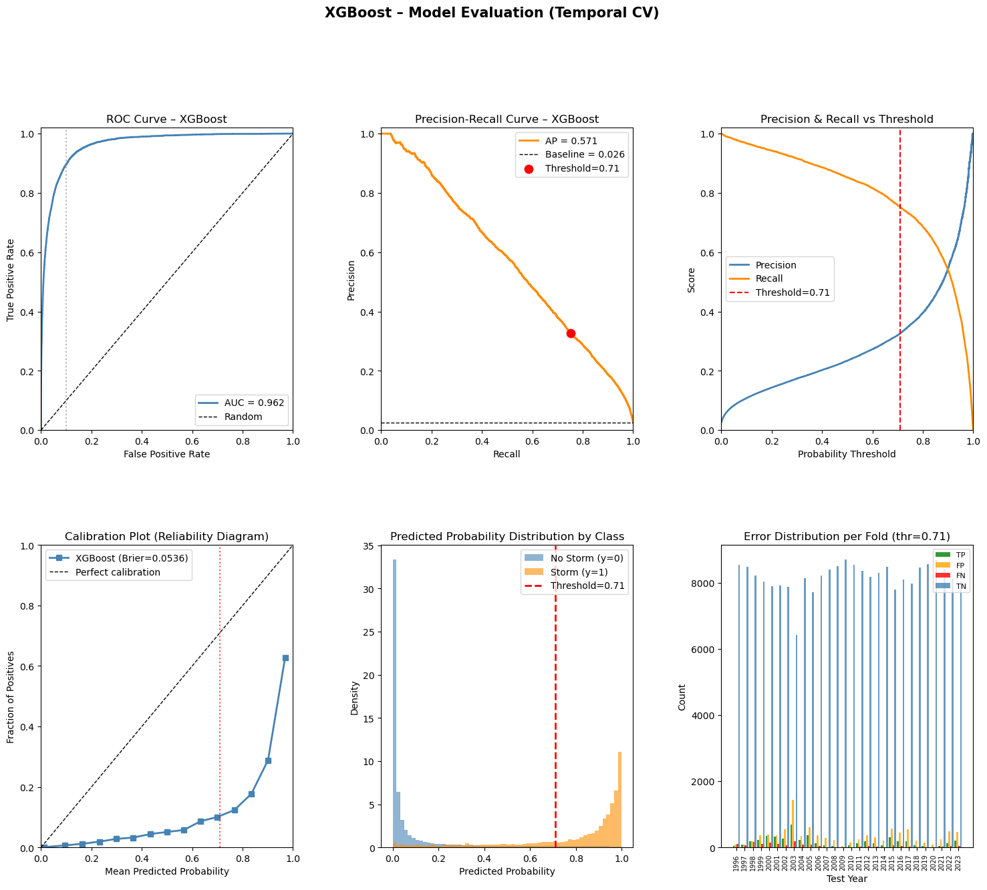
model-selection.ipynb

Slide 9
Limitations and potential
Will give many false positives
Further time horizon predictions not realistic without additional data sources
Optical data from sun
Model could be deployed with "online" data from NOAA
Data ingestion built, but online deployment not developed for lack of time
Business use case
Provide advanced warning of potential geomagnetic storm to grid operators

