Slide 1

Financial Fraud Detection
Zengrui Han, Ching Hsien Lee, Kuijun Liu and Bojue Wang
Notes:
[Sources]
- Content adapted from REPORT_DRAFT.md (user-provided).
- Visual style referenced from Financial_Fraud_Detection.pdf (user-provided).

Slide 2
1
Problem Setting
Financial fraud detection is an operational screening problem: institutions must flag rare suspicious activity under evolving behavior and high false-positive cost. In blockchain settings, that evidence often appears as money-flow patterns across related accounts, addresses, and transactions rather than isolated records.
Why this is challenging
Coordinated fraud rings are easier to detect when neighborhood structure is visible.
The labeled data is highly imbalanced, so accuracy is not a reliable headline metric.
Precision matters operationally because every false positive creates analyst review cost, while recall matters because missed illicit flows are costly.
The project tests a simple feature-only baseline against graph-aware models to see when neighborhood structure adds real value. Evaluation emphasizes illicit-class F1, precision, recall, ROC-AUC, and PR-AUC where available.
2
Notes:
[Sources]
- REPORT_DRAFT.md (user-provided).

Slide 3
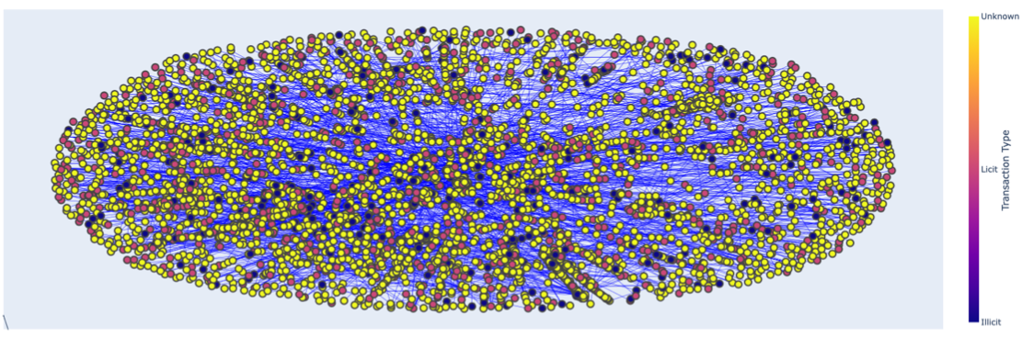
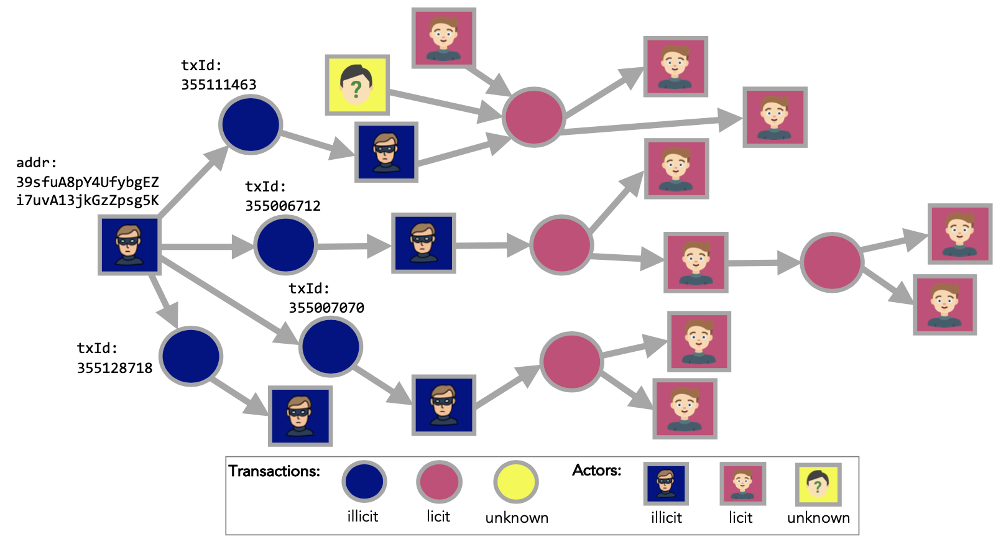
2
Datasets
Elliptic++
Transactions
Txn features
Wallet rows
203,769
182
1,268,260
Graph expansion adds address relations and wallet features
Transactions graph visualization
Relational edges
txn-txn 234,355 • txn-address 837,124 • address-address 2,868,964
Same labeled transaction set, plus address-level supervision and multi-task learning.
Label imbalance remains severe
unknown 157,205
licit 42,019
illicit 4,545
Actors graph visualization
3
Notes:
[Sources]
- REPORT_DRAFT.md (user-provided).

Slide 4
3
Models Evaluated
The project compares a strong tabular baseline against increasingly graph-aware models.
Modeling axis
Feature-only → Graph neighborhood → Heterogeneous relations → Auxiliary supervision
1
2
3
4
XGBoost
Baseline GCN
Wallet-upgrade GCN
Directed hetero + multi-task
Feature-only
transaction baseline
Homogeneous graph
with weighted loss
Richer features
within the graph
Multiple node types
and auxiliary supervision
Compared designs on Elliptic++
Baseline GCN
Wallet-upgrade GCN
Directed heterogeneous GNN
Multi-task directed heterogeneous GNN
Address pretraining followed by transaction fine-tuning
4
Notes:
[Sources]
- REPORT_DRAFT.md (user-provided).

Slide 5
4
Results
Model | Illicit F1 | Precision | Recall | ROC-AUC
XGBoost | 0.7700 | 0.8100 | 0.7300 | 0.9230
GCN | 0.2410 | 0.1401 | 0.8596 | 0.8138
Model | Illicit F1 | Precision | Recall | ROC-AUC
Baseline GCN | 0.2147 | 0.1325 | 0.5660 | 0.7772
Wallet-upgrade GCN | 0.2245 | 0.1379 | 0.6038 | 0.7769
Directed hetero GNN | 0.2250 | 0.1636 | 0.3601 | 0.7920
Address pretrain + finetune | 0.2379 | 0.1502 | 0.5708 | 0.7885
Multi-task directed hetero GNN | 0.2918 | 0.1875 | 0.6572 | 0.8560
Precision vs recall trade-off
Precision
XGBoost
0.81
Illicit F1 ranking
GCN
0.14
Baseline GCN
0.2147
Recall
Wallet-upgrade GCN
0.2245
XGBoost
0.73
Directed hetero GNN
0.2250
GCN
0.86
Address pre-train + fine-tune
0.2379
Multi-task directed hetero GNN
0.2918
5
Notes:
[Sources]
- REPORT_DRAFT.md (user-provided).

Slide 6
5
Discussion and Limitations
1
Tabular models remain very strong when the feature space is rich.
Caveats
On Elliptic, XGBoost outperformed the GCN by a large margin on illicit F1 and ROC-AUC.
Accuracy is not a useful headline metric because licit cases dominate the test set.
Threshold tuning or score calibration may improve operational precision.
Temporal drift can reduce performance if fraud patterns change over time.
Elliptic++ results still depend on the current split and preprocessing choices.
2
Graph structure becomes more useful as the dataset becomes richer and more heterogeneous.
On Elliptic++, the best results came from the multi-task directed heterogeneous GNN.
3
Threshold choice is critical under severe class imbalance.
Several GNN variants show reasonable ROC-AUC but low precision, which suggests ranking quality without an optimal operating threshold.
Likely next step: tune operating thresholds and calibration before deployment-oriented evaluation.
7
Notes:
[Sources]
- REPORT_DRAFT.md (user-provided).

