Slide 1

Forecasting
NYC Rat Activity
Erdos Data Science Project
“spring-2026-rat-activity-nyc”
Krishna Aryal
Kevin Dao
Yael Eisenberg
Ifeoluwa Solomon
Title photo: G. Scott Segler / Wikimedia Commons

Slide 2
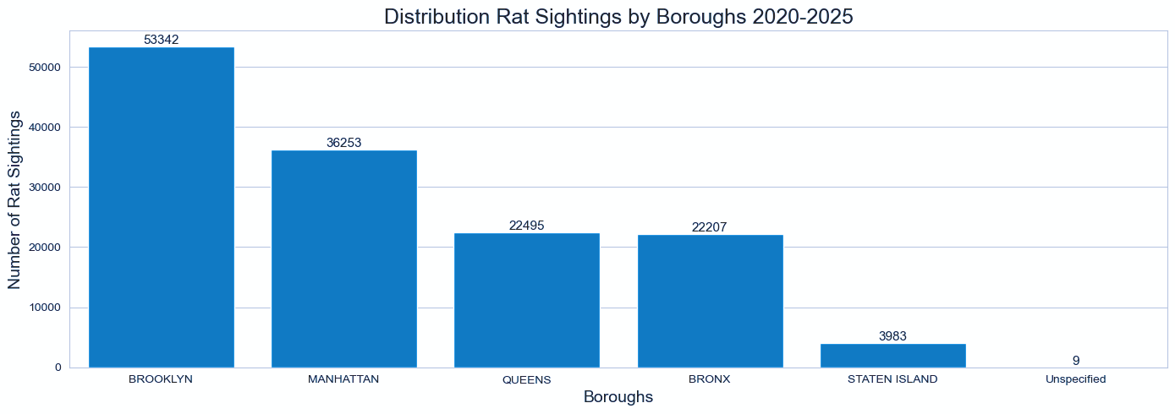
Why this project matters:
Rats are a nuisance & pose major health risks to NYC residents.
Spread disease, eat food, damage infrastructure, and can attack humans.
Short-term forecasts help plan for inspections and exterminations.
Borough-level forecasts matter due to distinct features of each borough.
Anticipate sightings to plan biweekly workschedules around.

Slide 3
What we asked and the tools we utilized
Can we predict the next 14 days of rat sightings for NYC and each borough?
Final data used
Open-Meteo weather
Engineered feature
Also Explored
inspections, catch basins, IRS, DSNY trash tonnage
NYC 311 Rat Sightings
Forecast Horizon: 14 days
Citywide + Borough
2020-01-01 to 2026-02-28
Why this scope?
Captures weekly patterns
Useful for planning
Faster walk-forward validation

Slide 4
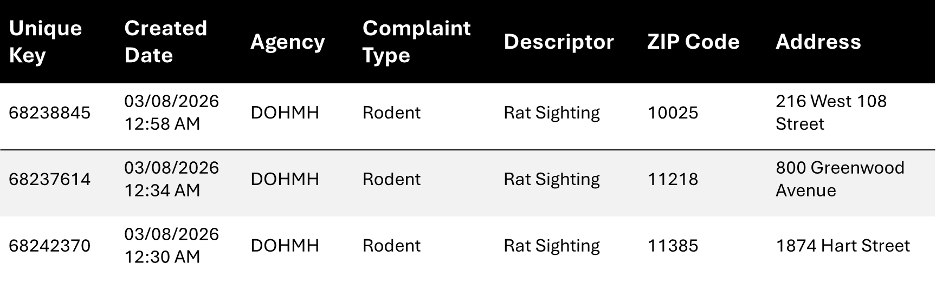
Exploratory Data Analysis
Raw Data: Many columns are redundant e.g. “Problem (formerly Complaint type)”
Collect Data to Convenient CSV: By borough & made .csv files for convenience
Relevant Columns: Borough, Created Date
Many empty columns e.g. Vehicle Type,Taxi Company Borough, Taxi Pick Up Location, etc
Sample of Data
The raw data offered many features and many irrelevant columns.
The dataset was large with roughly 140,000 rows and exactly 38 columns.

Slide 5
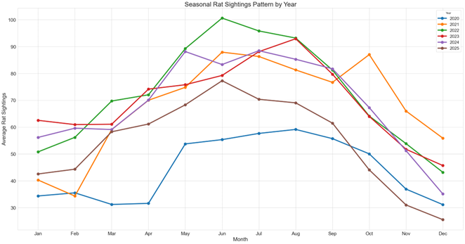
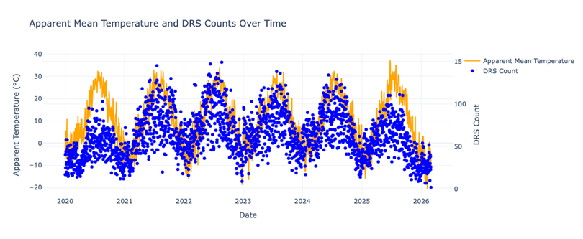
EDA: The Data has Real Structure
Sightings rise in warmer months and fall in winter.
Temperature lines up with daily sighting counts.
The series is very noisy, but not random.
That gave us a reason to try models that can learn seasonality and weather effects.

Slide 6
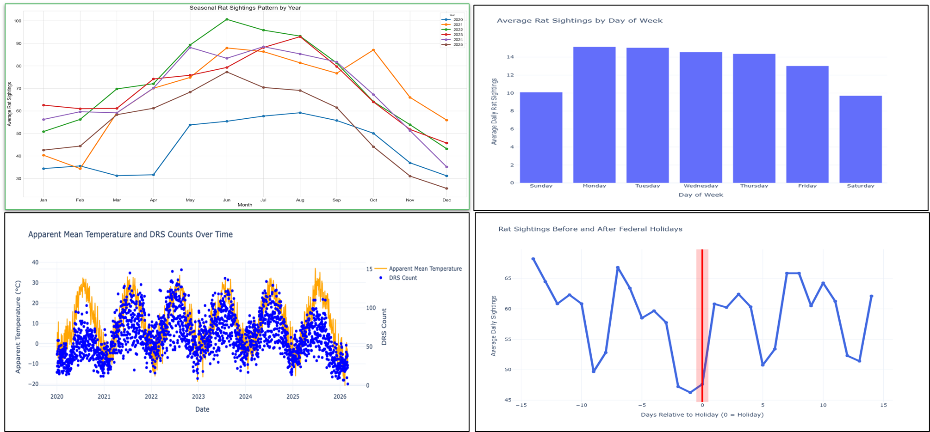
Exploratory Data Analysis Plots
Notes:
Sightings rise in warmer months and fall in winter.
Temperature lines up with daily sighting counts.
The series is noisy, but not random.
That gave us a reason to try models that can learn seasonality and weather effects.
Either include in slide or just keep as speaker note.

Slide 7

Modeling Workflow
2. Model/Tune/Validate
Validation
Walk-Forward Validation
26 folds
14-day test windows
Models
3. Selection
1. Inputs and Features
Daily 311 rat sightings
Weather data
Seasonal average
SARIMA
Prophet
Neural Prophet
XGBoost
Holt-Winters
Hybrid Models
Ensemble Models
Compare with mean RMSE
Evaluate chosen model on the holdout data
Design and Caution
• 14 days test windows
• Mindful of temporal leakage
• Holdout 2025-03-01 to 2026-02-28
Tuning
Tune parameters for models, consider derivative models of the best performers.
Notes:
(Kevin) Methodology / Justify our Cross validation choices and choice of holding out 1 year. Quick overview of Brooklyn.
What I will do: show the modeling workflow diagram briefly and do a (very) quick overview of how that looks with Brooklyn.
For our modeling workflow, we took the following approach.
First, we load the data, process it for relevant features for our forecasts, and then use walk-forward cross validation to evaluate the model.
We chose to hold out 1 year’s worth of data for finale valuations due to yearly seasonality.
We use 14 day test windows and 26 folds for this.
We compared many models such as Seasonal Average Forecast, Holt-Winters, SARIMAX, XGBoost, and Prophet.
Once we found a good model, we considered derivative models such as NeuralProphet or Prophet + XGBoost. We tuned parameters and selected features and for our final model, we picked the best performer.
Quick example with Brooklyn – load our saved data grouped by dates.
Ensure all dates are there.
Add the features and do a first comparison of models.
We see Prophet performed the best and beat the baseline with a nearly 20% reduction in mean RMSE.
Tune parameters and consider derivative models like NeuralProphet. We use Gridsearch and Optuna based on need.
NeuralProphet model has a mean RMSE of 7.116736.
We choose NeuralProphet as our final model and the holdout set. It gives a mean RMSE of 6.237 which is a good sign!

Slide 8
Example: Brooklyn - Input
Inputs
Collect Brooklyn entries
Group by date
Check for dates with 0 rat sightings
Load the rat sightings data
Ranges from 0 – 67 sightings per day
created_date | count
2020-01-01 | 7
2020-01-02 | 21
2020-01-03 | 13
2020-01-04 | 8
2020-01-05 | 5
... | ...
2025-02-24 | 20
2025-02-25 | 24
2025-02-26 | 28
2025-02-27 | 31
2025-02-28 | 15

Slide 9
Example: Brooklyn - Features
Features
Weather data from Open-Meteo
Lags, Moving Averages, One-Hot Encoders
Feature Selection via Experimentation
ds | y | dayofweek | quarter | month | year | dayofyear | dayofmonth | weekofyear | dayofweek_sin | dayofweek_cos | ... | Rat_mitigation_Zone | Rat_Czar_Appointed
2020-01-01 | 7 | 2 | 1 | 1 | 2020 | 1 | 1 | 1 | 0.974928 | -0.222521 | ... | 0 | 0
2020-01-02 | 21 | 3 | 1 | 1 | 2020 | 2 | 2 | 1 | 0.433884 | -0.900969 | ... | 0 | 0

Slide 10
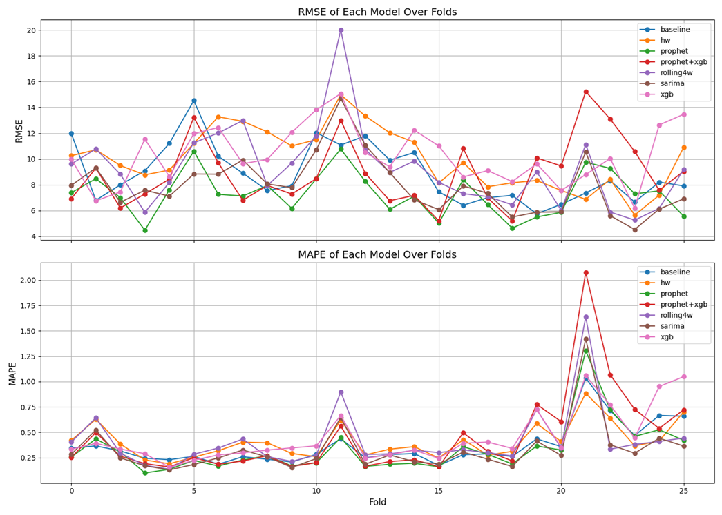

Example: Brooklyn – Validation and Models
model | baseline | hw | prophet | prophet+xgb | rolling4w | sarima | xgb
rmse (mean) | 8.856 | 10.031 | 7.309 | 8.872 | 9.237 | 7.945 | 10.257
mape (mean) | 0.366 | 0.409 | 0.330 | 0.443 | 0.412 | 0.329 | 0.445
Notes:
(Kevin) Methodology / Justify our Cross validation choices and choice of holding out 1 year. Quick overview of Brooklyn.
What I will do: show the modeling workflow diagram briefly and do a (very) quick overview of how that looks with Brooklyn.
For our modeling workflow, we took the following approach.
First, we load the data, process it for relevant features for our forecasts, and then use walk-forward cross validation to evaluate the model.
We chose to hold out 1 year’s worth of data for finale valuations due to yearly seasonality.
We use 14 day test windows and 26 folds for this.
We compared many models such as Seasonal Average Forecast, Holt-Winters, SARIMAX, XGBoost, and Prophet.
Once we found a good model, we considered derivative models such as NeuralProphet or Prophet + XGBoost. We tuned parameters and selected features and for our final model, we picked the best performer.
Quick example with Brooklyn – load our saved data grouped by dates.
Ensure all dates are there.
Add the features and do a first comparison of models.
We see Prophet performed the best and beat the baseline with a nearly 20% reduction in mean RMSE.
Tune parameters and consider derivative models like NeuralProphet. We use Gridsearch and Optuna based on need.
NeuralProphet model has a mean RMSE of 7.116736.
We choose NeuralProphet as our final model and the holdout set. It gives a mean RMSE of 6.237 which is a good sign!

Slide 11
Example: Brooklyn - Tuning
Tuning for Prophet
Gridsearch
'changepoint_prior_scale' 'seasonality_prior_scale'
mean RMSE of 7.17
mean RMSE improved
fold | rmse | mape
1 | 11.039 | 0.597
2 | 8.040 | 0.359
3 | 4.512 | 0.100
4 | 7.334 | 0.123
5 | 10.050 | 0.212
… | … | …
Mean | 7.171 | 0.300
Tuning for NeuralProphet
Optuna
Regress features: Weather
Parameters: epochs, learning_rate, ar_reg,
mean RMSE of 7.12 after minimal tuning
fold | rmse | mape
1 | 7.062 | 0.343
2 | 6.650 | 0.306
3 | 5.350 | 0.141
4 | 8.753 | 0.166
5 | 9.977 | 0.229
… | … | …
Mean | 7.117 | 0.292
Notes:
(Kevin) Methodology / Justify our Cross validation choices and choice of holding out 1 year. Quick overview of Brooklyn.
What I will do: show the modeling workflow diagram briefly and do a (very) quick overview of how that looks with Brooklyn.
For our modeling workflow, we took the following approach.
First, we load the data, process it for relevant features for our forecasts, and then use walk-forward cross validation to evaluate the model.
We chose to hold out 1 year’s worth of data for finale valuations due to yearly seasonality.
We use 14 day test windows and 26 folds for this.
We compared many models such as Seasonal Average Forecast, Holt-Winters, SARIMAX, XGBoost, and Prophet.
Once we found a good model, we considered derivative models such as NeuralProphet or Prophet + XGBoost. We tuned parameters and selected features and for our final model, we picked the best performer.
Quick example with Brooklyn – load our saved data grouped by dates.
Ensure all dates are there.
Add the features and do a first comparison of models.
We see Prophet performed the best and beat the baseline with a nearly 20% reduction in mean RMSE.
Tune parameters and consider derivative models like NeuralProphet. We use Gridsearch and Optuna based on need.
NeuralProphet model has a mean RMSE of 7.116736.
We choose NeuralProphet as our final model and the holdout set. It gives a mean RMSE of 6.237 which is a good sign!

Slide 12
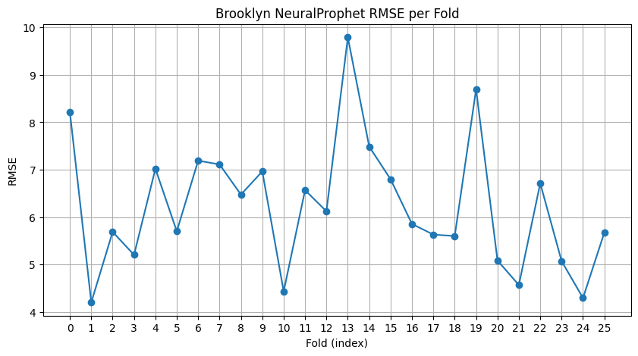
Example: Brooklyn - Selection
Evaluation
Choose NeuralProphet with mean RMSE of 7.12
Evaluate model on all data (2020-01-01 to 2026-02-28)
Use tuned parameters & features
mean RMSE of 6.237 is good indicator we did not overfit or underfit
fold | rmse | mape
1 | 4.200 | 0.158
2 | 5.688 | 0.221
3 | 5.203 | 0.112
4 | 7.020 | 0.272
5 | 5.701 | 0.182
... | ... | ...
mean | 6.237 | 0.350
Notes:
(Kevin) Methodology / Justify our Cross validation choices and choice of holding out 1 year. Quick overview of Brooklyn.
What I will do: show the modeling workflow diagram briefly and do a (very) quick overview of how that looks with Brooklyn.
For our modeling workflow, we took the following approach.
First, we load the data, process it for relevant features for our forecasts, and then use walk-forward cross validation to evaluate the model.
We chose to hold out 1 year’s worth of data for finale valuations due to yearly seasonality.
We use 14 day test windows and 26 folds for this.
We compared many models such as Seasonal Average Forecast, Holt-Winters, SARIMAX, XGBoost, and Prophet.
Once we found a good model, we considered derivative models such as NeuralProphet or Prophet + XGBoost. We tuned parameters and selected features and for our final model, we picked the best performer.
Quick example with Brooklyn – load our saved data grouped by dates.
Ensure all dates are there.
Add the features and do a first comparison of models.
We see Prophet performed the best and beat the baseline with a nearly 20% reduction in mean RMSE.
Tune parameters and consider derivative models like NeuralProphet. We use Gridsearch and Optuna based on need.
NeuralProphet model has a mean RMSE of 7.116736.
We choose NeuralProphet as our final model and the holdout set. It gives a mean RMSE of 6.237 which is a good sign!

Slide 13
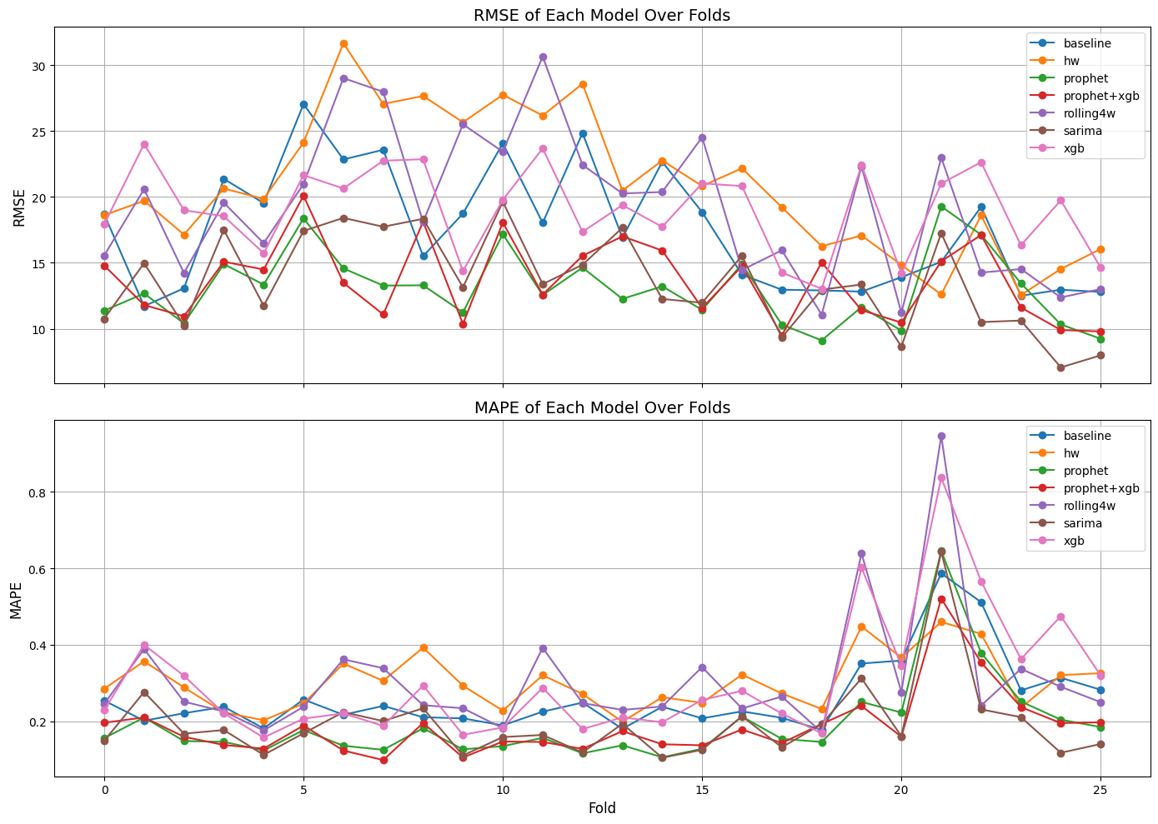
Results: Citywide
Citywide min: 9
Citywide max: 149
Citywide mean: 163.12
Model Selection: Hybrid Prophet + XGBoost
Mean RMSE of Hybrid Model: 12.14
Notable improvement over Prophet’s solo performance under cross-validation.
Mean RMSE of Hybrid Model on Holdout: 10.75
Mean RMSE of Seasonal Average Model:
17.57
Mean RMSE of Prophet: 13.08
Notes:
This slide shows the citywide results. Here you can see the RMSE and MAPE results for the seven models across all five Boroughs over 26 folds. Prophet (green line) consistently performed the best as a solo model, with a mean RMSE of 13.08. The model we chose was a hybrid of prophet and XGBoost which has a mean RMSE of 12.14, so incorporating complexity improved the model over Prophet’s mean RMSE. Notice that the mean RMSE of this hybrid model on the holdout (which is not shown on the plot) is 10.75, which indicates that the model is generalizing well to new data it hasn’t yet encountered.

Slide 14
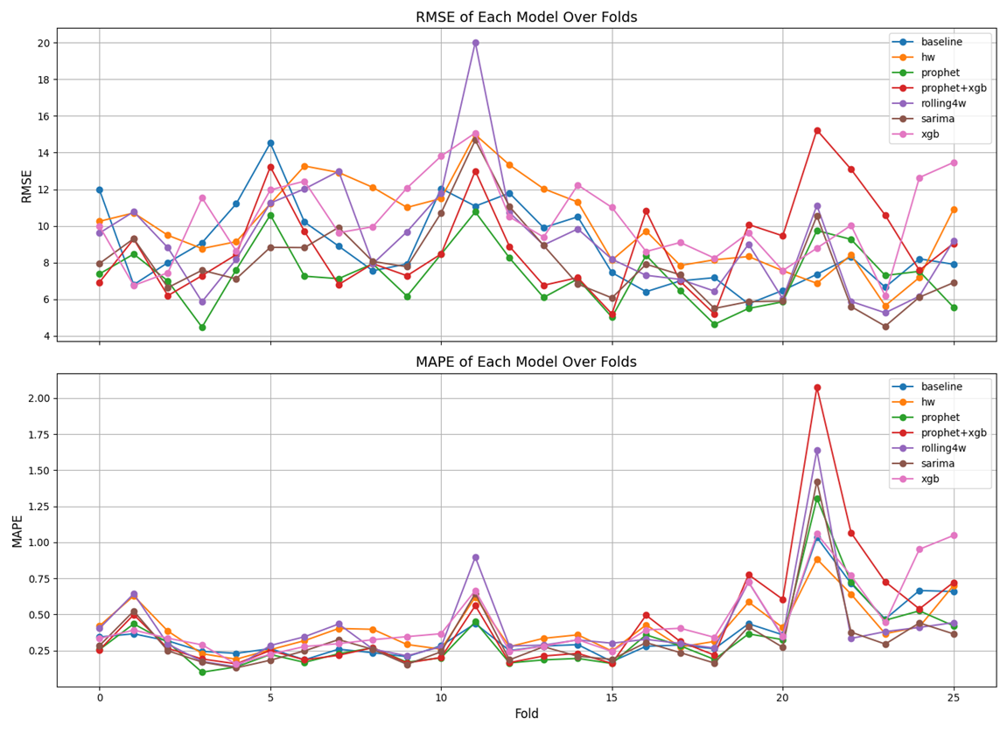
Results: Brooklyn
Brooklyn min: 9
Brooklyn max: 67
Brooklyn mean: 24.35
Model Selection: NeuralProphet
Mean RMSE of NeuralProphet: 7.12
The improvement of NeuralProphet is not drastic, but given Brooklyn’s size, the improvements can be valuable.
Mean RMSE of NeuralProphet on Holdout: 6.24
Mean RMSE of Prophet:
7.31
Mean RMSE of
SARIMA:
7.94
Notes:
This slide shows the results for Brooklyn, the borough with the majority of rat sighting 311 reports. Our best performing models are Sarima, Prophet, and Neural Prophet, of which the mean RMSE of Neural Prophet is the lowest, by a slight margin. However, given that Brooklyn has the largest population, these improvements can be valuable. Additionally, the disparity in general features for each borough suggests that rat activity should be studied on a localized scale.

Slide 15
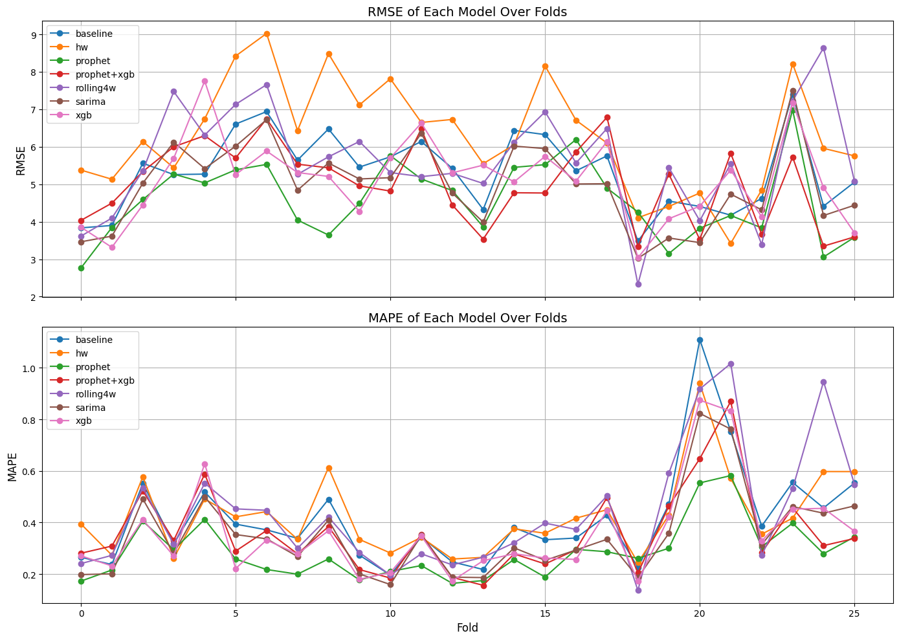
Results: Manhattan
Model Selection: Prophet
Mean RMSE of Prophet: 4.58
Mean RMSE of Prophet on Holdout: 4.86
Beat second place SARIMA at 4.98 in the 26-fold walk-forward validation.
Mean RMSE of NeuralProphet: 4.61
Mean RMSE of Hybrid Prophet + XGBoost*:
4.61.
* After more hyperparameter tuning, the hybrid model produced a mean RMSE of 4.375

Slide 16
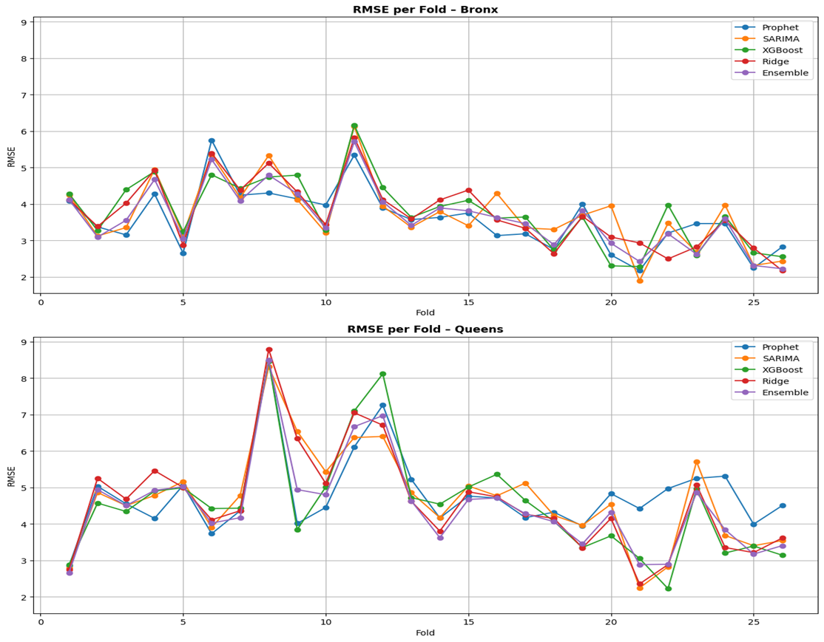
Results: Bronx /Queens
Model Selection: Prophet
Mean RMSE of Prophet: 2.9 / 3.9
For Queens we still prefer Prophet despite Ensemble’s better performance due to runtime of the Ensemble Model
Mean RMSE of Prophet on Holdout: 3.37 / 3.94
Mean RMSE of SARIMA:
3.0 / 3.8
Mean RMSE of Ensemble Model (average multiple model’s predictions):
2.9 / 3.6

Slide 17
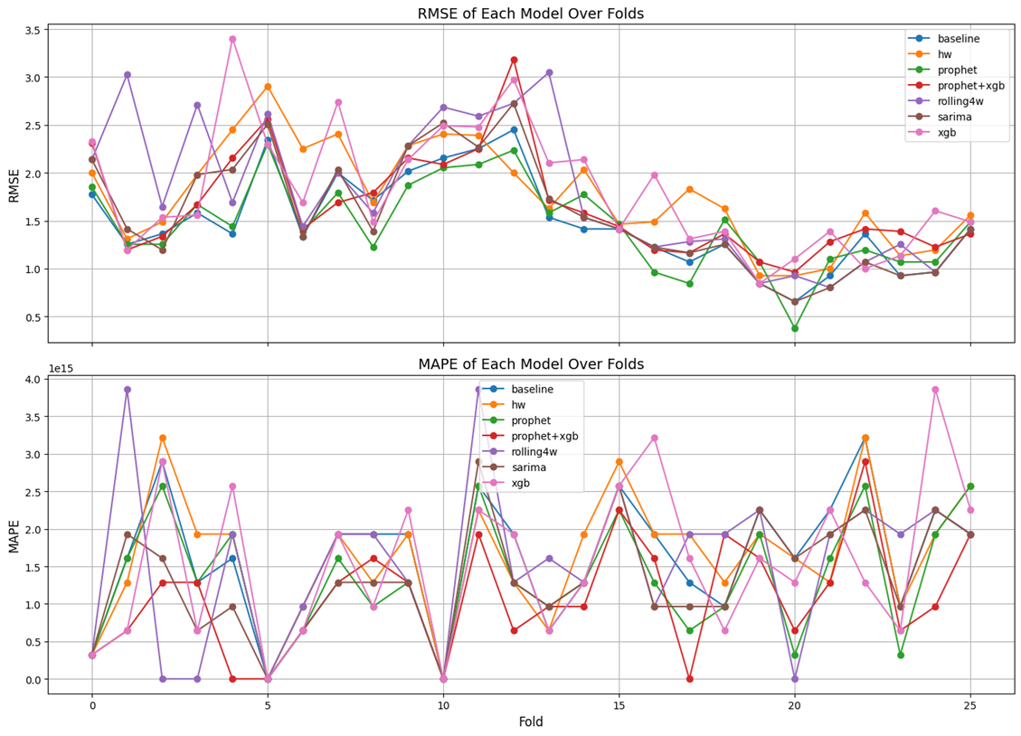
Results: Staten Island
Model Selection: Prophet
Mean RMSE of Prophet: 1.46
The margins are very slim.
Further work may be warranted.
Changing the metric might even be reasonable.
Mean RMSE of Prophet on Holdout: 1.38
Mean RMSE of Seasonal Average Model:
1.48
Mean RMSE of
SARIMA:
1.57

Slide 18
Lessons learned
Three useful lessons
More complexity ≠ Better Model
Citywide v.s. Borough
Outliers are hard to predict – XGBoost features do not always capture them well.
fold | rmse | mape
0 | 2.837809 | 0.189877
1 | 4.389223 | 0.252642
2 | 4.222367 | 0.357147
3 | 5.742150 | 0.314968
4 | 5.111527 | 0.386820
... | ... | ...
mean | 4.572423 | 0.285820
fold | RMSE
0 | 3.443420
1 | 4.367085
2 | 5.775564
3 | 6.363961
4 | 4.200340
... | ...
mean | 5.246825
Models such as SARIMA whose performance over “longer” forecast horizons tend to not perform better. 14 days ends up being too large for SARIMA to handle well.
NeuralProphet improved only slightly in the shown run.
The hybrid model was more complex, but not more useful here.

Slide 19

Future direction: Better Features, Better Data
How can the model improve further?
More feature engineering and feature selection
Explore borough-level patterns
Add inspections, DSNY refusal tonnage, catch basin, and other external signals
Add IRS income data
Better feature selection
External data sources
Borough-level patterns
Model insights
Key idea: Better feature design and richer data can further strengthen the model(s).
Notes:
Finally, I want to end with three future directions for this project.
First, we can improve the model by improving the inputs.
That means doing more feature engineering and feature selection,
exploring borough-level patterns, and adding richer external data
such as IRS income, inspections, DSNY, and catch basin information.
The goal is to make the model not only more accurate, but also easier to interpret.

Slide 20

Future direction: Weekly-Level Forecasting
Less noise
Clearer trends
More stable patterns
Easier forecasting
Weekly view: Less noise, clearer signal noise
Daily view: More detail, more noise
Key idea: Weekly data smooths short-term fluctuations, leading to more stable and reliable forecasts.
Notes:
Second, we can move from daily forecasting to weekly-level forecasting.
Daily data gives detail, but it is also noisy.
Weekly forecasting may smooth short-term fluctuations, reveal more
stable patterns, and be more useful for planning inspections and resource allocation.

Slide 21

Future direction: Other Spatial Levels and Model Extensions
Krishna Aryal
Other spatial levels
Model extensions
Advanced models
Explore borough-level and ZIP-code level modeling
More modeling work on Bronx and Queens
Graph-based methods for spatial relationships
Multivariate time series forecasting
Key idea: There is still much to explore and strong opportunities to improve the model(s) further.
Notes:
Third, we can extend the model to other spatial levels and new methods.
For example, we can build borough-level or ZIP-code-level models,
do more modeling for the Bronx and Queens, and explore
graph-based or multivariate forecasting approaches. So overall, the next step is not just making the model more complex,
but making it more informative, more stable, and more useful in practice.

Slide 22

References
New York City Open Data. (n.d.). *Rat sightings*.
Open-Meteo Data (n.d.). *Weather Data*.
Erdos Projects. (2026). *spring-2026-rat-activity-nyc* [GitHub repository]. GitHub.

Slide 23

Thank you for your attention.
Special thanks to the Erdos Institute and our mentor, Yang Yang.

