Slide 1
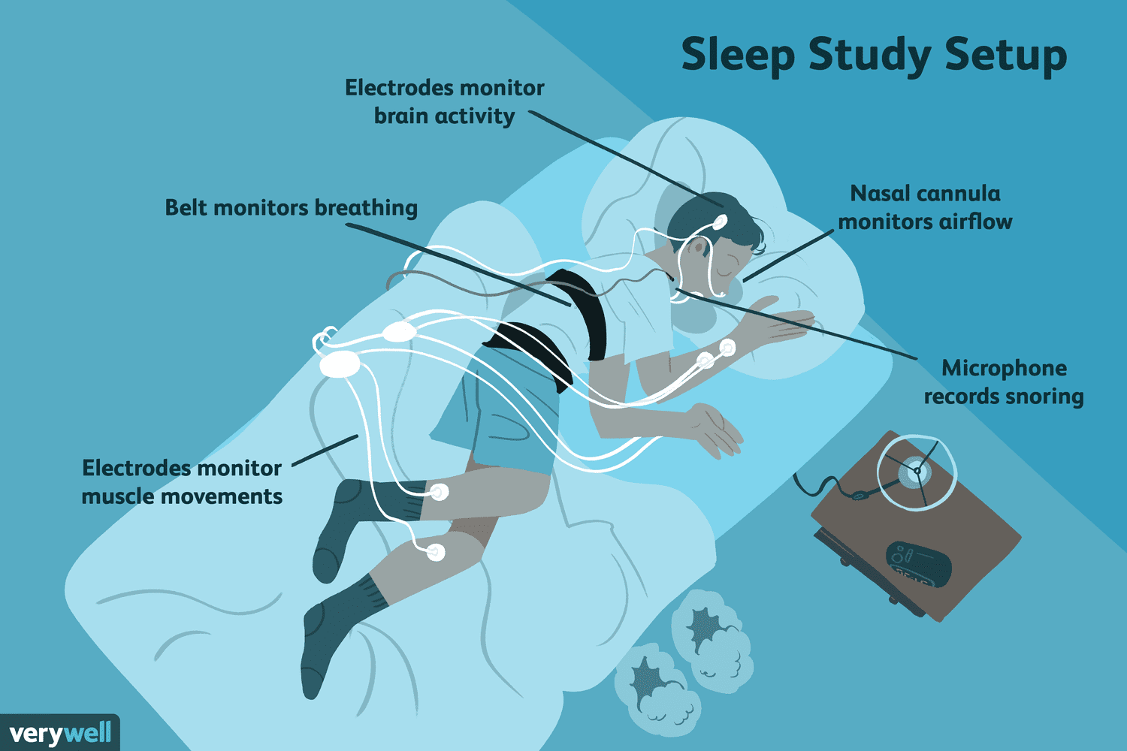

Towards Automated Sleep Analysis:
Stage Classification and Apnea Prediction
Ye Hong, Vaibhav Thakur, Aiqi Cheng
Spring 2026 Data Science Bootcamp
Erdős Institute
Notes:
Hi everyone, today I'll be walking you through our project on automated sleep analysis.
This work was done as part of the Erdős Institute Spring 2026 Data Science Bootcamp"
In this project we tackled two problems:
classifying sleep stages in real time, and
predicting apnea events before they happen.

Slide 2
Background
Background & Motivation:
~70 million U.S. adults have sleep disorders; Obstructive Sleep Apnea (OSA) is among the most prevalent and underdiagnosed.
Poor sleep quality independently elevates risk of chronic disease, cognitive decline, and cardiovascular conditions.
Goal 1: Build a model to predict sleep stage real-time.
Goal 2: Build a model to predict apnea events 10 seconds in advance
Notes:
To motivate this work — roughly 70 million American adults suffer from sleep disorders.
Specifically, poor sleep quality and Obstructive Sleep Apnea are independently linked to cardiovascular disease, cognitive decline, and other chronic conditions.
With that in mind, we set two concrete goals: first, build a model that can classify which sleep stage a person is in, in real time.
Second, build a model that can predict an apnea event 10 seconds before it occurs — giving enough lead time for a potential intervention.

Slide 3
Dataset
We used DREAMT dataset from Physionet
Collected from 100 participants(May–Sept 2022).
Participants wore an smartwatch throughout an overnight Polysomnography study.
Data:
Metadata for 100 subjects, e.g. Age, bmi, medical history
Time-series signal (100 Hz), e.g. EEG, EOG, EMG, heart rate, respiratory signals
Sleep stage (manually annotated): Wake, N1, N2, N3, REM
Apnea event (manually annotated)
Dataset available at: https://physionet.org/content/dreamt/2.1.0/.
Notes:
For our data, we used the DREAMT dataset from PhysioNet. It was collected from 100 participants using smartwatch and polysomnograpy.
The dataset includes subject metadata like age and BMI, high-frequency time-series signals, as well as manually annotated sleep stages and apnea events.

Slide 4
Preprocessing
Data Cleaning
Extract Feature Statistics
(5s window binning)
Fourier Transform - EEG, EOG, EMG
(25s window)
One-hot encoding
Categorical variables
Combined with Metadata
Notes:
Before modeling, we put the raw signals through several preprocessing steps.
For EEG, EOG, and EMG signals, we applied a Fourier Transform over a 25-second window to capture frequency-domain features.
For all time-domain signals, we extracted summary statistics using 5-second window binning.
Categorical metadata variables were one-hot encoded, and everything was combined into a unified feature set for modeling.

Slide 5
End-to-End Experimental Pipeline
100 subjects are divided into three non-overlapping partitions
Training Set (5-fold CV for hyperparameter tuning) 64%
Val Set
16%
Test
20%
Full Dataset
Hold-Out Split
5-Fold CV
Best Config Found
Retrain on Train
Test Set Evaluation
Notes:
Our experimental pipeline was designed as follow:
We split our 100 subjects into training, validation and test set.
We ran 5-fold cross-validation on the training set for hyperparameter tuning, then retrained using the best configuration, perform model selection on validation set, before final evaluation on the untouched test set.

Slide 6
Goal 1: Sleep stage prediction
Objective: classify 5 sleep stages (Wake, N1, N2, N3, REM) at each time step using PSG signals, wearable device signals and subject metadata
Metric: Macro F1 – equal importance across all stages
Challenges:
Large subject variability
Class imbalance and underrepresented transient stages

Slide 7
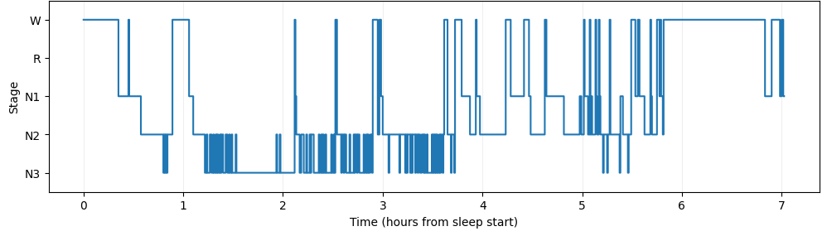
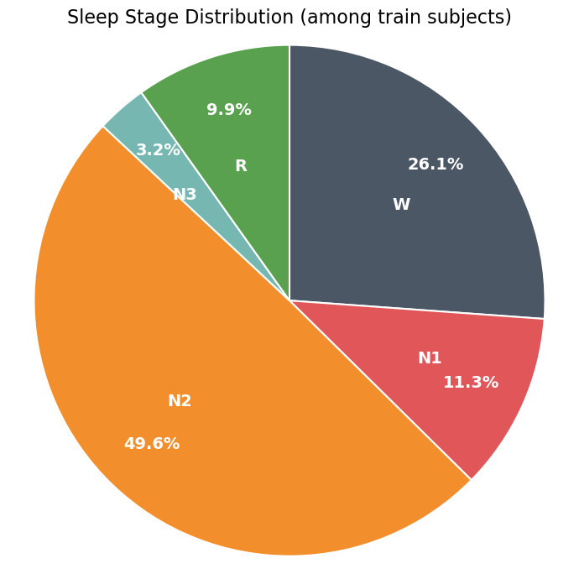
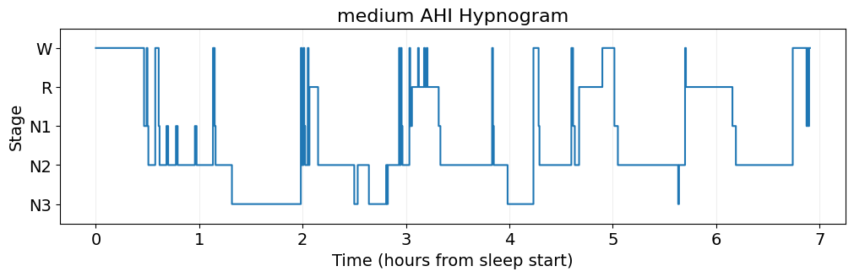
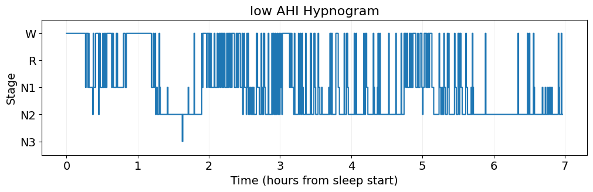
EDA

Slide 8
Models - training procedures
Feature Engineering:
reduce numerical precision for less noise
EEG features: relative band-power + cross-band ratios
Lag temporal features for dominant signals
Tabular Models (4Fold CV) hyperparameter search + class weights
Logistic Regression
XGBoost
LightGBM
Preprocessed raw data
Dataset loader train/val/test split
Training sequence models with iterative tunning and early stopping
BiLSTM
LSTM
CNN
Standard scaling
Load dataset into fixed-length sequences

Slide 9
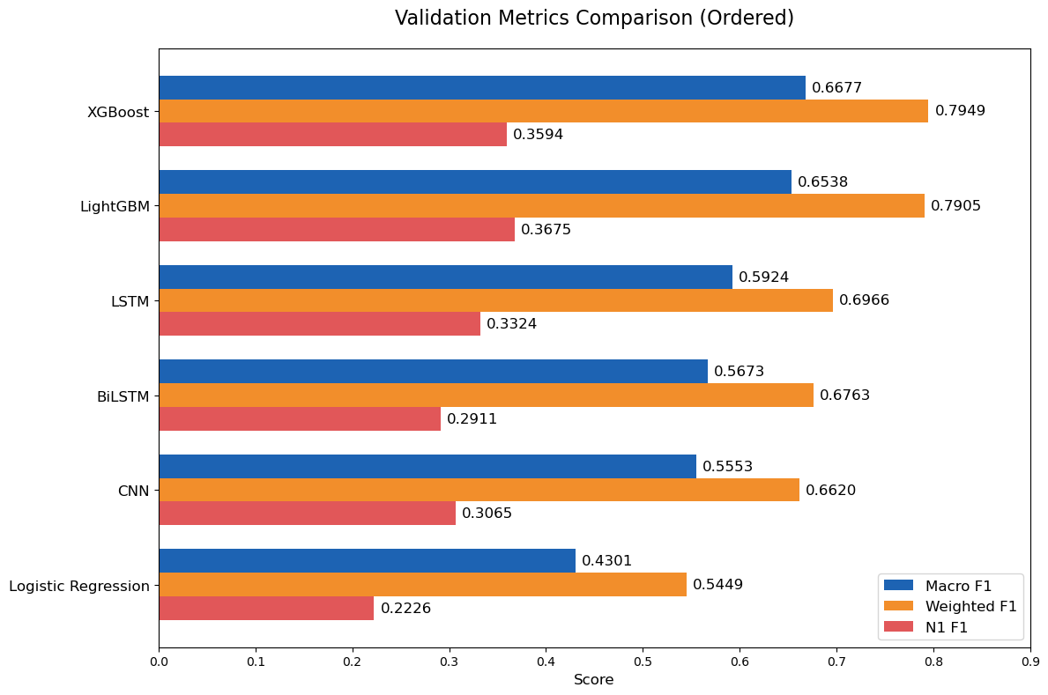
Validation Metrics
Model | Best Parameter
xgb | n_estimators = 630 max_depth = 6 learning_rate = 0.02685
lgb | n_estimators=507 learning_rate=0.0288 num_leaves=55 max_depth=6
LSTM | seq_len=30 lr=0.0005 hidden_dim=32
BiLSTM | seq_len=10 lr=0.001 hidden_dim=32
CNN | seq_len=30 lr=0.0005 channels=[32,64,64]
lgr | regularization=100

Slide 10
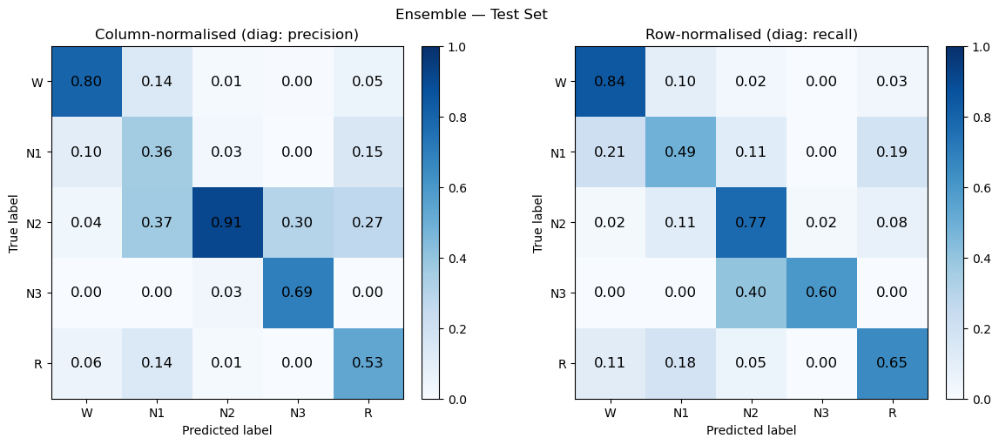
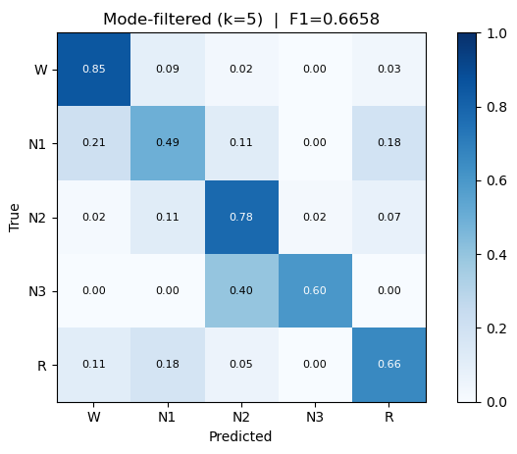
Test: Ensemble xgb + lgb
y_prob_xgb = xgb_model.predict_proba(X_test)
y_prob_lgb = lgb_model.predict_proba(X_test)
y_pred_ens = np.argmax(y_prob_xgb * 0.5 + y_prob_lgb * 0.5, axis=1)
kernel = 5
window = y[i-kernel//2 : i + kernel//2]
y[i] = max(Counter(window).values())
 | XGBoost | LightGBM | Ensemble 50/50 | Ens + mode5
Macro F1 | 0.6565 | 0.6579 | 0.6593 | 0.6658

Slide 11
Goal 2: Future apnea event prediction

Slide 12
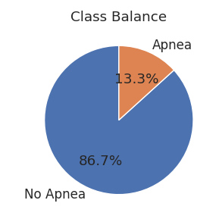
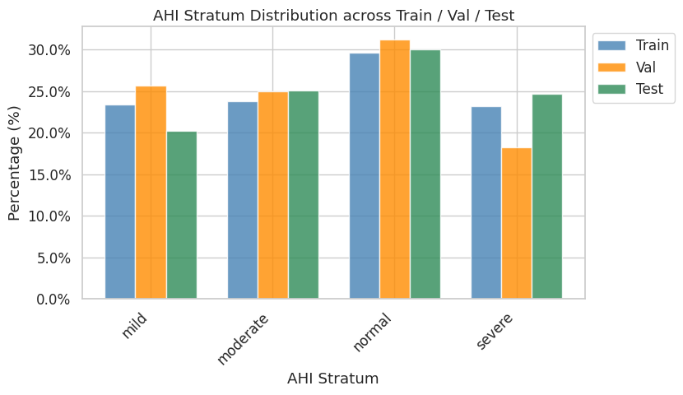
EDA
Class Imbalance
Stratified split by apnea severity
Apnea: no apnea ~ 1:7
Apnea frequency: train set 0.133, validation set 0.097, test set 0.127

Slide 13
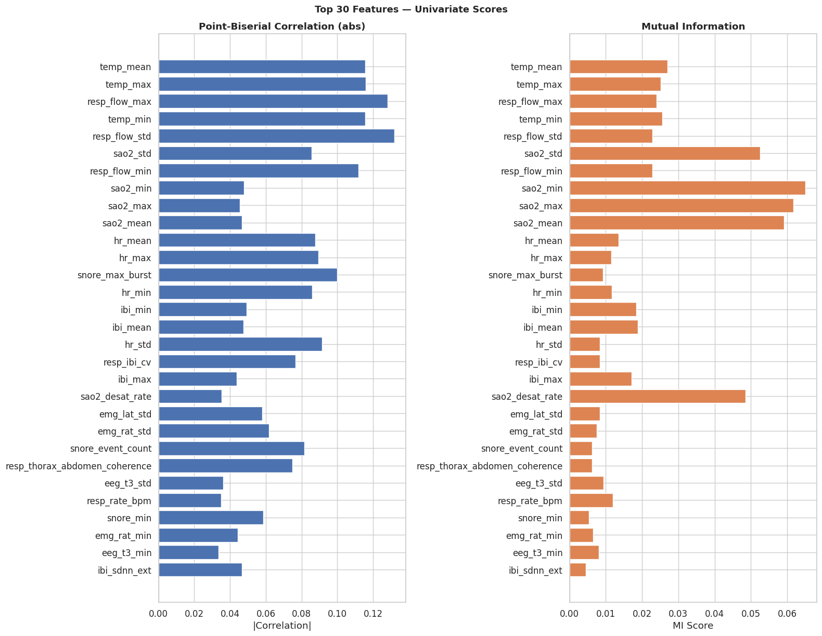
Feature rank
Top 30 Features
Rank features based on their point-biserial correlation and mutual information with target

Slide 14
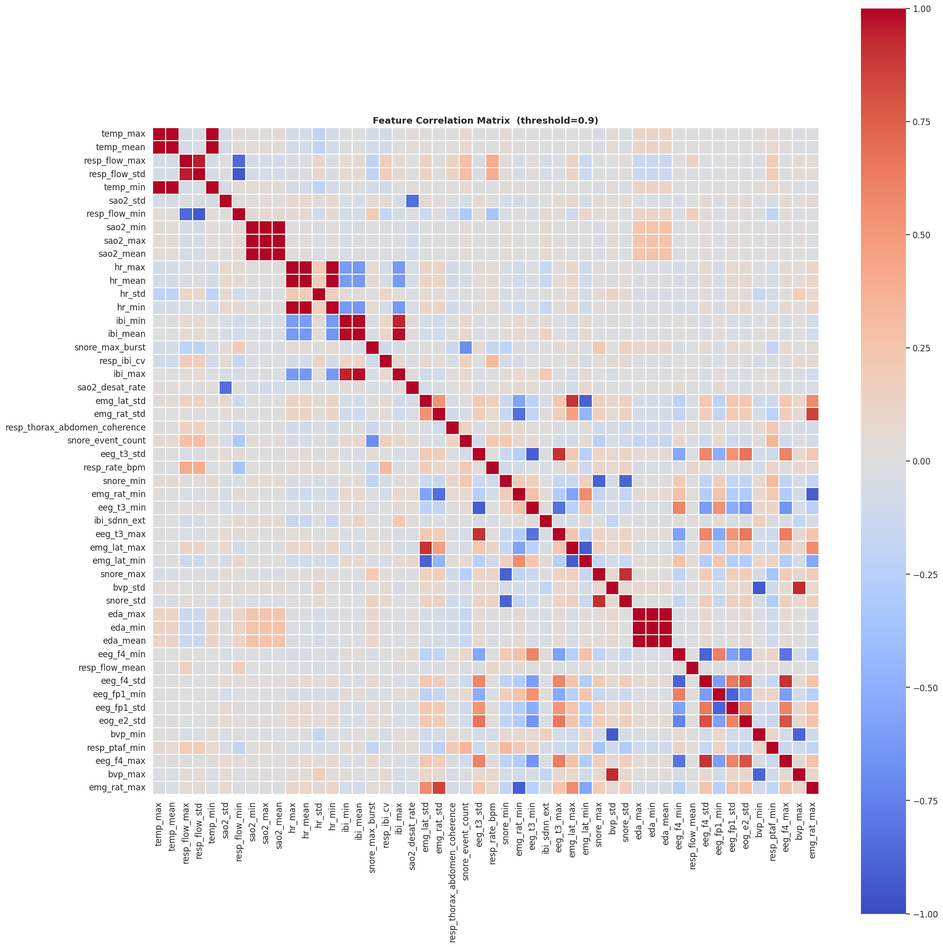
Feature removal
Feature Correlation matrix
Examine feature correlation → remove feature pairs with correlation > 0.9
Examine feature variance → drop near-zero variance features with low ranking
Result :127 → 67 time-series features

Slide 15
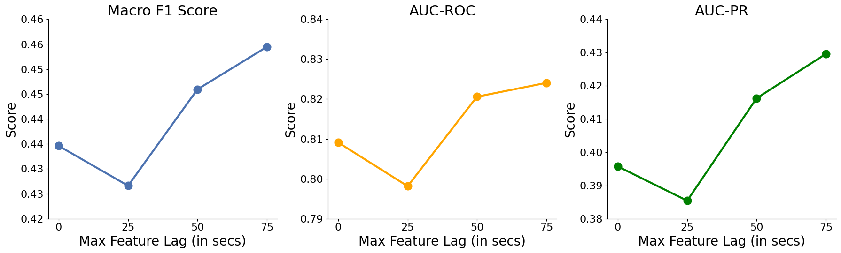
LightGBM with various feature lag
75s feature lag is the best

Slide 16
Final test metrics
AUC-ROC=0.786, AUC-PR=0.467, Accuracy= 0.88
 | precision | recall | F1
No apnea | 0.93 | 0.94 | 0.93
apnea | 0.54 | 0.50 | 0.52
Macro avg | 0.73 | 0.72 | 0.72
Weighted avg | 0.88 | 0.88 | 0.88

Slide 17
Discussion
Sleep stage:
The main limitation of real-time sleep stage prediction comes from class imbalance and ambiguous transitions between stages, rather than model complexity. Stage boundaries are inherently noisy, even with advanced PSG measurements
Future direction: improve per-stage discrimination, and combine models strategically for a system reliable overall
Apnea event:
75s lag of top features yielded the strongest performance of LightGBM, which suggested that extended temporal context is critical for anticipating breathing disruptions.
Future direction: apply LSTM or Transformer to include longer context

