Slide 1
Routing Models for Local VLMs on the SciVer Task
Conglong Xu
George Washington University
Department of Mathematics
1

Slide 2
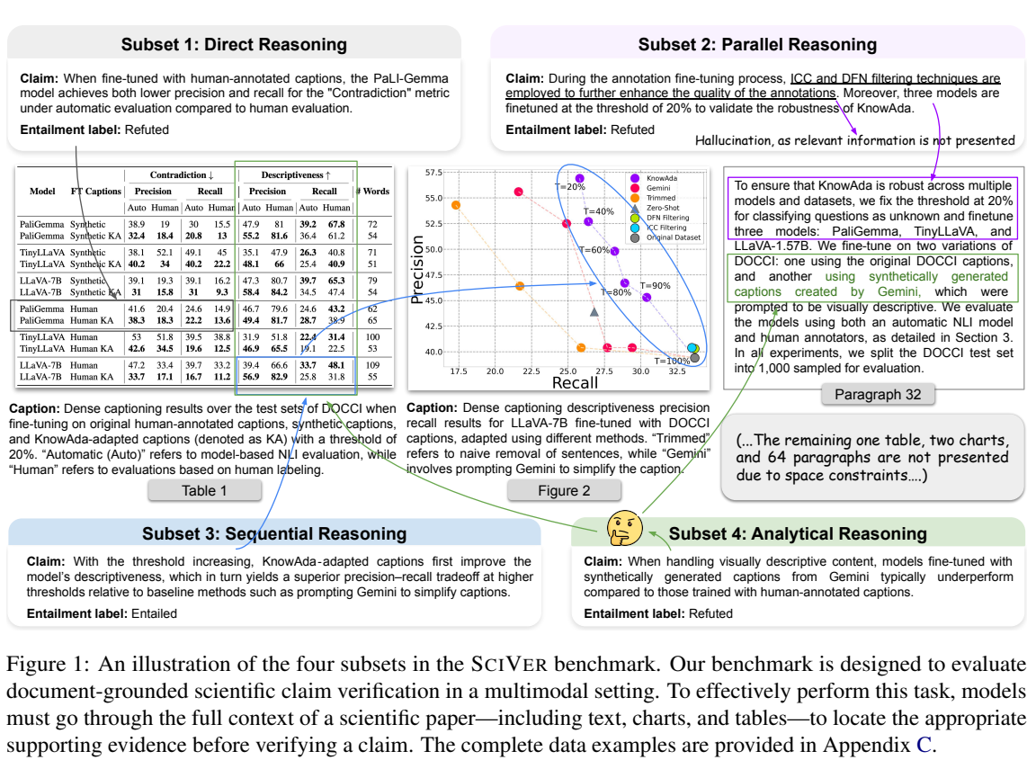
SCIVER ROUTER
SciVer is a multimodal chart-claim verification task
Why this task motivates routing
-
Each example pairs a scientific claim with multimodal paper evidence: text, charts, and tables.
-
SciVer distinguishes direct, parallel, sequential, and analytical reasoning subsets.
-
The original paper reports best average test accuracy of 77.7% for o4-mini versus 93.8% human expert accuracy.
-
A router can preprocess each chart-claim pair and assign it to the VLM predicted to perform best.
Source: Wang et al., SciVer, arXiv:2506.15569, Figure 1 and Table 3. The same paper reports GPT-4.1 at 70.8% on analytical reasoning versus 90.0% for human experts.
2

Slide 3
SCIVER ROUTER
The router workflow separates selection from evaluation
-
1. Build the matched, sanitized three-VLM router dataset.
router split | rows | paper groups
train | 568 | 434
validation | 123 | 95
test | 120 | 90
grouped CV | 10 folds inside train | paper_id kept intact
bootstrap | 1,000 held-out resamples | resampled with replacement
seed | 215
-
2. Construct base, chart-TDA, claim-NLP, and combined feature sets.
-
3. Split by paper_id into grouped train/validation/test sets.
-
4. Select hyperparameters by grouped 10-fold CV using either mean-regret-first or top-1-first ranking.
-
5. Refit the selected hyperparameters on train+validation and evaluate once on grouped test.
-
6. Train a final all-data model for future use after evaluation artifacts are written.
Key guardrail: paper_id groups stay intact through train/validation/test and through the 10-fold CV inside the training split.
3

Slide 4
SCIVER ROUTER
Key definitions for router evaluation
Observed five-run accuracy
Router target
fraction of five local runs that match the SciVer label for each item and VLM; target labels and regret are noisy when VLMs tie.
train one regression target per VLM accuracy, then select the VLM with the highest predicted accuracy.
Top-1 hit rate
Regret
fraction of held-out examples where the routed VLM is one of the observed best VLMs, counting ties as hits.
observed best accuracy minus the selected VLM's observed accuracy. Lower is better; zero means the router picked a best VLM.
Grouped 10-fold CV
training paper groups are split into 10 folds; each candidate trains on 9 folds, predicts the held-out fold, and every paper_id stays in one fold.
4

Slide 5
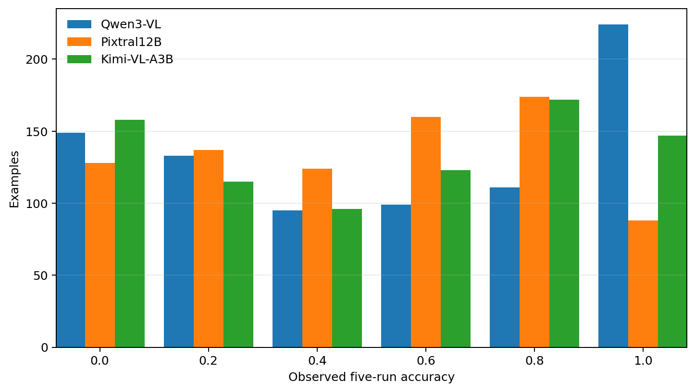
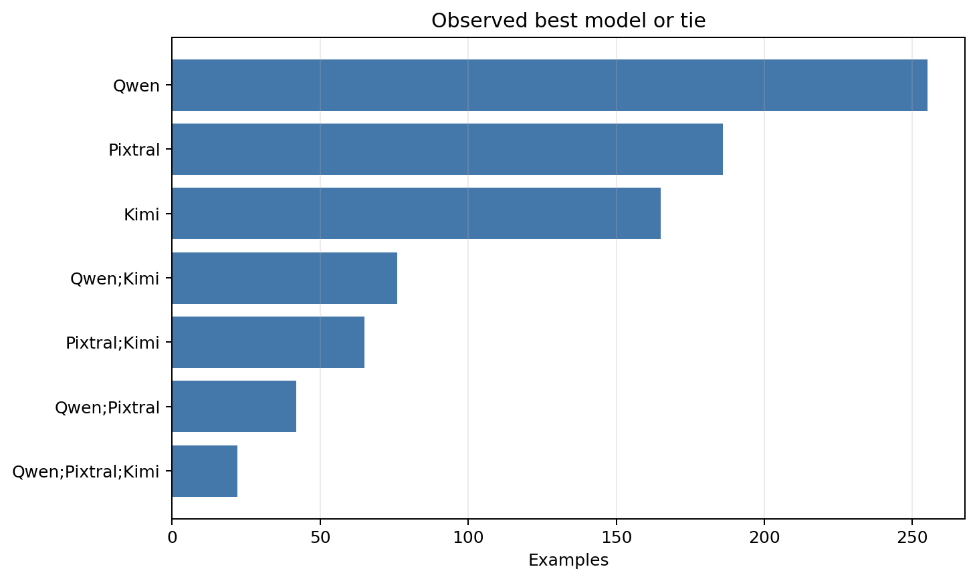
SCIVER ROUTER
Close VLM performance makes ties and switching matter
Because each item has five local repeats, observed accuracy can only take the six discrete values [0.0, 0.2, 0.4, 0.6, 0.8, 1.0]. Each group of bars shows how many chart-claim items fall at that accuracy value for each VLM.
Counts show which VLM or tie-set has the highest observed five-run accuracy for an item. Best-model targets are recomputed only over Qwen3-VL, Pixtral12B, and Kimi-VL-A3B.
VLM | mean observed accuracy
Qwen3-VL | 53.9%
Pixtral12B | 49.3%
Kimi-VL-A3B | 51.8%
5

Slide 6
SCIVER ROUTER
Features combine difficulty, chart structure, and claim semantics
feature family | public columns | meaning
12 cognitive dimensions | 12 | Human-coded chart difficulty annotations included as precomputed public features; deployment would require these annotations or an automatic proxy.
Base scalar features | 14 | Simple size, token, numeric, and image-shape summaries.
Chart TDA | 86 | Topological summaries of grayscale and edge-map chart structure.
Claim NLP | 81 | TF-IDF/SVD semantics, cue counts, alignment, numeric overlap, and token-level TDA.
Interpretation
The model does not see raw claims, captions, prompts, responses, labels, or images. It sees sanitized derived columns that are available to reproduce router training.
6

Slide 7
SCIVER ROUTER
Three router families test different assumptions about the feature signal
Ridge/ElasticNet
linear shrinkage
stable on small tabular data
XGBoost
boosted decision trees
captures nonlinear feature interactions
PyTorch MLP
one/two hidden layers
tests a small neural tabular router
All three predict one observed five-run accuracy per VLM and route to the highest predicted value.
7

Slide 8
SCIVER ROUTER
Evaluation: XGBoost + chart TDA leads the point estimates
section | model / baseline | router | features | top-1 | mean regret | median | selected candidate / models
Regret first | XGBoost chart TDA regret first | XGBoost | base + TDA | 49.2% | 0.243 | 0.200 | XGB: 200 trees, depth 3, lr 0.05
Regret first | Ridge/ElasticNet base regret first | Ridge/ElasticNet | base | 46.7% | 0.257 | 0.200 | Ridge alpha 0.1
Top-1 first | XGBoost chart TDA top-1 first | XGBoost | base + TDA | 49.2% | 0.243 | 0.200 | XGB: 200 trees, depth 3, lr 0.05
Top-1 first | Ridge/ElasticNet base top-1 first | Ridge/ElasticNet | base | 46.7% | 0.257 | 0.200 | Ridge alpha 0.1
Baseline | always pixtral12b | deterministic | - | 41.7% | 0.302 | - | pixtral12b: 120
Baseline | always qwen3vl | deterministic | - | 40.8% | 0.305 | - | qwen3vl: 120
Baseline | always kimi vl a3b | deterministic | - | 40.8% | 0.315 | - | kimi_vl_a3b: 120
Baseline | random | stochastic | - | 38.3% | 0.295 | - | kimi_vl_a3b: 38, pixtral12b: 38, qwen3vl: 44
The table combines the top two regret-first runs, top two top-1-first runs, and all baselines for the best-run split except train-global-best.
8

Slide 9
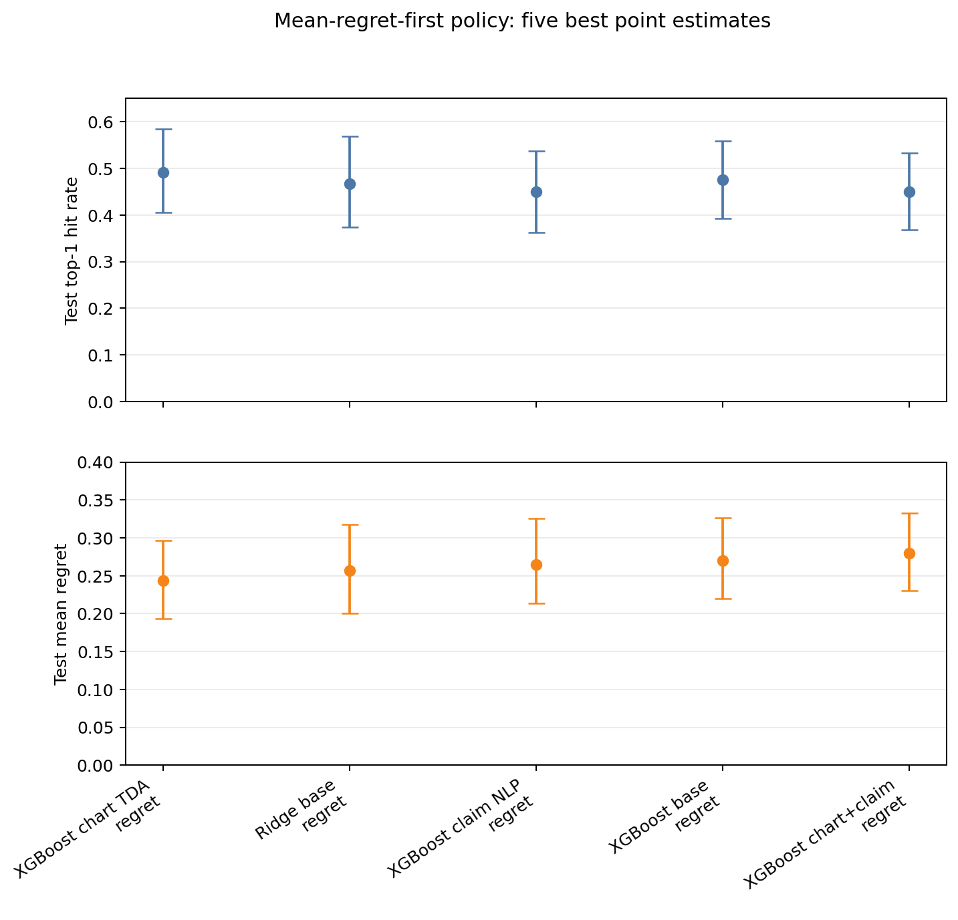
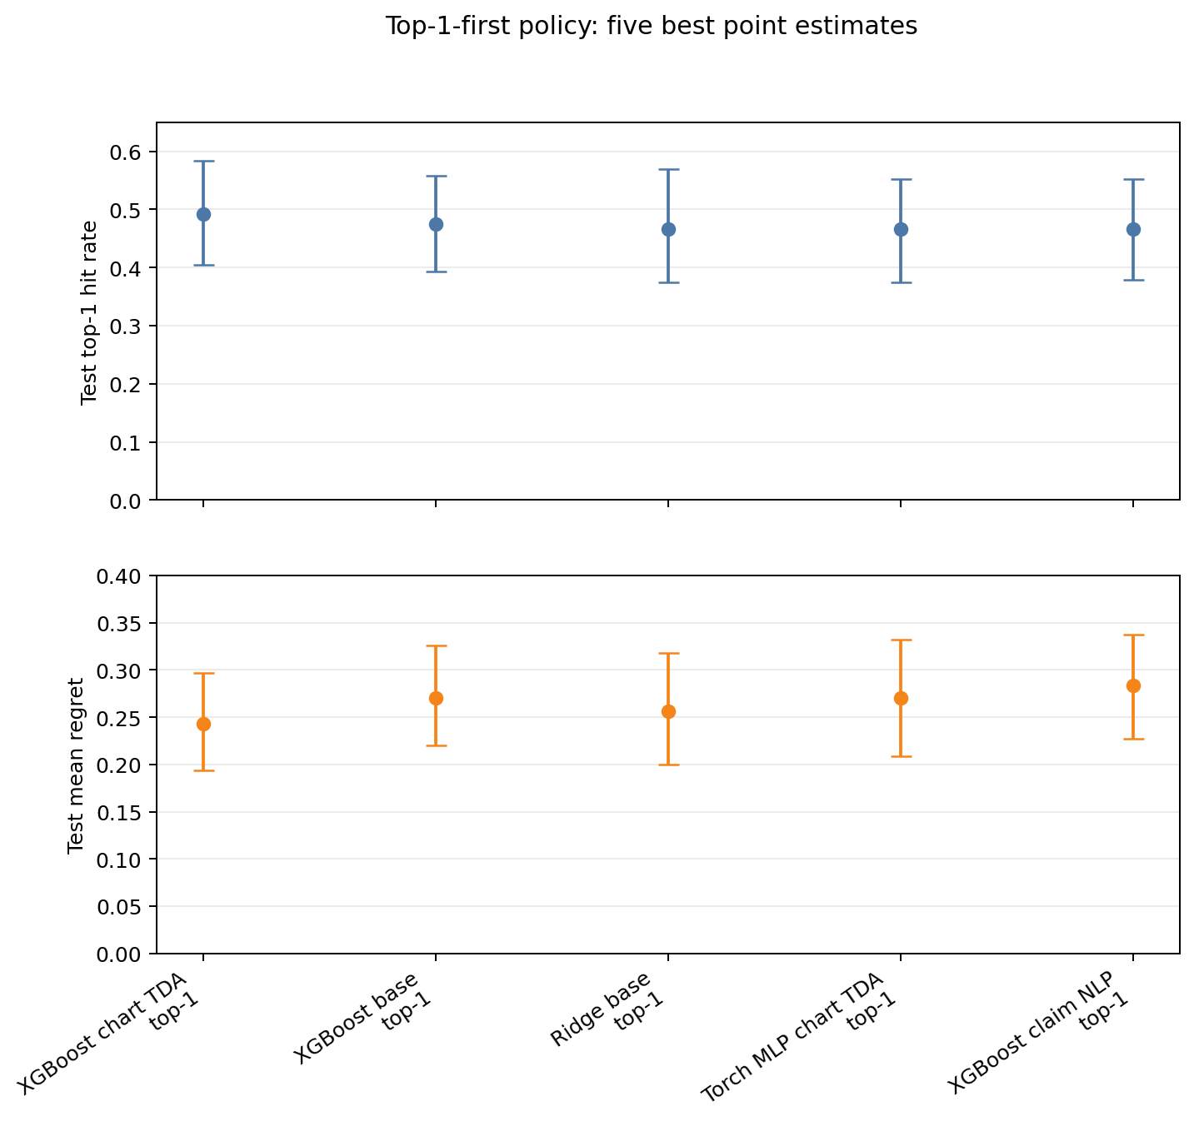
SCIVER ROUTER
Bootstrap intervals show the top runs are promising but uncertain
Only the five best point-estimate runs under the mean-regret-first policy are shown, sorted by lower held-out mean regret. Top panel shows tie-aware top-1; bottom panel shows mean regret.
Only the five best point-estimate runs under the top-1-first policy are shown, sorted by higher held-out top-1 hit rate. Intervals are grouped-bootstrap intervals over held-out paper groups.
Intervals resample held-out test paper groups only, after hyperparameters are fixed.
9

Slide 10
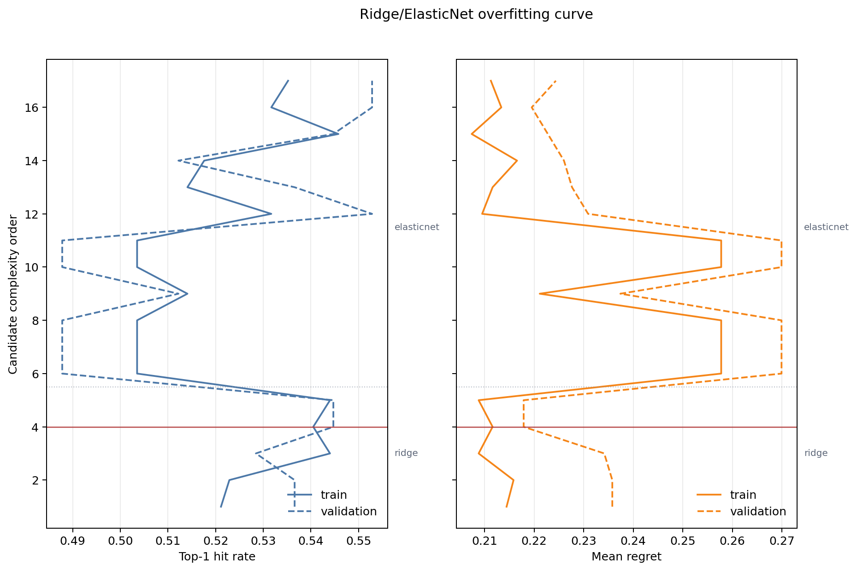
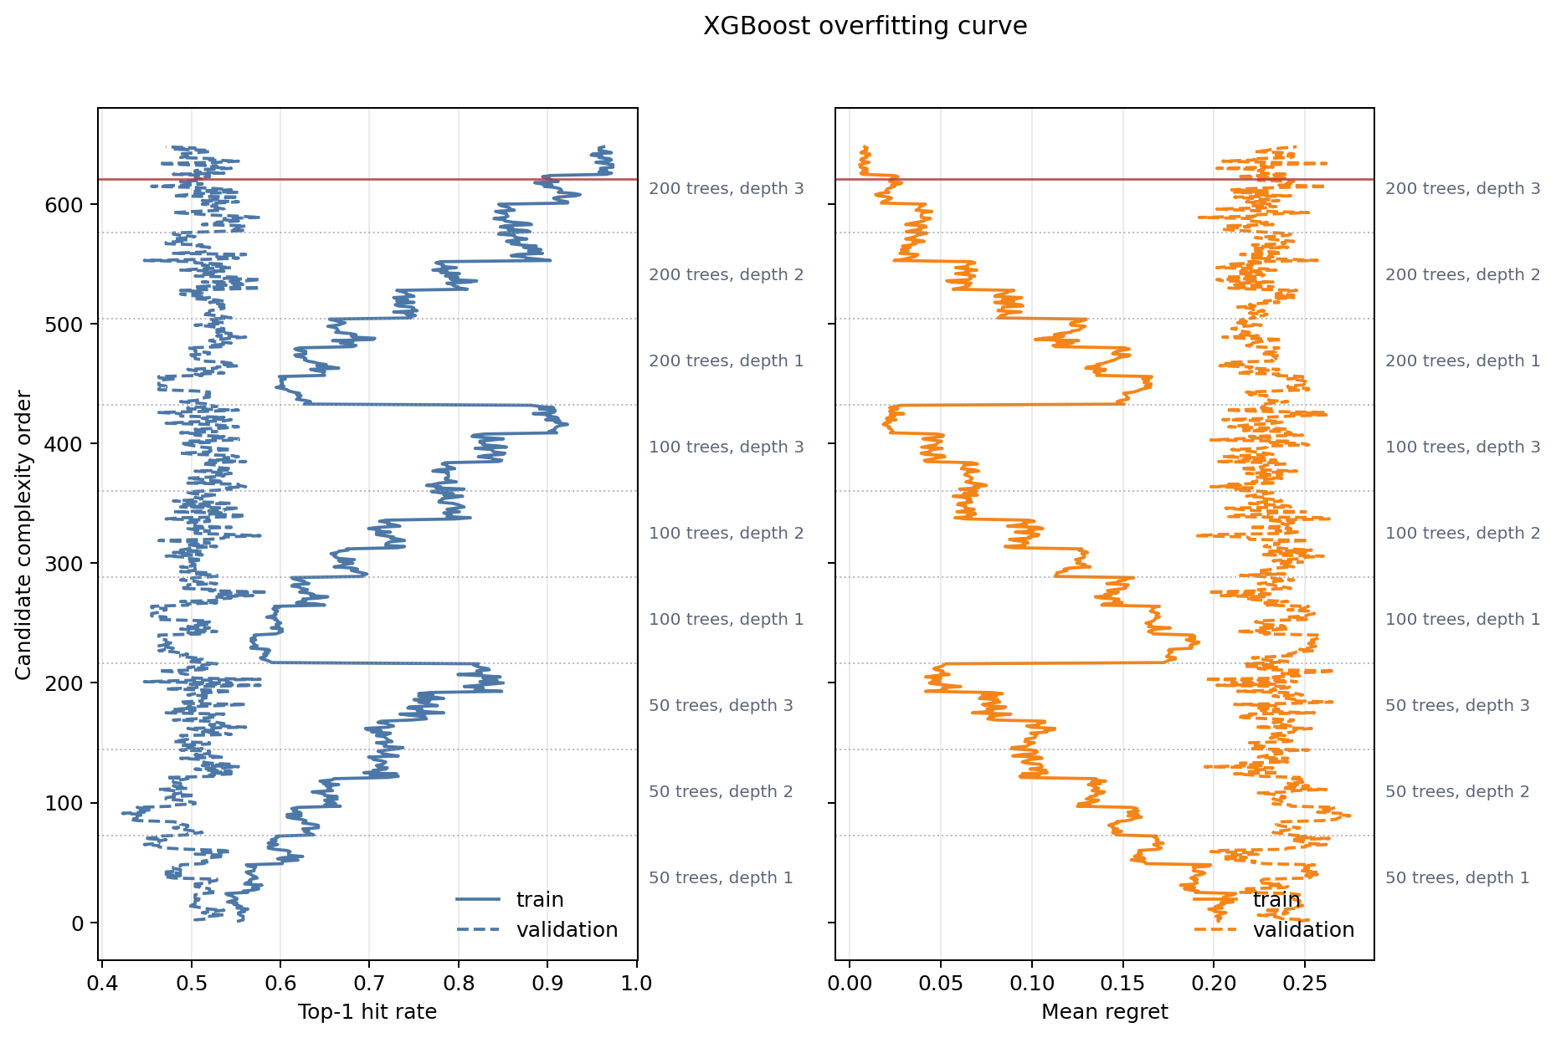
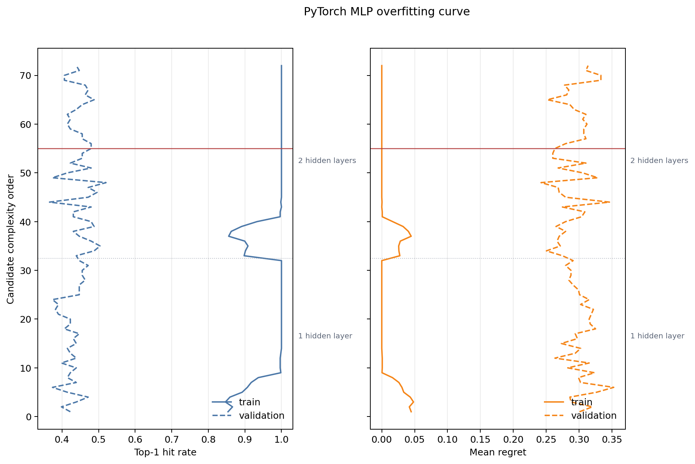
SCIVER ROUTER
Overfitting diagnostics compare train and validation behavior
Ridge/ElasticNet
XGBoost
PyTorch MLP
Curves show train versus grouped-validation top-1 and mean regret across regularization candidates for the best regret-first Ridge/ElasticNet run. The solid red horizontal line marks the selected candidate. Dotted horizontal separators mark Ridge versus ElasticNet candidate zones when both appear.
Curves show train versus grouped-validation metrics across the XGBoost grid. Dotted horizontal separators split tree-count/depth zones such as 50 trees depth 1, 50 trees depth 2, and so on; the right-side labels mark those zones. The solid red line marks the selected candidate.
Curves show train versus grouped-validation metrics across the PyTorch MLP grid. Dotted horizontal separators split one-hidden-layer and two-hidden-layer candidates; the solid red line marks the selected candidate.
Reading: large train-validation gaps are warning signs. The selected XGBoost and PyTorch MLP candidates fit the training groups much better than validation groups.
10

Slide 11
SCIVER ROUTER
Selected-candidate overfitting summary
router family | selected run | selected candidate | train top-1 | validation top-1 | top-1 gap | train regret | validation regret | regret gap | reading
Ridge/ElasticNet | Ridge/ElasticNet base | Ridge alpha 0.1 | 54.0% | 54.5% | -0.4% | 0.212 | 0.218 | 0.006 | limited overfitting signal
XGBoost | XGBoost chart TDA | XGB: 200 trees, depth 3, lr 0.05 | 90.3% | 51.2% | 39.1% | 0.023 | 0.231 | 0.208 | strong overfitting signal
PyTorch MLP | PyTorch MLP chart TDA + claim NLP | MLP 32x16, tanh, alpha 0.01 | 100.0% | 48.0% | 52.0% | 0.000 | 0.263 | 0.263 | strong overfitting signal
Takeaway
Ridge/ElasticNet shows limited overfitting signal. XGBoost and the PyTorch MLP show strong training gains that do not fully carry to grouped validation, so bootstrap/test evidence is essential.
11

Slide 12
SCIVER ROUTER
Acknowledgments and references
Acknowledgment
The 12 cognitive-difficulty dimensions used by this router study were engineered by the project AI Faithfulness in Scientific Reasoning.
Project repository: https://github.com/Erdos-Projects/summer26-ai-faithfulness-in-scientific-reasoning
SciVer paper and dataset
Wang et al., SciVer: Evaluating Foundation Models for Multimodal Scientific Claim Verification
Paper: https://arxiv.org/abs/2506.15569
Dataset: https://huggingface.co/datasets/chengyewang/SciVer
These sources provide the benchmark task, released dataset, and cognitive-difficulty annotation framework on which the routing experiments build.
12

