Slide 1
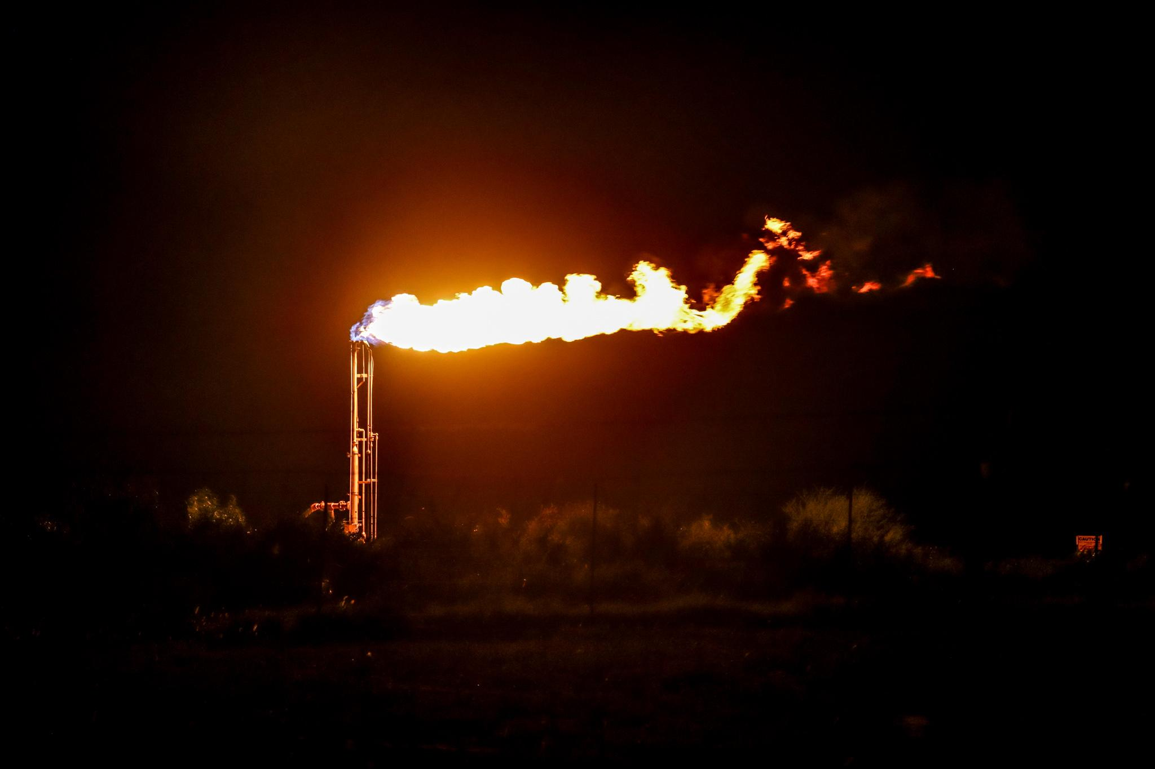
Erdős Institute Data Science Boot Camp (Summer 2026)
Flaring in the Permian: what satellites see vs what operators report

Slide 2




THE TEAM
Who Built This
Abhishek
Amey
Sabarenath
Vineeth
Graduate Student,
University of Michigan
Graduate Student,
Michigan State University
Graduate Student,
University of Michigan
Postdoc,
University of Michigan

Slide 3
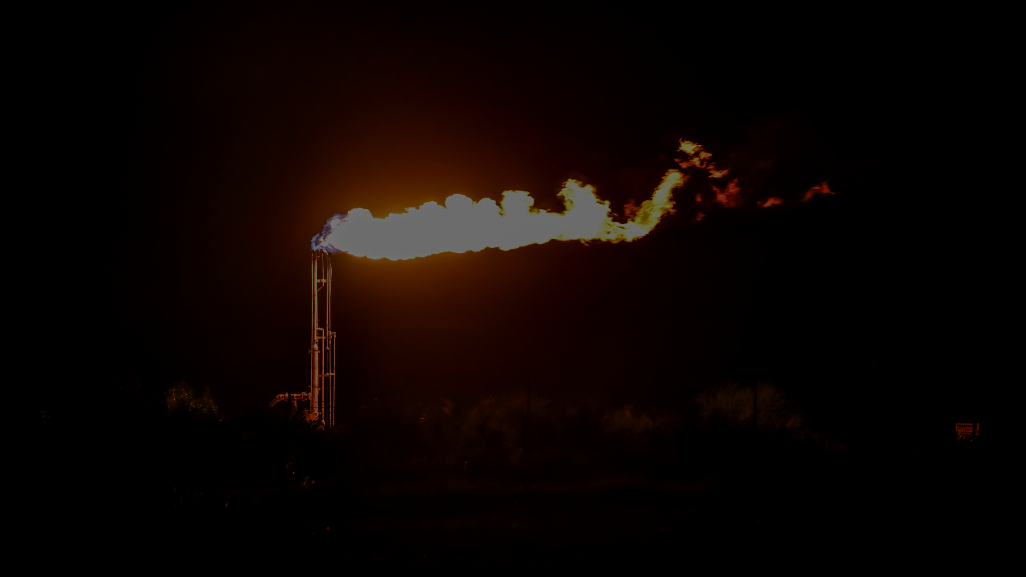
Satellite flaring data and the Texas reporting lag
The Permian basin, located in the states of Texas and New Mexico, accounts for ~44% of US crude oil production, and is one of the largest routine combustion sources on Earth.
Texas oil and gas well operators self-report the quantities of gas they vented or flared to the agency that regulates them, the Texas Railroad Commission, with a long time lag. Stable figures are only available months later.
VIIRS observes the same flares nightly, subject to cloud cover, and the detections are published within about a day.

Slide 4
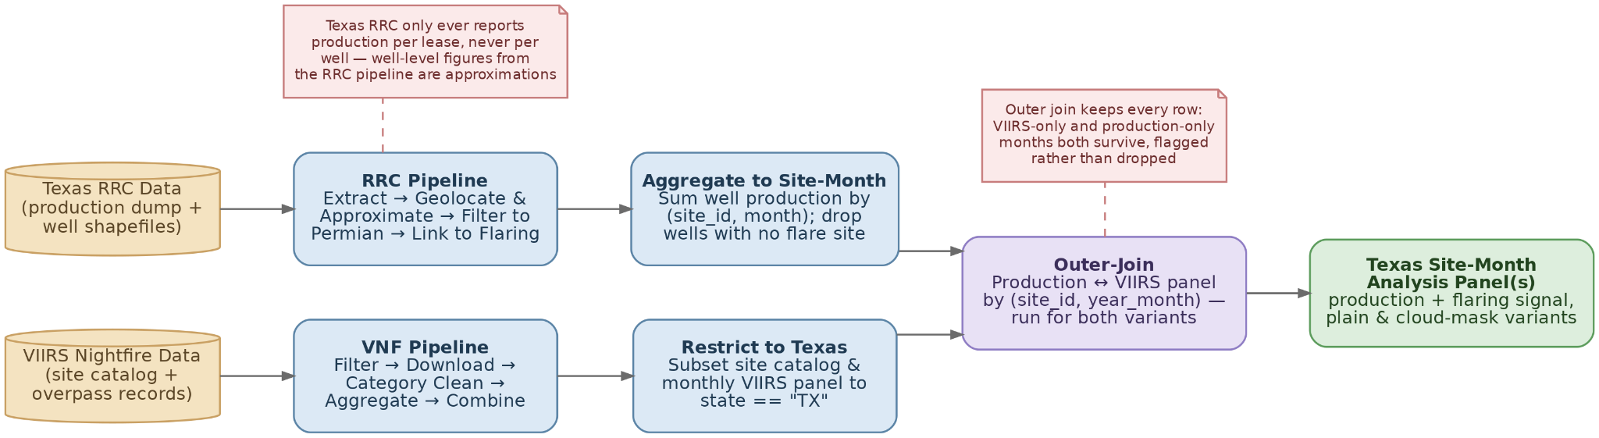
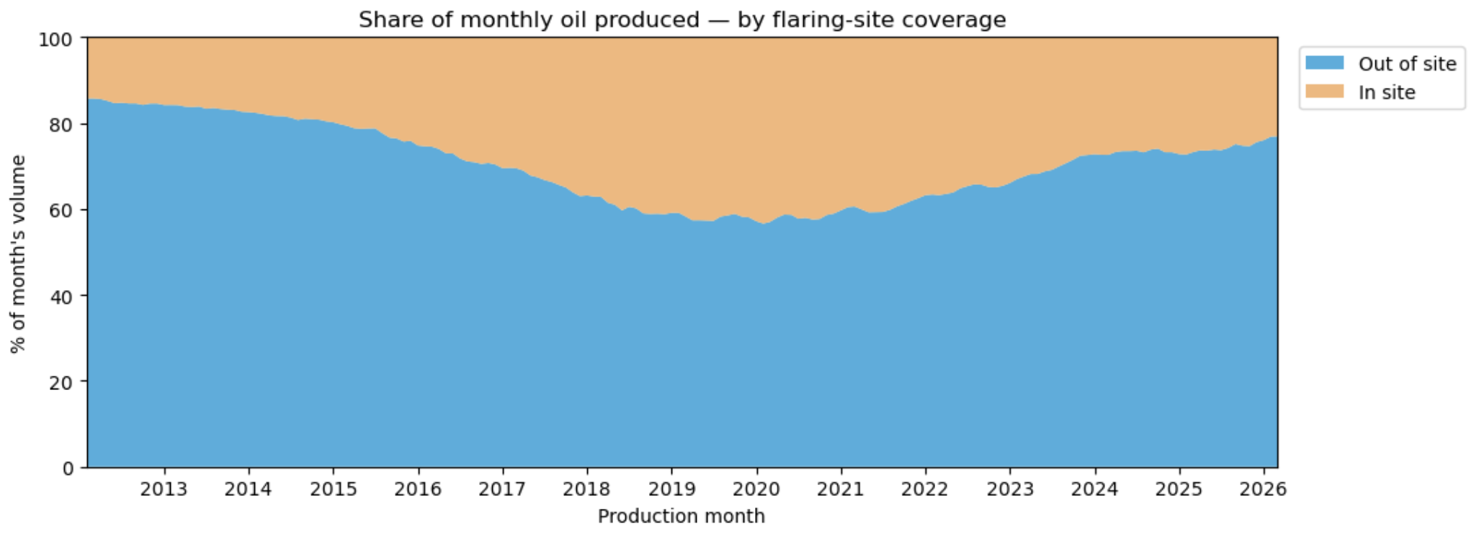
Data gathering and processing
Raw data source: Texas Railroad Commision and Earth Observation Group at the Colorado School of Mines
Permian basin:
West longitude: -105.21988
East longitude: -100.036107
North latitude: 34.021515
South latitude: 29.462935.
VIIRS sites account 31.6 of the total oil produced between 2012-2026
Peak: 43.1% in February 2020
23% in 2026

Slide 5
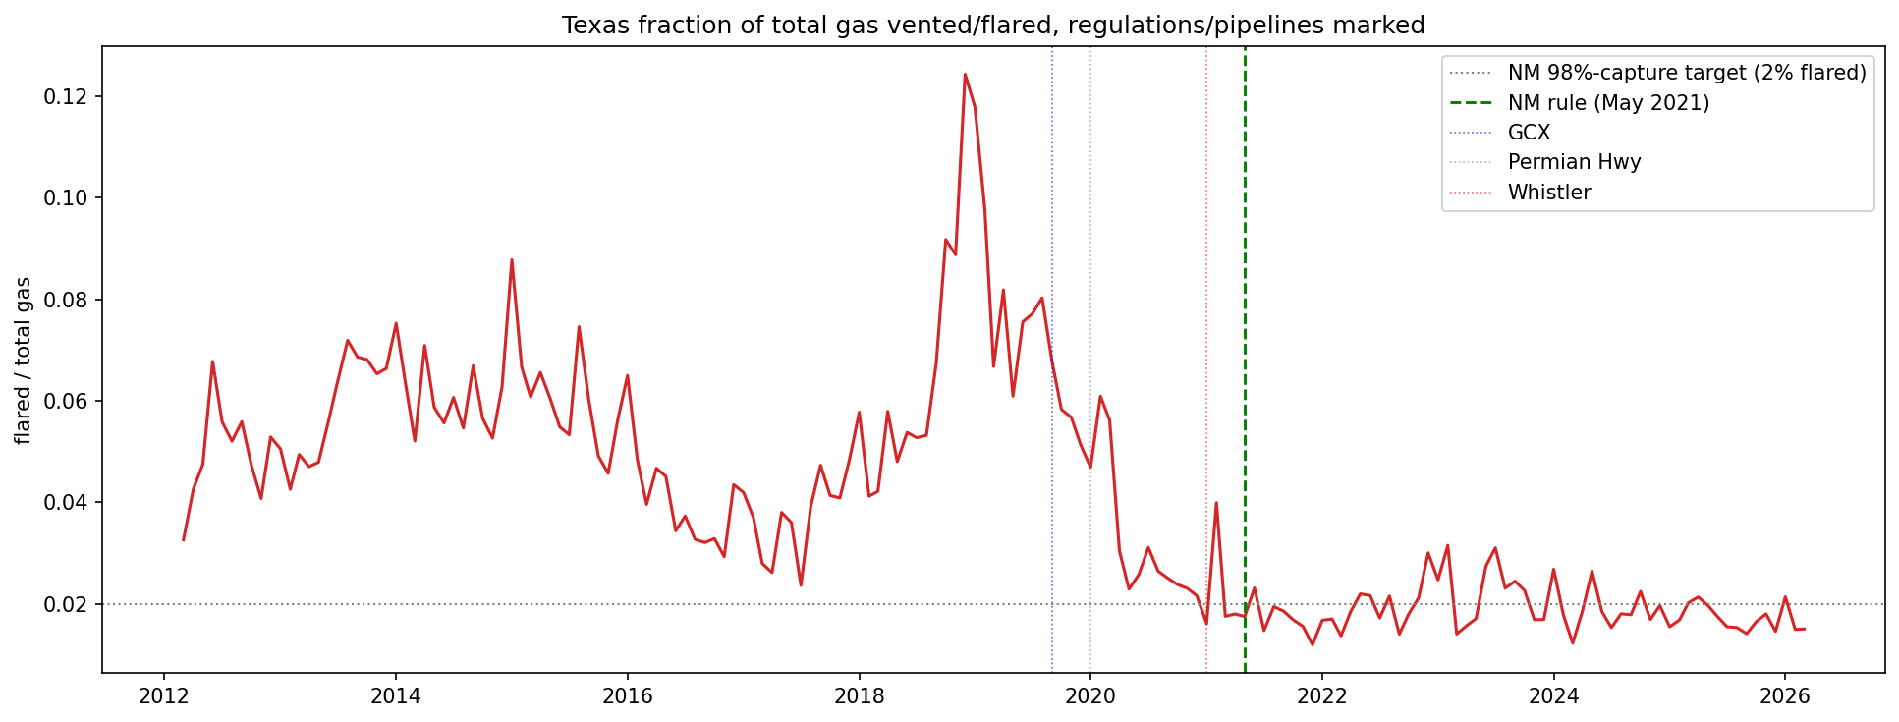
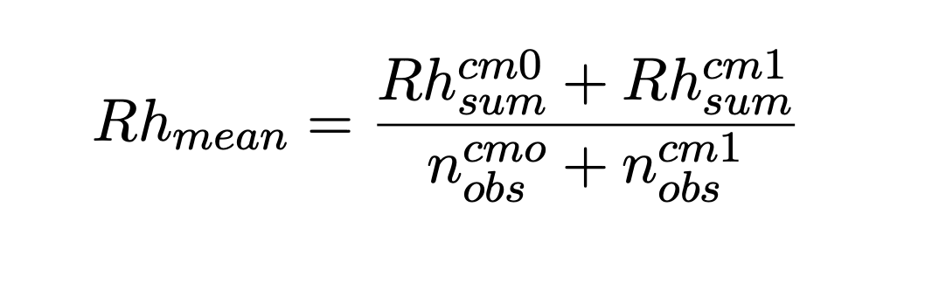
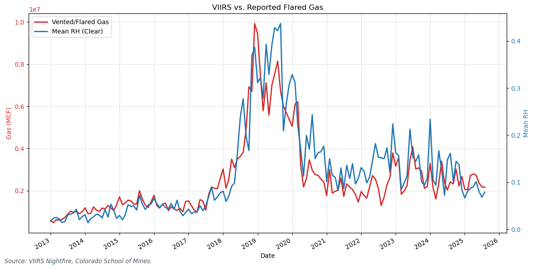
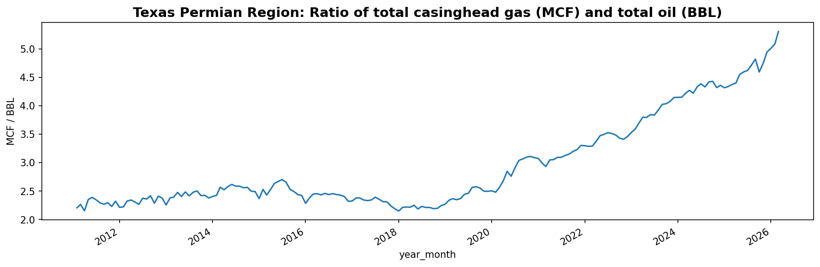
Feature engineering story
VIIRS observed flaring intensity → Flared gas volume → Total gas volume → Total oil produced

Slide 6
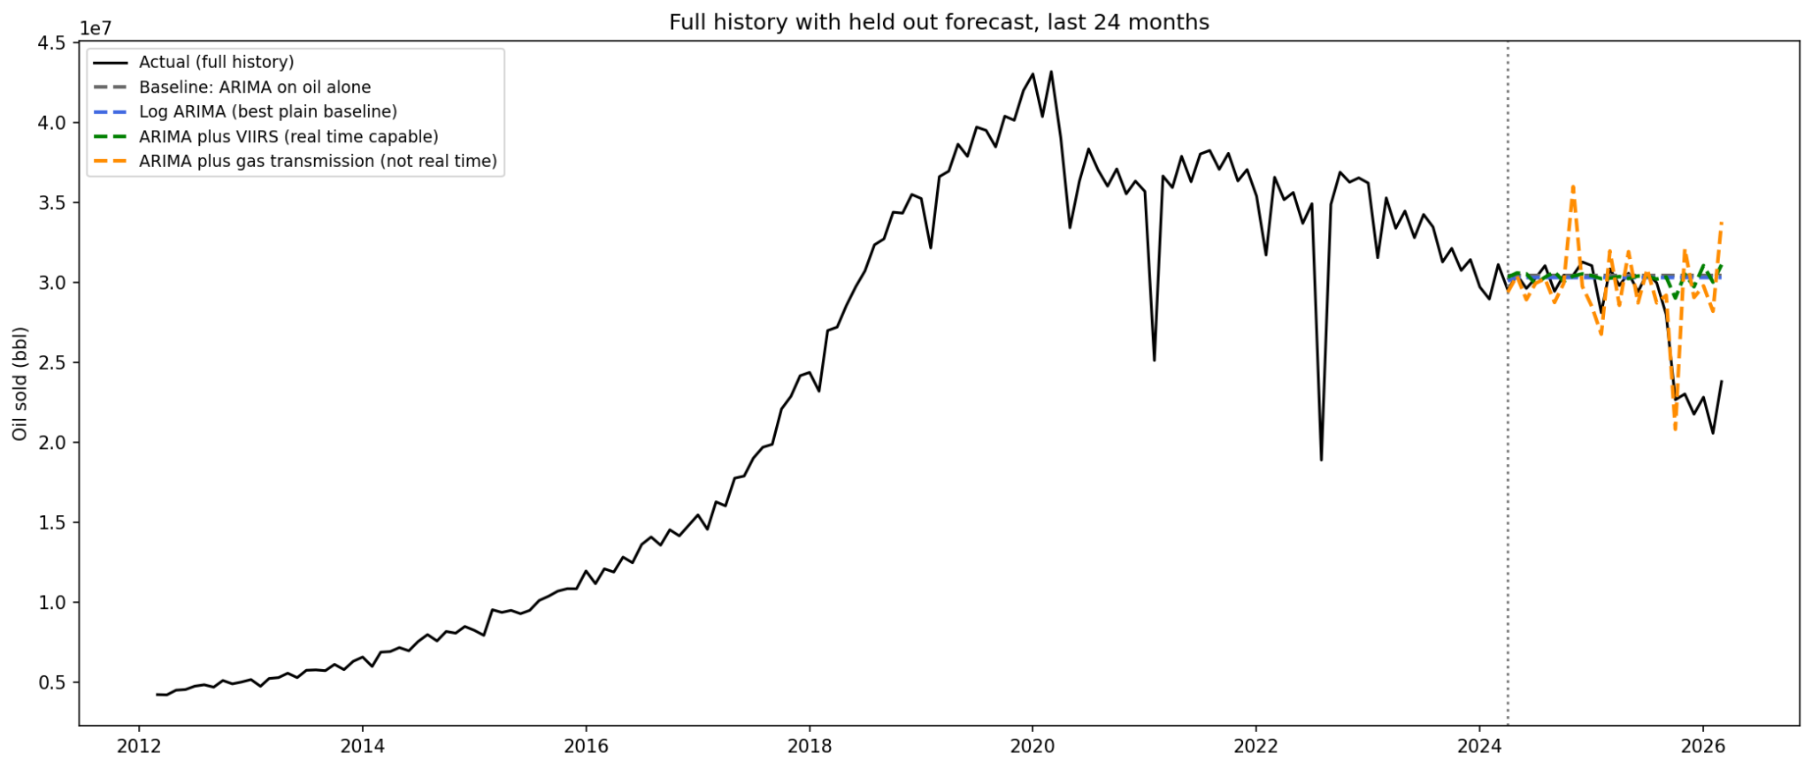
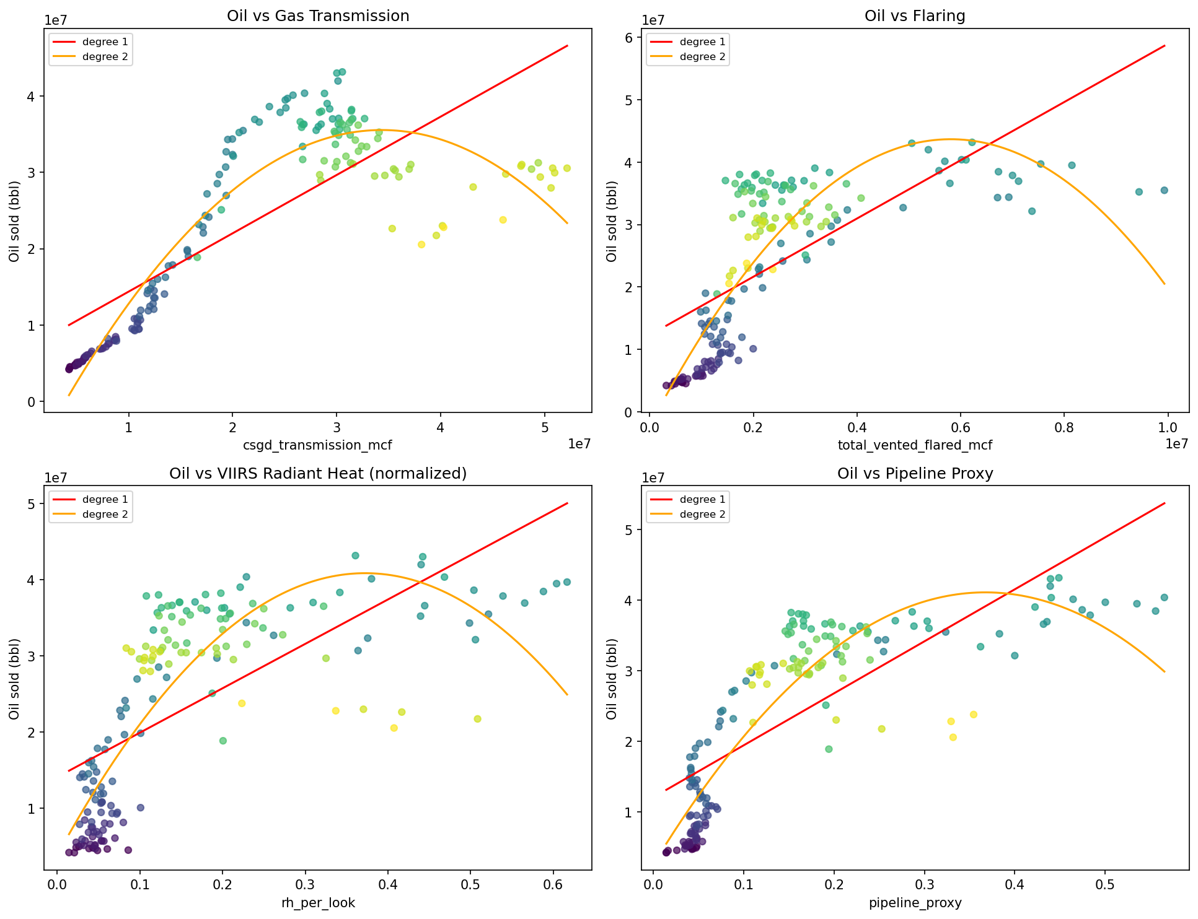
PREDICTING OIL PRODUCTION
Can Satellite Data Forecast Oil in Real Time
Oil's own history is a strong baseline. Everything else has to beat it.
Gas transmission predicts oil well, about 18% better, but shares oil's own reporting lag.
VIIRS, the only real time signal, gives
almost no improvement in any test.
The gas to oil relationship is a loop, not a line, tracing each well's rise and decline.
Flaring decouples from transmission during pipeline bottlenecks, a real mechanism finding.
[ Add fig4_forecast_comparison.png here: actual vs. baseline, log ARIMA, VIIRS, and gas transmission ]
Predictor | Real time | Full history | 2020 onward
VIIRS radiant heat | Yes | +2% | +3%
Pipeline proxy | Yes | about 6% worse | about 14% worse
Gas transmission (not real time) | No | +18% | +22%
Log and polynomial versions tried | N/A | no real gain | no real gain

Slide 7
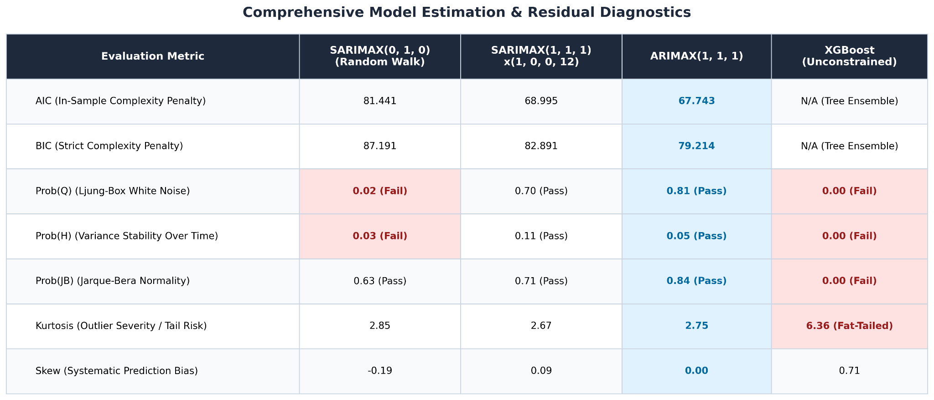

Flaring Time Series ARIMAX Modeling :
Proxy for Flaring: VIIRS radiant heat data shows strong historical correlation with official Texas vented/flared gas volumes, serving as a reliable indicator for the flaring volumes.
Goal: To find a time series model that captures the maximum amount of information from the historical data, leaving only random white noise as residuals. The optimum model is chosen keeping in mind both simplicity and stability in mind.
Model Performance: The non-seasonal ARIMAX(1,1,1) model demonstrates superior performance with the lowest AIC (67.74) and BIC (79.21) scores, indicating that adding a 12-month seasonal term provides no additional explanatory value.
Limitations of Tree Ensembles: Unlike parametric ARIMAX models, which scale smoothly along exponential trajectories, XGBoost fails time-series diagnostics (Prob(Q) = 0.00, kurtosis of 6.36) and struggles with extrapolation during extreme volume surges.
Statistical Validity: The ARIMAX(1,1,1) model produces white noise residuals (Prob(Q) = 0.81, Prob(JB) = 0.84), confirming stable error variance across both quiet and volatile regimes in the data.

Slide 8
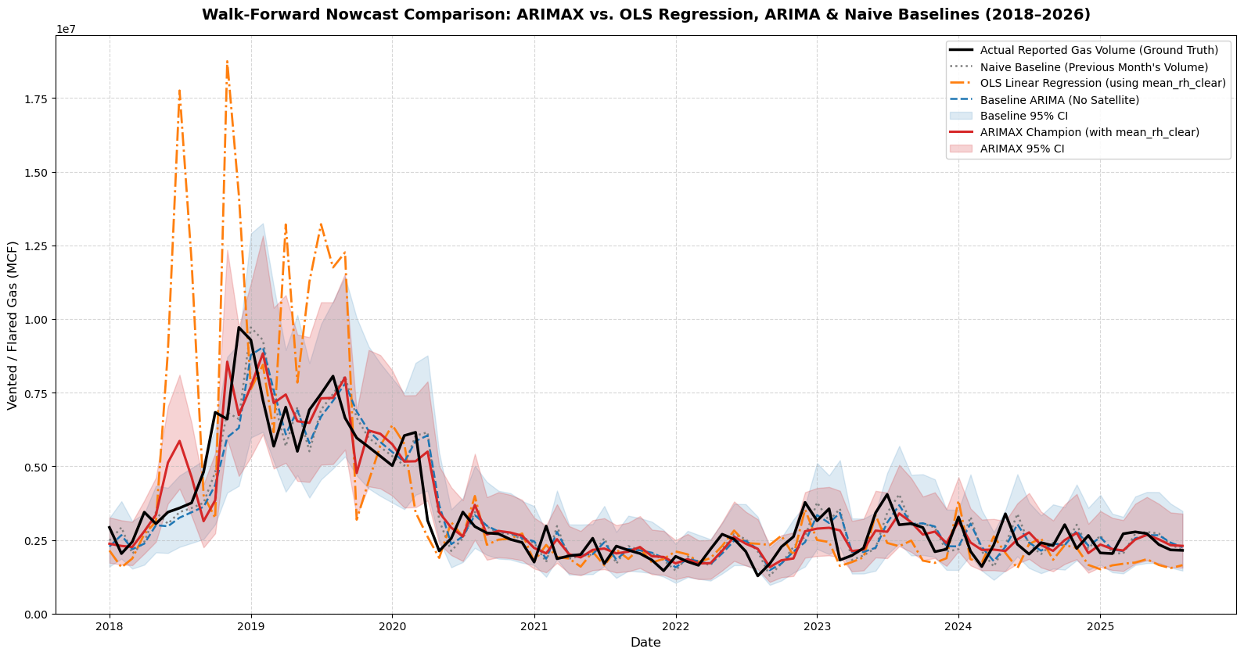
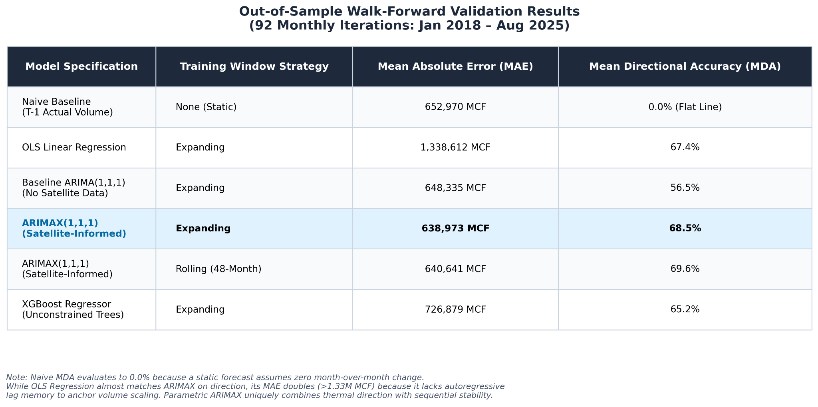
Out-of-Sample Predictive Power & Operational Nowcasting
92-Month Walk-Forward Validation (Jan 2018 – Aug 2025) across unseen data:
Walk-Forward Methodology: To simulate live deployment, we executed a 92-step walk-forward validation with an initial training data from 2013 - 2017. At each monthly step from 2018 to 2025, the model predicts one month ahead, ingests the newly revealed data point of the previous month, and dynamically re-estimates its coefficients.
12.0% Lift in Directional Accuracy (MDA): Adding VIIRS orbital thermal data increases Mean Directional Accuracy from 56.5% (Baseline ARIMA) to 68.5% (ARIMAX). A naive T−1 forecast scores 0.0% because it assumes zero month-over-month change.
Why ARIMAX Beats OLS & XGBoost on Precision (MAE):
vs. OLS Regression (1.33M MCF MAE): While OLS catches the almost the same direction accuracy (67.4% MDA), its error doubles because it lacks autoregressive lag memory and the momentum from previous months.
vs. XGBoost (711k MCF MAE): XGBoost captures decent direction (65.2% MDA), but suffers a +88,000 MCF MAE penalty because decision trees hit leaf-node extrapolation boundaries during record-breaking volume surges.

Slide 9
monthly_flaring_density
CONCLUSIONS:
Bridging the Regulatory Blind Spot:
Our model delivers flaring volume estimates to overcome the Texas Railroad Commission's 1- to 2-month reporting delay, converting satellite heat signals into flaring data weeks before official filings are published.
Who Benefits?
Commodity Traders
Environment Regulators - EPA, Texas RRC
Pipeline Planners

Slide 10
Thank you!
VIIRS Satellite Radiant Heat

