Slide 1
Tracert desarrollado con Python
Nombre: Eduardo Eliezar Castillo Hernández

Slide 2
Pseudo Codigo
UDP = crear_socketUDP();
RAW = crear_socketRAW();
RAW→establecer_Tiempo_de_Espera(5);
RAW→vincular_con(IP, Puerto);
Mientras (true){
  Tiempo_inicio = tiempoActual();
  UDP→enviar_Datagrama(IP_Destino, Puerto_destino, TTL);
  Paquete = RAW →recibir_ICMP();
  Tiempo_final = tiempoActual();
  RTT = (Tiempo_final – Tiempo_inicio) * 1000;
  imprimir_Informe(IP_Recibida, Puerto, RTT, Paquete);
  Si (Paquete→Codigo_ICMP = 3 Y Paquete→ Tipo_ICMP = 3)
    Terminar_ciclo;
    TTL = TTL + 1;
}

Slide 3
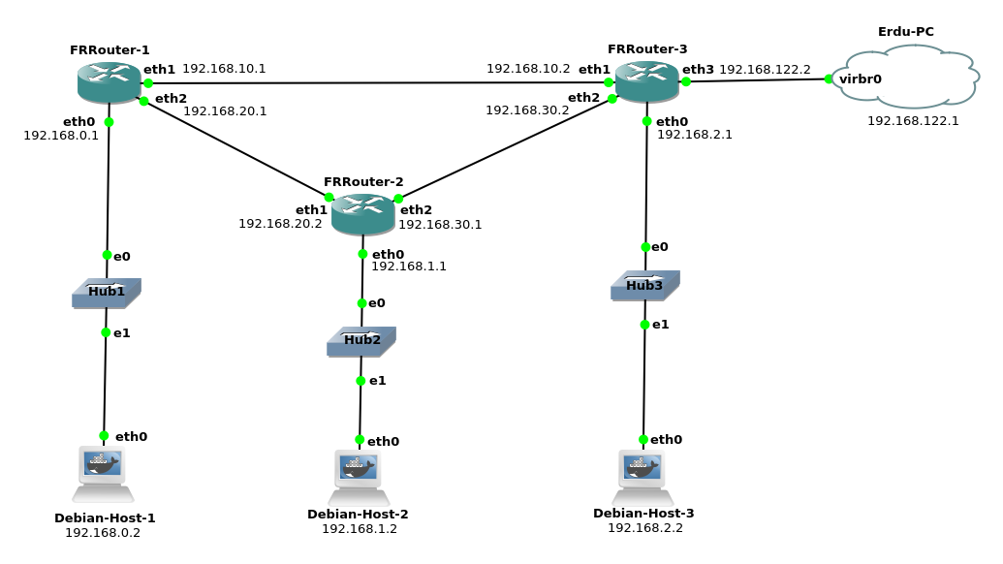
Topologia
Simulación del código al trazar la ruta de “Erdu-PC” a “Debian-Host-1”

Slide 4
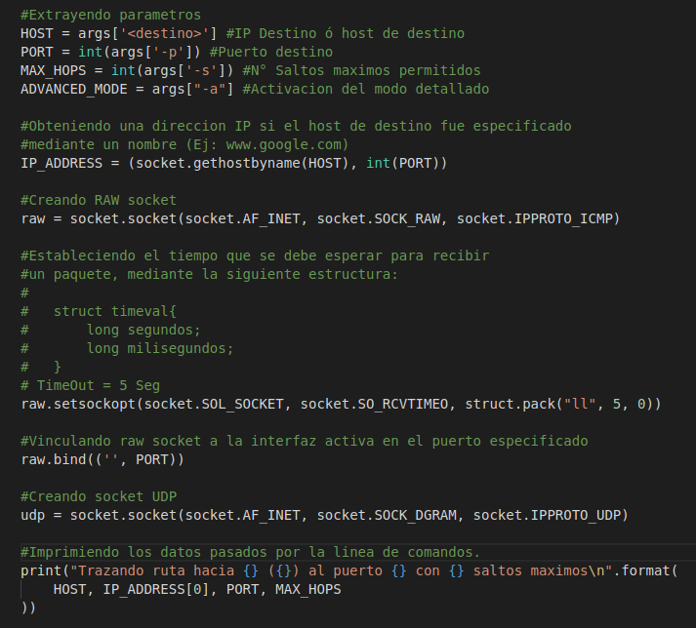
Python3 tracert.py -a 192.168.0.2
VARIABLES GLOBALES:
HOST =

Slide 5
Python3 tracert.py -a 192.168.0.2
VARIABLES GLOBALES:
HOST = 192.168.0.2
PORT =

Slide 6
Python3 tracert.py -a 192.168.0.2
VARIABLES GLOBALES:
HOST = 192.168.0.2
PORT = 33434
MAX_HOPS =

Slide 7
Python3 tracert.py -a 192.168.0.2
VARIABLES GLOBALES:
HOST = 192.168.0.2
PORT = 33434
MAX_HOPS = 30
ADVANCED_MODE =

Slide 8
Python3 tracert.py -a 192.168.0.2
VARIABLES GLOBALES:
HOST = 192.168.0.2
PORT = 33434
MAX_HOPS = 30
ADVANCED_MODE = True
IP_ADDRESS =

Slide 9
Python3 tracert.py -a 192.168.0.2
VARIABLES GLOBALES:
HOST = 192.168.0.2
PORT = 33434
MAX_HOPS = 30
ADVANCED_MODE = True
IP_ADDRESS =
(192.168.0.2, 33434)

Slide 10
Python3 tracert.py -a 192.168.0.2
VARIABLES GLOBALES:
HOST = 192.168.0.2
PORT = 33434
MAX_HOPS = 30
ADVANCED_MODE = True
IP_ADDRESS =
(192.168.0.2, 33434)
SOCKETS:
Socket UDP | Familia | Tipo | Protocolo
 | Puerto | TTL
Socket RAW | Familia | Tipo | Protocolo | IP | Puerto | Time Out

Slide 11
Python3 tracert.py -a 192.168.0.2
VARIABLES GLOBALES:
HOST = 192.168.0.2
PORT = 33434
MAX_HOPS = 30
ADVANCED_MODE = True
IP_ADDRESS =
(192.168.0.2, 33434)
SOCKETS:
Socket UDP | Familia | Tipo | Protocolo
 | Puerto | TTL
Socket RAW | Familia | Tipo | Protocolo | IP | Puerto | Time Out
 | IPv4 | RAW | ICMP

Slide 12
Python3 tracert.py -a 192.168.0.2
VARIABLES GLOBALES:
HOST = 192.168.0.2
PORT = 33434
MAX_HOPS = 30
ADVANCED_MODE = True
IP_ADDRESS =
(192.168.0.2, 33434)
SOCKETS:
Socket UDP | Familia | Tipo | Protocolo
 | Puerto | TTL
Socket RAW | Familia | Tipo | Protocolo | IP | Puerto | Time Out
 | IPv4 | RAW | ICMP |  |  | 5 seg

Slide 13
Python3 tracert.py -a 192.168.0.2
VARIABLES GLOBALES:
HOST = 192.168.0.2
PORT = 33434
MAX_HOPS = 30
ADVANCED_MODE = True
IP_ADDRESS =
(192.168.0.2, 33434)
SOCKETS:
Socket UDP | Familia | Tipo | Protocolo
 | Puerto | TTL
Socket RAW | Familia | Tipo | Protocolo | IP | Puerto | Time Out
 | IPv4 | RAW | ICMP | - | 33434 | 5 seg

Slide 14
Python3 tracert.py -a 192.168.0.2
VARIABLES GLOBALES:
HOST = 192.168.0.2
PORT = 33434
MAX_HOPS = 30
ADVANCED_MODE = True
IP_ADDRESS =
(192.168.0.2, 33434)
SOCKETS:
Socket UDP | Familia | Tipo | Protocolo
 | IPv4 | DGRAM | UDP
 | Puerto | TTL
 | -
Socket RAW | Familia | Tipo | Protocolo | IP | Puerto | Time Out
 | IPv4 | RAW | ICMP | - | 33434 | 5 seg

Slide 15
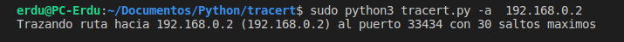
Python3 tracert.py -a 192.168.0.2

Slide 16
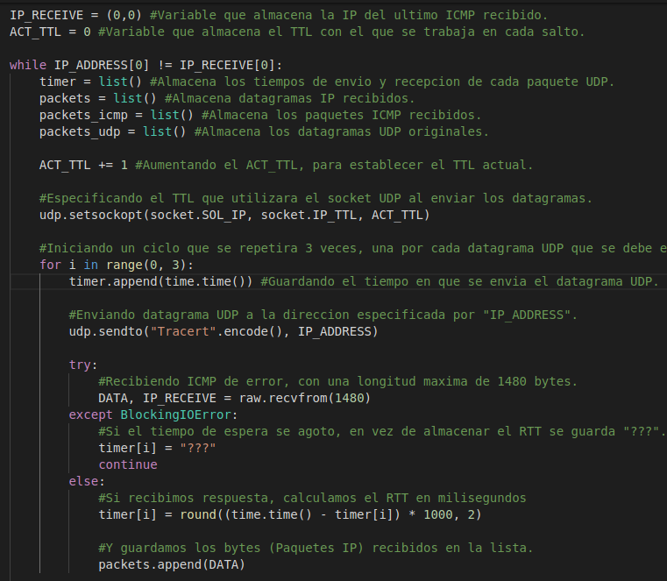
Python3 tracert.py -a 192.168.0.2
VARIABLES GLOBALES:
IP_ADDRESS =
(192.168.0.2, 33434)
IP_RECEIVE =
ACT_TTL =
SOCKETS:
Socket RAW | Protocolo | IP | Puerto | Time Out
 | ICMP | - | 33434 | 5 seg
Socket UDP | Puerto | TTL | Protocolo
 | - |  | UDP

Slide 17
Python3 tracert.py -a 192.168.0.2
VARIABLES GLOBALES:
IP_ADDRESS =
(192.168.0.2, 33434)
IP_RECEIVE = (0,0)
ACT_TTL =
SOCKETS:
Socket RAW | Protocolo | IP | Puerto | Time Out
 | ICMP | - | 33434 | 5 seg
Socket UDP | Puerto | TTL | Protocolo
 | - |  | UDP

Slide 18
Python3 tracert.py -a 192.168.0.2
VARIABLES GLOBALES:
IP_ADDRESS =
(192.168.0.2, 33434)
IP_RECEIVE = (0,0)
ACT_TTL = 0
SOCKETS:
Socket RAW | Protocolo | IP | Puerto | Time Out
 | ICMP | - | 33434 | 5 seg
Socket UDP | Puerto | TTL | Protocolo
 | - |  | UDP

Slide 19
Python3 tracert.py -a 192.168.0.2
VARIABLES GLOBALES:
IP_ADDRESS =
(192.168.0.2, 33434)
IP_RECEIVE = (0,0)
ACT_TTL = 0
Listas:
Timer | packets | Packets _icmp | Packets _udp
SOCKETS:
Socket RAW | Protocolo | IP | Puerto | Time Out
 | ICMP | - | 33434 | 5 seg
Socket UDP | Puerto | TTL | Protocolo
 | - |  | UDP

Slide 20
Python3 tracert.py -a 192.168.0.2
VARIABLES GLOBALES:
IP_ADDRESS =
(192.168.0.2, 33434)
IP_RECEIVE = (0,0)
ACT_TTL = 0
Listas:
Timer | packets | Packets _icmp | Packets _udp
SOCKETS:
Socket RAW | Protocolo | IP | Puerto | Time Out
 | ICMP | - | 33434 | 5 seg
Socket UDP | Puerto | TTL | Protocolo
 | - |  | UDP

Slide 21
Python3 tracert.py -a 192.168.0.2
VARIABLES GLOBALES:
IP_ADDRESS =
(192.168.0.2, 33434)
IP_RECEIVE = (0,0)
ACT_TTL = 1
Listas:
Timer | packets | Packets _icmp | Packets _udp
SOCKETS:
Socket RAW | Protocolo | IP | Puerto | Time Out
 | ICMP | - | 33434 | 5 seg
Socket UDP | Puerto | TTL | Protocolo
 | - |  | UDP

Slide 22
Python3 tracert.py -a 192.168.0.2
VARIABLES GLOBALES:
IP_ADDRESS =
(192.168.0.2, 33434)
IP_RECEIVE = (0,0)
ACT_TTL = 1
i =
Listas:
Timer | packets | Packets _icmp | Packets _udp
SOCKETS:
Socket RAW | Protocolo | IP | Puerto | Time Out
 | ICMP | - | 33434 | 5 seg
Socket UDP | Puerto | TTL | Protocolo
 | - | 1 | UDP

Slide 23
Python3 tracert.py -a 192.168.0.2
VARIABLES GLOBALES:
IP_ADDRESS =
(192.168.0.2, 33434)
IP_RECEIVE = (0,0)
ACT_TTL = 1
i = 0
Listas:
Timer | packets | Packets _icmp | Packets _udp
SOCKETS:
Socket RAW | Protocolo | IP | Puerto | Time Out
 | ICMP | - | 33434 | 5 seg
Socket UDP | Puerto | TTL | Protocolo
 | - | 1 | UDP

Slide 24
Python3 tracert.py -a 192.168.0.2
VARIABLES GLOBALES:
IP_ADDRESS =
(192.168.0.2, 33434)
IP_RECEIVE = (0,0)
ACT_TTL = 1
i = 0
Listas:
Timer | packets | Packets _icmp | Packets _udp
1.4519813
SOCKETS:
Socket RAW | Protocolo | IP | Puerto | Time Out
 | ICMP | - | 33434 | 5 seg
Socket UDP | Puerto | TTL | Protocolo
 | - | 1 | UDP

Slide 25
Python3 tracert.py -a 192.168.0.2
VARIABLES GLOBALES:
IP_ADDRESS =
(192.168.0.2, 33434)
IP_RECEIVE = (0,0)
ACT_TTL = 1
i = 0
Listas:
Timer | packets | Packets _icmp | Packets _udp
1.4519813
SOCKETS:
Socket RAW | Protocolo | IP | Puerto | Time Out
 | ICMP | - | 33434 | 5 seg
Socket UDP | Puerto | TTL | Protocolo
 | - | 1 | UDP

Slide 26
Topologia
Simulación del código al trazar la ruta de “Erdu-PC” a “Debian-Host-1”

Slide 27
Python3 tracert.py -a 192.168.0.2
VARIABLES GLOBALES:
IP_ADDRESS =
(192.168.0.2, 33434)
IP_RECEIV = (192.168.122.2,0)
ACT_TTL = 1
i = 0
Listas:
Timer | packets | Packets _icmp | Packets _udp
1.4519813
SOCKETS:
Socket RAW | Protocolo | IP | Puerto | Time Out
 | ICMP | - | 33434 | 5 seg
Socket UDP | Puerto | TTL | Protocolo
 | - | 1 | UDP

Slide 28
Python3 tracert.py -a 192.168.0.2
VARIABLES GLOBALES:
IP_ADDRESS =
(192.168.0.2, 33434)
IP_RECEIV = (192.168.122.2,0)
ACT_TTL = 1
i = 0
Listas:
Timer | packets | Packets _icmp | Packets _udp
1.4519813
SOCKETS:
timer[i] = (1.4525913 - 1.4519813) * 1000 = 0.61
Socket RAW | Protocolo | IP | Puerto | Time Out
 | ICMP | - | 33434 | 5 seg
Socket UDP | Puerto | TTL | Protocolo
 | - | 1 | UDP

Slide 29
Python3 tracert.py -a 192.168.0.2
VARIABLES GLOBALES:
IP_ADDRESS =
(192.168.0.2, 33434)
IP_RECEIV = (192.168.122.2,0)
ACT_TTL = 1
i = 0
Listas:
Timer | packets | Packets _icmp | Packets _udp
0.61
SOCKETS:
timer[i] = (1.4525913 - 1.4519813) * 1000 = 0.61
Socket RAW | Protocolo | IP | Puerto | Time Out
 | ICMP | - | 33434 | 5 seg
Socket UDP | Puerto | TTL | Protocolo
 | - | 1 | UDP

Slide 30
Python3 tracert.py -a 192.168.0.2
VARIABLES GLOBALES:
IP_ADDRESS =
(192.168.0.2, 33434)
IP_RECEIV = (192.168.122.2,0)
ACT_TTL = 1
i = 0
Listas:
Timer | packets | Packets _icmp | Packets _udp
0.61 | n Bytes
SOCKETS:
Socket RAW | Protocolo | IP | Puerto | Time Out
 | ICMP | - | 33434 | 5 seg
Socket UDP | Puerto | TTL | Protocolo
 | - | 1 | UDP

Slide 31
Python3 tracert.py -a 192.168.0.2
VARIABLES GLOBALES:
IP_ADDRESS =
(192.168.0.2, 33434)
IP_RECEIV = (192.168.122.2,0)
ACT_TTL = 1
i = 1
Listas:
Timer | packets | Packets _icmp | Packets _udp
0.61 | n Bytes
SOCKETS:
Socket RAW | Protocolo | IP | Puerto | Time Out
 | ICMP | - | 33434 | 5 seg
Socket UDP | Puerto | TTL | Protocolo
 | - | 1 | UDP

Slide 32
Python3 tracert.py -a 192.168.0.2
VARIABLES GLOBALES:
IP_ADDRESS =
(192.168.0.2, 33434)
IP_RECEIV = (192.168.122.2,0)
ACT_TTL = 1
i = 1
Listas:
Timer | packets | Packets _icmp | Packets _udp
0.61 | n Bytes
1.4526205
SOCKETS:
Socket RAW | Protocolo | IP | Puerto | Time Out
 | ICMP | - | 33434 | 5 seg
Socket UDP | Puerto | TTL | Protocolo
 | - | 1 | UDP

Slide 33
Python3 tracert.py -a 192.168.0.2
VARIABLES GLOBALES:
IP_ADDRESS =
(192.168.0.2, 33434)
IP_RECEIV = (192.168.122.2,0)
ACT_TTL = 1
i = 1
Listas:
Timer | packets | Packets _icmp | Packets _udp
0.61 | n Bytes
1.4526205
SOCKETS:
Socket RAW | Protocolo | IP | Puerto | Time Out
 | ICMP | - | 33434 | 5 seg
Socket UDP | Puerto | TTL | Protocolo
 | - | 1 | UDP

Slide 34
Python3 tracert.py -a 192.168.0.2
VARIABLES GLOBALES:
IP_ADDRESS =
(192.168.0.2, 33434)
IP_RECEIV = (192.168.122.2,0)
ACT_TTL = 1
i = 1
Listas:
Timer | packets | Packets _icmp | Packets _udp
0.61 | n Bytes
1.4526205
SOCKETS:
Socket RAW | Protocolo | IP | Puerto | Time Out
 | ICMP | - | 33434 | 5 seg
Socket UDP | Puerto | TTL | Protocolo
 | - | 1 | UDP

Slide 35
Python3 tracert.py -a 192.168.0.2
VARIABLES GLOBALES:
IP_ADDRESS =
(192.168.0.2, 33434)
IP_RECEIV = (192.168.122.2,0)
ACT_TTL = 1
i = 1
Listas:
Timer | packets | Packets _icmp | Packets _udp
0.61 | n Bytes
0.38
SOCKETS:
Socket RAW | Protocolo | IP | Puerto | Time Out
 | ICMP | - | 33434 | 5 seg
Socket UDP | Puerto | TTL | Protocolo
 | - | 1 | UDP

Slide 36
Python3 tracert.py -a 192.168.0.2
VARIABLES GLOBALES:
IP_ADDRESS =
(192.168.0.2, 33434)
IP_RECEIV = (192.168.122.2,0)
ACT_TTL = 1
i = 1
Listas:
Timer | packets | Packets _icmp | Packets _udp
0.61 | n Bytes
0.38 | n Bytes
SOCKETS:
Socket RAW | Protocolo | IP | Puerto | Time Out
 | ICMP | - | 33434 | 5 seg
Socket UDP | Puerto | TTL | Protocolo
 | - | 1 | UDP

Slide 37
Python3 tracert.py -a 192.168.0.2
VARIABLES GLOBALES:
IP_ADDRESS =
(192.168.0.2, 33434)
IP_RECEIV = (192.168.122.2,0)
ACT_TTL = 1
i = 2
Listas:
Timer | packets | Packets _icmp | Packets _udp
0.61 | n Bytes
0.38 | n Bytes
SOCKETS:
Socket RAW | Protocolo | IP | Puerto | Time Out
 | ICMP | - | 33434 | 5 seg
Socket UDP | Puerto | TTL | Protocolo
 | - | 1 | UDP

Slide 38
Python3 tracert.py -a 192.168.0.2
VARIABLES GLOBALES:
IP_ADDRESS =
(192.168.0.2, 33434)
IP_RECEIV = (192.168.122.2,0)
ACT_TTL = 1
i = 2
Listas:
Timer | packets | Packets _icmp | Packets _udp
0.61 | n Bytes
0.38 | n Bytes
1.4530149
SOCKETS:
Socket RAW | Protocolo | IP | Puerto | Time Out
 | ICMP | - | 33434 | 5 seg
Socket UDP | Puerto | TTL | Protocolo
 | - | 1 | UDP

Slide 39
Python3 tracert.py -a 192.168.0.2
VARIABLES GLOBALES:
IP_ADDRESS =
(192.168.0.2, 33434)
IP_RECEIV = (192.168.122.2,0)
ACT_TTL = 1
i = 2
Listas:
Timer | packets | Packets _icmp | Packets _udp
0.61 | n Bytes
0.38 | n Bytes
1.4530149
SOCKETS:
Socket RAW | Protocolo | IP | Puerto | Time Out
 | ICMP | - | 33434 | 5 seg
Socket UDP | Puerto | TTL | Protocolo
 | - | 1 | UDP

Slide 40
Python3 tracert.py -a 192.168.0.2
VARIABLES GLOBALES:
IP_ADDRESS =
(192.168.0.2, 33434)
IP_RECEIV = (192.168.122.2,0)
ACT_TTL = 1
i = 2
Listas:
Timer | packets | Packets _icmp | Packets _udp
0.61 | n Bytes
0.38 | n Bytes
1.4530149
SOCKETS:
Socket RAW | Protocolo | IP | Puerto | Time Out
 | ICMP | - | 33434 | 5 seg
Socket UDP | Puerto | TTL | Protocolo
 | - | 1 | UDP

Slide 41
Python3 tracert.py -a 192.168.0.2
VARIABLES GLOBALES:
IP_ADDRESS =
(192.168.0.2, 33434)
IP_RECEIV = (192.168.122.2,0)
ACT_TTL = 1
i = 2
Listas:
Timer | packets | Packets _icmp | Packets _udp
0.61 | n Bytes
0.38 | n Bytes
0.32 | n Bytes
SOCKETS:
Socket RAW | Protocolo | IP | Puerto | Time Out
 | ICMP | - | 33434 | 5 seg
Socket UDP | Puerto | TTL | Protocolo
 | - | 1 | UDP

Slide 42
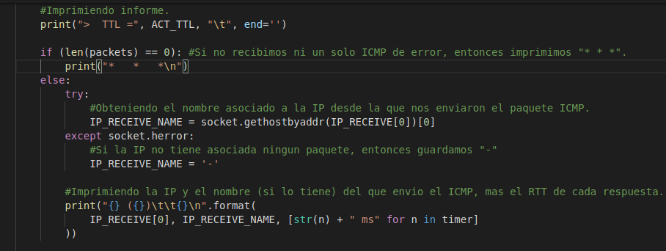
Python3 tracert.py -a 192.168.0.2
VARIABLES GLOBALES:
IP_ADDRESS = (192.168.0.2, 33434)
Listas:
IP_RECEIV = (192.168.122.2,0)
ACT_TTL = 1
Timer | packets | Packets _icmp | Packets _udp
0.61 | n Bytes
0.38 | n Bytes
0.32 | n Bytes
SOCKETS:
Socket RAW | Protocolo | IP | Puerto | Time Out
 | ICMP | - | 33434 | 5 seg
Socket UDP | Puerto | TTL | Protocolo
 | - | 1 | UDP

Slide 43
Python3 tracert.py -a 192.168.0.2
VARIABLES GLOBALES:
IP_ADDRESS = (192.168.0.2, 33434)
Listas:
IP_RECEIV = (192.168.122.2,0)
ACT_TTL = 1
Timer | packets | Packets _icmp | Packets _udp
0.61 | n Bytes
0.38 | n Bytes
0.32 | n Bytes
SOCKETS:
Socket RAW | Protocolo | IP | Puerto | Time Out
 | ICMP | - | 33434 | 5 seg
Socket UDP | Puerto | TTL | Protocolo
 | - | 1 | UDP

Slide 44
Python3 tracert.py -a 192.168.0.2
VARIABLES GLOBALES:
IP_ADDRESS = (192.168.0.2, 33434)
Listas:
IP_RECEIV = (192.168.122.2,0)
IP_RECEIVE_NAME =
ACT_TTL = 1
Timer | packets | Packets _icmp | Packets _udp
0.61 | n Bytes
0.38 | n Bytes
0.32 | n Bytes
SOCKETS:
Socket RAW | Protocolo | IP | Puerto | Time Out
 | ICMP | - | 33434 | 5 seg
Socket UDP | Puerto | TTL | Protocolo
 | - | 1 | UDP

Slide 45
Python3 tracert.py -a 192.168.0.2
VARIABLES GLOBALES:
IP_ADDRESS = (192.168.0.2, 33434)
Listas:
IP_RECEIV = (192.168.122.2,0)
IP_RECEIVE_NAME = “_gateway”
ACT_TTL = 1
Timer | packets | Packets _icmp | Packets _udp
0.61 | n Bytes
0.38 | n Bytes
0.32 | n Bytes
SOCKETS:
Socket RAW | Protocolo | IP | Puerto | Time Out
 | ICMP | - | 33434 | 5 seg
Socket UDP | Puerto | TTL | Protocolo
 | - | 1 | UDP

Slide 46
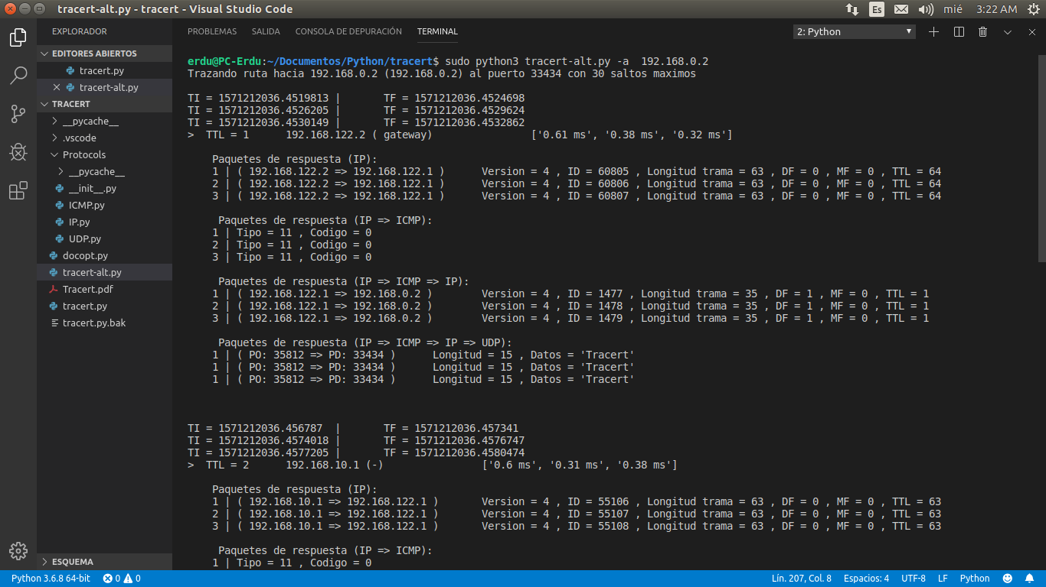
Python3 tracert.py -a 192.168.0.2

Slide 47
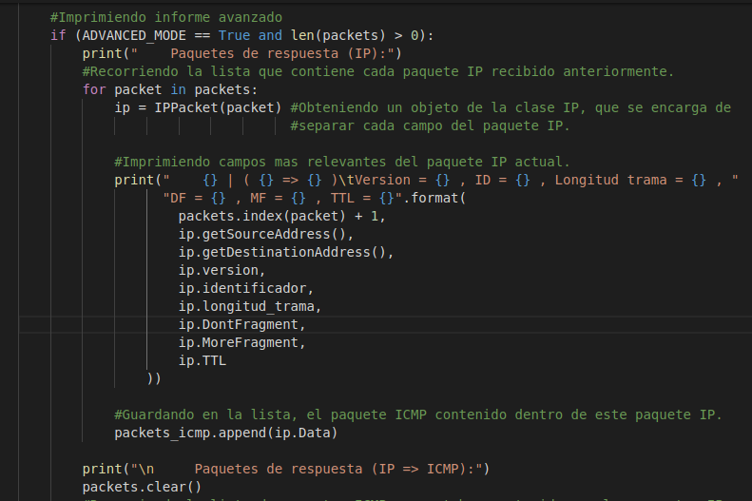
Python3 tracert.py -a 192.168.0.2
VARIABLES GLOBALES:
IP_ADDRESS =
(192.168.0.2, 33434)
IP_RECEIV =
(192.168.122.2,0)
ACT_TTL = 1
Listas:
Timer | packets | Packets _icmp | Packets _udp
0.61 | n Bytes
0.38 | n Bytes
0.32 | n Bytes
SOCKETS:
Socket RAW | Protocolo | IP | Puerto | Time Out
 | ICMP | - | 33434 | 5 seg
Socket UDP | Puerto | TTL | Protocolo
 | - | 1 | UDP

Slide 48
Python3 tracert.py -a 192.168.0.2
VARIABLES GLOBALES:
IP_ADDRESS =
(192.168.0.2, 33434)
IP_RECEIV =
(192.168.122.2,0)
ACT_TTL = 1
Listas:
Timer | packets | Packets _icmp | Packets _udp
0.61 | n Bytes
0.38 | n Bytes
0.32 | n Bytes
SOCKETS:
Socket RAW | Protocolo | IP | Puerto | Time Out
 | ICMP | - | 33434 | 5 seg
Socket UDP | Puerto | TTL | Protocolo
 | - | 1 | UDP

Slide 49
Python3 tracert.py -a 192.168.0.2
VARIABLES GLOBALES:
IP_ADDRESS =
(192.168.0.2, 33434)
IP_RECEIV =
(192.168.122.2,0)
ACT_TTL = 1
Listas:
Timer | packets | Packets _icmp | Packets _udp
0.61 | n Bytes
0.38 | n Bytes
0.32 | n Bytes
SOCKETS:
Socket RAW | Protocolo | IP | Puerto | Time Out
 | ICMP | - | 33434 | 5 seg
Socket UDP | Puerto | TTL | Protocolo
 | - | 1 | UDP

Slide 50
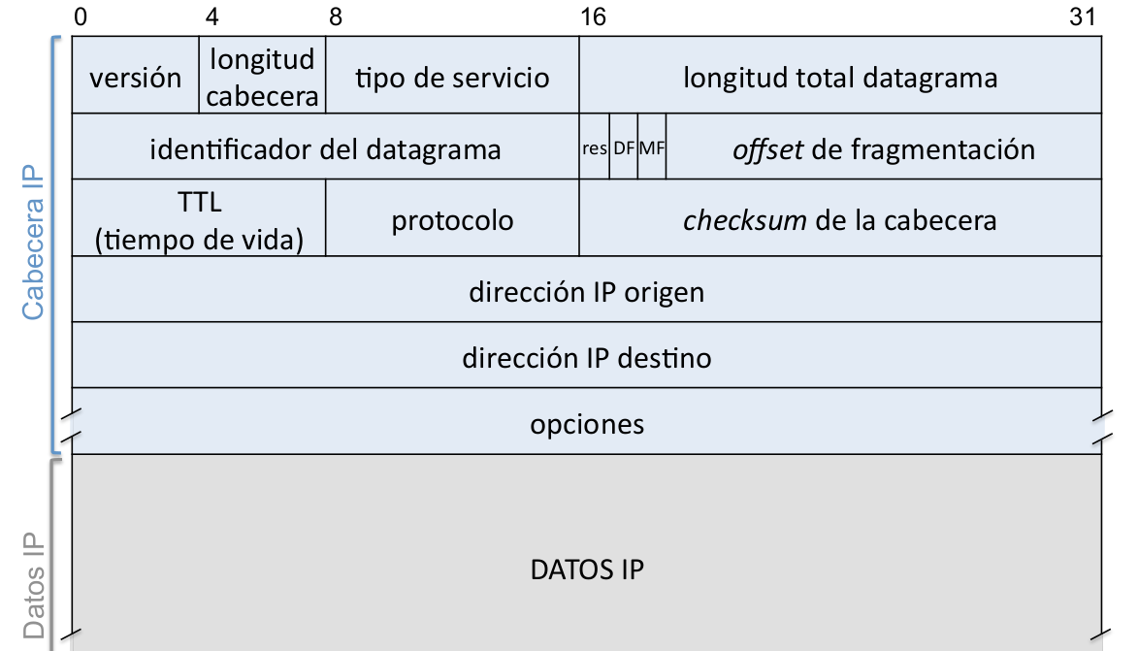
Campos del protocolo IP

Slide 51
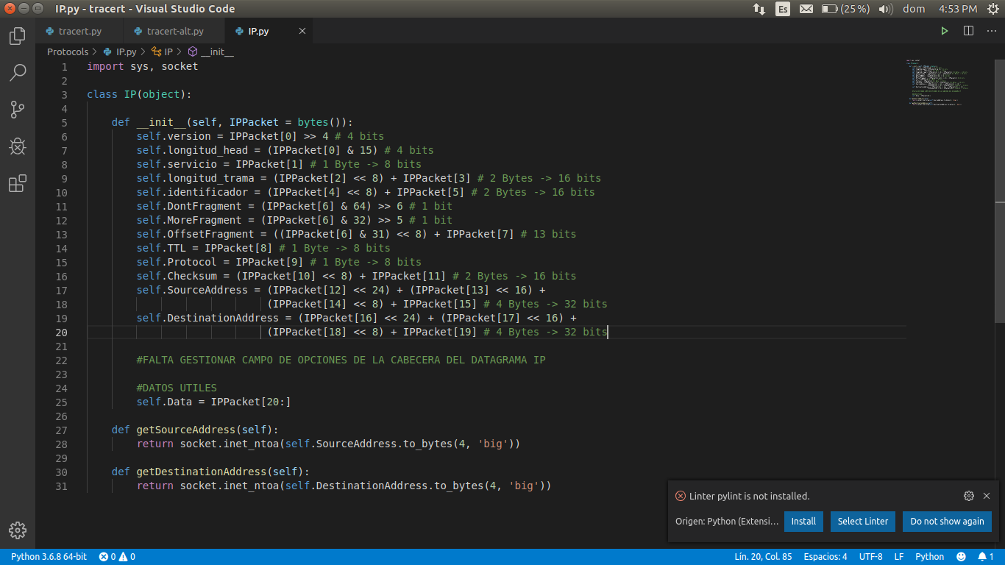
Nuevo Obj. “IPPacket”
Packets[0]
01000101 11000000 00000000 00111111 01111100 10011001 00000000 00000000 01000000 00000001 10001000 00010000 11000000 10101000 01111010 00000010 11000000 10101000 01111010 00000001 00001011 00000000 11110000 01110100 00000000 00000000 00000000 00000000 01000101 00000000 00000000 00100011 01101010 10011001 01000000 00000000 00000001 00010001 00010011 11011101 11000000 10101000 01111010 00000001 11000000 10101000 00000000 00000010 10001011 00110100 10000010 10011010 00000000 00001111 01100111 01100100 01010100 01110010 01100001 01100011 01100101 01110010 01110100
IPPacket[0] = 01000101
0 | 1 | 0 | 0 | 0 | 1 | 0 | 1

Slide 52
Nuevo Obj. “IPPacket”
Packets[0]
01000101 11000000 00000000 00111111 01111100 10011001 00000000 00000000 01000000 00000001 10001000 00010000 11000000 10101000 01111010 00000010 11000000 10101000 01111010 00000001 00001011 00000000 11110000 01110100 00000000 00000000 00000000 00000000 01000101 00000000 00000000 00100011 01101010 10011001 01000000 00000000 00000001 00010001 00010011 11011101 11000000 10101000 01111010 00000001 11000000 10101000 00000000 00000010 10001011 00110100 10000010 10011010 00000000 00001111 01100111 01100100 01010100 01110010 01100001 01100011 01100101 01110010 01110100
IPPacket[0] = 01000101
0 | 1 | 0 | 0 | 0 | 1 | 0 | 1
>> 4

Slide 53
Nuevo Obj. “IPPacket”
Packets[0]
01000101 11000000 00000000 00111111 01111100 10011001 00000000 00000000 01000000 00000001 10001000 00010000 11000000 10101000 01111010 00000010 11000000 10101000 01111010 00000001 00001011 00000000 11110000 01110100 00000000 00000000 00000000 00000000 01000101 00000000 00000000 00100011 01101010 10011001 01000000 00000000 00000001 00010001 00010011 11011101 11000000 10101000 01111010 00000001 11000000 10101000 00000000 00000010 10001011 00110100 10000010 10011010 00000000 00001111 01100111 01100100 01010100 01110010 01100001 01100011 01100101 01110010 01110100
IPPacket[0] = 01000101
 |  |  |  | 0 | 1 | 0 | 0

Slide 54
Nuevo Obj. “IPPacket”
Packets[0]
01000101 11000000 00000000 00111111 01111100 10011001 00000000 00000000 01000000 00000001 10001000 00010000 11000000 10101000 01111010 00000010 11000000 10101000 01111010 00000001 00001011 00000000 11110000 01110100 00000000 00000000 00000000 00000000 01000101 00000000 00000000 00100011 01101010 10011001 01000000 00000000 00000001 00010001 00010011 11011101 11000000 10101000 01111010 00000001 11000000 10101000 00000000 00000010 10001011 00110100 10000010 10011010 00000000 00001111 01100111 01100100 01010100 01110010 01100001 01100011 01100101 01110010 01110100
IPPacket[0] = 01000101
0 | 0 | 0 | 0 | 0 | 1 | 0 | 0

Slide 55
Nuevo Obj. “IPPacket”
Packets[0]
Version = 00000100 (4)
01000101 11000000 00000000 00111111 01111100 10011001 00000000 00000000 01000000 00000001 10001000 00010000 11000000 10101000 01111010 00000010 11000000 10101000 01111010 00000001 00001011 00000000 11110000 01110100 00000000 00000000 00000000 00000000 01000101 00000000 00000000 00100011 01101010 10011001 01000000 00000000 00000001 00010001 00010011 11011101 11000000 10101000 01111010 00000001 11000000 10101000 00000000 00000010 10001011 00110100 10000010 10011010 00000000 00001111 01100111 01100100 01010100 01110010 01100001 01100011 01100101 01110010 01110100
IPPacket[0] = 01000101
0 | 0 | 0 | 0 | 0 | 1 | 0 | 0

Slide 56
Nuevo Obj. “IPPacket”
Packets[0]
Version = 00000100 (4)
01000101 11000000 00000000 00111111 01111100 10011001 00000000 00000000 01000000 00000001 10001000 00010000 11000000 10101000 01111010 00000010 11000000 10101000 01111010 00000001 00001011 00000000 11110000 01110100 00000000 00000000 00000000 00000000 01000101 00000000 00000000 00100011 01101010 10011001 01000000 00000000 00000001 00010001 00010011 11011101 11000000 10101000 01111010 00000001 11000000 10101000 00000000 00000010 10001011 00110100 10000010 10011010 00000000 00001111 01100111 01100100 01010100 01110010 01100001 01100011 01100101 01110010 01110100

Slide 57
Nuevo Obj. “IPPacket”
Packets[0]
Version = 00000100 (4)
01000101 11000000 00000000 00111111 01111100 10011001 00000000 00000000 01000000 00000001 10001000 00010000 11000000 10101000 01111010 00000010 11000000 10101000 01111010 00000001 00001011 00000000 11110000 01110100 00000000 00000000 00000000 00000000 01000101 00000000 00000000 00100011 01101010 10011001 01000000 00000000 00000001 00010001 00010011 11011101 11000000 10101000 01111010 00000001 11000000 10101000 00000000 00000010 10001011 00110100 10000010 10011010 00000000 00001111 01100111 01100100 01010100 01110010 01100001 01100011 01100101 01110010 01110100
IPPacket[0] = 01000101
0 | 1 | 0 | 0 | 0 | 1 | 0 | 1

Slide 58
Nuevo Obj. “IPPacket”
Packets[0]
Version = 00000100 (4)
01000101 11000000 00000000 00111111 01111100 10011001 00000000 00000000 01000000 00000001 10001000 00010000 11000000 10101000 01111010 00000010 11000000 10101000 01111010 00000001 00001011 00000000 11110000 01110100 00000000 00000000 00000000 00000000 01000101 00000000 00000000 00100011 01101010 10011001 01000000 00000000 00000001 00010001 00010011 11011101 11000000 10101000 01111010 00000001 11000000 10101000 00000000 00000010 10001011 00110100 10000010 10011010 00000000 00001111 01100111 01100100 01010100 01110010 01100001 01100011 01100101 01110010 01110100
IPPacket[0] = 01000101
0 | 1 | 0 | 0 | 0 | 1 | 0 | 1
= 69
AND
0 | 0 | 0 | 0 | 1 | 1 | 1 | 1
= 15

Slide 59
Nuevo Obj. “IPPacket”
Packets[0]
Version = 00000100 (4)
01000101 11000000 00000000 00111111 01111100 10011001 00000000 00000000 01000000 00000001 10001000 00010000 11000000 10101000 01111010 00000010 11000000 10101000 01111010 00000001 00001011 00000000 11110000 01110100 00000000 00000000 00000000 00000000 01000101 00000000 00000000 00100011 01101010 10011001 01000000 00000000 00000001 00010001 00010011 11011101 11000000 10101000 01111010 00000001 11000000 10101000 00000000 00000010 10001011 00110100 10000010 10011010 00000000 00001111 01100111 01100100 01010100 01110010 01100001 01100011 01100101 01110010 01110100
IPPacket[0] = 01000101
0 | 1 | 0 | 0 | 0 | 1 | 0 | 1
= 69
AND
0 | 0 | 0 | 0 | 1 | 1 | 1 | 1
= 15
0

Slide 60
Nuevo Obj. “IPPacket”
Packets[0]
Version = 00000100 (4)
01000101 11000000 00000000 00111111 01111100 10011001 00000000 00000000 01000000 00000001 10001000 00010000 11000000 10101000 01111010 00000010 11000000 10101000 01111010 00000001 00001011 00000000 11110000 01110100 00000000 00000000 00000000 00000000 01000101 00000000 00000000 00100011 01101010 10011001 01000000 00000000 00000001 00010001 00010011 11011101 11000000 10101000 01111010 00000001 11000000 10101000 00000000 00000010 10001011 00110100 10000010 10011010 00000000 00001111 01100111 01100100 01010100 01110010 01100001 01100011 01100101 01110010 01110100
IPPacket[0] = 01000101
0 | 1 | 0 | 0 | 0 | 1 | 0 | 1
= 69
AND
0 | 0 | 0 | 0 | 1 | 1 | 1 | 1
= 15
0 | 0

Slide 61
Nuevo Obj. “IPPacket”
Packets[0]
Version = 00000100 (4)
01000101 11000000 00000000 00111111 01111100 10011001 00000000 00000000 01000000 00000001 10001000 00010000 11000000 10101000 01111010 00000010 11000000 10101000 01111010 00000001 00001011 00000000 11110000 01110100 00000000 00000000 00000000 00000000 01000101 00000000 00000000 00100011 01101010 10011001 01000000 00000000 00000001 00010001 00010011 11011101 11000000 10101000 01111010 00000001 11000000 10101000 00000000 00000010 10001011 00110100 10000010 10011010 00000000 00001111 01100111 01100100 01010100 01110010 01100001 01100011 01100101 01110010 01110100
IPPacket[0] = 01000101
0 | 1 | 0 | 0 | 0 | 1 | 0 | 1
= 69
AND
0 | 0 | 0 | 0 | 1 | 1 | 1 | 1
= 15
0 | 0 | 0

Slide 62
Nuevo Obj. “IPPacket”
Packets[0]
Version = 00000100 (4)
01000101 11000000 00000000 00111111 01111100 10011001 00000000 00000000 01000000 00000001 10001000 00010000 11000000 10101000 01111010 00000010 11000000 10101000 01111010 00000001 00001011 00000000 11110000 01110100 00000000 00000000 00000000 00000000 01000101 00000000 00000000 00100011 01101010 10011001 01000000 00000000 00000001 00010001 00010011 11011101 11000000 10101000 01111010 00000001 11000000 10101000 00000000 00000010 10001011 00110100 10000010 10011010 00000000 00001111 01100111 01100100 01010100 01110010 01100001 01100011 01100101 01110010 01110100
IPPacket[0] = 01000101
0 | 1 | 0 | 0 | 0 | 1 | 0 | 1
= 69
AND
0 | 0 | 0 | 0 | 1 | 1 | 1 | 1
= 15
0 | 0 | 0 | 0

Slide 63
Nuevo Obj. “IPPacket”
Packets[0]
Version = 00000100 (4)
01000101 11000000 00000000 00111111 01111100 10011001 00000000 00000000 01000000 00000001 10001000 00010000 11000000 10101000 01111010 00000010 11000000 10101000 01111010 00000001 00001011 00000000 11110000 01110100 00000000 00000000 00000000 00000000 01000101 00000000 00000000 00100011 01101010 10011001 01000000 00000000 00000001 00010001 00010011 11011101 11000000 10101000 01111010 00000001 11000000 10101000 00000000 00000010 10001011 00110100 10000010 10011010 00000000 00001111 01100111 01100100 01010100 01110010 01100001 01100011 01100101 01110010 01110100
IPPacket[0] = 01000101
0 | 1 | 0 | 0 | 0 | 1 | 0 | 1
= 69
AND
0 | 0 | 0 | 0 | 1 | 1 | 1 | 1
= 15
0 | 0 | 0 | 0 | 0

Slide 64
Nuevo Obj. “IPPacket”
Packets[0]
Version = 00000100 (4)
01000101 11000000 00000000 00111111 01111100 10011001 00000000 00000000 01000000 00000001 10001000 00010000 11000000 10101000 01111010 00000010 11000000 10101000 01111010 00000001 00001011 00000000 11110000 01110100 00000000 00000000 00000000 00000000 01000101 00000000 00000000 00100011 01101010 10011001 01000000 00000000 00000001 00010001 00010011 11011101 11000000 10101000 01111010 00000001 11000000 10101000 00000000 00000010 10001011 00110100 10000010 10011010 00000000 00001111 01100111 01100100 01010100 01110010 01100001 01100011 01100101 01110010 01110100
IPPacket[0] = 01000101
0 | 1 | 0 | 0 | 0 | 1 | 0 | 1
= 69
AND
0 | 0 | 0 | 0 | 1 | 1 | 1 | 1
= 15
0 | 0 | 0 | 0 | 0 | 1

Slide 65
Nuevo Obj. “IPPacket”
Packets[0]
Version = 00000100 (4)
01000101 11000000 00000000 00111111 01111100 10011001 00000000 00000000 01000000 00000001 10001000 00010000 11000000 10101000 01111010 00000010 11000000 10101000 01111010 00000001 00001011 00000000 11110000 01110100 00000000 00000000 00000000 00000000 01000101 00000000 00000000 00100011 01101010 10011001 01000000 00000000 00000001 00010001 00010011 11011101 11000000 10101000 01111010 00000001 11000000 10101000 00000000 00000010 10001011 00110100 10000010 10011010 00000000 00001111 01100111 01100100 01010100 01110010 01100001 01100011 01100101 01110010 01110100
IPPacket[0] = 01000101
0 | 1 | 0 | 0 | 0 | 1 | 0 | 1
= 69
AND
0 | 0 | 0 | 0 | 1 | 1 | 1 | 1
= 15
0 | 0 | 0 | 0 | 0 | 1 | 0

Slide 66
Nuevo Obj. “IPPacket”
Packets[0]
Version = 00000100 (4)
01000101 11000000 00000000 00111111 01111100 10011001 00000000 00000000 01000000 00000001 10001000 00010000 11000000 10101000 01111010 00000010 11000000 10101000 01111010 00000001 00001011 00000000 11110000 01110100 00000000 00000000 00000000 00000000 01000101 00000000 00000000 00100011 01101010 10011001 01000000 00000000 00000001 00010001 00010011 11011101 11000000 10101000 01111010 00000001 11000000 10101000 00000000 00000010 10001011 00110100 10000010 10011010 00000000 00001111 01100111 01100100 01010100 01110010 01100001 01100011 01100101 01110010 01110100
IPPacket[0] = 01000101
0 | 1 | 0 | 0 | 0 | 1 | 0 | 1
= 69
AND
0 | 0 | 0 | 0 | 1 | 1 | 1 | 1
= 15
0 | 0 | 0 | 0 | 0 | 1 | 0 | 1

Slide 67
Nuevo Obj. “IPPacket”
Packets[0]
Version = 00000100 (4)
01000101 11000000 00000000 00111111 01111100 10011001 00000000 00000000 01000000 00000001 10001000 00010000 11000000 10101000 01111010 00000010 11000000 10101000 01111010 00000001 00001011 00000000 11110000 01110100 00000000 00000000 00000000 00000000 01000101 00000000 00000000 00100011 01101010 10011001 01000000 00000000 00000001 00010001 00010011 11011101 11000000 10101000 01111010 00000001 11000000 10101000 00000000 00000010 10001011 00110100 10000010 10011010 00000000 00001111 01100111 01100100 01010100 01110010 01100001 01100011 01100101 01110010 01110100
IPPacket[0] = 01000101
0 | 1 | 0 | 0 | 0 | 1 | 0 | 1
= 69
AND
0 | 0 | 0 | 0 | 1 | 1 | 1 | 1
= 15
0 | 0 | 0 | 0 | 0 | 1 | 0 | 1
= 5

Slide 68
Nuevo Obj. “IPPacket”
Packets[0]
Version = 00000100 (4)
Longitud de cabecera = 00000101 (5)
01000101 11000000 00000000 00111111 01111100 10011001 00000000 00000000 01000000 00000001 10001000 00010000 11000000 10101000 01111010 00000010 11000000 10101000 01111010 00000001 00001011 00000000 11110000 01110100 00000000 00000000 00000000 00000000 01000101 00000000 00000000 00100011 01101010 10011001 01000000 00000000 00000001 00010001 00010011 11011101 11000000 10101000 01111010 00000001 11000000 10101000 00000000 00000010 10001011 00110100 10000010 10011010 00000000 00001111 01100111 01100100 01010100 01110010 01100001 01100011 01100101 01110010 01110100
0 | 0 | 0 | 0 | 0 | 1 | 0 | 1
= 5

Slide 69
Nuevo Obj. “IPPacket”
Packets[0]
Version = 00000100 (4)
Longitud de cabecera = 00000101 (5)
01000101 11000000 00000000 00111111 01111100 10011001 00000000 00000000 01000000 00000001 10001000 00010000 11000000 10101000 01111010 00000010 11000000 10101000 01111010 00000001 00001011 00000000 11110000 01110100 00000000 00000000 00000000 00000000 01000101 00000000 00000000 00100011 01101010 10011001 01000000 00000000 00000001 00010001 00010011 11011101 11000000 10101000 01111010 00000001 11000000 10101000 00000000 00000010 10001011 00110100 10000010 10011010 00000000 00001111 01100111 01100100 01010100 01110010 01100001 01100011 01100101 01110010 01110100

Slide 70
Nuevo Obj. “IPPacket”
Packets[0]
Version = 00000100 (4)
Longitud de cabecera = 00000101 (5)
Tipo de servicio = 11000000 (192)
01000101 11000000 00000000 00111111 01111100 10011001 00000000 00000000 01000000 00000001 10001000 00010000 11000000 10101000 01111010 00000010 11000000 10101000 01111010 00000001 00001011 00000000 11110000 01110100 00000000 00000000 00000000 00000000 01000101 00000000 00000000 00100011 01101010 10011001 01000000 00000000 00000001 00010001 00010011 11011101 11000000 10101000 01111010 00000001 11000000 10101000 00000000 00000010 10001011 00110100 10000010 10011010 00000000 00001111 01100111 01100100 01010100 01110010 01100001 01100011 01100101 01110010 01110100

Slide 71
Nuevo Obj. “IPPacket”
Packets[0]
Version = 00000100 (4)
Longitud de cabecera = 00000101 (5)
Tipo de servicio = 11000000 (192)
110 = prioridad (control de red)
0 = retardo normal
0 = rendimiento normal
0 = fiabilidad normal
00 = no usados...
01000101 11000000 00000000 00111111 01111100 10011001 00000000 00000000 01000000 00000001 10001000 00010000 11000000 10101000 01111010 00000010 11000000 10101000 01111010 00000001 00001011 00000000 11110000 01110100 00000000 00000000 00000000 00000000 01000101 00000000 00000000 00100011 01101010 10011001 01000000 00000000 00000001 00010001 00010011 11011101 11000000 10101000 01111010 00000001 11000000 10101000 00000000 00000010 10001011 00110100 10000010 10011010 00000000 00001111 01100111 01100100 01010100 01110010 01100001 01100011 01100101 01110010 01110100

Slide 72
Nuevo Obj. “IPPacket”
Packets[0]
Version = 00000100 (4)
Longitud de cabecera = 00000101 (5)
Tipo de servicio = 11000000 (192)
01000101 11000000 00000000 00111111 01111100 10011001 00000000 00000000 01000000 00000001 10001000 00010000 11000000 10101000 01111010 00000010 11000000 10101000 01111010 00000001 00001011 00000000 11110000 01110100 00000000 00000000 00000000 00000000 01000101 00000000 00000000 00100011 01101010 10011001 01000000 00000000 00000001 00010001 00010011 11011101 11000000 10101000 01111010 00000001 11000000 10101000 00000000 00000010 10001011 00110100 10000010 10011010 00000000 00001111 01100111 01100100 01010100 01110010 01100001 01100011 01100101 01110010 01110100

Slide 73
Nuevo Obj. “IPPacket”
Packets[0]
Version = 00000100 (4)
Longitud de cabecera = 00000101 (5)
Tipo de servicio = 11000000 (192)
01000101 11000000 00000000 00111111 01111100 10011001 00000000 00000000 01000000 00000001 10001000 00010000 11000000 10101000 01111010 00000010 11000000 10101000 01111010 00000001 00001011 00000000 11110000 01110100 00000000 00000000 00000000 00000000 01000101 00000000 00000000 00100011 01101010 10011001 01000000 00000000 00000001 00010001 00010011 11011101 11000000 10101000 01111010 00000001 11000000 10101000 00000000 00000010 10001011 00110100 10000010 10011010 00000000 00001111 01100111 01100100 01010100 01110010 01100001 01100011 01100101 01110010 01110100
16
9
8
1

Slide 74
Nuevo Obj. “IPPacket”
Packets[0]
Version = 00000100 (4)
Longitud de cabecera = 00000101 (5)
Tipo de servicio = 11000000 (192)
01000101 11000000 00000000 00111111 01111100 10011001 00000000 00000000 01000000 00000001 10001000 00010000 11000000 10101000 01111010 00000010 11000000 10101000 01111010 00000001 00001011 00000000 11110000 01110100 00000000 00000000 00000000 00000000 01000101 00000000 00000000 00100011 01101010 10011001 01000000 00000000 00000001 00010001 00010011 11011101 11000000 10101000 01111010 00000001 11000000 10101000 00000000 00000010 10001011 00110100 10000010 10011010 00000000 00001111 01100111 01100100 01010100 01110010 01100001 01100011 01100101 01110010 01110100
 |  |  |  |  |  |  |  | 0 | 0 | 0 | 0 | 0 | 0 | 0 | 0
16
9
8
1

Slide 75
Nuevo Obj. “IPPacket”
Packets[0]
Version = 00000100 (4)
Longitud de cabecera = 00000101 (5)
Tipo de servicio = 11000000 (192)
01000101 11000000 00000000 00111111 01111100 10011001 00000000 00000000 01000000 00000001 10001000 00010000 11000000 10101000 01111010 00000010 11000000 10101000 01111010 00000001 00001011 00000000 11110000 01110100 00000000 00000000 00000000 00000000 01000101 00000000 00000000 00100011 01101010 10011001 01000000 00000000 00000001 00010001 00010011 11011101 11000000 10101000 01111010 00000001 11000000 10101000 00000000 00000010 10001011 00110100 10000010 10011010 00000000 00001111 01100111 01100100 01010100 01110010 01100001 01100011 01100101 01110010 01110100
 |  |  |  |  |  |  |  | 0 | 0 | 0 | 0 | 0 | 0 | 0 | 0
16
9
8
1
<< 8

Slide 76
Nuevo Obj. “IPPacket”
Packets[0]
Version = 00000100 (4)
Longitud de cabecera = 00000101 (5)
Tipo de servicio = 11000000 (192)
01000101 11000000 00000000 00111111 01111100 10011001 00000000 00000000 01000000 00000001 10001000 00010000 11000000 10101000 01111010 00000010 11000000 10101000 01111010 00000001 00001011 00000000 11110000 01110100 00000000 00000000 00000000 00000000 01000101 00000000 00000000 00100011 01101010 10011001 01000000 00000000 00000001 00010001 00010011 11011101 11000000 10101000 01111010 00000001 11000000 10101000 00000000 00000010 10001011 00110100 10000010 10011010 00000000 00001111 01100111 01100100 01010100 01110010 01100001 01100011 01100101 01110010 01110100
0 | 0 | 0 | 0 | 0 | 0 | 0 | 0
16
9
8
1

Slide 77
Nuevo Obj. “IPPacket”
Packets[0]
Version = 00000100 (4)
Longitud de cabecera = 00000101 (5)
Tipo de servicio = 11000000 (192)
01000101 11000000 00000000 00111111 01111100 10011001 00000000 00000000 01000000 00000001 10001000 00010000 11000000 10101000 01111010 00000010 11000000 10101000 01111010 00000001 00001011 00000000 11110000 01110100 00000000 00000000 00000000 00000000 01000101 00000000 00000000 00100011 01101010 10011001 01000000 00000000 00000001 00010001 00010011 11011101 11000000 10101000 01111010 00000001 11000000 10101000 00000000 00000010 10001011 00110100 10000010 10011010 00000000 00001111 01100111 01100100 01010100 01110010 01100001 01100011 01100101 01110010 01110100
0 | 0 | 0 | 0 | 0 | 0 | 0 | 0
16
9
8
1
+ 00111111

Slide 78
Nuevo Obj. “IPPacket”
Packets[0]
Version = 00000100 (4)
Longitud de cabecera = 00000101 (5)
Tipo de servicio = 11000000 (192)
01000101 11000000 00000000 00111111 01111100 10011001 00000000 00000000 01000000 00000001 10001000 00010000 11000000 10101000 01111010 00000010 11000000 10101000 01111010 00000001 00001011 00000000 11110000 01110100 00000000 00000000 00000000 00000000 01000101 00000000 00000000 00100011 01101010 10011001 01000000 00000000 00000001 00010001 00010011 11011101 11000000 10101000 01111010 00000001 11000000 10101000 00000000 00000010 10001011 00110100 10000010 10011010 00000000 00001111 01100111 01100100 01010100 01110010 01100001 01100011 01100101 01110010 01110100
0 | 0 | 0 | 0 | 0 | 0 | 0 | 0 | 0 | 0 | 1 | 1 | 1 | 1 | 1 | 1
16
9
8
1

Slide 79
Nuevo Obj. “IPPacket”
Packets[0]
Version = 00000100 (4)
Longitud de cabecera = 00000101 (5)
Tipo de servicio = 11000000 (192)
Long. datagrama = 00000000 00111111 (63)
01000101 11000000 00000000 00111111 01111100 10011001 00000000 00000000 01000000 00000001 10001000 00010000 11000000 10101000 01111010 00000010 11000000 10101000 01111010 00000001 00001011 00000000 11110000 01110100 00000000 00000000 00000000 00000000 01000101 00000000 00000000 00100011 01101010 10011001 01000000 00000000 00000001 00010001 00010011 11011101 11000000 10101000 01111010 00000001 11000000 10101000 00000000 00000010 10001011 00110100 10000010 10011010 00000000 00001111 01100111 01100100 01010100 01110010 01100001 01100011 01100101 01110010 01110100
0 | 0 | 0 | 0 | 0 | 0 | 0 | 0 | 0 | 0 | 1 | 1 | 1 | 1 | 1 | 1
16
9
8
1

Slide 80
Nuevo Obj. “IPPacket”
Packets[0]
Version = 00000100 (4)
Longitud de cabecera = 00000101 (5)
Tipo de servicio = 11000000 (192)
Long. datagrama = 00000000 00111111 (63)
01000101 11000000 00000000 00111111 01111100 10011001 00000000 00000000 01000000 00000001 10001000 00010000 11000000 10101000 01111010 00000010 11000000 10101000 01111010 00000001 00001011 00000000 11110000 01110100 00000000 00000000 00000000 00000000 01000101 00000000 00000000 00100011 01101010 10011001 01000000 00000000 00000001 00010001 00010011 11011101 11000000 10101000 01111010 00000001 11000000 10101000 00000000 00000010 10001011 00110100 10000010 10011010 00000000 00001111 01100111 01100100 01010100 01110010 01100001 01100011 01100101 01110010 01110100
Cabecera + Datos = 63 Bytes

Slide 81
Nuevo Obj. “IPPacket”
Packets[0]
Version = 00000100 (4)
Longitud de cabecera = 00000101 (5)
Tipo de servicio = 11000000 (192)
Long. Datagrama = 00000000 00111111 (63)
01000101 11000000 00000000 00111111 01111100 10011001 00000000 00000000 01000000 00000001 10001000 00010000 11000000 10101000 01111010 00000010 11000000 10101000 01111010 00000001 00001011 00000000 11110000 01110100 00000000 00000000 00000000 00000000 01000101 00000000 00000000 00100011 01101010 10011001 01000000 00000000 00000001 00010001 00010011 11011101 11000000 10101000 01111010 00000001 11000000 10101000 00000000 00000010 10001011 00110100 10000010 10011010 00000000 00001111 01100111 01100100 01010100 01110010 01100001 01100011 01100101 01110010 01110100

Slide 82
Nuevo Obj. “IPPacket”
Packets[0]
Version = 00000100 (4)
Longitud de cabecera = 00000101 (5)
Tipo de servicio = 11000000 (192)
Long. Datagrama = 00000000 00111111 (63)
Identificador = 01111100 10011001 (31897)
01000101 11000000 00000000 00111111 01111100 10011001 00000000 00000000 01000000 00000001 10001000 00010000 11000000 10101000 01111010 00000010 11000000 10101000 01111010 00000001 00001011 00000000 11110000 01110100 00000000 00000000 00000000 00000000 01000101 00000000 00000000 00100011 01101010 10011001 01000000 00000000 00000001 00010001 00010011 11011101 11000000 10101000 01111010 00000001 11000000 10101000 00000000 00000010 10001011 00110100 10000010 10011010 00000000 00001111 01100111 01100100 01010100 01110010 01100001 01100011 01100101 01110010 01110100

Slide 83
Nuevo Obj. “IPPacket”
Packets[0]
Version = 00000100 (4)
Longitud de cabecera = 00000101 (5)
Tipo de servicio = 11000000 (192)
Long. Datagrama = 00000000 00111111 (63)
Identificador = 01111100 10011001 (31897)
01000101 11000000 00000000 00111111 01111100 10011001 00000000 00000000 01000000 00000001 10001000 00010000 11000000 10101000 01111010 00000010 11000000 10101000 01111010 00000001 00001011 00000000 11110000 01110100 00000000 00000000 00000000 00000000 01000101 00000000 00000000 00100011 01101010 10011001 01000000 00000000 00000001 00010001 00010011 11011101 11000000 10101000 01111010 00000001 11000000 10101000 00000000 00000010 10001011 00110100 10000010 10011010 00000000 00001111 01100111 01100100 01010100 01110010 01100001 01100011 01100101 01110010 01110100

Slide 84
Nuevo Obj. “IPPacket”
Packets[0]
Version = 00000100 (4)
Longitud de cabecera = 00000101 (5)
Tipo de servicio = 11000000 (192)
Long. Datagrama = 00000000 00111111 (63)
Identificador = 01111100 10011001 (31897)
01000101 11000000 00000000 00111111 01111100 10011001 00000000 00000000 01000000 00000001 10001000 00010000 11000000 10101000 01111010 00000010 11000000 10101000 01111010 00000001 00001011 00000000 11110000 01110100 00000000 00000000 00000000 00000000 01000101 00000000 00000000 00100011 01101010 10011001 01000000 00000000 00000001 00010001 00010011 11011101 11000000 10101000 01111010 00000001 11000000 10101000 00000000 00000010 10001011 00110100 10000010 10011010 00000000 00001111 01100111 01100100 01010100 01110010 01100001 01100011 01100101 01110010 01110100
0 | 0 | 0 | 0 | 0 | 0 | 0 | 0
= 0
AND
0 | 1 | 0 | 0 | 0 | 0 | 0 | 0
= 64
0 | 0 | 0 | 0 | 0 | 0 | 0 | 0
= 0

Slide 85
Nuevo Obj. “IPPacket”
Packets[0]
Version = 00000100 (4)
Longitud de cabecera = 00000101 (5)
Tipo de servicio = 11000000 (192)
Long. Datagrama = 00000000 00111111 (63)
Identificador = 01111100 10011001 (31897)
01000101 11000000 00000000 00111111 01111100 10011001 00000000 00000000 01000000 00000001 10001000 00010000 11000000 10101000 01111010 00000010 11000000 10101000 01111010 00000001 00001011 00000000 11110000 01110100 00000000 00000000 00000000 00000000 01000101 00000000 00000000 00100011 01101010 10011001 01000000 00000000 00000001 00010001 00010011 11011101 11000000 10101000 01111010 00000001 11000000 10101000 00000000 00000010 10001011 00110100 10000010 10011010 00000000 00001111 01100111 01100100 01010100 01110010 01100001 01100011 01100101 01110010 01110100
0 | 0 | 0 | 0 | 0 | 0 | 0 | 0
= 0
>> 6

Slide 86
Nuevo Obj. “IPPacket”
Packets[0]
Version = 00000100 (4)
Longitud de cabecera = 00000101 (5)
Tipo de servicio = 11000000 (192)
Long. Datagrama = 00000000 00111111 (63)
Identificador = 01111100 10011001 (31897)
01000101 11000000 00000000 00111111 01111100 10011001 00000000 00000000 01000000 00000001 10001000 00010000 11000000 10101000 01111010 00000010 11000000 10101000 01111010 00000001 00001011 00000000 11110000 01110100 00000000 00000000 00000000 00000000 01000101 00000000 00000000 00100011 01101010 10011001 01000000 00000000 00000001 00010001 00010011 11011101 11000000 10101000 01111010 00000001 11000000 10101000 00000000 00000010 10001011 00110100 10000010 10011010 00000000 00001111 01100111 01100100 01010100 01110010 01100001 01100011 01100101 01110010 01110100
 |  |  |  |  |  |  | 0
= 0

Slide 87
Nuevo Obj. “IPPacket”
Packets[0]
Version = 00000100 (4)
Longitud de cabecera = 00000101 (5)
Tipo de servicio = 11000000 (192)
Long. Datagrama = 00000000 00111111 (63)
Identificador = 01111100 10011001 (31897)
Don’t Fragment = 00000000 (0)
01000101 11000000 00000000 00111111 01111100 10011001 00000000 00000000 01000000 00000001 10001000 00010000 11000000 10101000 01111010 00000010 11000000 10101000 01111010 00000001 00001011 00000000 11110000 01110100 00000000 00000000 00000000 00000000 01000101 00000000 00000000 00100011 01101010 10011001 01000000 00000000 00000001 00010001 00010011 11011101 11000000 10101000 01111010 00000001 11000000 10101000 00000000 00000010 10001011 00110100 10000010 10011010 00000000 00001111 01100111 01100100 01010100 01110010 01100001 01100011 01100101 01110010 01110100
0 | 0 | 0 | 0 | 0 | 0 | 0 | 0
= 0

Slide 88
Nuevo Obj. “IPPacket”
Packets[0]
Longitud de cabecera = 00000101 (5)
Tipo de servicio = 11000000 (192)
Long. Datagrama = 00000000 00111111 (63)
Identificador = 01111100 10011001 (31897)
Don’t Fragment = 00000000 (0)
01000101 11000000 00000000 00111111 01111100 10011001 00000000 00000000 01000000 00000001 10001000 00010000 11000000 10101000 01111010 00000010 11000000 10101000 01111010 00000001 00001011 00000000 11110000 01110100 00000000 00000000 00000000 00000000 01000101 00000000 00000000 00100011 01101010 10011001 01000000 00000000 00000001 00010001 00010011 11011101 11000000 10101000 01111010 00000001 11000000 10101000 00000000 00000010 10001011 00110100 10000010 10011010 00000000 00001111 01100111 01100100 01010100 01110010 01100001 01100011 01100101 01110010 01110100

Slide 89
Nuevo Obj. “IPPacket”
Packets[0]
Longitud de cabecera = 00000101 (5)
Tipo de servicio = 11000000 (192)
Long. Datagrama = 00000000 00111111 (63)
Identificador = 01111100 10011001 (31897)
Don’t Fragment = 00000000 (0)
01000101 11000000 00000000 00111111 01111100 10011001 00000000 00000000 01000000 00000001 10001000 00010000 11000000 10101000 01111010 00000010 11000000 10101000 01111010 00000001 00001011 00000000 11110000 01110100 00000000 00000000 00000000 00000000 01000101 00000000 00000000 00100011 01101010 10011001 01000000 00000000 00000001 00010001 00010011 11011101 11000000 10101000 01111010 00000001 11000000 10101000 00000000 00000010 10001011 00110100 10000010 10011010 00000000 00001111 01100111 01100100 01010100 01110010 01100001 01100011 01100101 01110010 01110100
0 | 0 | 0 | 0 | 0 | 0 | 0 | 0
= 0
AND
0 | 0 | 1 | 0 | 0 | 0 | 0 | 0
= 32
0 | 0 | 0 | 0 | 0 | 0 | 0 | 0
= 0

Slide 90
Nuevo Obj. “IPPacket”
Packets[0]
Longitud de cabecera = 00000101 (5)
Tipo de servicio = 11000000 (192)
Long. Datagrama = 00000000 00111111 (63)
Identificador = 01111100 10011001 (31897)
Don’t Fragment = 00000000 (0)
01000101 11000000 00000000 00111111 01111100 10011001 00000000 00000000 01000000 00000001 10001000 00010000 11000000 10101000 01111010 00000010 11000000 10101000 01111010 00000001 00001011 00000000 11110000 01110100 00000000 00000000 00000000 00000000 01000101 00000000 00000000 00100011 01101010 10011001 01000000 00000000 00000001 00010001 00010011 11011101 11000000 10101000 01111010 00000001 11000000 10101000 00000000 00000010 10001011 00110100 10000010 10011010 00000000 00001111 01100111 01100100 01010100 01110010 01100001 01100011 01100101 01110010 01110100
0 | 0 | 0 | 0 | 0 | 0 | 0 | 0
= 0
>> 5

Slide 91
Nuevo Obj. “IPPacket”
Packets[0]
Longitud de cabecera = 00000101 (5)
Tipo de servicio = 11000000 (192)
Long. Datagrama = 00000000 00111111 (63)
Identificador = 01111100 10011001 (31897)
Don’t Fragment = 00000000 (0)
01000101 11000000 00000000 00111111 01111100 10011001 00000000 00000000 01000000 00000001 10001000 00010000 11000000 10101000 01111010 00000010 11000000 10101000 01111010 00000001 00001011 00000000 11110000 01110100 00000000 00000000 00000000 00000000 01000101 00000000 00000000 00100011 01101010 10011001 01000000 00000000 00000001 00010001 00010011 11011101 11000000 10101000 01111010 00000001 11000000 10101000 00000000 00000010 10001011 00110100 10000010 10011010 00000000 00001111 01100111 01100100 01010100 01110010 01100001 01100011 01100101 01110010 01110100
 |  |  |  |  |  |  | 0
= 0

Slide 92
Nuevo Obj. “IPPacket”
Packets[0]
Longitud de cabecera = 00000101 (5)
Tipo de servicio = 11000000 (192)
Long. Datagrama = 00000000 00111111 (63)
Identificador = 01111100 10011001 (31897)
Don’t Fragment = 00000000 (0)
More Fragment = 00000000 (0)
01000101 11000000 00000000 00111111 01111100 10011001 00000000 00000000 01000000 00000001 10001000 00010000 11000000 10101000 01111010 00000010 11000000 10101000 01111010 00000001 00001011 00000000 11110000 01110100 00000000 00000000 00000000 00000000 01000101 00000000 00000000 00100011 01101010 10011001 01000000 00000000 00000001 00010001 00010011 11011101 11000000 10101000 01111010 00000001 11000000 10101000 00000000 00000010 10001011 00110100 10000010 10011010 00000000 00001111 01100111 01100100 01010100 01110010 01100001 01100011 01100101 01110010 01110100
0 | 0 | 0 | 0 | 0 | 0 | 0 | 0
= 0

Slide 93
Nuevo Obj. “IPPacket”
Packets[0]
Long. Datagrama = 00000000 00111111 (63)
Identificador = 01111100 10011001 (31897)
Don’t Fragment = 00000000 (0)
More Fragment = 00000000 (0)
01000101 11000000 00000000 00111111 01111100 10011001 00000000 00000000 01000000 00000001 10001000 00010000 11000000 10101000 01111010 00000010 11000000 10101000 01111010 00000001 00001011 00000000 11110000 01110100 00000000 00000000 00000000 00000000 01000101 00000000 00000000 00100011 01101010 10011001 01000000 00000000 00000001 00010001 00010011 11011101 11000000 10101000 01111010 00000001 11000000 10101000 00000000 00000010 10001011 00110100 10000010 10011010 00000000 00001111 01100111 01100100 01010100 01110010 01100001 01100011 01100101 01110010 01110100

Slide 94
Nuevo Obj. “IPPacket”
Packets[0]
Long. Datagrama = 00000000 00111111 (63)
Identificador = 01111100 10011001 (31897)
Don’t Fragment = 00000000 (0)
More Fragment = 00000000 (0)
01000101 11000000 00000000 00111111 01111100 10011001 00000000 00000000 01000000 00000001 10001000 00010000 11000000 10101000 01111010 00000010 11000000 10101000 01111010 00000001 00001011 00000000 11110000 01110100 00000000 00000000 00000000 00000000 01000101 00000000 00000000 00100011 01101010 10011001 01000000 00000000 00000001 00010001 00010011 11011101 11000000 10101000 01111010 00000001 11000000 10101000 00000000 00000010 10001011 00110100 10000010 10011010 00000000 00001111 01100111 01100100 01010100 01110010 01100001 01100011 01100101 01110010 01110100
0 | 0 | 0 | 0 | 0 | 0 | 0 | 0
= 0
AND
0 | 0 | 0 | 1 | 1 | 1 | 1 | 1
= 31
0 | 0 | 0 | 0 | 0 | 0 | 0 | 0
= 0

Slide 95
Nuevo Obj. “IPPacket”
Packets[0]
Long. Datagrama = 00000000 00111111 (63)
Identificador = 01111100 10011001 (31897)
Don’t Fragment = 00000000 (0)
More Fragment = 00000000 (0)
01000101 11000000 00000000 00111111 01111100 10011001 00000000 00000000 01000000 00000001 10001000 00010000 11000000 10101000 01111010 00000010 11000000 10101000 01111010 00000001 00001011 00000000 11110000 01110100 00000000 00000000 00000000 00000000 01000101 00000000 00000000 00100011 01101010 10011001 01000000 00000000 00000001 00010001 00010011 11011101 11000000 10101000 01111010 00000001 11000000 10101000 00000000 00000010 10001011 00110100 10000010 10011010 00000000 00001111 01100111 01100100 01010100 01110010 01100001 01100011 01100101 01110010 01110100
0 | 0 | 0 | 0 | 0 | 0 | 0 | 0
= 0
<< 8

Slide 96
Nuevo Obj. “IPPacket”
Packets[0]
Long. Datagrama = 00000000 00111111 (63)
Identificador = 01111100 10011001 (31897)
Don’t Fragment = 00000000 (0)
More Fragment = 00000000 (0)
01000101 11000000 00000000 00111111 01111100 10011001 00000000 00000000 01000000 00000001 10001000 00010000 11000000 10101000 01111010 00000010 11000000 10101000 01111010 00000001 00001011 00000000 11110000 01110100 00000000 00000000 00000000 00000000 01000101 00000000 00000000 00100011 01101010 10011001 01000000 00000000 00000001 00010001 00010011 11011101 11000000 10101000 01111010 00000001 11000000 10101000 00000000 00000010 10001011 00110100 10000010 10011010 00000000 00001111 01100111 01100100 01010100 01110010 01100001 01100011 01100101 01110010 01110100
0 | 0 | 0 | 0 | 0 | 0 | 0 | 0

Slide 97
Nuevo Obj. “IPPacket”
Packets[0]
Long. Datagrama = 00000000 00111111 (63)
Identificador = 01111100 10011001 (31897)
Don’t Fragment = 00000000 (0)
More Fragment = 00000000 (0)
01000101 11000000 00000000 00111111 01111100 10011001 00000000 00000000 01000000 00000001 10001000 00010000 11000000 10101000 01111010 00000010 11000000 10101000 01111010 00000001 00001011 00000000 11110000 01110100 00000000 00000000 00000000 00000000 01000101 00000000 00000000 00100011 01101010 10011001 01000000 00000000 00000001 00010001 00010011 11011101 11000000 10101000 01111010 00000001 11000000 10101000 00000000 00000010 10001011 00110100 10000010 10011010 00000000 00001111 01100111 01100100 01010100 01110010 01100001 01100011 01100101 01110010 01110100
0 | 0 | 0 | 0 | 0 | 0 | 0 | 0

Slide 98
Nuevo Obj. “IPPacket”
Packets[0]
Long. Datagrama = 00000000 00111111 (63)
Identificador = 01111100 10011001 (31897)
Don’t Fragment = 00000000 (0)
More Fragment = 00000000 (0)
01000101 11000000 00000000 00111111 01111100 10011001 00000000 00000000 01000000 00000001 10001000 00010000 11000000 10101000 01111010 00000010 11000000 10101000 01111010 00000001 00001011 00000000 11110000 01110100 00000000 00000000 00000000 00000000 01000101 00000000 00000000 00100011 01101010 10011001 01000000 00000000 00000001 00010001 00010011 11011101 11000000 10101000 01111010 00000001 11000000 10101000 00000000 00000010 10001011 00110100 10000010 10011010 00000000 00001111 01100111 01100100 01010100 01110010 01100001 01100011 01100101 01110010 01110100
0 | 0 | 0 | 0 | 0 | 0 | 0 | 0 | 0 | 0 | 0 | 0 | 0 | 0 | 0 | 0

Slide 99
Nuevo Obj. “IPPacket”
Packets[0]
Long. Datagrama = 00000000 00111111 (63)
Identificador = 01111100 10011001 (31897)
Don’t Fragment = 00000000 (0)
More Fragment = 00000000 (0)
Offset = 0
01000101 11000000 00000000 00111111 01111100 10011001 00000000 00000000 01000000 00000001 10001000 00010000 11000000 10101000 01111010 00000010 11000000 10101000 01111010 00000001 00001011 00000000 11110000 01110100 00000000 00000000 00000000 00000000 01000101 00000000 00000000 00100011 01101010 10011001 01000000 00000000 00000001 00010001 00010011 11011101 11000000 10101000 01111010 00000001 11000000 10101000 00000000 00000010 10001011 00110100 10000010 10011010 00000000 00001111 01100111 01100100 01010100 01110010 01100001 01100011 01100101 01110010 01110100
0 | 0 | 0 | 0 | 0 | 0 | 0 | 0 | 0 | 0 | 0 | 0 | 0 | 0 | 0 | 0

Slide 100
Nuevo Obj. “IPPacket”
Packets[0]
Long. Datagrama = 00000000 00111111 (63)
Identificador = 01111100 10011001 (31897)
Don’t Fragment = 00000000 (0)
More Fragment = 00000000 (0)
Offset = 00000000 00000000 (0)
TTL = 01000000 (64)
01000101 11000000 00000000 00111111 01111100 10011001 00000000 00000000 01000000 00000001 10001000 00010000 11000000 10101000 01111010 00000010 11000000 10101000 01111010 00000001 00001011 00000000 11110000 01110100 00000000 00000000 00000000 00000000 01000101 00000000 00000000 00100011 01101010 10011001 01000000 00000000 00000001 00010001 00010011 11011101 11000000 10101000 01111010 00000001 11000000 10101000 00000000 00000010 10001011 00110100 10000010 10011010 00000000 00001111 01100111 01100100 01010100 01110010 01100001 01100011 01100101 01110010 01110100

Slide 101
Nuevo Obj. “IPPacket”
Packets[0]
Long. Datagrama = 00000000 00111111 (63)
Identificador = 01111100 10011001 (31897)
Don’t Fragment = 00000000 (0)
More Fragment = 00000000 (0)
Offset = 00000000 00000000 (0)
TTL = 01000000 (64)
Protocolo = 00000001 (ICMP)
01000101 11000000 00000000 00111111 01111100 10011001 00000000 00000000 01000000 00000001 10001000 00010000 11000000 10101000 01111010 00000010 11000000 10101000 01111010 00000001 00001011 00000000 11110000 01110100 00000000 00000000 00000000 00000000 01000101 00000000 00000000 00100011 01101010 10011001 01000000 00000000 00000001 00010001 00010011 11011101 11000000 10101000 01111010 00000001 11000000 10101000 00000000 00000010 10001011 00110100 10000010 10011010 00000000 00001111 01100111 01100100 01010100 01110010 01100001 01100011 01100101 01110010 01110100

Slide 102
Nuevo Obj. “IPPacket”
Packets[0]
Long. Datagrama = 00000000 00111111 (63)
Identificador = 01111100 10011001 (31897)
Don’t Fragment = 00000000 (0)
More Fragment = 00000000 (0)
Offset = 00000000 00000000 (0)
TTL = 01000000 (64)
Protocolo = 00000001 (ICMP)
Checksum = 10001000 00010000
01000101 11000000 00000000 00111111 01111100 10011001 00000000 00000000 01000000 00000001 10001000 00010000 11000000 10101000 01111010 00000010 11000000 10101000 01111010 00000001 00001011 00000000 11110000 01110100 00000000 00000000 00000000 00000000 01000101 00000000 00000000 00100011 01101010 10011001 01000000 00000000 00000001 00010001 00010011 11011101 11000000 10101000 01111010 00000001 11000000 10101000 00000000 00000010 10001011 00110100 10000010 10011010 00000000 00001111 01100111 01100100 01010100 01110010 01100001 01100011 01100101 01110010 01110100

Slide 103
Nuevo Obj. “IPPacket”
Packets[0]
Don’t Fragment = 00000000 (0)
More Fragment = 00000000 (0)
Offset = 00000000 00000000 (0)
TTL = 01000000 (64)
Protocolo = 00000001 (ICMP)
Checksum = 10001000 00010000
01000101 11000000 00000000 00111111 01111100 10011001 00000000 00000000 01000000 00000001 10001000 00010000 11000000 10101000 01111010 00000010 11000000 10101000 01111010 00000001 00001011 00000000 11110000 01110100 00000000 00000000 00000000 00000000 01000101 00000000 00000000 00100011 01101010 10011001 01000000 00000000 00000001 00010001 00010011 11011101 11000000 10101000 01111010 00000001 11000000 10101000 00000000 00000010 10001011 00110100 10000010 10011010 00000000 00001111 01100111 01100100 01010100 01110010 01100001 01100011 01100101 01110010 01110100
192
168
122
2
11000000.10101000.01111010.00000010

Slide 104
Nuevo Obj. “IPPacket”
Packets[0]
TTL = 01000000 (64)
Protocolo = 00000001 (ICMP)
Checksum = 10001000 00010000
IP Origen 192.168.122.2
01000101 11000000 00000000 00111111 01111100 10011001 00000000 00000000 01000000 00000001 10001000 00010000 11000000 10101000 01111010 00000010 11000000 10101000 01111010 00000001 00001011 00000000 11110000 01110100 00000000 00000000 00000000 00000000 01000101 00000000 00000000 00100011 01101010 10011001 01000000 00000000 00000001 00010001 00010011 11011101 11000000 10101000 01111010 00000001 11000000 10101000 00000000 00000010 10001011 00110100 10000010 10011010 00000000 00001111 01100111 01100100 01010100 01110010 01100001 01100011 01100101 01110010 01110100
192
168
122
2
11000000.10101000.01111010.00000010

Slide 105
Nuevo Obj. “IPPacket”
Packets[0]
TTL = 01000000 (64)
Protocolo = 00000001 (ICMP)
Checksum = 10001000 00010000
IP Origen = 192.168.122.2
01000101 11000000 00000000 00111111 01111100 10011001 00000000 00000000 01000000 00000001 10001000 00010000 11000000 10101000 01111010 00000010 11000000 10101000 01111010 00000001 00001011 00000000 11110000 01110100 00000000 00000000 00000000 00000000 01000101 00000000 00000000 00100011 01101010 10011001 01000000 00000000 00000001 00010001 00010011 11011101 11000000 10101000 01111010 00000001 11000000 10101000 00000000 00000010 10001011 00110100 10000010 10011010 00000000 00001111 01100111 01100100 01010100 01110010 01100001 01100011 01100101 01110010 01110100
192
168
122
1
11000000.10101000.01111010.00000001

Slide 106
Nuevo Obj. “IPPacket”
Packets[0]
TTL = 01000000 (64)
Protocolo = 00000001 (ICMP)
Checksum = 10001000 00010000
IP Origen = 192.168.122.2
IP Destino = 192.168.122.1
01000101 11000000 00000000 00111111 01111100 10011001 00000000 00000000 01000000 00000001 10001000 00010000 11000000 10101000 01111010 00000010 11000000 10101000 01111010 00000001 00001011 00000000 11110000 01110100 00000000 00000000 00000000 00000000 01000101 00000000 00000000 00100011 01101010 10011001 01000000 00000000 00000001 00010001 00010011 11011101 11000000 10101000 01111010 00000001 11000000 10101000 00000000 00000010 10001011 00110100 10000010 10011010 00000000 00001111 01100111 01100100 01010100 01110010 01100001 01100011 01100101 01110010 01110100
192
168
122
1
11000000.10101000.01111010.00000001

Slide 107
Nuevo Obj. “IPPacket”
Packets[0]
TTL = 01000000 (64)
Protocolo = 00000001 (ICMP)
Checksum = 10001000 00010000
IP Origen = 192.168.122.2
IP Destino = 192.168.122.1
01000101 11000000 00000000 00111111 01111100 10011001 00000000 00000000 01000000 00000001 10001000 00010000 11000000 10101000 01111010 00000010 11000000 10101000 01111010 00000001 00001011 00000000 11110000 01110100 00000000 00000000 00000000 00000000 01000101 00000000 00000000 00100011 01101010 10011001 01000000 00000000 00000001 00010001 00010011 11011101 11000000 10101000 01111010 00000001 11000000 10101000 00000000 00000010 10001011 00110100 10000010 10011010 00000000 00001111 01100111 01100100 01010100 01110010 01100001 01100011 01100101 01110010 01110100

Slide 108
Python3 tracert.py -a 192.168.0.2
VARIABLES GLOBALES:
IP_ADDRESS =
(192.168.0.2, 33434)
IP_RECEIV =
(192.168.122.2,0)
ACT_TTL = 1
Listas:
Timer | packets | Packets _icmp | Packets _udp
0.61 | n Bytes
0.38 | n Bytes
0.32 | n Bytes
SOCKETS:
Socket RAW | Protocolo | IP | Puerto | Time Out
 | ICMP | - | 33434 | 5 seg
Socket UDP | Puerto | TTL | Protocolo
 | - | 1 | UDP

Slide 109
Python3 tracert.py -a 192.168.0.2
VARIABLES GLOBALES:
IP_ADDRESS =
(192.168.0.2, 33434)
IP_RECEIV =
(192.168.122.2,0)
ACT_TTL = 1
Listas:
Timer | packets | Packets _icmp | Packets _udp
0.61 | n Bytes
0.38 | n Bytes
0.32 | n Bytes
SOCKETS:
Socket RAW | Protocolo | IP | Puerto | Time Out
 | ICMP | - | 33434 | 5 seg
Socket UDP | Puerto | TTL | Protocolo
 | - | 1 | UDP

Slide 110
Python3 tracert.py -a 192.168.0.2
VARIABLES GLOBALES:
IP_ADDRESS =
(192.168.0.2, 33434)
IP_RECEIV =
(192.168.122.2,0)
ACT_TTL = 1
Listas:
Timer | packets | Packets _icmp | Packets _udp
0.61 | n Bytes | N Bytes
0.38 | n Bytes
0.32 | n Bytes
SOCKETS:
Socket RAW | Protocolo | IP | Puerto | Time Out
 | ICMP | - | 33434 | 5 seg
Socket UDP | Puerto | TTL | Protocolo
 | - | 1 | UDP

Slide 111
Python3 tracert.py -a 192.168.0.2
VARIABLES GLOBALES:
IP_ADDRESS =
(192.168.0.2, 33434)
IP_RECEIV =
(192.168.122.2,0)
ACT_TTL = 1
Listas:
Timer | packets | Packets _icmp | Packets _udp
0.61 | n Bytes | n Bytes
0.38 | n Bytes | n Bytes
0.32 | n Bytes | n Bytes
SOCKETS:
Socket RAW | Protocolo | IP | Puerto | Time Out
 | ICMP | - | 33434 | 5 seg
Socket UDP | Puerto | TTL | Protocolo
 | - | 1 | UDP

Slide 112
Python3 tracert.py -a 192.168.0.2

Slide 113
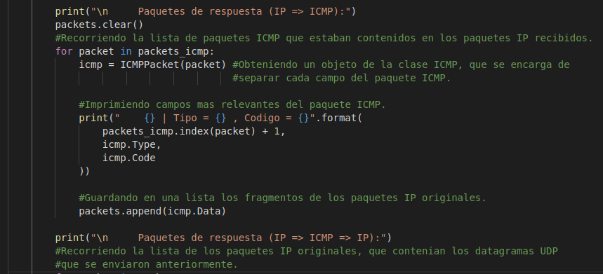
Python3 tracert.py -a 192.168.0.2
VARIABLES GLOBALES:
IP_ADDRESS =
(192.168.0.2, 33434)
Listas:
Timer | packets | Packets _icmp | Packets _udp
0.61 | n Bytes | n Bytes
0.38 | n Bytes | n Bytes
0.32 | n Bytes | n Bytes
SOCKETS:
Socket RAW | Protocolo | IP | Puerto | Time Out
 | ICMP | - | 33434 | 5 seg
Socket UDP | Puerto | TTL | Protocolo
 | - | 1 | UDP

Slide 114
Python3 tracert.py -a 192.168.0.2
VARIABLES GLOBALES:
IP_ADDRESS =
(192.168.0.2, 33434)
Listas:
Timer | packets | Packets _icmp | Packets _udp
0.61 |  | n Bytes
0.38 |  | n Bytes
0.32 |  | n Bytes
SOCKETS:
Socket RAW | Protocolo | IP | Puerto | Time Out
 | ICMP | - | 33434 | 5 seg
Socket UDP | Puerto | TTL | Protocolo
 | - | 1 | UDP

Slide 115
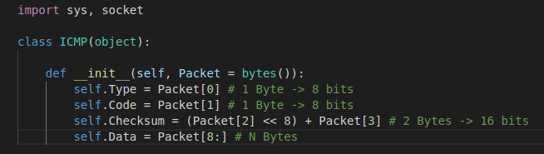
Nuevo Obj. “ICMPPacket”
Packets_icmp[0]
00001011 00000000 11110000 01110100 00000000 00000000 00000000 00000000 01000101 00000000 00000000 00100011 01101010 10011001 01000000 00000000 00000001 00010001 00010011 11011101 11000000 10101000 01111010 00000001 11000000 10101000 00000000 00000010 10001011 00110100 10000010 10011010 00000000 00001111 01100111 01100100 01010100 01110010 01100001 01100011 01100101 01110010 01110100
Tipo = 00001011 (11) →TTL Excedido

Slide 116
Nuevo Obj. “ICMPPacket”
Packets_icmp[0]
00001011 00000000 11110000 01110100 00000000 00000000 00000000 00000000 01000101 00000000 00000000 00100011 01101010 10011001 01000000 00000000 00000001 00010001 00010011 11011101 11000000 10101000 01111010 00000001 11000000 10101000 00000000 00000010 10001011 00110100 10000010 10011010 00000000 00001111 01100111 01100100 01010100 01110010 01100001 01100011 01100101 01110010 01110100
Tipo = 00001011 (11)
Codigo = 00000000 (0)

Slide 117
Nuevo Obj. “ICMPPacket”
Packets_icmp[0]
00001011 00000000 11110000 01110100 00000000 00000000 00000000 00000000 01000101 00000000 00000000 00100011 01101010 10011001 01000000 00000000 00000001 00010001 00010011 11011101 11000000 10101000 01111010 00000001 11000000 10101000 00000000 00000010 10001011 00110100 10000010 10011010 00000000 00001111 01100111 01100100 01010100 01110010 01100001 01100011 01100101 01110010 01110100
Tipo = 00001011 (11)
Codigo = 00000000 (0)
Tipo 11 y Codigo 0 = TTL Excedido.

Slide 118
Nuevo Obj. “ICMPPacket”
Packets_icmp[0]
00001011 00000000 11110000 01110100 00000000 00000000 00000000 00000000 01000101 00000000 00000000 00100011 01101010 10011001 01000000 00000000 00000001 00010001 00010011 11011101 11000000 10101000 01111010 00000001 11000000 10101000 00000000 00000010 10001011 00110100 10000010 10011010 00000000 00001111 01100111 01100100 01010100 01110010 01100001 01100011 01100101 01110010 01110100
Tipo = 00001011 (11)
Codigo = 00000000 (0).
Checksum = 11110000 01110100

Slide 119
Nuevo Obj. “ICMPPacket”
Packets_icmp[0]
00001011 00000000 11110000 01110100 00000000 00000000 00000000 00000000 01000101 00000000 00000000 00100011 01101010 10011001 01000000 00000000 00000001 00010001 00010011 11011101 11000000 10101000 01111010 00000001 11000000 10101000 00000000 00000010 10001011 00110100 10000010 10011010 00000000 00001111 01100111 01100100 01010100 01110010 01100001 01100011 01100101 01110010 01110100
Tipo = 00001011 (11)
Codigo = 00000000 (0)
Checksum = 11110000 01110100
4 Bytes (32 bits) no utilizados.

Slide 120
Python3 tracert.py -a 192.168.0.2
VARIABLES GLOBALES:
IP_ADDRESS =
(192.168.0.2, 33434)
Listas:
Timer | packets | Packets _icmp | Packets _udp
0.61 |  | n Bytes
0.38 |  | n Bytes
0.32 |  | n Bytes
SOCKETS:
Socket RAW | Protocolo | IP | Puerto | Time Out
 | ICMP | - | 33434 | 5 seg
Socket UDP | Puerto | TTL | Protocolo
 | - | 1 | UDP

Slide 121
Python3 tracert.py -a 192.168.0.2

Slide 122
Python3 tracert.py -a 192.168.0.2
VARIABLES GLOBALES:
IP_ADDRESS =
(192.168.0.2, 33434)
Listas:
Timer | packets | Packets _icmp | Packets _udp
0.61 |  | n Bytes
0.38 |  | n Bytes
0.32 |  | n Bytes
SOCKETS:
Socket RAW | Protocolo | IP | Puerto | Time Out
 | ICMP | - | 33434 | 5 seg
Socket UDP | Puerto | TTL | Protocolo
 | - | 1 | UDP

Slide 123
Python3 tracert.py -a 192.168.0.2
VARIABLES GLOBALES:
IP_ADDRESS =
(192.168.0.2, 33434)
Listas:
Timer | packets | Packets _icmp | Packets _udp
0.61 | n Bytes | n Bytes
0.38 |  | n Bytes
0.32 |  | n Bytes
SOCKETS:
Socket RAW | Protocolo | IP | Puerto | Time Out
 | ICMP | - | 33434 | 5 seg
Socket UDP | Puerto | TTL | Protocolo
 | - | 1 | UDP

Slide 124
Python3 tracert.py -a 192.168.0.2
VARIABLES GLOBALES:
IP_ADDRESS =
(192.168.0.2, 33434)
Listas:
Timer | packets | Packets _icmp | Packets _udp
0.61 | n Bytes | n Bytes
0.38 | n Bytes | n Bytes
0.32 | n Bytes | n Bytes
SOCKETS:
Socket RAW | Protocolo | IP | Puerto | Time Out
 | ICMP | - | 33434 | 5 seg
Socket UDP | Puerto | TTL | Protocolo
 | - | 1 | UDP

Slide 125
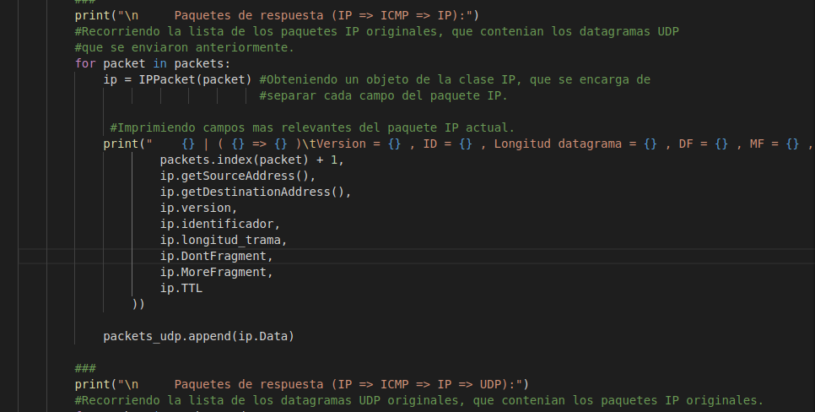
Python3 tracert.py -a 192.168.0.2
VARIABLES GLOBALES:
IP_ADDRESS = (192.168.0.2, 33434)
Listas:
Timer | packets | Packets _icmp | Packets _udp
0.61 | n Bytes | n Bytes
0.38 | n Bytes | n Bytes
0.32 | n Bytes | n Bytes
SOCKETS:
Socket RAW | Protocolo | IP | Puerto | Time Out
 | ICMP | - | 33434 | 5 seg
Socket UDP | Puerto | TTL | Protocolo
 | - | 1 | UDP

Slide 126
Python3 tracert.py -a 192.168.0.2
VARIABLES GLOBALES:
IP_ADDRESS = (192.168.0.2, 33434)
Listas:
Timer | packets | Packets _icmp | Packets _udp
0.61 | n Bytes | n Bytes
0.38 | n Bytes | n Bytes
0.32 | n Bytes | n Bytes
SOCKETS:
Socket RAW | Protocolo | IP | Puerto | Time Out
 | ICMP | - | 33434 | 5 seg
Socket UDP | Puerto | TTL | Protocolo
 | - | 1 | UDP

Slide 127
Python3 tracert.py -a 192.168.0.2

Slide 128
Python3 tracert.py -a 192.168.0.2
VARIABLES GLOBALES:
IP_ADDRESS = (192.168.0.2, 33434)
Listas:
Timer | packets | Packets _icmp | Packets _udp
0.61 | n Bytes | n Bytes
0.38 | n Bytes | n Bytes
0.32 | n Bytes | n Bytes
SOCKETS:
Socket RAW | Protocolo | IP | Puerto | Time Out
 | ICMP | - | 33434 | 5 seg
Socket UDP | Puerto | TTL | Protocolo
 | - | 1 | UDP

Slide 129
Python3 tracert.py -a 192.168.0.2
VARIABLES GLOBALES:
IP_ADDRESS = (192.168.0.2, 33434)
Listas:
Timer | packets | Packets _icmp | Packets _udp
0.61 | n Bytes | n Bytes | n Bytes
0.38 | n Bytes | n Bytes
0.32 | n Bytes | n Bytes
SOCKETS:
Socket RAW | Protocolo | IP | Puerto | Time Out
 | ICMP | - | 33434 | 5 seg
Socket UDP | Puerto | TTL | Protocolo
 | - | 1 | UDP

Slide 130
Python3 tracert.py -a 192.168.0.2
VARIABLES GLOBALES:
IP_ADDRESS = (192.168.0.2, 33434)
Listas:
Timer | packets | Packets _icmp | Packets _udp
0.61 | n Bytes | n Bytes | n Bytes
0.38 | n Bytes | n Bytes | n Bytes
0.32 | n Bytes | n Bytes | n Bytes
SOCKETS:
Socket RAW | Protocolo | IP | Puerto | Time Out
 | ICMP | - | 33434 | 5 seg
Socket UDP | Puerto | TTL | Protocolo
 | - | 1 | UDP

Slide 131
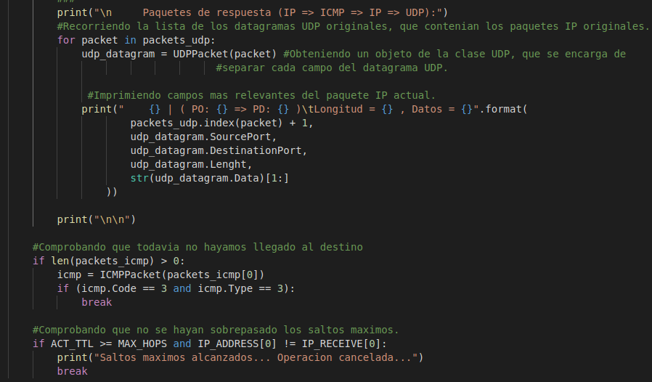
Python3 tracert.py -a 192.168.0.2
VARIABLES GLOBALES:
IP_ADDRESS = (192.168.0.2, 33434)
IP_RECEIVE =
(192.168.122.2, 0)
MAX_HOPS = 30
ACT_TTL = 1
Listas:
Timer | packets | Packets _icmp | Packets _udp
0.61 | n Bytes | n Bytes | n Bytes
0.38 | n Bytes | n Bytes | n Bytes
0.32 | n Bytes | n Bytes | n Bytes
SOCKETS:
Socket RAW | Protocolo | IP | Puerto | Time Out
 | ICMP | - | 33434 | 5 seg

Slide 132
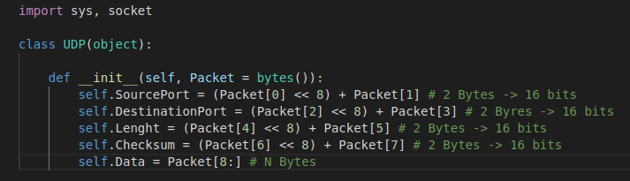
Nuevo Obj. “UDPPacket”
Packets_udp[0]
10001011 00110100 10000010 10011010 00000000 00001111 01100111 01100100 01010100 01110010 01100001 01100011 01100101 01110010 01110100
Puerto origen: 39047

Slide 133
Nuevo Obj. “UDPPacket”
Packets_udp[0]
10001011 00110100 10000010 10011010 00000000 00001111 01100111 01100100 01010100 01110010 01100001 01100011 01100101 01110010 01110100
Puerto origen = 39047
Puerto destino = 33434

Slide 134
Nuevo Obj. “UDPPacket”
Packets_udp[0]
10001011 00110100 10000010 10011010 00000000 00001111 01100111 01100100 01010100 01110010 01100001 01100011 01100101 01110010 01110100
Puerto origen = 39047
Puerto destino = 33434
Longitud = 15

Slide 135
Nuevo Obj. “UDPPacket”
Packets_udp[0]
10001011 00110100 10000010 10011010 00000000 00001111 01100111 01100100 01010100 01110010 01100001 01100011 01100101 01110010 01110100
Puerto origen = 39047
Puerto destino = 33434
Longitud = 15

Slide 136
Python3 tracert.py -a 192.168.0.2
VARIABLES GLOBALES:
IP_ADDRESS = (192.168.0.2, 33434)
IP_RECEIVE =
(192.168.122.2, 0)
MAX_HOPS = 30
ACT_TTL = 1
Listas:
Timer | packets | Packets _icmp | Packets _udp
0.61 | n Bytes | n Bytes | n Bytes
0.38 | n Bytes | n Bytes | n Bytes
0.32 | n Bytes | n Bytes | n Bytes
SOCKETS:
Socket RAW | Protocolo | IP | Puerto | Time Out
 | ICMP | - | 33434 | 5 seg

Slide 138
This work is licensed under a Creative Commons Attribution-ShareAlike 3.0 Unported License.
It makes use of the works of
Kelly Loves Whales and Nick Merritt.

