Slide 1
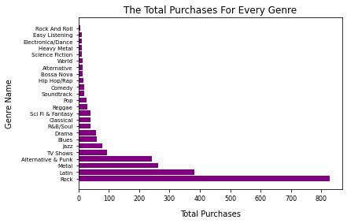
The Total Purchases For Every Genre
<visualization>
We can see from this figure the total purchases for every genre and notice that Rock is the most popular genre.

Slide 2
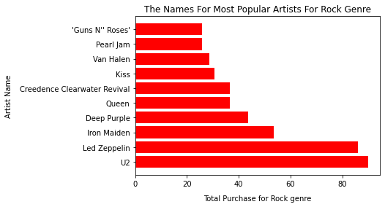
The Names For Most Popular Artists For Rock Genre
<visualization>
Now in this figure we have the top 10 artists for rock genre and notice U2 is the most popular artist for rock genre.

Slide 3
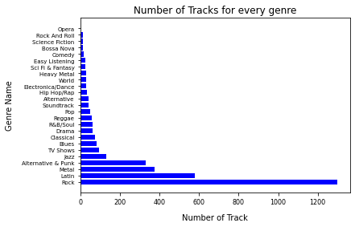
Number of Tracks for every genre
<visualization>
We saw number of tracks that are made for every genre of music and Rock is the most type is made.

Slide 4
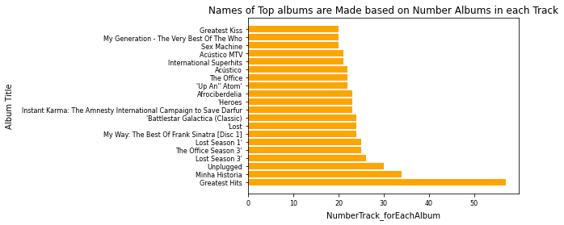
Names of Top made albums based on Number Albums in each Track
<visualization>
Here there are figure that explains title of each album in each tracks and notice Greatest Hits is the most popular based number of this albums in each tracks

