Slide 1

Wafrly AI ✈️
AI-Powered Travel Cost Estimator & Flight Intelligence System
Team Members:
Ahmed Mohamed Tarek (225119)
Omar Mohamed Ahmed (249153)
Mohamed Ramadan (247247)
Youssef Tarek (240190)
Ibrahim Hafez (247403)
Instructors:
Dr. Motaaz
Eng. Sohaila Ashraf
Course: CS313x Spring 2026
"Find smarter flights. Predict prices. Travel better."

Slide 2

The Problem
Modern air travel generates an overwhelming volume of pricing data — yet travelers have almost no intelligent tools to interpret it.
Unpredictable Prices
Fares fluctuate constantly with no clear signals indicating whether today's price is a good deal.
Time-Consuming Comparisons
Comparing airlines, routes, and departure windows manually is slow and error-prone.
No Price Context
Travelers lack data-driven benchmarks to classify a fare as low, fair, or expensive.
Missing Insights
Passenger sentiment and historical trends are rarely surfaced at the point of booking.

Slide 3
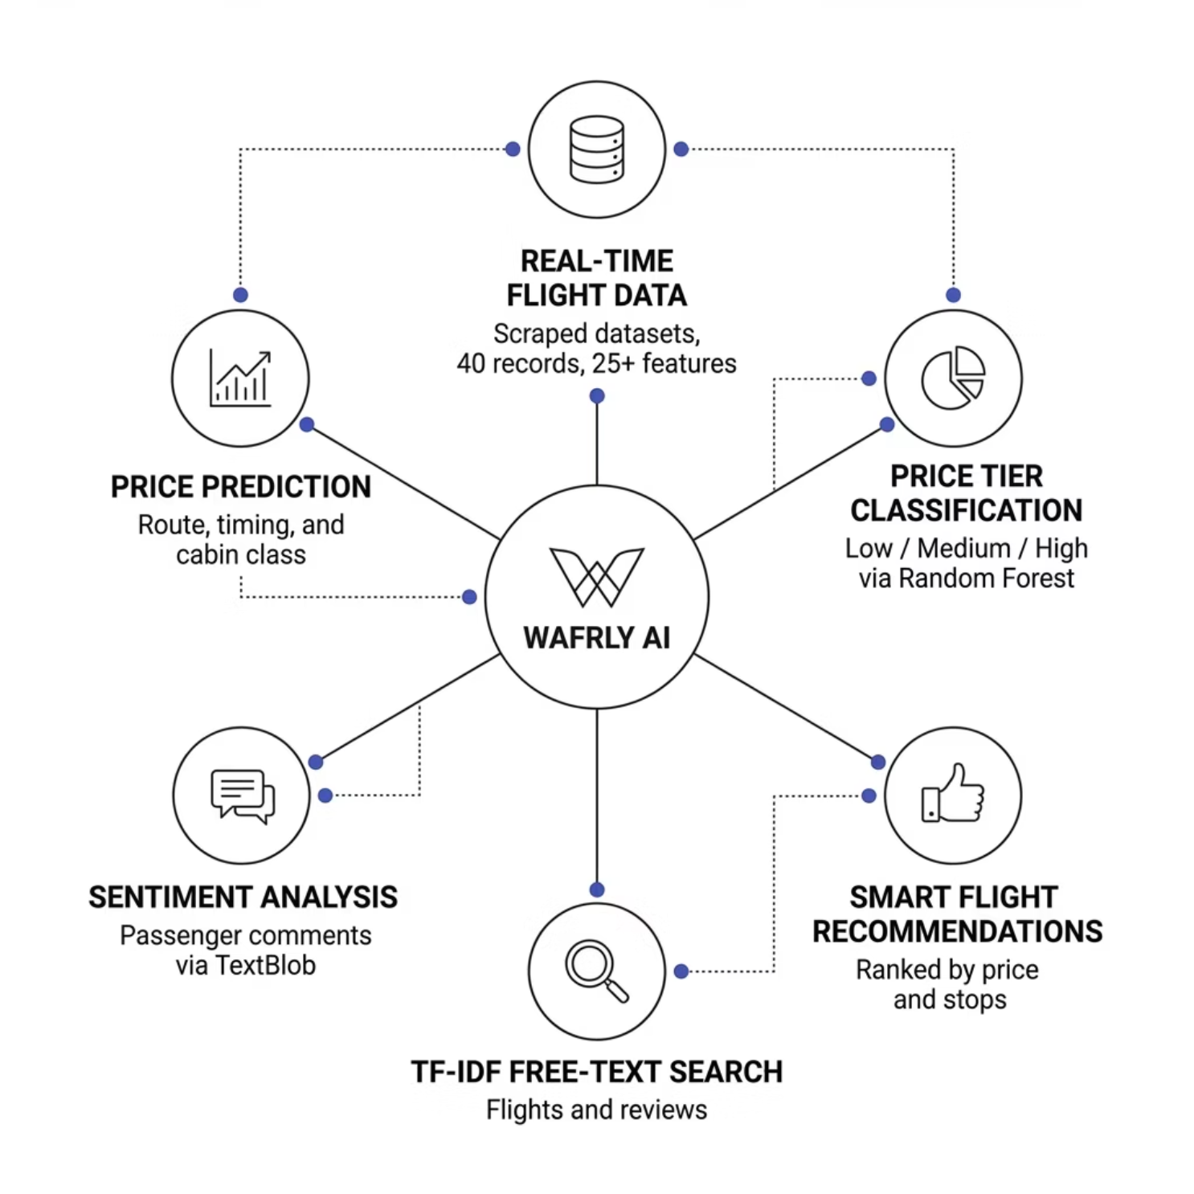

Our Solution — Wafrly AI
A full-stack intelligent flight search and price estimation system that transforms raw data into actionable travel intelligence.
What Wafrly Delivers
Real-time flight data from scraped booking platforms
AI-powered price tier classification: Low / Medium / High
Smart recommendations ranked by price and stops
TF-IDF free-text search across flights and reviews
Sentiment analysis on passenger comments
Price prediction based on route, timing, and cabin class

Slide 4

System Architecture
Wafrly uses a clean two-tier architecture — a Python Flask backend serves all AI logic, while a React + Vite frontend delivers an interactive dashboard UI.
React UI
7-page interactive dashboard
Three-node System Architecture
Dataset & AI Models
Flask REST API
Excel data, RF, TF-IDF, TextBlob
Python backend with 9 endpoints
The system covers four international routes — CAI ↔ ICN and CAI ↔ PAR — across eight major airlines including Emirates, Qatar Airways, Air France, and Turkish Airlines.

Slide 5

Data Collection & Feature Engineering
Dataset Overview
Scraped real flight data from booking platforms (May 2026)
40 flight records × 25 columns
Price range: $169 – $1,194 USD
Cleaned and enriched in Jupyter Notebook
10 Engineered Features
price_tier — classification target (Low / Medium / High)
price_per_min — efficiency metric ($/minute)
departure_hour + time_of_day — temporal signals
is_weekend + is_nonstop — binary flags
cabin_numeric, provider_savings, route_popularity, text_summary

Slide 6

AI & Machine Learning Features
Three intelligent components power Wafrly's core capabilities.
Random Forest Classifier
TF-IDF Information Retrieval
Sentiment Analysis (TextBlob)
Classifies flights into price tiers (Low / Medium / High) using duration, stops, cabin class, and departure timing. Evaluated with accuracy, F1-score, precision, and recall.
Free-text search engine across flights and passenger comments. Ranks results by cosine similarity. Top keywords: economy, nonstop, morning, China Eastern.
Analyzes passenger reviews and classifies them as Positive, Neutral, or Negative. Returns polarity scores from 0–100 for fine-grained sentiment tracking.

Slide 7
REST API — 9 Intelligent Endpoints
GET /api/health
Server status & record count
GET /api/stats
Full dataset statistics
GET /api/insights
Key route & airline insights
GET /api/recommend
Ranked flight recommendations
GET /api/search?q=...
TF-IDF free-text search
POST /api/predict
AI price prediction (ML model)
GET /api/flights
Paginated, filterable flight table
GET /api/keywords
Top TF-IDF keywords
POST /api/sentiment
Sentiment analysis on any text

Slide 8
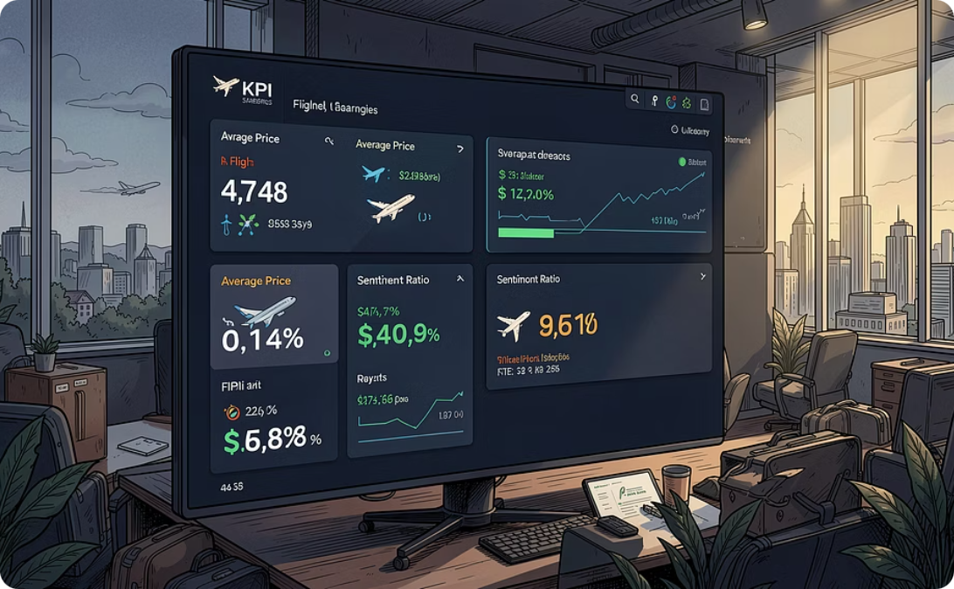
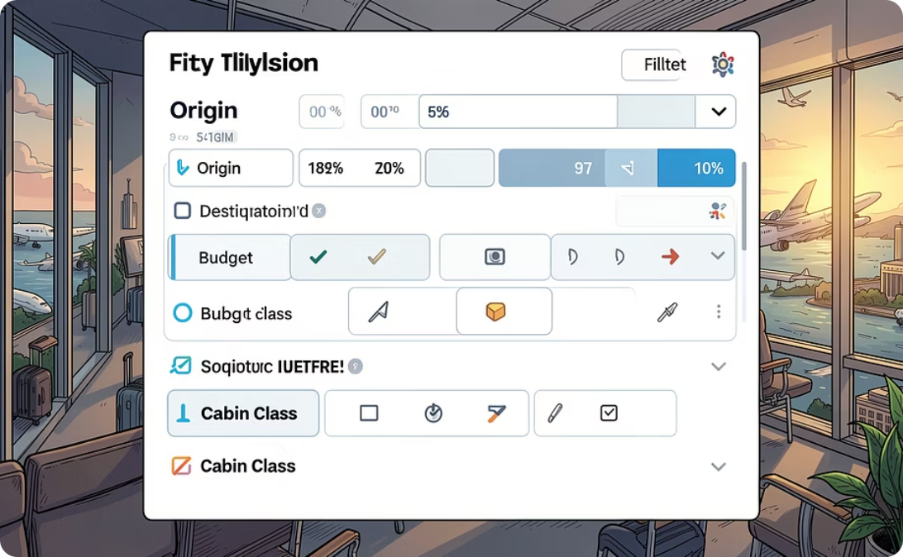
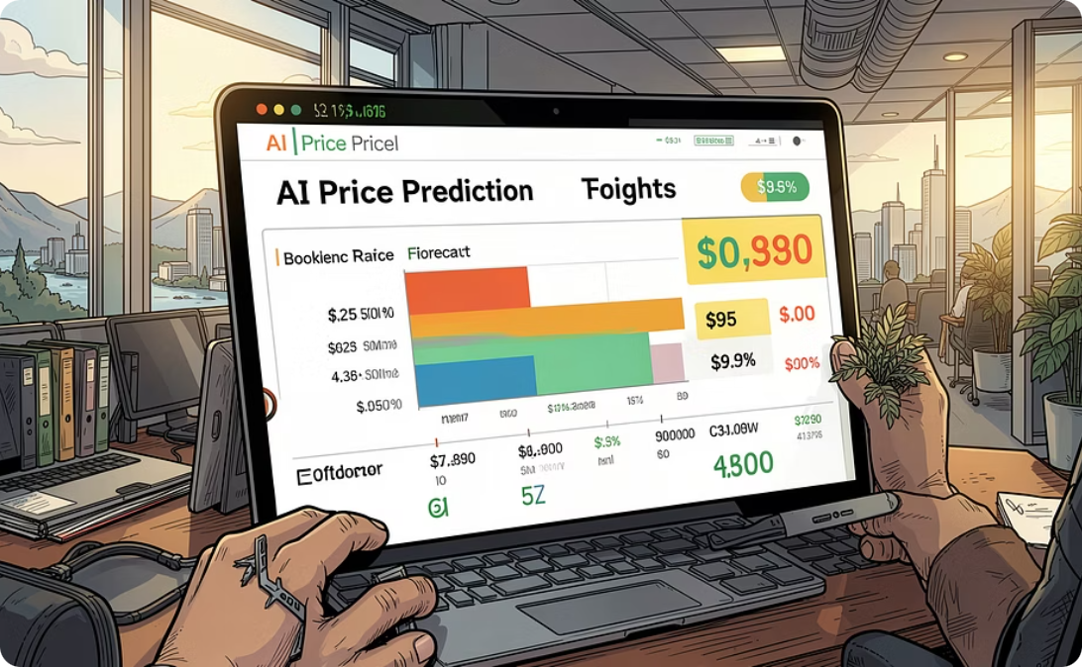
Interactive Web Dashboard
A 7-page React application delivering a complete travel intelligence experience — from KPI overviews to real-time AI predictions.
Dashboard & Explorer
Recommend & Search
Predict & Sentiment
KPI overview: total flights, avg price, top destination, sentiment ratio. Airline performance breakdown with route-level metrics.
Filter by origin, destination, budget, and cabin class. TF-IDF free-text search across flights and passenger reviews.
AI price forecasting with confidence bounds. Real-time sentiment tester for passenger comments. TF-IDF keyword word cloud.

Slide 9

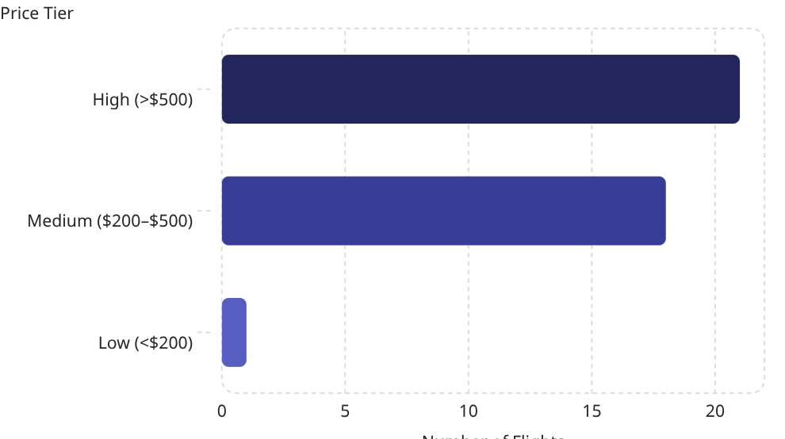
AI Price Prediction — How It Works
Wafrly's prediction model applies time-based pricing factors to estimate future fares with confidence bounds.
60+ Days
7 Days
20% discount applied
12% time-based premium
14–30 Days
Under 7 Days
Standard base price
30% last-minute premium
Pricing factors are applied sequentially based on how far in advance the traveler books, with deeper discounts for early bookings and premiums for last-minute purchases.
Example: CAI → ICN
Booking 30 days ahead → ~$520
Confidence range: $426 – $614
Key Findings
Most popular route: CAI → ICN (Cairo to Seoul)
Majority of flights classified as "High" tier (>$500)
Nonstop flights command premium pricing
Morning departures carry ~15% price premium
Weekend travel averages 8% more than weekdays
Best booking window: 30–45 days in advance

Slide 10

Evaluation, Results & Tech Stack
Model Evaluation
Technologies Used
Random Forest Classifier
Backend
Python · Flask · Flask-CORS · Pandas · NumPy · scikit-learn · TextBlob · openpyxl
Frontend
React 18 · Vite · Vanilla CSS · JavaScript ES6+
Data
Excel datasets · Jupyter Notebook · 40 records × 25 features
Stratified K-Fold cross-validation
Metrics: Accuracy, F1-Score (weighted), Precision, Recall
Confusion Matrix visualized
TF-IDF Search
Cosine similarity ranking quality
Top keywords: economy, nonstop, morning, CAI, ICN
Sentiment Analysis
Wafrly AI demonstrates a complete, production-ready pipeline — from raw scraped data to intelligent, user-facing predictions.
Validated against manual labeling
TextBlob polarity benchmarking

