Slide 1
Intelligent Imaging Insight Integration (i²)²
Eren Yilmaz

Slide 2
Goal
Deploying medical image processing tools
Interfaces for connecting python to PACS systems
Testing with existing AI algorithms

Slide 3
How?
All clinical systems speak „DICOM“
Picture Archiving
and Communcation System
(PACS)
DICOM
Python Framework
Image Processing Tool 1
Image Processing Tool 1
Image Viewer

Slide 4
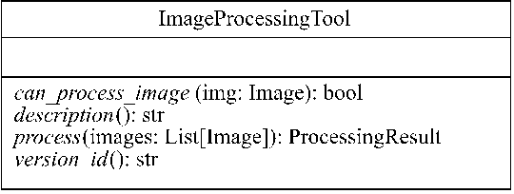
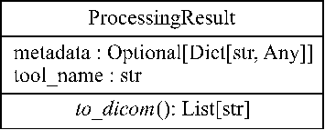
Integrating more AI tools

