Slide 1
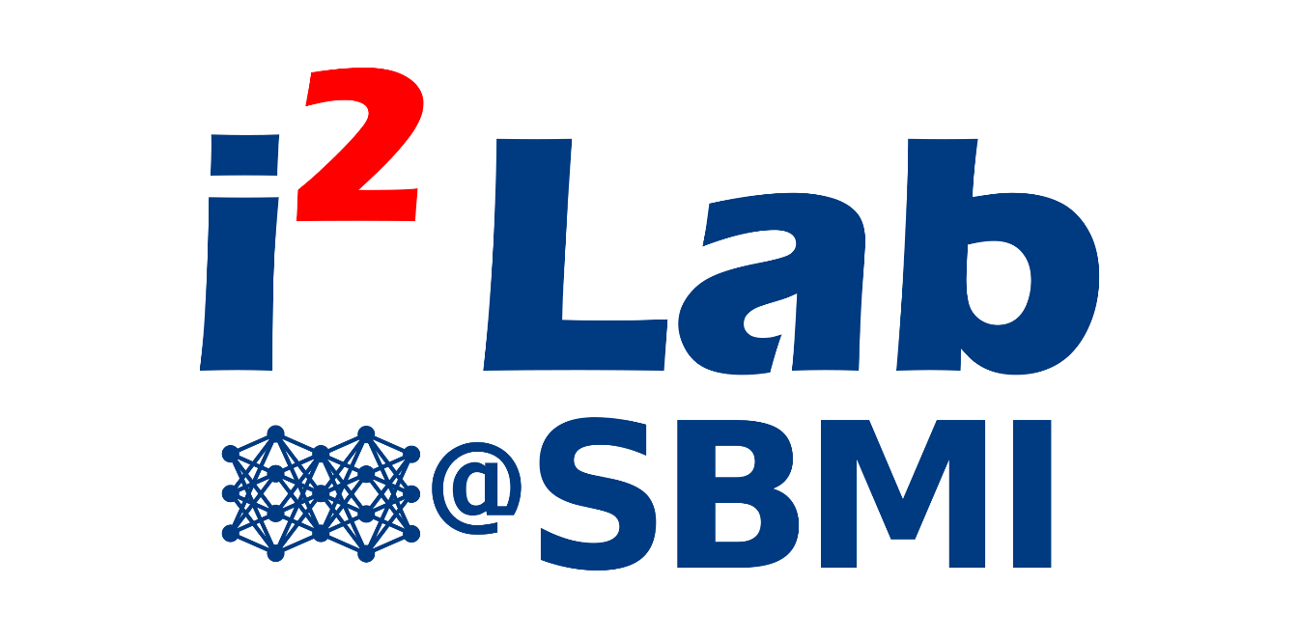

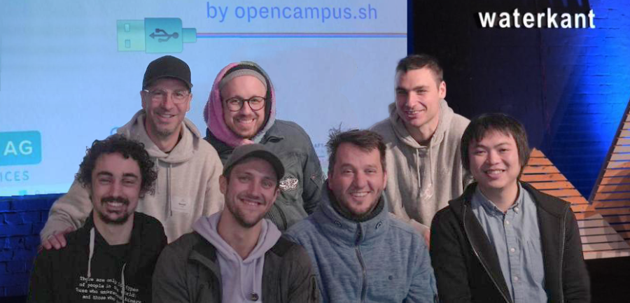
AI/ML Imaging Tool Deployment in clinical IT infrastructure

Slide 2
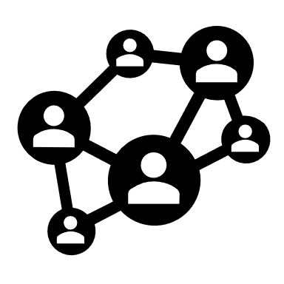





Motivation
i2lab is developing different AI models for imaging radiology – with national and international partners
Our AI models can detect caries or severity of vertebral fractures to support clinicians
There are many different AI models for medical applications – getting it into the clinic is the challenge we want to tackle
Notes:
Bringing AI "out of the lab and into the clinic" is a major challenge, particularly with regard to data protection requirements and ethical and user-specific hurdles. Simple and secure integration into the existing IT infrastructure of clinics is needed so that the AI tools developed can also be used in the clinic and serve as an assistant to doctors and radiologists. The aim of the 5-day hackathon is to tackle this problem outside of research and to develop possible solutions within the secure infrastructure of the UKSH. To this end, we are constructing a test

Slide 3
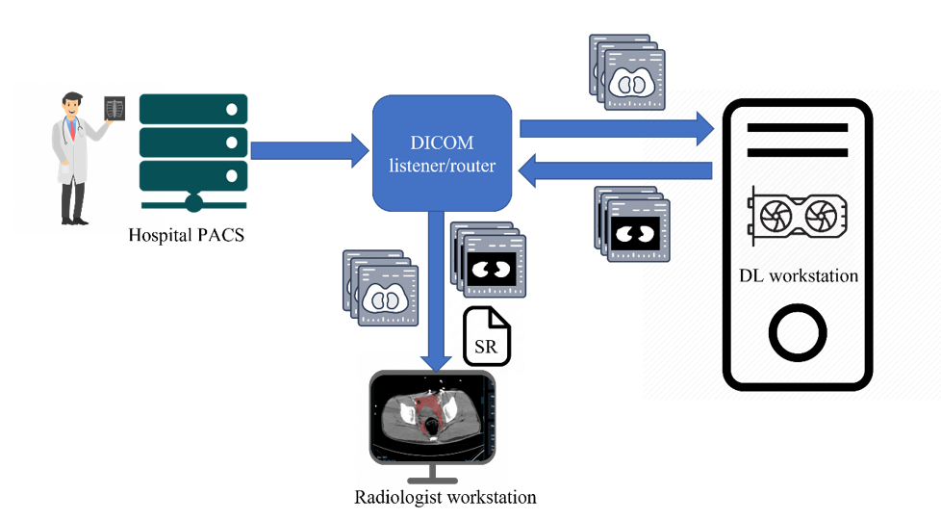
Our starting point
Inspired from a recent journal article on deploying AI in clinical workflow.
A vendor-agnostic, PACS integrated, and DICOM-compatible software-server pipeline for testing segmentation algorithms within the clinical radiology workflow.

Slide 4
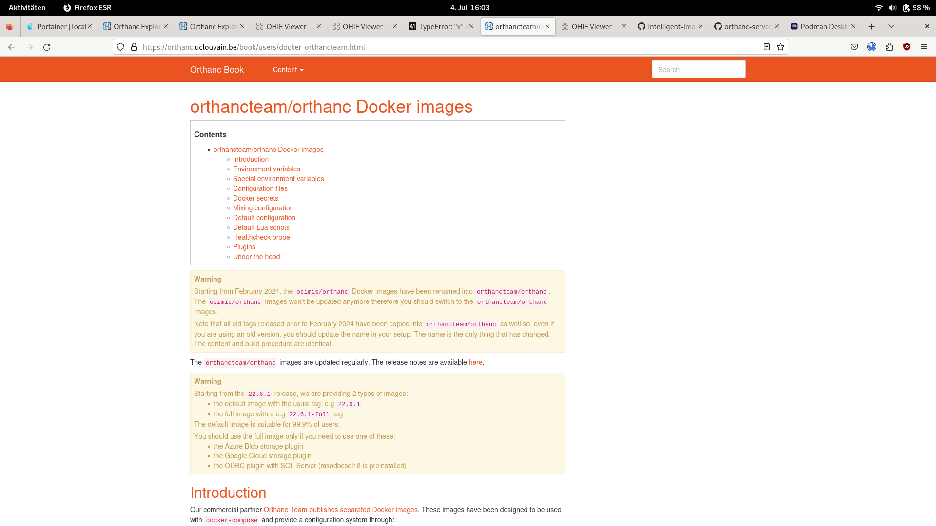
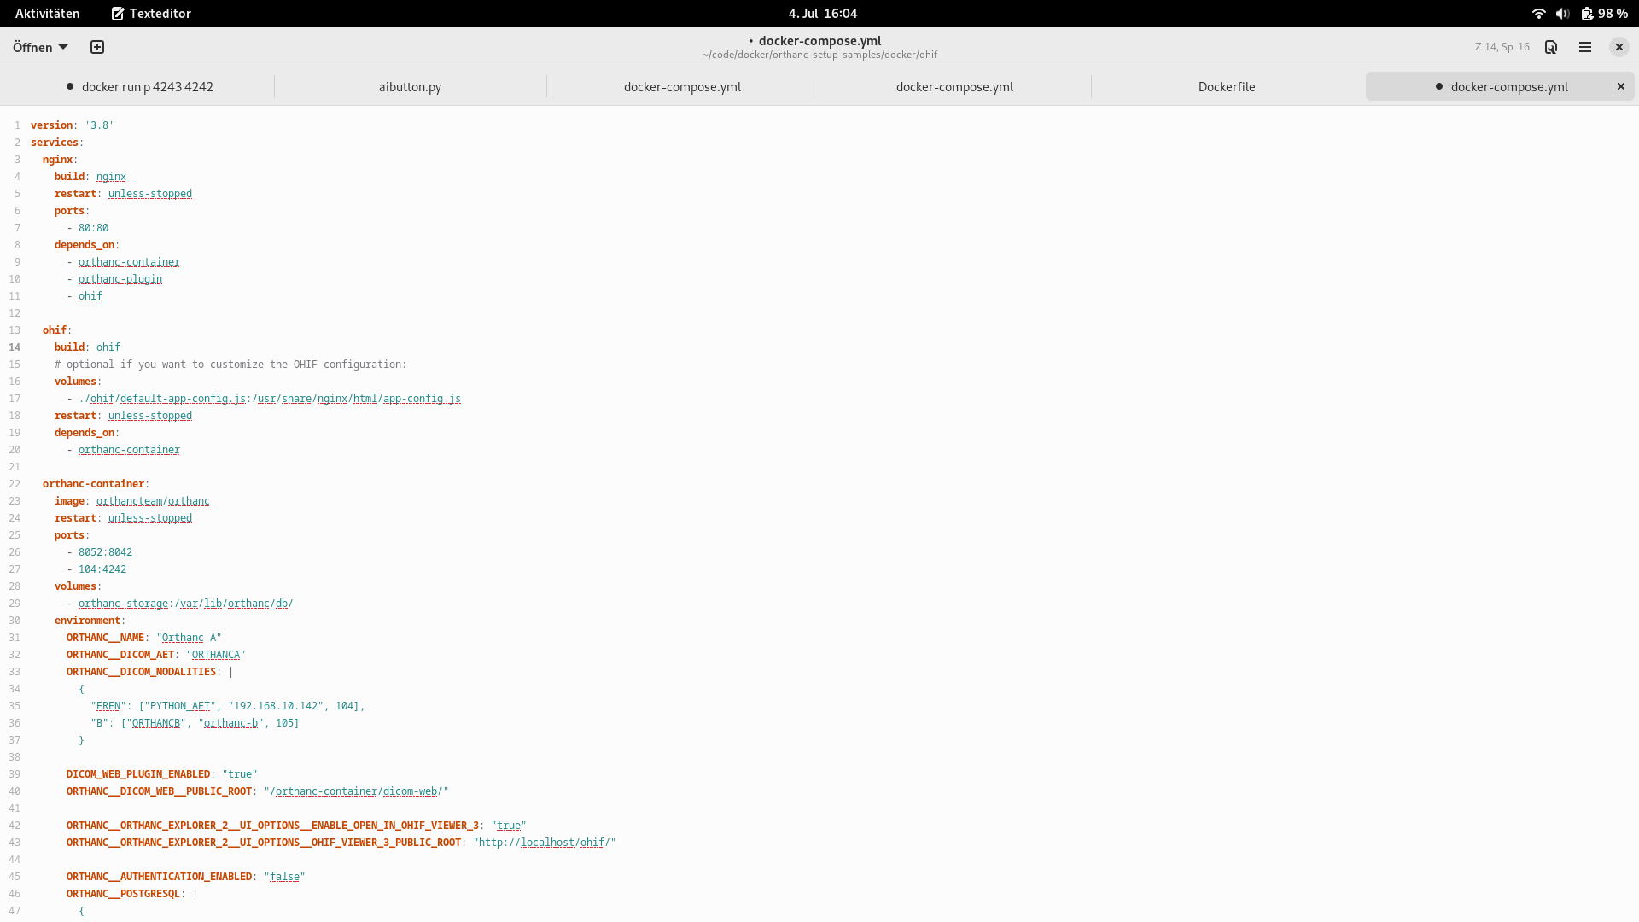
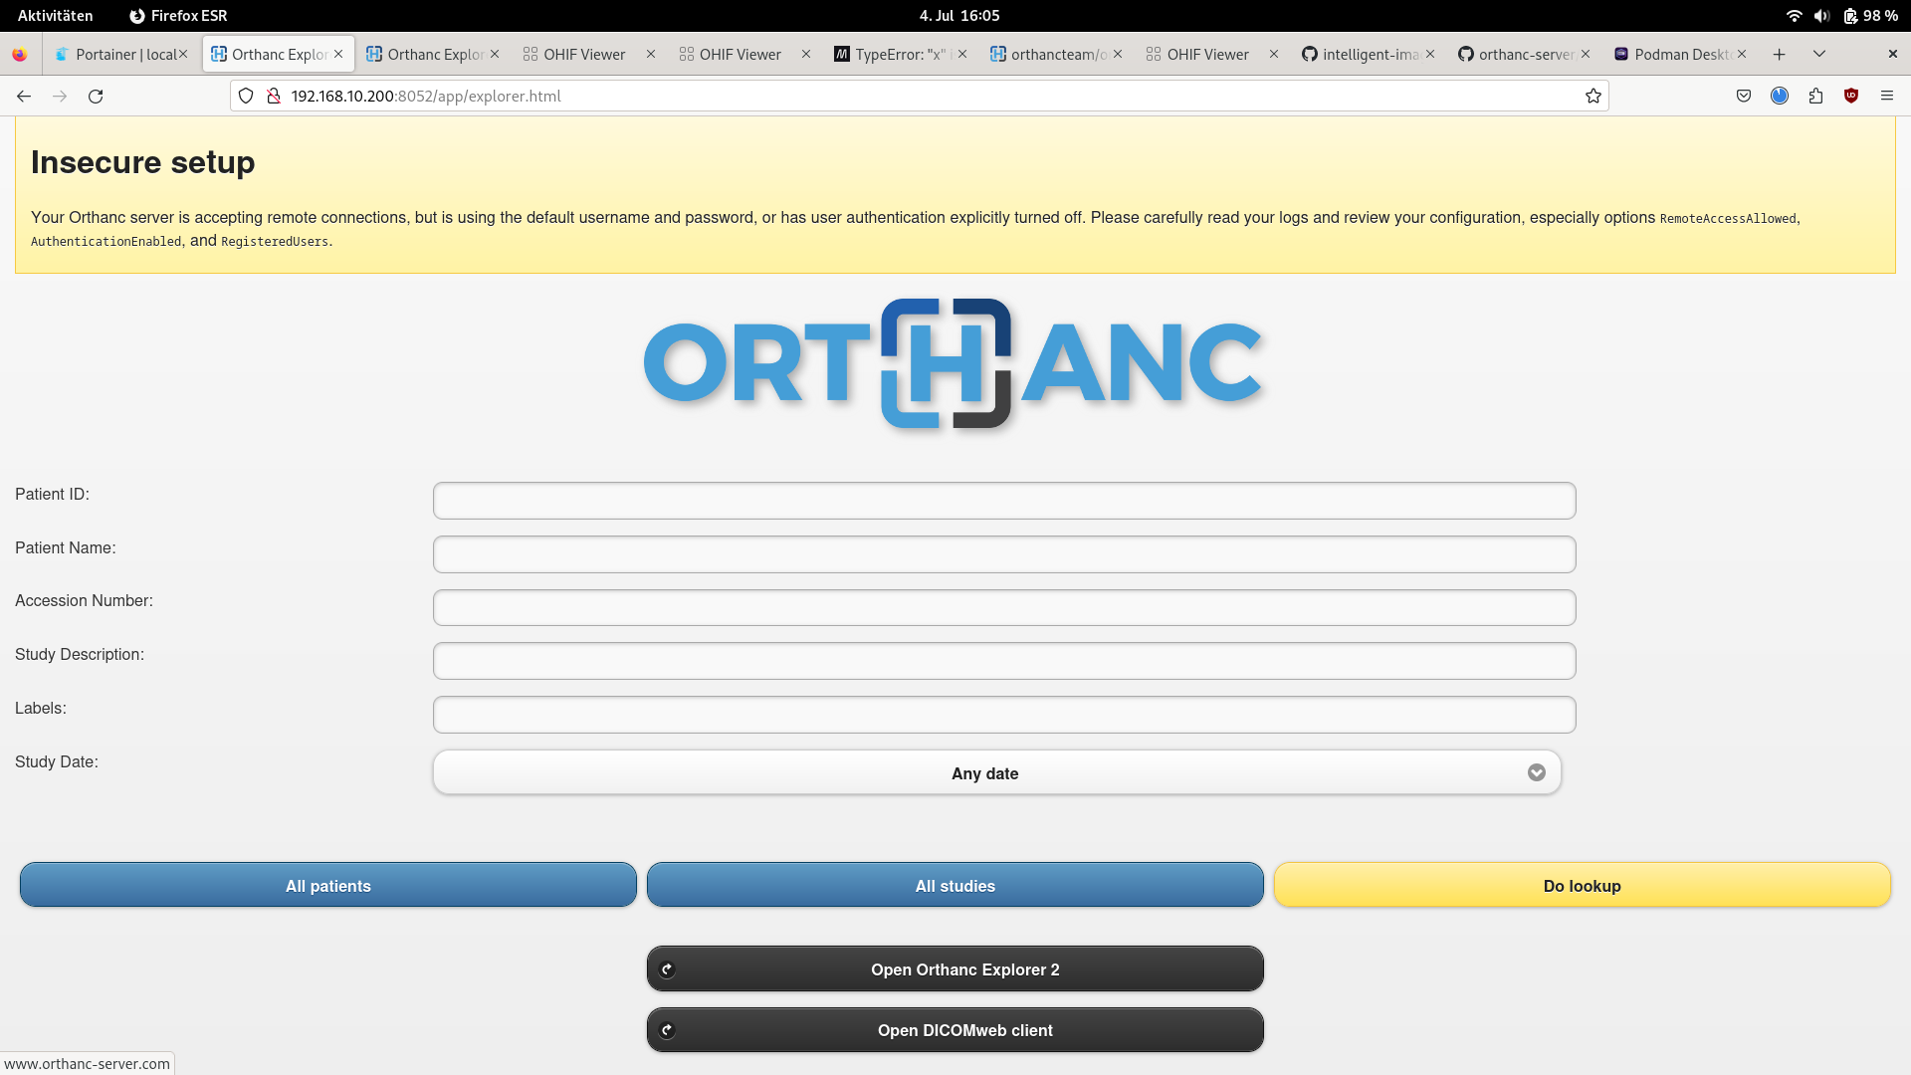
Creating a copy of a PACS user interface
Picture archiving and communication system (PACS) are primarily used in healthcare organizations to securely store images and clinically-relevant reports.

Slide 5
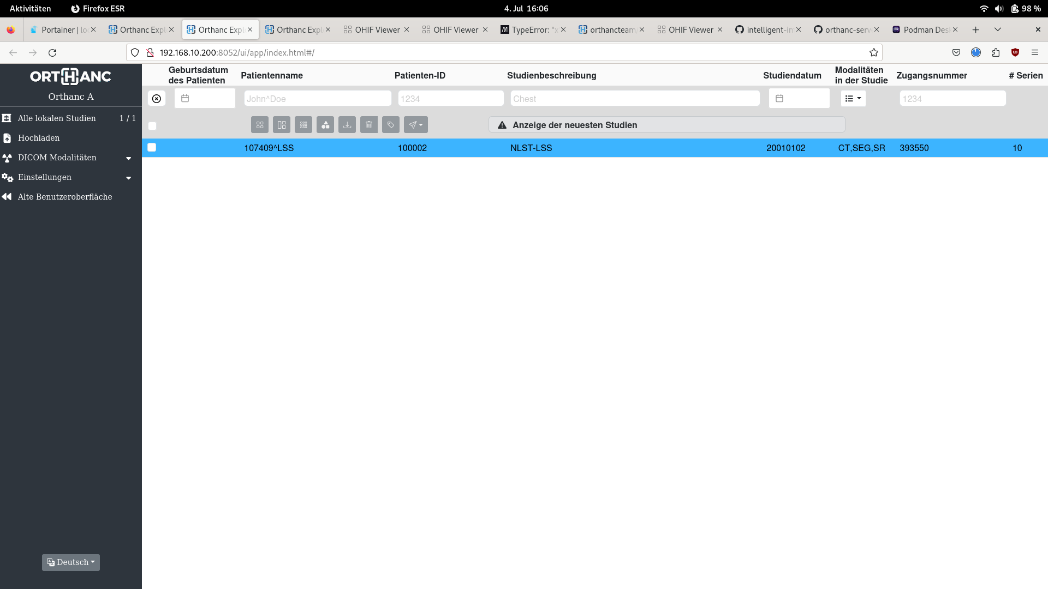
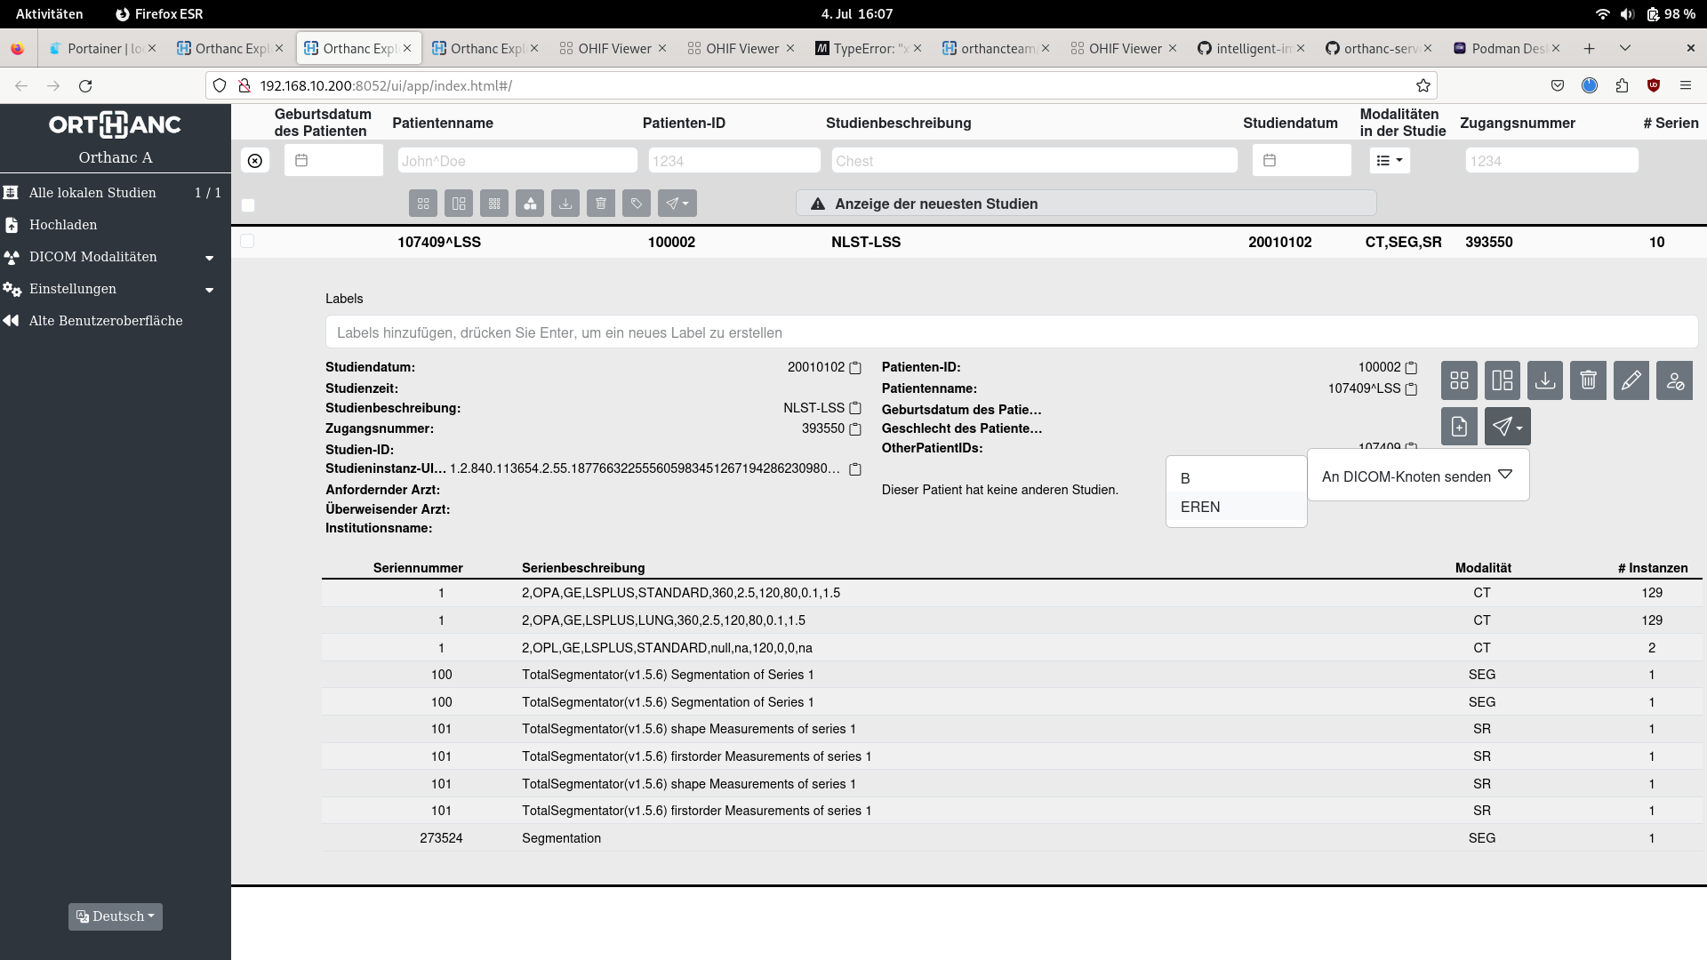
Selecting patient study and data
PACS web-interface in Explorer 2
Patient data without segmentation
Patient data without segmentation

Slide 6
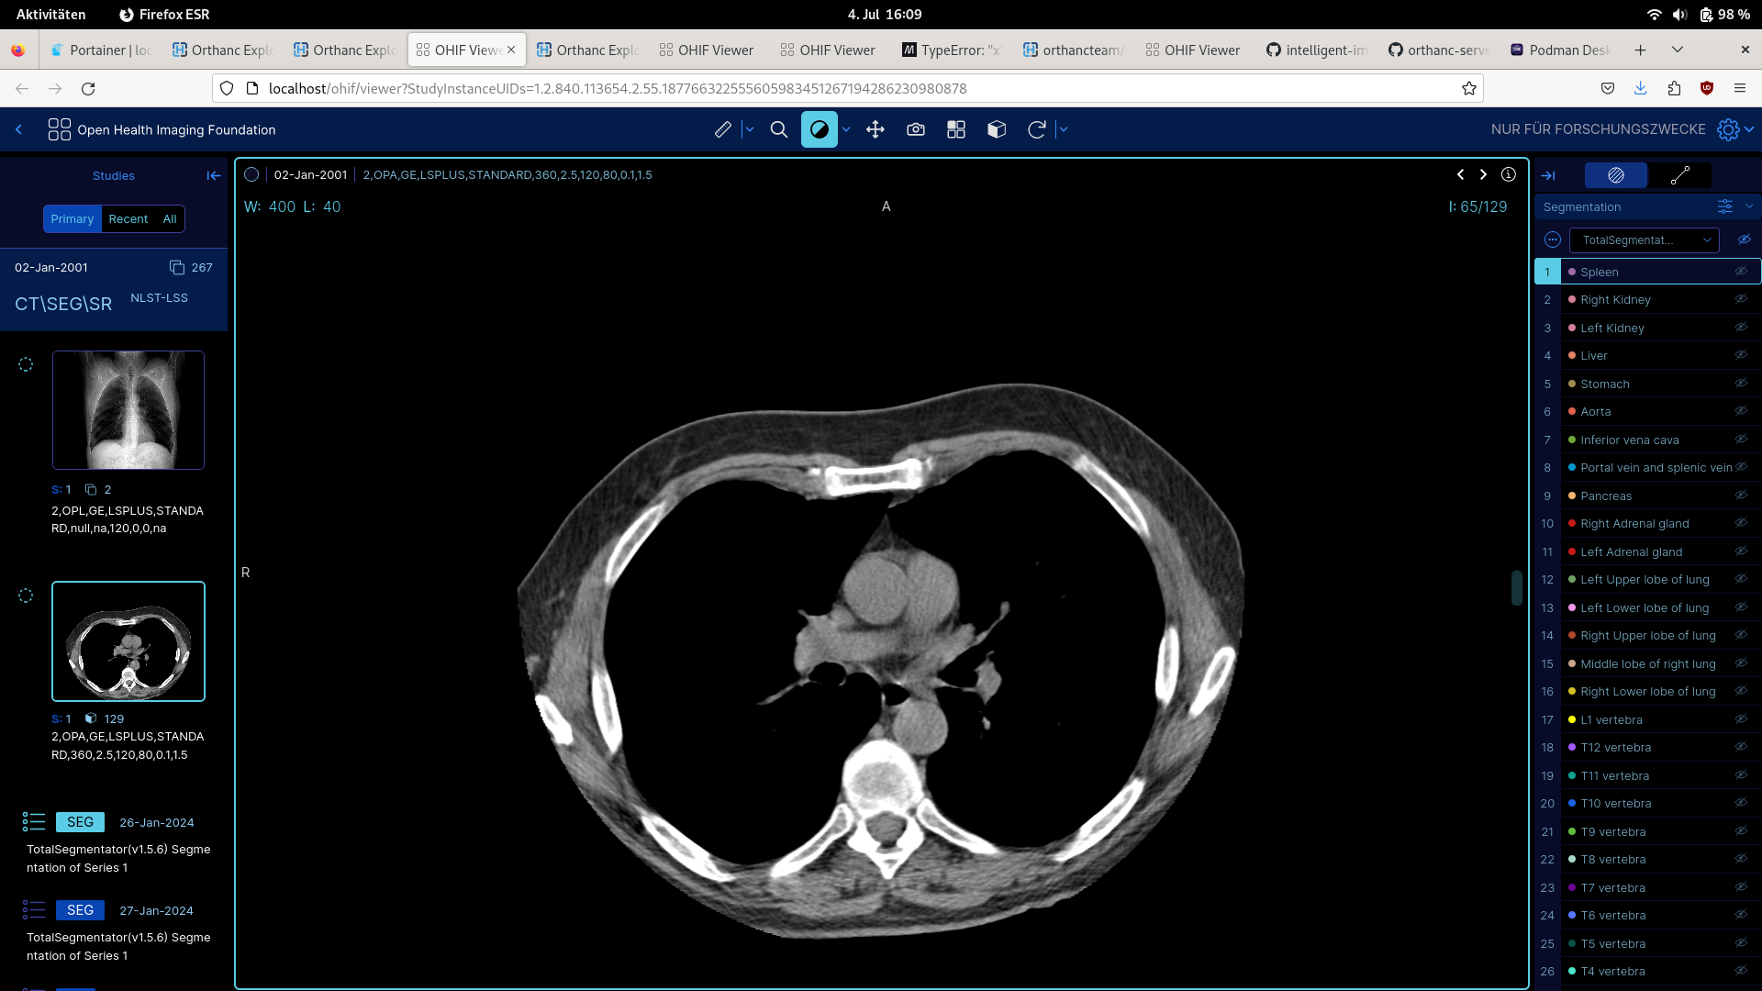
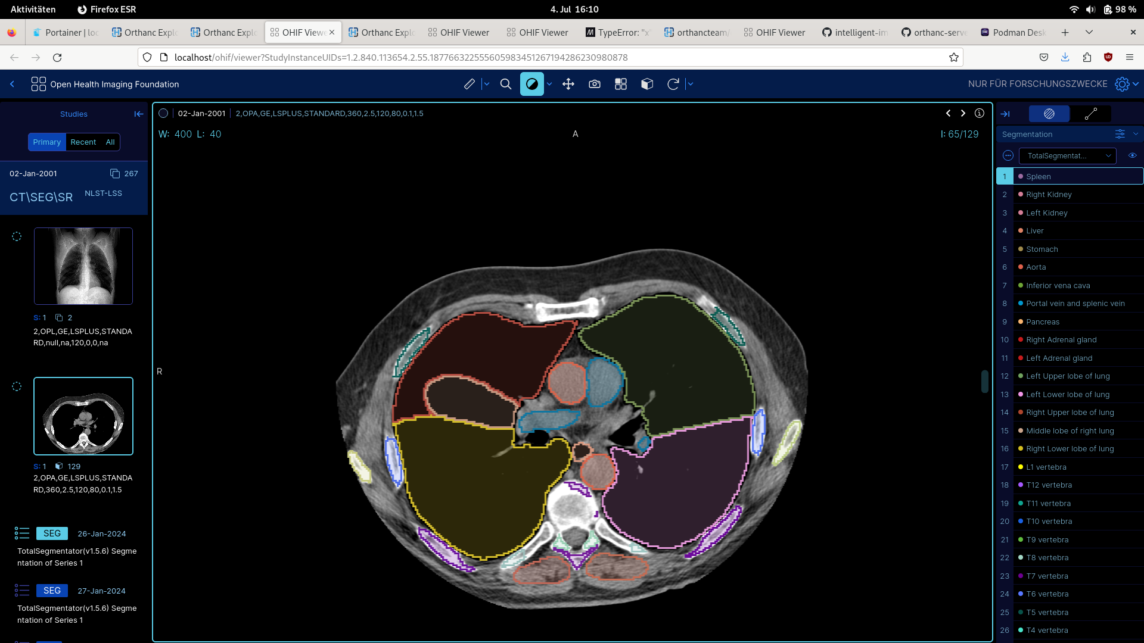
Image data
Visualization of the patient’s image data in the OHIF Viewer, startet via the PACS web-interface
3D volume without segmentation
3D volume with segmentation

Slide 7
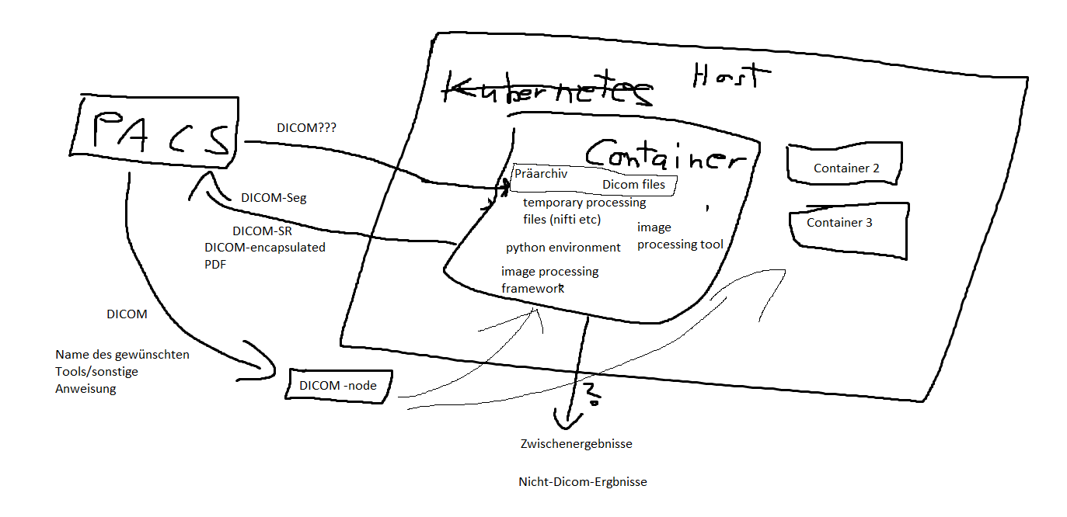

Slide 8






AI tool integration
ImageProcessingTool
ProcessingResult
can_process_image()
description()
metadata
tool_name
process()
version_id()
to_dicom()

Slide 9


Outlook and Challenges
Successful deployment of AI into our test environment
Converting AI outputs into DICOM data format
Test in clinic / PDF to DICOM / Integrate more AI models

