Slide 1
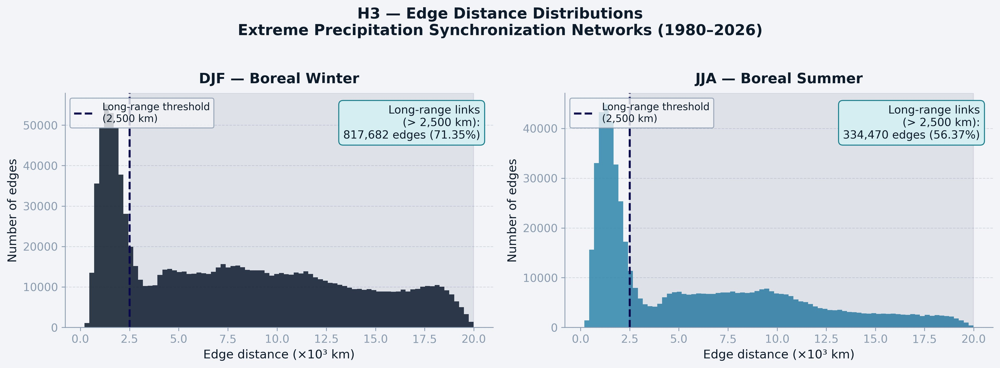
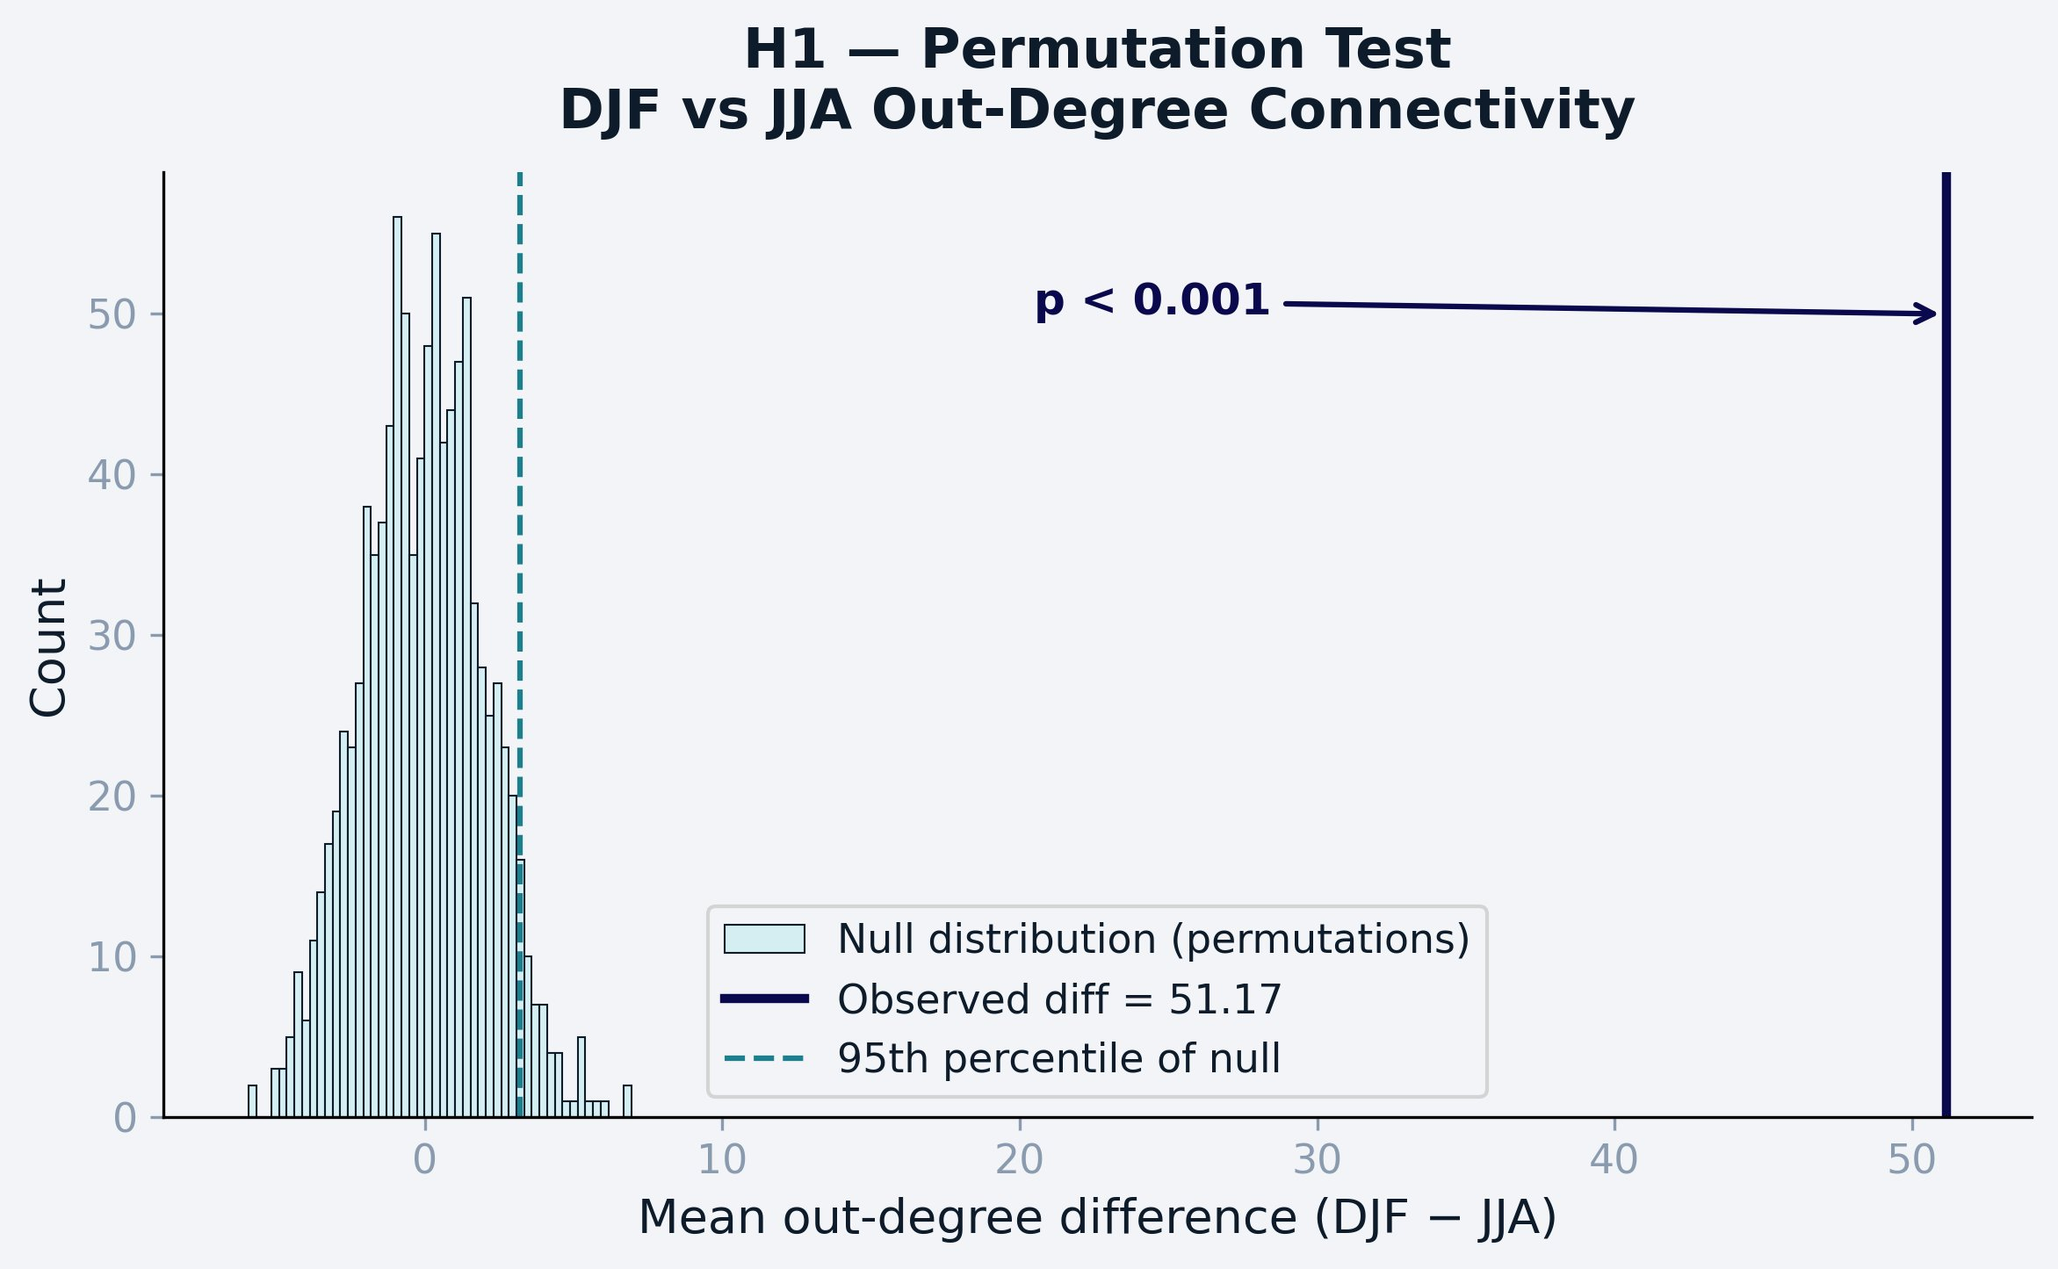
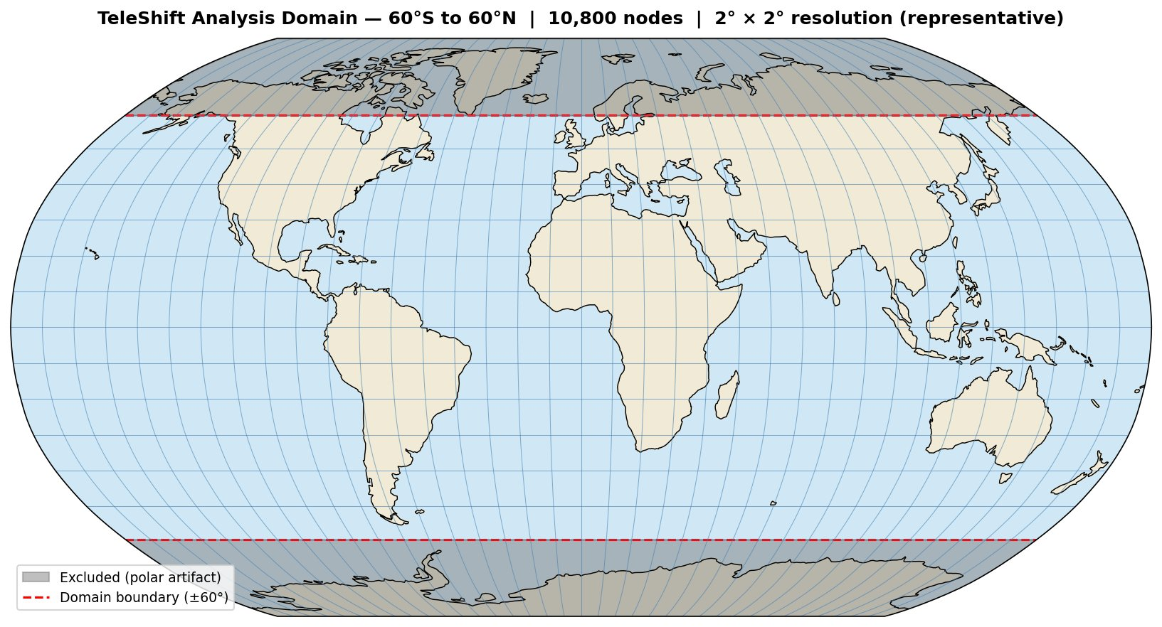
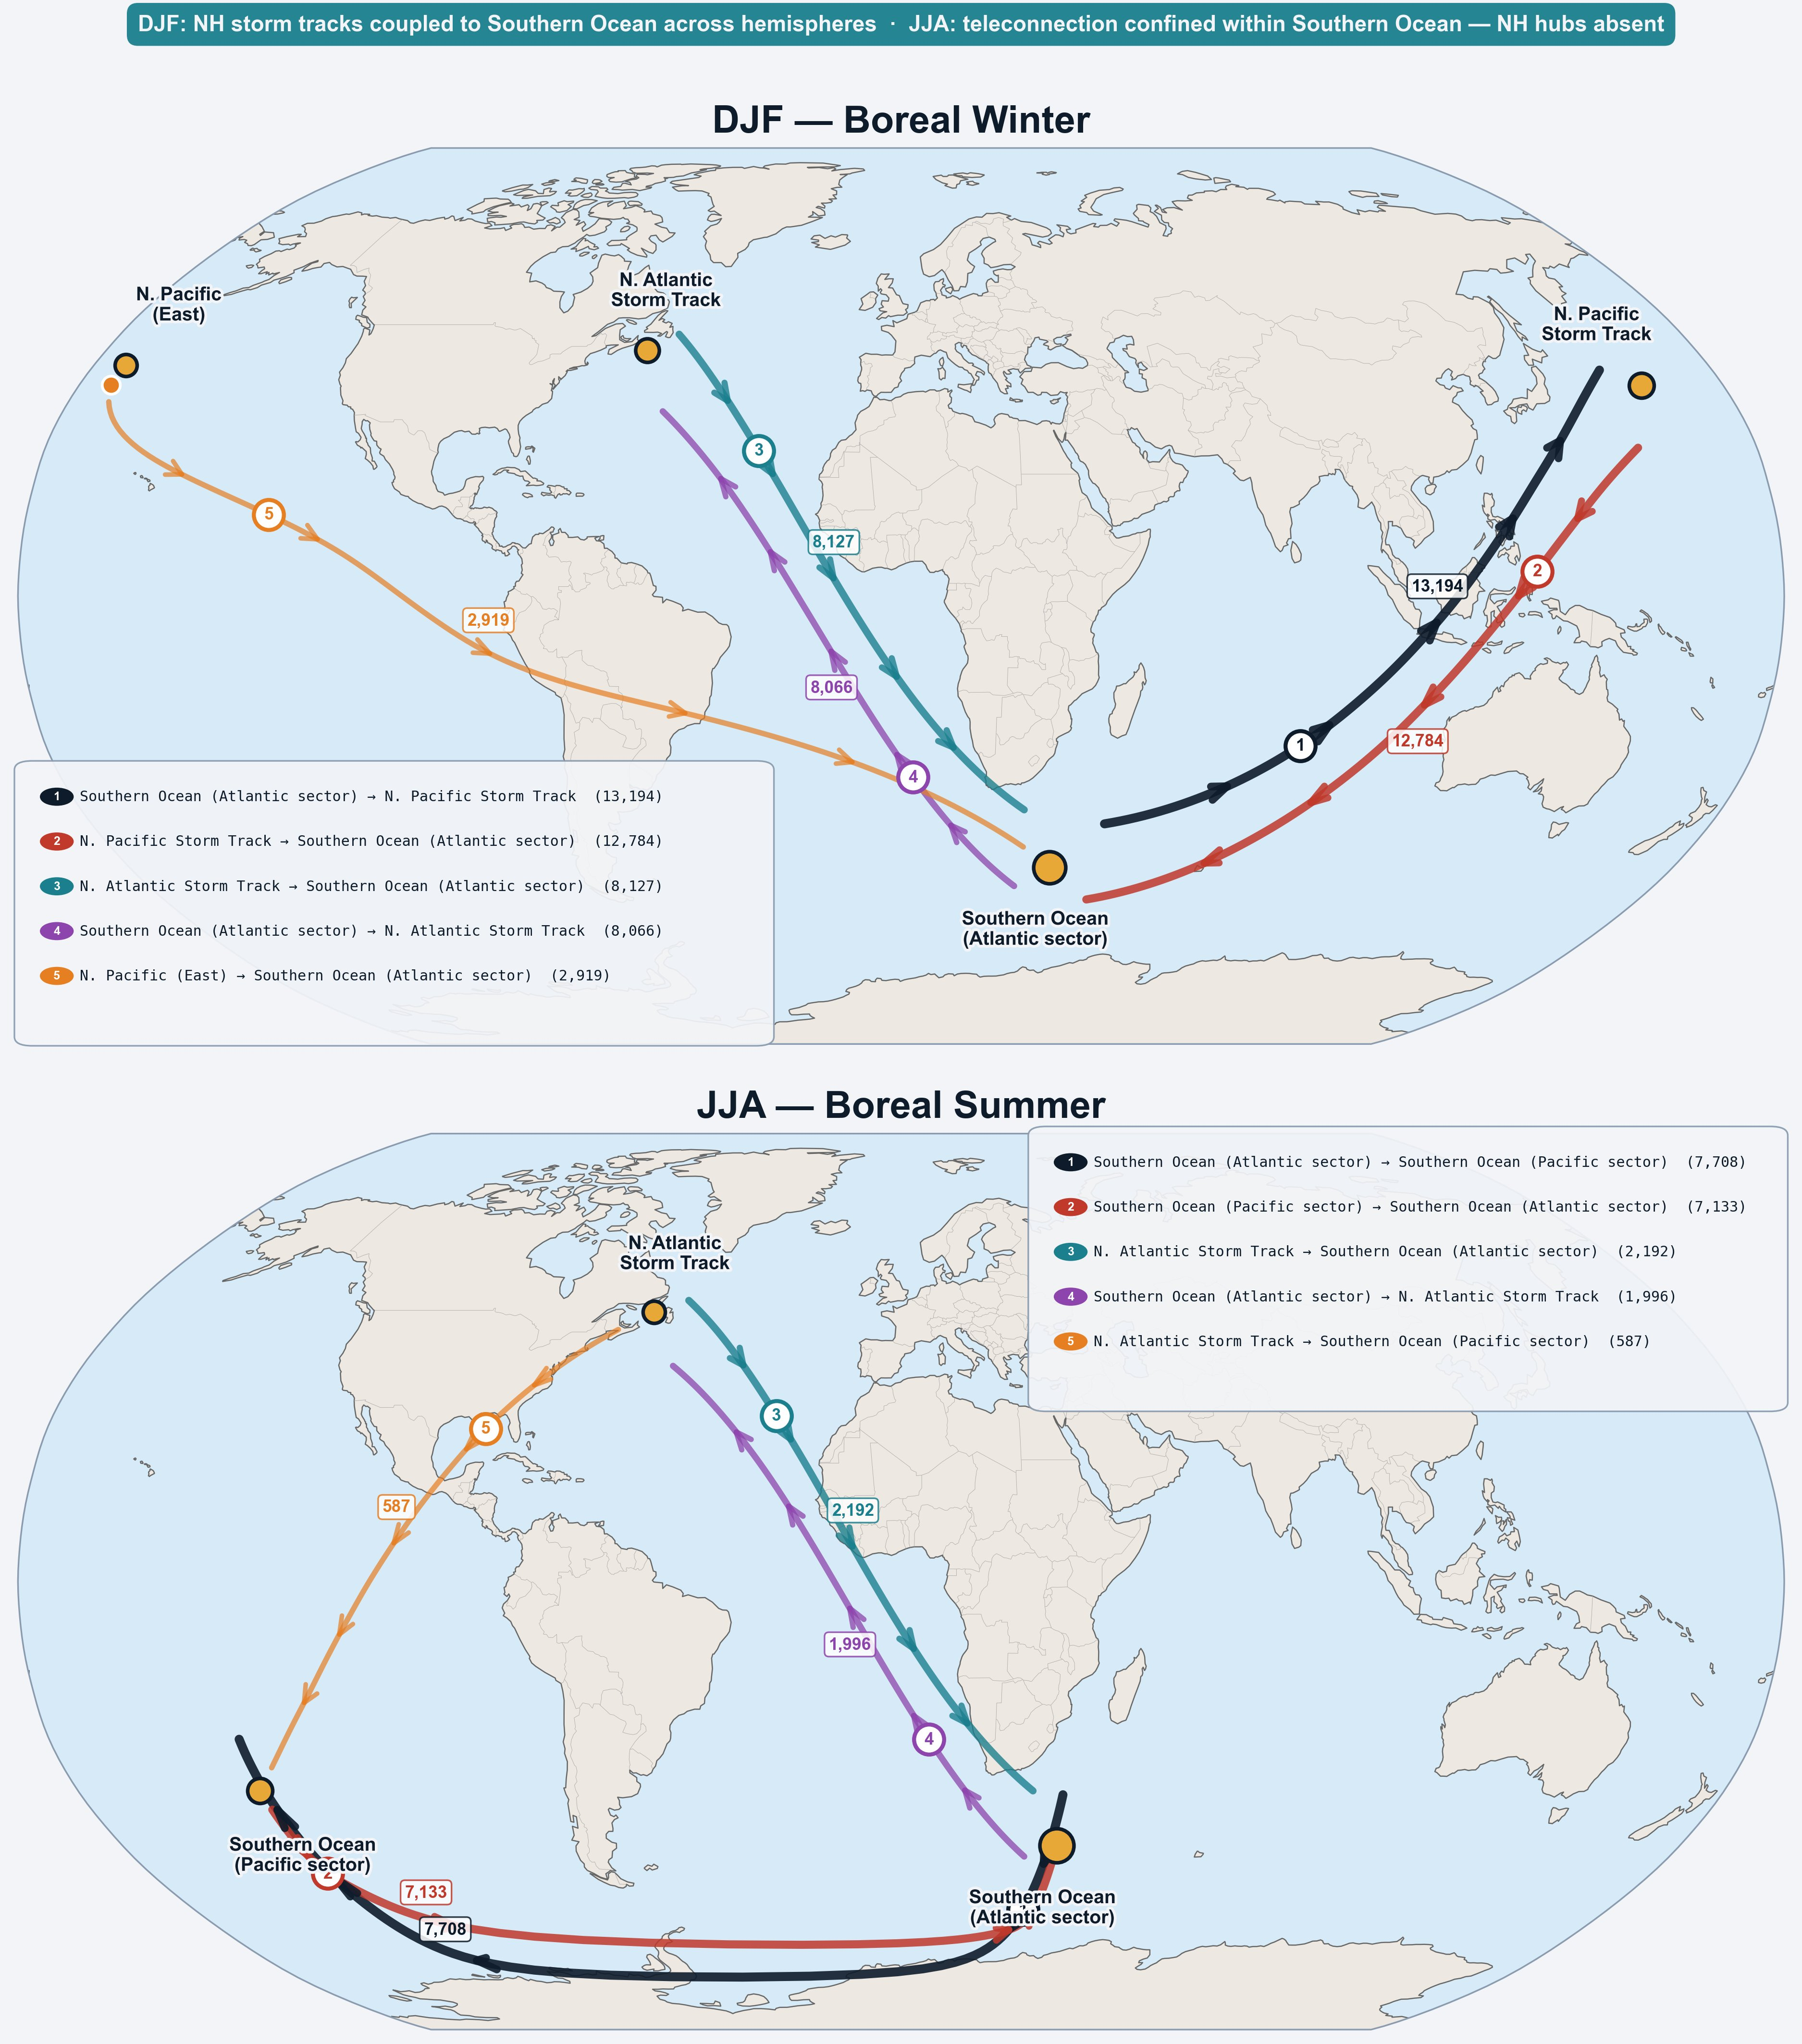
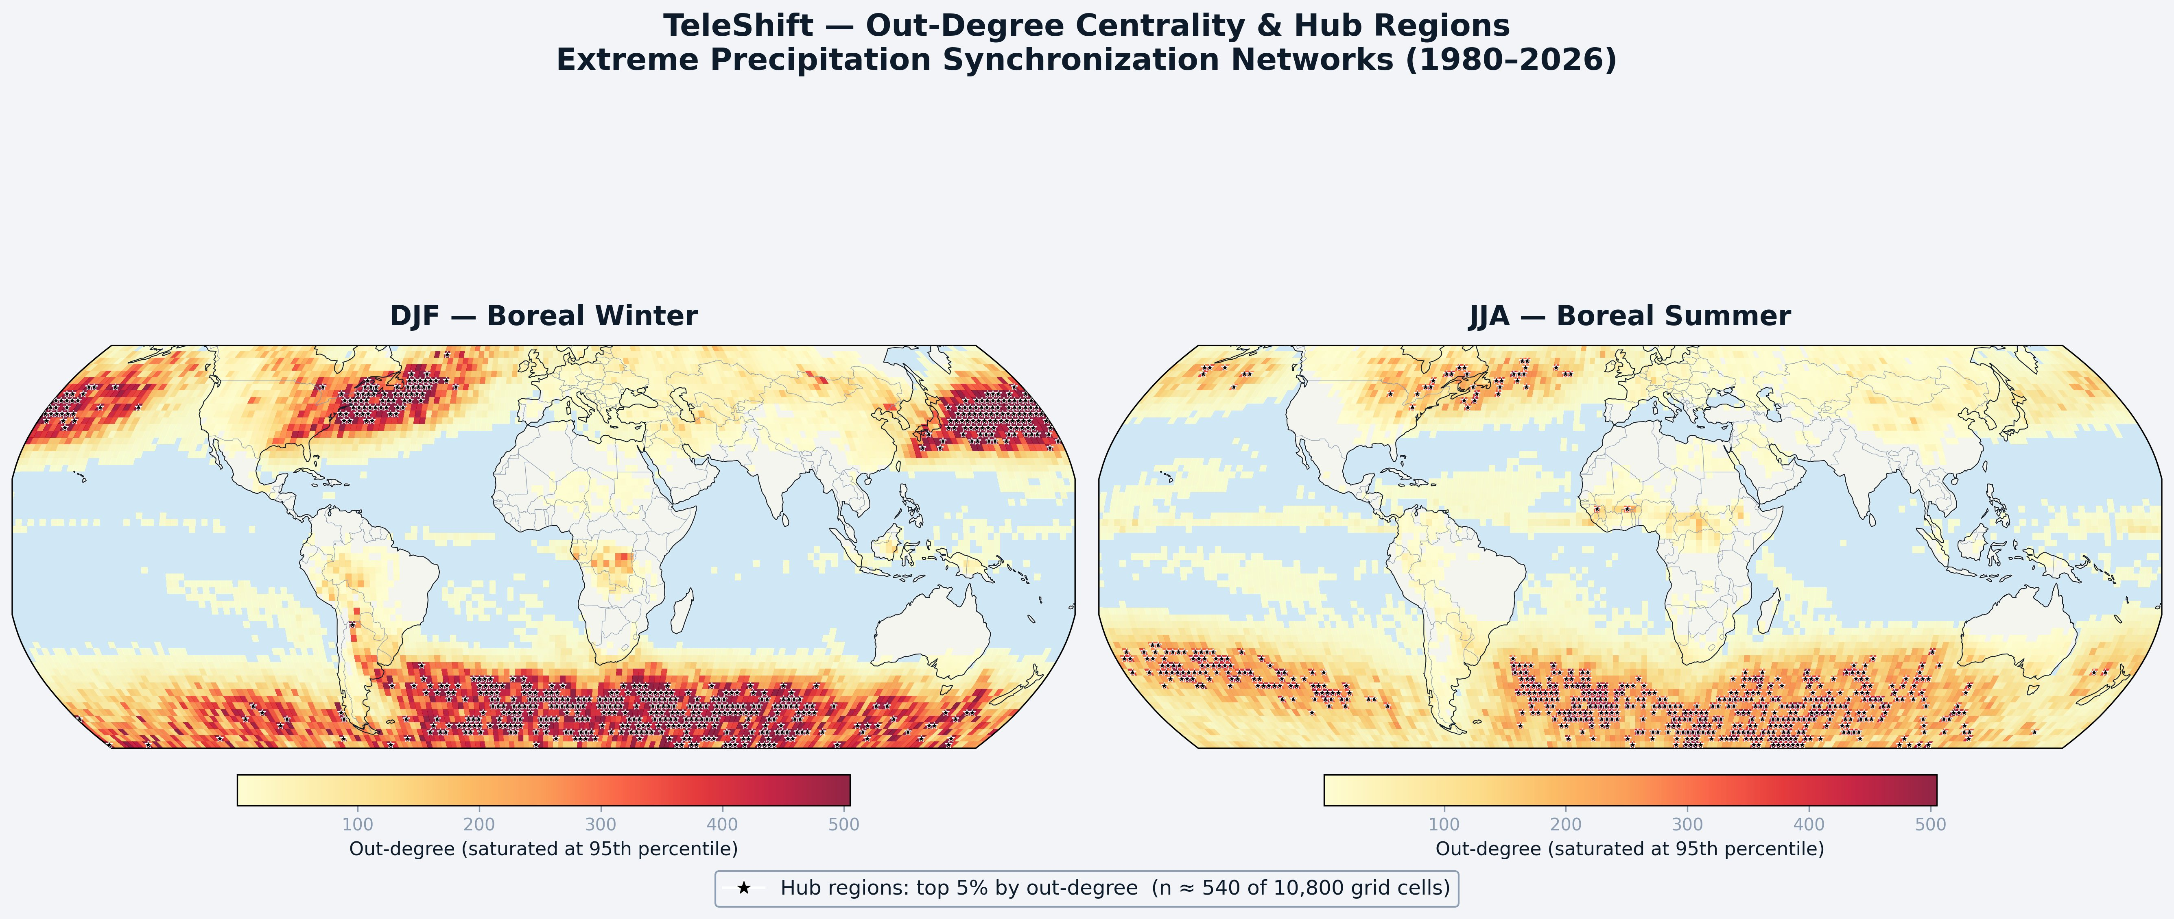
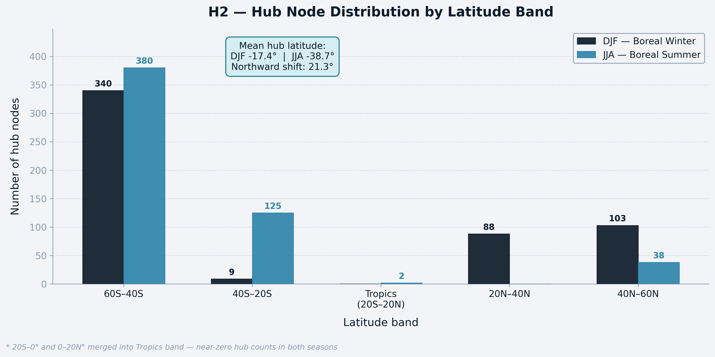
TeleShift
Seasonal Reorganization of Global Extreme Precipitation Synchronization Networks
Mehmet Eren Kendirci | Faculty of Engineering and Natural Sciences, Sabancı University | NetSciSU Miniconference 2026
Introduction & Motivation
H1 -- Winter Connectivity Dominates
H3 -- Long-Range Links More Abundant in Winter
Extreme weather events -- floods, droughts, intense rainfall -- frequently strike simultaneously across different continents, driven by large-scale atmospheric wave patterns linking distant regions.
Understanding teleconnection patterns is critical for:
Seasonal forecasting and early warning systems
Climate risk assessment across interconnected economies
Identifying physical mechanisms linking regional extreme events globally
Climate networks provide a principled framework: nodes represent geographic locations, directed edges encode statistically significant lagged co-occurrence of extreme events. TeleShift asks: how do these global networks reorganize between boreal winter (DJF) and summer (JJA)?
93%
more directed edges
DJF vs JJA
p < 0.001
permutation test
0/1000 exceeded observed
71%
of DJF links span
>2,500 km
56%
in JJA
(p < 0.001)
Three Hypotheses Tested
H1 Winter network connectivity significantly exceeds summer
H2 Hub regions shift geographically between seasons
H3 Long-range links (>2,500 km) more abundant in winter
Data & Domain
Fig. 5 -- Edge distance distributions. DJF (dark) has far more long-range edges; shared y-axis enables direct seasonal comparison.
Source: ERA5 reanalysis (ECMWF) -- state-of-the-art atmospheric reanalysis combining model physics with billions of global observations
Variable: Total daily precipitation | Period: 1980-2026 (46 years) | ~4,211 DJF days, ~4,232 JJA days -- processed independently
Domain: 60S-60N | polar regions excluded -- at 2x2 degree resolution polar cells are only ~7 km wide, confirmed to produce 100% spurious hubs in unmasked networks
Resolution: regridded to 2x2 degrees -- 10,800 nodes; 1-degree resolution produced >99.99% short-range artifact edges
Both seasons share a structurally similar distribution — a sharp local peak below 2,500 km followed by a broad plateau of long-range links extending to 20,000 km. However, DJF (dark) maintains substantially higher edge counts than JJA (teal) across virtually every distance bin above 2,500 km, not just in total. This means winter does not simply have more links — it has proportionally more long-range links at every scale simultaneously, consistent with a globally active Rossby wave field. ES decay lengths confirm the reach difference: DJF λ=2,530 km vs JJA λ=2,248 km.
Fig. 2 -- Permutation test: observed difference (51.2) lies entirely outside the null distribution of 1,000 permutations (p<0.001).
The null distribution (bell curve) shows what seasonal differences look like by chance. The observed DJF-JJA mean out-degree difference (51.2, solid line) falls entirely outside -- zero of 1,000 permutations exceed it. DJF networks are fundamentally more connected than JJA.
Top Teleconnection Flows by Season
Fig. 1 -- Analysis domain: 60S to 60N, 10,800 nodes at 2x2 degree resolution.
H2 -- Hub Regions Shift Geographically
Methodology
Step 1 — Extreme Event Definition
For each grid cell independently, days are flagged as extreme when precipitation exceeds the local 90th percentile of that season's distribution. This produces a binary time series per location (1 = extreme day, 0 = normal day), with ~10% of days flagged everywhere -- making cross-location comparisons meaningful regardless of local climate regime.
Step 2 — Directional Event Synchronization (ES)
ES measures whether extreme events at location i tend to precede those at j within a dynamic time window. For each directed pair (i → j), the score is:
q(i→j) = c(j|i) / √(nᵢ × nⱼ)
where c(j|i) counts how many extreme events at j are preceded by one at i within window τ = min(inter-event intervals at i and j) / 2. The window adapts to local event density: when events are frequent the window is narrow (avoiding spurious coincidences); when rare it expands (capturing slow-propagating signals). Scores range 0 to 1; higher values indicate stronger lagged synchronization.
Step 3 — Significance Thresholding via Surrogates
Rather than applying an arbitrary score cutoff, significance is assessed by comparing each ES score against a null distribution built from surrogate data: event times are randomly shuffled 1,000 times (preserving event counts but destroying temporal structure), and ES scores are recomputed for 10,000 randomly sampled pairs per shuffle. Only edges where the observed ES score exceeds the 95th percentile of this null distribution (α=0.05) enter the final network -- ensuring every retained edge represents a genuine lagged relationship unlikely to arise by chance.
Step 4 — Directed Network Construction
Significant directed edges are assembled into two weighted DiGraphs -- one per season. Each node carries geographic coordinates; each edge (i→j) carries its ES score as weight. This yields: DJF: 1,145,959 directed edges (threshold ES > 0.1401) | JJA: 593,363 directed edges (threshold ES > 0.1415). Out-degree and in-degree are computed separately per node, enabling identification of teleconnection sources vs receivers.
Fig. 3 -- Out-degree centrality: DJF (left) and JJA (right). Black stars = hub nodes (top 5%, n=540). NH storm track hubs emerge exclusively in DJF.
The YlOrRd heatmap shows out-degree centrality (red = highest). In DJF, intense red bands appear across the N. Atlantic and N. Pacific storm tracks -- entirely absent in JJA. Both seasons show a persistent Southern Ocean band. Hub stars confirm these as the primary teleconnection source regions. Note that rather than an entire shift, we observe the emergence of new hub regions between seasons.
21.3 degree northward shift in mean hub latitude | p < 0.001 (3 independent tests)
Out-Degree: Teleconnection Sources
Fig. 6 -- DJF: active cross-hemispheric NH-SH coupling. JJA: teleconnection confined within Southern Ocean.
The out-degree of a node i is the number of other locations that i significantly drives -- i.e. how many nodes have i as a teleconnection source. A node with high out-degree exports predictive influence to many distant locations.
In DJF the 5 strongest flows span entire hemispheres: Southern Ocean drives N. Pacific (13,194 edges), N. Pacific reciprocates (12,784), N. Atlantic couples to Southern Ocean (8,127). In JJA, flows 1 and 2 both link the two Southern Ocean sectors -- the global network collapses to intra-Southern-Ocean circulation with only weak residual N. Atlantic connections.
In-Degree: Teleconnection Receivers
The in-degree of a node i is the number of locations that significantly drive i. High in-degree nodes are teleconnection receivers, influenced by upstream atmospheric signals.
Hub Definition
Hubs are nodes in the top 5% of out-degree distribution -- grid cells that significantly drive extreme precipitation synchronization in the greatest number of other locations (n=540 of 10,800 nodes). Hubs are identified independently per season, enabling direct seasonal comparison of their geographic positions.
Why Out-Degree for Hub Identification?
Unexpected Findings
Southern Ocean (40S-60S) dominates hub activity in BOTH seasons -- prior literature predicted tropical monsoon hub dominance in JJA
Tropics (20S-20N) show near-zero hub presence year-round -- ES captures midlatitude Rossby wave sources, not tropical convective drivers
DJF percolation is gradual (globally distributed edges); JJA is abrupt (regionally clustered) -- a qualitative structural difference not captured by simpler metrics
In this network, in/out-degree correlation r=0.9875 -- nearly symmetric at daily resolution, meaning most hubs are simultaneously strong sources and receivers. Despite this symmetry, out-degree is used because it directly captures which regions export predictive influence to others -- the physically most interpretable definition of a teleconnection source and the most relevant quantity for seasonal comparison.
Fig. 4 -- Hub counts per latitude band. NH storm track bands (20N-60N) activate exclusively in DJF.
In JJA (blue), nearly all hubs cluster in the Southern Ocean (60S-40S) and SH subtropics (40S-20S) -- tropics and NH are virtually empty. In DJF (dark), while Southern Ocean remains dominant, hubs in 20N-40N and 40N-60N rise sharply (88 and 103 nodes), driving the 21.3 degree northward shift in mean hub latitude.
KEY FINDINGS
CONCLUSION & REFERENCES
H1: DJF contains 93% more directed edges than JJA (p<0.001) -- boreal winter is the dominant season for global extreme precipitation teleconnectivity. H2: Hub regions shift 21.3 degrees northward in DJF (p<0.001), driven by NH storm track hubs absent in JJA. H3: 71% of DJF links span >2,500 km vs 56% in JJA (p<0.001), forming a cross-hemispheric long-range backbone. Together: DJF is a globally interconnected regime linking NH storm tracks to the Southern Ocean; JJA is a regionally fragmented regime confined within the Southern Ocean.
Quiroga et al. 2002 Phys. Rev. E
Event Synchronization method
Malik et al. 2012 Climate Dynamics
ES for climate network analysis
Boers et al. 2014 Nature Comm.
ES for extreme precipitation
Boers et al. 2019 Nature
2,500 km threshold, Rossby waves
Stauffer & Aharony 1994
Percolation Theory
Network Science Course
Sabancı University 2026

