Slide 1
The Risk of Hypertension Prediction Using Simple Life Factors
Eren Ufuktepe
Mi Young Kwon
Pei Liu
Mentor
Dr. Tim Green

Slide 2
CONTENTS
Introduction
Dataset
Methods
Modeling
Summary

Slide 3
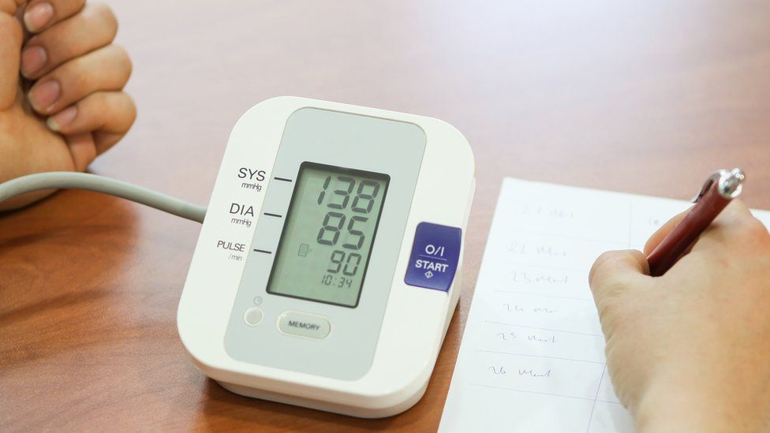
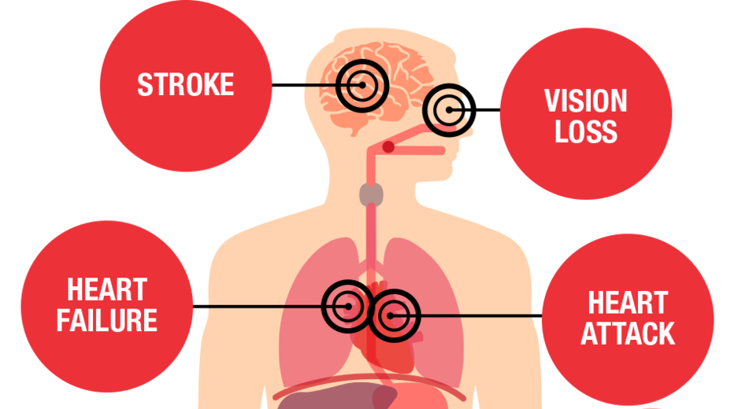
Introduction
In 2017, the American College of Cardiology and the American Heart Association published new guidelines for hypertension management and defined high hypertension as a blood pressure at or above 130/80 mmHg.
Health Threats From High Blood Pressure
https://www.heart.org/en/health-topics/high-blood-pressure/health-threats-from-high-blood-pressure

Slide 4
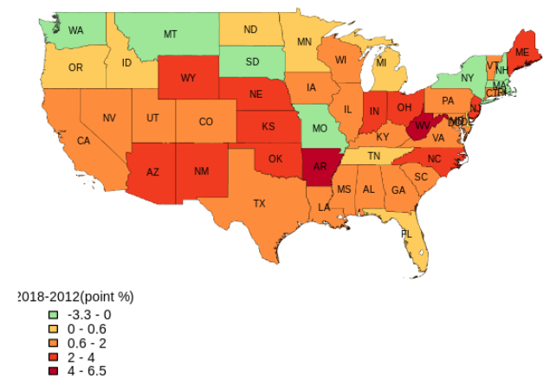
Introduction - Hypertension increase in US
Hypertension increase in 2018 compared to 2012
◼ Most of states hypertension percentage increased in 2018 than 2012
Notes:
Hypertension US data
Explore High Blood Pressure in the United States | 2018 Annual Report | AHR (americashealthrankings.org)
- Decreased compared to 2012: Montana(MT), New Hampshire(NH), New York(NY), District of Columbia(DC), Massachusetts(MA), South Dakota(SD), Washington(WA), Missouri(MO)
- States over 40% of hypertension in 2018 : Alabama(AL), Arkansas(AR), Mississippi(MS), West Virginia(WV)
- break: minus decrease, 25%, 75%,96%, 100%
24.5% - 43.5%

Slide 5
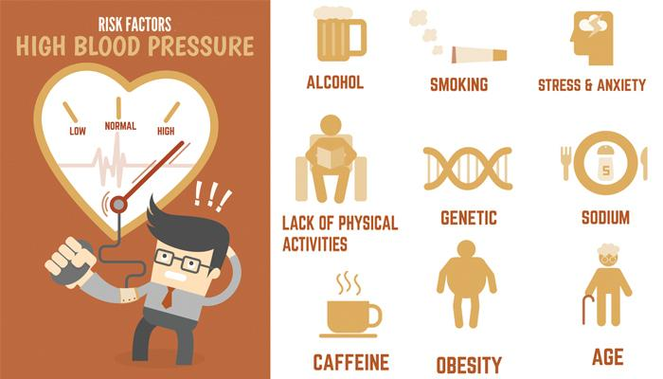
Introduction - Question, Audience, Objective
Questions:
Can we predict the risk of hypertension using simple life-style factors?
Audience:
Physicians/nurses
Objective:
This study will lend evidence for physicians/nurses to provide advice about lifestyle behaviors for patients who have high risk of hypertension.
Risk factors for high blood pressure
https://www.avogel.co.uk/health/mens-health/high-blood-pressure-what-you-need-to-know/

Slide 6
Dataset
National Health and Nutrition Examination Survey [1]
Authority: A major program of the National Center for Health Statistics (NCHS), which is part of the Centers for Disease Control and Prevention (CDC).
Purpose: designed to assess the health and nutritional status of adults and children in the US
Availability: survey data are available on the internet for data users and researchers throughout the world
Year: Since 1999, the survey became a continuous program
Content: It includes demographic, dietary, examination, laboratory and health-related questions.
Population: >9000 participants each cycle year survey
https://www.cdc.gov/nchs/nhanes/index.htm
Notes:
Note: * The NHANES program suspended field operations in March 2020 due to the coronavirus disease 2019 (COVID-19) pandemic. As a result, data collection for the NHANES 2019-2020 cycle was not completed and the collected data are not nationally representative.
[1] https://wwwn.cdc.gov/nchs/nhanes/continuousnhanes/default.aspx?BeginYear=2017

Slide 7
Dataset
2009 - 2018 NHANES dataset
2017-2018 is the latest dataset that is completed and has a nationally representative sample. We merge dataset from 2009 to 2018.
Between 2009 and 2018, 47,652 people have completed the surveys.
Components | Tables | Columns
Demographics | 1 | Age, Gender, Race, Active Duty
Dietary | 1 | Fishes, Sodium, Potassium, Caffeine, Salt usage, Cholesterol
Examination | 1 | Pulse Regularity, Systolic Blood Pressure, Diastolic Blood Pressure
Laboratory | 1 | Insulin
Questionnaire | 7 | Smoke, Alcohol, Weight, Height, Sedentary Activity, Sleep Hours, Diabetes

Slide 8
Methods - Data analysis pipeline
1. Data collection and storage
2. Data cleaning and data preparation
3. Exploratory data analysis
Web scraping.
SQL table creation.
Creating single dataset from tables.
Missing value imputation
Outliers detection
Data standardization
Data transformation
Univariate / bivariate / multivariate data analysis
Descriptive statistics
Clustering analysis
4. Feature engineering
5. Model building
6. Model evaluation
7. Final products
Feature creation
Feature transformations
Feature selection
Random sampling (hold-out, train and test)
Hyperparameters tuning
Model selection
Validate/test models
Performance measure
Cross-validation
Fairness/Bias analysis
Dashboard
Easy model formula/charts

Slide 9
Methods
Data cleaning and preparation
Drop patients who are younger than 20 and patients who are 80 years old.
Drop variables according to unique values (only 1 unique values)
Remove missing variables that have missing values >60%
Missing data imputation and data standardization/transformation
BMI was calculated according to height and weight measurements by dividing weight in pounds (lb) by height in inches (in) squared and multiplying by a conversion factor of 703.
Formula: weight (lb) / [height (in)]2 x 703
Feature engineering
Changed continuous data to categorical values; <25%: 1, 25%~75%: 2, 75%~90%: 3, >90%: 5
One hot encoding
Data standardization
Domain knowledge selection
Feature importance
Random Forest, XGBoost, Gradient Boosting, Decision Tree, Logistic Regression
Notes:
[1] https://www.cdc.gov/nccdphp/dnpao/growthcharts/training/bmiage/page5_2.html

Slide 10
Methods - Target Variable
Systolic blood pressure greater than or equal to 130 mmHg or diastolic blood pressure greater than or equal to 80 mmHg [1]
Currently taking prescribed medicine for HBP
Was told having high blood pressure at least once by a doctor
Hypertension
[1] Whelton PK, Carey RM, Aronow WS, Casey DE, Collins KJ, Dennison C, et al. Hypertension. 2018;71(19):e13–115.
Notes:
[1] Whelton PK, Carey RM, Aronow WS, Casey DE, Collins KJ, Dennison C, et al. 2017 ACC/AHA/AAPA/ABC/ACPM/AGS/APhA/ASH/ASPC/NMA/PCNA Guideline for the prevention, detection, evaluation, and management of high blood pressure in adultsexternal icon. Hypertension. 2018;71(19):e13–115.

Slide 11
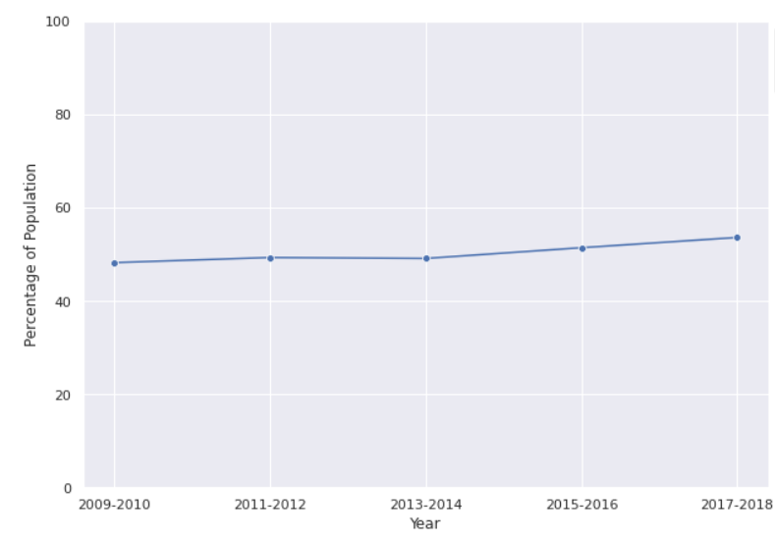
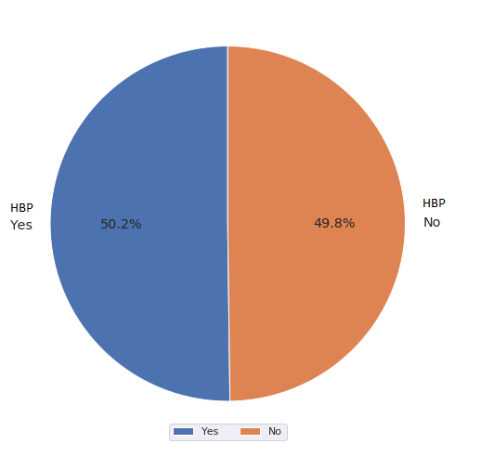
Results - Prevalence of hypertension
Between 2009-2018 survey period, the overall prevalence of hypertension is 50.2%.
The high blood pressure percentage in the United States increased from 2009 to 2018.
Hypertension percentage in each year
The prevalence of hypertension among adult
49.3%
49.1%
51.4%
53.6%
48.2%

Slide 12
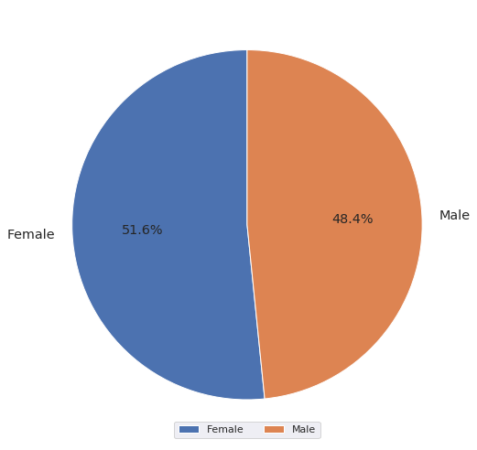
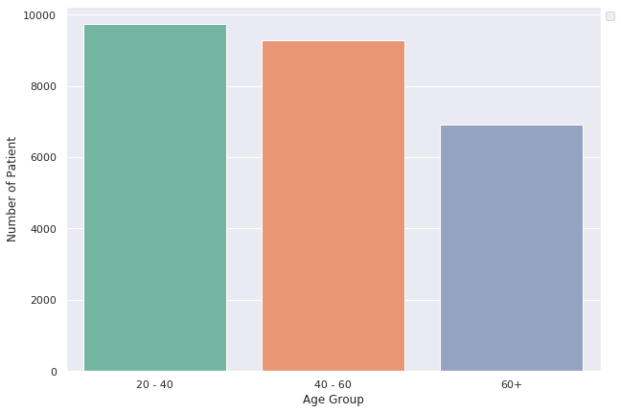
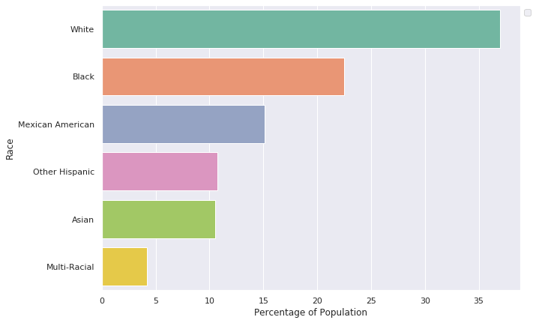
Results- Distribution for Age, Race, Gender (Participants characteristics)
Age Distribution
Race Distribution
Gender Distribution
Age: among the three age groups, 20-40 group has higher number and >60 group has a little lower number
Race: the order of % population in the data is White>Black>Mexican American > Other Hispanic > Asian> Multi-Races
Gender: 51.6% are female and 48.4% are male

Slide 13
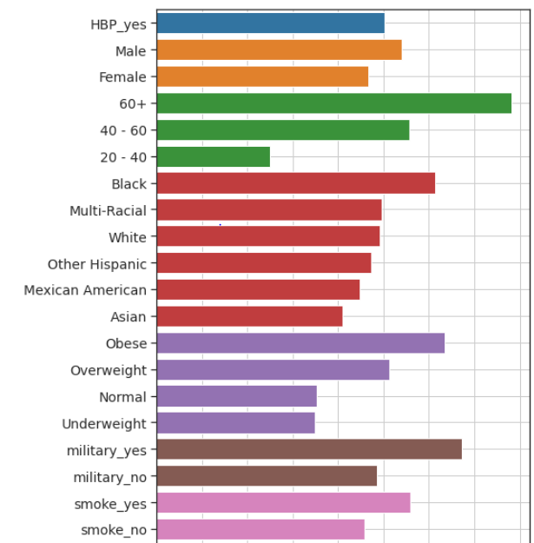
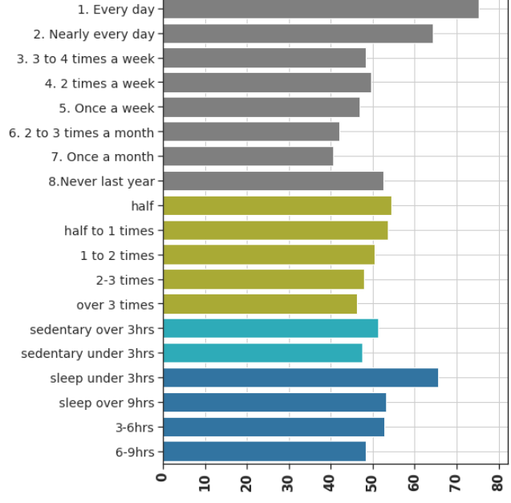
Results - Bivariate Analysis
50.2%
alcohol
Sodium
Notes:
bivariate

Slide 14
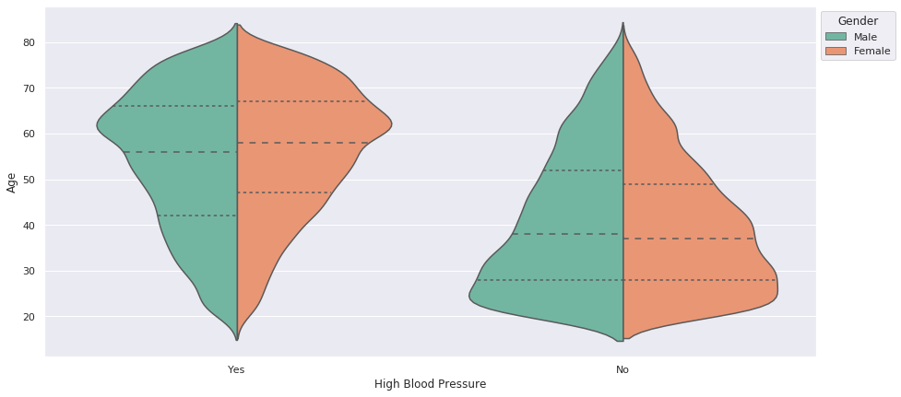
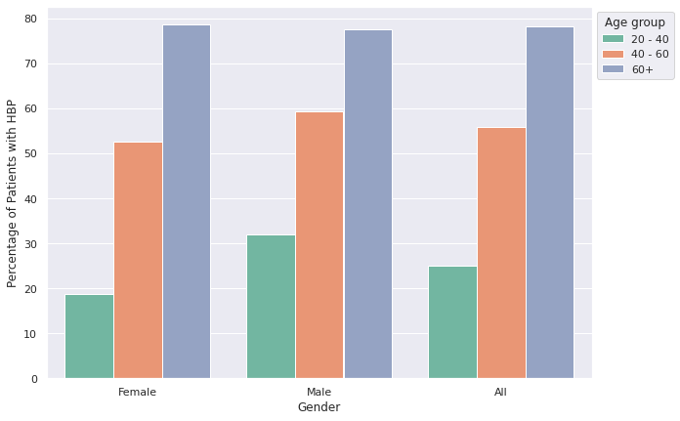
Results – Hypertension by Age and Gender
The prevalence of hypertension among age/gender
The prevalence of having hypertension by age/gender.
Age: The higher the age, the higher risk of high blood pressure.
Gender: Males have a higher hypertension risk than females (aged <60), especially in the age range of 20-40.

Slide 15
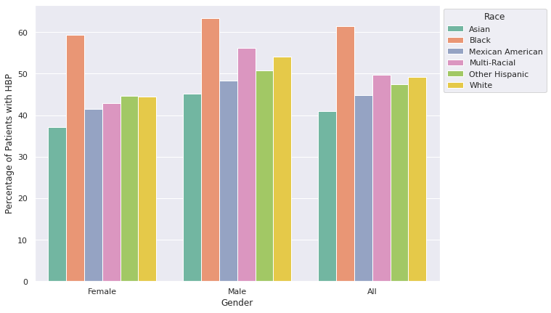
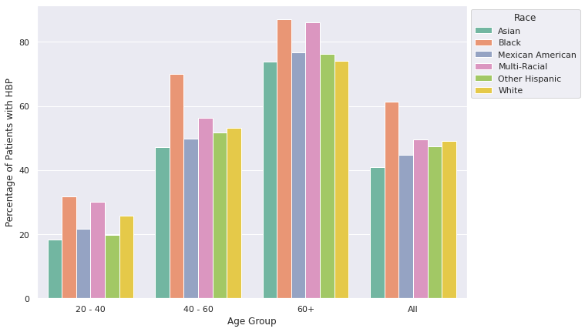
Results – Hypertension by Race, Age and Gender
The prevalence of hypertension among race/gender
The prevalence of hypertension among race/age
Race: Hypertension prevalence is higher for black adults than in other races.
Gender: Males have a higher risk of hypertension than females in all races.
Age: The higher the age, the higher risk of high blood pressure. However, in the 40-60 age range, black people have a higher risk for high blood pressure.

Slide 16
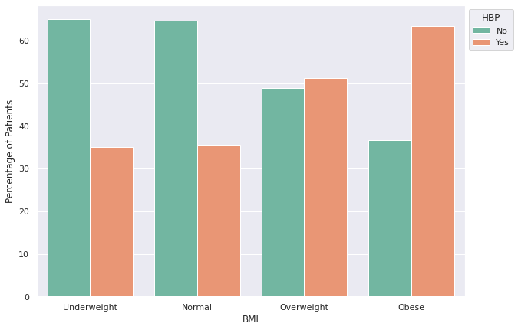
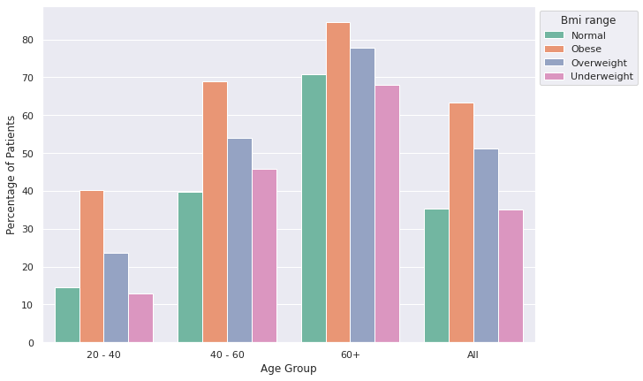
Results – Hypertension by BMI and Age
The prevalence of hypertension among BMI
The prevalence of hypertension among BMI/age
BMI: the increase of BMI, the increase of hypertension prevalence
Age: BMI is a significant factor for all age group especially for 20-40 and 40-60 age groups.

Slide 17
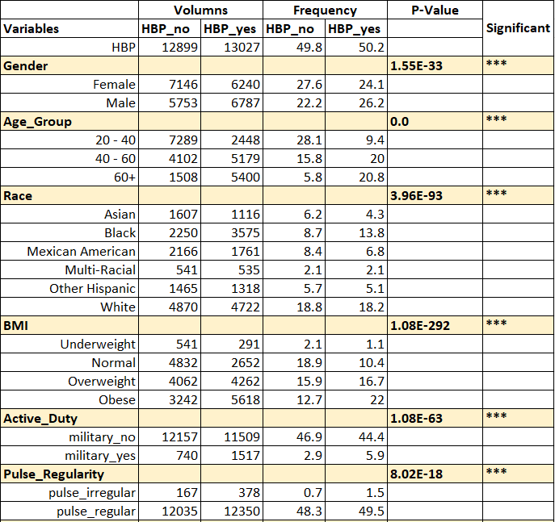
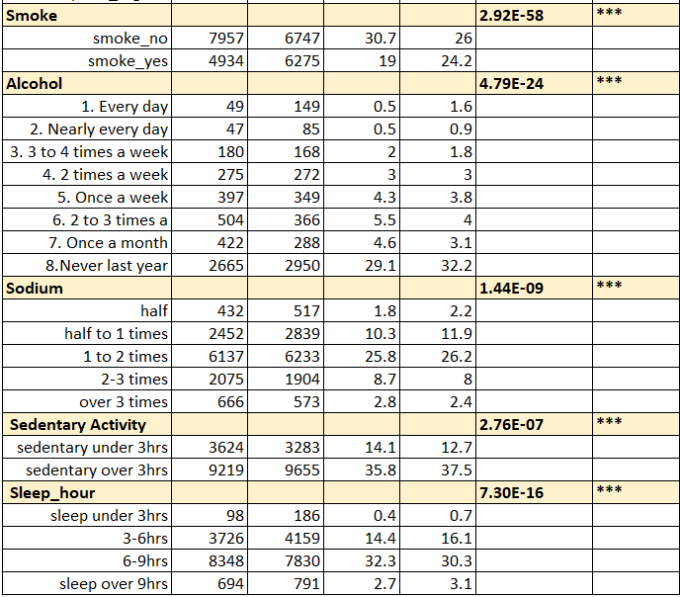
Results – Features statistical analysis
Chi2 Test between two categorical variables (Target variable is the hypertension)
Alpha = 0.001
Notes:
11 - 16

Slide 18
Model – Study design
2009-2018 total 47,652 data and 50 features
Data preparation and feature selection
14,038 samples clean data and 7 features
50% from 2017-2018 data, 25% from 2009-2016
Validation set
4112
Training set
9926
~70%
~30%
Model training 75%
Model test 25%
Notes:
4112
14038
9926

Slide 19

Model – Evaluation Metrics
False negative rate FNR = FN/(TP+FN)
Sensitivity, hit rate, recall, or true positive rate TPR = TP/(TP+FN)
Area under the ROC Curve (considering both TPR and FPR (sensitivity and specificity))
Specificity or true negative rate TNR = TN/(TN+FP)
Fall out or false positive rate FPR = FP/(FP+TN)
https://www.healthcarelawfirm.net/2019/11/14/prescribing-wrong-medication/

Slide 20
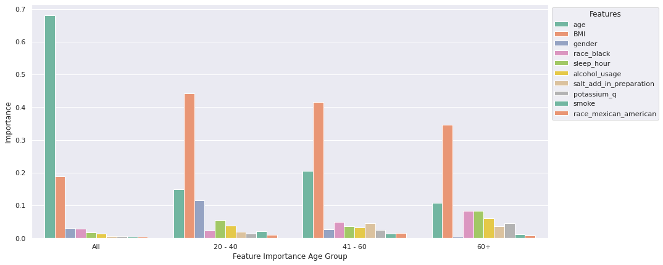
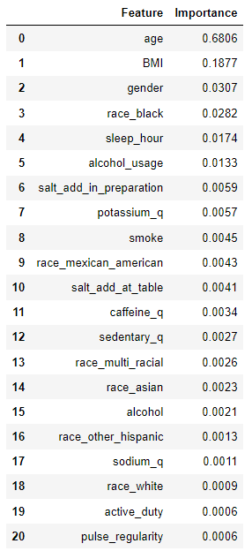
Model - Feature importance/feature selection
Default Feature Importance by Gradient Boosting
Feature importance: age, BMI, gender, race, sleep hours, and alcohol usage are the six most important features in all data
Final Features: Age, BMI, gender, race, sleep hour, alcohol usage, and smoking (7 features)
Notes:
GradientBoostingClassifier

Slide 21
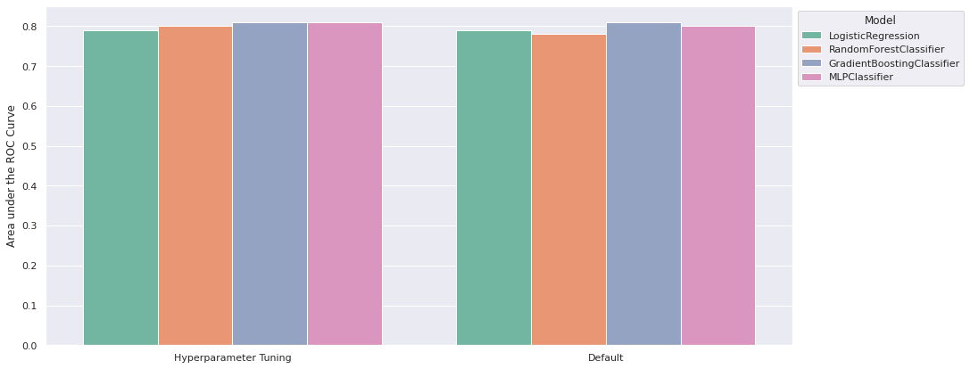
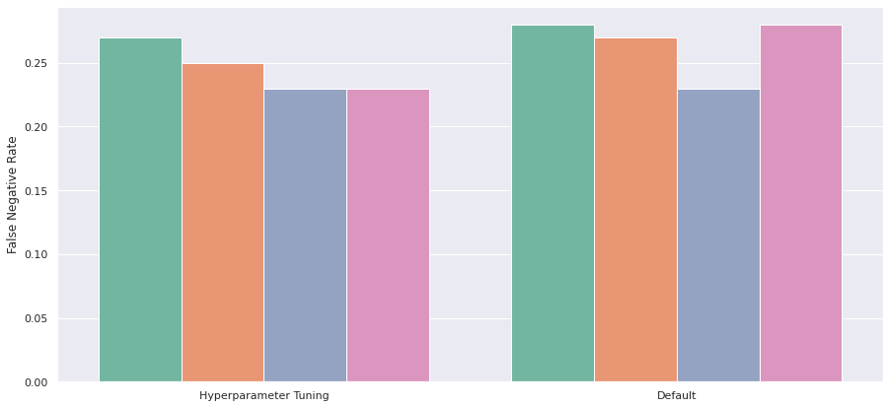
Model - Hyperparameter Tuning
AUC of ROC was the targeted scoring in the hyperparameter tuning, which considers both sensitivity and specificity or true positive rate and false positive rate.
After parameter tuning for all four models, Logistic Regression, Random Forest, and MLP Classifier is improved based on false negative rate. However, Gradient Boosting isn’t improved.
Challenge: resource and time limitation

Slide 22
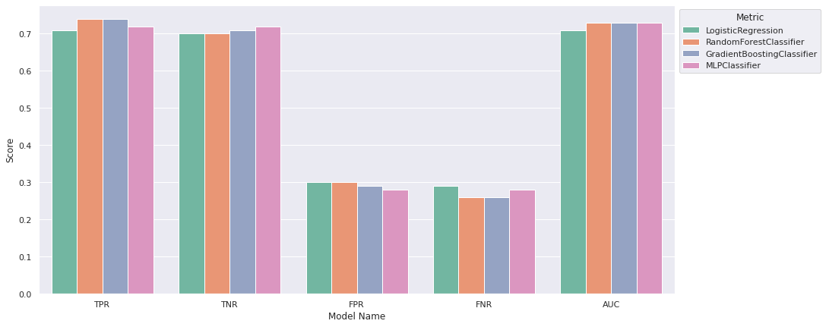

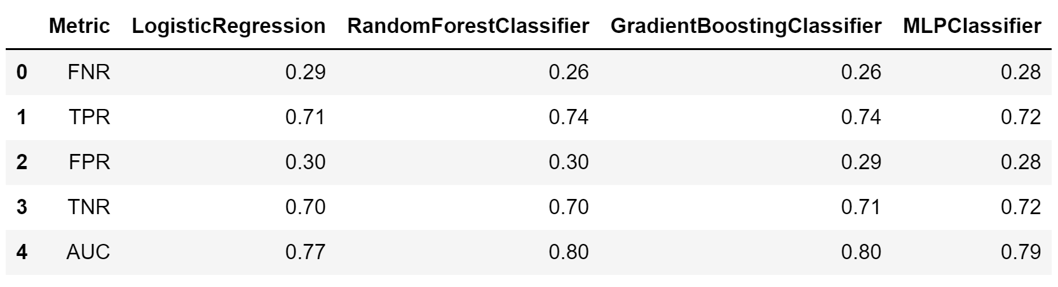
Model - Selections
Four different classifier models were evaluated and compared.
Gradient Boosting Classifier was the best model for predicting hypertension risk with smaller FNR and FPR.

Slide 23
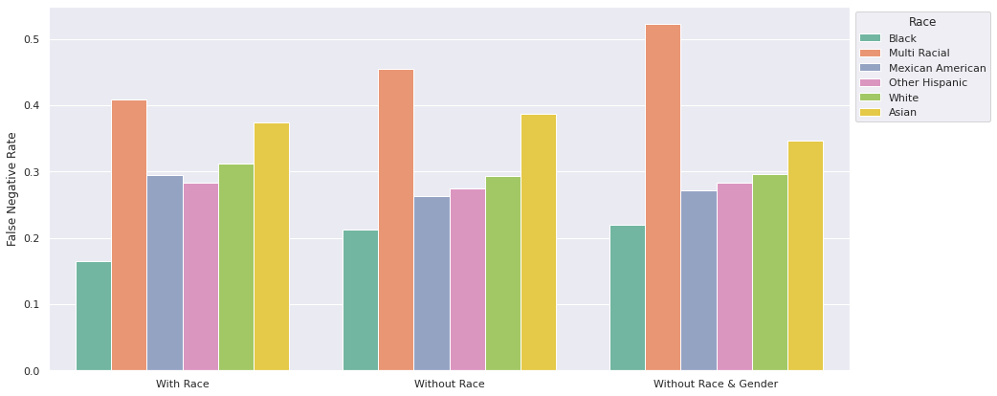
Model - Fairness/Bias Analysis for Race
The Gradient Boosting Classifier is evaluated with and without race feature.
The prediction performance for each race group is compared for model with and without race feature.
Without race feature, the FNRs for black, multi-racial and asian people are increased; the FNRs for mexican american, other hispanic and white people are decreased.

Slide 24
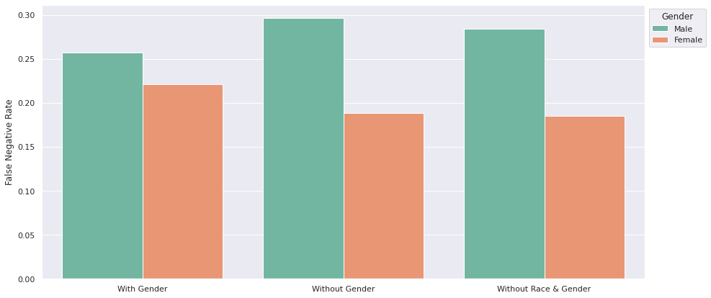
Model - Fairness/Bias Analysis for Gender
The Gradient Boosting Classifier is evaluated with and without gender feature.
The prediction performance for each gender is compared for model with and without gender feature.
Without gender feature, the FNRs for male is increased; the FNRs for female is decreased, which causes higher disparity for gender.

Slide 25
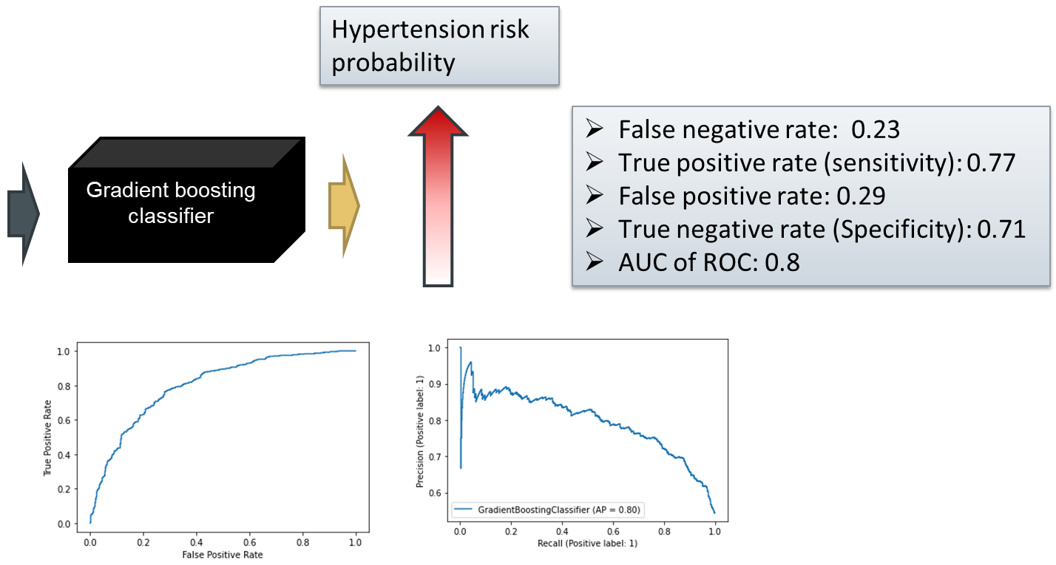
Model - Validation Results
•Age
•BMI
•Gender
•Race
•Alcohol usage
•Sleep hour
•Smoke

Slide 26
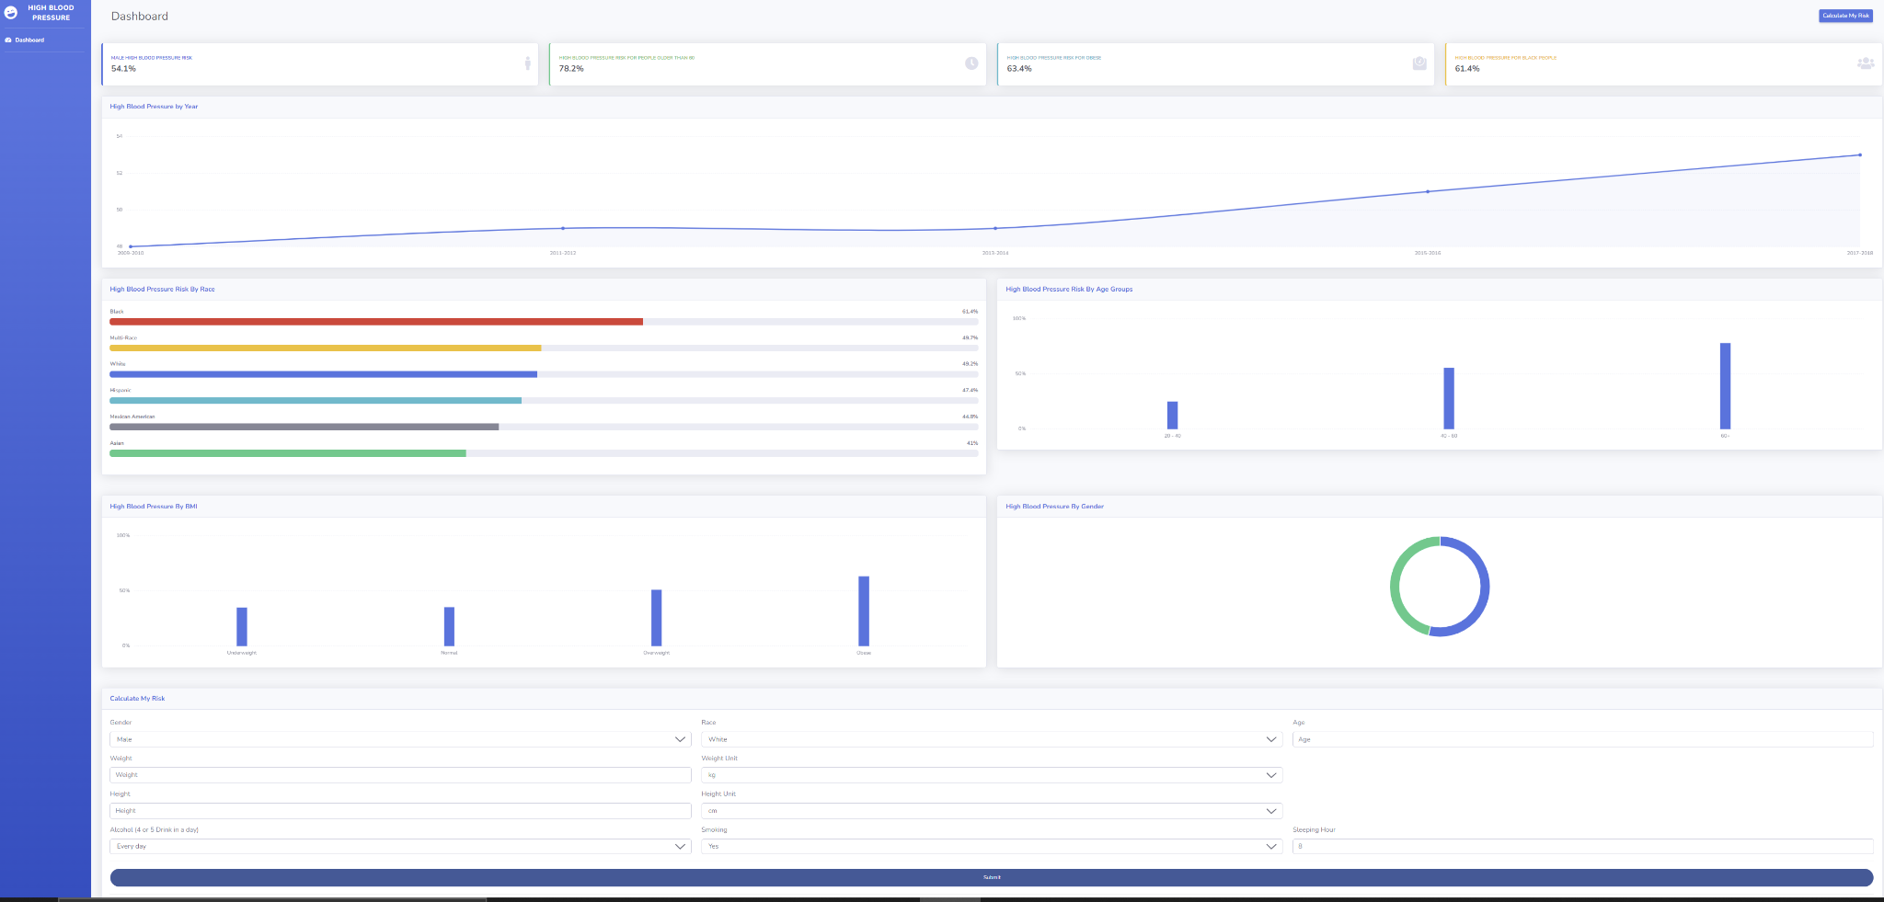
Dashboard

Slide 27
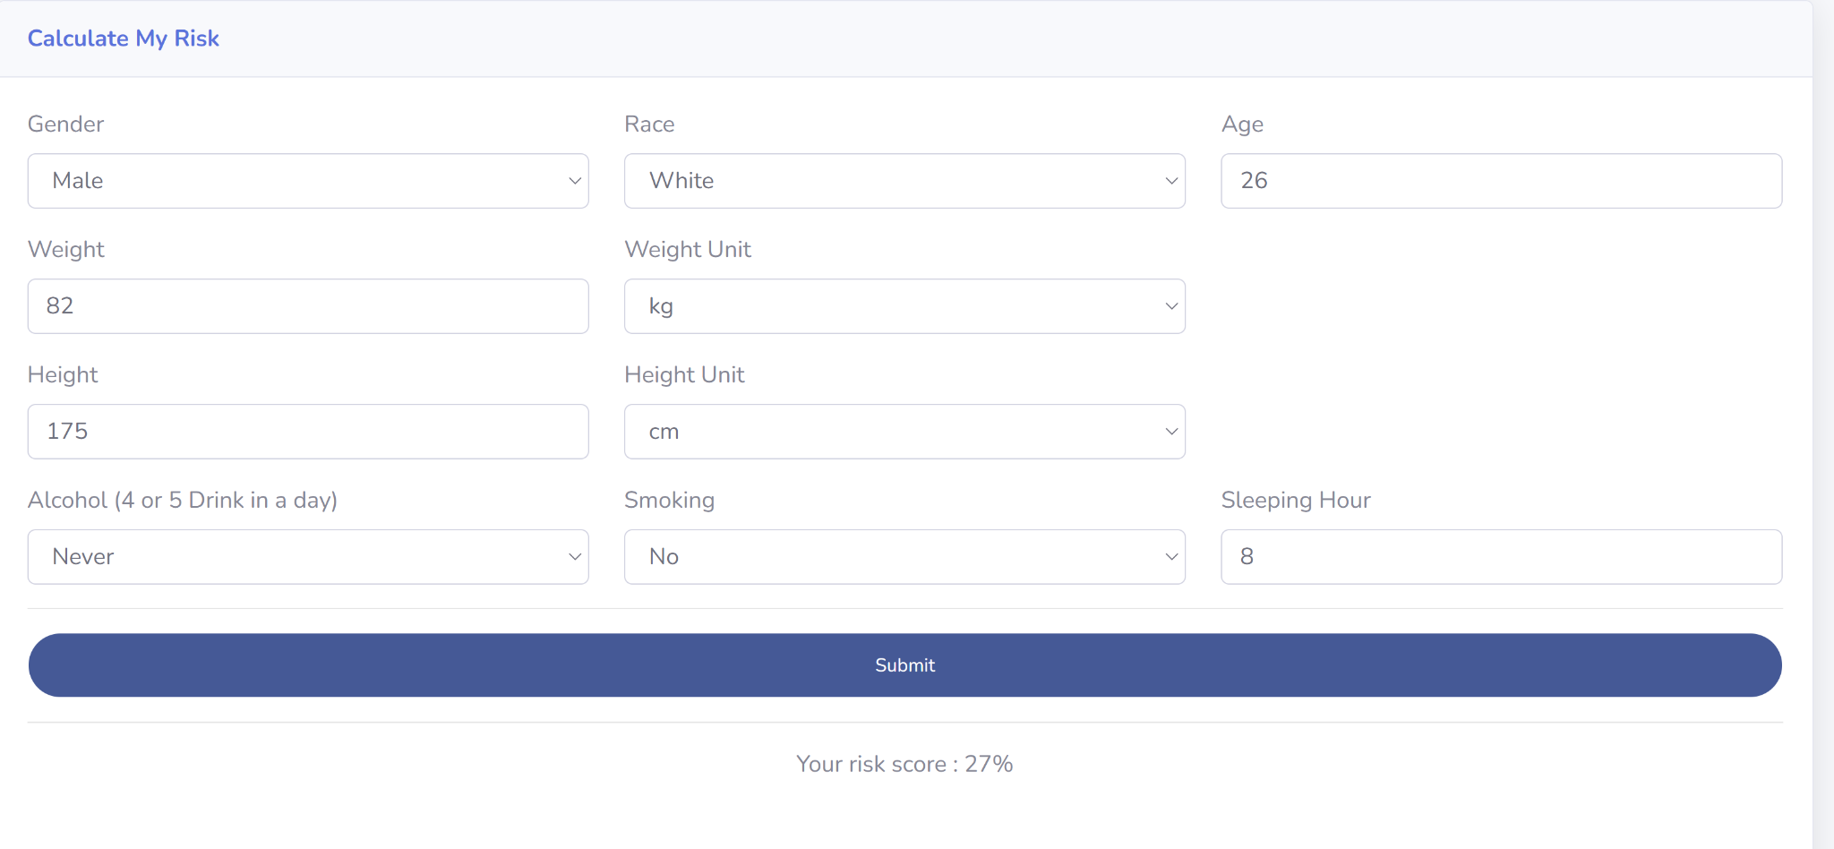
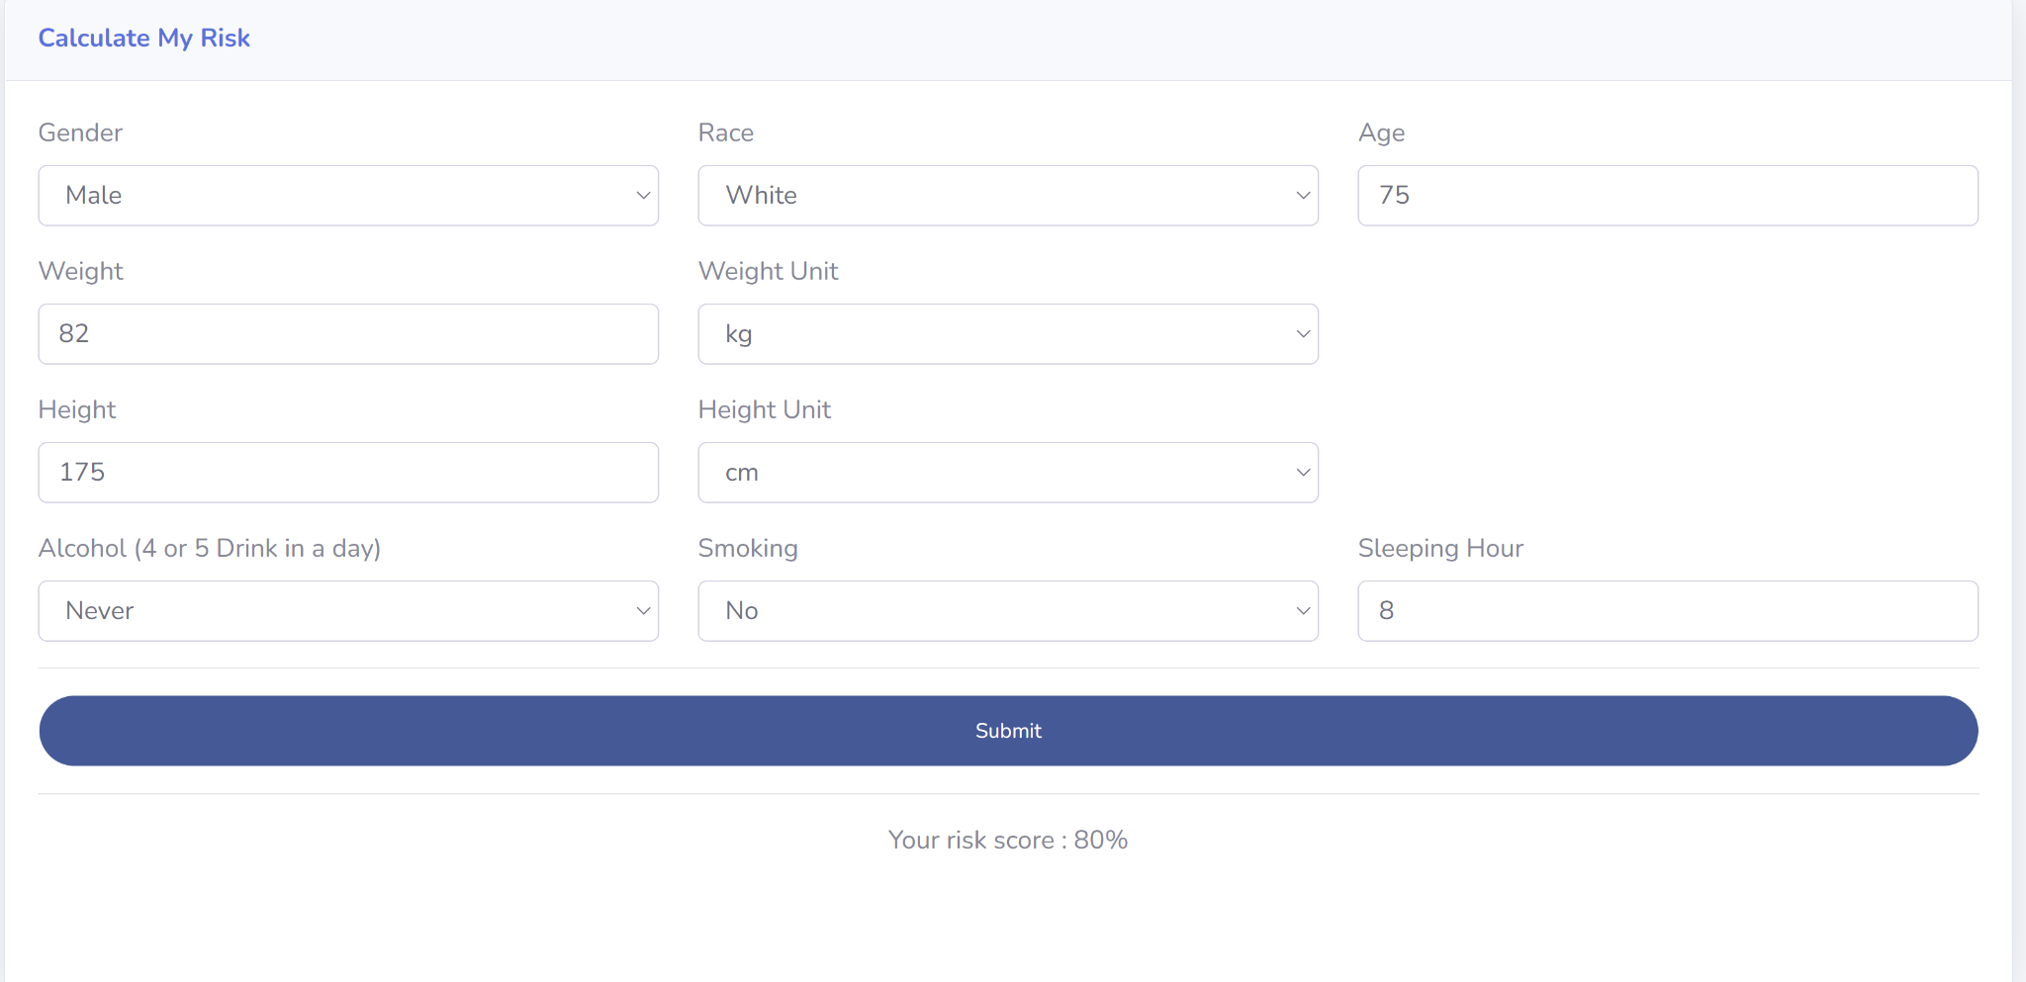
Dashboard - Case study

Slide 28
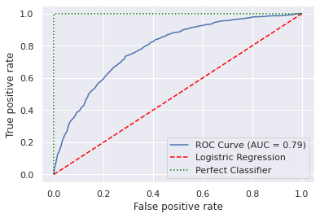
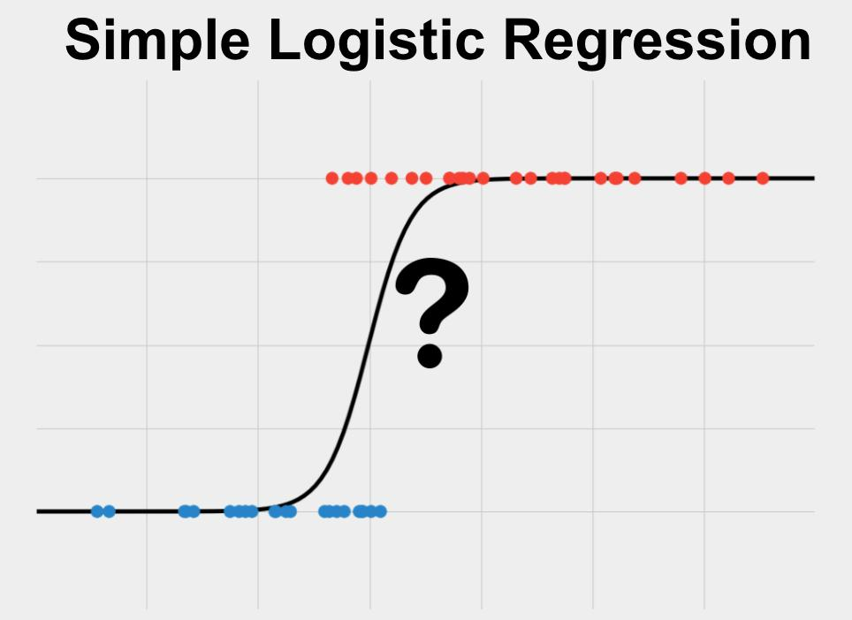

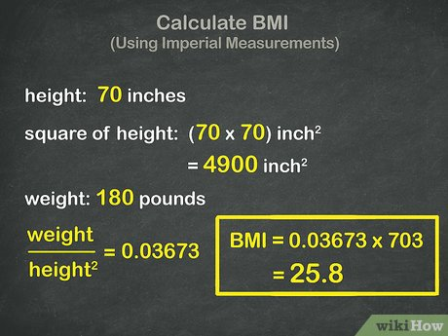
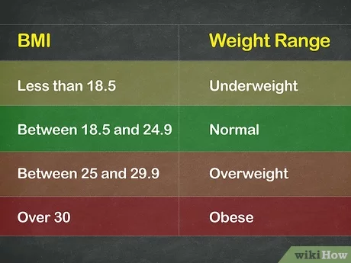

Model – Easy model with Logistic Regression
Age
BMI
1
2
1
4
3
2
Z= BMI*0.56 + Age *0.063 – 4.66
P
3
4
Notes:
explain

Slide 29
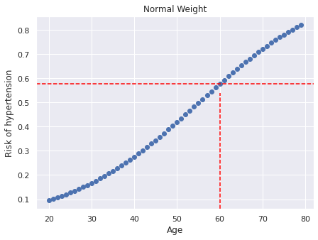
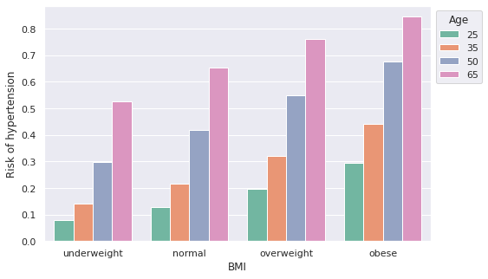
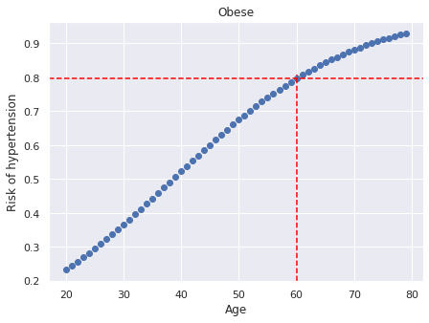
Model – Easy model
The risk of hypertension increases dramatically with people getting older.
BMI is another important factor contributing to hypertension.
People without computer or calculator can use these charts to estimate the risk of getting hypertension based on their age and BMI.

Slide 30
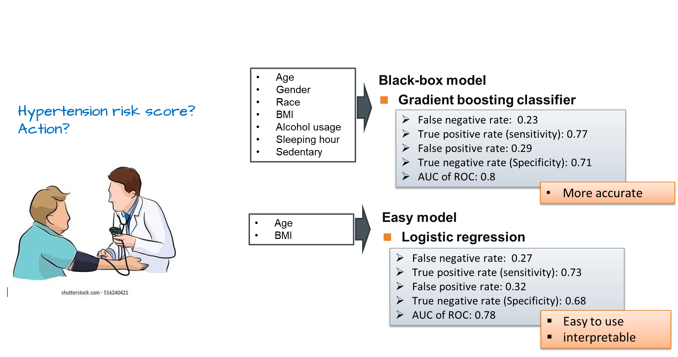
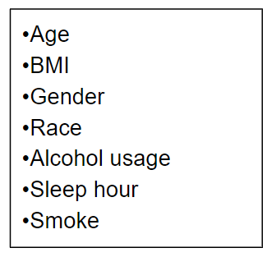

Slide 31
Thank you!

Slide 32
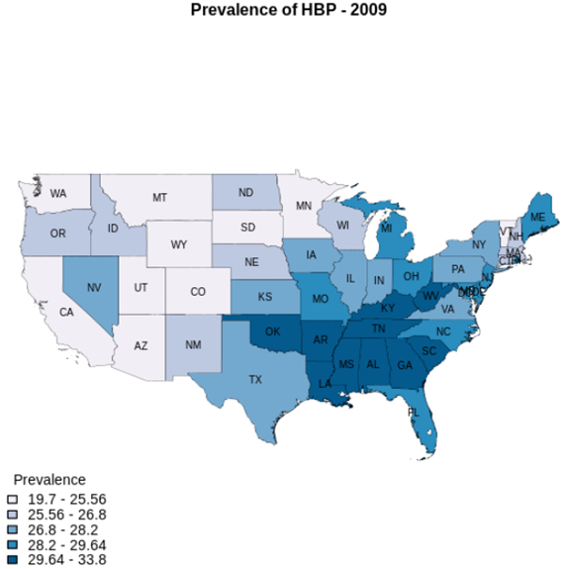
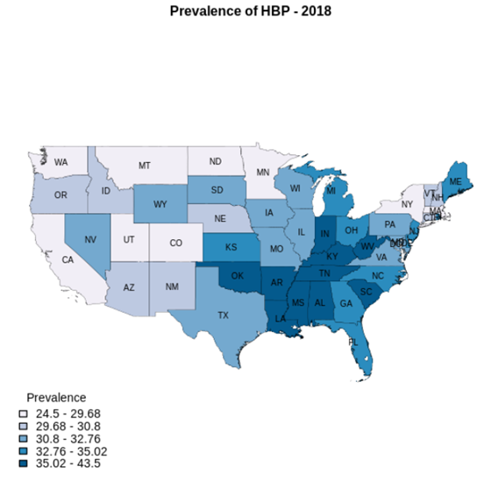
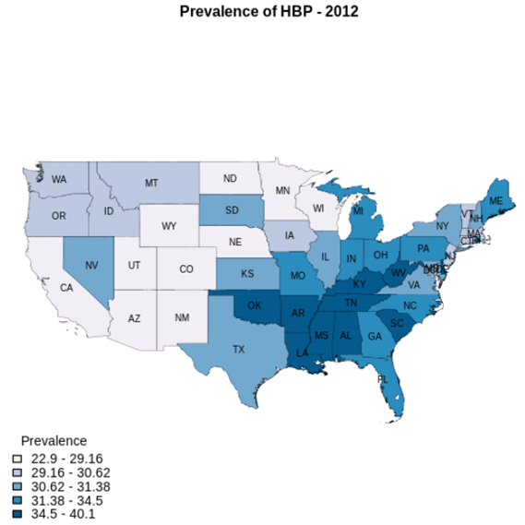
Backup

