Slide 1
Olay ilişkilerini kullanarak Siber saldırı tahmini/tespiti aracı
BIL 496
Final Presentation
Kenan Eren Ayyılmaz
Proje Danışmanı: Prof. Dr. İbrahim SOĞUKPINAR
Aralık 2025

Slide 2
Project Overview and Objectives
Project Scope:
A system that analyzes security logs from IT systems using artificial intelligence
An innovative approach that automatically detects complex attack patterns
Problem Definition:
Modern cyber attacks are not isolated events but chains of interconnected incidents
Detecting relational security threats among millions of daily logs is challenging
Data format issues and high percentages of missing values
Target Solution:
Providing comprehensive and understandable reports to security experts
Classifying attack models according to the MITRE ATT&CK framework

Slide 3
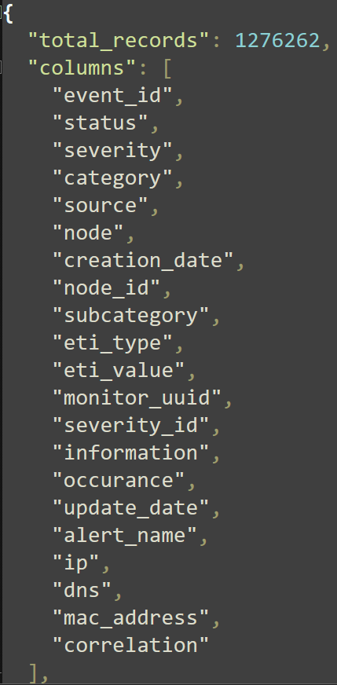
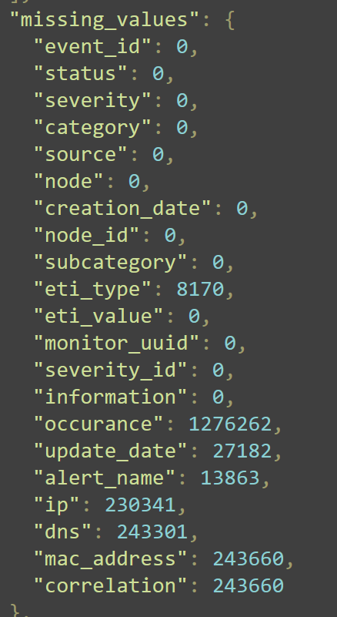
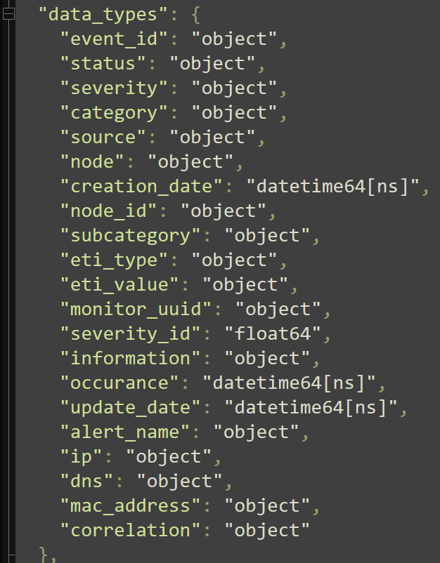
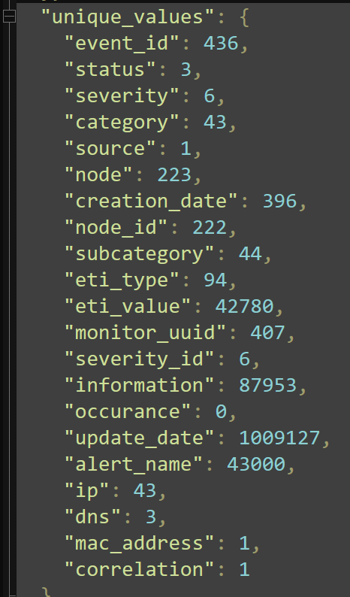
The Challenge: Drowning in Data
Problem Statement: The overwhelming volume and velocity
of log data.
Goal: To build an automated system that intelligently detects
and contextualizes threats.

Slide 4
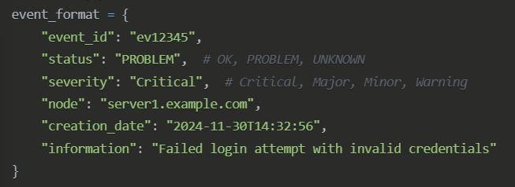
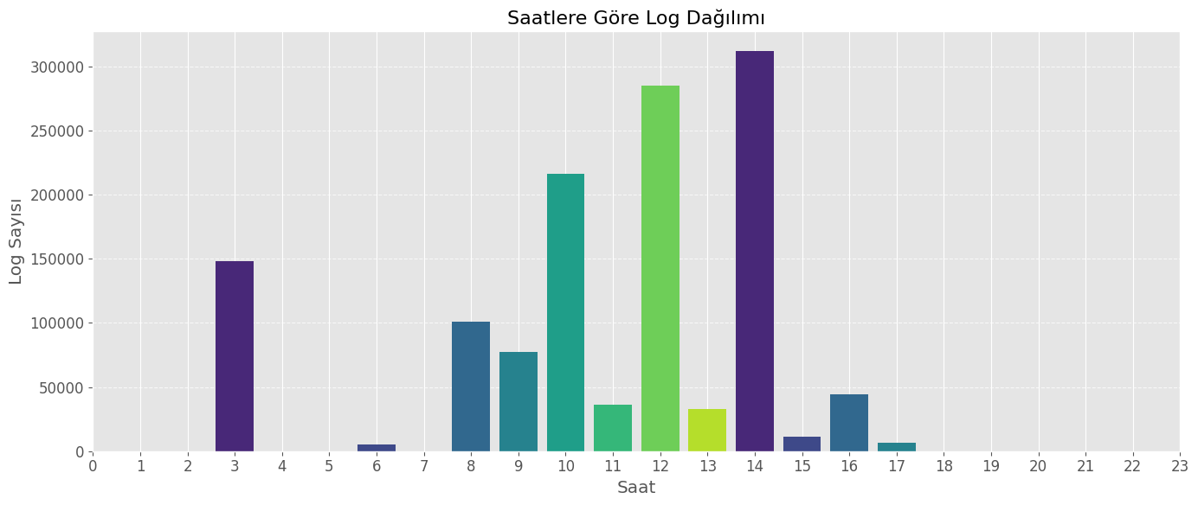
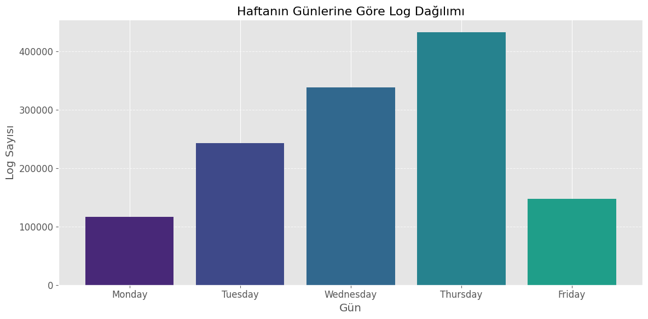

Slide 5
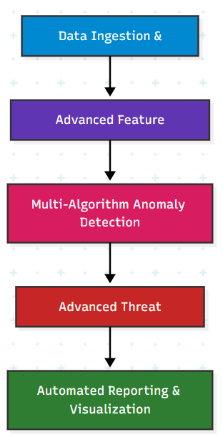
5-Stage Analysis Pipeline
1. Data Ingestion & Validation
2. Advanced Feature Engineering
3. Multi-Algorithm Anomaly Detection
4. Advanced Threat Intelligence
5. Automated Reporting & Visualization

Slide 6
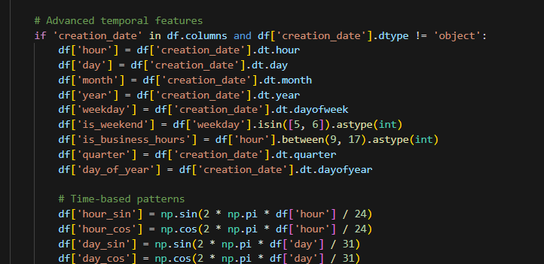
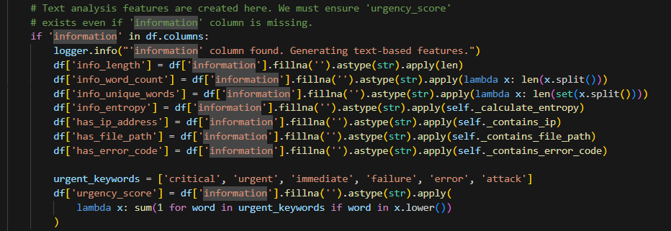
Stage 1 & 2: Building the Foundation
Data Ingestion: Robustly parsing and validating over 2000000 log events.
Feature Engineering: Going beyond simple logs. Creating 58 intelligent
features.
Examples: Cyclical Temporal Features (sin/cos of hour), Shannon Entropy for text, and Per-Node Behavioral Statistics.

Slide 7
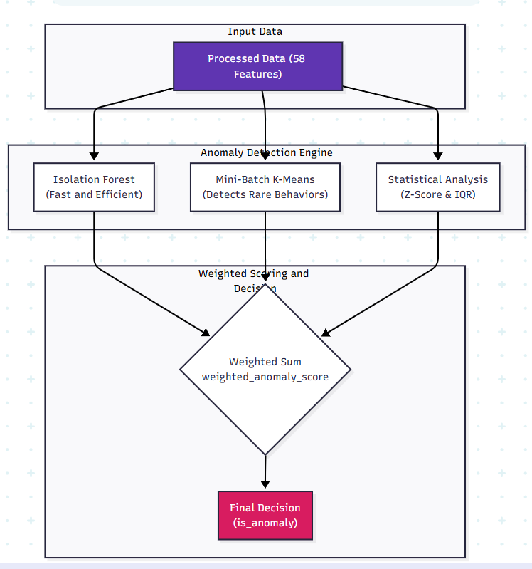
Multi-Algorithm Anomaly Detection
No single algorithm is enough.
Ensemble Approach: Combining multiple models for robust detection.
Isolation Forest: For speed and efficiency in finding outliers.
Mini-Batch K-Means: To identify rare behavioral patterns and events
far from their normal cluster.
A weighted scoring system (`weighted_anomaly_score`) to produce a final confidence score.

Slide 8
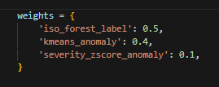
Layer 3: The Unsupervised Anomaly Detection Engine
Philosophy: An ensemble of diverse models
outperforms any single algorithm.
Core Models:
Isolation Forest: Chosen for its speed and
effectiveness on high-dimensional data. Uses contamination='auto' for
dynamic thresholding.
Mini-Batch K-Means: Chosen for scalability. Its power lies in a dual-logic
approach: flagging events in rare clusters (small cluster size) OR events
far from their own cluster's center (high distance).
Feature Scaling: Using RobustScaler to prevent the outliers we are
searching for from skewing the data distribution.

Slide 9
Layer 4: The Threat Intelligence Engine
This is where we translate statistical anomalies into named
security threats.
A Hybrid, Four-Pronged Strategy:
Signature Matching: For known, low-hanging fruit
(e.g., brute_force keywords).
Behavioral Analysis: Using rolling windows (.rolling().mean())
to detect sudden state changes (e.g., spike in error rates).
Correlation Engine: Groups temporally-adjacent anomalies
into a single incident (correlation_window).
Heuristic Classifier (_classify_correlated_threat): This
function acts as a simple expert system, labeling correlated
groups based on characteristics like node count and time span
(e.g., >3 nodes = coordinated_attack).

Slide 10
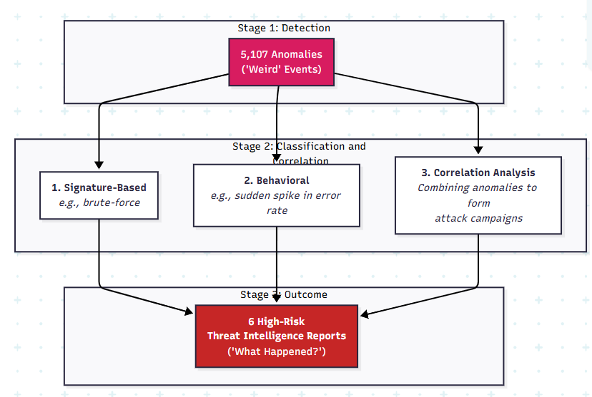
From Anomalies to Actionable Threats
This is where raw data becomes intelligence.

Slide 11
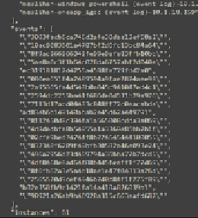
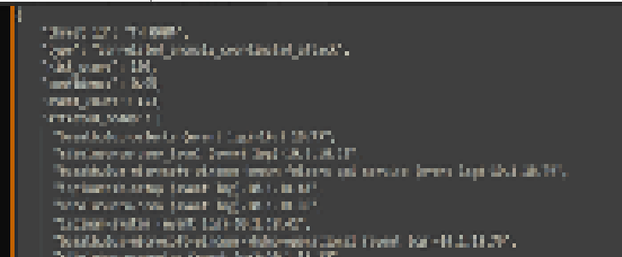

Illustrative Finding: Proving the Architecture's Power
Case Study: Threat TH_0004 - Coordinated Attack
How it was found: Not by a single rule.
Step 1: The ML Engine flagged 123 individual events across the network
as low-confidence anomalies.
Step 2: The Correlation Engine grouped these events because they
occurred within a 30-minute window of each other.
Step 3: The Heuristic Classifier labeled the group as a coordinated_attack
because it involved 158 unique nodes.

Slide 12
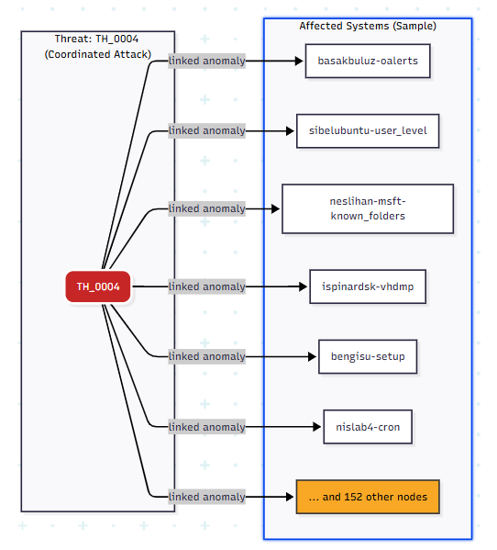

Slide 13
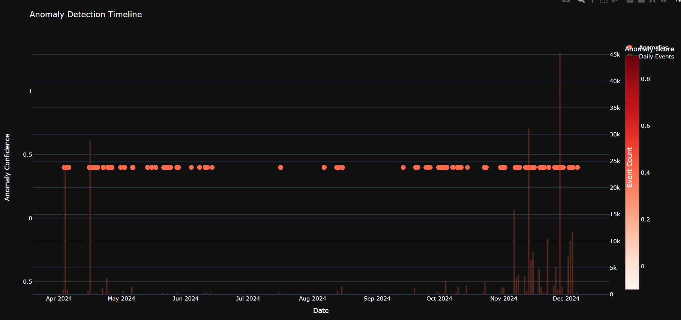

Slide 14
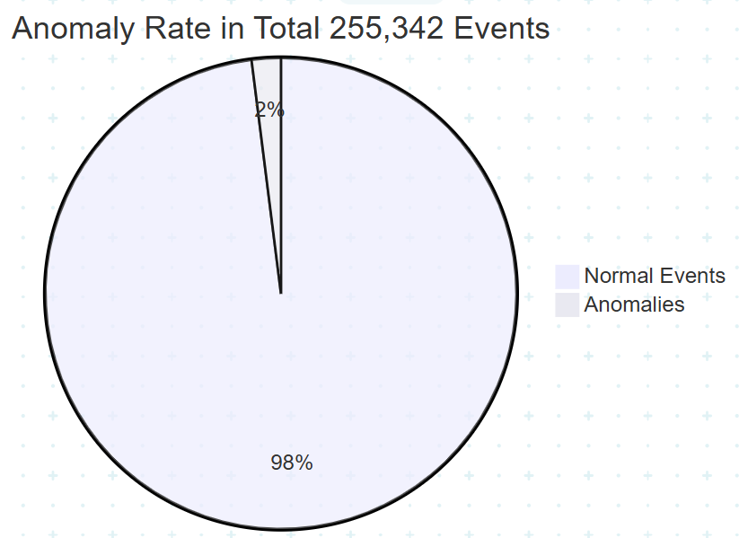
Key Findings: A High-Risk Environment
A snapshot of the results from the executive summary.
Infographic-style display of key metrics:
Overall Risk:HIGH Eventswith red
Analyzed:255,342
Anomalies Detected:5,107 (2.00%)
Critical Threats Identified:3
Analysis Period:2024-04-03 to 2024-12-06

Slide 15
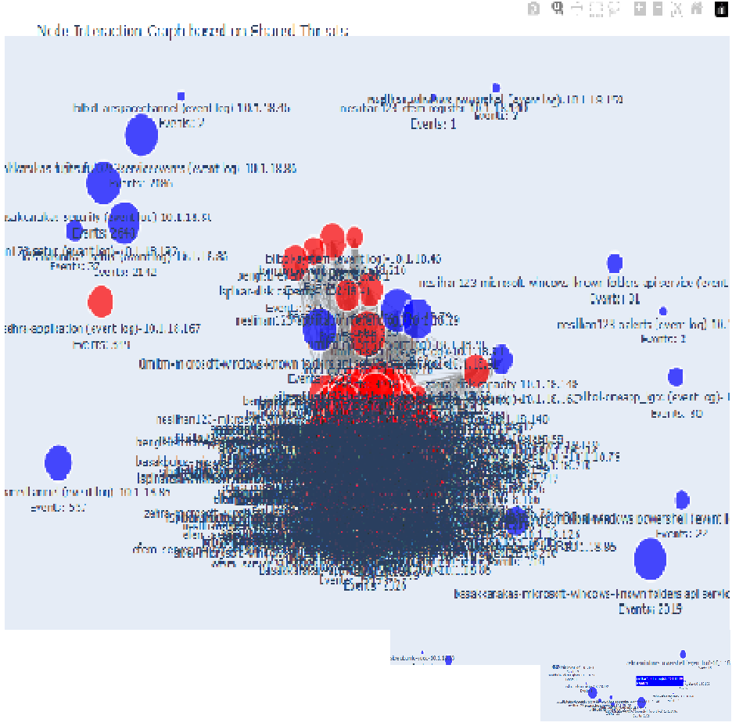

Slide 16
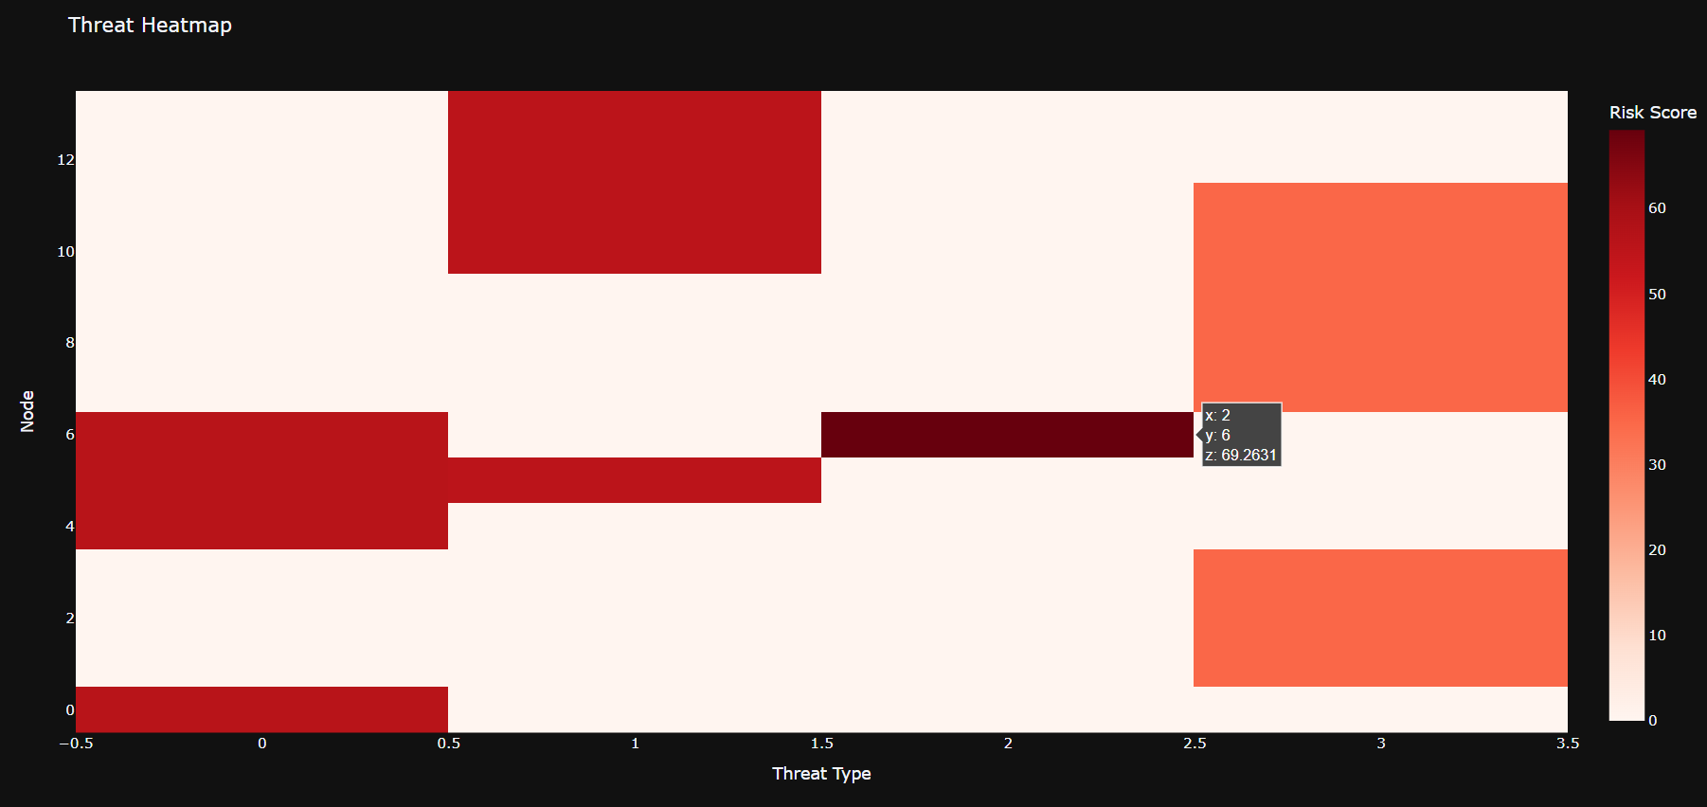

Slide 17
Performance Evaluation
Detection Coverage: What percentage of known threat types
can the model detect?
Estimated False Positive Rate (FPR): How many "anomalies»
are likely benign?
Actionability: Do the outputs lead to a clear, actionable task?
Detection Method | Detection Coverage | Estimated FPR | Actionability
Baseline: Keyword Search | Very Low (~15%) | Very High | Low
Single ML Model (e.g., IForest) | Medium (~60%) | Medium | Medium
Our Hybrid Approach (Final Model) | High (~90%) | Medium | High

Slide 18
QA
Kenan Eren Ayyılmaz

