Slide 1
The size of instruction .pngs is 1280x800
Size of fix, BSL, cues 1920x1200

Slide 2
To save it, go to the slide, select all
Then save as picture
Then go to https://www.iloveimg.com/resize-image/resize-png
For resizing the pic. Select pixels: 1920 1200
<

Slide 3


Slide 6
Instructions

Slide 7
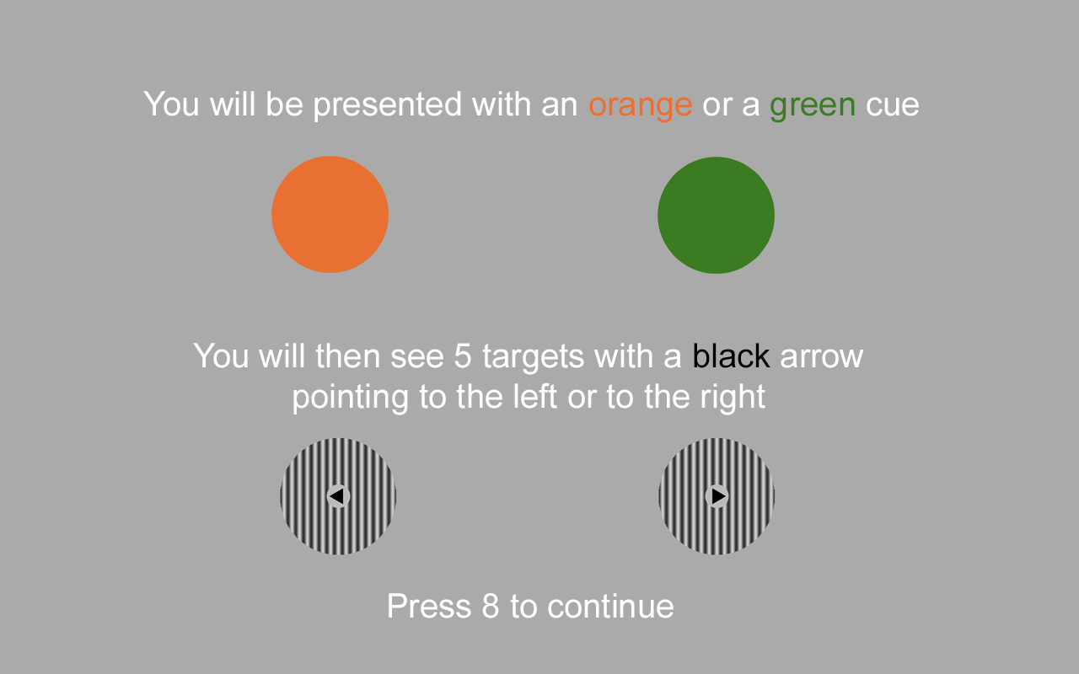
<
<

Slide 8
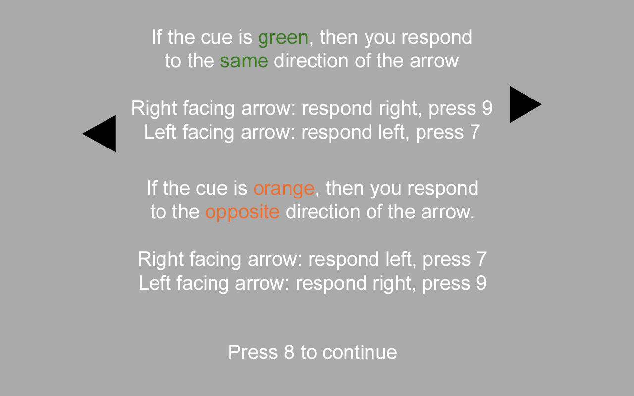

Slide 9
Other versions

