Slide 1
Paging

Slide 2
What?
In computer operating systems, paging is a memory management scheme by which a computer stores and retrieves data from secondary storage[a] for use in main memory. In this scheme, the operating system retrieves data from secondary storage in same-size blocks called pages.
The Paging Library helps you load and display small chunks of data at a time. Loading partial data on demand reduces usage of network bandwidth and system resources.

Slide 3
Set up
To import Paging components into your Android app, add the following dependencies to your app's build.gradle file:
dependencies { def paging_version = "2.1.2" implementation "androidx.paging:paging-runtime:$paging_version" // For Kotlin use paging-runtime-ktx // alternatively - without Android dependencies for testing testImplementation "androidx.paging:paging-common:$paging_version" // For Kotlin use paging-common-ktx // optional - RxJava support implementation "androidx.paging:paging-rxjava2:$paging_version" // For Kotlin use paging-rxjava2-ktx }

Slide 4
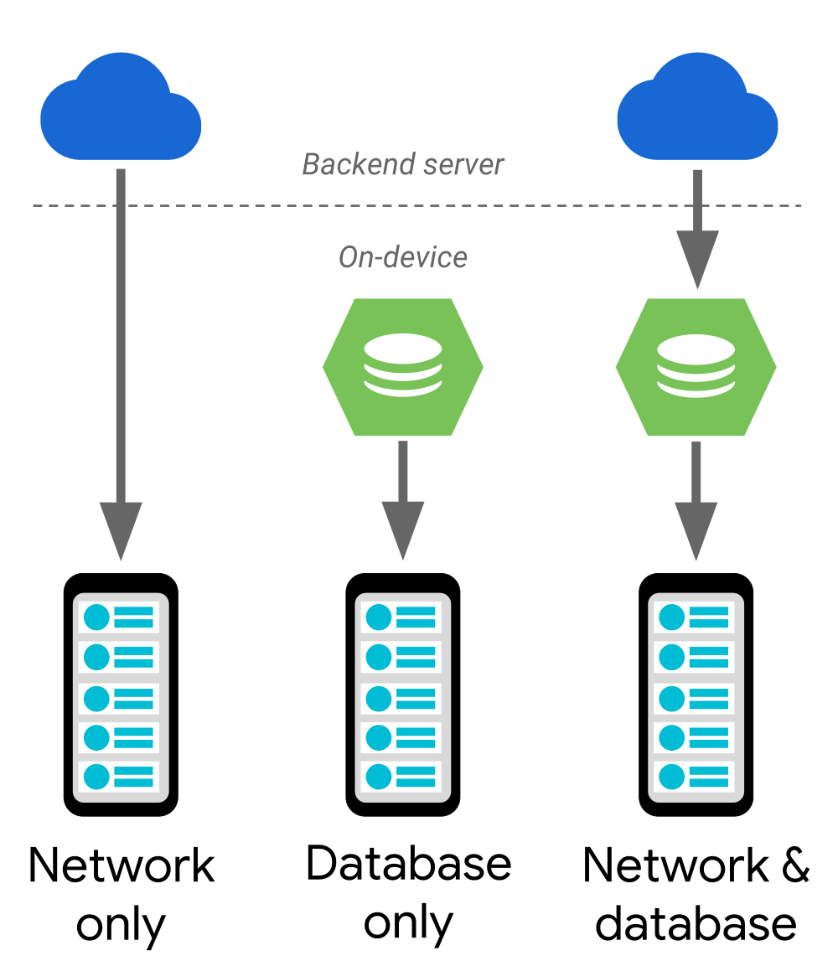
Support different data architectures
The Paging Library supports the following data architectures:
Served only from a backend server.
Stored only in an on-device database.
A combination of the other sources, using the on-device database as a cache.

Slide 5
Paged list
The Paging Library's key component is the PagedList class, which loads chunks of your app's data, or pages. As more data is needed, it's paged into the existing PagedList object. If any loaded data changes, a new instance of PagedList is emitted to the observable data holder from a LiveData or RxJava2-based object. As PagedList objects are generated, your app's UI presents their contents, all while respecting your UI controllers' lifecycles.
public class ConcertViewModel extends ViewModel { private ConcertDao concertDao; public final LiveData<PagedList<Concert>> concertList; // Creates a PagedList object with 50 items per page. public ConcertViewModel(ConcertDao concertDao) { this.concertDao = concertDao; concertList = new LivePagedListBuilder<>( concertDao.concertsByDate(), 50).build(); } }

Slide 6
Data
Each instance of PagedList loads an up-to-date snapshot of your app's data from its corresponding DataSource object. Data flows from your app's backend or database into the PagedList object.
It can bee easily sync with Room as data source
But for more you need to implement the DataSource

Slide 7
Data Source
To implement, extend one of the subclasses: PageKeyedDataSource, ItemKeyedDataSource, or PositionalDataSource.
Use PageKeyedDataSource if pages you load embed keys for loading adjacent pages. For example a network response that returns some items, and a next/previous page links.
Use ItemKeyedDataSource if you need to use data from item N-1 to load item N. For example, if requesting the backend for the next comments in the list requires the ID or timestamp of the most recent loaded comment, or if querying the next users from a name-sorted database query requires the name and unique ID of the previous.
Use PositionalDataSource if you can load pages of a requested size at arbitrary positions, and provide a fixed item count. PositionalDataSource supports querying pages at arbitrary positions, so can provide data to PagedLists in arbitrary order.

Slide 8
Immutable Data
A PagedList / DataSource pair are a snapshot of the data set. A new pair of PagedList / DataSource must be created if an update occurs, such as a reorder, insert, delete, or content update occurs. A DataSource must detect that it cannot continue loading its snapshot (for instance, when Database query notices a table being invalidated), and call invalidate(). Then a new PagedList / DataSource pair would be created to load data from the new state of the Database query.

Slide 9
Paging 3
In-memory caching for your paged data. This ensures that your app uses system resources efficiently while working with paged data.
Built-in request deduplication, ensuring that your app uses network bandwidth and system resources efficiently.
Configurable RecyclerView adapters that automatically request data as the user scrolls toward the end of the loaded data.
First-class support for Kotlin coroutines and Flow, as well as LiveData and RxJava.
Built-in support for error handling, including refresh and retry capabilities.

