Slide 1
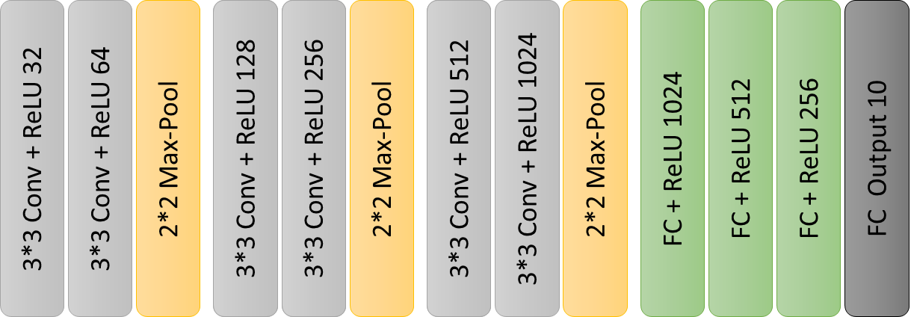
3*3 Conv + ReLU 32
3*3 Conv + ReLU 64
2*2 Max-Pool
3*3 Conv + ReLU 128
3*3 Conv + ReLU 128
3*3 Conv + ReLU 256
3*3 Conv + ReLU 256
2*2 Max-Pool
3*3 Conv + ReLU 512
3*3 Conv + ReLU 512
3*3 Conv + ReLU 1024
2*2 Max-Pool
FC + ReLU 1024
FC + ReLU 512
FC + ReLU 256
FC Output 10

Slide 2
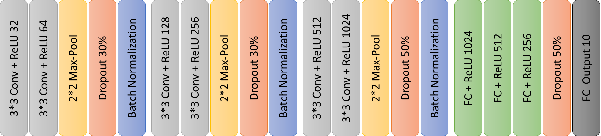
3*3 Conv + ReLU 32
3*3 Conv + ReLU 128
3*3 Conv + ReLU 64
3*3 Conv + ReLU 256
2*2 Max-Pool
Dropout 30%
3*3 Conv + ReLU 256
Batch Normalization
3*3 Conv + ReLU 128
3*3 Conv + ReLU 128
3*3 Conv + ReLU 256
3*3 Conv + ReLU 256
2*2 Max-Pool
Dropout 30%
3*3 Conv + ReLU 256
Batch Normalization
3*3 Conv + ReLU 512
3*3 Conv + ReLU 128
3*3 Conv + ReLU 1024
3*3 Conv + ReLU 256
2*2 Max-Pool
Dropout 50%
3*3 Conv + ReLU 256
Batch Normalization
FC + ReLU 1024
3*3 Conv + ReLU 128
FC + ReLU 512
3*3 Conv + ReLU 256
FC + ReLU 256
Dropout 50%
3*3 Conv + ReLU 256
FC Output 10

Slide 3
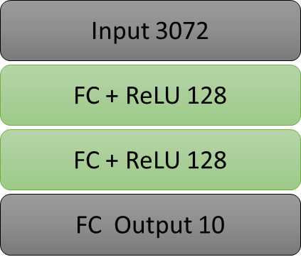
Input 3072
FC + ReLU 128
FC + ReLU 128
FC Output 10

