Slide 1
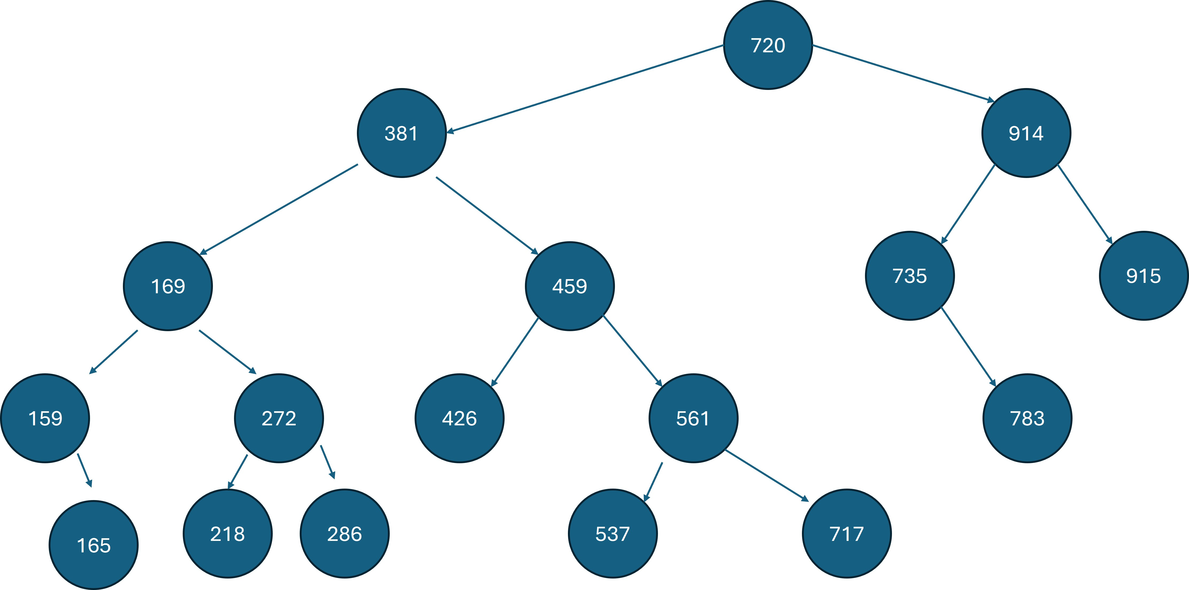
AVL Tree
Author: Erfan Rezaei Course: Data Structures Instructor: Alireza Nikian
University: Islamic Azad University, Najafabad Branch

Slide 2
Reminder
X
TL < X
BST =>
TR > X
TL
TR

Slide 3
Reminder
Input: [1 : n]
1
h = n - 1
Search, Insert, Delete
BST
2
3
Big-Oh = O(h) = O(n)
4
Unbalanced !!
n
Worst case

Slide 4
⌊log ​n⌋ ≤ h ≤ n - 1
Best case
Worst case
+1
0
+1
Balance ?
-1
h(TR) – h(TL) =
0
-1

Slide 5
40, 60, 50, 33, 55, 11
⌊log ​n⌋ ≤ h ≤ n - 1
n = 6
40
AVL
50
BST
33
60
33
60
Balance
11
50
11
40
55
55
h = 3
h = ⌊log ​n⌋ = 2
✅
Best case

Slide 6

AVL Tree
An AVL tree defined as a self-balancing Binary Search Tree (BST) where the difference between heights of left and right subtrees for any node cannot be more than one.
Search, Insert, Delete
Self-balancing how?
Big-Oh = O(log n)
- Balance Factor:
The difference between the heights of the left subtree and the right subtree for any node is known as the balance factor of the node.
{-1, 0, +1}

Slide 7
+1
BF =
0
-1
+1
0
40
AVL
50
BST
-1
-2
0
-1
33
60
33
60
0
1
11
50
0
0
11
40
55
0
0
55

Slide 8
Self-balancing how?
An AVL tree may rotate in one of the following four ways to keep itself balanced:
Left Rotation
Right Rotation
Left-Right Rotation
Right-Left Rotation

Slide 9
Left Rotation
2
0
Z
Z
Y
+1
Y
Y
0
0
0
Z
X
X
X

Slide 10
Right Rotation
-2
Z
Z
0
Y
-1
Y
Y
0
0
X
Z
0
X
X

Slide 11
Left-Right Rotation
-2
-2
Z
0
Z
1
X
Y
X
0
0
0
Y
Z
X
Y

Slide 12
Right-Left Rotation
2
2
0
Z
Z
X
-1
Y
X
0
0
Z
Y
0
Y
X

Slide 13
Insertion in an AVL Tree
Let w be the node to be inserted.
Perform standard BST insert for w.
Starting from w, travel up and find the first unbalanced node. Let z be the first unbalanced node, y be the child of z that comes on the path from w to z and x be the child of y that comes on the path from w to z.
Re-balance the tree by performing appropriate rotations on the subtree rooted with z. There can be 4 possible cases that need to be handled as x, y and z can be arranged in 4 ways. Following are the possible 4 arrangements:
y is the left child of z and x is the left child of y (Left Left Case)
y is the left child of z and x is the right child of y (Left Right Case)
y is the right child of z and x is the right child of y (Right Right Case)
y is the right child of z and x is the left child of y (Right Left Case)

Slide 14
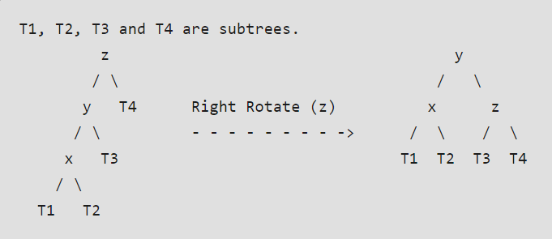
Left Left Case

Slide 15
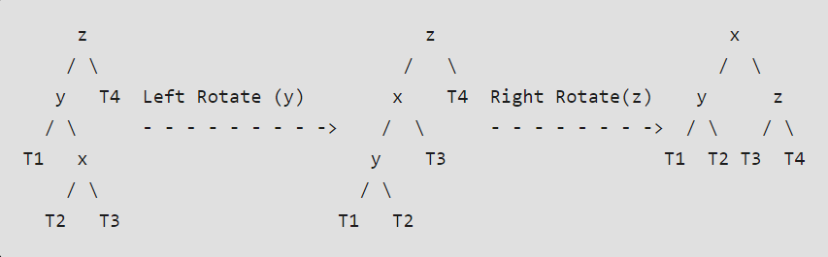
Left Right Case

Slide 16
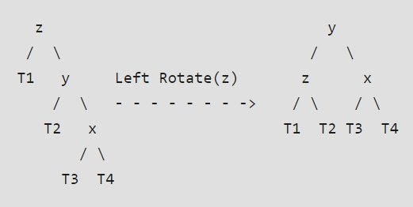
Right Right Case

Slide 17
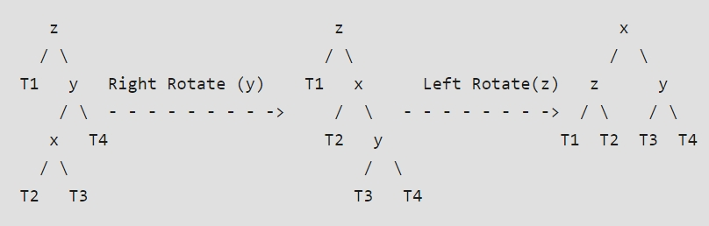
Right Left Case

Slide 18
Practice
Draw the AVL tree for the following numbers.
25, 20, 5, 34, 50, 30, 10

Slide 19
Deletion in an AVL Tree
Let w be the node to be deleted.
Perform standard BST delete for w.
Starting from w, travel up and find the first unbalanced node. Let z be the first unbalanced node, y be the larger height child of z, and x be the larger height child of y. Note that the definitions of x and y are different from insertion here.
Re-balance the tree by performing appropriate rotations on the subtree rooted with z. There can be 4 possible cases that needs to be handled as x, y and z can be arranged in 4 ways just like insertion. Following are the possible 4 arrangements:
y is the left child of z and x is the left child of y (Left Left Case)
y is the left child of z and x is the right child of y (Left Right Case)
y is the right child of z and x is the right child of y (Right Right Case)
y is the right child of z and x is the left child of y (Right Left Case)

Slide 20
Notes !!
Note that, Unlike insertion, in deletion, after we perform a rotation at z, we may have to perform a rotation at ancestors of z. Thus, we must continue to trace the path until we reach the root.
In code implementation, The idea is to use recursive BST insert and delete, after these operations, we get pointers to all ancestors one by one in a bottom-up manner. So, we don’t need a parent pointer to travel up. The recursive code itself travels up and visits all the ancestors of nodes.
The rotation operations (left and right rotate) take constant time (O(1)) as only a few pointers are being changed there. Updating the height and getting the balance factor also takes constant time (O(1)). So, the time complexity of the AVL insert, delete, search remains the same as the BST operations which were O(h) where h is the height of the tree. Since the AVL tree is balanced, the height is O(log n). So, time complexity of AVL insert, delete and search is always O(log n).

Slide 21
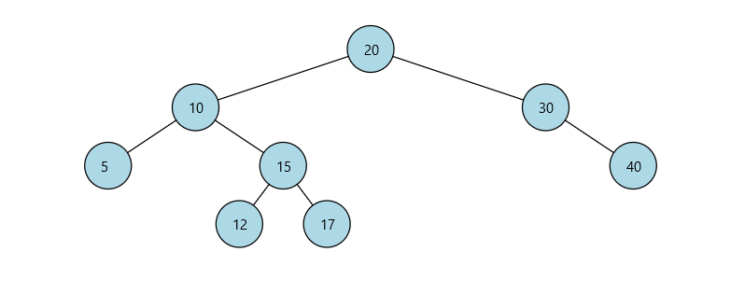
Practice
Perform deletion for node 20 on the following AVL tree.

Slide 22
The End

