Slide 1
Thread Pools
Author: Erfan Rezaei Course: Operating Systems Instructor: Alireza Nikian
University: Islamic Azad University, Najafabad Branch

Slide 2

Why do we need Thread Pools?
1- Thread Creation Is Expensive
Creating a thread takes time and system resources (e.g., memory for the call stack, OS scheduling overhead).
In high-performance or real-time systems, creating a new thread for each task is inefficient.
🧨 Problem: Creating/destroying threads frequently = performance bottlenecks.

Slide 3
Why do we need Thread Pools?
2- Too Many Threads = System Crash or Thrashing
If you create too many threads (e.g., thousands of users), the system may:
Run out of memory (each thread needs its own stack).
Spend all time context-switching between threads (called CPU thrashing).
🧨 Problem: Uncontrolled thread creation can degrade or crash the system.

Slide 4
Why do we need Thread Pools?
3- No Reuse of Threads
Without pooling, each task gets a new thread.
When a task finishes, the thread dies — wasted effort.
🧨 Problem: Threads not reused → inefficient resource usage.

Slide 5
Why do we need Thread Pools?
4- Hard to Manage Thread Lifecycle
Manually managing threads (start, interrupt, kill) is complex and error-prone.
Developers had to deal with: Race conditions, Deadlocks, and Manual synchronization.
🧨 Problem: Manual thread management = high risk of bugs.

Slide 6
Why do we need Thread Pools?
5- Lack of Task Scheduling or Throttling
No way to Limit the number of concurrent threads, delay or schedule execution, and queue tasks in a managed way
🧨 Problem: No control over execution policies or workload limits.

Slide 7
What is Thread Pool?
A thread pool reuses previously created threads to execute current tasks and offers a solution to the problem of thread cycle overhead and resource thrashing. Since the thread is already existing when the request arrives, the delay introduced by thread creation is eliminated, making the application more responsive.

Slide 8
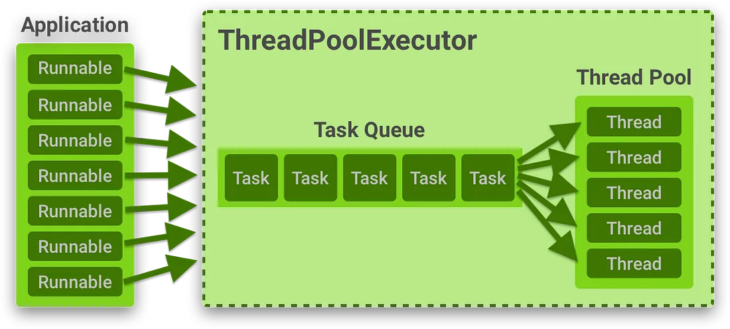

Slide 9
The End

