Slide 1
Clustering and expectation maximization
School of Electrical and Computer Engineering
University of Tehran
Erfan Darzi
erfandarzi@ut.ac.ir

Slide 2


Clustering as graph cut
Describe the pairwise distance via a graph

Slide 3
Clustering as graph cut
Describe the pairwise distance via a graph
Clustering can be obtained via graph cut

Slide 4
Clustering as graph cut
Describe the pairwise distance via a graph
Clustering can be obtained via graph cut

Slide 5
Clustering as graph cut
Describe the pairwise distance via a graph
Clustering can be obtained via graph cut
Cut by class label
Cut by cluster label

Slide 6
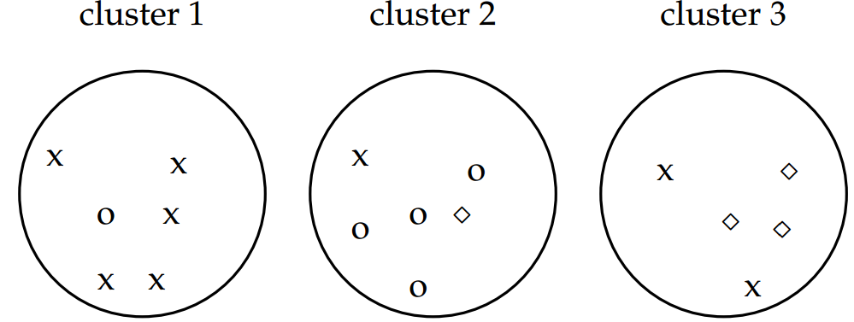
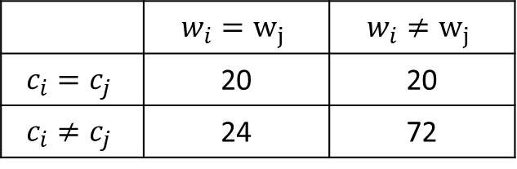

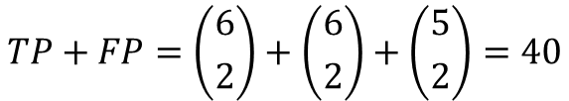
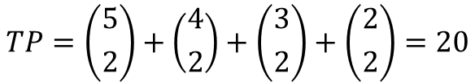
Recap: external validation
Given class label $Ω$ on each instance
Rand index
 | $$w_{i}=w_{j}$$ | $$w_{i}≠w_{j}$$
$$c_{i}=c_{j}$$ | 20 | 20
$$c_{i}≠c_{j}$$ | 24 | 72
$$TP+FP=\left({6 \atop 2}\right)+\left({6 \atop 2}\right)+\left({5 \atop 2}\right)=40$$
$$TP=\left({5 \atop 2}\right)+\left({4 \atop 2}\right)+\left({3 \atop 2}\right)+\left({2 \atop 2}\right)=20$$

Slide 7
k-means Clustering
Hongning Wang

Slide 8
Today’s lecture
k-means clustering
A typical partitional clustering algorithm
Convergence property
Expectation Maximization algorithm
Gaussian mixture model

Slide 9







Partitional clustering algorithms
Partition instances into exactly k non-overlapping clusters
Flat structure clustering
Users need to specify the cluster size k
Task: identify the partition of k clusters that optimize the chosen partition criterion

Slide 10
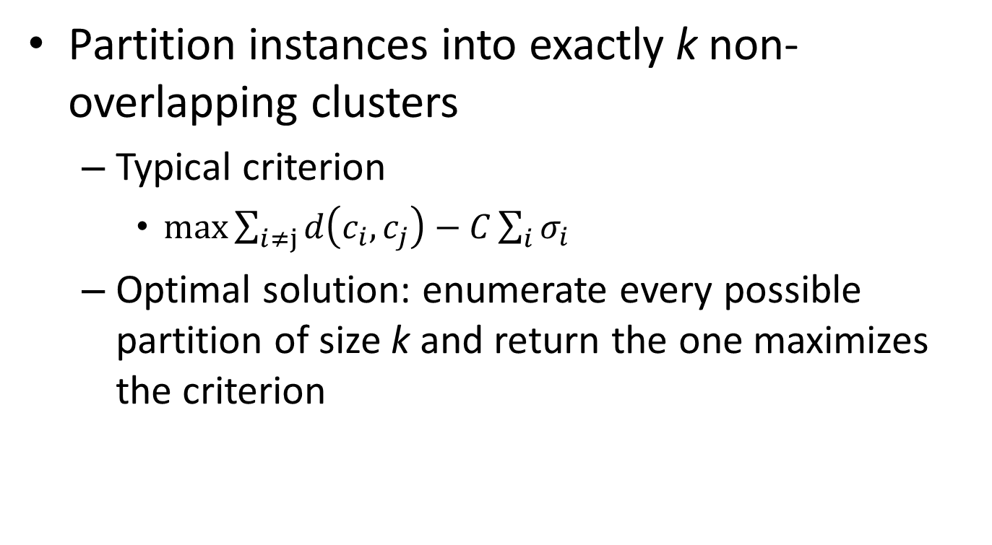
Partitional clustering algorithms
Partition instances into exactly k non-overlapping clusters
Typical criterion
$\max{\sum_{i≠j}{d\left(c_{i},c_{j}\right)}−C\sum_{i}{σ_{i}}}$
Optimal solution: enumerate every possible partition of size k and return the one maximizes the criterion
Optimize this in an alternative way
Inter-cluster distance
Intra-cluster distance
Let’s approximate this!
Unfortunately, this is NP-hard!

Slide 11
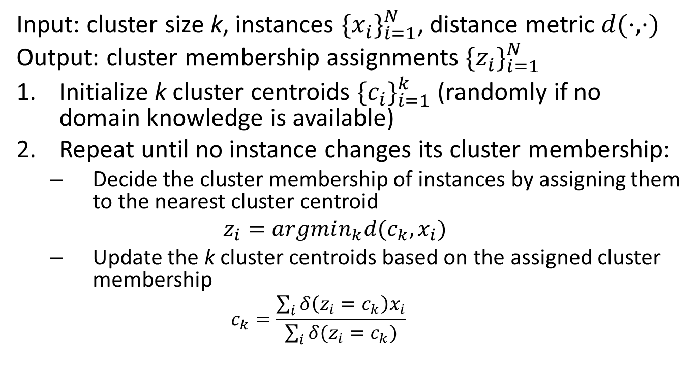
k-means algorithm
Input: cluster size k, instances ${\{x_{i}\}}_{i=1}^{N}$, distance metric $d(⋅,⋅)$
Output: cluster membership assignments ${\{z_{i}\}}_{i=1}^{N}$
Initialize k cluster centroids ${\{c_{i}\}}_{i=1}^{k}$ (randomly if no domain knowledge is available)
Repeat until no instance changes its cluster membership:
Decide the cluster membership of instances by assigning them to the nearest cluster centroid
$$z_{i}=argmin_{k}d(c_{k},x_{i})$$
Update the k cluster centroids based on the assigned cluster membership
$$c_{k}=\frac{\sum_{i}{δ\left(z_{i}=c_{k}\right)x_{i}}}{\sum_{i}{δ(z_{i}=c_{k})}}$$
Minimize intra distance
Maximize inter distance

Slide 12
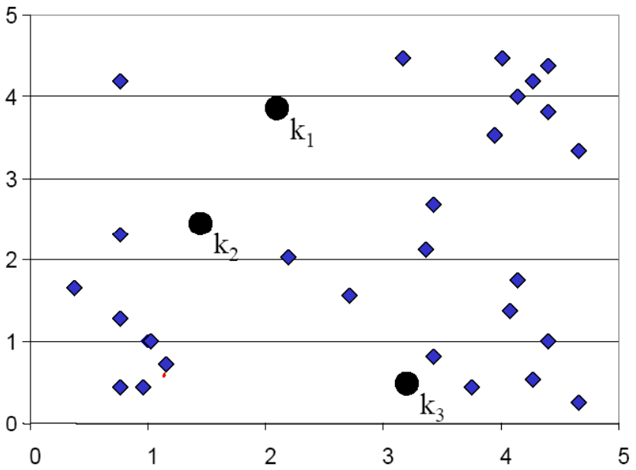
k-means illustration

Slide 13
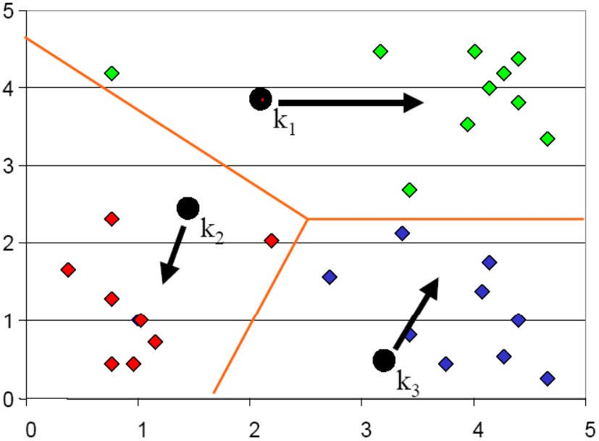
k-means illustration
Voronoi diagram

Slide 14
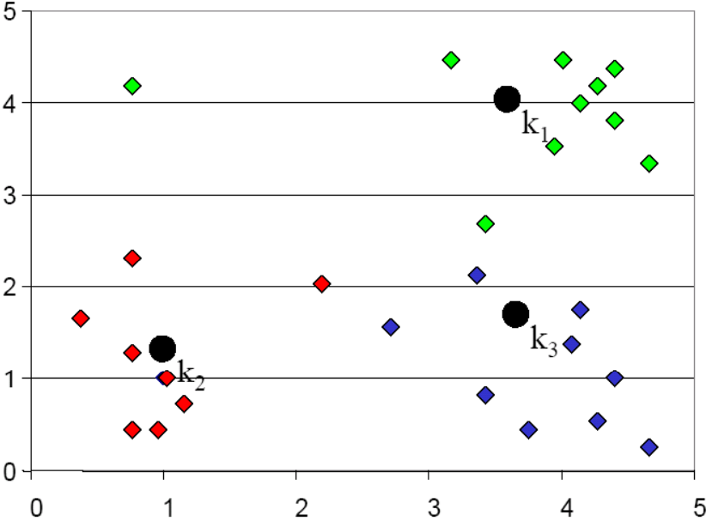
k-means illustration

Slide 15
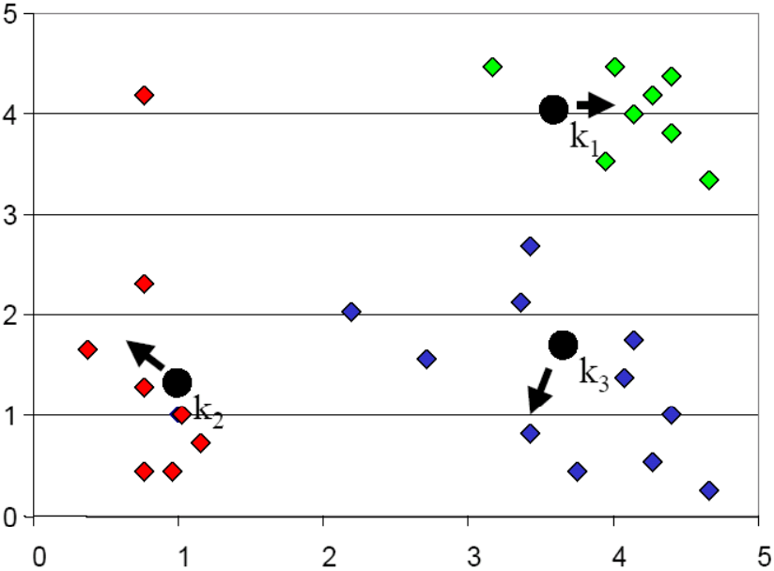
k-means illustration

Slide 16
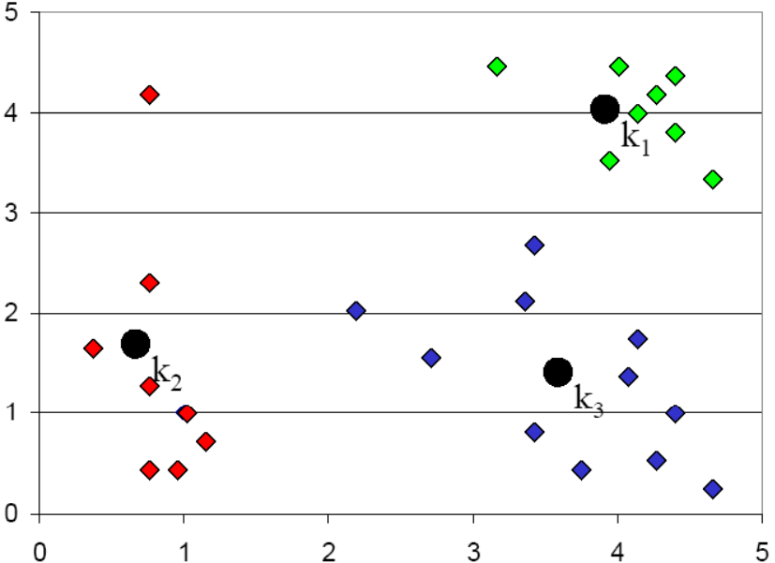
k-means illustration

Slide 17
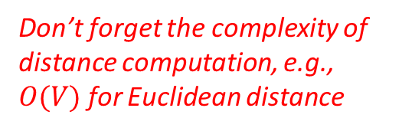
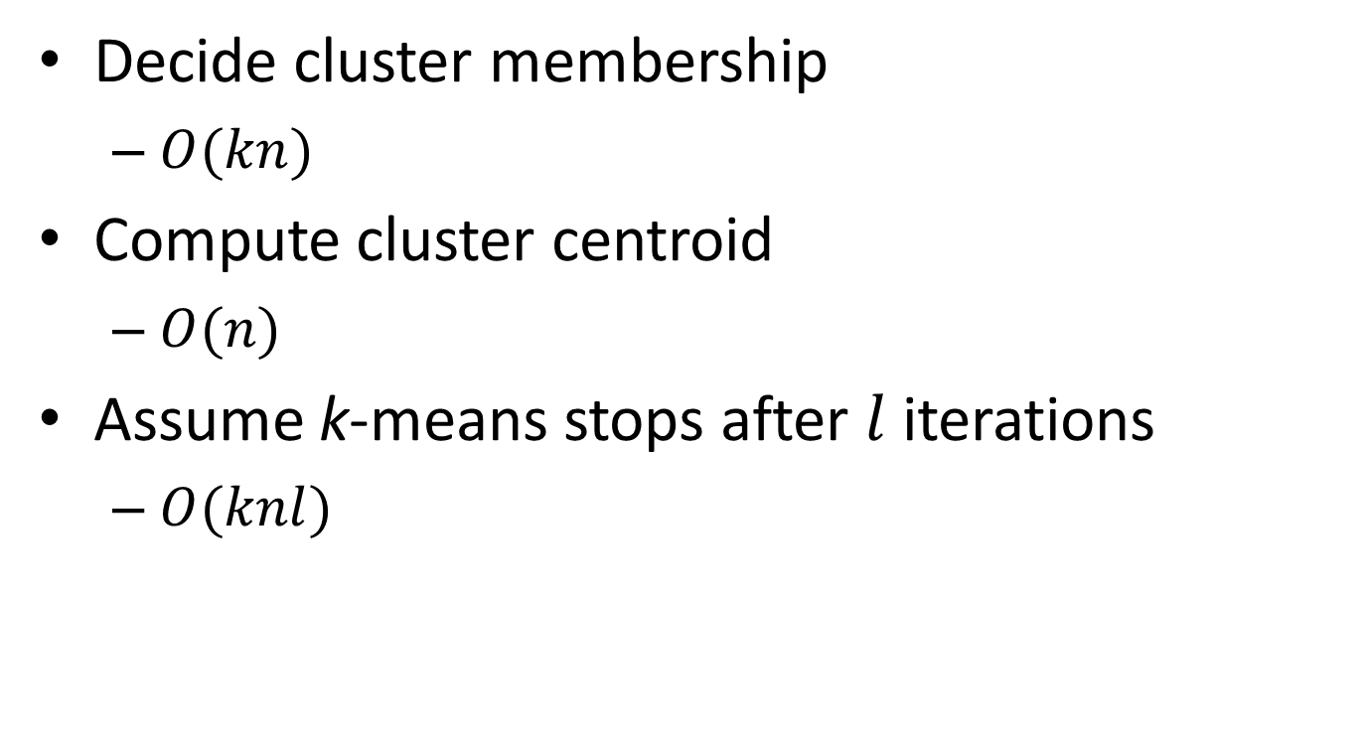
Complexity analysis
Decide cluster membership
$O(kn)$
Compute cluster centroid
$O(n)$
Assume k-means stops after $l$ iterations
$O(knl)$
Don’t forget the complexity of distance computation, e.g., $O(V)$ for Euclidean distance

Slide 18
Convergence property
Why will k-means stop?
Answer: it is a special version of Expectation Maximization (EM) algorithm, and EM is guaranteed to converge
However, it is only guaranteed to converge to local optimal, since k-means (EM) is a greedy algorithm

Slide 19
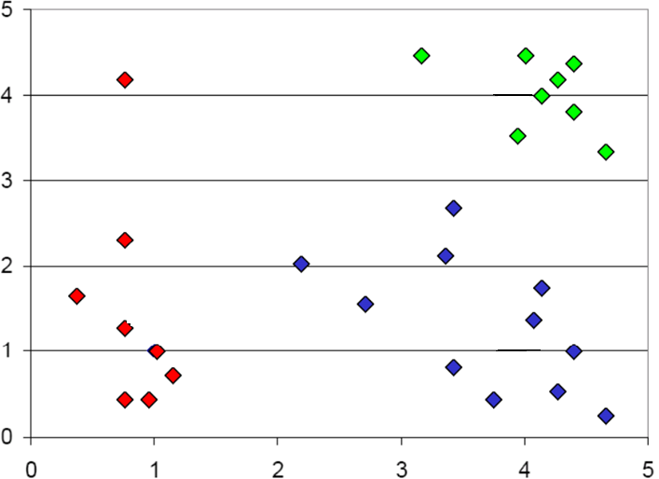




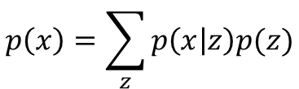
Probabilistic interpretation of clustering
The density model of $p\left(x\right)$ is multi-modal
Each mode represents a sub-population
E.g., unimodal Gaussian for each group
$$p(x|z=2)$$
Mixture model
$$p(x|z=1)$$
$$p\left(x\right)=\sum_{z}{p\left(x | z\right)p(z)}$$
Unimodal distribution
Mixing proportion
$$p(x|z=3)$$

Slide 20

Probabilistic interpretation of clustering
If $z$ is known for every $x$
Estimating $p(z)$ and $p(x|z)$ is easy
Maximum likelihood estimation
This is Naïve Bayes
$$p(x|z=2)$$
Mixture model
$$p(x|z=1)$$
$$p\left(x\right)=\sum_{z}{p\left(x | z\right)p(z)}$$
Unimodal distribution
Mixing proportion
$$p(x|z=3)$$

Slide 21
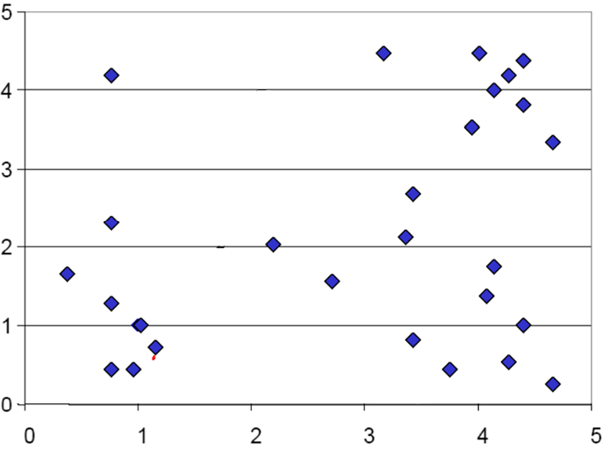




Probabilistic interpretation of clustering
Usually a constrained optimization problem
But $z$ is unknown for all $x$
Estimating $p(z)$ and $p(x|z)$ is generally hard
$\max_{α,β}{\sum_{i}{\log{\sum_{z_{i}}{p\left(x_{i} | z_{i},β\right)p(z_{i}|α)}}}}$
Appeal to the Expectation Maximization algorithm
$$p\left(x | z=2\right)?$$
Mixture model
$$p\left(x | z=1\right)?$$
$$p\left(x\right)=\sum_{z}{p\left(x | z\right)p(z)}$$
Unimodal distribution
Mixing proportion
$$p\left(x | z=3\right)?$$

Slide 22
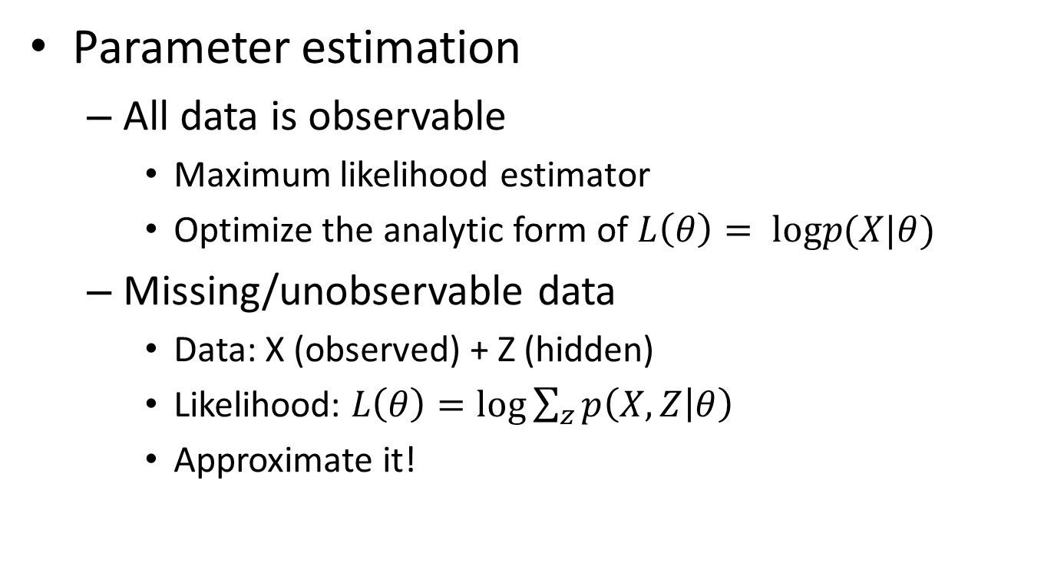
Introduction to EM
Parameter estimation
All data is observable
Maximum likelihood estimator
Optimize the analytic form of $L\left(θ\right)= logp(X|θ)$
Missing/unobservable data
Data: X (observed) + Z (hidden)
Likelihood: $L\left(θ\right)=\log{\sum_{z}{p\left(X,Z | θ\right)}}$
Approximate it!
E.g. cluster membership
Most of cases are intractable

Slide 23
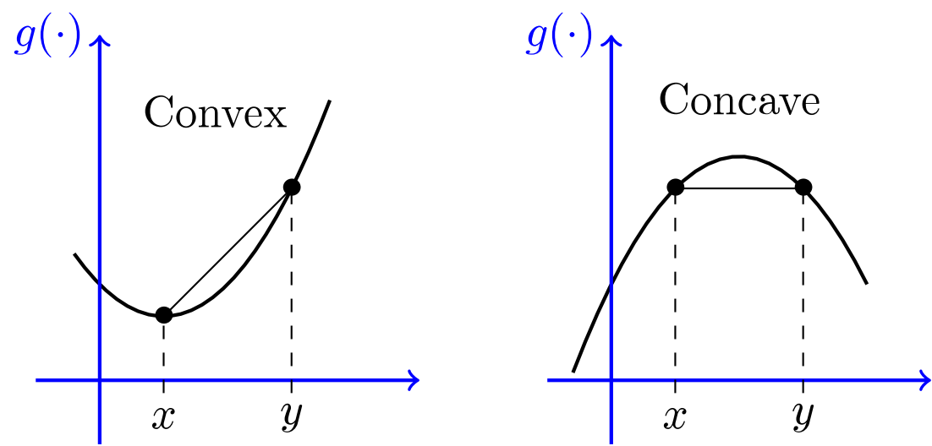
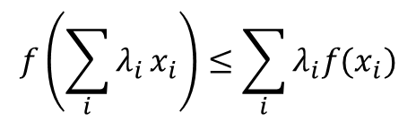


Background knowledge
Jensen's inequality
For any convex function $f(x)$ and positive weights $λ,$
$$f\left(\sum_{i}{λ_{i}}x_{i}\right)≤\sum_{i}{λ_{i}f(x_{i})}$$
$$\sum_{i}{λ_{i}}=1$$

Slide 24
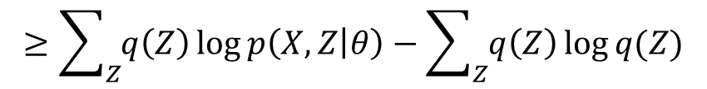


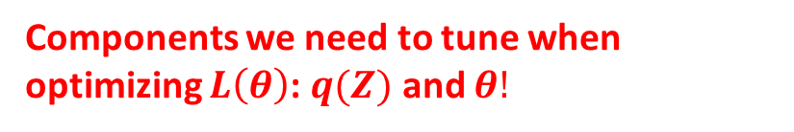

Expectation Maximization
Maximize data likelihood function by pushing the lower bound
$L\left(θ\right)= log\sum_{Z}{p\left(X,Z | θ\right)}=\log{\sum_{Z}{\frac{q\left(Z\right)p\left(X,Z | θ\right)}{q\left(Z\right)}}}$
Proposal distributions for $Z$
Jensen's inequality
$$≥\sum_{Z}{q\left(Z\right)\log{p\left(X,Z | θ\right)}}−\sum_{Z}{q\left(Z\right)\log{q(Z)}}$$
$$f\left(E\left[x\right]\right)≥E[f(x)]$$
Lower bound!
Components we need to tune when optimizing $L\left(θ\right)$: $q(Z)$ and $θ!$

Slide 25
Intuitive understanding of EM
Data likelihood p(X| θ)
Easier to optimize, guarantee to improve data likelihood
Lower bound
θ

Slide 26
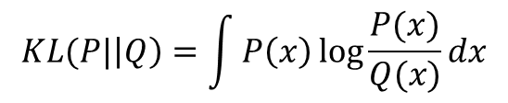


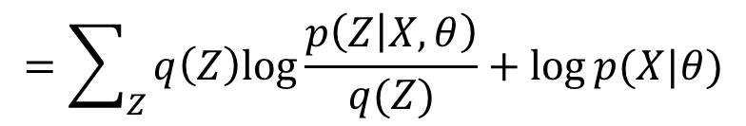
Expectation Maximization (cont)
Optimize the lower bound w.r.t. $q(Z)$
$L\left(θ\right)≥\sum_{Z}{q\left(Z\right)\log{p\left(X,Z | θ\right)}}−\sum_{Z}{q\left(Z\right)\log{q(Z)}}$
$$=\sum_{Z}{q\left(Z\right)\left[\log{p\left(Z | X,θ\right)}+\log{p(X|θ)}\right]}−\sum_{Z}{q\left(Z\right)\log{q(Z)}}$$
$$=\sum_{Z}{q\left(Z\right)log\frac{p\left(Z | X,θ\right)}{q(Z)}}+log⁡p(X|θ)$$
negative KL-divergence between $q(Z)$ and $p\left(Z | X,θ\right)$
Constant with respect to $q(Z)$
$$KL(P|\left|Q\right)=\int{P\left(x\right)\log{\frac{P(x)}{Q(x)}}dx}$$

Slide 27
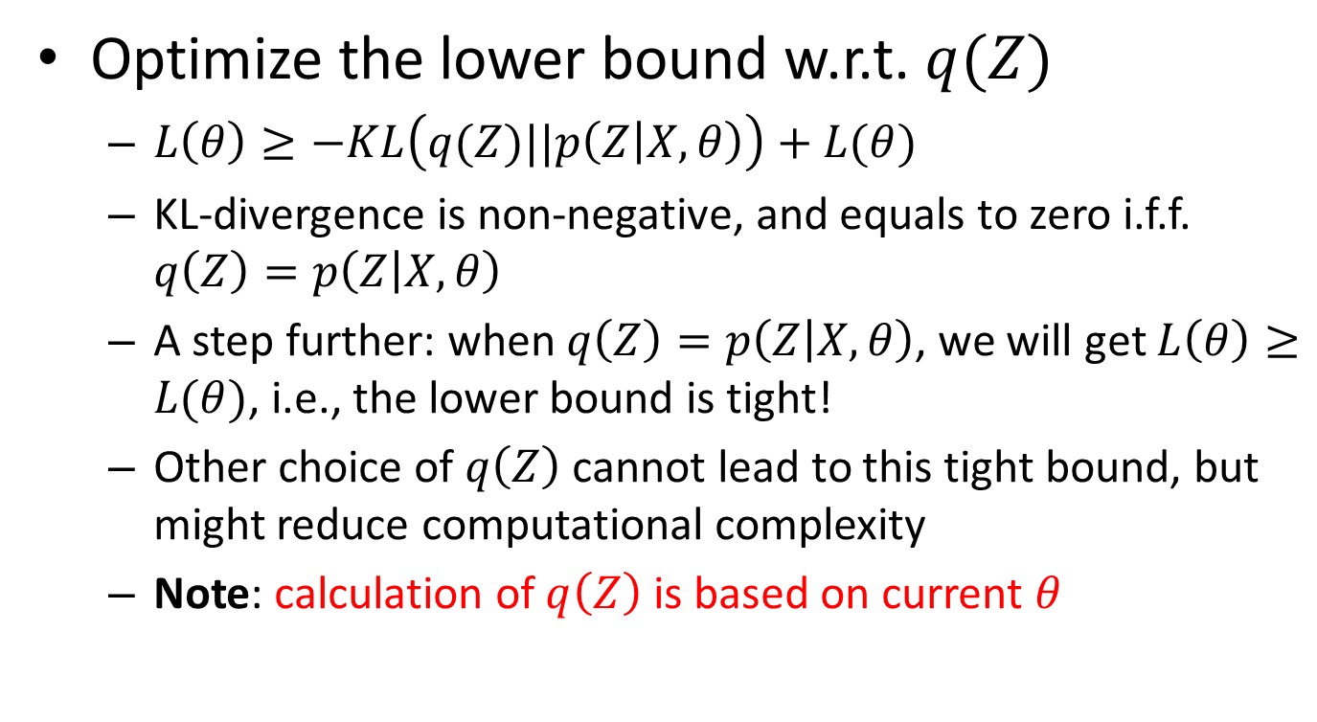
Expectation Maximization (cont)
Optimize the lower bound w.r.t. $q(Z)$
$L\left(θ\right)≥−KL\left(q(Z)||p\left(Z | X,θ\right)\right)+L(θ)$
KL-divergence is non-negative, and equals to zero i.f.f. $q\left(Z\right)=p\left(Z | X,θ\right)$
A step further: when $q\left(Z\right)=p\left(Z | X,θ\right)$, we will get $L\left(θ\right)≥L(θ)$, i.e., the lower bound is tight!
Other choice of $q\left(Z\right)$ cannot lead to this tight bound, but might reduce computational complexity
Note: calculation of $q\left(Z\right)$ is based on current $θ$

Slide 28


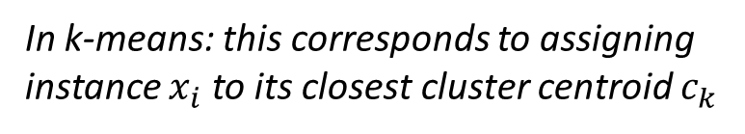
Expectation Maximization (cont)
Optimize the lower bound w.r.t. $q(Z)$
Optimal solution: $q\left(Z\right)=p\left(Z|X,θ^{t}\right)$
Posterior distribution of $Z$ given current model $θ^{t}$
In k-means: this corresponds to assigning instance $x_{i}$ to its closest cluster centroid $c_{k}$
$$z_{i}=argmin_{k}d(c_{k},x_{i})$$

Slide 29


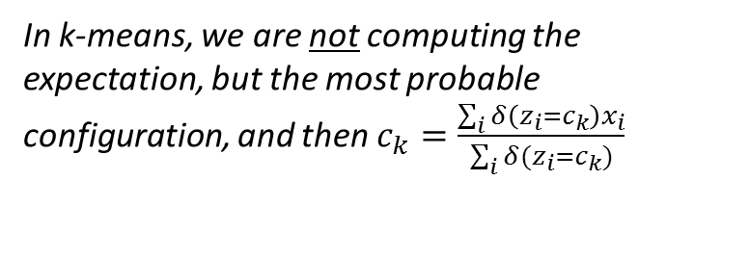

Expectation Maximization (cont)
Optimize the lower bound w.r.t. $θ$
$L\left(θ\right)≥\sum_{Z}{p\left(Z|X,θ^{t}\right)\log{p\left(X,Z | θ\right)}}−\sum_{Z}{p\left(Z|X,θ^{t}\right)\log{p\left(Z|X,θ^{t}\right)}}$
$θ^{t+1}=argmax_{θ} \sum_{Z}{p\left(Z|X,θ^{t}\right)\log{p\left(X,Z | θ\right)}}$
Constant w.r.t. $θ$
$$=argmax_{θ}E_{Z|X,θ^{t}}\left[\log{p(X,Z|θ)}\right]$$
Expectation of complete data likelihood
In k-means, we are not computing the expectation, but the most probable configuration, and then $c_{k}=\frac{\sum_{i}{δ\left(z_{i}=c_{k}\right)x_{i}}}{\sum_{i}{δ(z_{i}=c_{k})}}$

Slide 30
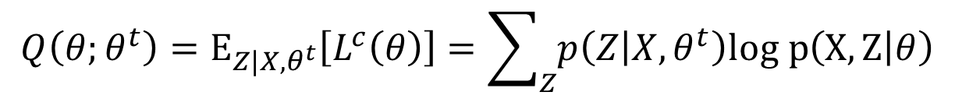
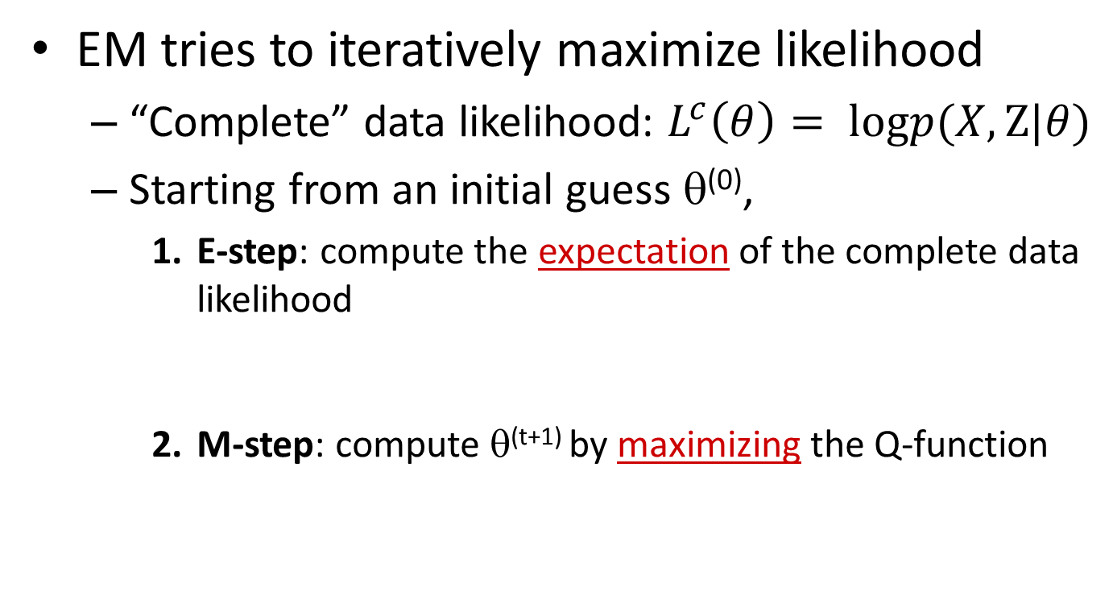

Expectation Maximization
EM tries to iteratively maximize likelihood
“Complete” data likelihood: $L^{c}\left(θ\right)= logp(X,Z|θ)$
Starting from an initial guess θ⁽⁰⁾,
E-step: compute the expectation of the complete data likelihood
M-step: compute θ^{(t+1)} by maximizing the Q-function
$$Q\left(θ;θ^{t}\right)=E_{{Z|X,θ}^{t}}\left[L^{c}\left(θ\right)\right]=\sum_{Z}{p\left(Z | X,θ^{t}\right)log p\left(X,Z | θ\right)}$$
$$θ^{t+1}=argmax_{θ}Q\left(θ;θ^{t}\right)$$
Key step!

Slide 31
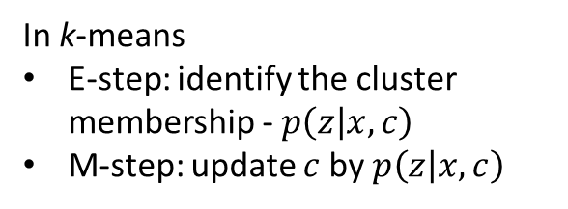
An intuitive understanding of EM
In k-means
E-step: identify the cluster membership - $p\left(z | x,c\right)$
M-step: update $c$ by $p\left(z | x,c\right)$
Data likelihood p(X| θ)
next guess
current guess
Lower bound
(Q function)
θ
E-step = computing the lower bound
M-step = maximizing the lower bound

Slide 32

Convergence guarantee
Proof of EM
$$\log{p\left(X | θ\right)}=\log{p\left(Z,X | θ\right)−\log{p(Z|X,θ)}}$$
Taking expectation with respect to $p(Z|X,θ^{t})$ of both sides:
$$\log{p\left(X | θ\right)}=\sum_{Z}{p(Z|X,θ^{t})\log{p\left(Z,X | θ\right)}}−\sum_{Z}{p(Z|X,θ^{t})\log{p(Z|X,θ)}}$$
$$=Q\left(θ;θ^{t}\right)+H(θ;θ^{t})$$
Cross-entropy
Then the change of log data likelihood between EM iteration is:
$$\log{p\left(X | θ\right)−\log{p(X|θ^{t})}}=Q\left(θ;θ^{t}\right)+H\left(θ;θ^{t}\right)−Q\left(θ^{t};θ^{t}\right)−H(θ^{t};θ^{t})$$
By Jensen’s inequality, we know $H\left(θ;θ^{t}\right)≥H\left(θ^{t};θ^{t}\right)$, that means
$$\log{p\left(X | θ\right)−\log{p(X|θ^{t})}}≥Q\left(θ;θ^{t}\right)−Q\left(θ^{t};θ^{t}\right)≥0$$
M-step guarantee this

Slide 33
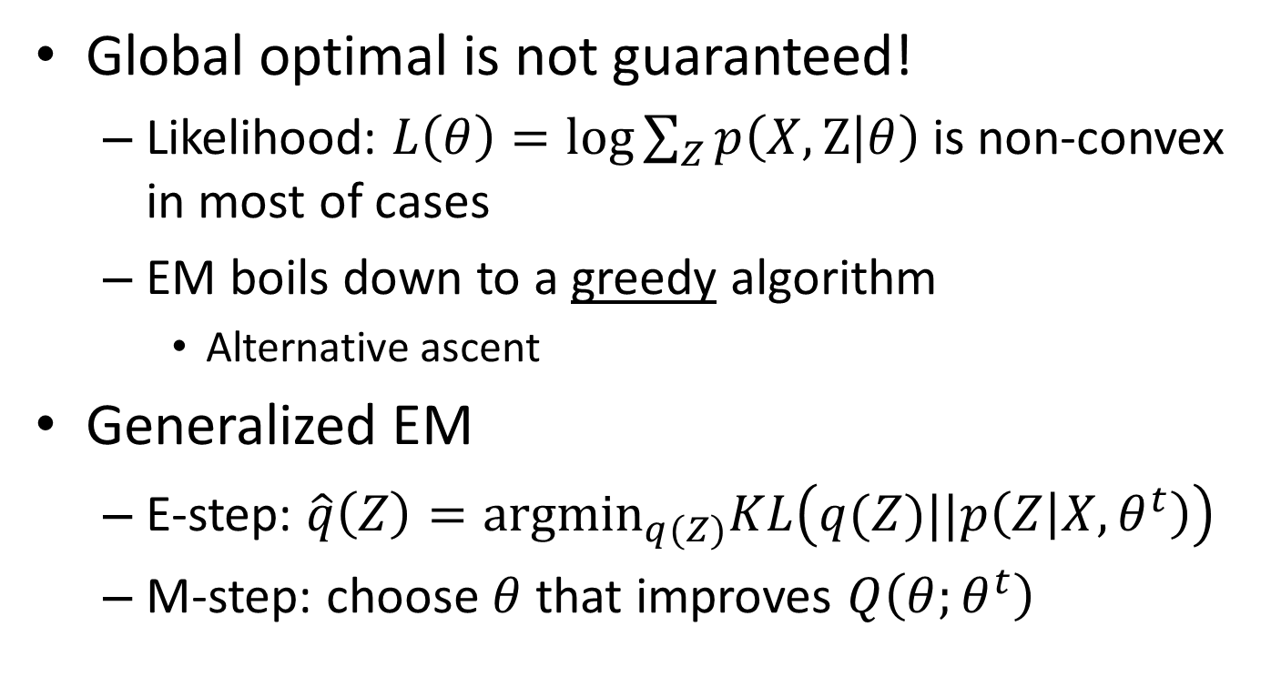
What is not guaranteed
Global optimal is not guaranteed!
Likelihood: $L\left(θ\right)=\log{\sum_{Z}{p\left(X,Z | θ\right)}}$ is non-convex in most of cases
EM boils down to a greedy algorithm
Alternative ascent
Generalized EM
E-step: $\hat{q}\left(Z\right)={argmin}_{q(Z)}KL\left(q(Z)||p\left(Z | X,θ^{t}\right)\right)$
M-step: choose $θ$ that improves $Q\left(θ;θ^{t}\right)$

Slide 34
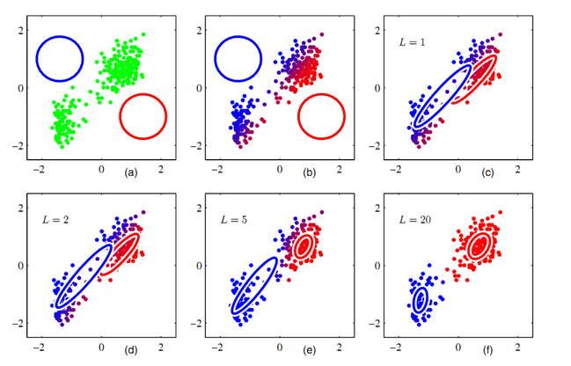

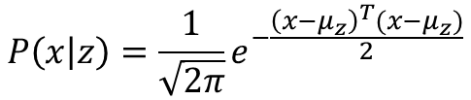
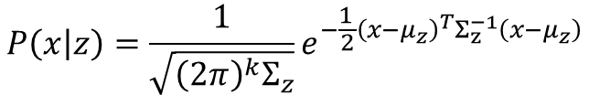
k-means v.s. Gaussian Mixture
If we use Euclidean distance in k-means
We have explicitly assumed $p(x|z)$ is Gaussian
Gaussian Mixture Model (GMM)
$p\left(x | z\right)=N\left(μ_{z},Σ_{z}\right)$
$p\left(z\right)=α_{z}$
$$P\left(x | z\right)=\frac{1}{\sqrt{2π}}e^{−\frac{{\left(x−μ_{z}\right)}^{T}(x−μ_{z})}{2}}$$
$$P\left(x | z\right)=\frac{1}{\sqrt{{\left(2π\right)}^{k}Σ_{z}}}e^{−\frac{1^{ }}{2}{\left(x−μ_{z}\right)}^{T}Σ_{z}^{−1}\left(x−μ_{z}\right)}$$
Multinomial
In k-means, we assume equal variance across clusters, so we don’t need to estimate them
We do not consider cluster size in k-means

Slide 35
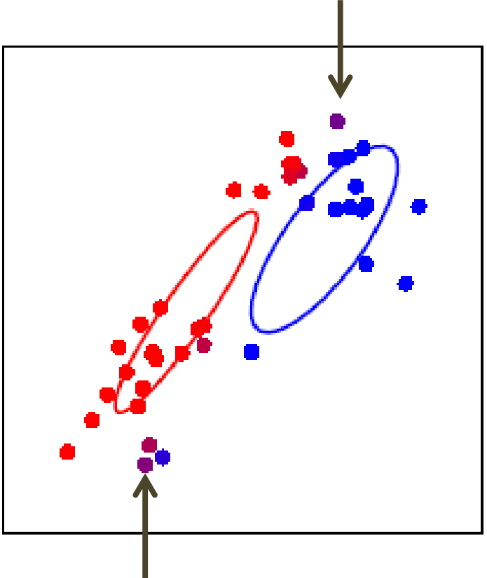
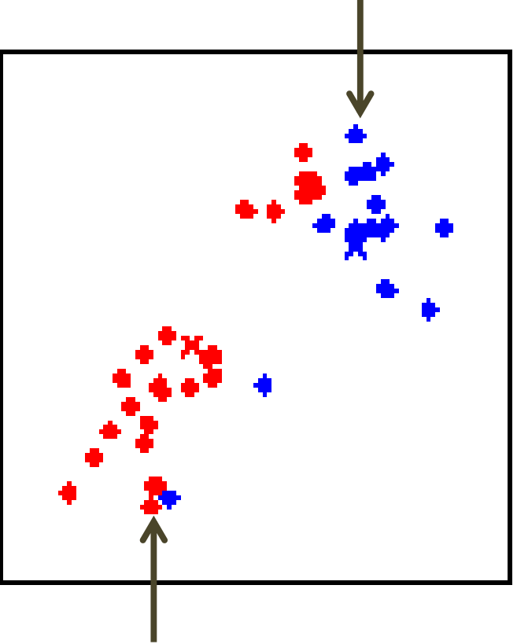
k-means v.s. Gaussian Mixture
Soft v.s., hard posterior assignment
GMM
k-means

Slide 36
k-means in practice
Extremely fast and scalable
One of the most popularly used clustering methods
Top 10 data mining algorithms – ICDM 2006
Can be easily parallelized
Map-Reduce implementation
Mapper: assign each instance to its closest centroid
Reducer: update centroid based on the cluster membership
Sensitive to initialization
Prone to local optimal

Slide 37
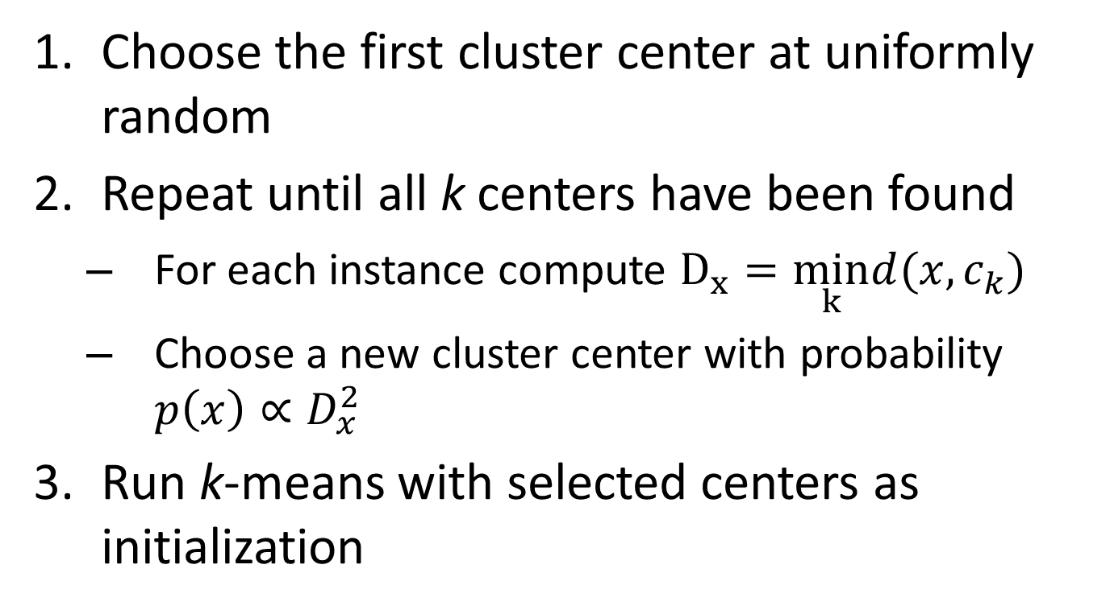
Better initialization: k-means++
Choose the first cluster center at uniformly random
Repeat until all k centers have been found
For each instance compute $D_{x}=\min_{k}d(x,c_{k})$
Choose a new cluster center with probability $p\left(x\right)∝D_{x}^{2}$
Run k-means with selected centers as initialization
new center should be far away from existing centers

Slide 38
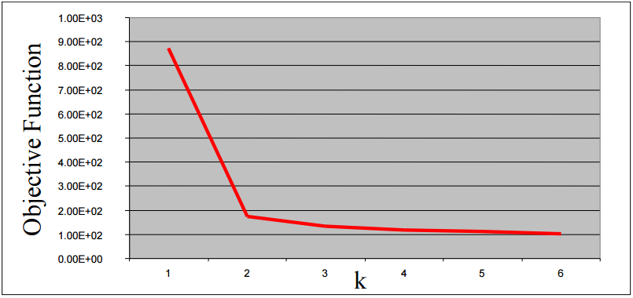

How to determine k
Vary $k$ to optimize clustering criterion
Internal v.s. external validation
Cross validation
Abrupt change in objective function

Slide 39
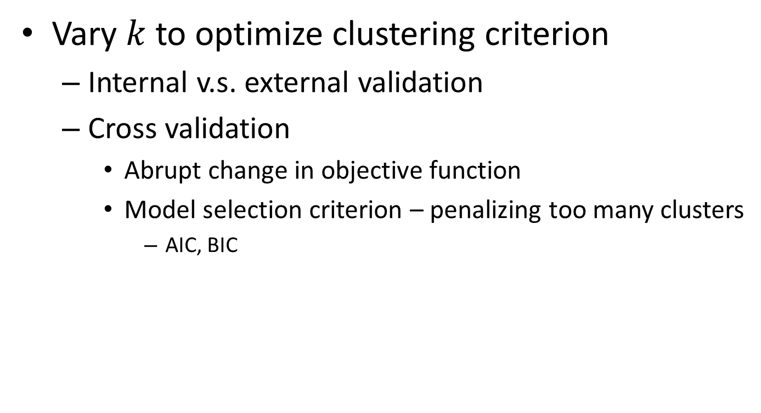
How to determine k
Vary $k$ to optimize clustering criterion
Internal v.s. external validation
Cross validation
Abrupt change in objective function
Model selection criterion – penalizing too many clusters
AIC, BIC

