Slide 1
BACKTESTING
3 Technical Factors
Team Members: Jingsi Xu, Luhao Wang, Xunshen Chen, Muqing Xiong

Slide 2
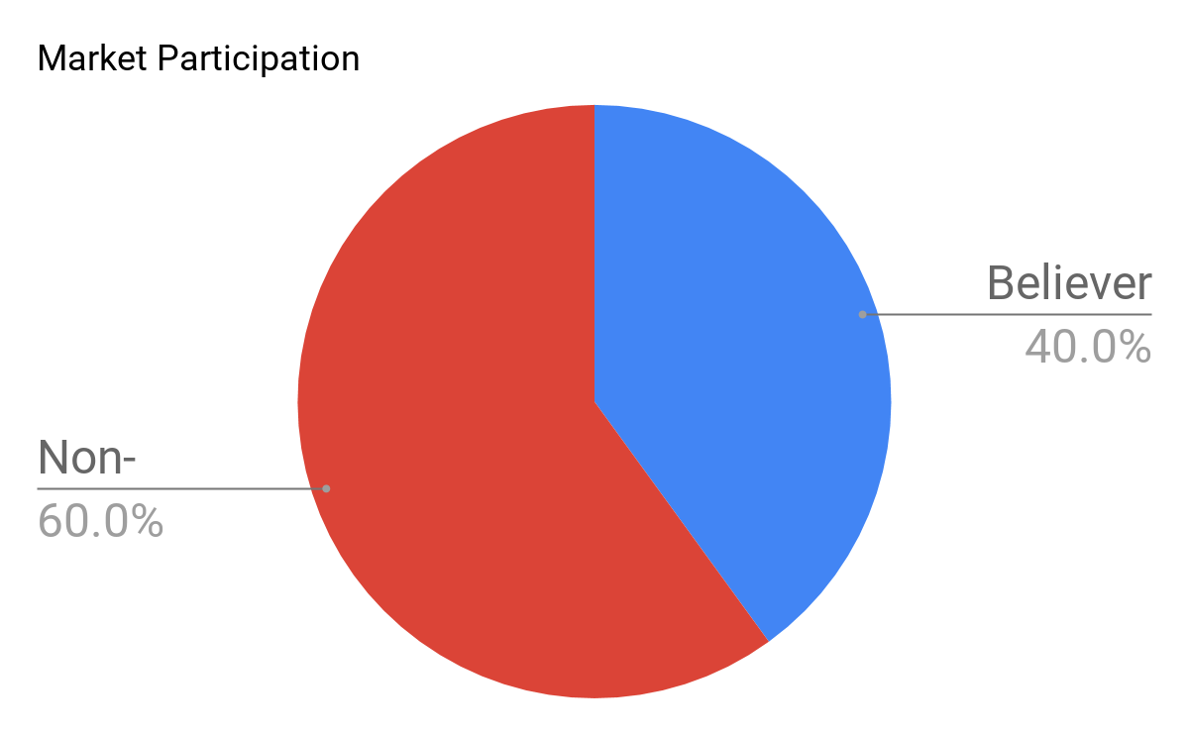
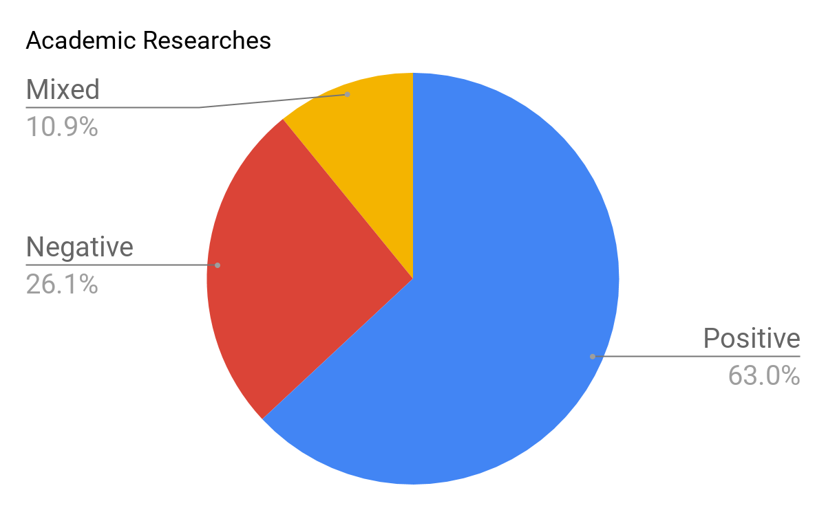
Project Purpose
Backtesting on 22 firm-characteristics factors including 3 technical factors.
Why technical factors?
About 40% of market practitioners appear to believe that technical analysis is an important factor in determining price movement.
From 1990s, more studies were on profitability of technical factors in stock market. Among a total of 92 modern studies, 58 studies found positive results regarding technical trading strategies, while 24 studies obtained negative results. 10 studies indicated mixed results.
References:
1. Firm Characteristics and Empirical Factor Models: A Data-Mining Experiment, Author: Leonid Kogan and Mary Tian.
2. Technical Analysis in Financial Markets, Prof. dr C.H. Hommes, and Prof. dr H.P. Boswijk
3. The Profitability of Technical Analysis: A Review, Cheol-Ho Park and Scott H. Irwin

Slide 3

CONTENTS
Factors
1
2
Data
3
Correlation & Regression
4
Performance Analysis

Slide 4
Technical Factors - Theory
RSI
Relative Strength Index
MACD
Moving Average Convergence Divergence
BBP%
Bollinger bands%
The RSI was originally developed by J. Welles Wilder Jr. and introduced in 1978
A momentum indicator to evaluate overbought or oversold conditions in the stock price by measuring the magnitude of recent price changes.
Above 70 —— overbought
Below 30 —— oversold
The MACD was created by Gerald Appel in the late 1970s.
A trend-following momentum that shows the relationship between short and long term moving average of a security’s price, revealing changes in the strength, direction, momentum, and duration of a trend in a stock's price.
crosses above SL —— buy
crosses below SL —— sell
The BBP was created by John Bollinger, by famous technical trader,in the early 1980’s
It measures percentage of two standard deviations (positively and negatively) away from a simple moving average (SMA) of the security's price. BBP considers not only the moving trend but also the volatility of the stock.

Slide 5


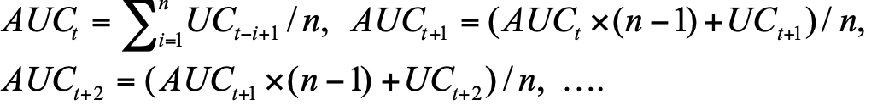
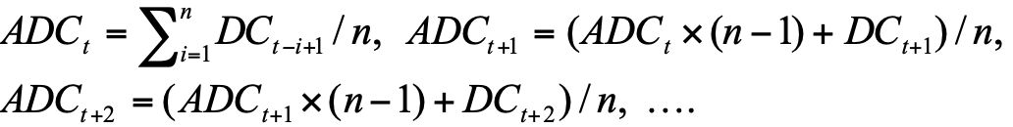

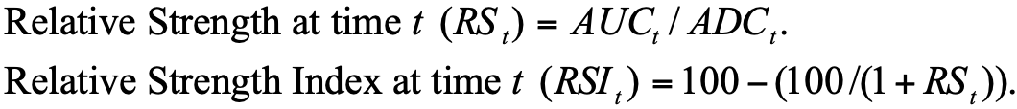
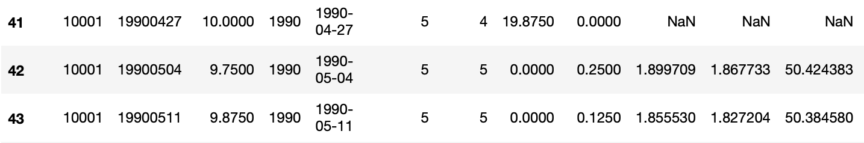
Technical Factors - Calculation
PS: One week as a period
RSI
BBP%
1st Step: Calculate UC/DC
2ed Step: Average Up Closes over 42 weeks at each time point
MACD
3rd Step: Average Down Closes over 42 weeks at each time point
1st Step: Calculate MACD
4th Step: Calculate RSI
2ed Step: Set signal line
3rd Step:
MACD - Signal Line

Slide 6
Initial Factors (3+19)
Category |  | Name | Expected Sign | Literature
Technical(3) | RSI | Relative Strength Index | + | Wilder(1978)
 | MACD | Moving Average Convergence Divergence | + | Gerald Appel(late 1970s)
 | BBP | Bollinger bands% | - | John Bollinger(early 1980s)
Valuation(2) | EP | Earnings-to-Price | + | Fama, E. F. and French (1996)
 | lnSIZE | ln of Market Cap | - | Banz (1981 )
Investment(4) | IA | Investment-to-Asset | - | Lyandres, Sun, and Zhang (2008)
 | IG | Investment Growth | - | Xing, Y. (2008)
 | IK | Investment-to-Capital | - | Xing, Y. (2008)
 | NOA | Net Operating Assets | - | Hirshleifer, Hou, Teoh, and Zhang (2004)
Prior Returns(2) | MOM | Momentum | + | Jegadeesh and Titman (1993)
 | LTR | Long-Term Reversal | - | DeBondt and Thaler (1985)
Financial Distress(2) | OS | Ohlson score (Financial Distress) | - | Soohun Kim and Georgios Skoulakis(2018)
 | LEV | Market Leverage | + | Bhandari (1988)

Slide 7
Initial Factors (3+19)
Category |  | Name | Expected Sign | Literature
Earning(4) | ROA | Return-on-Assets | + | Chen et al. (2010)
 | ROE | Return-on-Equity | + | Gompers, and Vuolteenaho (2002)
 | SG | Sales Growth | + | Lakonishok, Shleifer, and Vishny (1994)
 | SUE | Standardized unexpected earning | + | Ball, R. and P. Brown (1968)
 | lnSIZE | ln of Market Cap | - | Banz (1981 )
Earning Financing(2) | CI | Composite Insurance | - | Daniel, K. and S. Titman (2006)
 | NS | Net Stock Issue | - | Fama, E. F. and K. French (1993)
Other(3) | TO | Turnover Ratio | - | Lee, C. M. and B. Swaminathan (2000)
 | OK | Organizational Capital | + | Eisfeldt and Papanikolaou (2012)
 | BETA | Market Beta | - | Frazzini and Pedersen (2011)

Slide 8
Data Cleaning
Steps
Gather: data from “WRDS” & “27 factors data package”;
Merge: all data of available factors by “year” & “PERMNO”;
Recalculate: pick mid-year data, compute the mean of each window year from monthly data, Z-Scores by industry
Clean: delete insufficient data factors, omit NA;
Reconstructure: separate data into in-sample data (1990.6-2008.6) and out-sample data (2009.6-2016.6).
Results of raw data
4488 unique stocks of 26 years (1990.6 - 2016.6),
with 34,560 observations and 27 variables (760,000+ points)

Slide 9
Correlation Analysis
Factor | Expected Sign | T-stat | Factor | Expected Sign | T-stat
zRSI | + | 2.158 | zROA | + | -2.124
zMACD | + | -1.921 | zROE | + | -1.035
BBP | - | -0.597 | zlnSIZE | - | -1.972
zEP | + | 3.112 | zMOM | + | 3.087
zIA | - | -3.056 | zOS | - | -0.778
zIG | - | -2.387 | zSG | + | -0.215
zIK | - | -2.096 | zSUE | + | 3.087
zLEV | + | 4.380 | zBETA | - | -1.238
zNOA | - | -3.932 | zCI | - | -1.926
zNS | - | -3.507 | zLTR | - | -3.574
zOK | + | 2.855 | zTO | - | -2.327
Notes:
corr.test
highlighted factors have same sign as expected sign
0.6 multicollinearity

Slide 10
In the Sample Estimation(1990-2008)
NAME | COEFFICIENTS | expected sign | FM_TSTATISTCS
zEP | 0.001286098 | + | 0.21967143
zIA | -0.002882020 | - | -0.50462618
zIG | -0.003407888 | - | -1.00510845
zIK | -0.000352863 | - | -0.09784048
zLEV | 0.013965996 | + | 2.28774702
zNOA | -0.006840441 | - | -1.20916239
zNS | -0.007240278 | - | -2.59537771
zOK | 0.005756759 | + | 1.83428519
zROA | -0.000447843 | + | -0.06632511
zROE | -0.001228424 | + | -0.23048121
Notes:
linear regression for all by year, calculated FM-tstat, keep FM-tstat > 1.5
linear regression after dropping 12 remaining 10
3 technical

Slide 11
In the Sample Estimation(1990-2008)
NAME | COEFFICIENTS | expected sign | FM_TSTATISTCS
zlnSIZE | -0.010658738 | - | -1.21180529
zMOM | 0.006532899 | + | 1.06557499
zOS | -0.009861766 | - | -1.54800991
zSG | 0.008082607 | + | 1.50900709
zSUE | 0.006245376 | + | 1.53571894
zBETA | -0.002098057 | - | -0.35707096
zCI | 0.002547513 | - | 0.60937373
zLTR | -0.006177293 | - | -1.44445478
zTO | -0.002148257 | - | -0.30214887
zRSI | 0.004535160 | + | 0.65822182
zMACD | -0.007004227 | + | -1.39627204
BBP | -0.049184308 | - | -1.36567766
Notes:
FM-t 1.3
RSI hot topics

Slide 12
Out of Sample(2009-2016)
Year | Month | Long Ret | Short Ret | Port. Ret (L-S)
2009 | 7 | 10.32% | 9.50% | 0.82%
2009 | 8 | 3.49% | 2.78% | 0.71%
2009 | 9 | 7.37% | 8.10% | -0.72%
2009 | 10 | -4.02% | -5.29% | 1.27%
2009 | 11 | 4.67% | 4.48% | 0.19%
……………… | .
2017 | 2 | 0.68% | 1.65% | -0.97%
2017 | 3 | 1.66% | 1.43% | 0.23%
2017 | 4 | 1.97% | 2.68% | -0.71%
2017 | 5 | -2.32% | -0.37% | -1.96%
2017 | 6 | 2.54% | 3.10% | -0.57%
Notes:
We calculated the final score of each stock by adding up the products of z-score and t-statistics of each factor, and long the top 10% stock and short the bottom 10%. Here is the result of Long Portfolio Return, Short Portfolio Return, and long-short Portfolio return from 2009 to 2016.

Slide 13
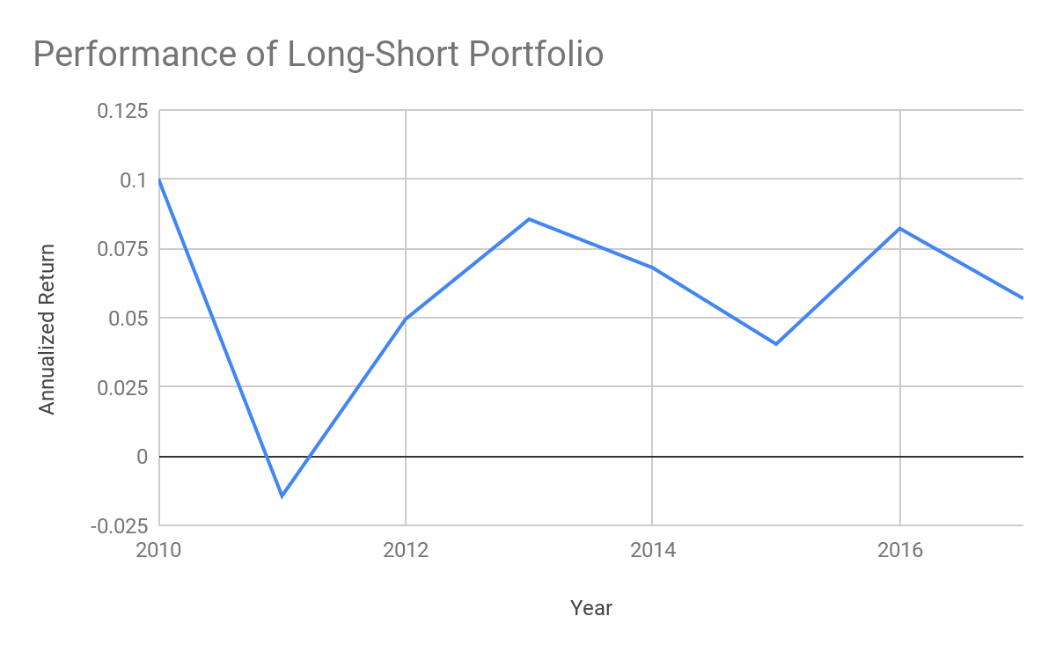
Performance Evaluation
Performance Measure | Value
Monthly Mean return | 0.48%
Annualized mean return | 5.85%
Annualized Sharpe Ratio | 1.057689
CAPM Alpha | 0.005833
FF 3 Factor alpha | 0.005742
Corhart 4 Factor Alpha | 0.005756
Annualized IR | 1.286294
0.10012453
0.08554631
0.08219218
0.06801239
0.04944513
0.05689262
0.04045241
-0.01438594

Slide 14
Conclusion
With 5.85% average annualized return and 1.058 annualized Sharpe Ratio, our model is profitable although further research about taxes, transaction fee, and market impact is needed.
Technical factors tend to have smaller t-statistics in regression over 1990-2008. Momentum factor is even not picked in our final model.
Future work to improve our model. (1)For technical indicators, use shorter moving window with short-term return, and rebalance our portfolio dynamically. (2)Add Macro Factors (like GDP, inflation, etc) and Alternative Factors (like star analyst recommendations, insider purchase, behavioral factors etc) in the future study.

Slide 15
THANK
YOU

