Slide 1
C2CAMP Digital Objects as Foundational Entities in the Global Data World
J. Wood: Live in exciting times and it can all go heavily wrong.
R.J. Smits: Is RDA more than just a bunch of talkers?

Slide 2
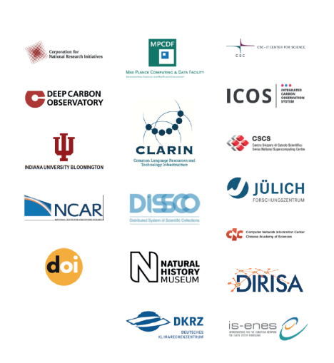

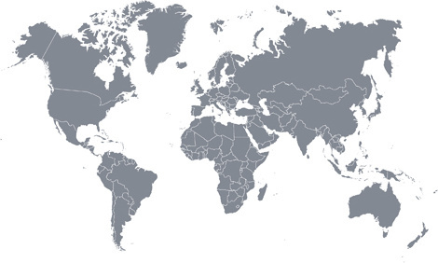
The core partners
some research infrastructures (ICOS, CLARIN, DISSCO, ENES)
some typical data centers working closely with communities
some HPC centers working also with communities
some IT providers
all grown from close RDA collaborations and joint priorities
all agree that scientific cases are in the driving seat
all have shown commitment and competence
C2CAMP: Intercontinental and Interdisciplinary

Slide 3
What‘s holding us back? It is time to MOVE
Too much time is wasted on identifying useful tools and services – faster selection based on data types and rich metadata is required to facilitate re-use effectively
Scientists are confronted with too much detail in an increasingly complex data landscape, they want to work at higher levels of abstraction enabling scalability: Scientific Digital Objects
Scientists and managers need wide scale data tracing and reproducibility to facilitate trust and verification
A new impulse to achieve a higher degree of interoperability and overcome fragmentation between different disciplines is urgently required
Improved ways to automatically create scientific annotations and assertions to capture and exploit knowledge are needed
Inefficiencies prevent professional data intensive science and broad participation
RDA EU 2013 Survey: 75% of time of data scientists is wasted on data wrangling
M. Brodie MIT Survey: 80% of time of data scientists is wasted on data wrangling
CrowdFlower 2017 Survey: 79% of time of data scientists is wasted on data wrangling
the biggest costs factors are bad data organisation and bad data quality
how to cope with the increasing amount/complexity of data (IoT, etc.)
Data industry is confronted with the same challenges preventing innovation and a path towards a strong Data Economy.

Slide 4
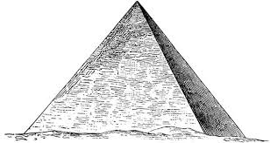

A new Impulse is Needed
Create a momentum towards convergence in a hopelessly fragmented space
and synchronise minds who all have brilliant ideas.
Define a solid basis for future developments and heavy
investments
J. Hendler (W3C): need a new commodity layer again
G. Strawn (BRDI): seem to be at a point comparable to the
moment where Internet was born
Pyramids: get a few basic principles right and solve logistics
systematically to build giants
establish the basis for common DO management and processing in a systematic and systemic way to face coming challenges
implement FAIR by applying RDA DFT‘s Core Data Model
implement efficiency based on stable references and on clear types
implement trust based on verification, tracibility and reproducibility through DOs
specify and implement the components required to build the flexible data architectures
Build on what is already out there.
Second wave of innovation comes after we start move.
$$α$$

Slide 5
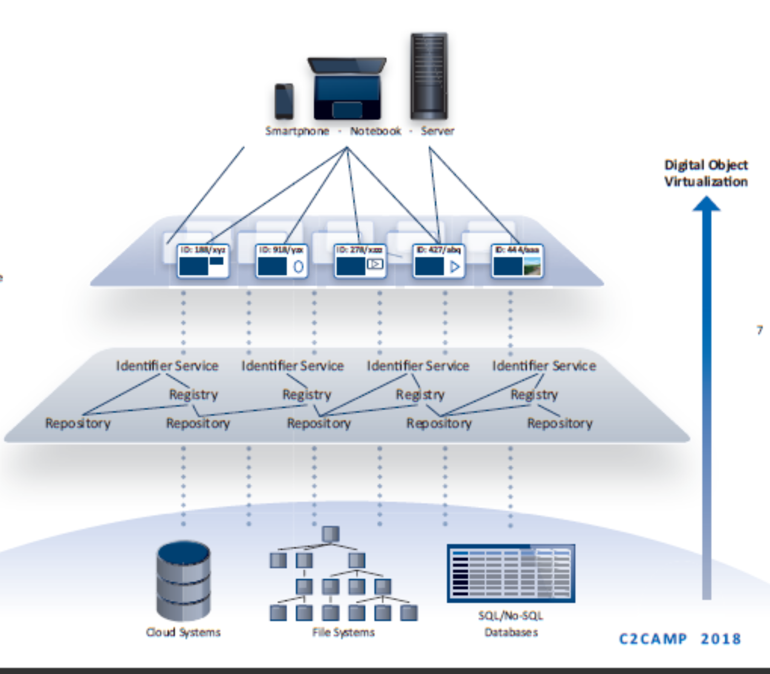
Towards a DO Infrastructure
flexible testbed to build and integrate methods based on DO concept
come to a systematic and systemic solution for the data challenges
be prepared for the phase of automatic processing of scientific data
make it simple for researchers by reducing complexity and let them work in the world of DOs, i.e. working with metadata and PIDs
integrate components specified by RDA, OAI, W3C etc.
Example1: provide operators to work with DOs (move, delete, etc.)
Example2: build workflows based on a types and proper provenance
Landscape of trustworthy repositories and registries based on interoperable components.

Slide 6
Relevant Activities
FAIR principles summarised broad discussions into a globally accepted common language and are an important step towards more convergence, but not a blueprint for infrastructure building
US seems to be ready to fund a small seed project and work out a larger program along C2CAMP core ideas
China is busy setting up a national PID infrstructures for everyone anticipating the coming challenges (IoT) and enabling systematic approaches
RDA is a global platform that needs to be used more intensively to work on specifications of components and its characteristics
GOFAIR is an emerging platform to bring together implementers and trainers, C2CAMP will act as Implementation Network in GOFAIR to synchronise with others
EU activities
EOSC is a great attempt to synchronise minds in Europe, C2CAMP would add the synchronisation concept which is yet missing
PRACE/HPC/EDI lack a convincing DO management concept, Exascale without DO management would lack impact on data economy, FENIX as part of C2CAMP
FREYA addresses PID usage for schlolarly communication
C2CAMP is FAIR compliant and adds an implementation concept missing in EOSC.

Slide 7
What is needed in Europe?
C2CAMP
is just the start of a movement with long-term perspective
will have different sub-projects possibly embedded in other projects
Core Group is devoted to synchronise the activities based on increased specifications and a compliance stamp
is already working on requirements and specifications with limited capacity
will further use RDA to push additional specifications of components
is organising an interaction with industry (RDA plenary in Berlin)
what is needed
a soon interaction with the EOSC HLEG to discuss the challenges and concepts
a seed project also in Europe to engage with US, CN, etc. in organising workshops, participating in the synchronisation task & stimulate RDA /GOFAIR (2 x 1/2 FTE + travel funds)
some participation in coming projects such as Clusters, HPC/EDI, etc. to not loose momentum in Europe
a focus on DO Infrastructure in mid-term to remain competitive (design study?)
a strategic meeting with several stakeholders in autumn 2018
Who is taking leadership and how?

