Slide 1
Implementation of PIDs in the Slovenian Open Access Infrastructure
Milan Ojsteršek,
University of Maribor, Faculty of Electrical Engineering and Computer Science
milan.ojstersek@um.si
tel.: +386 2 220 74 51, +386 40 696 538
The Slovenian open access infrastructure is partly financed by the European Union, European Regional Development Fund and Ministry of Education, Science and Sport of the Republic of Slovenia within the framework of the Operational Programme for Strengthening Regional Development Potentials for Period 2007 - 2013.
Notes:
A national network of open access repositories provides additional services for users such as federated search across all involved repositories and permanent storage of theses, dissertations, research publications and research data. The presentation will discuss organisational and technical aspects of establishing a Slovenian open access infrastructure. Many thanks to all involved in the establishment of Slovenian open access infrastructure (my collaborators in Laboratory for Heterogenous Systems (Janez Brezovnik, Marko Ferme, Goran Hrovat, Albin Bregant, Jan Bezget, Mladen Borovič), University library of Maribor (Dunja Legat, Zdenka Petermanec, Aljoša Nikl, Marko Višič), Mojca Kotar, Miro Pušnik, Cvetka Teja Koler Povh, Mirjam Kotar, Ivan Kanič, Janez Jug, Petruša Miholič, Vanesa Valentinčič, IZUM (Davor Šoštarič, Robert Vehovec), dLib.si, videolectures.NET, Ministry of Defence, Social Science Data Archive, management of all Slovenian universities, Ministry of education, science and sport).

Slide 2
The state of open access in Slovenia in 2012
More than 40 open access journals and more than 20 digital archives and repositories.
Publications have been duplicated across different repositories or digital archives.
Inadequate quality of metadata of research publications, research data, dissertations and theses.
Processes for submission of theses, dissertations, research publications, research data and other academic production have not been established.
No common search engine for theses, dissertations, research publications, research data and other academic production.
Lack of common recommender system and plagiarism detection system.
Lack of metadata, data, content, submission and preservation policies.
Notes:
Prior to the implementation of this project, there were already some open access repositories and digital archives in Slovenia that contained the final study works and research publications. These contents were, in most cases, inserted by librarians and not by the authors. Most institutions did not define adequate processes and legal background that would enable authors to deposit their publications within the repositories. An exception was the Digital Library of the University of Maribor, where such a process had already been implemented, thus enabling students to submit their final study works to the digital library. As it was impossible to simultaneously search the contents from different repositories and digital archives and with an absence of processes and policies for the submission of content, the consortium of Slovenian universities has decided to sign up to a call from the Ministry of Education, Science and Sport and has received funding for the establishment of a national infrastructure of open access (from the Ministry and the European Regional Development Fund).
During the initial import of metadata from digital archives, repositories and our national cataloguing system COBISS.SI into the national open access infrastructure, we discovered certain deficiencies in the metadata of the bibliographical records. Here are some of the more frequent:
Metadata containing spelling errors (e.g., wrong URL, misspelt title …).
Only a minimal range of metadata is provided (e.g., the title, keywords and authors), whereas other metadata are unavailable (e.g., abstract, title and keywords in other languages etc.). A lot of scientific papers don‘t contain metadata about journals or proceedings in which its have been published or these metadata have been uncompleted for citation in different citation styles.
Some fields contain semantically different data as foreseen by the content of the field (e.g., a patent number is stored in the subtitle field, as the COMARC format does not provide a field for inserting patent numbers).
Due to the long history of COBISS (it was started in 1981), some fields have remained alphanumeric, although they should be numeric. In some cases data is still entered as alphanumeric instead of only numeric.
Some of the metadata that are entered in the institutional repository are, on the other hand, not contained by COMARC. In our case, theese metadata describes patents (patent number, patent expiry date), projects (project number, funding scheme, project title, project acronym, type of access, embargo date), metadata about copyright (COMARC enables insertion of this field in string format, instead of attribute data about the licence), geographic coverage (e. g., COMARC does not support attribute data for geographical coordinates or usage of geographical vocabularies).

Slide 3
A network diagram of the Slovenian open access infrastructure
Open Science Slovenia (http://www.openscience.si)
similar content detection,
federated search,
recommendation system.
RUL
DKUM
RUP
RUNG
DIRROS
REVIS
Other digital archives
ePrints.FRI
PeFprints
JSASA
SSDA
dLib
Videolectures.NET
DKMORS
CLARIN.si
Notes:
The infrastructure consists of Slovenian universities’ repositories (repository of University of Ljubljana, digital library of University of Maribor, repository of University of Primorska and repository of University of Nova Gorica), a repository for research organisations, repository for faculties which are not part of universities and a national portal that aggregates content from the repositories and other Slovenian archives (Digitalna knjižnica Slovenije (dLib.si), VideoLectures.NET, digital library of Ministry of Defence (DKMORS), Social Science data archive (SDA) and ScieVie repository). The national portal ‘openscience.si’ provides a common search engine, recommendations for similar publications, and similar text detection.

Slide 4
Achievements
A national approach to building of open access infrastructure.
Web and mobile application for repositories and the national open science portal. Presentation of content is customized for users with visual and cognitive disabilities.
Templates for amendments to the policies about a mandatory electronic copy of research publications, research data and final study works is developped for all partner institutions.
Development of adapted processes for filling publications from students and employments on all partner institutions.
Open Aire compatibility is established to facilitate in registration, discovery, access and re-use of research publications and research data, in particular in the context of Horizon 2020 funded projects across European countries.
Integration with COBISS, SICRIS, higher education information system, university information systems and university autethication systems.
Plagiarism detection software is developed and included into processes for filling publications from students and employments.
Recommendation system of similar works within repositories and between repositories, Dlib, DKMOS SSDA, JSASA and Videolectures.NET is developed.

Slide 5

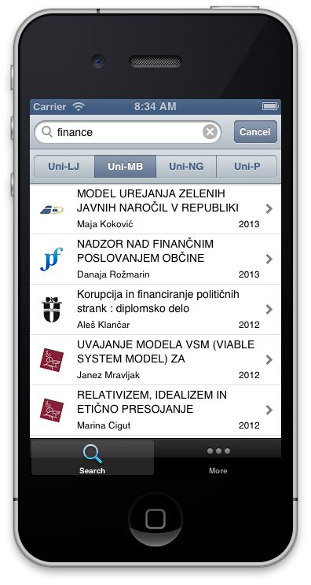


The institutional repository linked to external systems and the national portal
UL document management system
InstitutionalWeb servers
web service
JavaScript API
RSS
OpenAIRE,
DART-Europe,
BASE,
ROAR,
OpenDOAR
…
ARNES AAI or University authentication system
Institutional repository
OAI-PMH
XML or LDAP
web service
XML or
LDAP
web service
SRU/SRW
University academic information system
Open Science Slovenia
web service
web service
XML, web service, OAI-PMH
OAI-PMH
SRU/SRW
XML
JSON
OAI-PMH
EPrints repositories
Social Science Data Archives
dLib.si
Videolectures.NET
DKMORS
Other sources
Notes:
Figure shows how the institutional repository of a Slovenian university is linked to other systems. In order to establish the processes of submission and the cataloguing of publications, the institutional repository is linked to the authentication system of the university or ARNES AAI the Slovenian academic authentication system, the university academic information system, and the national bibliographic catalogue (COBISS.SI). At the University of Ljubljana the electronic versions of publications are additionally stored within their own document management system after they have been catalogued. Other institutions keep the electronic versions of publications in their institutional repository. The national portal is used as a secondary storage of publications and metadata. The institutional repository sends metadata and electronic versions of publications to the national portal immediately after their cataloguing within COBISS.SI. Every institutional repository also receives additional metadata about researchers and research organisations from Slovenian common research information system (SICRIS) via the national portal. A common recommendation system is installed at the national portal “Open Science Slovenia”. On clicking on the document in the institutional repository, the national portal sends a list of similar documents. The recommendation consists of publication titles from within the same institutional repository and of publication titles from other institutional repositories and digital archives (dLib.si, VideoLectures.NET, DKMORS. SSDA).
A JavaScript API is also available in the institutional repository. It is used for mobile and web applications to display information about publications. Once included within a website (e.g., the faculty website), it enables simple or advanced searches as well as browsing through publications within the institutional repository. An example of such inclusion can be seen on the website »Publications of the Faculty of Social Sciences« from the University of Ljubljana. Faculties and their staff can also use the publication metadata in RSS, JSON or RDF formats. RSS feeds are also generated for lists of the latest submitted or the most downloaded publications.
The institutional repositories have a back-end intended for use by the administrators, and a front-end intended for the general public and registered users. The back-end is used by student officers, librarians, and system administrators. The student office mainly carries out the review of final study works, whilst the librarians review the publications of both students and staff, and catalogue them in COBISS.SI as well as import the COBISS.SI metadata records into the institutional repository.
The back-end allows the librarian to import the metadata records of those publications from COBISS.SI and link electronic versions of the publication to it. In this way the metadata of those publications that have already been catalogued in COBISS.SI can be imported into the institutional repository. Such publications are mostly older and were published before the establishment of the institutional repository but electronic versions of them do exist and the universities have cleared the appropriate copyright for storing them in their repositories and the enabling of web access.
By logging onto the institutional repository, students and staff from the Universities of Maribor and Nova Gorica can submit their publications and final study works into the repository and review their content (metadata and similar documents, as found by the plagiarism detector). The submissions of final study works from students at the Universities of Ljubljana and Primorska take place as universities’ academic information systems. The submissions of research publications and data by researchers are done in institutional repositories. A bilingual (Slovenian and English) interface is available for the visitors of web and mobile applications (Android, iPhone and Windows Phone). The website is suitable for people with disabilities and enables browsing as well as simple and advanced search functions.
Those faculties and academies that had already established the repositories (Faculty of Computer Science, Faculty of Civil and Geodetic Engineering, and the Faculty of Education) are part of the University of Ljubljana; therefore all of the content from these repositories has been transferred into the Repository of the University of Ljubljana via the national portal. The latter obtains the new metadata records daily using OAI-PMH servers. These records are then enriched using internal metadata from the EPrints XML and metadata from COBISS.SI. The linking can be done only if the librarians have entered the URL into COBISS.SI or if the EPrints XML description contains the COBISS.SI identifier. In the case of overlapping data, the national portal takes metadata from COBISS.SI as they are more trustworthy. In many cases, the two sets of metadata complement each other. For example, if a record exists where the librarians did not provide an abstract in the alternative language in COBISS.SI or they did not provide a parent publication in EPrints, then the metadata are simply merged.
From the beginning of 2014, the European Commission has required that in Horizon 2020 open access is provided to all publications from co-funded projects. The European Commission co-financed the European open access infrastructure for research (projects OpenAIRE (2009-2012) and OpenAIREplus (2011-2014)). They have established a server, which collects the metadata of publications that were published as a result of co-funded EU projects. Due to this, the institutional repositories needed to store additional metadata of publications. Researchers have to input the funder’s acronym, the funding scheme, the project number, and optionally the project title and the project acronym. A common vocabulary that stores the funders’ and funding schemes has been established. It includes data from the European Commission and data about all funders and funding schemes, as currently used by all Slovenian funders. Each institutional repository has an OAI-PMH server, which returns an OpenAIRE compatible XML for publications. EC servers can therefore use these publications to evaluate the compliance of co-funded projects. The OAI-PMH server is also used by open access registries of repositories and search engines (OpenDOAR, ROAR, DART-Europe, BASE, etc.).
ARNES AAI - Slovenian Academic Authentication System. Retrieved February 18, 2014, from http://www.arnes.si/en/services/arnesaai.html.
FDV Publications. Retrieved February 18, 2014, from http://www.fdv.uni-lj.si/en/fdv-publications/home.
Web Accessibility Initiative. Retrieved February 18, 2014, from http://www.w3.org/WAI/.
Open Access Infrastructure for Research in Europe. Retrieved February 18, 2014, from https://www.openaire.eu/.

Slide 6
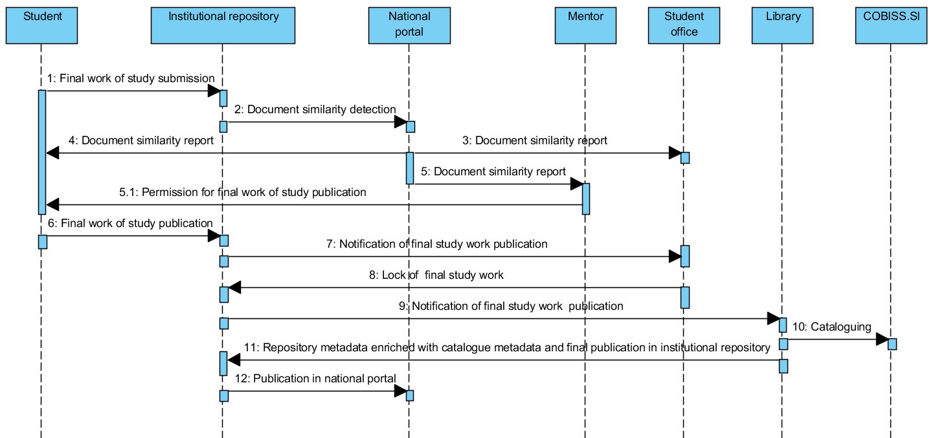
A sequence diagram of final study work submission and publication at the universities of Maribor and of Nova Gorica
Notes:
The process, which was established at universities, allows authors to submit their work into the institutional repository. After which, the submission is reviewed and catalogued into COBISS.SI by a librarian. Based on the experiences accumulated since 2008, it was found that a manual review of metadata is mandatory as in many cases the submissions are incomplete or contain spelling errors. In addition, only librarians can normalise those authors using the CONOR.SI authority file. After the publication metadata have been successfully catalogued within the COBISS.SI, they can be transferred to the institutional repository via SRU/SRW services.
The working group, which consisted of librarians, legal experts and IT professionals from all four Slovenian universities, suggested the submission processes of the final study works. Slovenia lacks a common university academic information system (UAIS), therefore each university provided its own variation of this process. Students at the universities of Maribor and of Nova Gorica submit their final study works into university repository, which is filled with some metadata from university academic information system. A sequence diagram of the final study work publications of the universities of Maribor and of Nova Gorica is presented in slide. The submissions at the universities of Ljubljana and Primorska take place at university academic information system, the sequence of operations is otherwise the same as described for the universities of Maribor and of Nova Gorica.

Slide 7
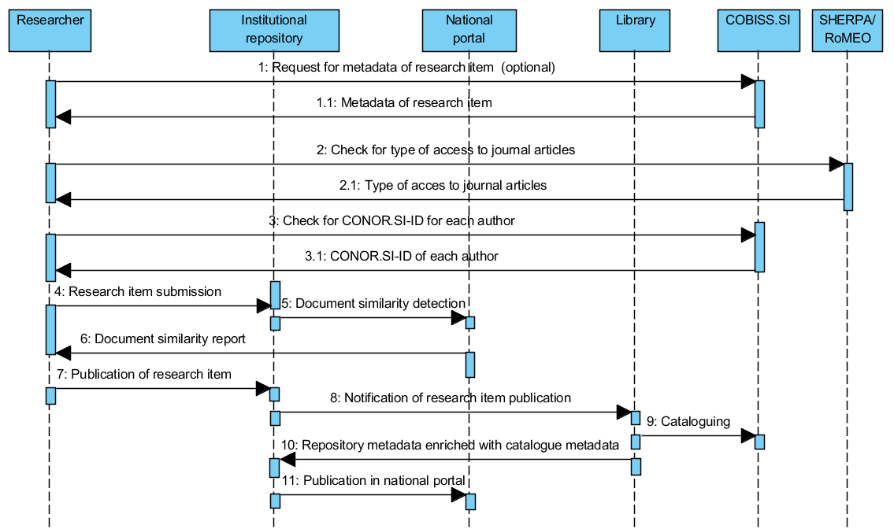
A sequence diagram of research item submission and publication
Notes:
All four institutions have established the same process for submission of research publications, which is presented the sequence diagram in the slide. Researchers can submit articles, monographic chapters, monographs, conference papers, e-lectures, publications about patents, research data, and other types of publications. The types of publications are adapted according to the COBISS.SI typology (http://home.izum.si/COBISS/bibliografije/Tipologija_eng.pdf), which is used by the Slovenian Research Agency for researchers’ bibliographies evaluation. Once researchers are logged into the institutional repository, they can submit new content as a whole, or they can use metadata from the catalogued record in COBISS.SI (optional request and reply on the beginning of the process). In the latter case, the institutional repository takes care of the metadata transfer from COBISS.SI using the SRU/SRW protocol. In this case, researchers only need to provide the electronic version of their publications. A link to the SHERPA/RoMEO portal is also enabled to the publication authors, so they can check what type of access they can use depending on the publisher's copyright transfer agreement. During the insertions of names and surnames, suggestions from the CONOR.SI authoritative file are provided. These suggestions include the year of birth, if available in CONOR.SI, and researcher identifier from SICRIS, which simplifies the determination of the correct author. This can greatly simplify the librarian’s work of cataloguing the publication in COBISS.SI. Authors can also determine the copyright holder and the type of access to the full-text publication. They can choose between immediate publication, closed access or delayed publication with embargo (these metadata are part of OpenAIRE compliance).

Slide 8
Support for data archives and digital preservation
HPC
EUDAT
IZUM analytics
InstitutionalWeb servers
ARNES
OpenAIRE,
DART-Europe,
BASE,
ROAR,
OpenDOARRre3data
….
ARNES AAI or University authentication system
Institutional repository
University academic information system
Open Science Slovenia
EPrints repozitoriji
dLib.si
VideoLectures.NET
DKMORS
Other sources

Slide 9
Problems with local and global unique identifiers
Metadata records of digital objects use one ore more global or local unique identifiers: COBISS ID, URN, URL, DOI, Handle, PURL, PMID, PMCID, ArXivID, ISBN, ISSN, e-ISBN, e-ISSN, ID inside repository, NRID.
Persons or organizations have one or more global or local unique identifiers: CONORID, SICRISID, Institutional digital identity, Institutional ID, ORCID, VIAFID, ResearcherID, GoogleScholarID, Researchgate ID, personal ID, passport number, tax number….
The same problems with unique identifiers are in identification of research groups, funders, instruments, projects, research infrastructures, vocabularies, software, APIs…

Slide 10
Linking of global and local identifiers
For Person:
COBISS: http://splet02.izum.si/cobiss/bibliography?langbib=eng&code=A2688355
ArrsID: http://sicris.izum.si/search/rsr2.aspx?lang=eng&id=06823
ORCID: http://orcid.org/0000-0003-1743-8300
ResearcherID: http://www.researcherid.com/rid/K-2942-2014
Google Scholar: http://scholar.google.si/citations?user=kyQveUYAAAAJ
ResearchGate: http://www.researchgate.net/profile/Milan_Ojstersek
For scientific paper:
COBISS_ID: 18052630
DOI: 10.1108/PROG-02-2014-0005
NUK URN: URN:SI:UM:DK:2GL96NSW

Slide 11
How to solve different problems with PIDs
How to solve problem with GDPR?
How to solve a problem of multiple versions, duplication or deletion of digital objects? Are we need to have more identifiers for same DO and aggregate them into collection. Are we need to deprecate PID after deletion of DO?
How to solve problem with migration of digital objects to other location?
How to solve problem with PIDs protocol independence? Are we need URIs or CURIEs for PID resolution?
Digital objects are in open, close or embargo access. How to solve authorization on EU level?

Slide 12
Where you find more information
National portal of open science: http://www.openscience.si/Default.aspx
DKUM: https://dk.um.si/info/index.php/eng/
RUL: http://repozitorij.uni-lj.si/info/index.php/eng/
RUP: http://repozitorij.upr.si/info/index.php/eng/
RUNG: http://repozitorij.ung.si/info/index.php/eng
DIRROS: http://dirros.openscience.si/info/index.php/eng
REVIS: http://revis.openscience.si/info/index.php/eng
Our publication:
Milan Ojsteršek , Janez Brezovnik , Mojca Kotar , Marko Ferme , Goran Hrovat , Albin Bregant , Mladen Borovič , (2014) "Establishing of a Slovenian open access infrastructure: a technical point of view", Program: electronic library and information systems, Vol. 48 Iss: 4, pp.394 – 412
http://www.emeraldinsight.com/doi/full/10.1108/PROG-02-2014-0005

