Slide 1
Digital Object Architecture An Introduction
Christophe Blanchi
DONA Foundation
November 4th 2019

Slide 2
Digital Object Architecture – An Introduction
DONA Foundation
Digital Object Architecture Overview
Handle System
DOIP
Global Handle Registry

Slide 3
Digital Object Architecture – An Introduction
DONA Foundation
Digital Object Architecture Overview
Handle System
DOIP
Global Handle Registry

Slide 4
The DONA Foundation
The DONA Foundation is based in Geneva Switzerland for neutrality reasons. From its statutes it has two clear and distinct purposes:
Promote the DOA Adoption: Provide coordination, software, and other strategic services for the technical development, evolution, application, and other uses in the public interest around the world of the Digital Object Architecture (DOA) and related X.1255 standard with a mission to promote interoperability across heterogeneous information systems across many different countries, domains, and industries.
Publish and evolve DOIP and Handle System standards.
Provide documentation, tutorials, reference implementations.
Administer and maintain the stable operations of the Global Handle Registry (GHR), a key component of the DOA, and shall authorize and coordinate its administration with multiple multi stakeholders across the world know as Multi-Primary Administrators (MPAs).

Slide 5
Digital Object Architecture – An Introduction
DONA Foundation
Digital Object Architecture Overview
Handle System
DOIP
Global Handle Registry

Slide 6
Motivations for the Digital Object Architecture
Need to facilitate the secure discovery, access, exchange, and reuse of information represented in digital form across a wide range of types and sources of data.
Make data / services a “First Class Citizen” in the Internet.
Identifiable and locatable over time.
Accessible in a consistent manner.
Understandable to be accessed and reused.
Attributable, protected, secure, and trusted.
Manageable from the simplest to the most complex.
Able to persist over long periods of time if needed.
Manageable according to local policies and laws.
Need to scale in the Trillions of items

Slide 7
Digital Object Architecture Overview
The DOA is a logical extension of the Internet.
Based on the same architectural ideas embedded in the Internet’s architecture and which have sustained its evolution, the three most important of which are:
Open Architecture. Two defined protocols: Handle Protocol, DOIP
Independence from the underlying technologies.
Minimized complexity for users.
Provides a framework for managing digital information and services of all kinds whether in the Internet or not using the Digital Object (DO) as its basic structure.
Built-in Security.
Built-in extensible typing system for describing new types of resources such as data, operations, services, interfaces, and protocols to name a few.
Distributed and highly scalable

Slide 8
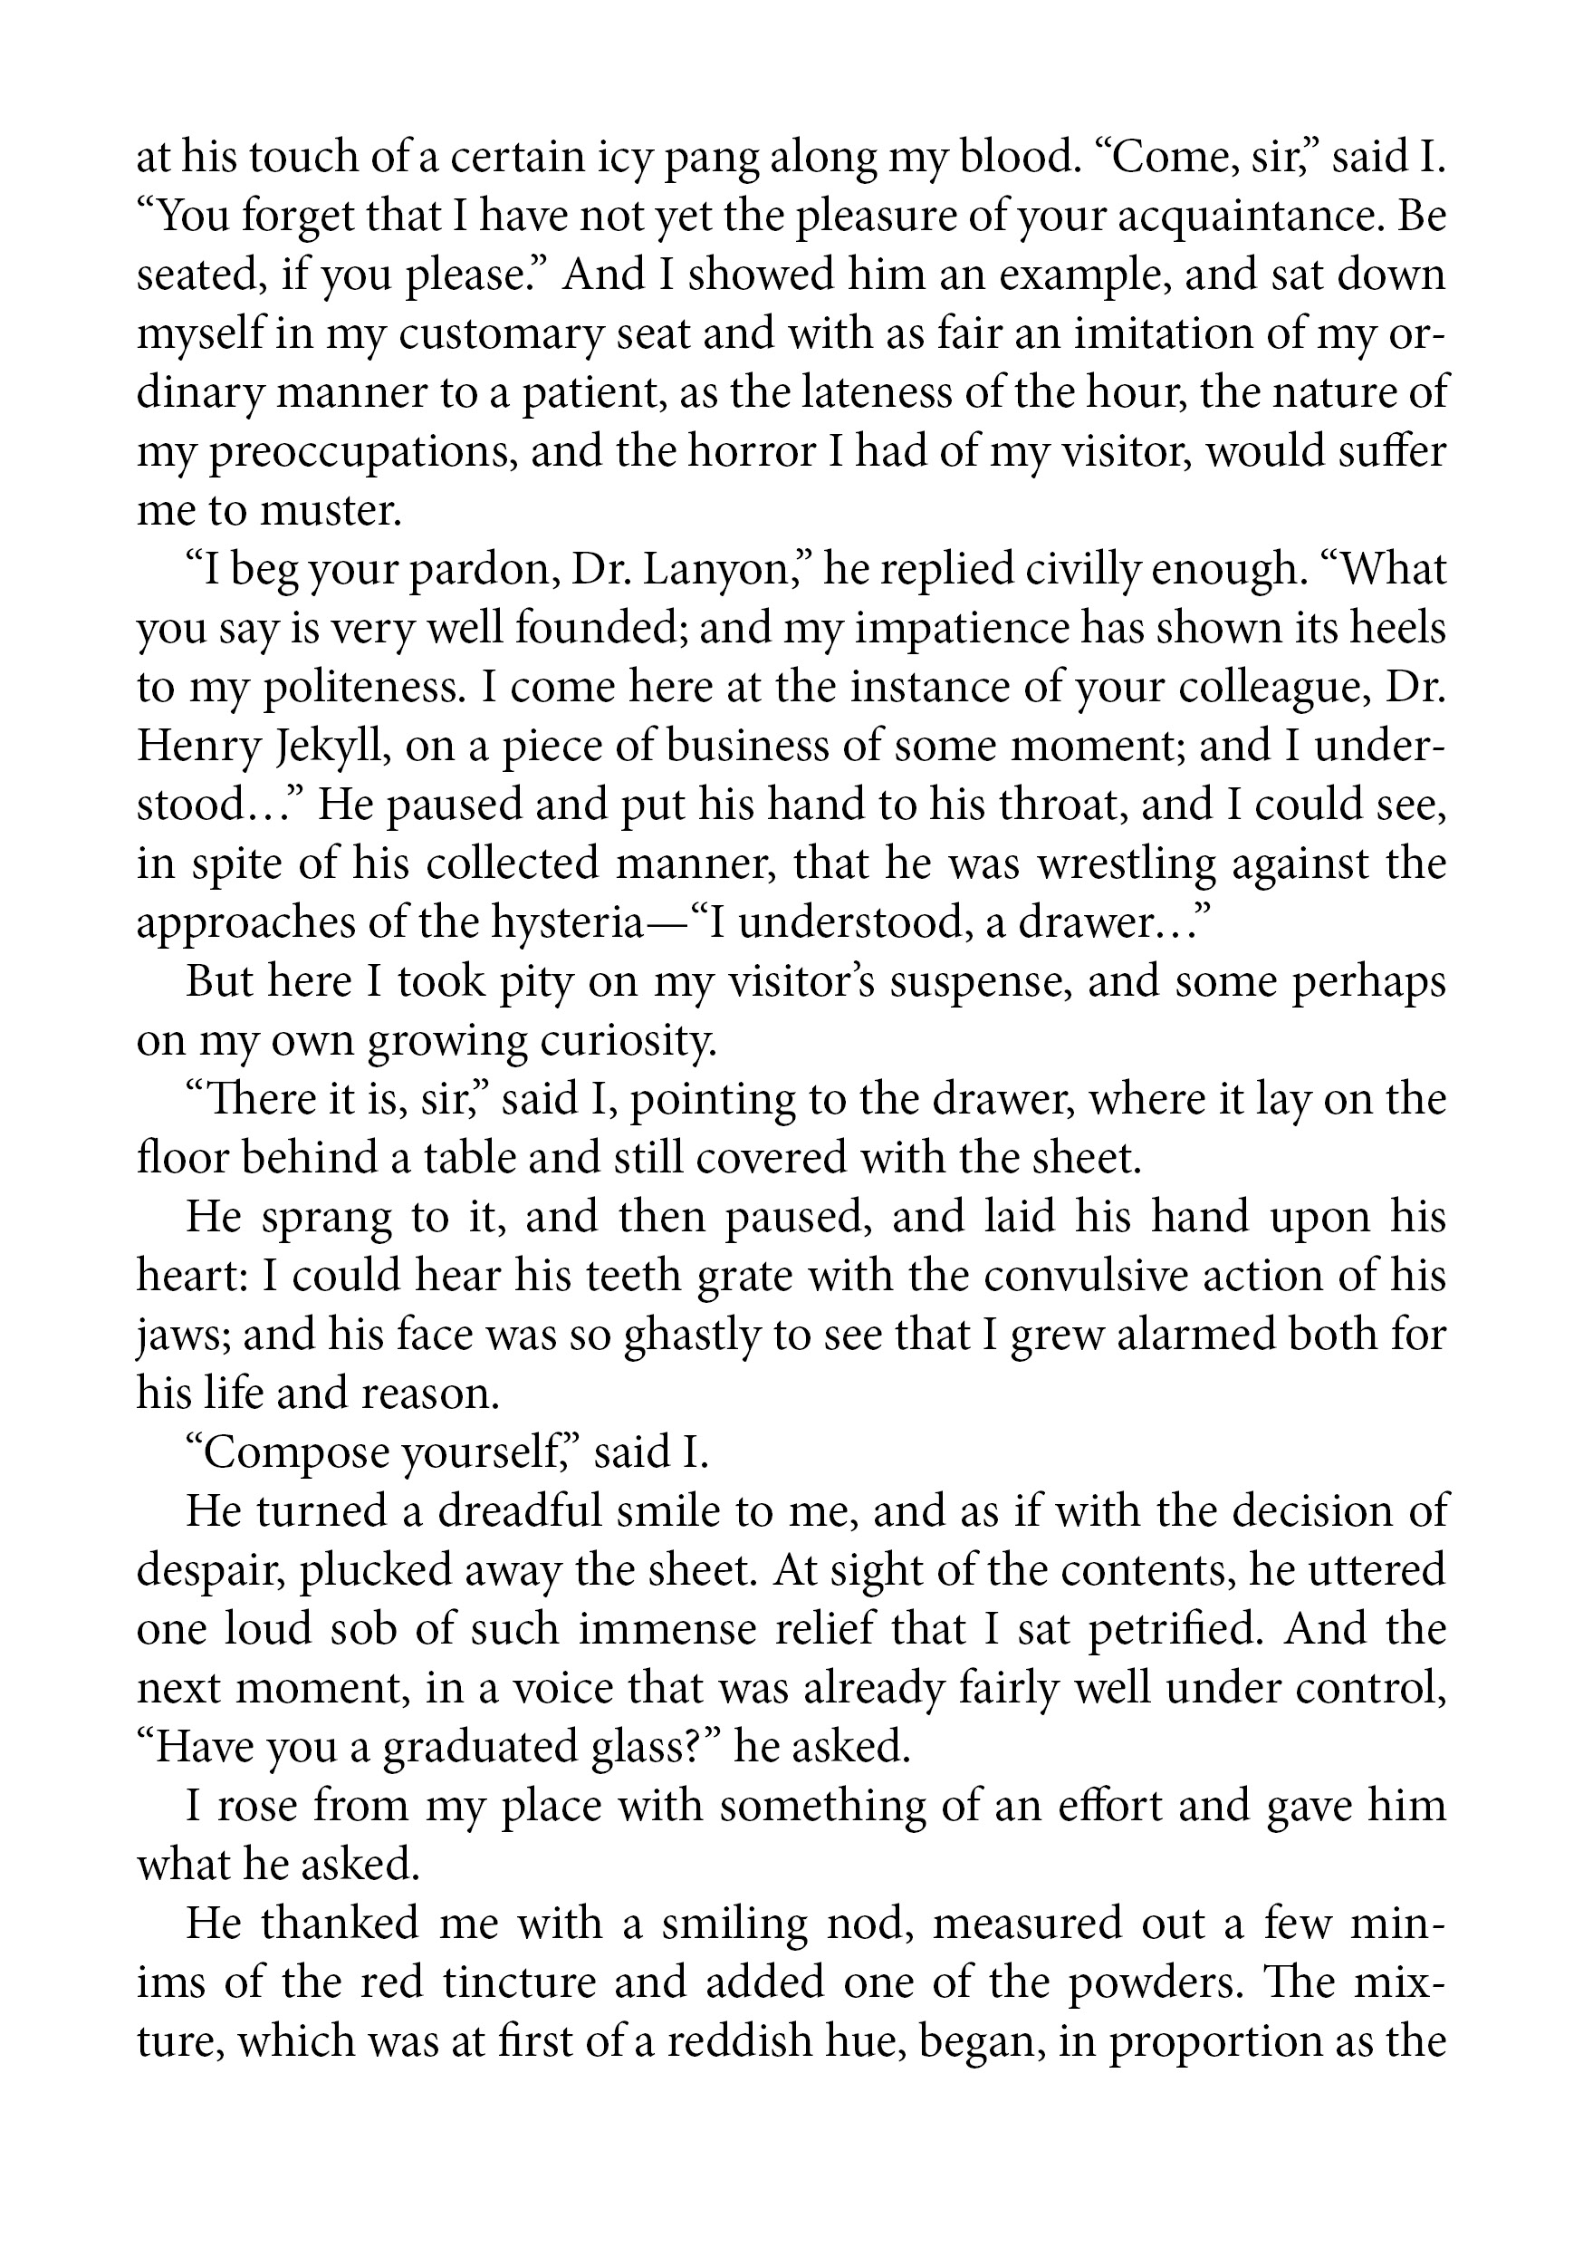


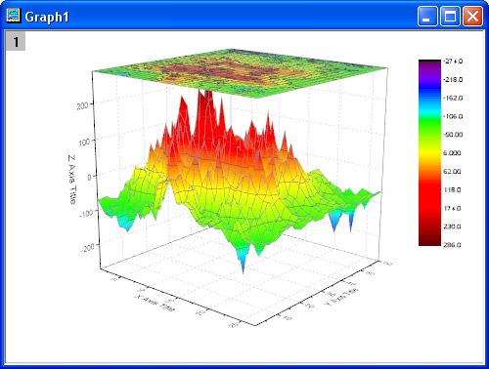
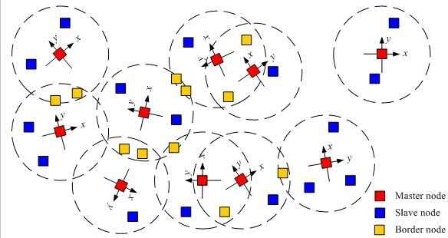

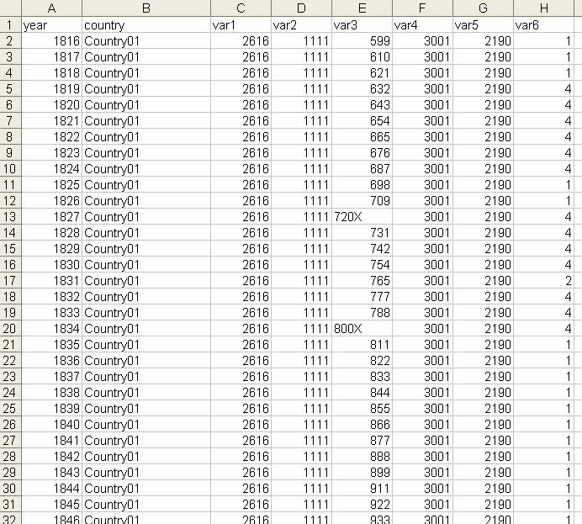



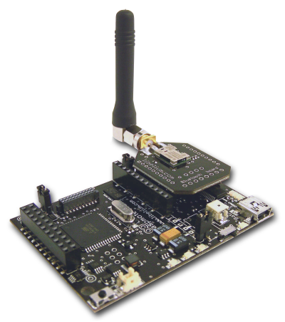
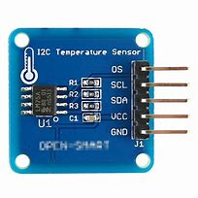

DOA – Abstracting Data and Services
ID:55.1/….
Local Handle Service
1
3
DO Repository
ID:44.1/….
DO Registry
Local Handle Service
2
DO Repository
ID:11.1/….
Local Handle Service
DO Registry
ID:11.1/….
DOIP Service
DOIP Service
DOIP Service
End users, clients, services, IoT devices, etc…
Digital Objects
Digital Object Based Services:
Securely identified abstracted systems, services, and data sources.
Exiting or future systems, service and data sources.

Slide 9
Digital Object Architecture – A Paradigm Change
It is no longer about the service but about every individual pieces of data within that service.
Every email in an IMAP account could be globally shared with any specific person independently of IMAP.
Sharing can become ubiquitous: any file, any program, any service, any item available in digital form can be shared and accessed from anywhere while the clients accessing the information can be authenticated and authorized.
The ability to interact with data and services is no longer tied to different protocol interfaces but different operations that can be performed on a DO.
This is an incremental improvement where type registries can provide part of the solutions.

Slide 10

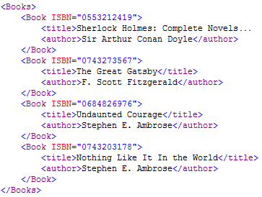




Digital Object Architecture: 3 Components
DO Clients
DO Service - Repositories
Access
Resolve
Search
DO Service - Registries
Handle Service

Slide 11
Digital Object Architecture: Two DO Protocols
Handle protocol – Leverages the Global Handle Registry™ to resolve any handle globally.
Allotment of globally unique identifiers known as handles.
Provides rapid secure resolution of a handle into a digital object structured as a handle record.
Provides distributed administration of handles and their records.
Has built in PKI and security.
DOIP – Interoperable access to distributed, independently managed services and data sources.
DOIP is a protocol to interact with digital objects.
Leverages existing transport encryption standards such as TLS.
Provides built-in security leveraging the PKI of the Handle System™.
Leverages the Handle for typing of data and operations and for client authentication.

Slide 12
Digital Object – Basis of the DOA
id: the DO’s identifier: A handle
type: The type of the DO. (typically a handle)
attributes: 0 or more key-value pairs.
key: DO Type describing the type of the value
value: the an instance of the associated type.
elements: 0 or more elements each consisting of:
id: ID of the element. Must be unique in the DO.
type: the type of the element.
length(optional): the length of the data element.
attributes: 0 or more key-value pairs.
data: the payload of the data element.
signature Optional
DOIP
Specific

Slide 13
Two Synergistic and Complimentary Protocols
The Handle Protocol used in the Handle System is a global, rapid, and secure resolution service that resolves handles into digital object structured handle records.
For many applications, the Handle System can be a complete solution for managing Digital Objects.
Other use cases may need their Digital Object to have the additional capabilities provided by DOIP.
DO that need extensible operations, authentication, and access controls.
Big Data: large data sets with different access methods.
IoT devices: many different sorts of protocols with varying taxonomies.
Other uses cases require new and different security solutions.
The DOIP implementation uses the Handle System for its PKI and to resolve a Digital Object identifier into information needed to connect to the appropriate DOIP Service.

Slide 14
Handle Protocol and DOIP Comparative Uses
Characteristics | Handle System | DOIP Service
Data set size | Small to medium (< 100k) | Small to Very Large
Access Control | Handle Admin Based / PKI authentication / Public / Private | Extensible
Authentication | PKI authentication Password | PKI Authentication Extensible
Streamable Protocol | No | Yes
Extensible Operations | No | Yes
Functionality | Resolution and administration of handles. | DO Service DO Repository – DO Registry – Extensible
Root of Trust | Global Handle Registry (GHR) | Each DOIP Service may be independent of the GHR.

Slide 15
Digital Object Architecture – An Introduction
DONA Foundation
Digital Object Architecture Overview
Handle System
DOIP
Global Handle Registry

Slide 16




Interacting with Digital Objects - Handles
55.123/AE0-123-5BA
Handle Service
Client
Resolve ID
Handle Protocol
Handle Record
(Digital Object)
Type
Registry
Counterfeit and
Supply chain management

Slide 17
What is a Handle?
A handle is an identifier consisting of a prefix and a suffix separated by a “/”
Handles are unique and resolvable using the Handle System.
Prefixes are allotted to local handle service providers and most prefix handle records are accessible from the “Global Handle Registry” (GHR®) and, in some cases, from selected local handle services.
A handle prefix is typically resolvable by the GHR to an IP address for a Local Handle Service.
The handle is resolvable by the Local Handle Service into a handle record.
Character Set: Unicode 2.0
Encoding: UTF-8
Prefix: Currently allocating only numeric values.
Suffix: No restrictions.
35.1234/12345678
Prefix
Suffix

Slide 18
Handle Record
Handle
Type
Handle Data
35.1525/b.2009.59.5.9
HS_ADMIN
handle=0.na/35.1525; index=200;
[delete hdl,add val,read val,modify val,del admin,add admin,list]
URL
http://www.caliber.net/abs/35.1525/2009.59.5.9
0.TYPE/METADATA
<metadata><author>John Doe</author><dateCreated>2016-01-02<
0.TYPE/DATA-SIG
9.eyJkaWdlc3RzIjp7ImFsZyc3RzIjp7Ic3RzIjp7IsfsdI6IlNIQS0yNTYiLCJkaWdlc….
0.TYPE/SHA256
eyJhbGciOiJSUzI1NiJ9.eyJkaWdlc3RzIjp7ImFsZyI6IlNIQS0yNTYiLCJkaWdlc….
HS_PUBKEY
0000000B4453415F5055425F4B4559000000000015009760508F15230B….
HS_CERT
0EPdfui8l4yszmLkiaSfleJEY6r7ThLwY27ykZKx9xxwPiVneS4NWh_W5SsW-….
HS_SIGNATURE
DuTmIPRpWA6BQaPfvYUmFpn_o5meE3NoR8PB_z4SuxQoVQAC0Pu3KS….

Slide 19
Handle Resolution - Overview
MPA 22
MPA 21
Resolve 10.152/59.5
Resolve 0.NA/10.152
GSP 11
DONA
MPA 20
Handle Services
Handle Service for 0.NA/10.152
MPA 10
MPA 86
Global
Handle
Registry
Handle Service
35.1
Handle Service
20.123.1
Resolve 10.152/59.5
Handle Service
10.152
Handle Service
86.1
Local Handle Service 10.152
Local Handle Service 35.1
Local Handle Service 86.1
Authoritative
Service 1
Authoritative
Service
Mirror
Service 1
…...
Mirror
Service n
Authoritative
Service 1
Authoritative
Service 2
SVR
#1
SVR
#2
`
SVR
#1
Authoritative Service for 10.152
SVR
#1
SVR
#2
SVR
#3
SVR
#4
SVR
#n
...
10.1525/59.5
URL
4
http://www.acme.com/
HS_SIG
20
eyJhbGciOiJSUzI1NiJ9…..

Slide 20

Handle Resolution using the GHR- Service Info Request
Request: Resolve 10.152/59.5
Client requests a specific GSP in the GHR to resolve the prefix handle 0.NA/10.152
Global Handle Registry
Security Features:
Privacy: Encrypted client request
Authentication:
Cryptographic authentication of the target GSP service
Cryptographic authentication of the resolving client
Audit trail: GSP logs the full client request

Slide 21
Handle Resolution using the GHR - Service Info Request
2. The targeted GSP Responds with the Service Information for the 10.152 service.
Global Handle Registry
xcccxv
xc
xc
xc
...
xcccxv
xc
xc
xc
..
xccx
xc
xc
xc
..
Client receives the Service Information for the 10.152
Service.
xccx
xc
xc
xc
..
xcccxv
xc
xc
xc
..
Security Features
Privacy: Encrypted client request
Authentication:
Cryptographic Authentication of the target GSP service
Cryptographic Authentication of the resolving client
Audit trail: GSP logs the full client request
Privacy: Response from GSP is encrypted
Authorization: Response only provides what the authenticated client is allowed to see
Non-repudiation: Service information is signed by the GSP service and it is verified by the client.
xccx
xc
xc
xc
..
xccx
xc
xc
xc
..
xcccxv
xc
xc
xc
..
xccx
xc
xc
xc
..
xccx
xc
xc
xc
..
Handle Service Information

Slide 22
Handle Service Information
xcccxv
xc
xc
xc
...
xcccxv
xc
xc
xc
..
xccx
xc
xc
xc
..
xccx
xc
xc
xc
..
xcccxv
xc
xc
xc
..
xccx
xc
xc
xc
..
xccx
xc
xc
xc
..
xcccxv
xc
xc
xc
..
xccx
xc
xc
xc
..
xccx
xc
xc
xc
..
Handle Services | IP Addresses | Port Number | Public Key | …
Authoritative Service Service 1 Service 2 | 12.34.45.67 12.34.56.68 | 2641 2641 | 5ec6f944… 55fa26ca… | … …
Mirror Service 1 Service 1 Service 2 Service 3 | 12.45.67.71 12.45.67.72 12.45.67.73 | 2641 2641 2641 | C77ee70…22d81f1… 43a7a1f…. | … … …
Mirror Service 2 Service 1 Service 2 | 32.23.23.12 32.23.23.13 | 2641 2641 | A80b56… b56757…

Slide 23
Handle Resolution – Handle Service Request
Global Handle Registry
3. Client queries Server #2
in Mirror Service 1
to resolve 10.152/59.5
Security Features
Privacy: Encrypted client request
Authentication:
Cryptographic Authentication of the target LHS service
Cryptographic Authentication of the resolving client
Audit trail: LHS logs the full client request
Handle Service for 10.152
Mirror Service 2
Authoritative
Service
SVC
#1
SVC
#2
SVC
#1
SVC
#2
Mirror Service 1
SVC
#1
SVC
#2
SVC
#3

Slide 24
Handle Resolution – Handle Service Request
Global Handle Registry
10.152/59.5.9
URL
4
http://www.acme.com/
HS_SIG
20
eyJhbGciOiJSUzI1NiJ9…..
4. Server responds with the 10.152/59.5.9 handle record
Security Features
Privacy: Encrypted client request.
Authentication:
Cryptographic Authentication of the target LHS service.
Cryptographic Authentication of the resolving client.
Audit trail: LHS logs the full client request.
Privacy: Response from Mirror is encrypted.
Authorization: Response only provides the values that the authenticated client is allowed to see.
Non-repudiation: Handle record is signed by the Mirror Service and can be verified by the client.
Handle Service for 10.152
Mirror Service 2
Authoritative
Service
SVC
#1
SVC
#2
SVC
#1
SVC
#2
Mirror Service 1
SVC
#1
SVC
#2
SVC
#3
Acme Local Handle Service

Slide 25
Digital Object Architecture – An Introduction
DONA Foundation
Digital Object Architecture Overview
Handle System
DOIP
Global Handle Registry

Slide 26

Interacting with DOs – Handle Protocol and DOIP
Handle Service
55.123/AE0-123-5BA
Resolve ID
Handle Protocol
Client
Handle Record
DO State Metadata
DOIP Services
DO Request
DO Response
DOIP
DO
Repository
CORDRA
Big Data
Systems
DO
Registry

Slide 27
DOIP Interaction with a Digital Object
DOIP is a simple query-response protocol.
A client resolve a DO’s handle into state information about that DO.
The client establishes a DOIP connection with the DO.
Secure connection, basic client/server authentication.
Client sends a DOIP request to the DOIP Service.
The DOIP Request specify what operation to perform on the DO.
The DOIP Service performs the request on the DO and sends a DOIP response to the client.
The DO’s DOIP Response is subject to the client credentials and associated access controls.
The client parses the responses according to the rules associated with the requested operation.

Slide 28
DOIP: Interacting with DOs using Operations
DOs may be asked to list of operations they can perform:
DOIP Defined Operations: create, read, update attributes etc…
User Defined Operations: GetTemperature, SetFanSpeed, etc…
Access Control Operations.
A DOIP Request includes what operation to perform on the target DO.
A DO Repository is a DO that has repository operations.
A DO Registry is a DO that has registry operations.
A DO can range from the very simple to the very complex.
Operations are themselves defined as Digital Objects:
Identified using handles, globally unique and resolvable.
Provide a description, may include software modules.
Operations and Types can be registered in type registries to facilitate their discovery and reuse.

Slide 29
DOIP Deployments
DOIP is a simple protocol that can be used to provide access to existing databases, services, and systems.
DOIP can be integrated with existing systems to provide DO based access to specific information and services of that system.
DO Repository and DO registries are key component of the DOA that have reference implementations.
Can themselves be integrated with existing system.
A DOIP implementation can define and register its own serialization of the DOIP protocol as a Digital Object to make it useable by other clients.

Slide 30
Digital Object Architecture – An Introduction
DONA Foundation
Digital Object Architecture Overview
Handle System
DOIP
Global Handle Registry

Slide 31
GHR Service Provider
An organization that is credentialed and authorized by DONA to create derived prefixes from its allotted credential prefix is known as a Multi-Primary Administrator (MPA).
Each such organization is allotted a credential by DONA (such as 35) and authorized to provide GHR services using that credential. This typically entails allotting prefixes derived from their credential (such as 35.100) and providing GHR resolution services.
Each such organization can create and unlimited number of derived prefixes and allot them to organizations that wish to provide local handle services.
A maximum of 1 million one-delimiter prefixes may exist in the GHR.
All GHR Services verify and replicate any and all valid prefixes created/modified by all other GHR Service Providers in accordance with DONA Foundation Policies and Procedures .

Slide 32
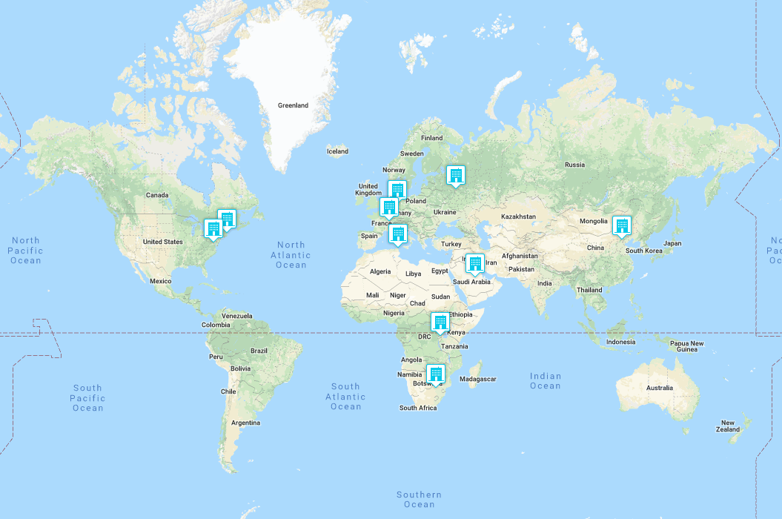
DONA GHR Service Deployment Overview
DONA has currently 9 credentialed MPAs that provide GHR services.
ITU is also a GHR Service Provider although not an MPA.
Our goal is to provide a wide geographical coverage and redundancy of service with 12 MPA by the end of 2020.

Slide 33
MPA GHR Operations
Global Handle Registry
RA 1
DONA
MPA GHR
Service 86
RA 2
MPA
Credentials
IDF
MPA
DONA GHR Service
MPA GHR Service 10
RA 2
Allots Prefixes
derived from
0.NA/10
e.g. 0.NA/10.123
Org. A
Replicates new prefixes
Cryptographically and
validation
CNRI
MPA
MPA GHR
Service 20
MPA GHR
Service 21
Org. B
Prefix
Request
Allots
Prefixes
derived from
0.NA/20
e.g. 0.NA/20.1.1
Org. 1
GWDG
MPA
Org. C
MPA GHR
Service 22
Org. 2
Every MPA replicates every other MPA’s prefixes.
Each MPA can allot unlimited derived prefixes.
An MPA can only allot derived prefixes from its allotted prefix.
Only prefixes with 0 or 1 delimiter are replicated within the GHR.
Org. 3

Slide 34
MPA GHR Scaling
MPA GHR
Service
Authoritative
Additional
Resolution svc
Additional
Resolution svc
Additional
Resolution svc
SVR
#1
SVR
#2
SVR
#3
SVR
#4
SVR
#n
SVR
#1
SVR
#2
SVR
#3
SVR
#4
SVR
#n
Additional
Resolution svc
Additional
Resolution svc
Additional
Resolution svc
SVR
#1
SVR
#2
SVR
#3
SVR
#4
SVR
#n

Slide 35
Thank you.

