Slide 1
PIDs in Language-based research
Dieter Van Uytvanck
EU PID service workshop
4 November 2019
Amsterdam

Slide 2
Introduction

Slide 3
CLARIN?
Common Language Resources and Technology Infrastructure
ESFRI ERIC status since 2012, Landmark since 2016
that provides easy and sustainable access for scholars in the humanities and social sciences and beyond
to digital language data
in written, spoken, video or multimodal form
to advanced tools
to discover, explore, exploit, annotate, analyse or combine them, wherever they are located
through a single sign-on online environment

Slide 4
CLARIN ERIC in members and centres
A consortium of:
20 members: AT, BG, CY, CZ, DE, DK, EE, FI, GR, HR, HU, IT, LT, LV, NL, NO, PL, PT, SE, SI
4 observers: FR, UK, IS, SA
>50 centres

Slide 5
Data architecture at a CLARIN centre
Repository at a CLARIN centre
Single text or recording
Corpus
Lexicon
Wordnet
Grammar
...
Language Data
Metadata
Language Tools
Web application
Web service
Web service pipeline
Stand-alone application
...

Slide 6
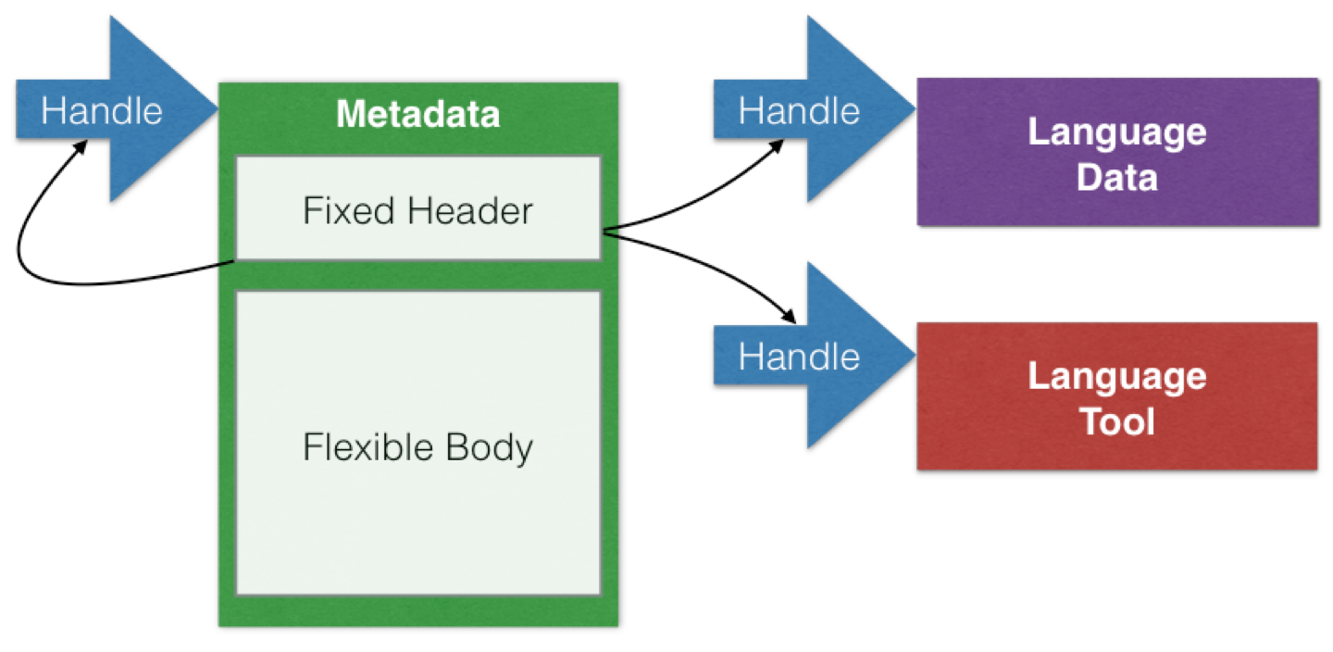
The CLARIN data architecture:
Persistent Identifiers (PIDs)

Slide 7



Data discovery and processing
Language Data
Metadata
Language Tools
Language Data
Metadata
Language Tools
Harvested Metadata
Metadata Search
Data Analysis
Indexation
Selection
Language Data
Metadata
Language Tools
Language Data
Metadata
Language Tools

Slide 8
PIDs: Organisational setup

Slide 9
Organisational setup
Centres are free to choose their PID providers, as long as they remain compatible with the technical requirements
In practice:
Most use Handles, either (800k)
Directly via CNRI (own handle server, often DSpace-based)
Via EPIC, with API support
Some use DOIs (8400)
Via own libraries/institutions
CLARIN ERIC is:
Non-allocating member of EPIC
Direct member of DataCite

Slide 10
Suggestion: link checking

Slide 11
Organisational setup
Trusting PIDs is good, but checking them is better
https://curate.acdh.oeaw.ac.at/statistics
Currently: 7 mio links for 1 mio metadata records
Checking links is resource-consuming activity, costs:
time
implementation effort
computation resources of the provider
Right now, many do this in isolation
CLARIN, EPIC, DataCite, Europeana, […]
Ideal case for pooling efforts
Have 1 central (or federated) checker with shared read-access via a simple API

Slide 13
CLARIN & the Digital Object Architecture

Slide 14
Language Resource Switchboard switchboard.clarin.eu and clarin.eu/eosc
Match based on language, format & task
Language Data
Language Tools
Language Resource Switchboard
Language Data
Language Tools
Language Data
Language Tools
Language Data
Language Tools

Slide 15
Language Resource Switchboard (switchboard.clarin.eu)
Language Data
Language Resource Switchboard
Language Tools
CLARIN & EOSC-hub
Via metadata
Virtual Language Observatory
Virtual Collection Registry
EUDAT
Via metadata
B2DROP
[cloud storage]
Parthenos
Via metadata
D4Science
[Virtual Research Environment]
DOA
Via direct input of digital objects
Matching based on mime type and language information stored in handle

Slide 16
CLARIN Digital Object requirements
PID Kernel Information
Community profile
Persistent Identifier
Metadata Identifier
Mimetype
Language
License?
Language Data
Metadata
text/plain
ISO639-3: nld
GPL v3
Describes

Slide 17
Virtual Collections (collections.clarin.eu)
Digital Object
Collection
Metadata
URL
Metadata
Object
Metadata
Object
PID
Metadata
Object
Digital Object
Referencing object via URL
Object metadata managed by collection owner
Referencing object via PID
Object metadata managed by collection owner
Referencing object via Digital Object Identifier
Object metadata collected via DO protocol

Slide 18
Next steps
Select a DTR [done] > the EPIC one
Register an account [done]
Create a prototype profile [waiting for documentation]
Register a few example handles and make them full-fledged Digital Objects
Adjust the Switchboard so that it
can recognize Digital Objects when a handle is provided as input [done: handle support]
https://collections.clarin.eu/app/details/1020
extract relevant metadata from the DO to feed it into the switchboard as parameter
Adjust the Virtual Collection Registry
(if project granted) further steps > DSpace extension etc. [project on reserve list]

Slide 19
Summary
CLARIN use-cases
Language Resource Switchboard
Virtual Collection Registry
Important DO properties
Mime Type
Language
License
Reference to descriptive / user metadata

Slide 20
Digital Object Protocol
Language Resource Switchboard
Language Data
Metadata
Language Tools
DO Interface
Uniform interface to object:
DO Metadata
Bitstream
Descriptive metadata
Virtual Collection Registry
DO Interface
Language Data
Metadata
Language Tools
Other services

