Slide 1

Agenda ok?
13.00 Klaas Welcome
13.05 Peter Challenges and State of the Art
Session 1 – Community Views
13.35 Dieter CLARIN view on PID Landscape
14.05 Tobias ENES view on PID Landscape
14.35 Alex DISSCO viw on PID Landscape
15.05 coffea break
Session 2 – Organisational Views
15.30 Milan Slowenian National View
15.50 Ognjen Greece National View
16.10 Christophe DONA ready to serve?
16.30 Ulrich/Mark Are European services ready?
17.00 Discussion about Requirements & Declaration
9.00 Peter Summary & Declaration
9.20 Klaas/Ulrich Landscape and Roles
10.15 Coffee Break
10.30 Karel Luyben EOSC PID Requirements
11.00 Kostas Glinos EC PID Requirements
11.30 Conclusions for a EU PID Landscape
12.30 Lunch
13.30 Internal Meeting
15.00 End
Policy
oriented

Slide 2


PID Challenges and State of the Art
Bringing People Together to Advance Data Science!
Amsterdam PID Meeting
Peter Wittenburg
Max Planck Computing & Data Facility

Slide 3
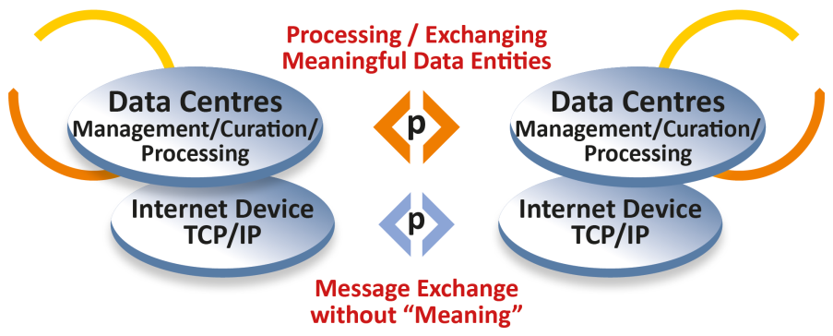
Internet at the start
some
applications
FTP
SMTP
GOPHER
etc.
82/85
complex,
many different types,
scientifically driven
„simple“, few types,
technologically driven

Slide 4
Web came next
some
applications
many
applications
FTP
SMTP
GOPHER
etc.
WWW
HTTP
HTML
URI
91/94
82/85
complex,
many different types,
scientifically driven
„simple“, few types,
technologically driven

Slide 5
Handles little later
some
applications
many
applications
Handle
System
FTP
SMTP
GOPHER
etc.
WWW
HTTP
HTML
URI
92/96
91/94
82/85
complex,
many different types,
scientifically driven
„simple“, few types,
technologically driven

Slide 6
Kahn&Wilensky Papers
10/12
DO
Architecture
some
applications
many
applications
Handle
System
FTP
SMTP
GOPHER
etc.
WWW
HTTP
HTML
URI
A Framework for
Distributed Digital
Object Services
(Kahn & Wilensky)
92/96
91/94
82/85
95/06
complex,
many different types,
scientifically driven
„simple“, few types,
technologically driven

Slide 7
1st Applications of Handles
10/12
DO
Architecture
02
„large“
repositories
some
applications
many
applications
Handle
System
Publishers
DOI
FTP
SMTP
GOPHER
etc.
WWW
HTTP
HTML
URI
A Framework for
Distributed Digital
Object Services
(Kahn & Wilensky)
92/96
02/12
91/94
82/85
95/06
complex,
many different types,
scientifically driven
„simple“, few types,
technologically driven

Slide 8
Why Handles and not URIs
URIs are protocol dependent, PIDs must not
URIs include locational/ownership semantics, PIDs should not
URI practices produce link rot, PIDs must not
Handles allow to point to different locations, URIs not
May be more
Therefore
librarians started with Handles
little later publishers with DOIs
MPI repository with non-reproducible material started with handles
Many others same time
CNRI understood that it is not anymore about registering some publications

Slide 9
RDA came in
14
RDA DFT
Core Model
10/12
DO
Architecture
02
„large“
repositories
some
applications
many
applications
Handle
System
Publishers
DOI
FTP
SMTP
GOPHER
etc.
WWW
HTTP
HTML
URI
A Framework for
Distributed Digital
Object Services
(Kahn & Wilensky)
92/96
02/12
91/94
82/85
95/06
complex,
many different types,
scientifically driven
„simple“, few types,
technologically driven

Slide 10
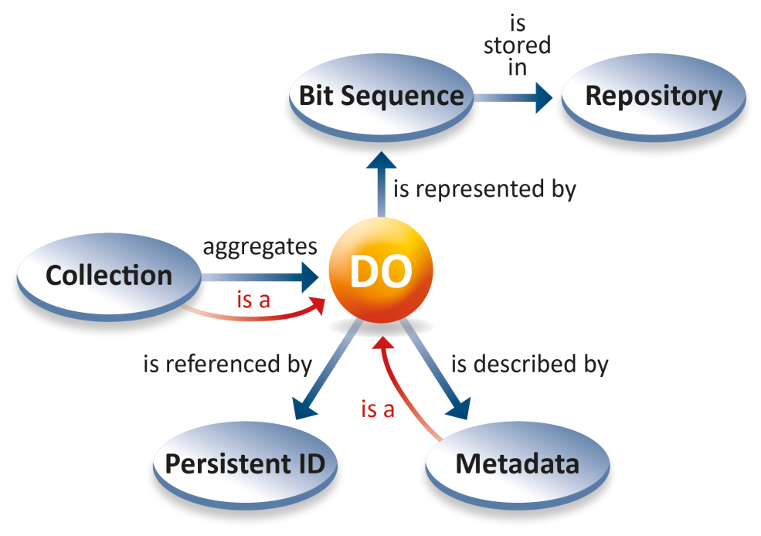
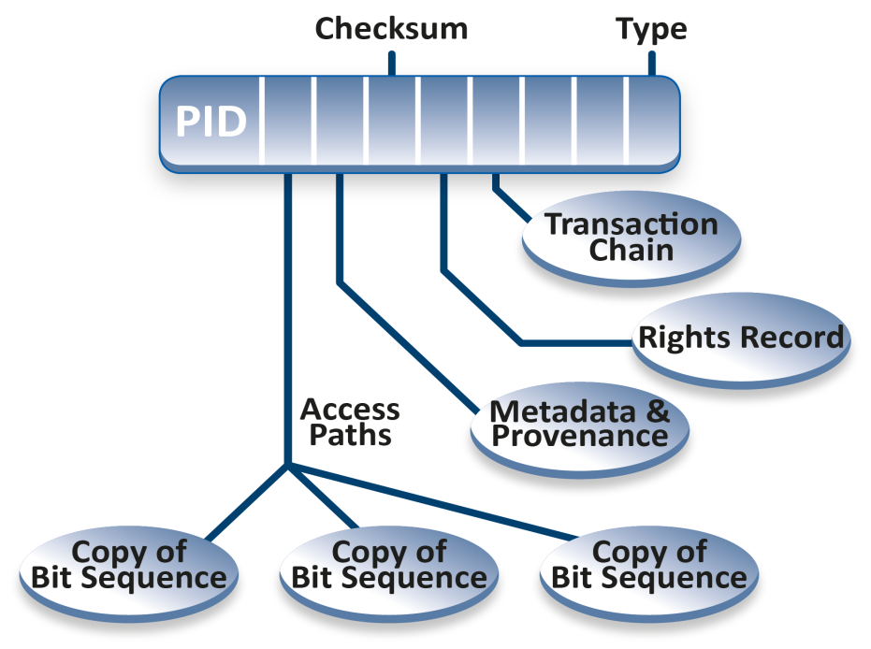
RDA DFT
Kahn & Wilensky: DO is an instance of an abstract data type that has two
components, data and key-metadata. The data is typed. The key-metadata includes
a handle.
RDA
Kernel
DTR
DFT: a DO has a structured bit sequence stored in some repositories, is assigned a
PID and is described by metadata. DOs can be aggregated to collections which are also DO. Metadata descriptions are DOs.
The DO‘s PID Record is resolved to essential attributes enabling human/machine actions.

Slide 11

The FAIR Rocket
14
RDA DFT
Core Model
10/12
DO
Architecture
02
„large“
repositories
some
applications
many
applications
Handle
System
Publishers
DOI
FTP
SMTP
GOPHER
etc.
WWW
HTTP
HTML
URI
A Framework for
Distributed Digital
Object Services
(Kahn & Wilensky)
92/96
02/12
FAIR F1
91/94
82/85
95/06
complex,
many different types,
scientifically driven
„simple“, few types,
technologically driven

Slide 12
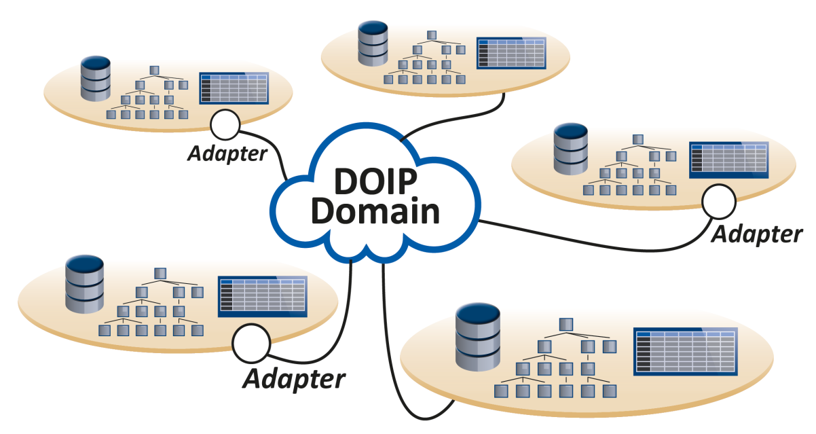
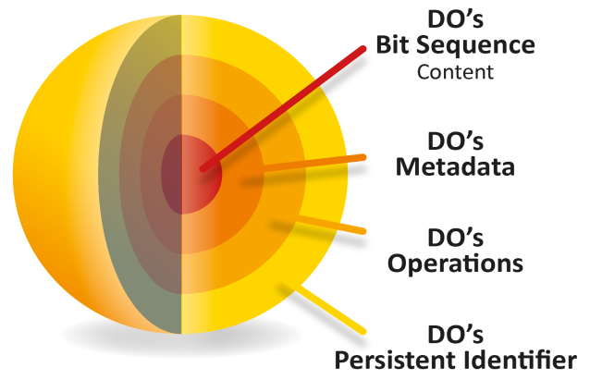
DOIP from DONA
improved specification and implementation of DO Architecture
DOIP V2.0 specifying unified client – DO Server interaction
DOIP V2.0 Implementation
CORDRA DO Server Reference Implementation
all is PID based

Slide 13
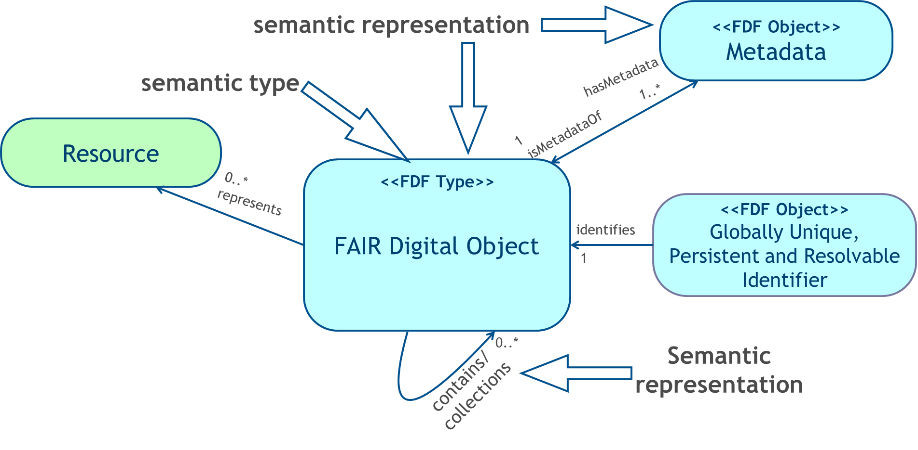

FAIR requires Semantic Explicitness
(in close collaboration with Luiz Bonino
and by borrowing mechanisms from LD)

Slide 14
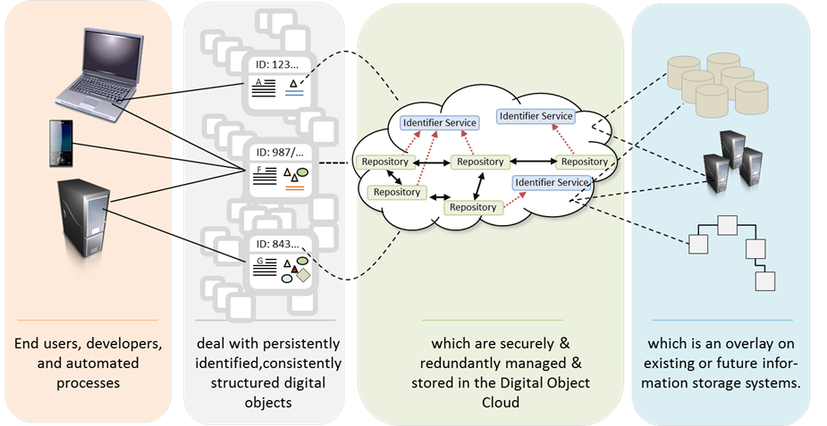
clouds
files
hdms
dbs
etc
What does it solve?
virtualisation
local
virtualisation
mikro
procedures
FDOs are the integrative technology for federative infrastructures!

Slide 15
State
EOSC is a must
FAIR is a must for EOSC - F1: every data/MD to have a PID
EC: FDO is a federative infrastructure for EOSC
Yet no functioning PID offer to implement this
billions of PIDs necessary
Absurd cost models
No service for all data scientists
Publishers interested in future businesses on our data
Publishers dominating the PID discussions, creating dependencies
Crossref makes real money with layered services
where is Datacite going?
they are in a competitive mode although collaboration is required
Do they address the requirements of FAIR F1? Nooo
does not deliver money
legacy to be addressed
however linking is of interest to researchers (looking short term)

Slide 16
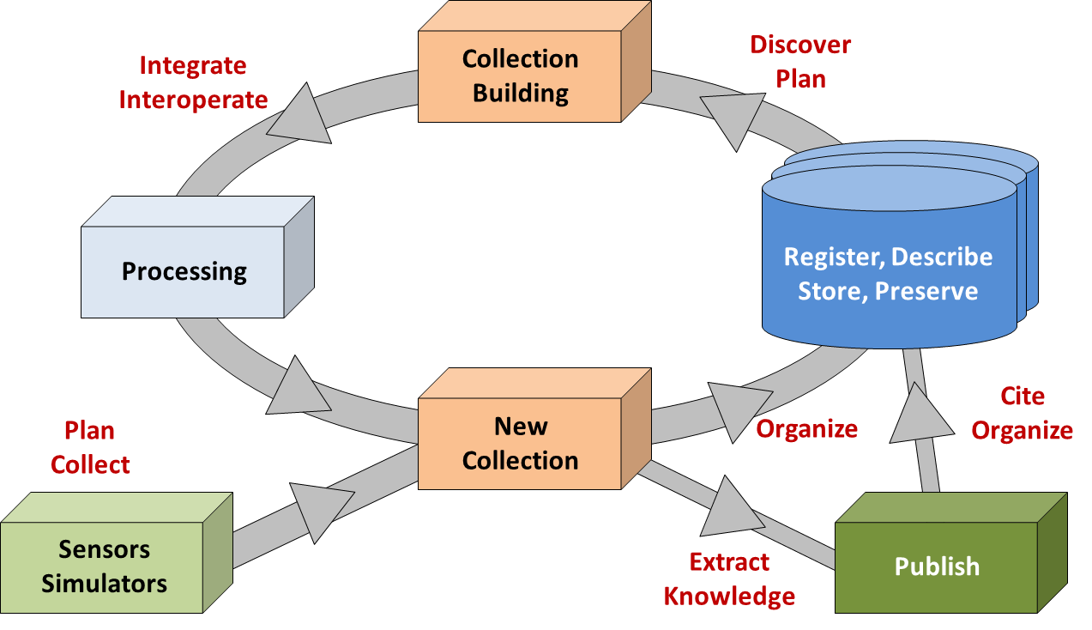
Where is the data?
1000s of repositories
mostly in RO
80% dark data
have 90+ % of data
high granularity
references
no lobby
need low costs
small fraction is published
low granularity
citations
big lobby
costs?

Slide 17
Landscape
1,5 FTE
CN PID Coalition
DONA
Global Handle System
RU PID Services
IDF
ePIC
European PID Coalition
9 FTE
? FTE
Crossref
Datacite
FREYA
EUDAT
great job – much done ☺
broad community
DOIs + business model
technical restrictions
mixing PIDs and metadata
mixing PIDs and linking
mixing PIDs and commerce
no research independence
no performance tuning
great job – much done ☺
no real community
too few people
professorware
complex organisation
open for scalability
tuning supported
flex. Kernel Attributes
DTR support
no mixtures
machine actionable
research independence
to be done ☺
to be broadly known
some more people
professional
simple organisation
scalable
tuning supported
flex. Kernel Attributes
DTR support
no mixtures
machine actionable
research independence

Slide 18
Decision & Threat
Publisher/Library
Cloud
restricted basic services
extended added value services
high costs
binding
=
PID+
=
=
European
PID Coalition
flexible, tunable basic services
limited added value services
low costs
no binding
=
PID
=
=

Slide 19
Decision & Threat
closed publisher controlled domain of data
(PID registry, Org registry, MD schemas, Metrix, Repositories)
Publisher/Library
Cloud
restricted basic services
extended added value services
high costs
binding
=
PID+
=
=
X
European
PID Coalition
flexible, tunable basic services
limited added value services
low costs
no binding
=
PID
=
=
Open Science domain of data
(PID registry, Org registry, MD schemas, Metrix, Repositories)
GAIA

Slide 20
Decision & Threat
closed publisher controlled domain of data
(PID registry, Org registry, MD schemas, Metrix, Repositories)
Who controls services on scientific data?
The fight has been opened
Too many naive colleagues
Where does Datacite go?
Is it already lost?
Publisher/Library
Cloud
restricted basic services
extended added value services
high costs
binding
=
PID+
=
=
European
PID Coalition
flexible, tunable basic services
limited added value services
low costs
no binding
=
PID
=
=
Open Science domain of data
(PID registry, Org registry, MD schemas, Metrix, Repositories)
GAIA

