Slide 1

EOSC Working Groups FAIR & Architecture
Sarah Jones
Chair of EOSC FAIR WG
Twitter: @sjDCC
Jean-Francois Abramatic
Chair of EOSC Architecture WG
GEDE webinar on EOSC progress, 7th November 2019

Slide 2
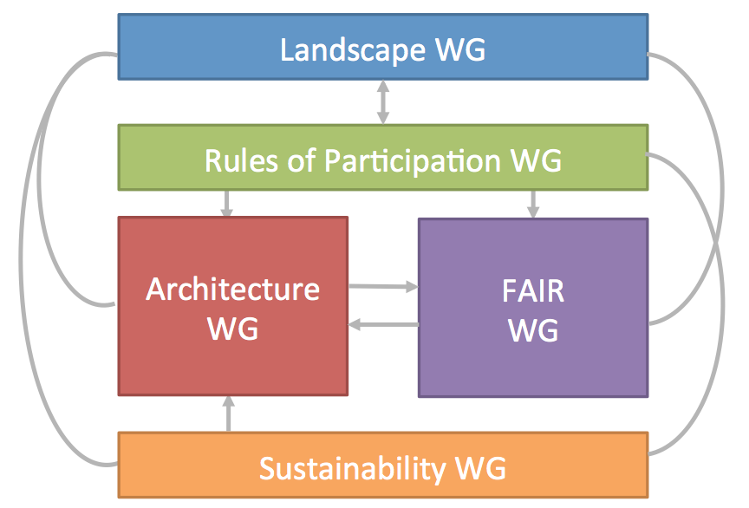
EOSC Exec Board Working Groups
https://www.eoscsecretariat.eu/eosc-working-groups

Slide 3
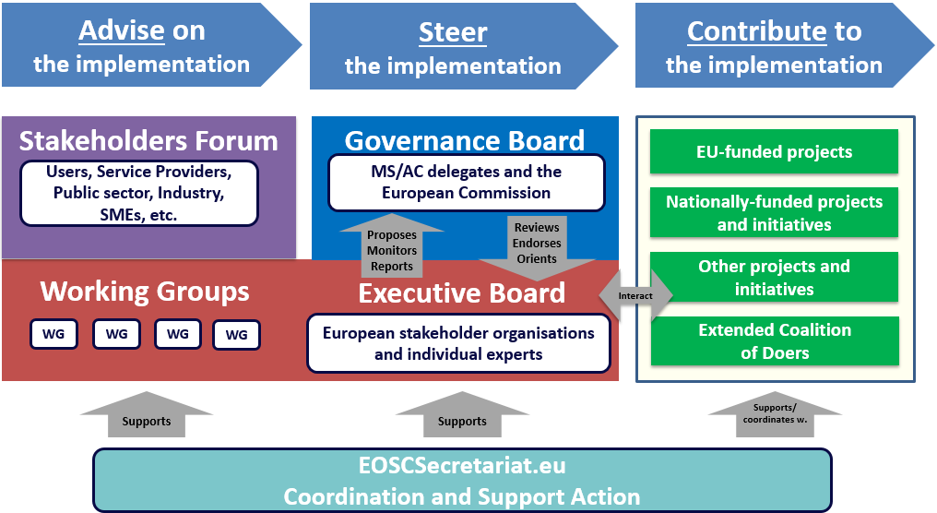
Where the Working Groups sit

Slide 4
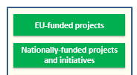

WGs are not reinventing wheels
Need to reach out to H2020 projects, national initiatives, RIs and coalition of the doers
Working Groups dependent on YOU!
You produce and we coordinate & endorse
Collectively we will build EOSC
Interact

Slide 5



Procedures and inputs
Define Build
Governance Board
EU funded projects
National initiatives
Coalition of Doers
Executive Board
Coordinate Endorse
WG Landscape
WG Sustainability
WG Architecture
WG FAIR
WG Rules of Participation
Consult
Test
Iterate

Slide 6

Work Plan is published
Contents
A first EOSC iteration by end 2020
Timeline
Procedures and required inputs
http://doi.org/10.2777/972843

Slide 7
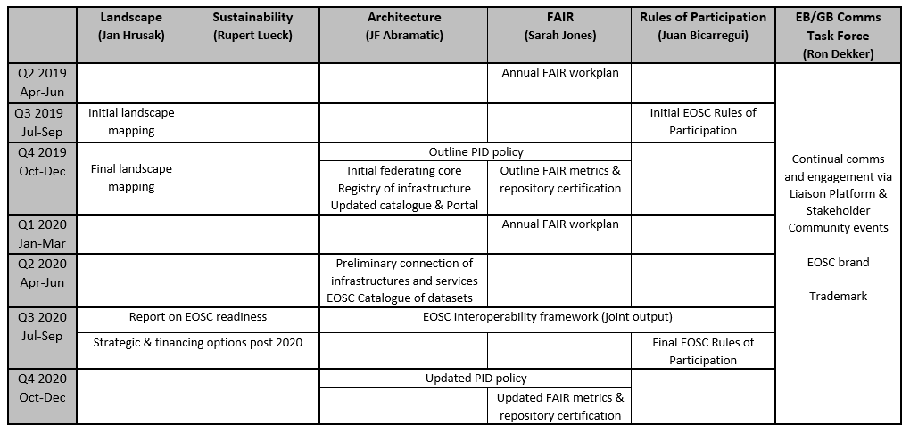
Timeline
Iteration and testing built into plan
Initial / outline outputs → TEST → Updated / final
Agree versions for implementation post 2020

Slide 8
FAIR Working Group update
www.eoscsecretariat.eu/working-groups/fair-working-group

Slide 9



Chair: Sarah Jones
Independent Expert
WHAT
WHY
Provide recommendations on the implementation of FAIR, including corresponding requirements for services, in order to foster cross-disciplinary interoperability
Connect people, data and service via standards
Be the glue
HOW
Data standards & sharing agreements
Upscale best-practice solutions
EOSC Interoperability Framework
Identify service requirements for FAIR
Persistent Identifier Policy for EOSC
Frameworks to assess FAIR data and certify services that enable FAIR
Converge towards globally-accepted frameworks
Q2 2019 2019 Annual FAIR work plan
Q4 2019 PID policy defined
Outline metrics for FAIR data & service certification
Q1 2020 2020 Annual FAIR work plan
Q3 2020
EOSC Interoperability Framework
Q4 2020
Updated PID policy
Updated FAIR metrics & service certification
testing & iterating

Slide 10
Key deliverables
Metrics for FAIR data and repository certification
First version due Q4 2019 and final version Q4 2020
Persistent Identifier policy
With Architecture
First version due Q4 2019 and final version Q4 2020
EOSC Interoperability Framework
Using FAIR practice outcomes as an input
With Architecture and Rules of Participation
Due Q3 of 2020

Slide 11
Getting FAIR up and running
Initial F2F meeting on 4th July
Second F2F meeting on 12 Sept
Monthly telecons in June, Aug, Sept, Oct & Nov
Regular Task Force telecons
2020 – monthly telecons and 4 F2F meetings planned
Tues 28th Jan in Porto (PIDapalooza)
Thurs 21st May in Karlsruhe (EOSC-Hub) - tbc
Thurs 3rd Sept in Brussels
Thurs 5th Nov in Brussels

Slide 12



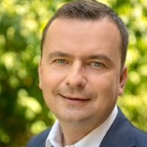


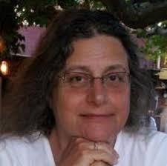

FAIR WG task forces (and leaders)
Dynamic duo
Rob Hooft
Marta Teperek
Semantic specialists
Oscar Corcho
Krzys Kurowski
FAIR practice
Interoperability
PID policy
Metrics & certification
Identifier nerds
Peter Wittenburg
Rachael Kotarski
Research leads
Francoise Genova
Magnus Aronsen

Slide 13
Task Force progress to date
Reviewing existing literature and activity (all TFs)
Developing a matrix and mapping FAIR maturity
Considering the coverage and format needed for the EOSC Interoperability Framework
Drafting an initial PID policy for consultation at EOSC Symposium in November
Collaborating with RDA WG & FAIRsFAIR on data metrics and repository certification

Slide 14
What can be done in a short time?
Lots has already been done before the EOSC governance structure was formed!
By end 2020 we can endorse / reach consensus on key principles and fundamental services for EOSC e.g.
All datasets must have a persistent identifier and metadata in agreed (community) standards
PIDs need to be globally unique, persistent and resolvable
Require mature, established PID service providers

Slide 15
How to integrate RI experience?
Through Exec Board and Working Group members e.g. Jan Hrusak, Ron Dekker
By sharing your approaches as inputs to WGs
By providing feedback on consultations
Engage via the Research Data Alliance, EOSC Liaison platform and Symposium

Slide 16
How will WGs work together?
Each Coordinator is on Exec Board and shares progress in monthly meetings
Collective discussions e.g. what is MVP for EOSC
Shared access to google drives for Coordinators and some WGs e.g. Architecture & FAIR
Joint Task Forces on PIDs and Interoperability
…

Slide 17
Architecture Working Group update
www.eoscsecretariat.eu/working-groups/architecture-working-group

Slide 18


Chair: Jean-Francois Abramatic
Independent Expert
WHAT
WHY
Propose a technical framework to enable and sustain an evolving EOSC, including an interoperability layer to build the federation of systems
Define the interoperability layer necessary for seamless operation of the EOSC federation core
Identify the federated core of EOSC
HOW
Review current offerings and define
EOSC core services and their interfaces
EOSC OS APIs for reuse by thematic services
EOSC portal components and catalogues
EOSC data description standards
Other standards and best practices
Converge towards globally-accepted frameworks
Q2 2020
Preliminary connection of most EOSC infra & services
EOSC catalogue of datasets
Q3 2020
Interoperability framework
(joint)
Q4 2020
PID policy
(joint)
Q4 2019 Initial EOSC federating core
Registry of data infrastructure
Updated EOSC catalogue of services and portal

Slide 19
Architecture WG membership
Nominations from Governance Board
Member States & Associated Countries
Nominations from H2020 projects
European Commission
Executive Board: Jean-François Abramatic
EOSC Secretariat: Daniel Mallmann

Slide 20
Architecture WG initial steps
Building a team
Understanding the technical landscape
Identifying areas of work
Launching task forces
Ensuring consistency
Promoting results

Slide 21
Areas of Work
Task Forces Launched
Authentication & Authorization Infrastructure (AAI)
Persistent IDentifier Technical Architecture
Under investigation
Glossary (with Landscape WG)
Metadata
Understanding the technical landscape
Collecting background documents
EC Policy brief
EOSC-Hub
EOSC-Pilot
Freya

Slide 22
AAI Task Force
Co-Chairs: Klaas Wierenga, Leif Johansson
Charter to be approved on November 26
Goal
Current state
Gaps
Deliverables & Timeline

Slide 23
PID Technical Architecture
Co-Chairs: Tobias Weigel, Brian Matthews
Partner with FAIR WG on PID Policy
Charter
Goals: Quality, Interoperability, Best practices
Current state: Diversity
Use cases
PID services
Resources
Deliverables & Timeline
PID Policy
Initial Q4 2019
Final Q4 2020
PID Architecture document
Final. Q4 2020
First meeting held on October 30

Slide 24

Engage with us!
https://www.eoscsecretariat.eu/events/eosc-symposium-2019

Slide 25

Thanks for listening!
Questions?

