Slide 1
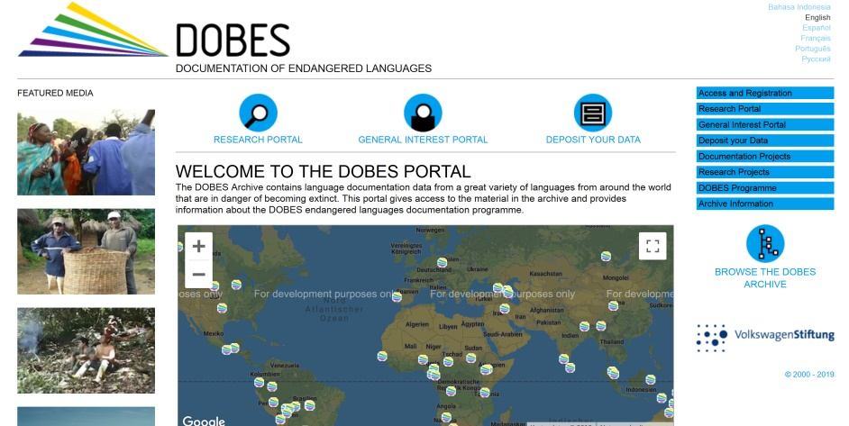
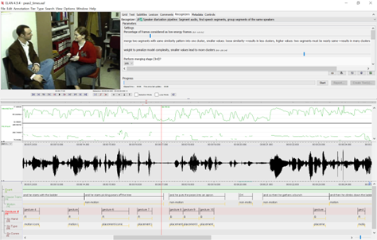
Connecting The Language Archive to DOIP
general info
The digital repository at the MPI for Psycholinguistics has several sub-collections. One is the well-known DOBES archive. In total it contains about 110 TB with contributions from many researchers worldwide.
The whole holding at MPI is organised as a hierarchical collection (tree) to enable to do management operations, setting rights, etc. The links to establish the tree are in the metadata. For top level nodes in the tree different right situations are given.
The leafs of the tree can be individual digital objects of any type. However, digital entities can be bundled to one complex DO. One often used bundle structure is when recordings share the same time axis (as shown in the picture: video streams, audio streams, complex layers of annotations).
The reason for having bundlles is to have a simple way to access the components jointly for processing and visualisation.

Slide 2
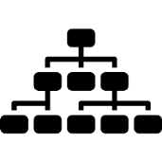
Connecting The Language Archive to DOIP
repository embedding – running since 2003, changed to FEDORA 2018
management
OAI-PMH
external search
local search
repository
local browse
upload
setting rights
access/download
visualise
data can be of any type, type checkers are used to verify specifications
hierarchy nodes (collections) are DOs as well
metadata is according to CMDI standards, metadata contains the hierarchy information allowing to build the hierarchy
Handles are assigned and are placed in the metadata

Slide 3
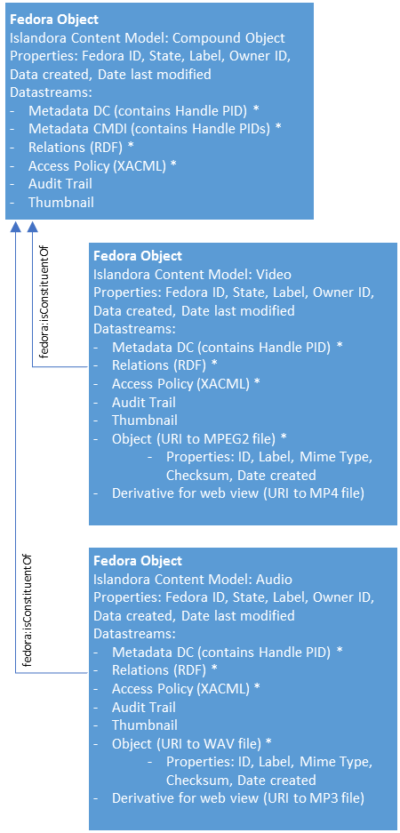
Connecting The Language Archive to DOIP
Fedora Structure
software is based on FEDORA and Islandora
Islandora is an open-source digital repository system based on Fedora Commons, Drupal and a host of additional applications. Islandora may be used to create large, searchable collections of digital assets of any type.
every object has
system metadata incl. Handle
scientific metadata (CMDI)
relations
ACL
every bundle object has
info on the bundle
every object in the bundle has in addition the data bit sequence

Slide 4
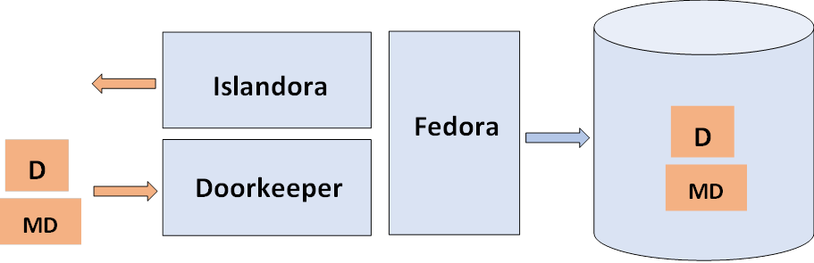
Connecting The Language Archive to DOIP
DoorKeeper
upload/change is complex and handled by homemade doorkeeper and deposit user interface, which have various functions
access is straightforward via Islandora by specifying the PID or URL
upload is done using the doorkeeper for objects with metadata (individual files, bundles, collections)
the steps include
upload all entities to form a submission package (objects and metadata)
validating on CMDI metadata and data formats using FITS
compute MD5 checksums for all
ingests all elements into archive storage
minting Handles for all entities, create the Handle Records and adding Handles to the metadata
creating XACML access policies
creating FOXML for all Fedora objects
triggering the indexing for the internal search
generating DC for the external search via OAI-PMH

Slide 5
Connecting The Language Archive to DOIP
DOIP Access
DOIP
DOIP
Service
Client
access is straightforward
client sends a get request to the DOIP service using a DOIP package
DOIP service
needs to do user authentication
needs to inform Islandora about the request and delegate authentication (user ID, Object ID)
Individual Object: Islandora checks permissions and returns bit sequence
Bundle Object:
Islandora sends bundle metadata and object metadata
Client needs to interprete the bundle and issue get requests for individual Objects
Client receives all elements of bundle and does visualisation

Slide 6
Connecting The Language Archive to DOIP
DOIP Upload – Version A
DOIP ?
Doorkeeper
Islandora
D
DOIP
Service
Fedora
SIP
MD
Deposit UI
all „archive logic“ is outside of DOIP – Doorkeeper sends „atomic“ commands
obviously the client is the Doorkeeper knowing all aspects about collections, bundles and the steps to be performed
but DOIP does not know what an upload package is
many questions??

Slide 7
Connecting The Language Archive to DOIP
DOIP Upload – Version B
DOIP ?
Deposit UI
Islandora
D
SIP
DOIP
Service
Fedora
MD
Doorkeeper
all „archive logic“ is inside of archive – client send a request with an upload package and a request to launch operation „doorkeeper“
the UI gathers all entities to be stored and the DOIP Service just calls the Doorkeeeper
hardly anything to be changed – implementation is straightforward
many questions??
would a Fedora-DOIP package help?

Slide 8
Connecting The Language Archive to DOIP
Possible Benefit – multiple upload
DOBES
repository
DOIP
Service
DOBES
logic
D
MD
DOIP
CORDRA
repository
CORDRA
DOIP
Service
D
Deposit UI
DOIP
MD
DOIP
MPCDF
repository
DOIP
Service
MPCDF
logic
D
seems to be easy
does CORDRA know about bundles?
many questions??
MD

Slide 9
Connecting The Language Archive to DOIP
Possible Benefit - Replication
repository A
DOIP
Service
some
logic
A
D
MD
DOIP
Replication
Client
repository B
DOIP
DOIP
Service
some
logic
B
D
MD
a typical task for such a repository is to replicate all data maintaining all information to another repository which for sure uses different storage systems, applies different data organisation principles, etc.
currently we are doing this using rsync which means that all data is safe, but not all information about DOs such as access permissions etc. are replicated
could DOIP help - many questions??

Slide 10
Connecting The Language Archive to DOIP
Possible Benefit – WF Engine
DOIP ?
Deposit UI
Islandora
D
SIP
DOIP
Service
Fedora
MD
Doorkeeper
Doorkeeper workflow
upload all entities to form a submission package (objects and metadata)
validating on CMDI metadata and data formats using FITS
compute MD5 checksums for all
ingests all elements into archive storage
minting Handles for all entities, create the Handle Records and adding Handles to the metadata
creating XACML access policies
creating FOXML for all Fedora objects
triggering the indexing for the internal search
generating DC for the external search via OAI-PMH
would it help to have a generic WF engine behind DOIP Service?

Slide 11
Connecting The Language Archive to DOIP
Possible Benefit – Client Access
repository A
DOIP
Service
some
logic
A
D
MD
DOIP
Visualiszation
Client
repository B
DOIP
DOIP
Service
some
logic
B
D
MD
could a visualisation client be built that ignores the archive logic
would be great but needs to call a „bundle operation“
many questions??

