Slide 1

1D Bin Packing Problem using Tabu Search
CSE480/591 – Optimization with Metaheuristics
Erhan Onaldı
Yeditepe University, Fall 2025

Slide 2
OUTLINE
Problem Definition
Dataset and Benchmark Instances
Tabu Search Algorithm
Experimental Study
Results and Discussion

Slide 3
Problem Definition: 1D Bin Packing
The One-Dimensional Bin Packing Problem (1D-BPP) is a classical NP-hard combinatorial optimization problem.
Given a set of items with fixed sizes and identical bins with a fixed capacity, the goal is to assign each item to exactly one bin such that the total size of items in any bin does not exceed the capacity.
The objective is to minimize the total number of bins used.
Due to its computational complexity and wide range of real-world applications, 1D-BPP is a common benchmark problem for evaluating metaheuristic optimization algorithms.

Slide 4
Formal Problem Definition
Decision variables: x_{ij}, y_{j}
Objective: minimize Σy_{j}
Capacity and assignment constraints

Slide 5
Dataset and Benchmark Instances
To evaluate the proposed Tabu Search algorithm, multiple datasets were used.
First, the small example instance defined in Phase 2 was employed to verify the correctness of the implementation.
For performance evaluation, benchmark instances from the OR-Library Falkenauer dataset were selected, covering small, medium, and large problem sizes.
In addition, synthetic instances with uniformly distributed item sizes were generated to further test scalability under controlled conditions.

Slide 6
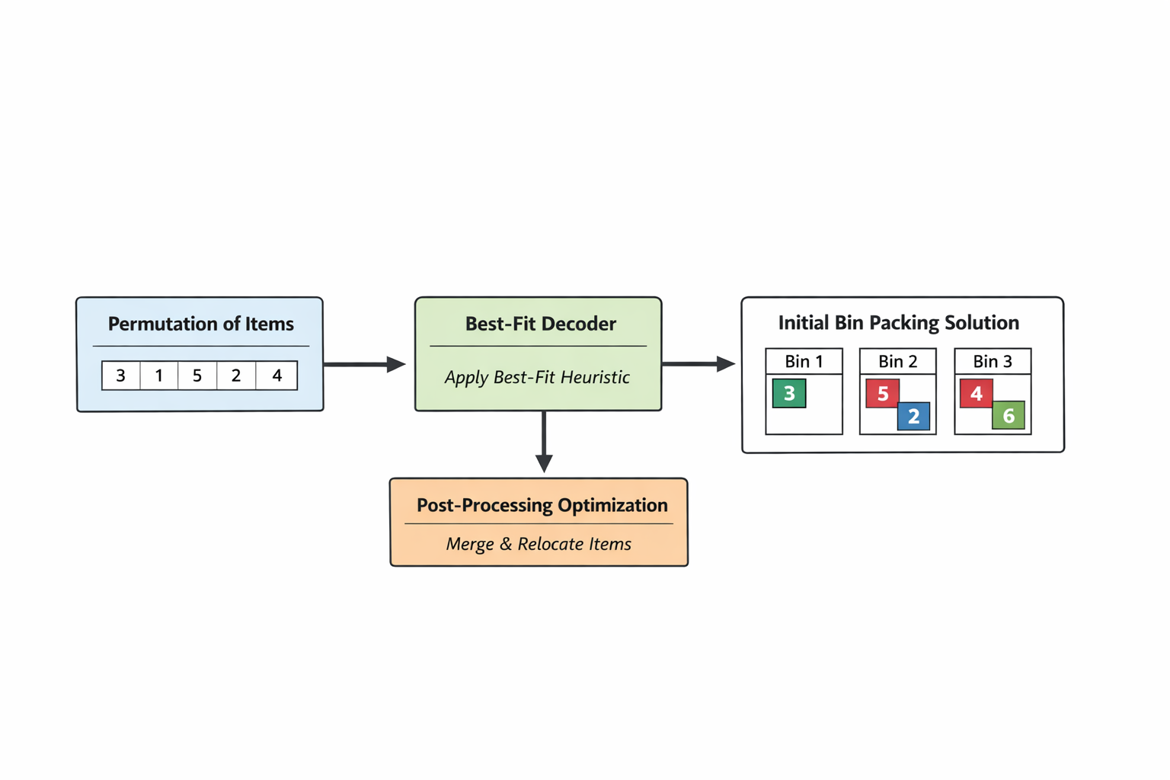
Solution Representation
A candidate solution is represented as a permutation of item indices.
This permutation is decoded into an actual bin packing solution using a Best-Fit constructive heuristic.
Items are processed sequentially according to the permutation order and placed into the feasible bin that leaves the least remaining space.
After decoding, a post-processing step attempts to reduce the number of bins by relocating items from lightly loaded bins to other bins whenever possible.

Slide 7
Tabu Search Algorithm
Tabu Search is a trajectory-based metaheuristic that iteratively explores the neighborhood of the current solution.
Starting from an initial permutation generated using decreasing item sizes, the algorithm evaluates neighboring solutions obtained through swap and insert moves.
A tabu list is used to prevent cycling by temporarily forbidding recently applied moves, while an aspiration criterion allows tabu moves if they improve the global best solution.
Diversification is applied when the search stagnates to explore new regions of the solution space.

Slide 8
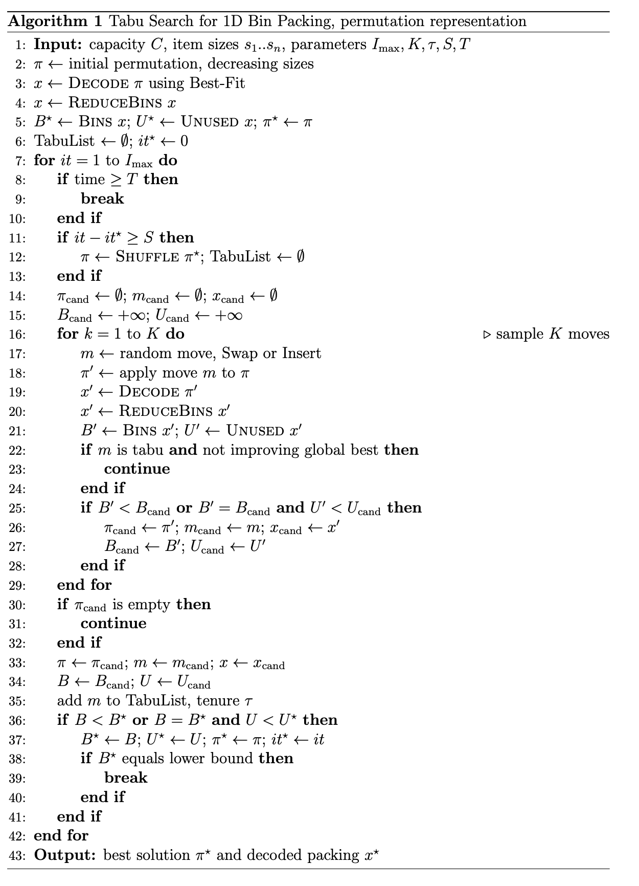
Tabu Search Algorithm Pseudo Code
This slide summarizes the overall flow of the Tabu Search algorithm used in this study.
The algorithm repeatedly samples a subset of neighboring solutions, selects the best admissible move according to the objective function, and updates the tabu memory.
The process continues until a stopping condition is satisfied.

Slide 9
Experimental Setup
All experiments were conducted using a fixed experimental protocol to ensure fairness and reproducibility.
Each instance was executed five independent times using different random seeds.
A time limit of two seconds per run was imposed, and performance was evaluated using mean and best objective values, standard deviation, and computation time.
The same algorithm parameters were used across all benchmark instances.

Slide 10
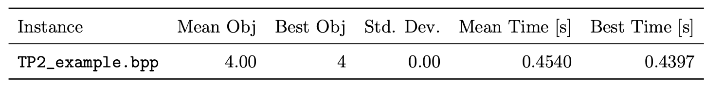
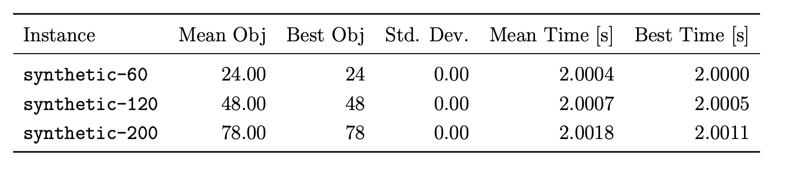
TP2 & Synthetic Instances
The results on the Phase 2 example instance demonstrate that the algorithm consistently finds the optimal solution using four bins, confirming correctness.
Synthetic instances exhibit stable behavior across runs due to the fixed random seed, serving as a scalability sanity check.
In all cases, the standard deviation is zero, indicating deterministic behavior under the chosen experimental settings.

Slide 11
Results: OR-Library Benchmarks
Experimental results on OR-Library benchmark instances show that the proposed Tabu Search algorithm produces stable solutions across different problem sizes.
Due to the fixed time limit, runtime values are nearly constant, while early termination occurs when the theoretical lower bound is reached.
The algorithm performs consistently on both uniform and triplet-based instance classes.

Slide 12
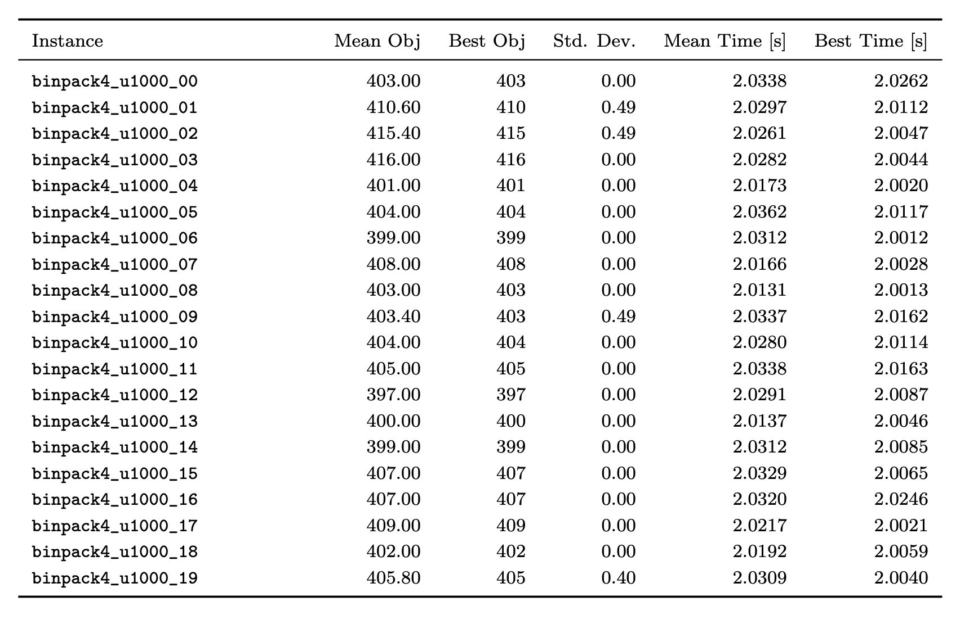
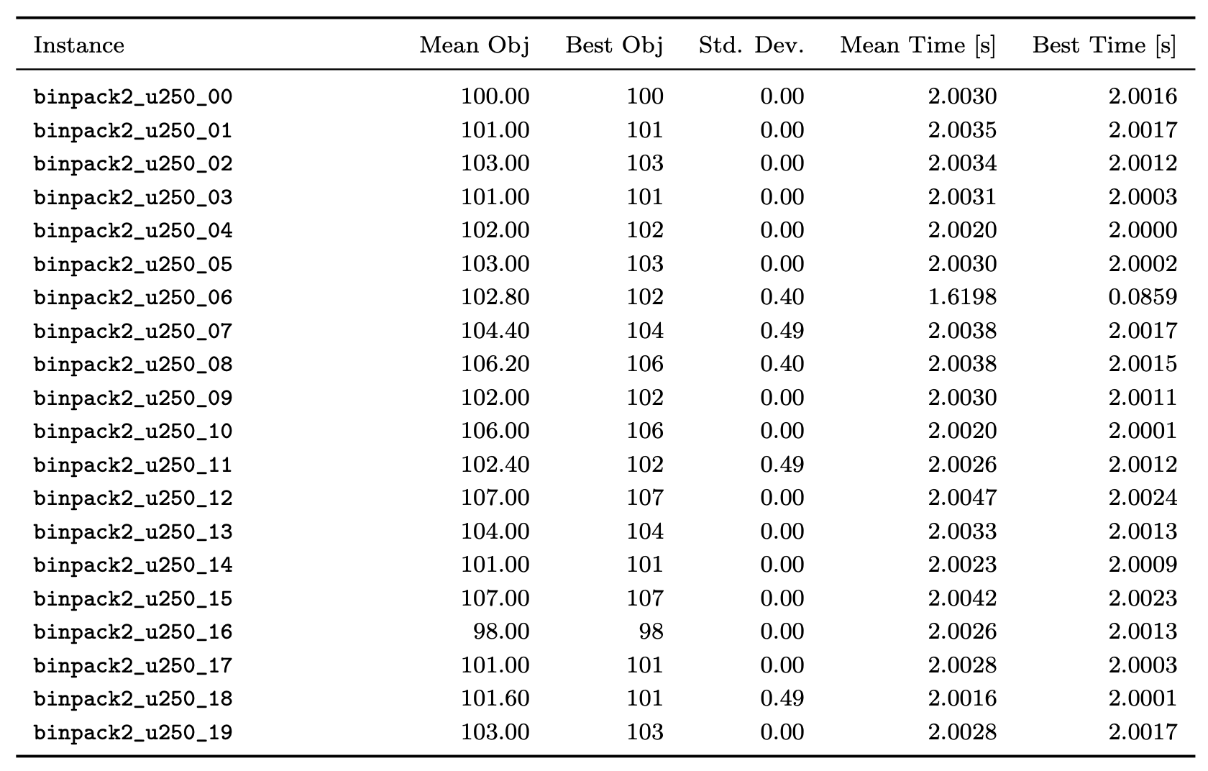
Results: OR-Library Benchmarks

Slide 13
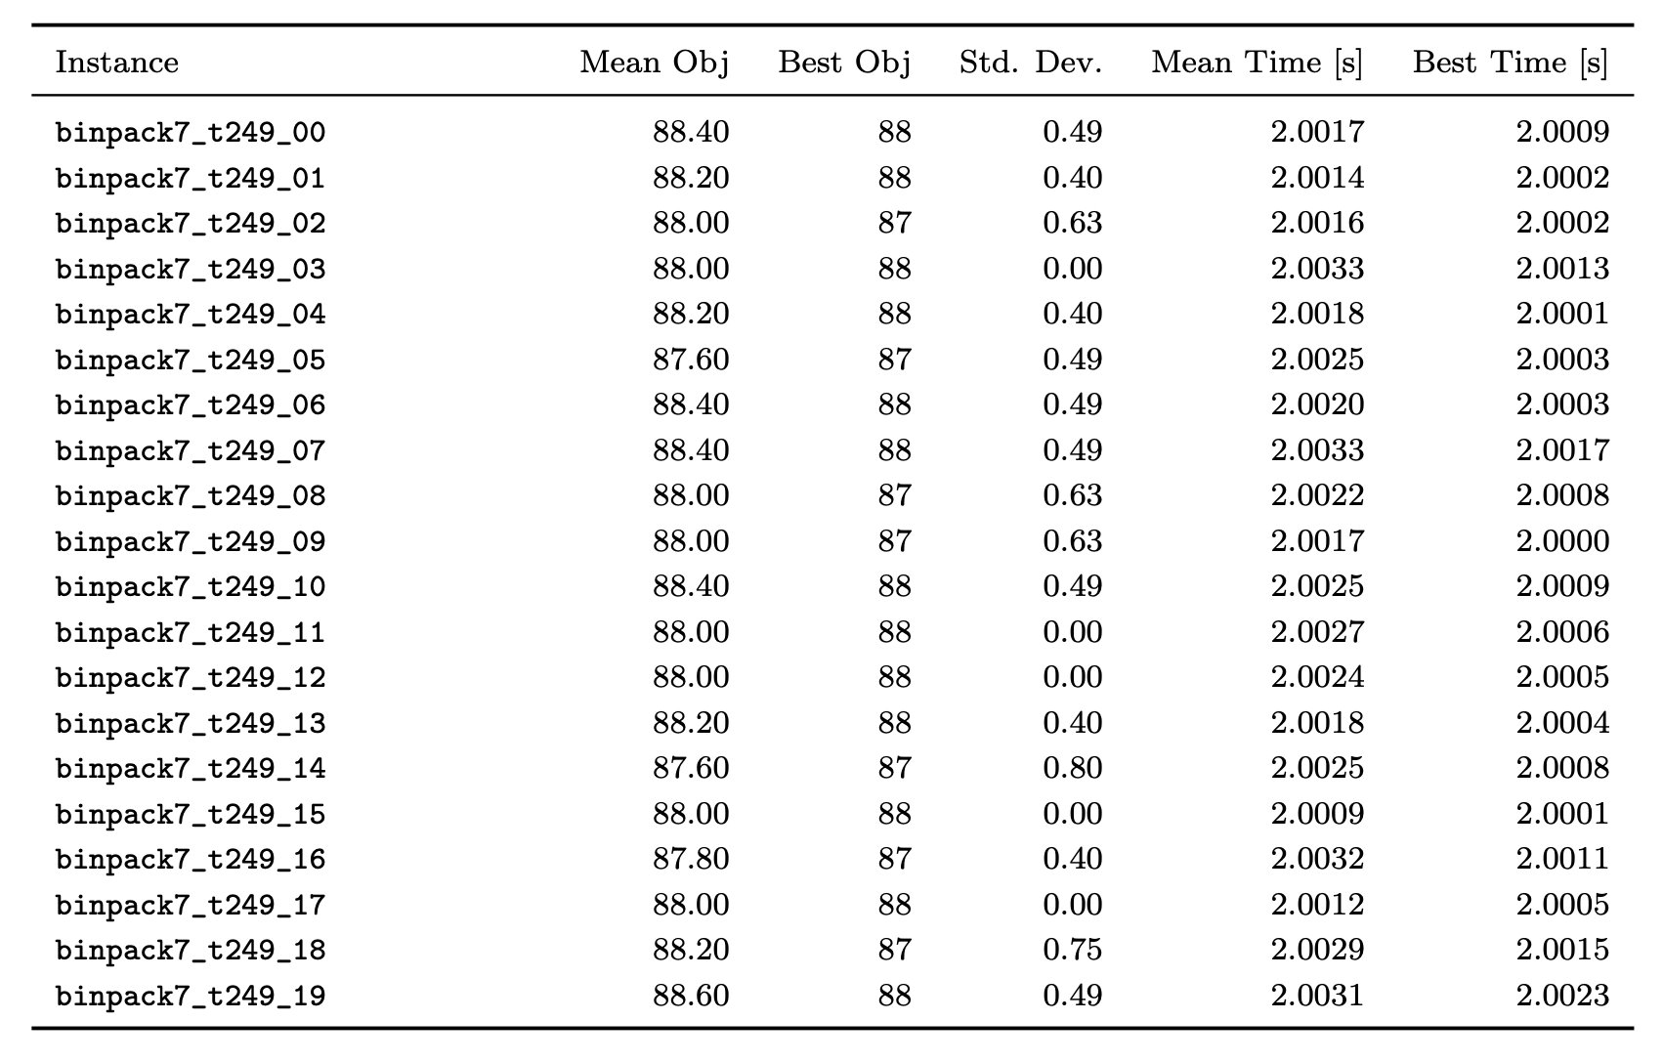
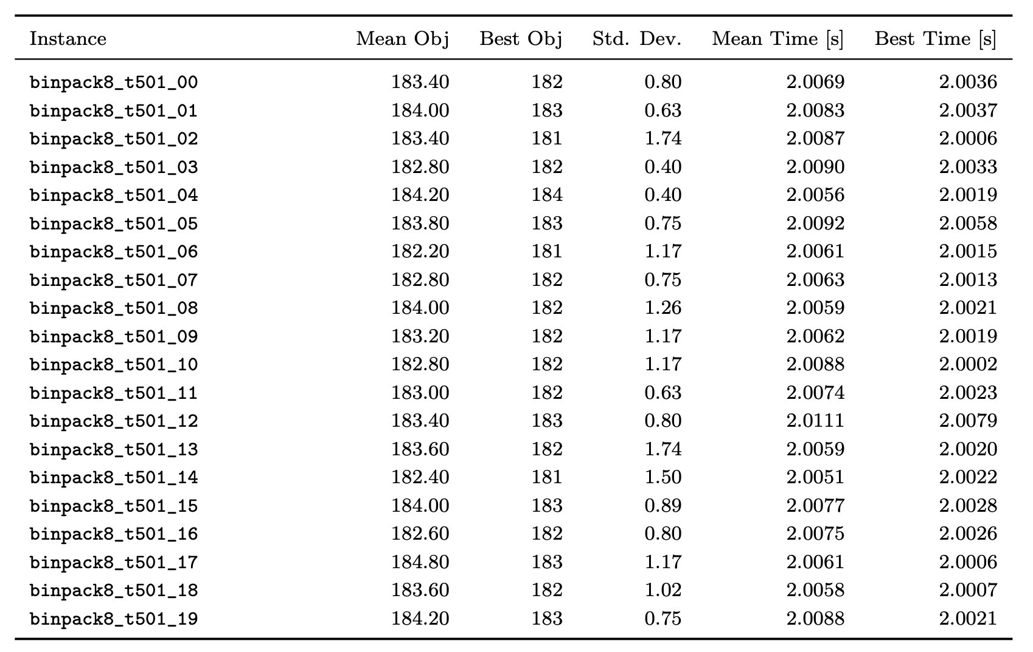
Results: OR-Library Benchmarks

Slide 14
Discussion and Conclusion
The results indicate that Tabu Search provides a robust and effective solution approach for the 1D Bin Packing Problem.
The algorithm balances solution quality and computation time, particularly for medium-to-large instances.
While no direct comparison with other metaheuristics was conducted, the results confirm that the proposed design satisfies all project requirements and performs reliably.

Slide 15
THANK YOU

