Slide 1




follow
BOARDS
services
PROSES
SENSORS
TEAMS

Slide 2
SMART
follow
BOARDS
services
PROSES
SENSORS
TEAMS
METERING
DIGITALENT SCHOLARSHIP BATCH II 2019
UNIVERSITAS HASANUDDIN

Slide 3
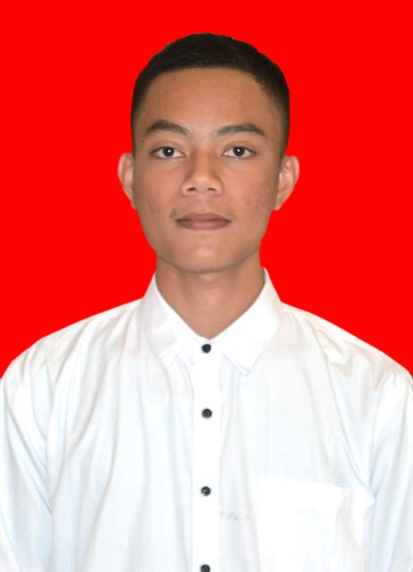
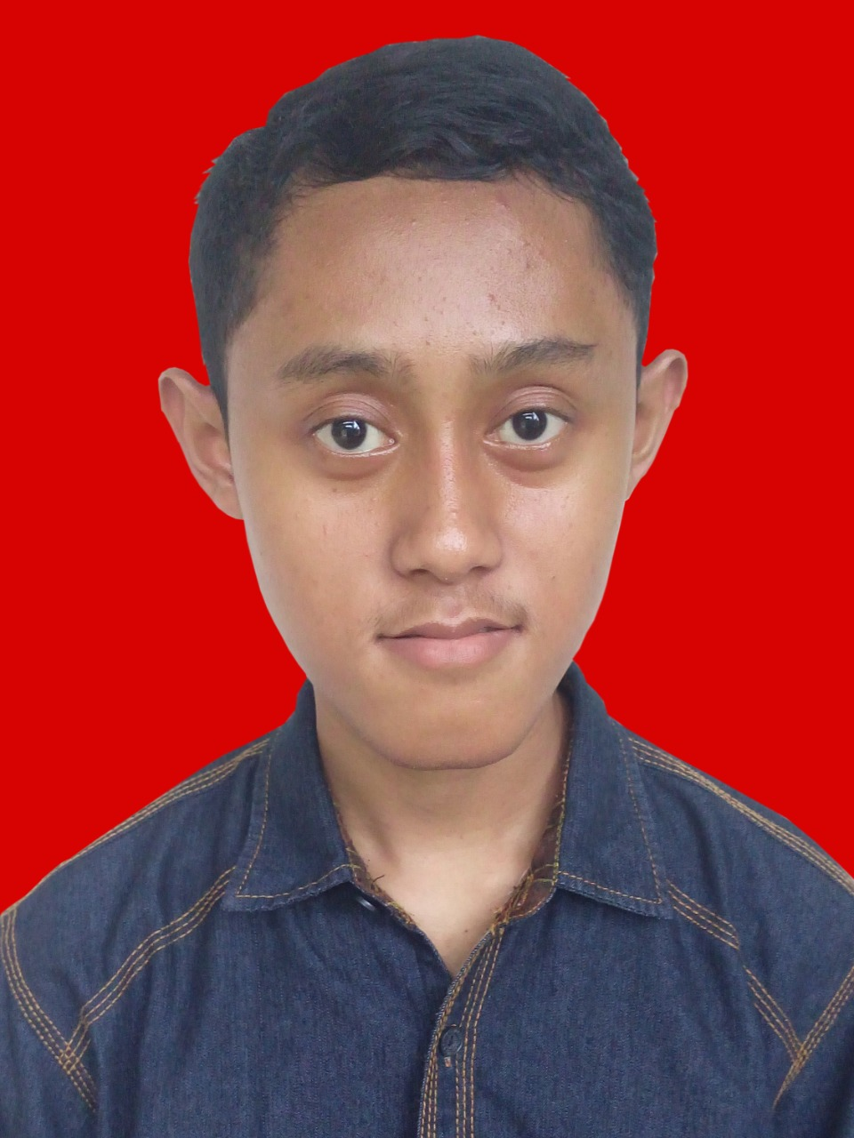
follow
PROSES
BOARDS
services
SENSORS
TEAMS
MUH KHAERIL SYAM
SABTIAN JULIANA
TEKNIK INFORMATIKA
TEKNIK INFORMATIKA
UNIVERSITAS HASANUDDIN
UNIVERSITAS HASANUDDIN

Slide 4
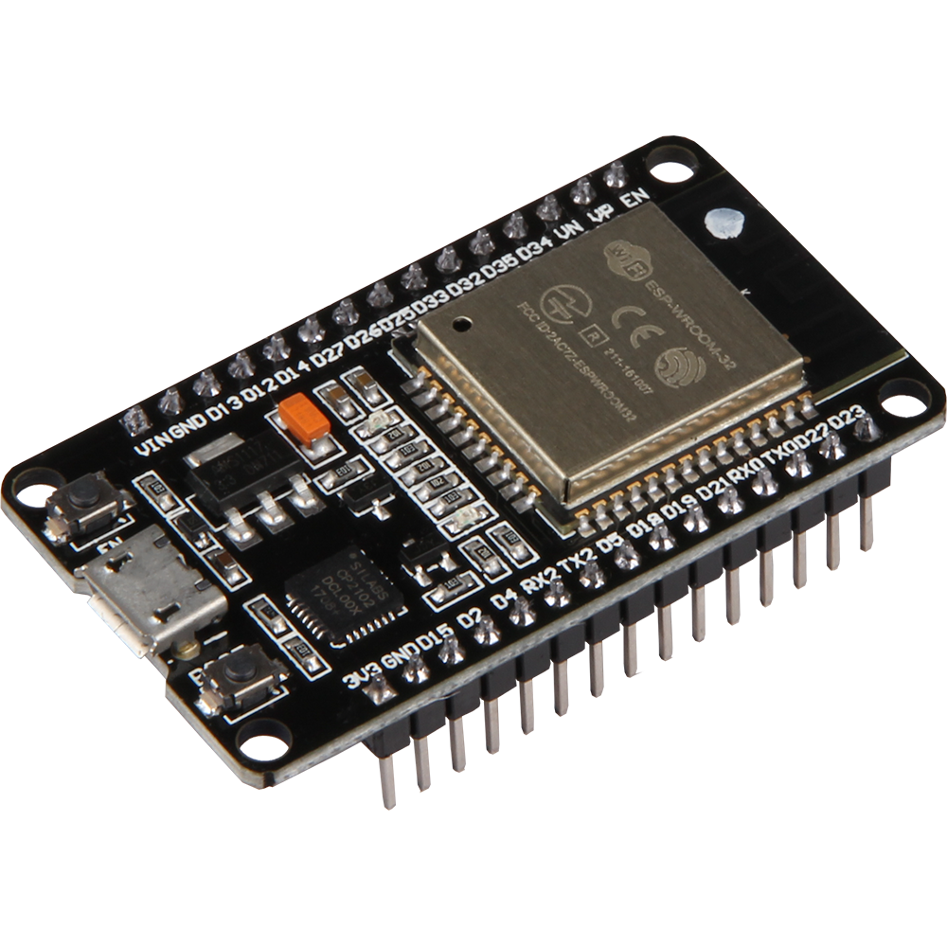
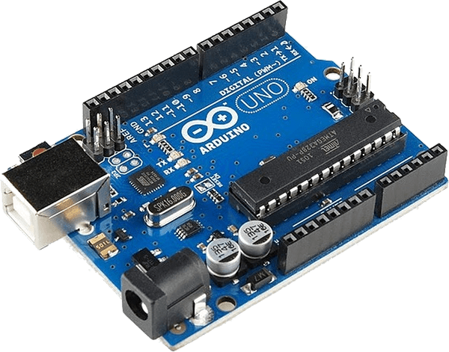
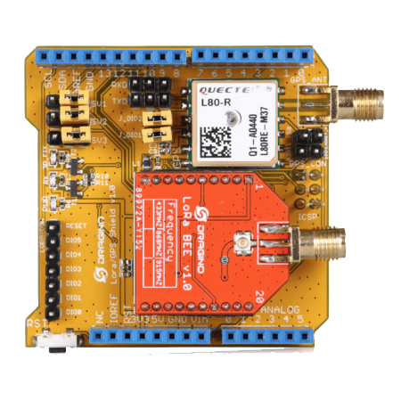
1
2
3
ARDUINO
UNO
LoRa
DRAGINO
Esp32
follow
BOARDS
services
PROSES
SENSORS
TEAMS

Slide 5
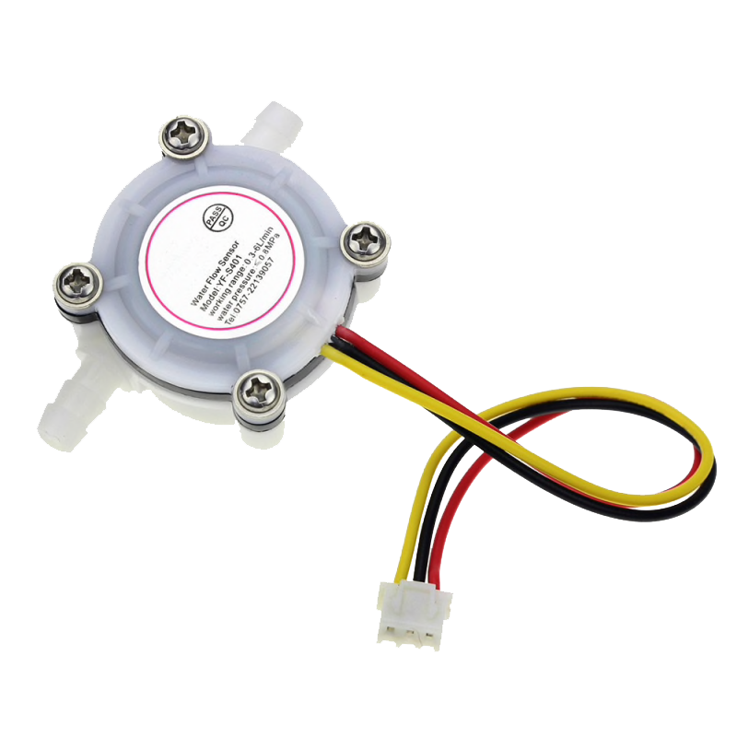
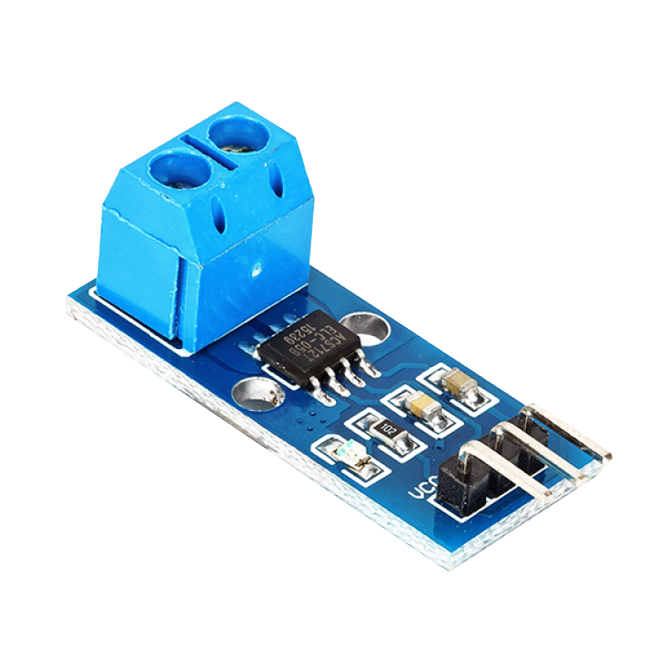
1
2
WATER
FLOW
ACS 712
follow
BOARDS
services
PROSES
SENSORS
TEAMS

Slide 6





follow
BOARDS
services
PROSES
SENSORS
TEAMS

Slide 7






Web Design
Web Design
Here you need to add some brief about the service that your company is providing currently
Here you need to add some brief about the service that your company is providing currently
Web Design
Web Design
history
follow
services
teams
Here you need to add some brief about the service that your company is providing currently
Here you need to add some brief about the service that your company is providing currently
timeline
TEAMS
Web Design
Web Design
Here you need to add some brief about the service that your company is providing currently
Here you need to add some brief about the service that your company is providing currently

Slide 8



follow
history
services
teams
timeline
TEAMS
8M
6M
7M
Add Some Brief Text Here to Explain
Add Some Brief Text Here to Explain
Add Some Brief Text Here to Explain

