Slide 2
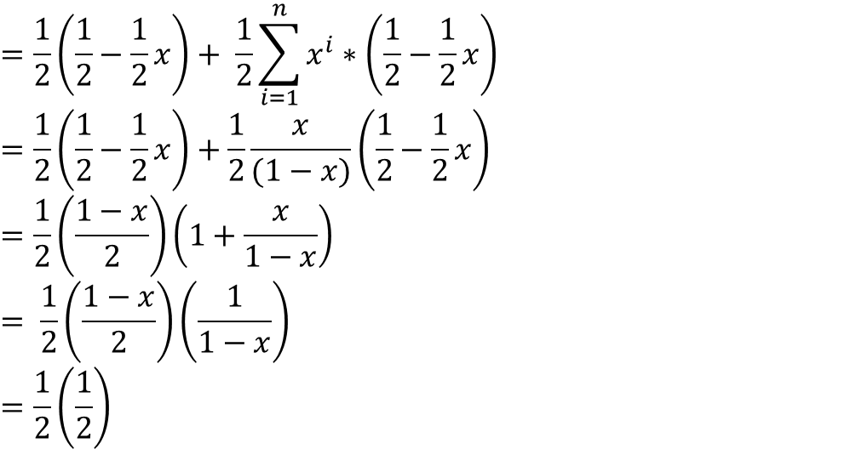
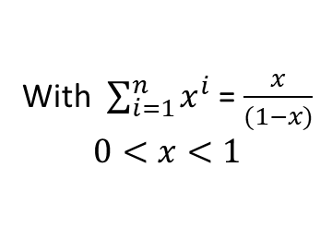
$$=\frac{1}{2}\left(\frac{1}{2}−\frac{1}{2}x\right)+ \frac{1}{2}\sum_{i=1}^{n}{x^{i}}∗\left(\frac{1}{2}−\frac{1}{2}x\right)$$
$$=\frac{1}{2}\left(\frac{1}{2}−\frac{1}{2}x\right)+\frac{1}{2}\frac{x}{(1−x)}\left(\frac{1}{2}−\frac{1}{2}x\right)$$
$$=\frac{1}{2}\left(\frac{1−x}{2}\right)\left(1+\frac{x}{1−x}\right)$$
$$= \frac{1}{2}\left(\frac{1−x}{2}\right)\left(\frac{1}{1−x}\right)$$
$$=\frac{1}{2}\left(\frac{1}{2}\right)$$
With $\sum_{i=1}^{n}{x^{i}}$ = $\frac{x}{(1−x)}$
$0<x<1$
$n→∞$

