Slide 1





Git/Github
Workshop

Slide 2




AGENDA
01
02
03
04
What is Git/Github
Download/Setup
My First Repository
Pull Request

Slide 3

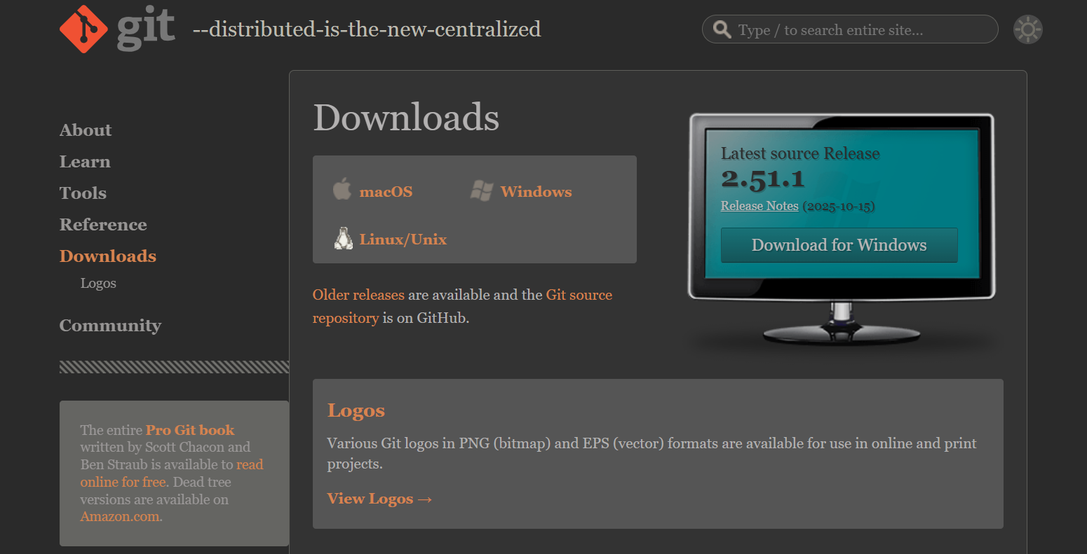


Git Bash and Github Profile

Slide 4
Common Commands
Command | Direct Translation | Used For
cd <name> | “Change Directory” | Move between folders on the machine
mkdir <name> | “Make Directory” | Add a new folder (Directory) in that location
ls | “List” | Lists all files and folders in your current directory
. / .. | Here / one step up | Used to denote the current directory/ Used to denote one directory up
pwd | “Present working Directory” | Used to get the path to your location

Slide 5
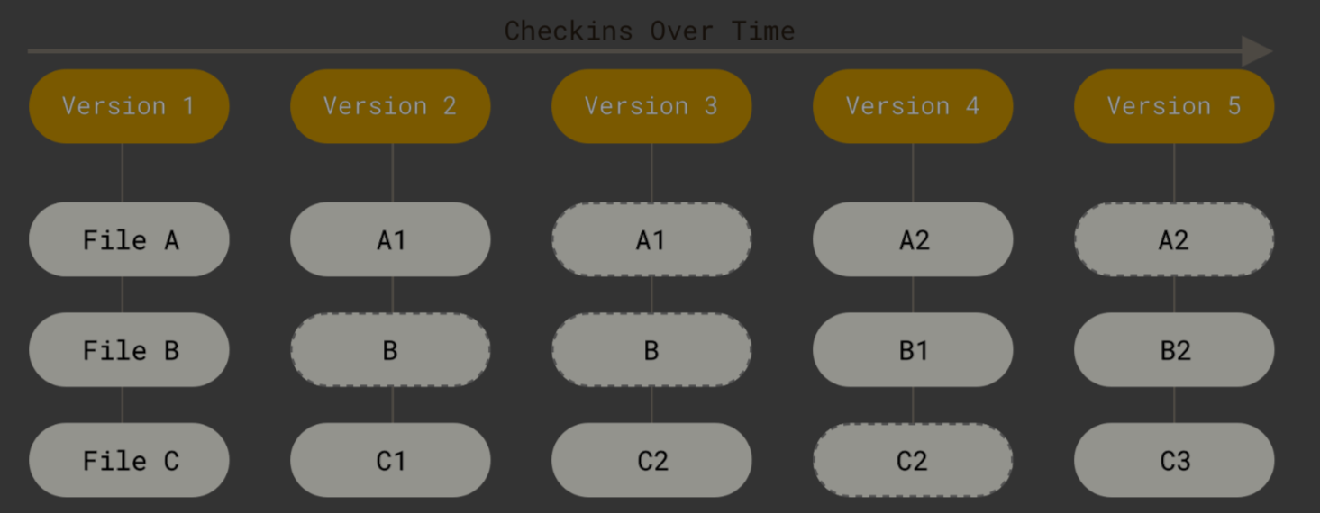
What is Git
Software Version Control System
Takes a screenshot of your repository as is
Used for branches/merging
Used for collaborative work

Slide 6
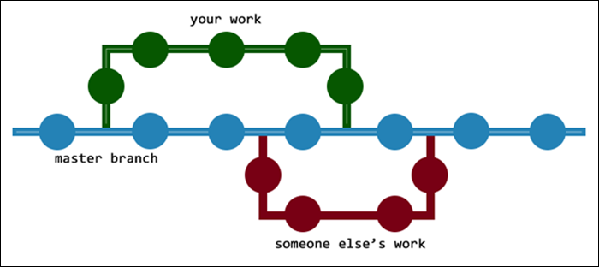
How is it Used Collaboratively?

Slide 7
Common Git Commands
git init
git clone <link>
git status git add <file_name>
git add <filename>
git commit –m “”
Initialize Git repository in this location
– initialize repository and add the files from this link
– What is the status of the files on my repository
- Add this file to the staging area (I plan to commit these changes)
– Commit all my changes and add a message “”

Slide 8


Practice

Slide 9
Final Tips
Avoid capitals and spaces while naming
Always include a commit message
Use a “.gitignore” file to avoid private files ever being committed/public
Practice with everything!!

Slide 10
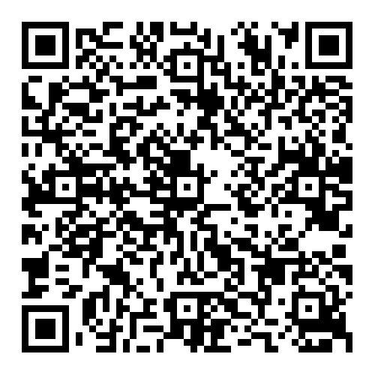
STMU IEEE Hub
EXAMPLE
Steps
Scan the QR Code or go to GitHub and search "STMU IEE Hub“
Have Fun!!!

Slide 11



THANK YOU

