Slide 1
Auto Encoders
Eric Foote
3502094
April 2021
Introduction to AI

Slide 2
Original Plans / Motivation
I was originally going to outline a language translator. However, I ran in to some issues with trying to create the auto encoder model on my own with out using tutorials so I decided instead to study some of the theory behind this model.

Slide 3
Background Information
Auto encoders are a type of neural network that is trained to reconstruct its input
Consists of 3 portions
  The encoder
  The code
  The decoder

Slide 4

Mathematical Representation

Slide 5
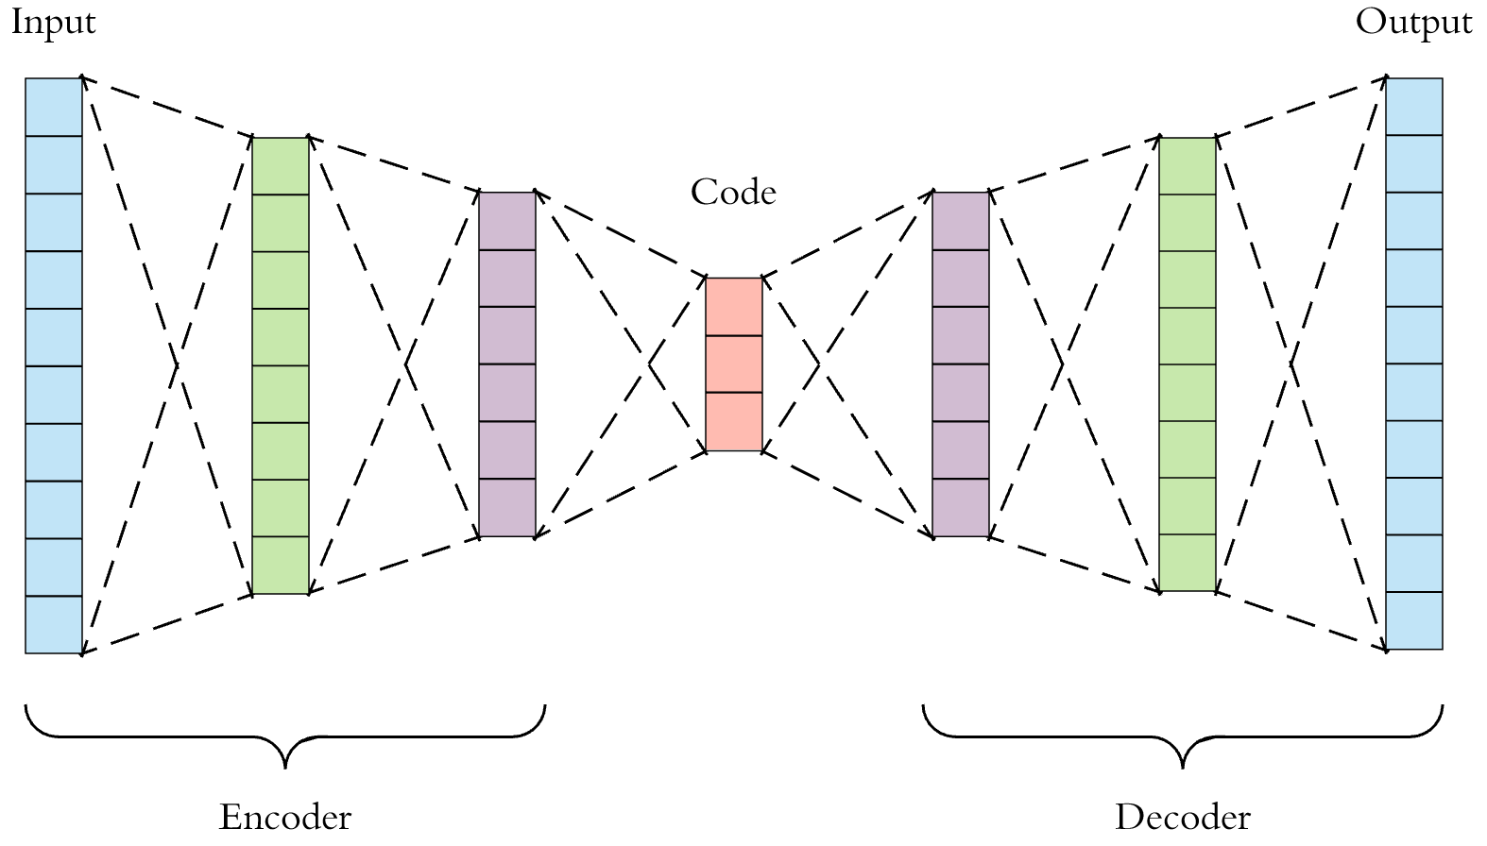

Slide 6
Special Case
Using the previous definition if A and B are linear operations, this means that our auto encoder is an linear auto encoder.
Linear auto encoders. “would achieve the same latent representation as Principle Component Analysis (PCA)” (https://arxiv.org/pdf/2003.05991v2.pdf)

Slide 7
Types of Auto Encoders
Convolutional
Variational
Denoising
Deep

Slide 8
Convolutional
CAE learn to encode the input in a set of simple signals and then reconstruct the input from them

Slide 9
Variational
Tend to make strong assumptions related to the distribution of the variables
The probability distribution of the latent vector of a variational auto encoder typically matches the training data much closer than a standard autoencoder

Slide 10
Denoising
Add some noise to the input image and learn to remove it
Avoid copying the input to output without learning features about the data

Slide 11
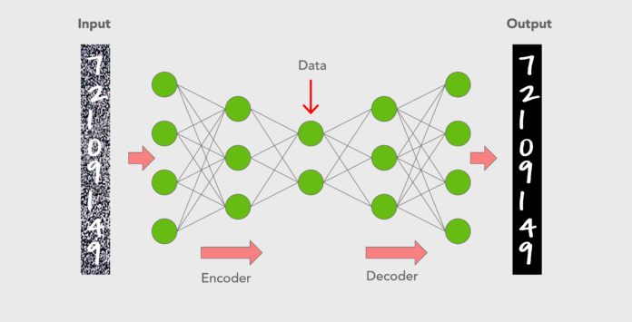
Example of this

Slide 12
Deep
More layers than a simple auto encoder and thus are able to learn more complex features.

Slide 13
Applications
Data compression (Not as efficient as traditional algorithms)
Image Denoising
Dimensionality Reduction
Feature Extraction
Image Generation
Image Colourization
Machine Translation

Slide 14
Sources
https://iq.opengenus.org/applications-of-autoencoders/
https://sci2lab.github.io/ml_tutorial/autoencoder/
https://www.mygreatlearning.com/blog/autoencoder/
https://arxiv.org/pdf/2003.05991v2.pdf
http://proceedings.mlr.press/v27/baldi12a/baldi12a.pdf
https://en.wikipedia.org/wiki/Autoencoder
https://towardsdatascience.com/understanding-latent-space-in-machine-learning-de5a7c687d8d
https://user-images.githubusercontent.com/34431729/58381821-3ab67400-7ffd-11e9-9f06-6d1045c5ecbc.png

