Slide 1
Card Games over Network
Eric Foote
3502094
Network Programming
April 2021

Slide 2
Original Plans
I was originally going to create software with the user choice of 5 different games available over the network with a variable number of players
Currently however, I am only at 2 games designed and partially coded up with none of them working properly trying to get 2 players working
Everything works up to actually playing the game

Slide 3
Networking Features
Socket
Server Socket
Multi threaded Server using over ridden Run method
Buffered Reader
Buffered Writer

Slide 4
Games Chosen
Blackjack (Partially Implemented)
Poker (Designed but server side is missing)

Slide 5
Design Process
Created the various GUI’s for all the elements
Coded the Client Side
Coded the Server Side

Slide 6
Future Work
Get the games working
Add additional games to the software
Add a chat for people
Enhance the server side to allow logging

Slide 7
Live Demo
I am unable to live demo since this computer is having problems
So here is some images of how it looks and partially works

Slide 8
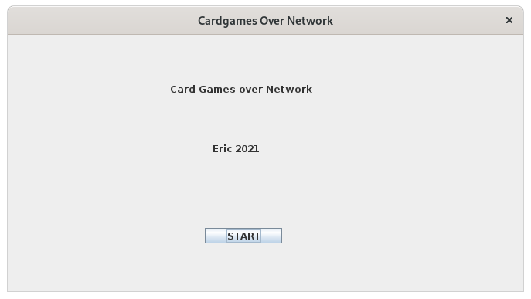
Title Screen

Slide 9
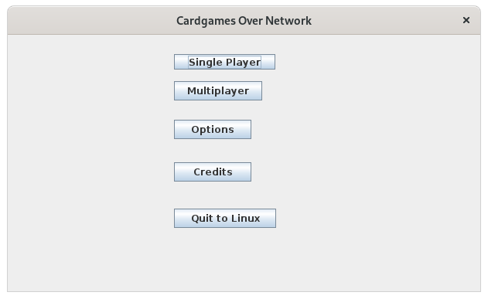
Main Menu

Slide 10
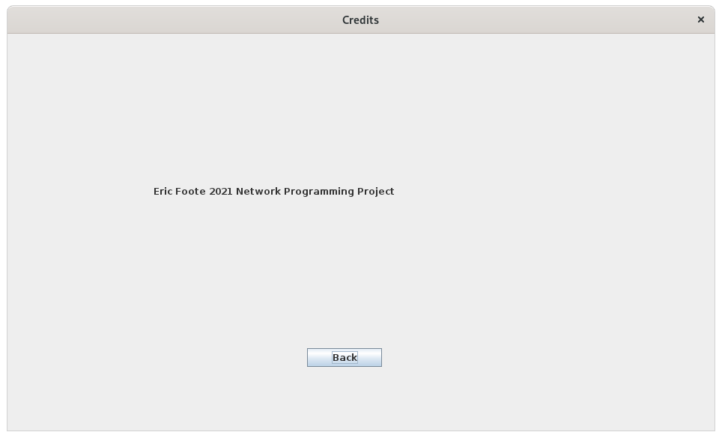
Credits

Slide 11
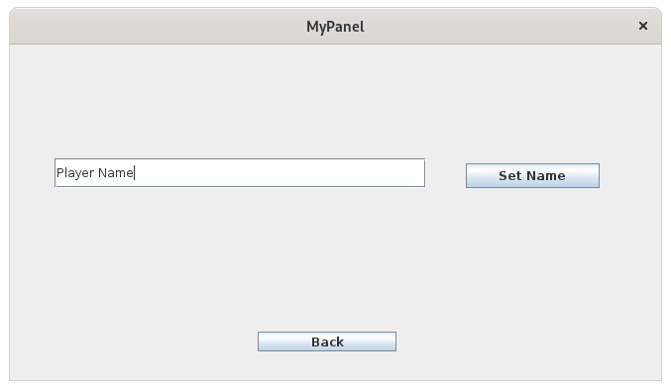
Options

Slide 12
Original Plans for Options
My original plans were going to be to set the player name, write it to a file and allow the client side program to have that name set
Set the size of the jframes going forward, write it to a file and allow the client side program to have the dimensions of the frame set

Slide 13
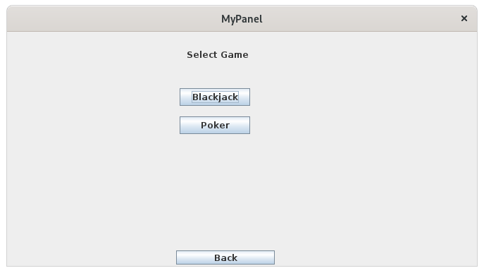
Single Player

Slide 14
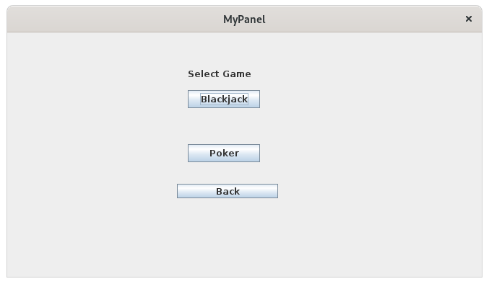
Multiplayer

Slide 15
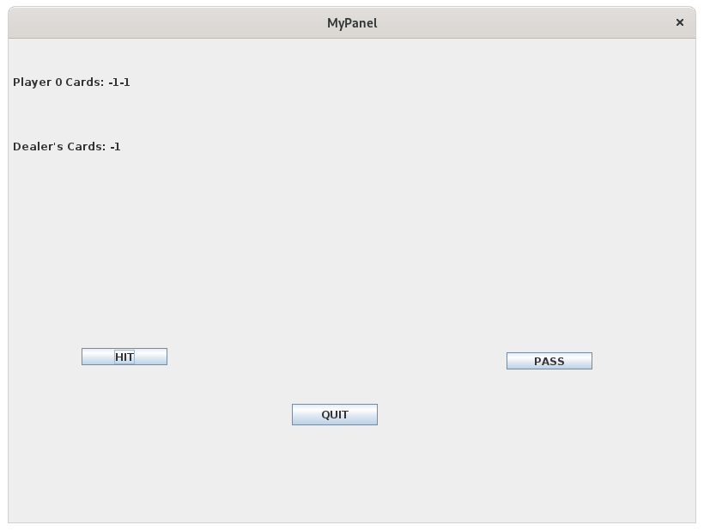
Blackjack

Slide 16
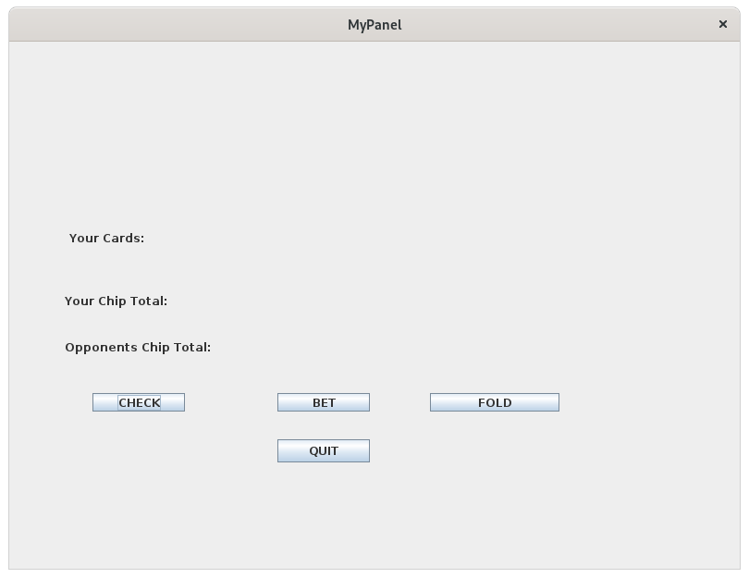
Poker

Slide 17
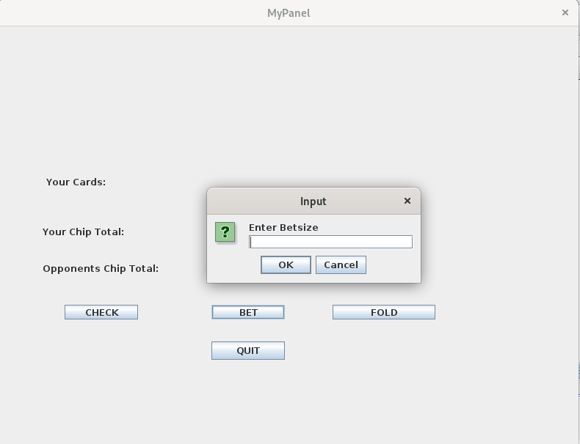
Bet Screen For Poker

