Slide 1
Mini Project 3 Optimal Chess KRK-Endgame Position
Eric Lai

Slide 2
Agenda
Background
Goals
Definitions
Dataset
EDA
Model Evaluation
Summary

Slide 3
Background
In chess, Endgame refers to the stage that most pieces have been captured and only a few remain.
Positioning is vital in the Endgame since each remaining piece becomes more decisive.
If not handled carefully, the player who has the upper hand may be forced to a draw.

Slide 4
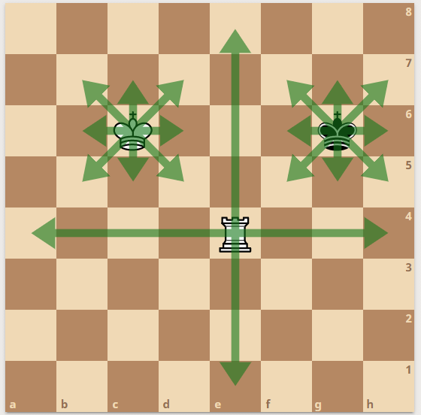
Background
In this project we will look into the Chess Endgame Database to find out the best endgame position for white and black, assuming white has a rook and king left, black only has the king left, and it is black's turn to move.

Slide 5
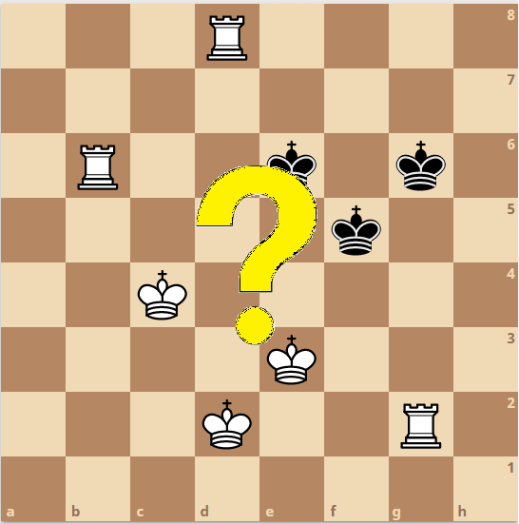
Goals
1) Find out the best position for White and Black pieces in this particular scenario
2) Build a model to predict the result based on the position of the pieces

Slide 6
Definitions
White has an upper hand so White would want to win the game
Black has no mean to checkmate White King, so the best Black can do is to force a draw

Slide 7
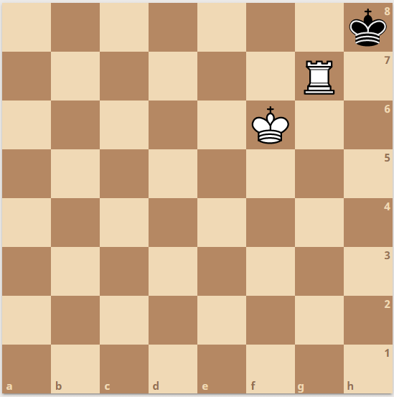
Definitions
In this study, we define a draw as:
1) White cannot checkmate in 16 moves
2) Black cannot make a move when it is his turn

Slide 8
Dataset
Chess Endgame Database for White King and Rook against Black King (KRK) - Black-to-move Positions Drawn or Lost in N Moves
Source
Creators: Database generated by Michael Bain and Arthur van Hoff at the Turing Institute, Glasgow, UK.
Donor: Michael Bain (mike '@' cse.unsw.edu.au), AI Lab, Computer Science University of New South Wales, Sydney 2052, Australia.
Number of Instances: 28056 (No missing / invalid data)
Attribute Information: White King file
White King rank
White Rook file
White Rook rank
Black King file
Black King rank
Optimal White winning moves (0-16 or draw)

Slide 9
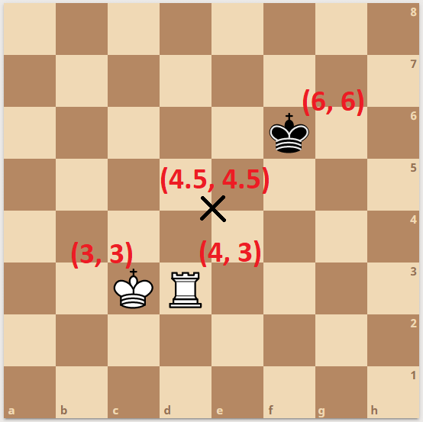
EDA
Convert the positions into coordinate to calculate distance between each piece as well as the centre
$$distance= \sqrt{{\left(x_{1}−x_{2}\right)}^{2}+{\left(y_{1}−y_{2}\right)}^{2}}$$

Slide 10
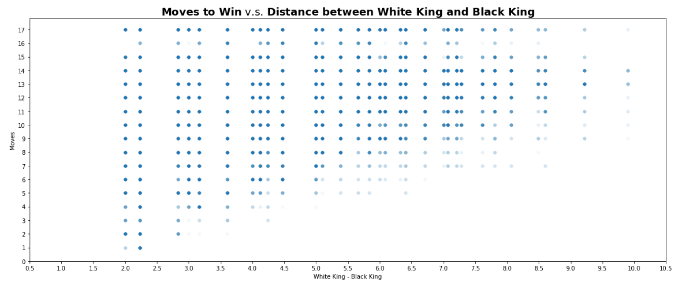
EDA
Convert “draw” into “17” for later use
Draw
White wins

Slide 11
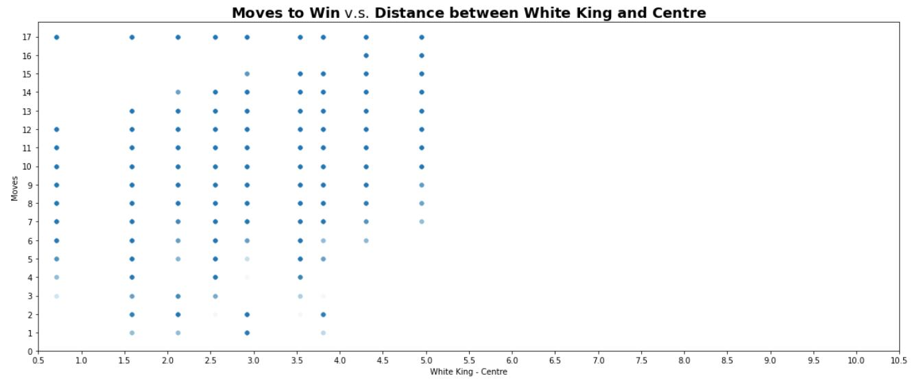
EDA
Convert “draw” into “17” for later use
Draw
White wins

Slide 12
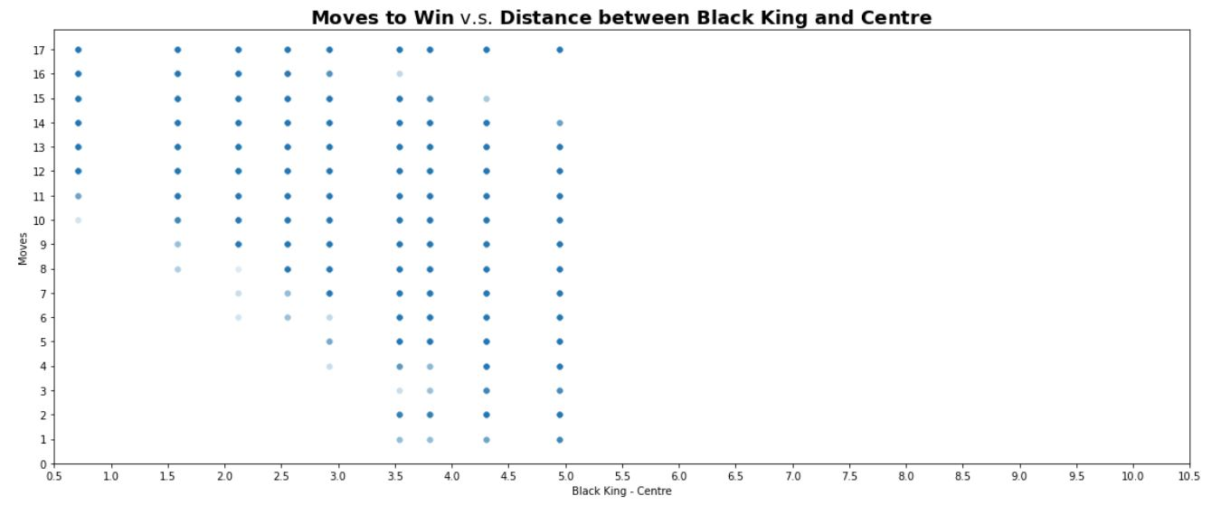
EDA
Convert “draw” into “17” for later use
Draw
White wins

Slide 13
Model Evaluation
Features:
Distance of White King – Black King
Distance of White King – Centre
Distance of Black King – Centre
Target:
Result (Winning move in 1-4: easy win
5-12: normal win
13-16: difficult win
No winning move (17): draw
Models:
Decision Tree, Random Forest, Extra Trees, Ada Boost, LightGBM

Slide 14
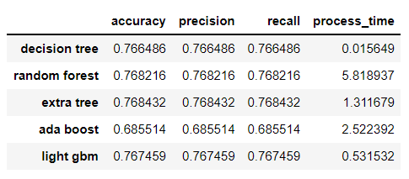
Model Evaluation
normal win 13327
difficult win 11303
draw 2796
easy win 603
Baseline accuracy: 0.48

Slide 15
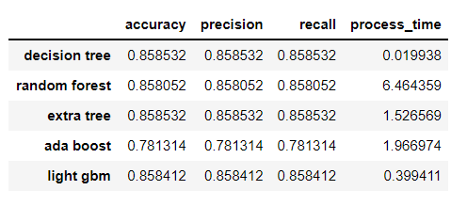
Model Evaluation (Ignore draw data)
normal win 13327
difficult win 11303
easy win 603
Baseline accuracy: 0.53

Slide 16
Summary
Black King is more likely to survive for at least 10 moves if it is near the centre of the board.
The further Black King is away from White King, the longer Black King can survive.
White has better chance to win if White King is near the centre since it can easily reach Black King within 4 moves.
The four models Decision Tree, Random Forest, Extra Tree and Light GBM have similar accuracy. In contrast, Ada Boost is relatively less accurate.
Random Forest and Extra Tree have a slightly better result, at the cost of much longer processing time.
When not considering "draw" (remove all rows with "draw"), the accuracy has become higher.

Slide 17
Q & A

Slide 18
THE END

