Slide 1
Mini Project 2
Australian Energy Consumption Prediction

Slide 2
GOAL
Predict annual Total Energy Consumption
Predict annual Energy Consumption per industry

Slide 3
DATA
Australian Energy Statistics 2020
Population in largest city
Rural population
Source: Department of Industry, Science, Energy and Resources
The World Bank

Slide 4
Energy Consumption Growth
Energy Consumption (PJ)
Year

Slide 5
Machine Learning Models
Linear Regression
Ridge Regression
SVM

Slide 6
Features for prediction
Population:
Total Population
Population in largest cities
Rural population
Economy:
GDP

Slide 7
Targets
Total Annual Energy Consumption
Annual Energy Consumption in
Manufacturing
Electricity Generation
Transport

Slide 8
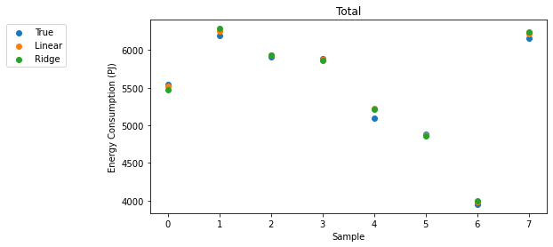
Total Annual Energy Consumption
Model | Average R² Score
Linear Regression | 96.76%
Ridge Regression | 96.88%
SVM | -3.30%

Slide 9
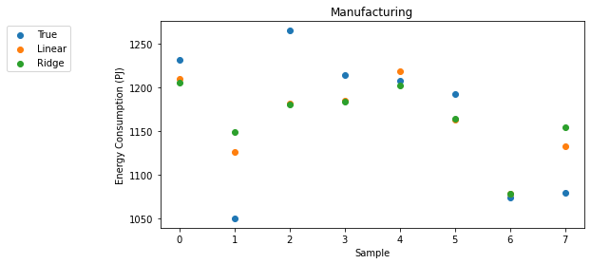
Manufacturing
Model | Average R² Score
Linear Regression | 30.65%
Ridge Regression | 27.83%
SVM | -10.38%

Slide 10
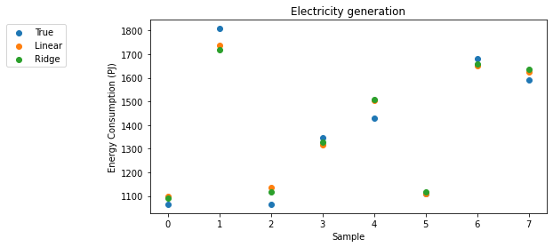
Electricity Generation
Model | Average R² Score
Linear Regression | 88.71%
Ridge Regression | 88.87%
SVM | 8.66%

Slide 11
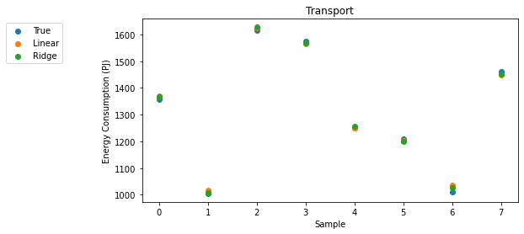
Transport
Model | Average R² Score
Linear Regression | 98.82%
Ridge Regression | 98.92%
SVM | 34.19%

Slide 12
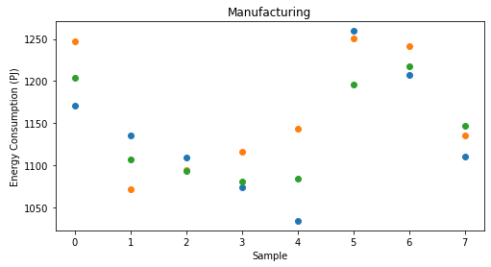
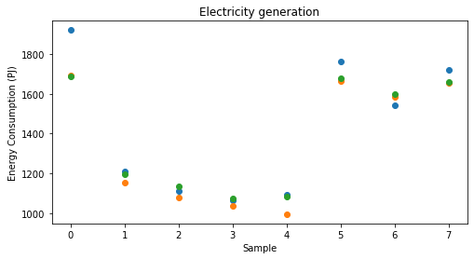
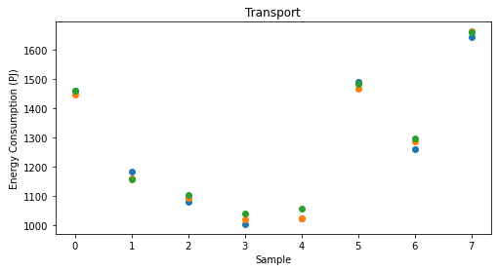

All At Once
Model | Average R² Score
Linear Regression | 78.84%
Ridge Regression | 80.42%
SVM | 52.77%

Slide 13
Q & A

Slide 14
THE END

