Slide 1
Mini Project 2
Australian Energy Consumption Prediction

Slide 2
GOAL
Predict annual Total Energy Consumption
Predict annual Energy Consumption per industry

Slide 3
DATA
Australian Energy Statistics 2020
Population in largest city
Rural population
Source: Department of Industry, Science, Energy and Resources
The World Bank

Slide 4
Energy Consumption Growth
Energy Consumption (PJ)
Year

Slide 5
Machine Learning Models
Linear Regression
Ridge Regression
SVM

Slide 6
Features for prediction
Population:
Total Population
Population in largest cities
Rural population
Economy:
GDP

Slide 7
Targets
Total Annual Energy Consumption
Annual Energy Consumption in
Manufacturing
Electricity Generation
Transport

Slide 8
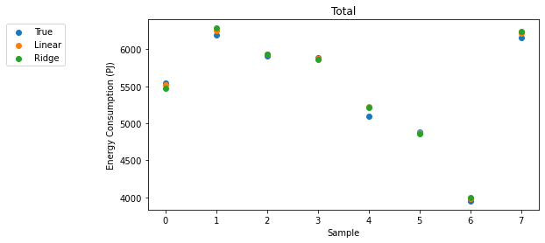
Total Annual Energy Consumption
Model | Average R² Score
Linear Regression | 96.76%
Ridge Regression | 96.88%
SVM | -3.30%

Slide 9
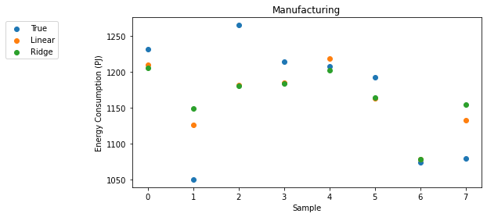
Manufacturing
Model | Average R² Score
Linear Regression | 30.65%
Ridge Regression | 27.83%
SVM | -10.38%

Slide 10
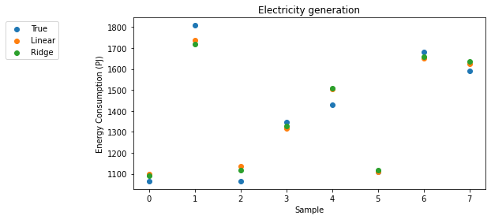
Electricity Generation
Model | Average R² Score
Linear Regression | 88.71%
Ridge Regression | 88.87%
SVM | 8.66%

Slide 11
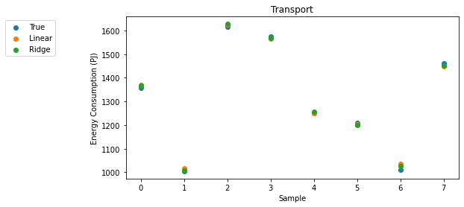
Transport
Model | Average R² Score
Linear Regression | 98.82%
Ridge Regression | 98.92%
SVM | 34.19%

Slide 12
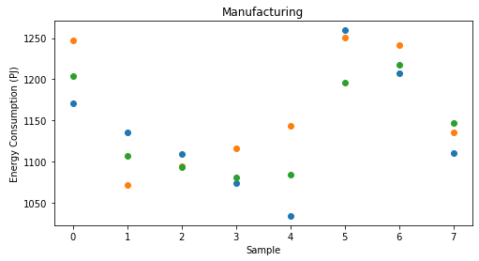
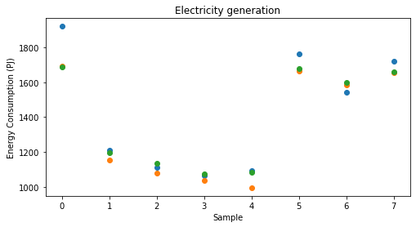
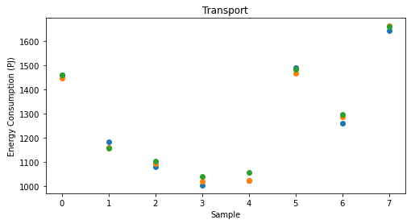

All At Once
Model | Average R² Score
Linear Regression | 78.84%
Ridge Regression | 80.42%
SVM | 52.77%

Slide 13
Conclusions
Both Linear and Ridge Regression performed well in predicting total annual energy consumption
Population and GDP are good indicators to predict the energy consumption of industries like Transport and Electricity Generation, but not Manufacturing.

Slide 14
Q & A

Slide 15
THE END

