Slide 1
College of Science Ratings
Student Opinion from Rate My professor Website

Slide 2
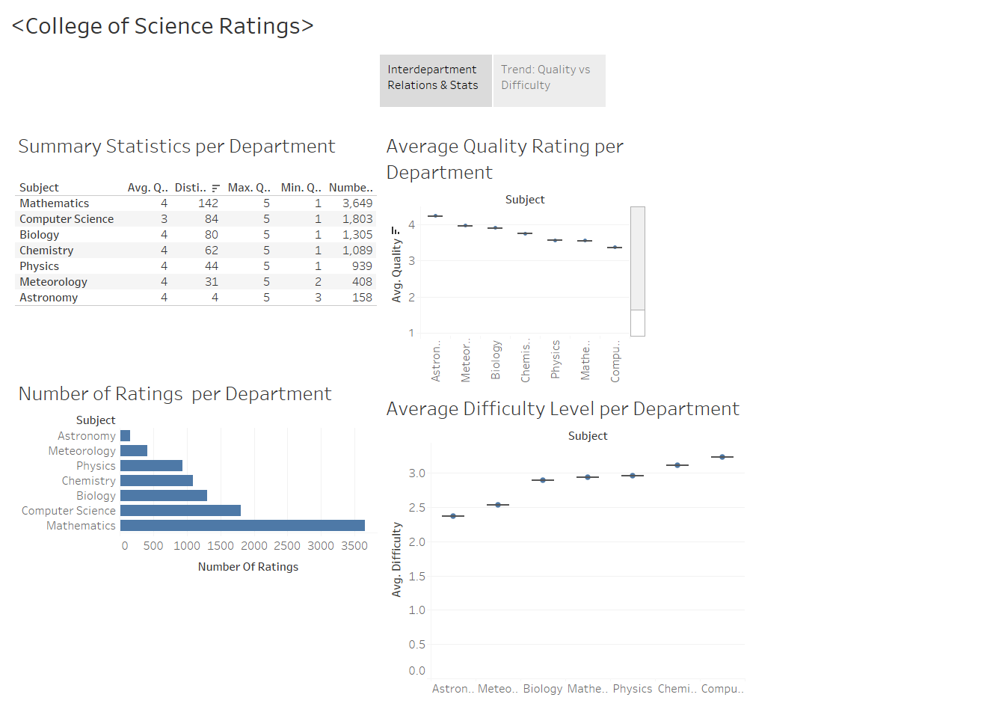

Slide 3
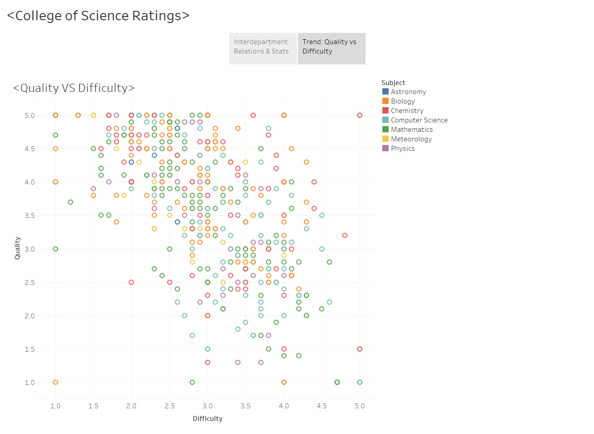

Slide 4
