Slide 1
Cartographie
Map
- _roadmap
+ <<property>> roadmap
+ <<interface>> landscape()
Path
*
Road
*
*
Position
+ <<property>> x
+ <<property>> y
*
TrafficCircle
+ init_roads()
+ landscape()
LinearRoad
+ init_roads()
+ landscape()
LinearRoadWithTrafficLight
+ init_roads()
+ landscape()

Slide 2
Objets de la carte
GraphicalItem
+ get_components()
RoadItem
- <<classmethod>> Get_items()
+ <<property>> is_running
+ <<property>> position
+ foward()
Path
1
+<<property>> path
Vehicule
+ <<property>> speed
+ <<property>> next_position
+ get_plot()
+ forward()
TrafficLight
+ get_plot()
+ forward()

Slide 3
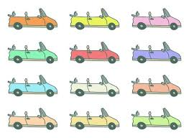
Distance et vitesse
Scénario :
Frame x
Frame x+1
Frame x
Frame x+1
Speed = 1
Speed = 2
Path = {
Position
Position
Position }
d1
d1
d2

