Slide 1
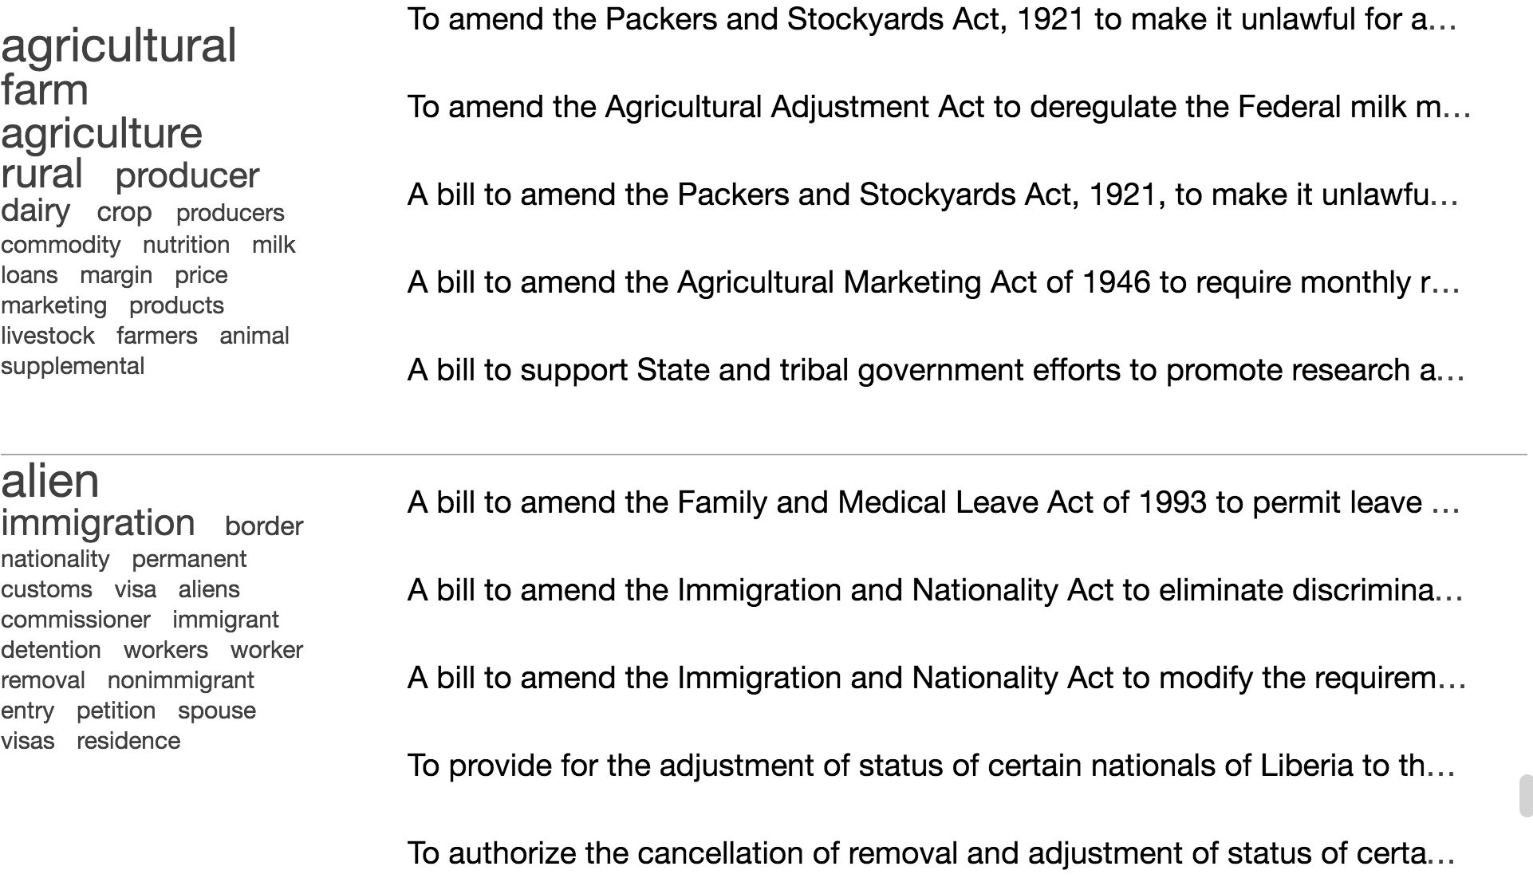
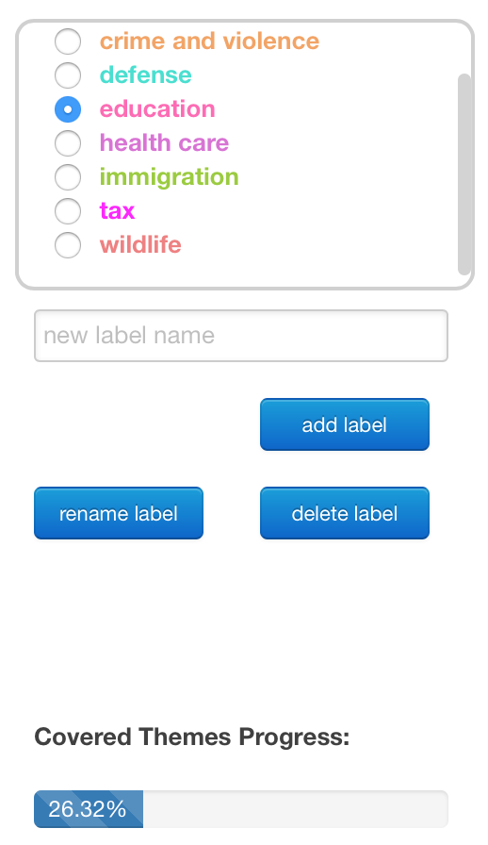
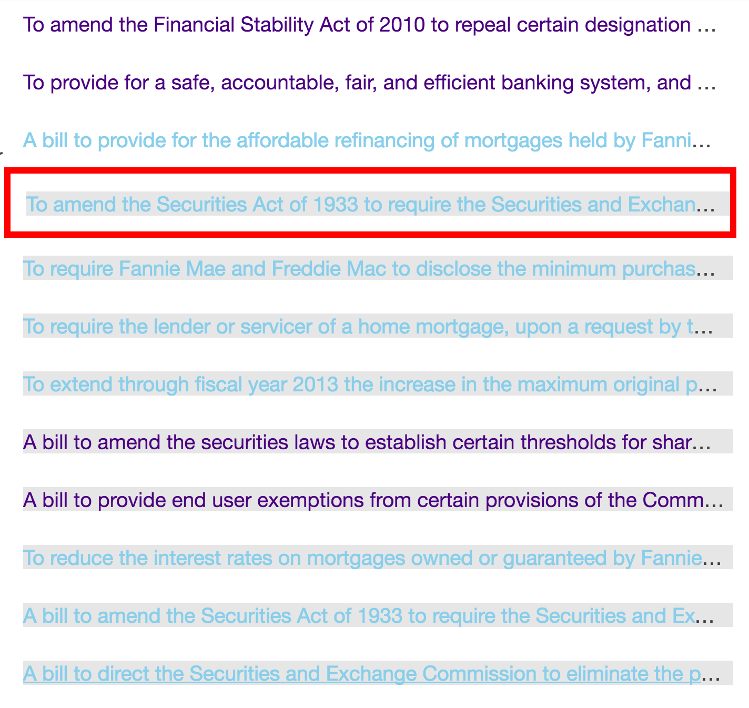
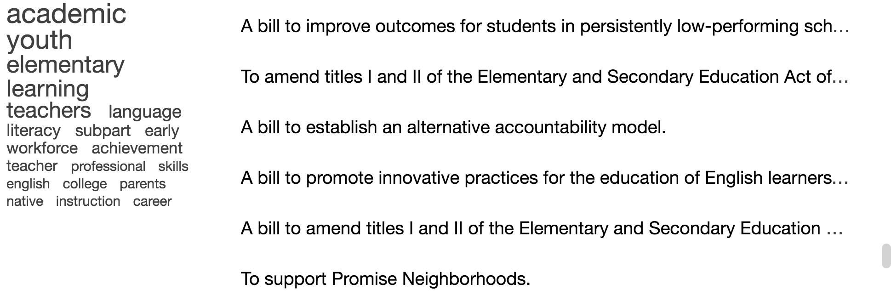
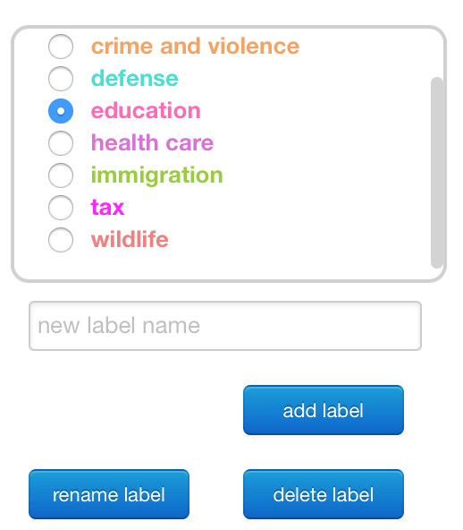
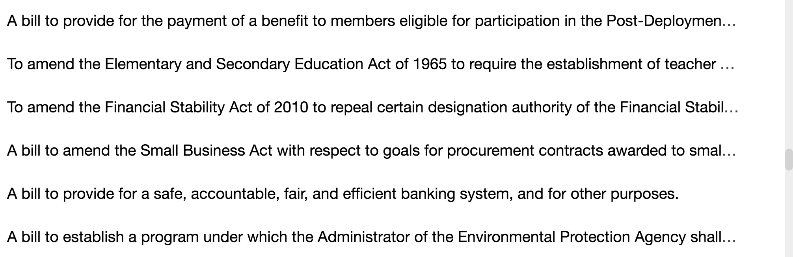
Classifier/Manually assigned label (if any)
Existing labels’ list
Existing labels’ menu
(c) Labeling dialog box
16 more topics
Manually labeled documents
Selected document to label next
(a) Topic Overview (TA and TR)
Classifier labeled documents
(d) The selected document to label next is displayed with a
red box around it. Also, after the classifier runs, some documents get a label assigned, get highlighted in gray, and get colored based on the label.
(b) List Overview (LA and LR)

