Slide 1
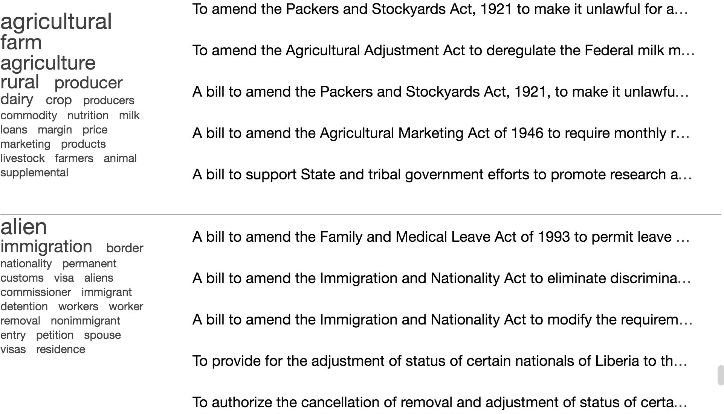
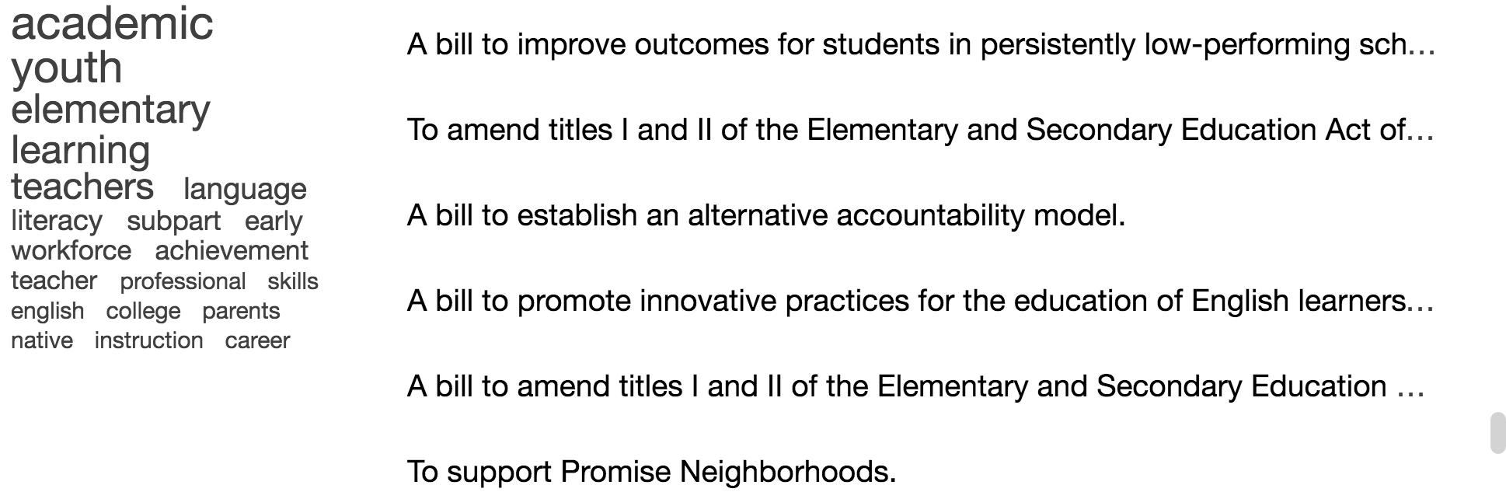
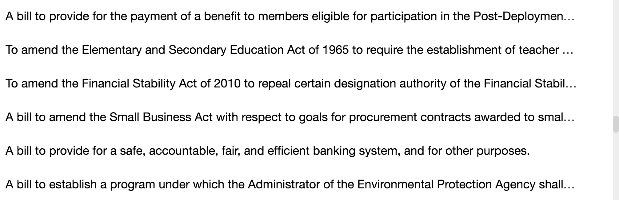
(c) Labeling dialog box
16 more topics
(a) Topic Overview (TA and TR)
(d) The selected document to label next is displayed with a
red box around it. Also, after the classifier runs, some documents
get a label assigned, get highlighted in gray, and get colored based
on the label.
(b) List Overview (LA and LR)

