Slide 1
TRkScan WorkReport
杨子坤 Zikun Yang
2024/10/29

Slide 2
Section I
Aim and function

Slide 3
Aim and function
Cascade pipeline for annotation of complex TR regions
De novo motif finding
Single-base-pair resolution annotation
Motif clustering
Common mutant motif identification
visualization

Slide 4
Section II
Available assays

Slide 5
Available output and assays
Output and assays
annotation output: start, end, motif, CIGAR ……
Motif clustering result
Common mutant motif identification result
Visualization result

Slide 6
Section III
Methods

Slide 7
Flow diagram
Filter Ns
Count k-mer
Split into windows
Build dbg
Get motif from single window
compress dbg
Find cycle
Ref motif
Merge motif
Build suffixArray
Annotate single motif
Cal distance
DP to link
Output aligned bed

Slide 8
Input parameters
INPUT FILE
OUTPUT FILE
-k,--ksize INT k-mer size
-m,--motif FILE reference motif set
-f,--force annotate with motif X in given motif set no matter whether motif X is in the sequence

Slide 9
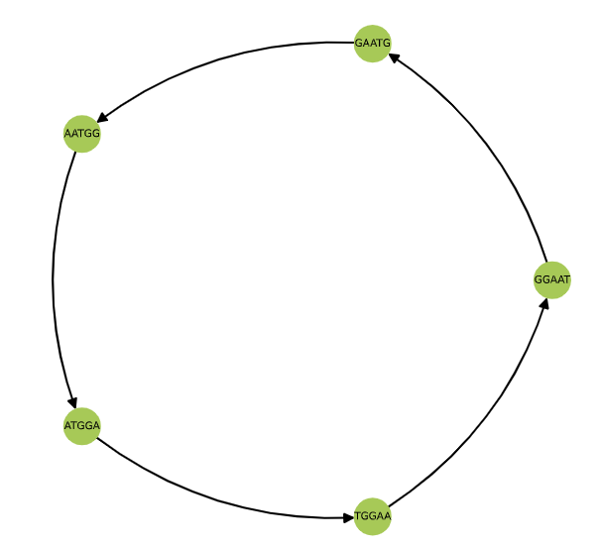
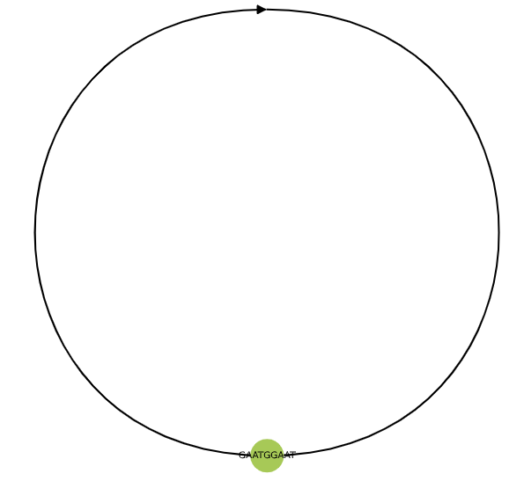
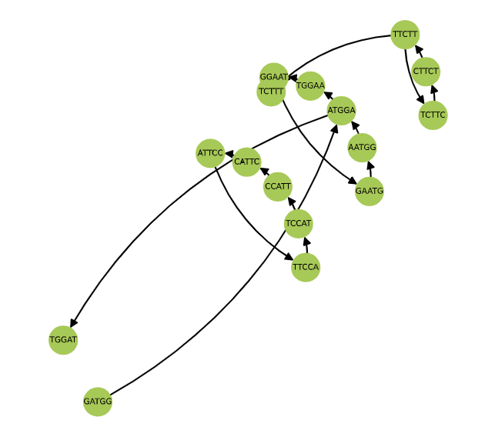
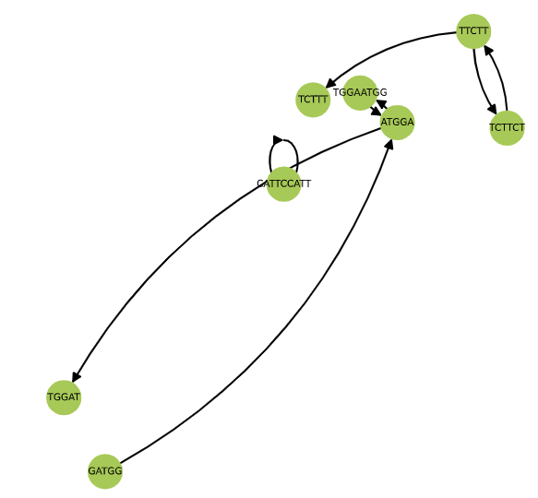
Main step 1 – Get motif from sequence
Filter Ns
original
compact
Count k-mer
Split into windows
Build dbg
Get motif from single window
compress dbg
Merge motif
Find cycle
Ref motif
‘AATGG’
Annotate single motif
Build suffixArray
Cal distance
DP to link
Output aligned bed
‘AATGG’, ’CCATT’, ’CTT’

Slide 10
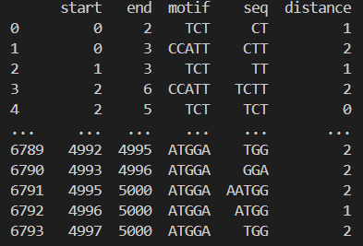
Main step 2 – Annotate single motif
Filter Ns
Count k-mer
Suffix Array + LCP
Split into windows
Build dbg
Get motif from single window
compress dbg
Find cycle
max_distance
Ref motif
Merge motif
Annotate single motif
Build suffixArray
Cal distance
DP to link
Output aligned bed

Slide 11
Main step 3 – Link single motif annotation through dynamic programing (DP)
Filter Ns
Count k-mer
Split into windows
Build dbg
gap_penalty = 1
distance_penalty = 1
perfect_bonus = 0.5
Get motif from single window
compress dbg
Merge motif
Find cycle
Ref motif
Annotate single motif
Build suffixArray
Cal distance
DP to link
Output aligned bed
If skip a base:
-> score -= gap_penalty
If match:
if perfect match:
score += perfect_bonus * length
score += length – distance_penalty * distance

Slide 12
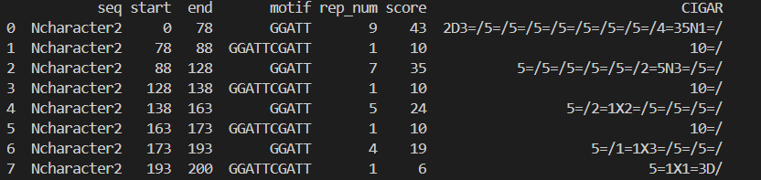
Main step 4 – Get motif from sequence
Filter Ns
Count k-mer
Split into windows
Build dbg
Get motif from single window
compress dbg
Merge motif
Find cycle
Ref motif
Annotate single motif
Build suffixArray
Cal distance
DP to link
Output aligned bed

Slide 13
CIGAR-like mapping result
Symbol | Name | Brief Description | Consumes Query | Consumes Ref
M | Match | no insertion or deletions, bases may not agree | ✓ | ✓
I | Insertion | additional base in query (not in reference) | ✓ | ✗
D | Deletion | query is missing base from reference | ✗ | ✓
= | Equal | no insertions or deletions, and bases agree | ✓ | ✓
X | Not Equal | no insertions or deletions, bases do not agree | ✓ | ✓
N | None | no query bases to align, an expected read gap (spliced read) | ✗ | ✓
S | Soft-Clipped | bases on end of read are not aligned but stored in SAM | ✓ | ✗
H | Hard-Clipped | bases on end of read are not aligned, not stored in SAM | ✗ | ✗
P | Padding | neither read nor reference has a base here | ✗ | ✗
https://timd.one/blog/genomics/cigar.php

Slide 14
CIGAR-like mapping result
Symbol | Name | Brief Description | Consumes Query | Consumes Ref
/ | End of motif | Back to the start of a motif | NA | NA
NEW ADDED
One example:
QUERY: ATTTTGGCATATG--ATTNNNNNNTGGC
REFERENCE: ATT-TGGCATTTGGCATT------TGGC
CIGAR-like: 3=1I4=/2=1X2=2D/3=6N4=

Slide 15
Section IV
Example result

Slide 16
Simulated data test
Key point | Motif | Complete | Note
De novo find motif | A | ✓ | 1bp_TR.fasta, k=5
De novo find motif | AATGG, TTACC | ✓ | 5bp_TR.fasta, k=5
De novo find motif | pCht sequence | ✓ | 32bp_TR.fasta, k=7
De novo find motif | R1_cons.11Jul21_CHM13 | ✓ | 171bp_TR.fasta, k=7
Nested motif | ATTGG, TTG | ✓ | nestedMotif.fasta, k=7
Sequence with N |  | ✓ | N.fasta, k=5

Slide 17
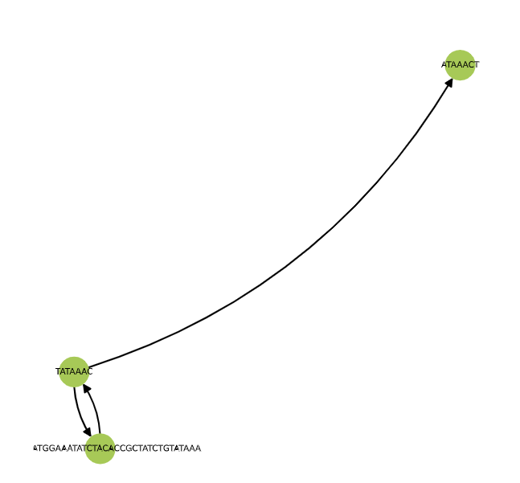
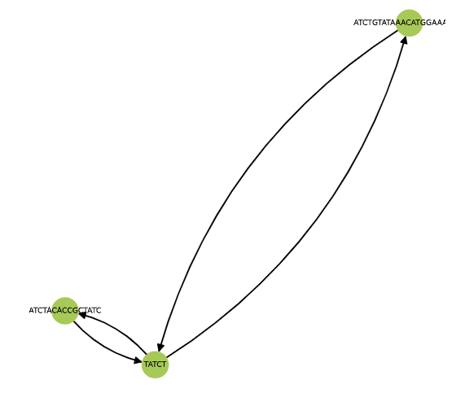
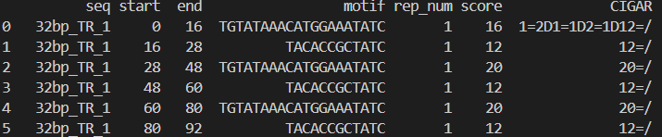
Effect of k-mer size on motif acquiring
32bp pCht in Pan
TAAACATGGAAATATCTACACCGCTATCTGTA
K=5
K=7
Recurring 5-mer in single motif
From 32bp pCht test

Slide 18
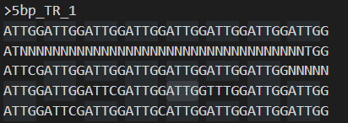
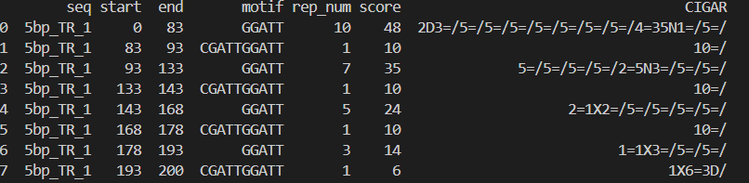
Nested motif example

Slide 19
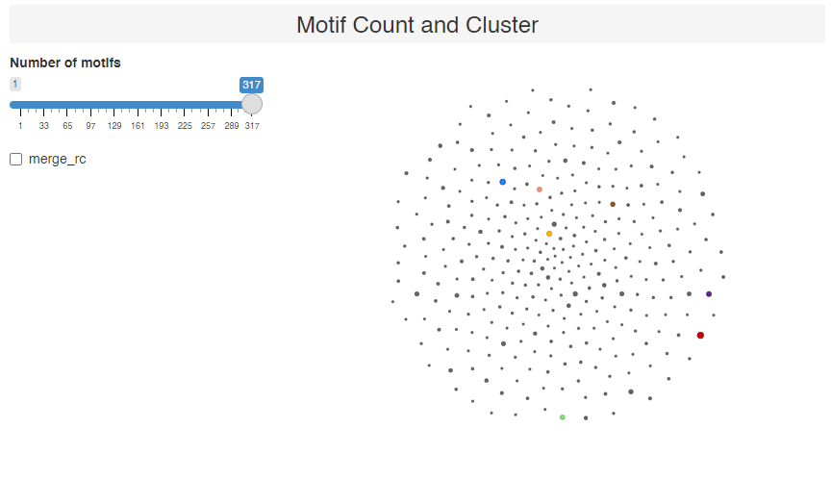
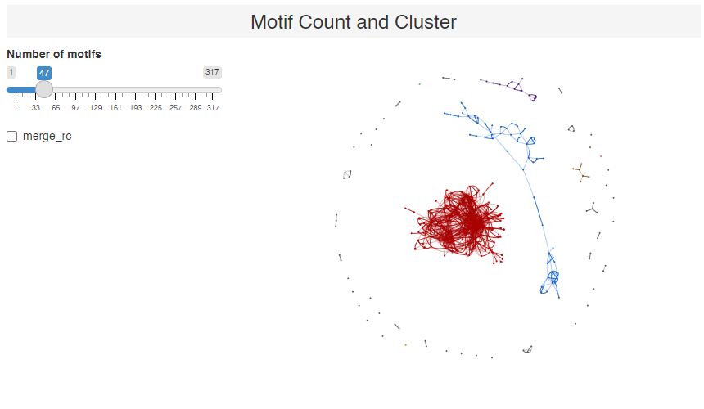
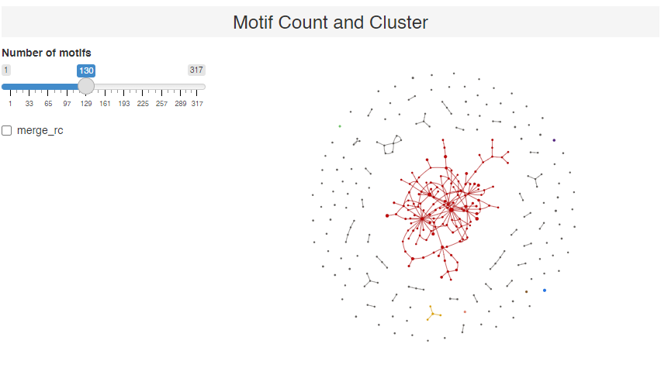
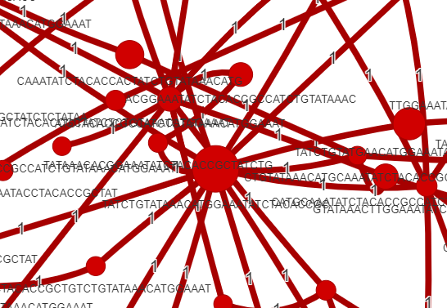
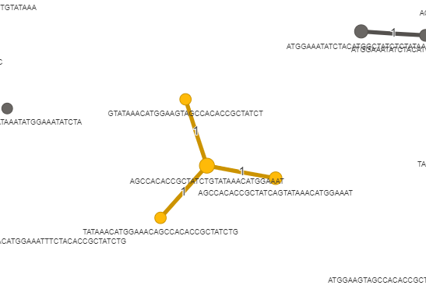
pCHT sequence with spacers
K=13

Slide 20
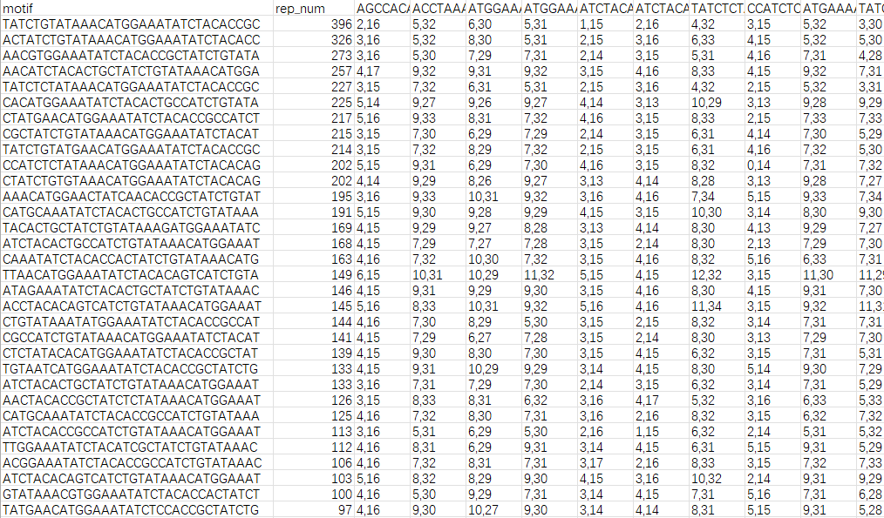
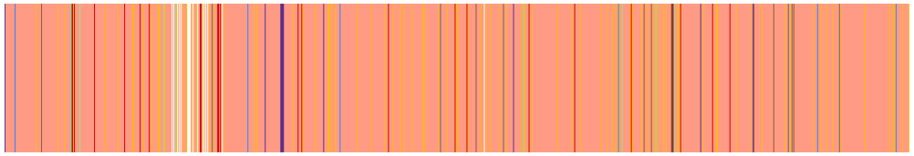
pCHT sequence with spacers
K=13

Slide 21
Section V
Future Plan

Slide 22
Future plan
To do | Complete
Border polishing | ✗
Reference motif calibration | ✗
Visualization | ✗
HOR N-mer identification (loop weight) | ……
…… | ……
…… | ……

Slide 23
THANKS
TRkScan WorkReport
杨子坤 Zikun Yang
2024/11/29

Slide 24
24-12-20
TRkScan WorkReport
杨子坤 Zikun Yang
2024/12/20

Slide 25
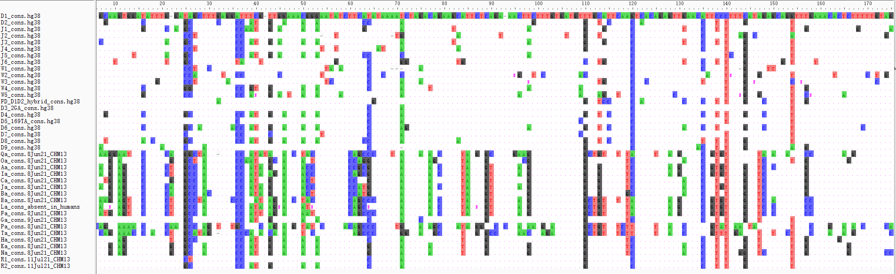
D1 D2 monomer alignment
From science paper

Slide 26
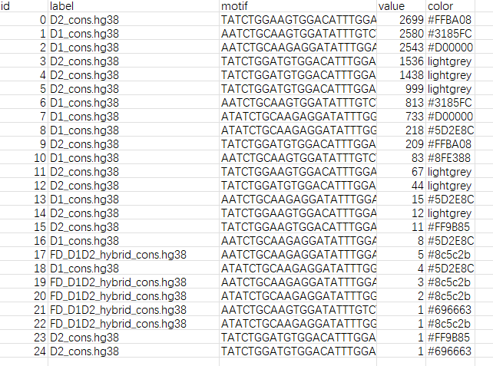
Annotation result

Slide 27
Annotation validation
Top1 D2
Top2&3 D1
Top18 D1 D2 hybrid

Slide 28
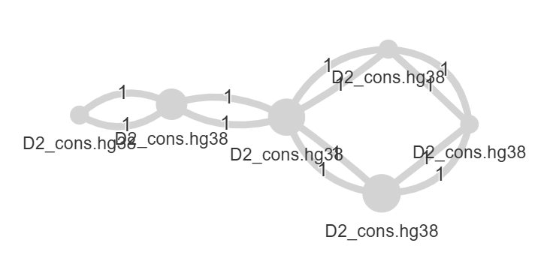
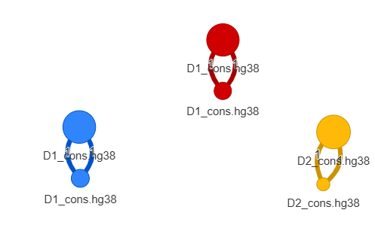
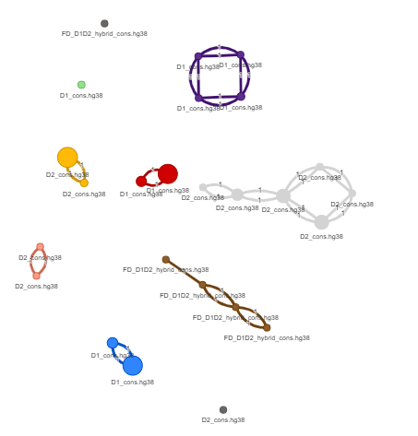
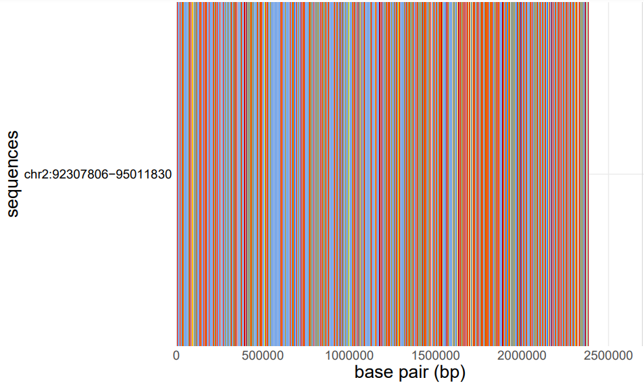
HOR of Human chromosome 2
More
Less
# of all motifs: 25
# of cluster: 10 (given)
Repetitive Number
Whole Picture of This Region

Slide 29
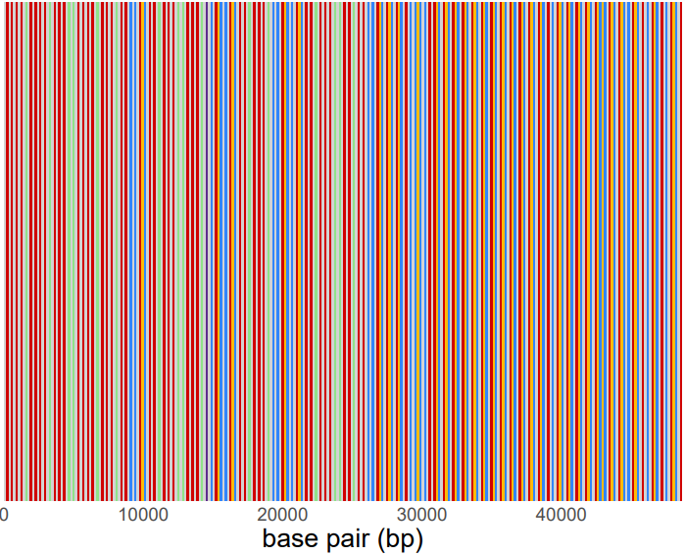
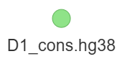
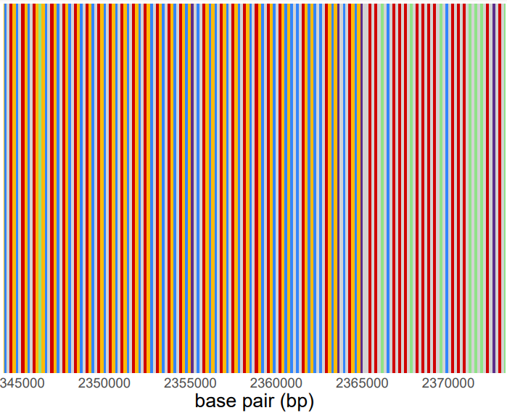
Layer structure of HOR region end

Slide 30
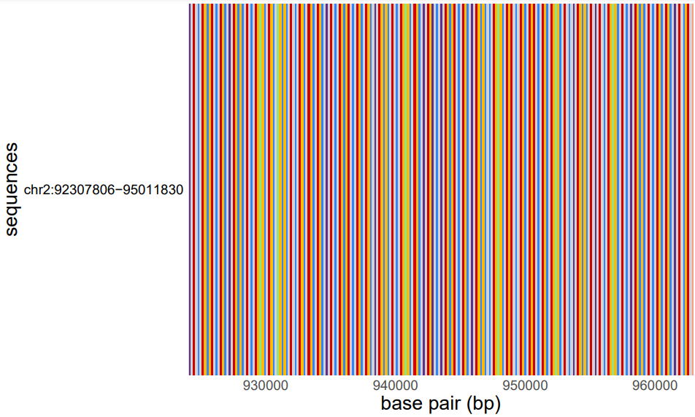
Mi

Slide 31
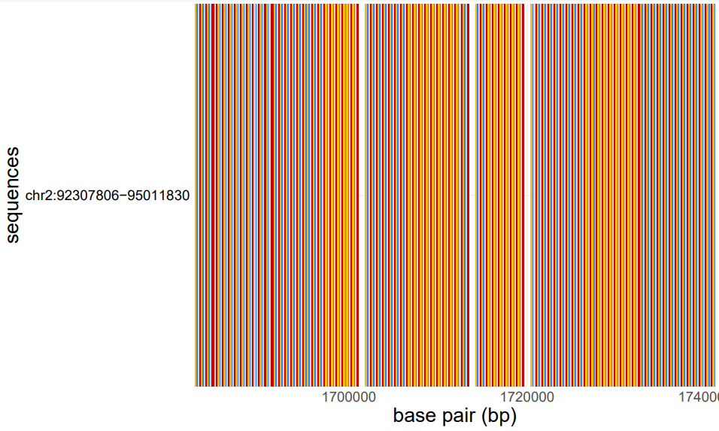
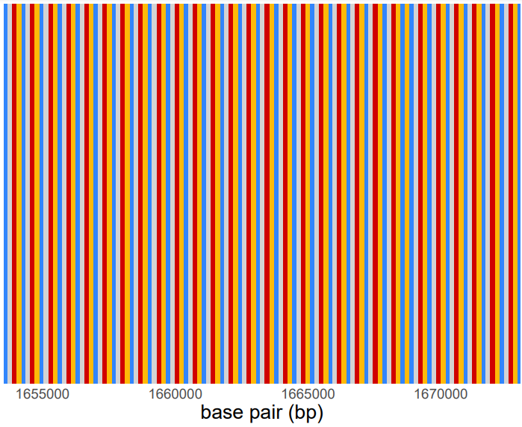
Snapshots of this region
D1 D2 D1 D2

Slide 32
To do
 | function1 | function2 | function3
TRkScan | 🆗 | 🆗 | 🆗
Tool1
Tool2
Tool3
Motif size ?
TR in T2T-CHM13 total base pair?
New era?
pCht
Centromere
NEW: multiple variants! TE insertion, high mutation rate
Hence: need an integrative tool package
Section-1 diagram and function, simulation, heatmap ( + and - chain)? What’s new
Section-2 application, 1 chr in human has inversion, centromere invert? -> shilong
Get HOR region coordinates in great apes -> Xinrui
拟南芥 nature paper, massive TE insertion
Section-3 New biology:
HSatII and HSatIII in short arm in orangutan, enrich in TE
pCht motif set? Not a base pair difference
PCA (gorilla , chimp, bonobo) <--> kmer-based PCA, challenge a old opinion
new TE cluster? Not only SD spacer

Slide 33
24-12-27
TRkScan WorkReport
杨子坤 Zikun Yang
2024/12/27

Slide 34
Statistics of tandem repeats in T2T-CHM13
paper

Slide 35
Research background and drawbacks

Slide 36


Research background and drawbacks
Table1 Function comparison of related tools
Tools | TRF | StringDecomposer (SD) | VAMOS | MotifScope | TRkScan
Motif length | 1-X | Depend on DB | Depend on DB |  | 1-X
multithread | ❌ | ❌ | ✅ | ❌ | ✅
Table2 Function comparison of related tools
Tools | De novo motif finding | Mutant motif identification | Motif annotation | TE insertion identification | Merge reverse complementary
TRF | ✅ | ❌ | ❌ | ❌ | ❌
StringDecomposer (SD) | ❌ | ❌ | ✅ | ❓ | ❓
VAMOS | ❌ | ✅(not de novo) | ✅ | ❓ | ❓
MotifScope | ✅ | ✅ | ✅ | ❌ | ❌
TRkScan | ✅ | ✅ | ✅ | ✅ | ✅
Sequence
Sequence
Transposable elements
(TEs)
Reverse complementary
Common
ATTGG
ATTGG x n
Mutant
ATTCG
A
a
A
A
A
A
A
A
A
A
A’
A’
A
A

Slide 37
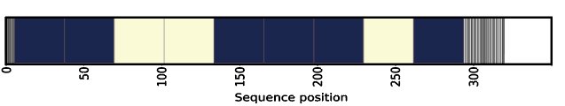
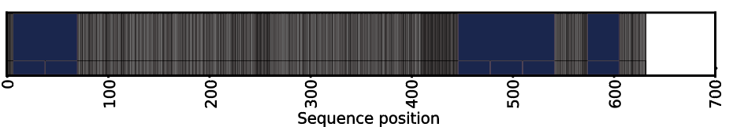
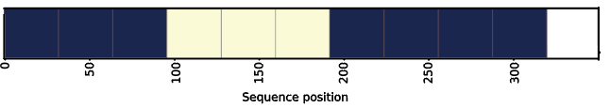
Research background and drawbacks
Table1 Function comparison of related tools
Tools | De novo motif finding | Mutant motif identification | Motif annotation | TE insertion identification | Merge reverse complementary
DATA | 32 bp satellite | x 6 …AAA… x 4 …ATA…
OURS | Same | x 6 x 4
TRF | Same | x 10
VAMOS | NA | NA | NA | NA | NA
MotifScope | Same | x 6 x 3
merge
(A)n

Slide 38
Research background and drawbacks
Table1 Function comparison of related tools
Tools | De novo motif finding | Mutant motif identification | Motif annotation | TE insertion identification | Merge reverse complementary
DATA | 32 bp satellite | x 6 …AAA… x 4 …ATA…
OURS | Same | x 6 x 4
TRF | Same | x 10
VAMOS | NA | NA | NA | NA | NA
MotifScope | Same | x 6 x 3
merge
(A)n

Slide 39
Our mission and aim

Slide 40
TRkScan’s framework and function

Slide 41
Arguments and usage

Slide 42
Benchmarks of TRkScan
empirical de novo STR mutation rate to be 5.24 × 10⁻⁵ mutations per locus per generation
Edit distance

Slide 43
Benchmarks of TRkScan

Slide 44
Benchmarks of TRkScan

