Slide 1
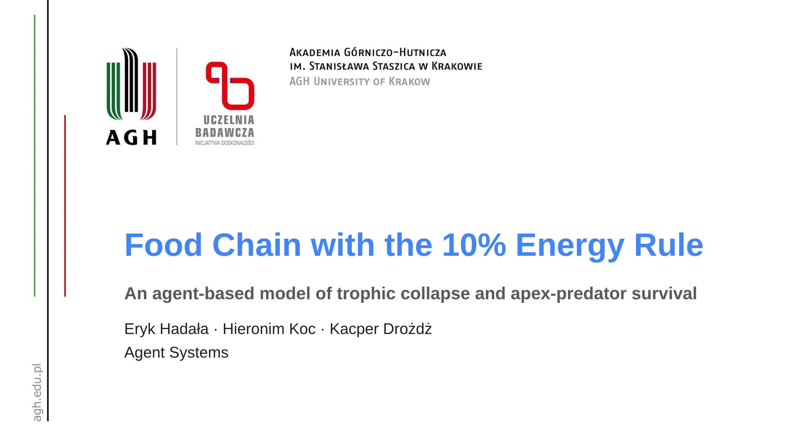
Notes:
Speaker (~15s): Our project is an agent-based simulation of a five-level food chain governed by the ecological 10% energy rule. The question we ask: under that hard rule, how long can each level survive - and what decides the fate of the apex predator.

Slide 2
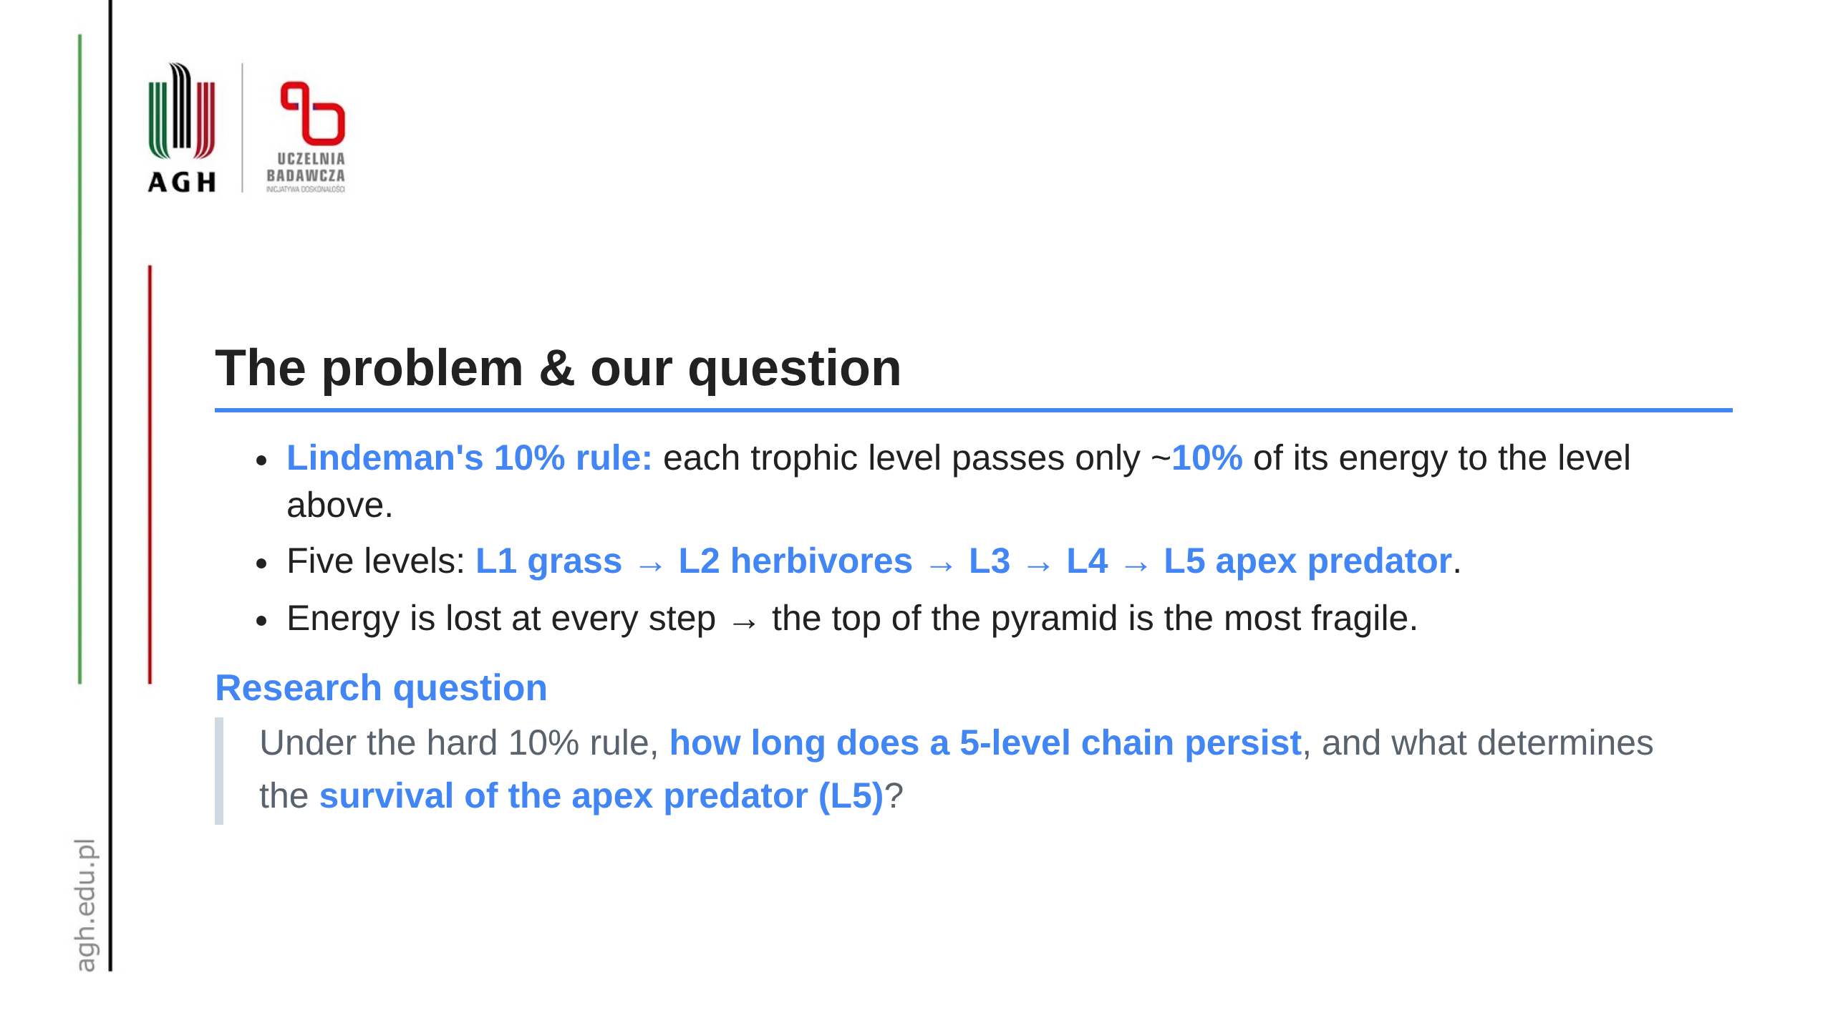
Notes:
Speaker (~45s): Only a tenth of the energy crosses each level, so a huge producer base supports a tiny apex. We don't ask "does it reach equilibrium" - we ask how long each level lasts and which parameters keep the apex alive longest.

Slide 3
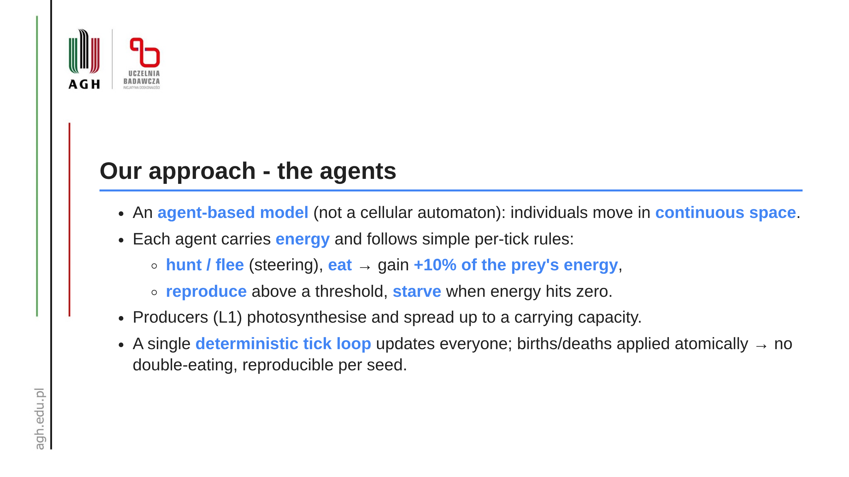
Notes:
Speaker (~60s): Every individual is an agent with an energy budget. Predators steer toward prey and away from threats; eating transfers exactly 10% of the prey's energy. One central scheduler steps the world tick by tick, so a given seed always reproduces the same run.

Slide 4
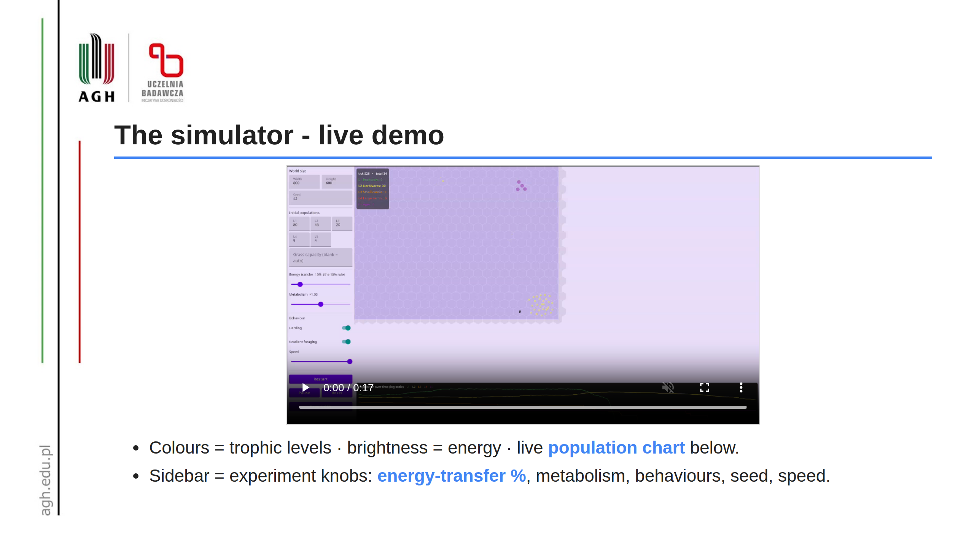
Notes:
Speaker (~90s): Here is the model running. Watch the bottom chart: grass and herbivores oscillate, then the upper predators drop out one by one. Every slider on the left is an experiment knob - energy yield, metabolism, herding - which we sweep next.

Slide 5
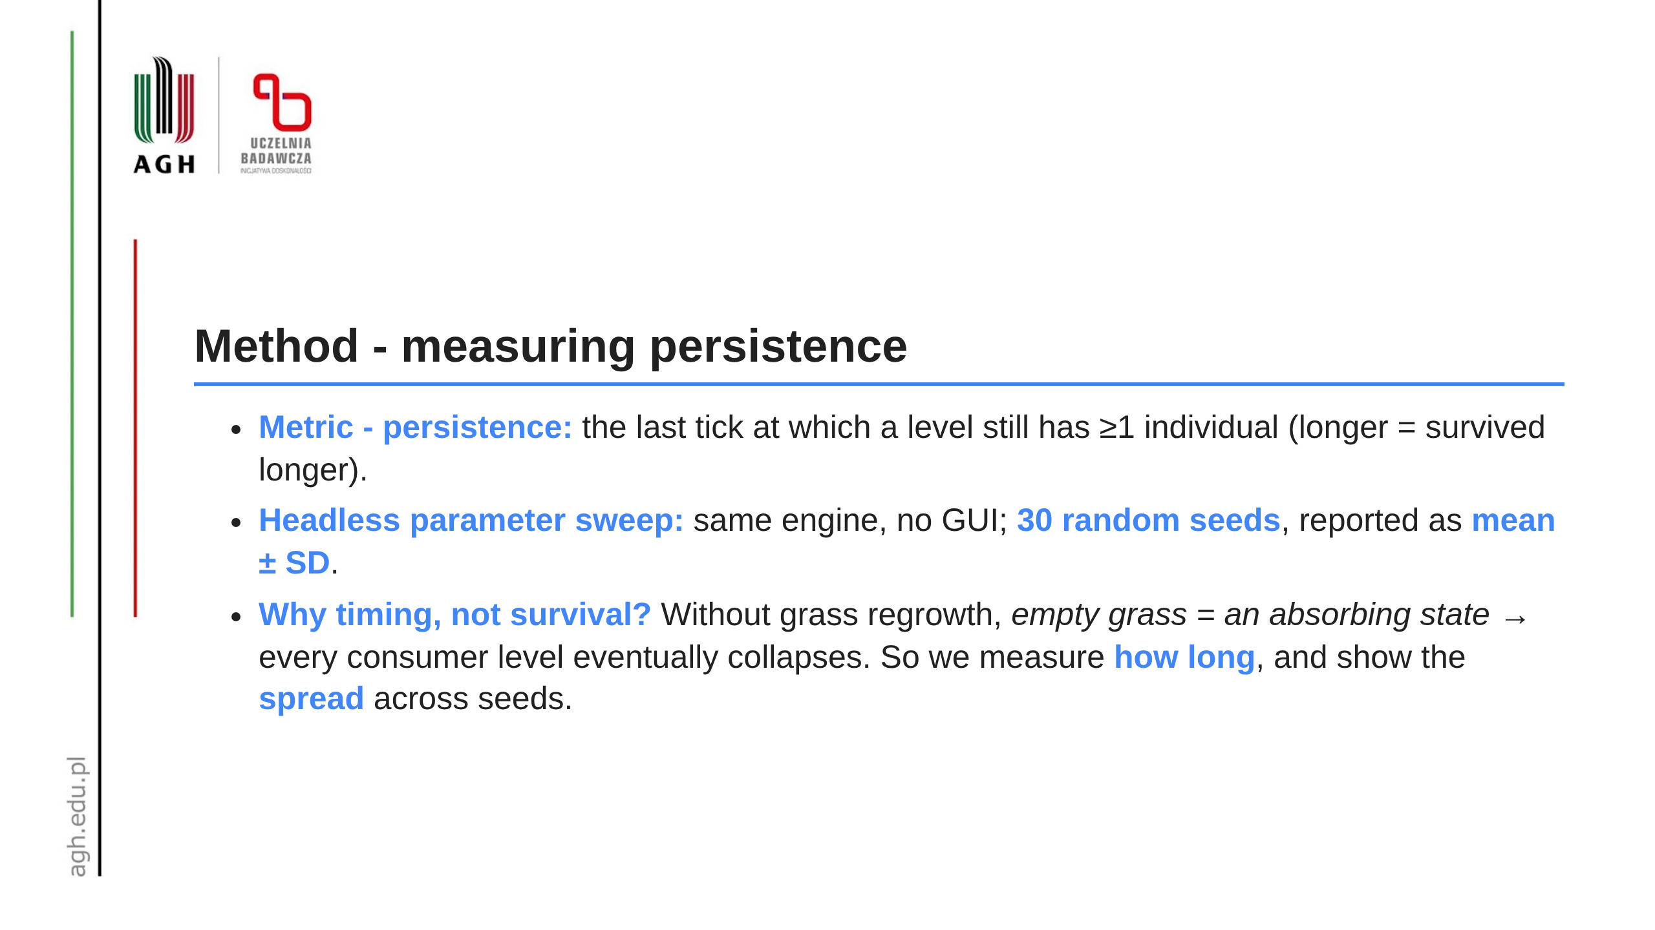
Notes:
Speaker (~30s): We run the engine head-less over a grid of parameters, thirty seeds each, and report mean plus/minus one standard deviation. Because collapse is inevitable here, the meaningful number is duration, and the error bars tell us what is signal vs noise.

Slide 6
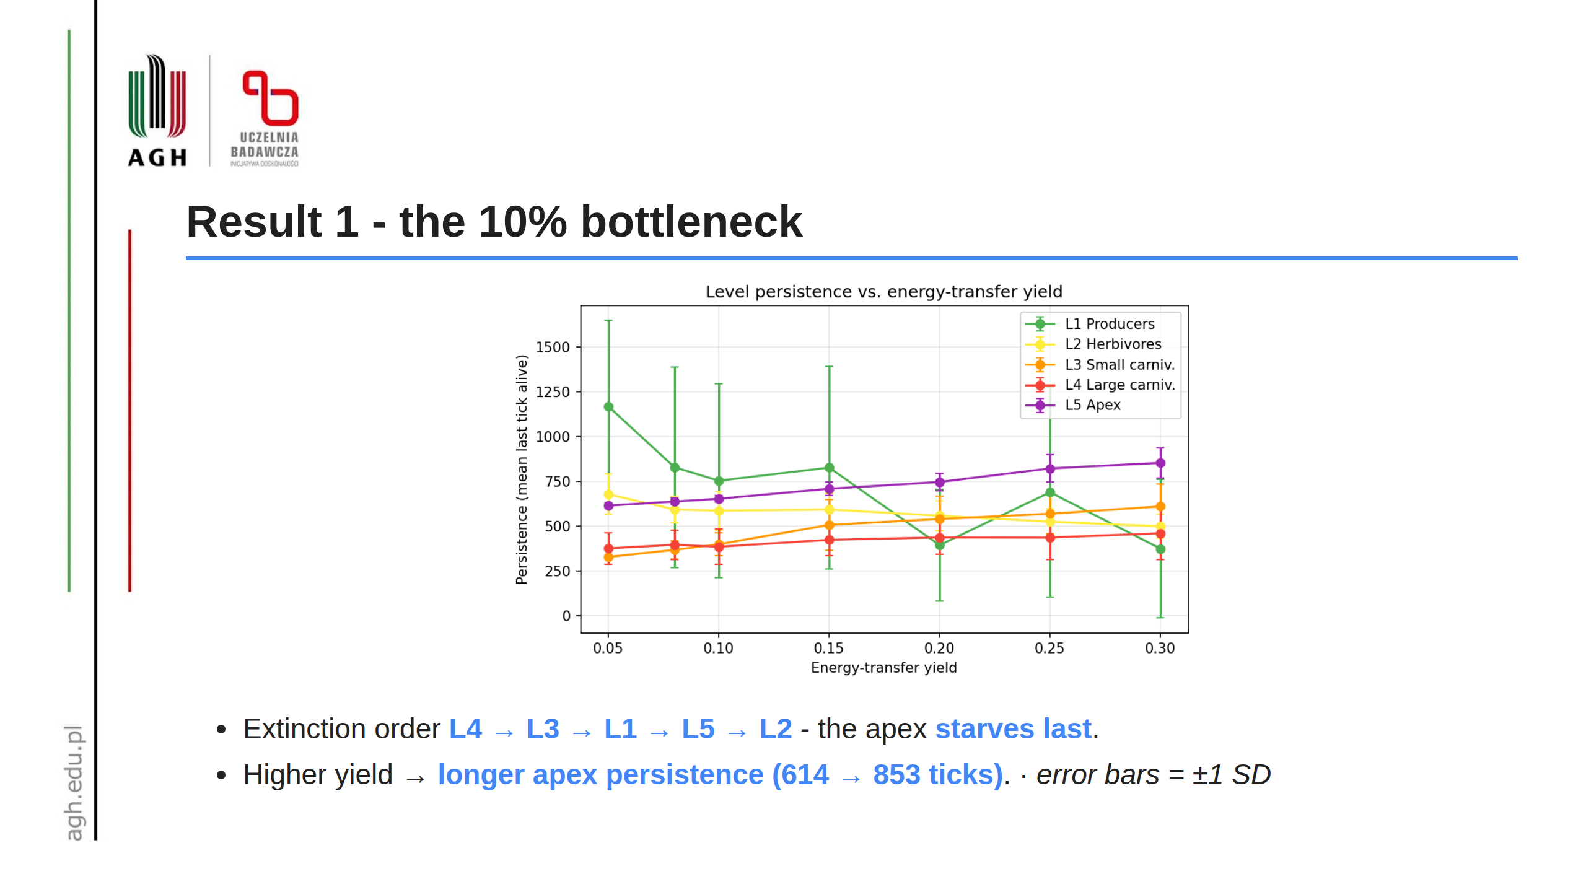
Notes:
Speaker (~60s): Middle predators die first - squeezed from both sides. The apex lingers not because it thrives but because nothing eats it. Crucially, the more efficient the energy transfer, the longer L5 holds on - a direct readout of the 10% rule.

Slide 7
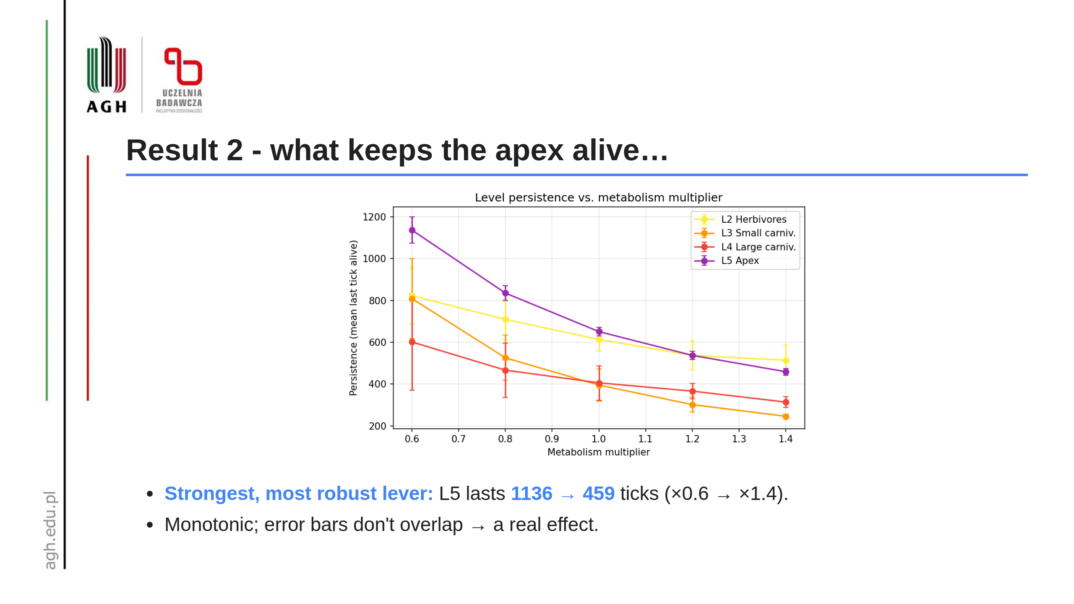
Notes:
Speaker (~45s): The single biggest factor is the cost of living. Halve metabolism and the apex lasts more than twice as long. The trend is clean and the error bars are tight - this is a robust result.

Slide 8
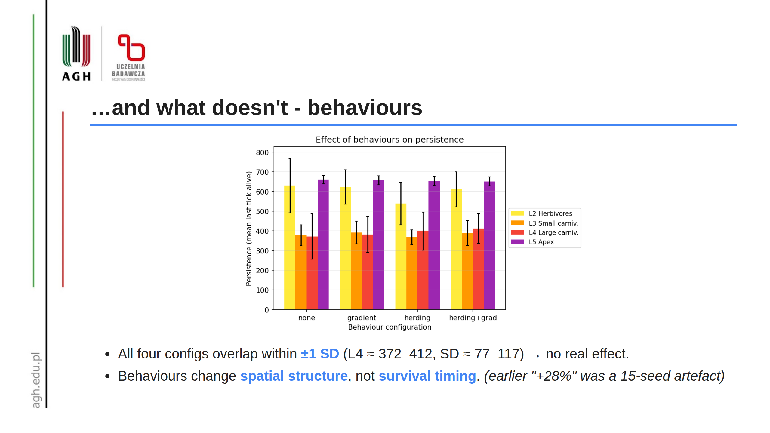
Notes:
Speaker (~75s): This is our honesty slide. With more seeds and error bars, the apparent benefit of herding vanishes into the noise - every configuration overlaps. Emergent movement changes how agents cluster, but it does not change who survives or for how long.

Slide 9
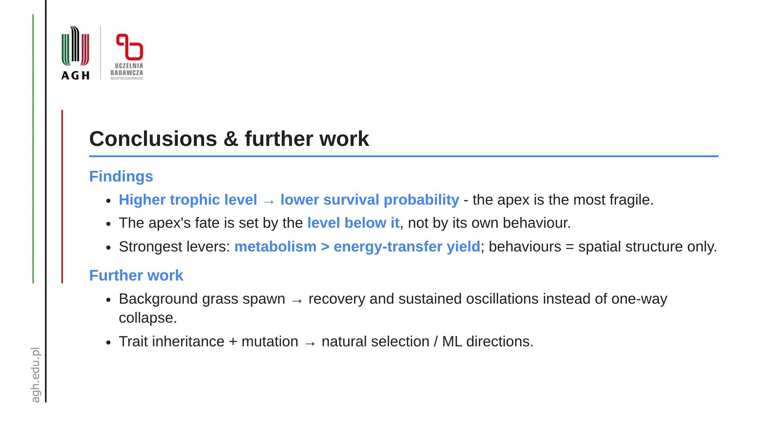
Notes:
Speaker (~45s): The take-away is the fragility of the top of the energy pyramid, exactly as the 10% rule predicts. Next we'd add grass regeneration so the system can recover, and heritable traits to study selection. Thank you - happy to take questions.

