Slide 1
AI3023 · MLW
Spaceship Titanic
Passenger Transport Prediction
From simple baselines to a stable boosted ensemble
Nova@MLW · Zhentao Luo · Zihao Chen · Zhuangtao Xiong · Zirui Su
Data analysis · Baseline modeling · Tree optimization · Final ensemble

Slide 2
02
CONTENTS
01
02
03
04
05
Dataset & EDA
Feature Engineering
Baseline Models
Tree Models & Ensemble
Results & Demo
What makes this tabular problem difficult?
How raw IDs, cabins and spending become usable signals
Logistic Regression and SVM as the starting point
RF, XGBoost, LightGBM, CatBoost and blending
Performance, cost, reproducibility and conclusion
A high-score story: data understanding → model limits → targeted optimization → submission
02

Slide 3
01
Data understanding & analysis
From dataset to understand
pre: Zhuangtao Xiong 2430034081

Slide 4
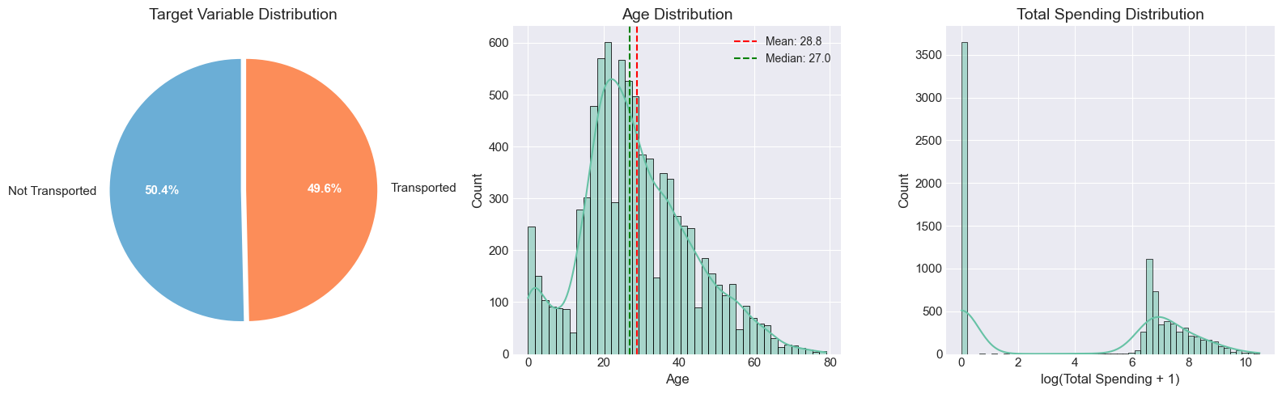
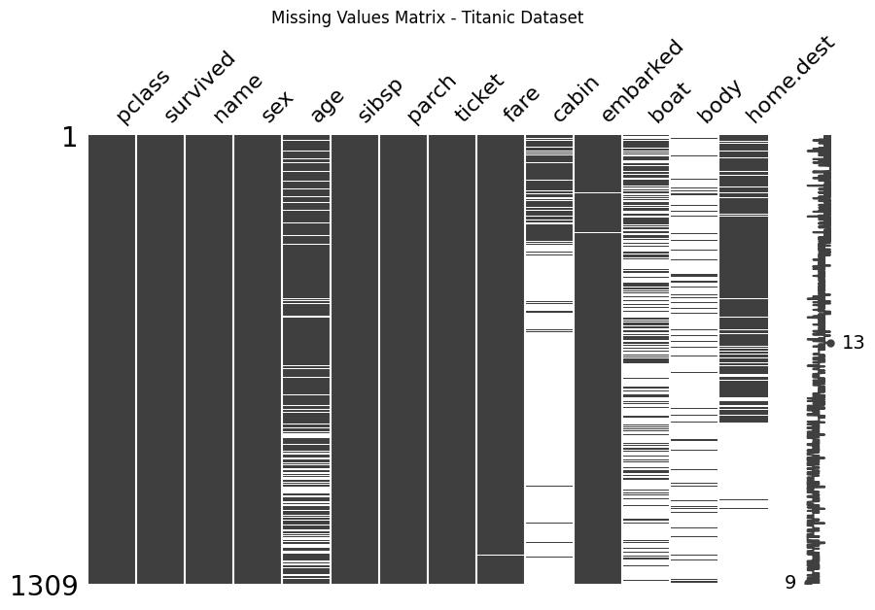
03
Data Understanding
Nova@MLW · Zhuangtao XIONG 2430034081
Dataset Understanding
8,693
4,277
14
training rows
test rows
train columns
first thought:
Encoding: one-hot?...?
median/mean/mode imputation?
features engineering→ how？
Transformation→ what method？
Modeling→ logistic regression?...?
Key dataset challenges
1.mixed data types
2.a lot of missing values
3.hidden information in IDs
4.heavily skewed spending
5.strong non-linear feature interactions.
goal: make it easier for the model to predict
03

Slide 5
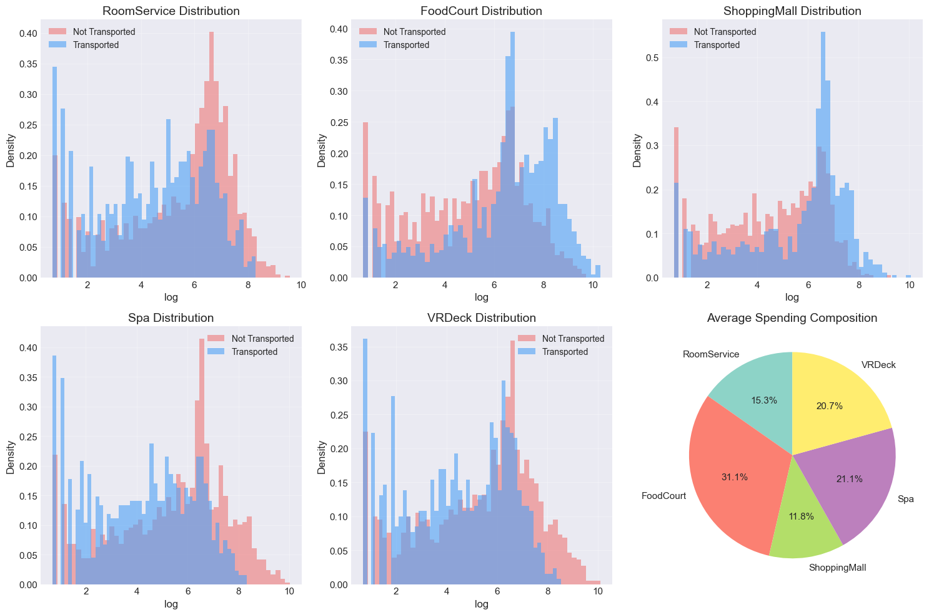
04
EDA overview
04
Nova@MLW · Zhuangtao XIONG 2430034081
EDA overview
8,693
4,277
14
training rows
test rows
train columns
Bimodal distribution
Pink = Not Transported, Blue = Transported
Non-transported passengers tend to spend more money.
bimodal pattern
Not Transported: 50.4%
Transported: 49.6%
Key finding:
The target classes are highly balanced, nearly 50:50.
right-skewed unimodal distribution
most young adults
04

Slide 6
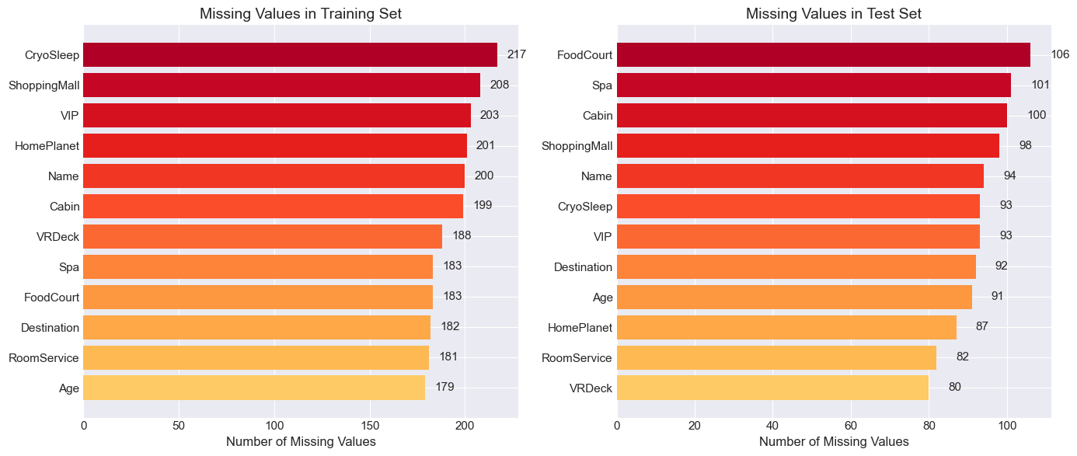
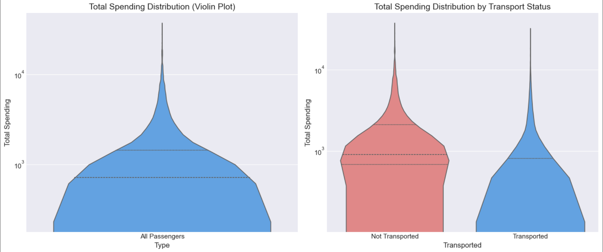
05
Exploratory Data Analysis
05
Nova@MLW · Zhuangtao XIONG 2430034081
EDA Findings: Missingness and Spending Behavior
Missing values in train/test
Spending distribution and outliers
Train/test missing patterns match, use one strategy
long tail:
Numeric features: Fill with median
Categorical features: Fill with mode
Special fields(name/ID): Fill with constant + add missingness flags
Skewed spending (long tail)
Higher spending passenger→ less likely to be transported
many people do not spend money.
05

Slide 7
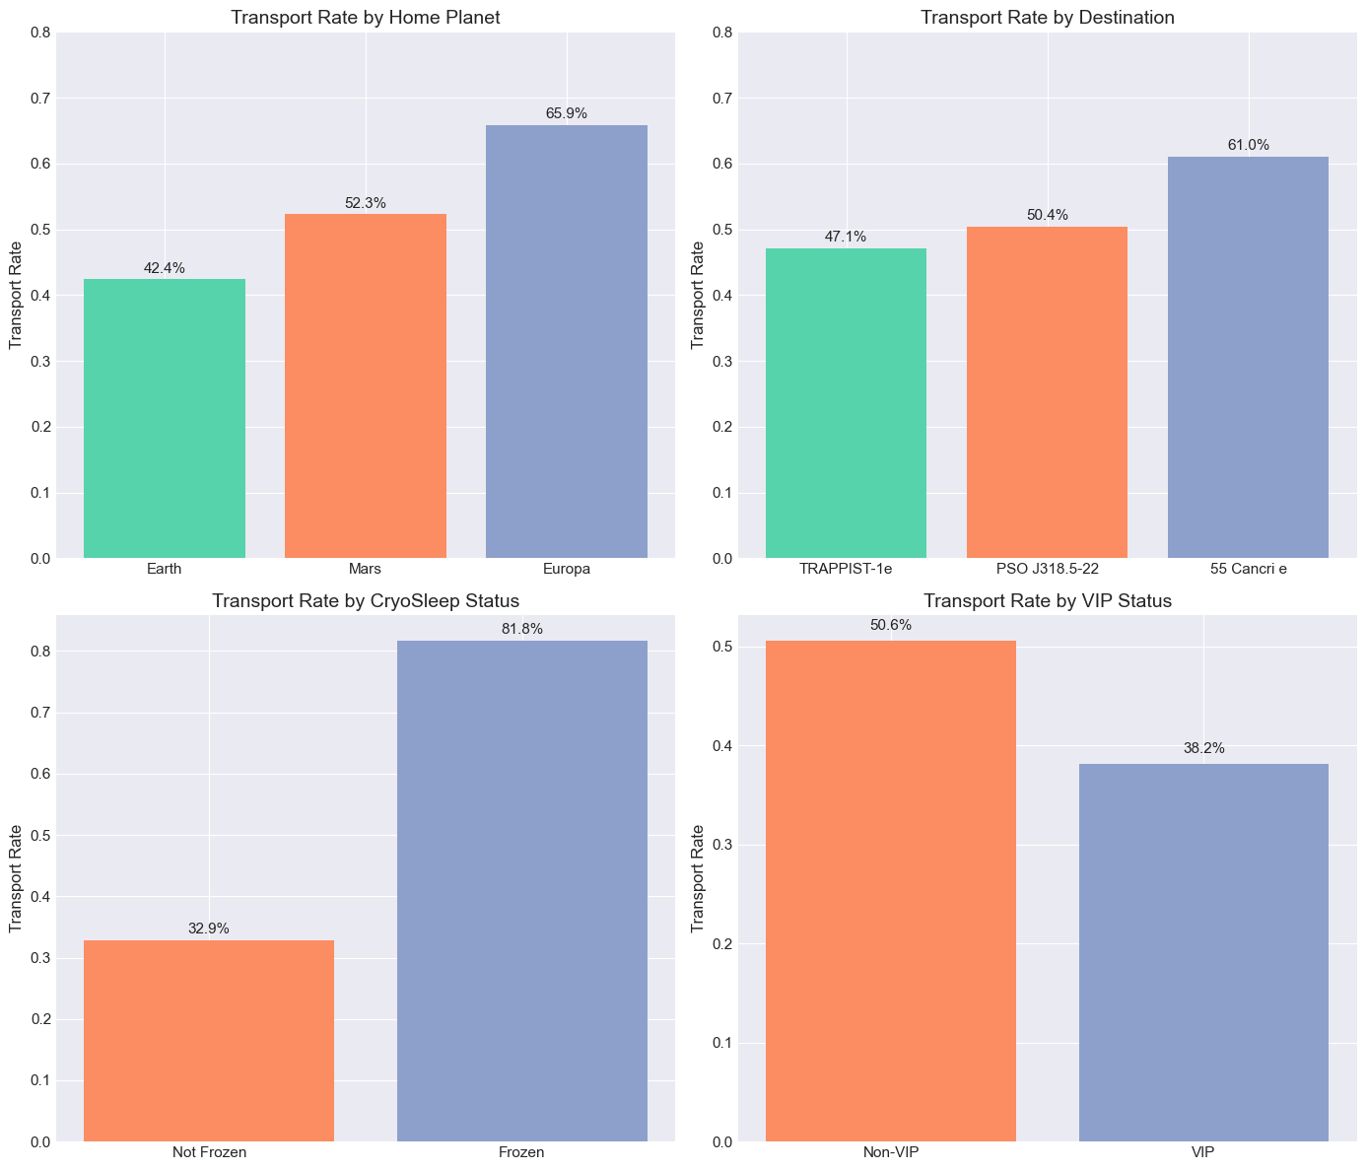
06
Exploratory Data Analysis
06
Nova@MLW · Zhuangtao XIONG 2430034081
EDA Findings: Strong Categorical Signals
Transport rates by categorical feature
What the plots told us
• Europa passengers have higher transported rate than Earth
• Destination changes transported rate
• CryoSleep sharply separates transported probability
• VIP shows a weaker negative relationship
So we created interactions
CryoAndNoSpend · CryoAndSpend (frozen or not)/
HomePlanet_Destination(route) · group-level counts(family)
07

Slide 8
02
Preprocessing & Models Selection
Why Logistic Regression and SVM are not enough
pre: Zirui Su 2430034081

Slide 9
07
Feature Engineering
07
Nova@MLW · Zirui SU 2430034058
Feature Engineering & Preprocessing
Group
GroupId, PassengerNo
same group usually have same outcome patterns
Preprocessing Details
Numerical:
• median imputation
Categorical:
• constant imputation
• string conversion
• One-Hot encoding
Cabin
CabinDeck, CabinNum, CabinSide
The transported rates for different cabin positions vary significantly.
Leakage prevention:
• train/test combined only for count features
Name
Surname, NameLength
Passengers with the same surname may belong to the same family.
07
Spending
TotalSpend, NoSpend, LuxurySpend, BasicSpend, LuxuryRatio
The spending data is skewed to the right. Separate zero spenders, preserve the ratio feature's structure
Dual-path Design
CatBoost keeps raw categorical strings passed via cat_features, while others take the One-Hot encoded path. That's because CatBoost natively supports categorical features.
Age
AgeBin, IsChild, IsSenior
People of different age groups show different tranported rates.
Interactions
CryoAndSpend, CryoAndNoSpend
CryoSleep has a strong relationship with spending features.

Slide 10
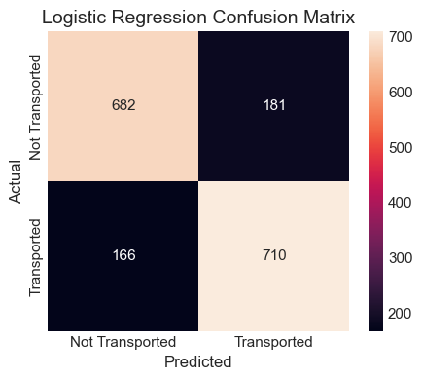
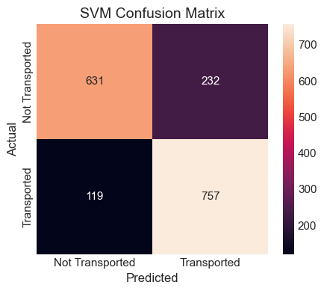
08
Model Optimization
08
Nova@MLW · Zirui SU 2430034058
Baseline Model Analysis
Logistic regression and SVM
Logistic regression
SVM
CV: 0.8033
Training Time: 0.9893s
Inference Time: 0.06ms
CV: 0.8062
Training Time: 22.1788s
Inference Time: 19.2656ms
Advantage:
Logistic regression trains fast and has low computational cost
Advantage:
SVM can capture non-linearity and its performance is acceptable
Disadvantage:
Can only learn linear relationships
Sensitive to outliers in spending
Disadvantage:
The running speed is extremely slow
The computational cost is simply too high.
Conclusion:
The simple linear and kernel methods are not enough for our requirements, so we turned to tree models instead.
07

Slide 11
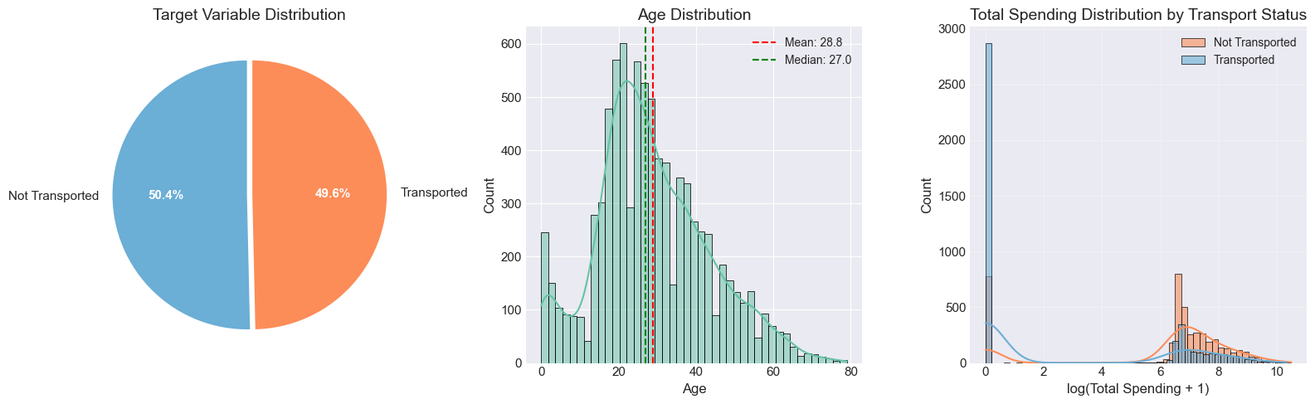
09
Model Optimization
09
Nova@MLW · Zirui SU 2430034058
Why Ensemble Tree Models Fit This Dataset Better
The dataset is small-to-medium, mixed-type, and interaction-heavy—exactly where tree models are strong.
No scaling required
Non-linear patterns learned automatically
1
unlike Logistic Regression or SVM, trees don't need normalization
2
no manual binning rules needed"
Feature interactions
Robustness
3
CryoSleep × spending × route patterns can be learned automatically
4
less sensitive to outliers and skewed spending distributions
EDA finding
transported passengers generally spend less, but the pattern is non-linear and tied to CryoSleep.
09

Slide 12
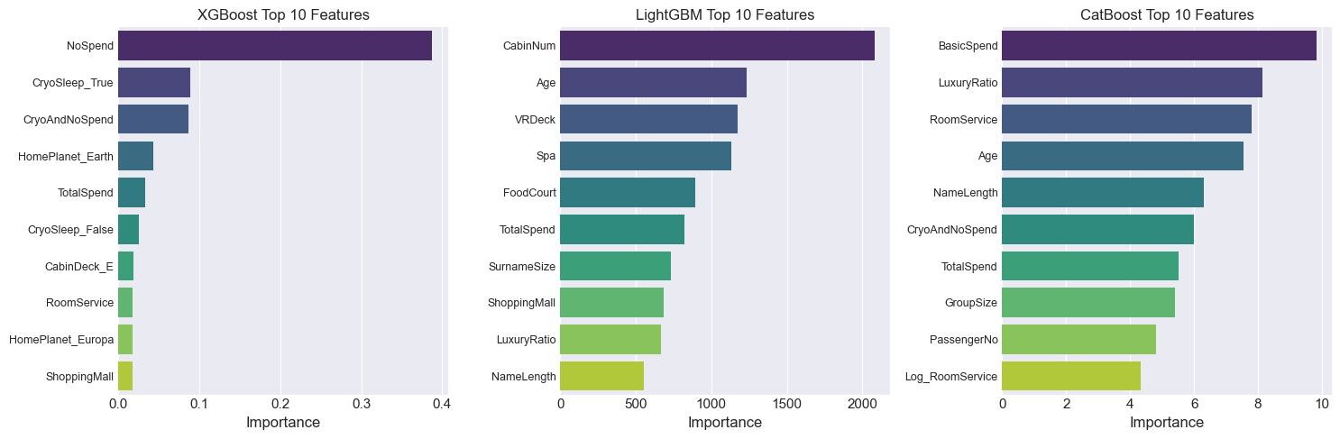
10
Model Optimization
10
Nova@MLW · Zirui SU 2430034058
Tree Model Search: More Options, More Complementary Errors
We did not rely on one single model, but tested and kept three powerful boosting models.
XGBoost
regularized boosting view
LightGBM
efficient boosted tree model
CatBoost
strong categorical model
L1/L2 + second-order gradients; fixes boundary cases
leaf-wise growth and histogram splits + fastest training spend
native categorical handling + ordered boosting
Decision: Keep all three for ensemble — each captures different error patterns
10

Slide 13
03
Optimization Journey
From single Model to Stable Ensemble
Test baselines → analyze failures → compare error patterns → select stable ensemble

Slide 14
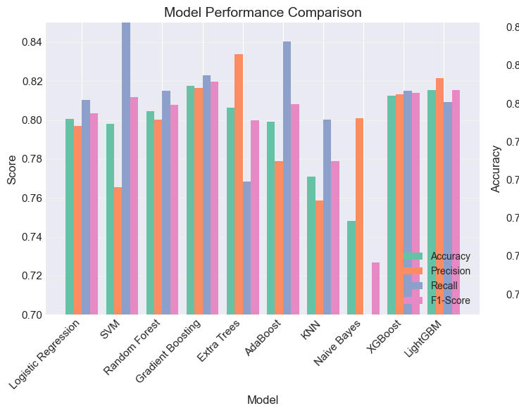
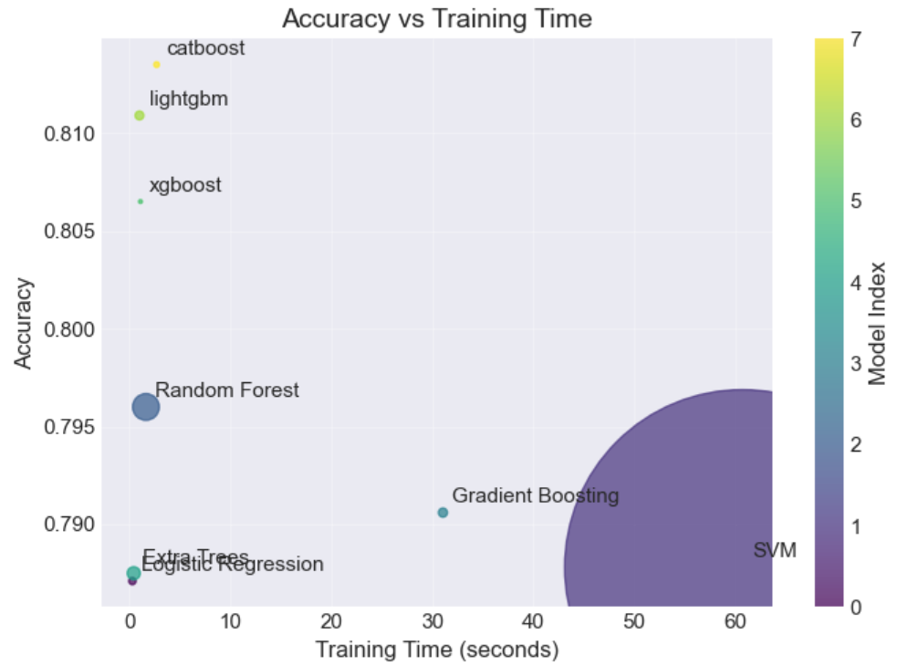
Nova@MLW · Zhentao LUO 2430034048
11
Optimization
13
Early Optimization Attempts and Their Problems
Model performance comparison
Accuracy vs. training time
higher complexity ≠ better efficiency
LightGBM, XGBoost, CatBoost → a stronger balance between accuracy and computational cost
13

Slide 15
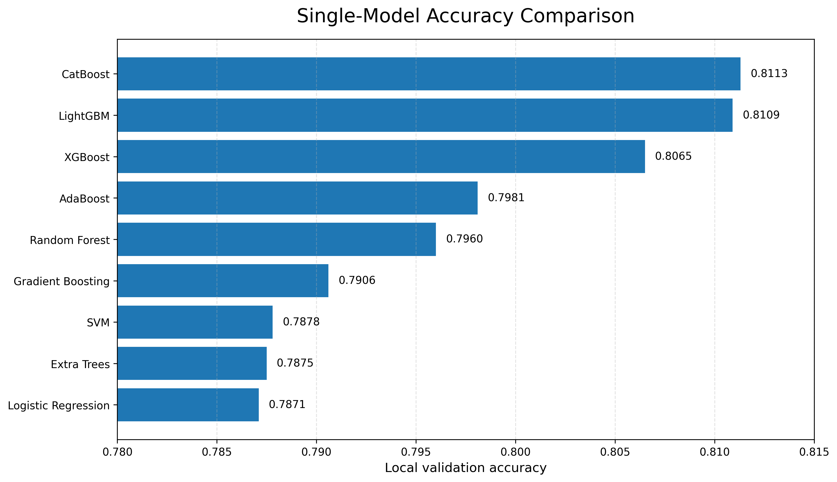
Nova@MLW · Zhentao LUO 2430034048
12
Optimization
Early Optimization Attempts and Their Problems
More complexity did not always create better generalization.
Logistic Regression
fast and interpretable; too linear to capture interaction:like cryosleep*spending
AdaBoost / Random Forest
non-linear trees; higher cost
XGBoost
useful for boudary cases; too unstable as main model
LightGBM
Efficient and accurate; but may make more aggressive decisions on ambiguous samples
CatBoost
Result evidence: complex branches and extra models did not surpass the retained static ensemble.
Strongest single model; cannot solve all boundary-case errors
0.8113
0.8109
0.8065
Single-model results show a clear trend: boosted-tree models provide stronger accuracy than early baseline methods.
Catboost
LightGBM
XGBoost
11
11

Slide 16
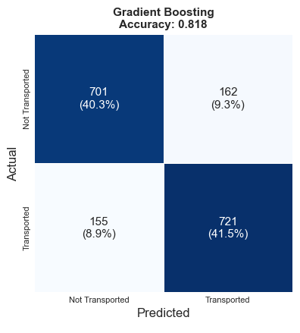
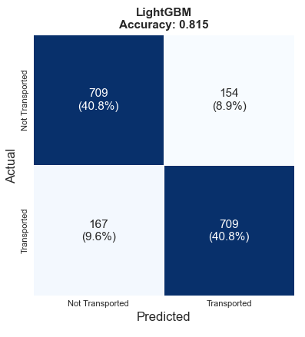
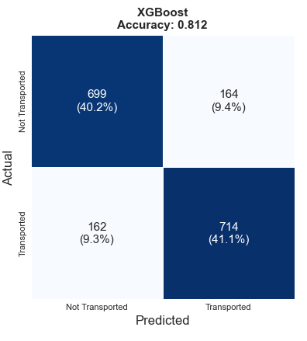
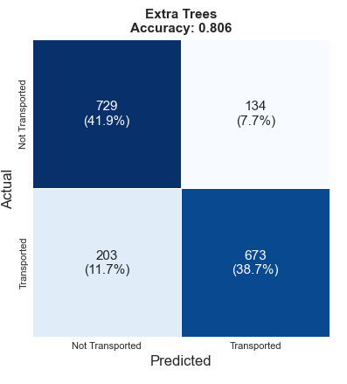
Nova@MLW · Zhentao LUO 2430034048
13
Optimization
14
Error Analysis: Why the Ensemble Choice Is Defensible
The boosted models are close in accuracy, but their confusion matrices are not identical.
Key findings
• Models with similar accuracy still made different types of errors.
• LightGBM and Gradient Boosting produced more balanced error patterns.
• XGBoost helped some boundary cases, but was unstable as the main model
• Extra Trees, dynamic stacking and aggressive feature engineering added noise instead of reliable improvement.
The best result came from controlled feature engineering + a compact boosted ensemble
14

Slide 17
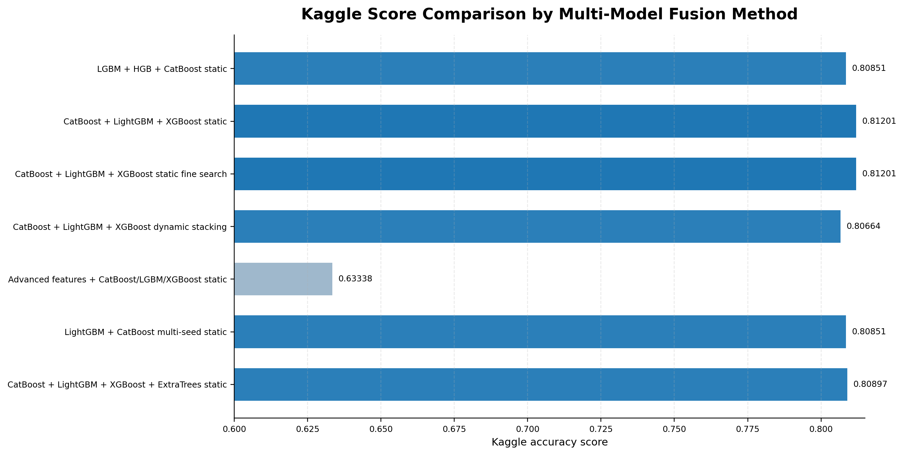
Nova@MLW · Zhentao LUO 2430034048
14
Optimization
14
Multi-Model Fusion Comparison
Static boosted-tree fusion produced the most stable retained result compared with dynamic stacking and aggressive feature engineering.
Key Findings
Best retained score
0.81201
CatBoost + LightGBM + XGBoost static
0.80664
Dynamic stacking
lower stability
0.63338
Advanced FE
damaged train/test consistency
Final choice:
compact static fusion

Slide 18
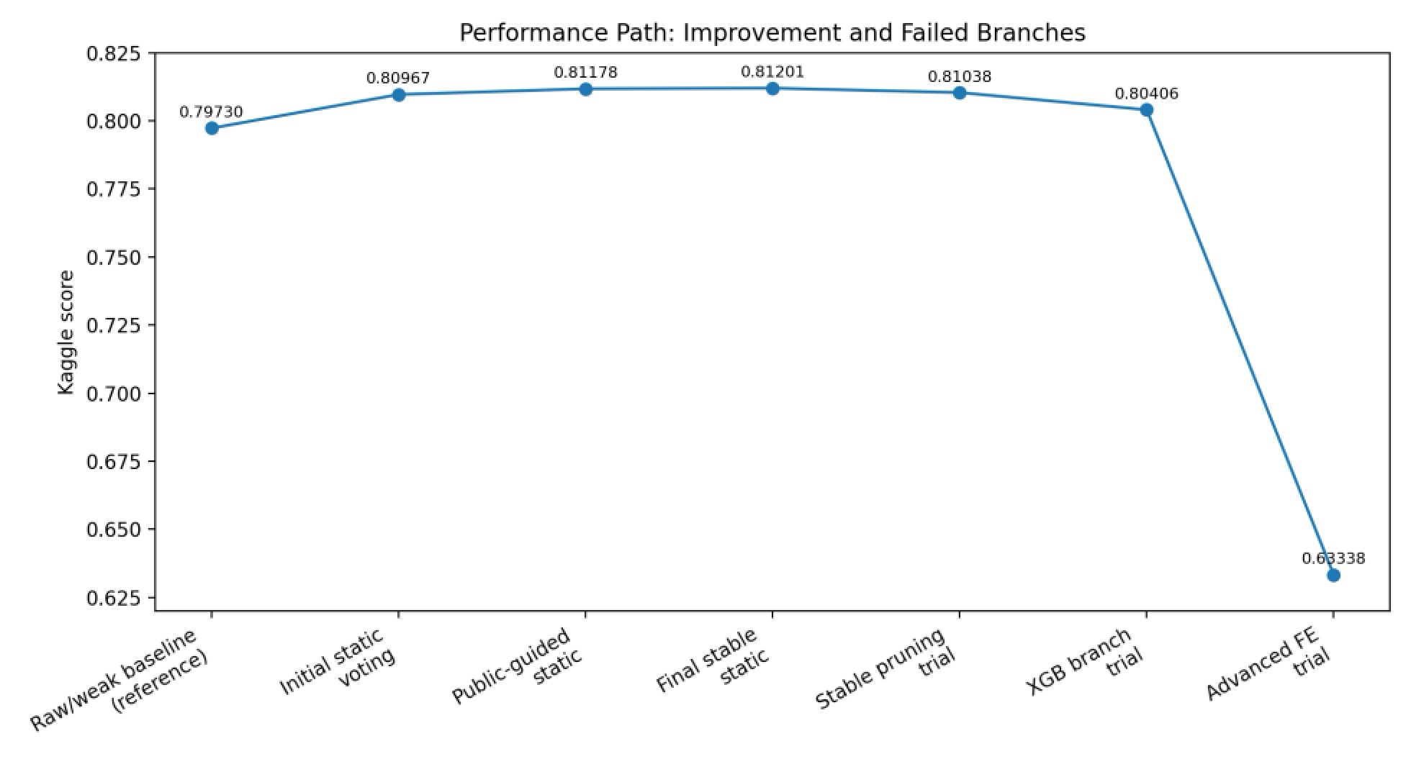
Nova@MLW · Zhentao LUO 2430034048
15
Optimization
14
Performance Path: Improvement and Failed Branches
The final model was chosen not only for score, but for stability across optimization attempts.
What the path tells us
Static ensemble tuning produced the most reliable improvement.
The score moved from the weak baseline to above 0.81 after weighted voting.
Fine search reached a plateau
Nearby weights and thresholds repeatedly stayed around the same high-score region.
Single-branch optimization was not enough
Pruning and XGBoost-only branches looked reasonable locally but did not transfer as well.
Aggressive features damaged stability
Over-complex feature construction broke train/test consistency and caused the largest drop.
0.81201
0.80406
0.63338
final stable
XGB branch
advanced FE
12
14

Slide 19
Nova@MLW · Zhentao LUO 2430034048
16
Optimization
12
Optimization: Ensemble Learning + Threshold Tuning
ensemble formula
final_score = α × probability_blend + (1 − α) × rank_blend
CatBoost
0.7600
LightGBM
0.2325
→
weighted probability blend
→
probability + rank stabilization
→
threshold 0.5050
→
XGBoost
0.0075
rank blend α = 0.8125

Slide 20
Nova@MLW · Zhentao LUO 2430034048
17
Optimization
12
Code Logic: Static Ensemble Pipeline
Feature engineering
Train base models
Static ensamble blend
Load data
Final Submission
→
→
→
→
resolve train/test paths read Transported target
Groupid, cabin split, spending logs, ratios, Cryo interactions
5-fold StratifiedKFold XGBoost · LightGBM · CatBoost
weighted probability blend + percentile rank blend
threshold = 0.5050 write final CSV
We avoided over-complex branches and selected a static ensemble
The final pipeline rebuilds predictions from train/test data and keeps the result stable, explainable, and reproducible
12

Slide 21
Summary
陈子浩 2430034007
1
Final stability accuracy rate
2
Optimal solution:
3
Core advantage
4
Methodology
0.81201
→
CatBoost + LightGBM + XGBoost Static Weighted Integration
→
High stability, strong generalizability, and complete reproducibility
→
Progressive Optimization from a Simple Baseline to Controllable Integration
Core message
The final solution is not a sudden jump; it is a controlled path from simple models to a compact boosted ensemble.

Slide 22
18
Summary Analysis Zihao CHEN 2430034007
16
Nova@MLW · AI3023 ML Workshop
Key Technology Pathway Review
The complete optimization chain from data to model
Data Understanding and EDA
Identify hidden grouping/cabin mode
Identifying the nonlinear distribution of consumption and age
Extracting predictive signals from strong classification features
Precision Feature Engineering
Analysis broken down into four major dimensions: Grouping, Cabin Class, Consumption, and Age
Construction of interaction features based on EDA findings
Dual-view features adapt to different models
Model Iteration and Integration
Linear baseline → Single-tree model → Multi-tree fusion
Eliminate complex and ineffective branches, focusing on stable improvement
A dual integration strategy combining probability weighting and rank fusion
16

Slide 23
19
Summary Analysis Zihao CHEN 2430034007
17
Nova@MLW · AI3023 ML Workshop
Model Generalizability and Stability Assurance
0.812
0.8147
6+
4
selected public score
OOF threshold-search accuracy
model families compared
evaluation angles
Avoid overfitting and pursue genuine generalization capability
->The training set and test set exhibit highly consistent performance without significant overfitting.
->No test set labels or any tricks targeting the test set were used throughout.
->By employing a static integration pipeline with only retraining, the results are fully reproducible.
->Avoid overfitting on the current test set and ensure stable performance when switching test sets
->Prioritize model combinations with strong generalization capabilities over pursuing the highest single-score result
17

Slide 24
20
Summary Analysis Zihao CHEN 2430034007
16
Nova@MLW · AI3023 ML Workshop
Core Experiences and Insights
The key takeaways from this competition
-> Simplicity > complexity: excessive feature engineering and dynamic stacking instead introduce noise
->Complementarity outweighs singularity: The error differences among various tree models represent the core value of integration.
-> Stability priority: Stable medium scores are preferable to fluctuating high scores
->Data-driven optimization: Improvements are based on EDA and error analysis, rather than blind experimentation
16

Slide 25
THANK YOU
Final Takeaway
Step by step, we turned data insights into engineered features, then turned complementary tree models into a stable final submission.
0.812
simple → complex
Q&A
selected public score
clear modeling logic
Questions?
AI3023 Machine Learning Workshop · Nova@MLW

