Slide 1

Bank Loan Approval Prediction
Members:
Alwin Chong Wei Shen
Eric Lim Jun Kit Ng Weng Lam
2300327
2105156
2207666

Slide 2
DATA SPLITTING
Full
Dataset
60%
Train
20%
Validation
20%
Test

Slide 3
EDA & PREPROCESSING (PART 1)
LoanID | Age | … | HasCoSigner | Default
IA35XVH6ZO | 28 | … | No | 0
Y8UETC3LSG | 28 | … | Yes | 1
RM6QSRHIYP | 41 | … | Yes | 0
: | : | : | : | :
Before
153196 x 18(row x column)
Age | … | HasCoSigner | Default
28 | … | No | 0
28 | … | Yes | 1
41 | … | Yes | 0
: | : | : | :
After
153196 x 17(row x column)

Slide 4
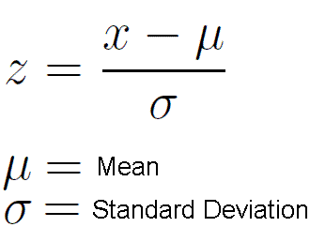
EDA & PREPROCESSING (PART 2)
NORMALISATION
Z-SCORE
COLUMNS INVOLVED:
Age
Income
LoanAmount
CreditScore
MonthsEmployed
NumCreditLines
InterestRate
LoanTerm
DTIRatio

Slide 5
EDA & PREPROCESSING (PART 3)
Categorical | Categorical Value | Numerical Value
HasMortgage, HasDependents, HasCosigner | No | 0
 | Yes | 1
MaritalStatus | Single | 1
 | Married | 2
 | Divorced | 3
Education | High School | 1
 | Bachelor’s | 2
 | Master’s | 3
 | PhD | 4
EmplomentType | Unemployed | 1
 | Part-time | 2
 | Full-time | 3
 | Self-employed | 4
LoanPurpose | Education | 1
 | Home | 2
 | Business | 3
 | Auto | 4
 | Other | 5
CONVERT
CATEGORICAL
TO
NUMERICAL

Slide 6
EDA & PREPROCESSING (PART 4)
ONE
HOT
ENCODING
BEFORE ENCODING | AFTER ENCODING
MaritalStatus | MaritalStatus_1
 | MaritalStatus_2
 | MaritalStatus_3
Education | Education_1
 | Education_2
 | Education_3
 | Education_4
EmplomentType | EmplomentType_1
 | EmplomentType_2
 | EmplomentType_3
 | EmplomentType_4
LoanPurpose | LoanPurpose_1
 | LoanPurpose_2
 | LoanPurpose_3
 | LoanPurpose_4
 | LoanPurpose_5
ONE
HOT
ENCODING
CREATE
DUMMY VARIABLES
FOR TARGETED COLUMNS

Slide 7
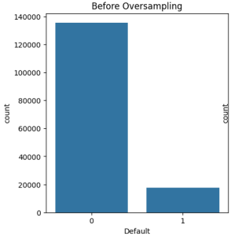
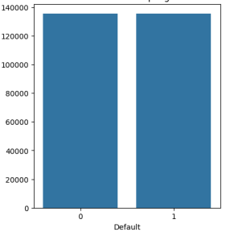
PROBLEM & SOLUTION
Class Imbalance
Using SMOTE
Oversampling Data
count

Slide 8
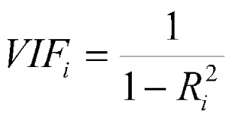
EDA & PREPROCESSING (PART 5)
ASSUMPTION:
If VIF > 3, Strong Multicollinearity
THEN DROP
THE TARGETED
COLUMNS
VARIANCE INFLATION FACTOR (VIF)
COLUMNS DROPPED
MaritalStatus_1 (3.743785)
MaritalStatus_2 (3.666009)
MaritalStatus_3 (3.823498)

Slide 9
ANALYSIS
Model used for predicting:
Models | Is it used for predicting?
 | Yes/No | If no, why?
Decision Tree (DT) | Yes | -
Gaussian Naïve Bayes (GausNB) | Yes | -
K Nearest-Neighbors (KNN) | Yes | -
Logistic Regression (LR) | Yes | -
Neural Network (MLP) | Yes | -
Random Forest (RF) | Yes | -
Support Vector Machine (SVM) | No | Take a very long training time Hardware limitation, prolonged training will cause CPU overheating

Slide 10
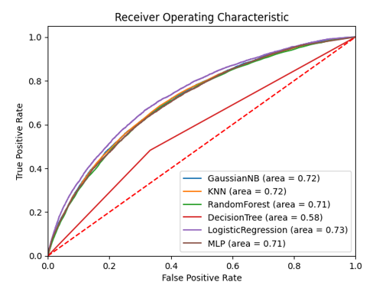
ANALYSIS
Table below shows the result obtained from each model trained and tested on Validation data:
Roc Curve for Validation data:
Model | Default = 0 |  |  | Default = 1 |  |  | Accuracy | AUC Score
 | Precision | Recall | F1 | Precision | Recall | F1
DT | 0.91 | 0.67 | 0.77 | 0.16 | 0.48 | 0.24 | 0.65 | 0.58
GausNB | 0.93 | 0.77 | 0.84 | 0.23 | 0.52 | 0.32 | 0.74 | 0.72
KNN | 0.94 | 0.61 | 0.74 | 0.19 | 0.71 | 0.30 | 0.62 | 0.72
LR | 0.91 | 0.90 | 0.91 | 0.31 | 0.34 | 0.32 | 0.84 | 0.73
MLP | 0.91 | 0.88 | 0.89 | 0.27 | 0.35 | 0.30 | 0.82 | 0.72
RF | 0.91 | 0.85 | 0.88 | 0.25 | 0.39 | 0.31 | 0.79 | 0.71
SVM | - | - | - | - | - | - | - | -

Slide 11
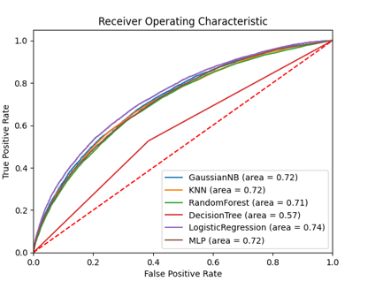
ANALYSIS
Table below shows the result obtained from each model trained and tested on Test data:
Roc Curve for Test data:
Model | Default = 0 |  |  | Default = 1 |  |  | Accuracy | AUC Score
 | Precision | Recall | F1 | Precision | Recall | F1
DT | 0.91 | 0.62 | 0.73 | 0.15 | 0.53 | 0.24 | 0.60 | 0.57
GausNB | 0.93 | 0.78 | 0.85 | 0.24 | 0.54 | 0.33 | 0.75 | 0.72
KNN | 0.94 | 0.61 | 0.74 | 0.19 | 0.71 | 0.30 | 0.62 | 0.72
LR | 0.91 | 0.91 | 0.91 | 0.33 | 0.35 | 0.34 | 0.84 | 0.74
MLP | 0.91 | 0.88 | 0.90 | 0.28 | 0.36 | 0.32 | 0.82 | 0.72
RF | 0.92 | 0.83 | 0.87 | 0.25 | 0.43 | 0.32 | 0.79 | 0.71
SVM | - | - | - | - | - | - | - | -

Slide 12
CONCLUSION OF ANALYSIS
Best model:
Logistic Regression
Why?
High Accuracy, AUC Score
(Default = 0) Great Precision, Recall, F1-score
(Default = 1) Acceptable Precision, Recall, F1-score

Slide 13
PREDICTION
LoanID | Default
A01 | 0
A02 | 0
A03 | 0
A04 | 1
A05 | 0
A06 | 1
A07 | 0
A08 | 0
A09 | 0
A10 | 0
LoanID | Default
B01 | 0
B02 | 0
B03 | 0
B04 | 0
B05 | 0
B06 | 1
B07 | 1
B08 | 0
B09 | 0
B10 | 0
4 bank loans risk of getting default
!
A04, A06, B06, B07
REJECTED
!
!
!
OTHER LOANS
APPROVED

Slide 14
THANK YOU

