Slide 1
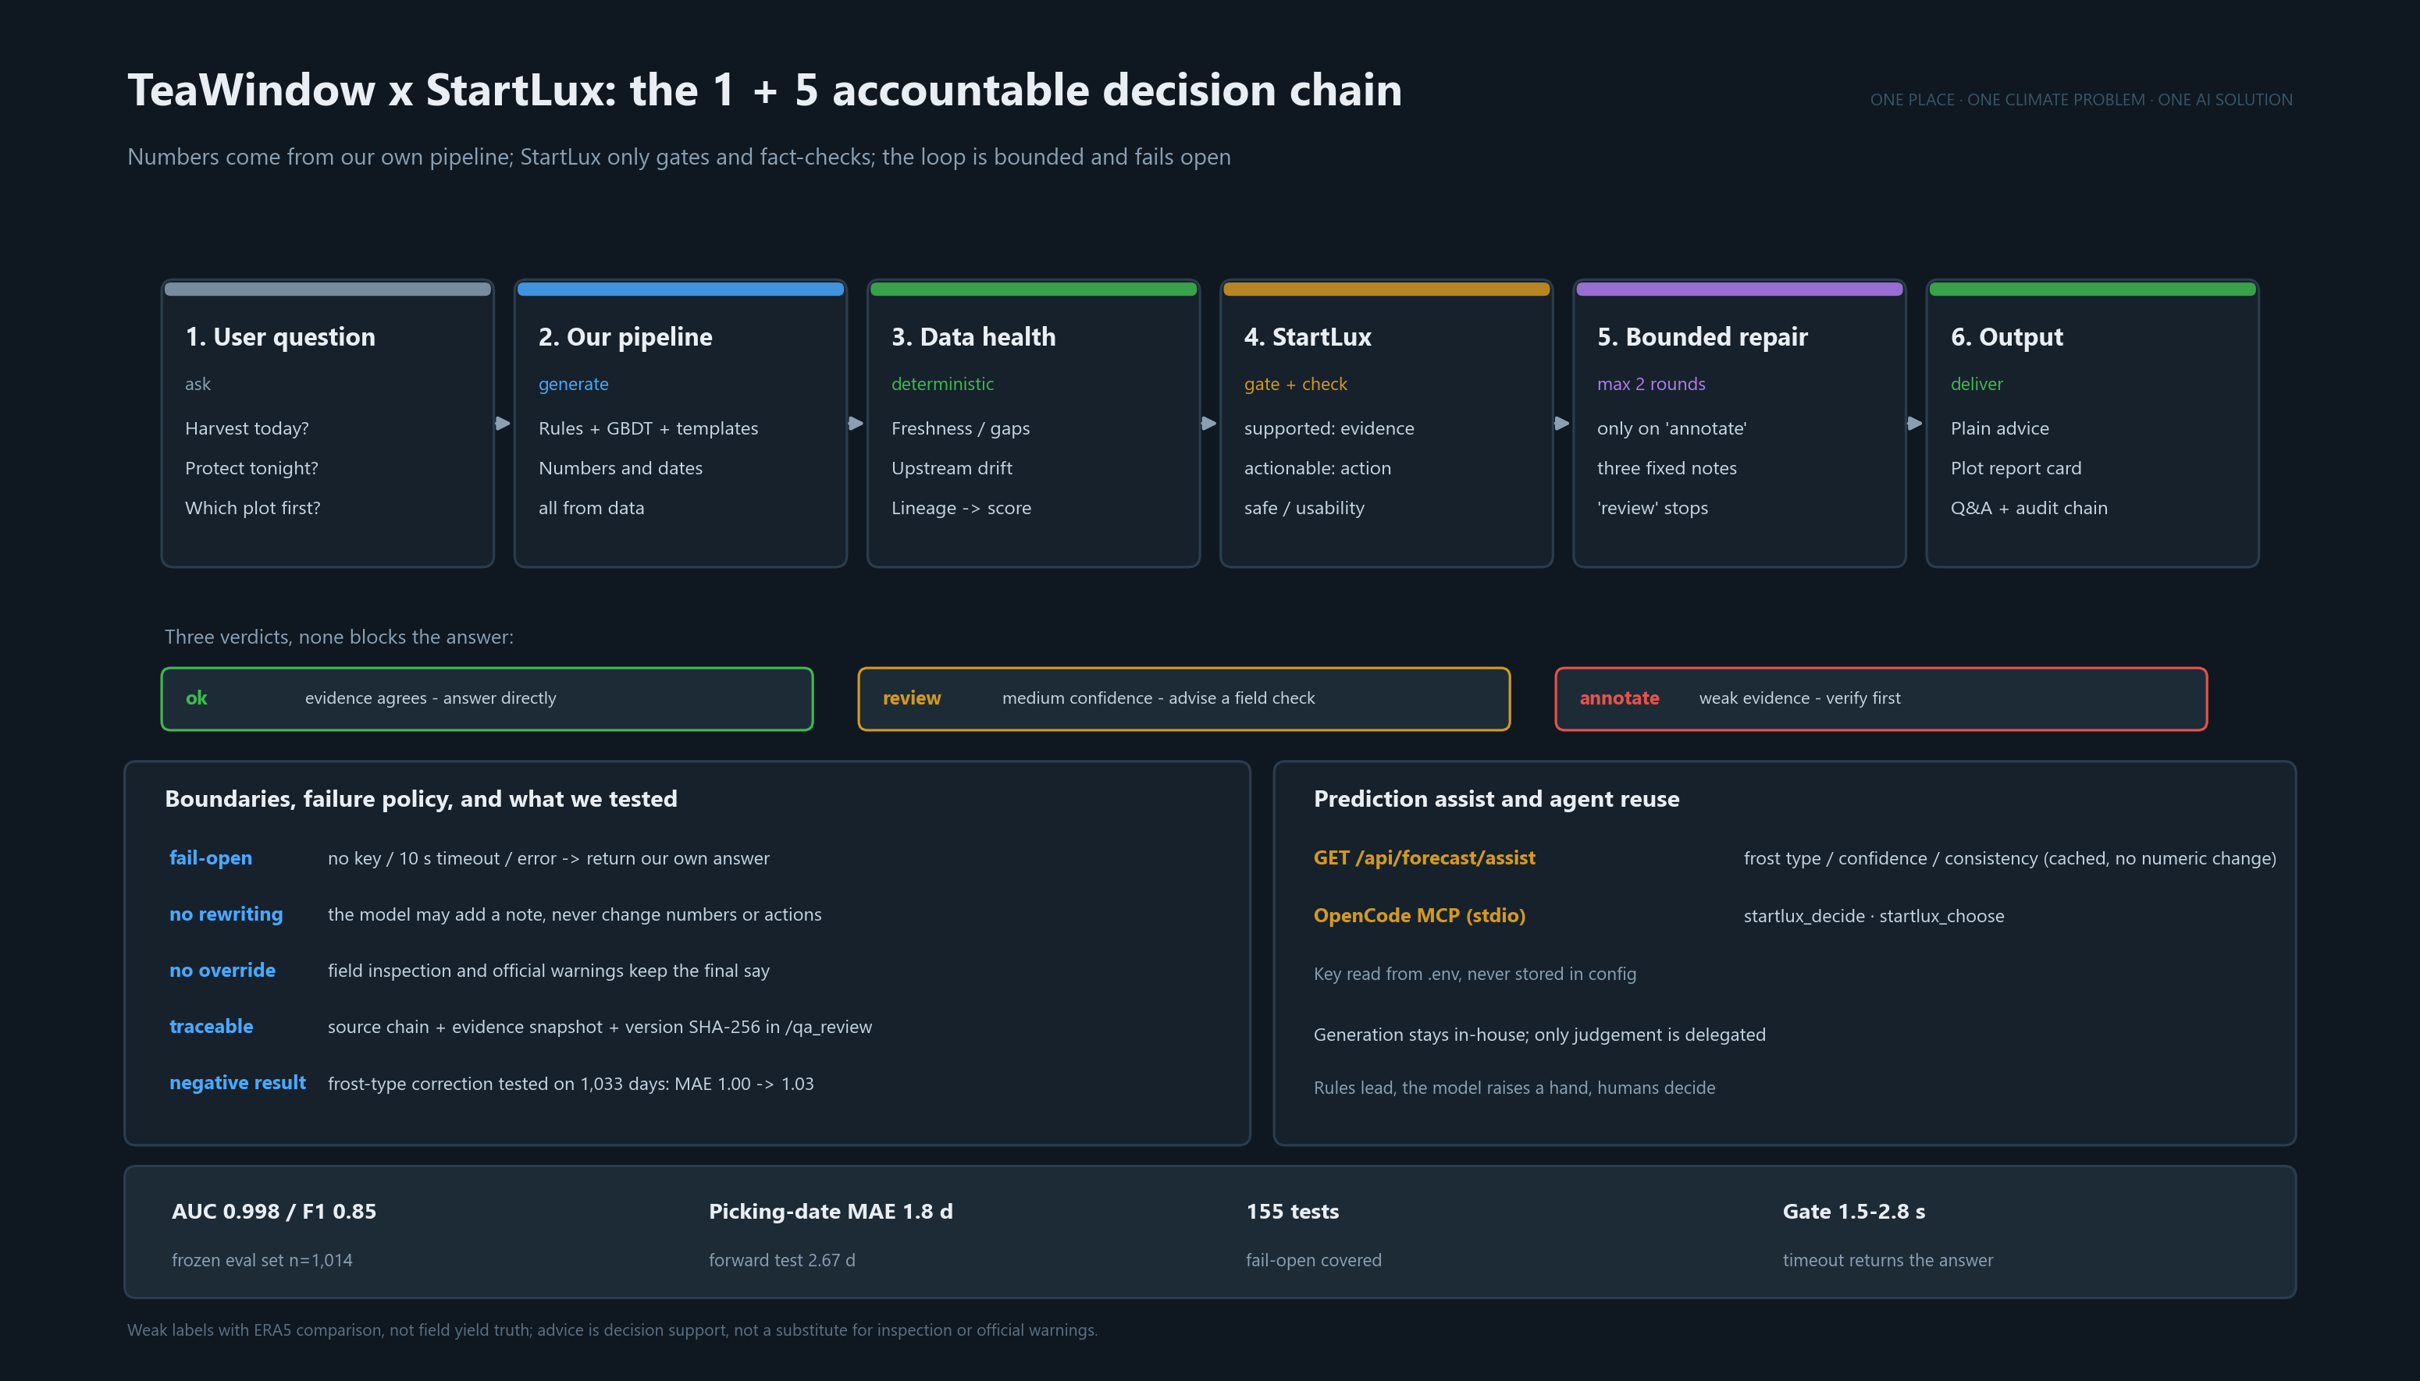
Notes:
60-second script: six stages; generation stays in-house, StartLux only gates and fact-checks. Three verdicts never block the answer; only 'annotate' triggers a repair, at most twice. Boundaries: fail-open, no rewriting, no override, traceable; the frost-type correction was tested and rejected (1.00 to 1.03).

